Slide 1
RDA and Authority Records: Enhancing Discovery
Adam L. Schiff
Principal Cataloger
University of Washington Libraries
aschiff@uw.edu
OLA Conference 2014
April 17, 2014

Slide 2
RDA Framework
RDA is aligned with two conceptual models:
FRBR (Functional Requirements for Bibliographic Records)
FRAD (Functional Requirements for Authority Data)
Entity-relationship models
Person, Family, Corporate Body, Place
Work, Expression

Slide 3
Entities and Attributes
Each entity has various attributes, e.g.
Person: Gender, Date of Birth, Date of Death, Place of Birth, Associated Country, Affiliation, Language, Profession/Occupation, etc.
Entities can have relationships with other entities, e.g.
Corporate Body B is the successor of Corporate Body A
Person is the founder of Corporate Body
Work A was adapted into Work B
Person is the translator of Expression of Work

Slide 4
MARC 21 Authority Format
New fields and subfields to record attributes
New subfields and codes to explicitly record the nature of relationships
LC-PCC Policy Statements, NACO documentation, and PCC best practices and guidelines have been developed

Slide 5
Documentation
MARC 21 Authority Format
http://www.loc.gov/marc/authority/
Descriptive Cataloging Manual (DCM) Section Z1
and LC Guidelines Supplement to MARC 21 Format for Authority Data
http://www.loc.gov/catdir/cpso/z1andlcguidelines.html
Notes:
These are also available in Cataloger’s Desktop. The DCM Z1 supplements the MARC 21 Authority Format and provides information on LC and PCC practices regarding coding of authority fields. The LC Guidelines Supplement provides information on which authority fields and subfields are or aren’t used in name, series, and subject authority records created by LC or by NACO and SACO participants.

Slide 6
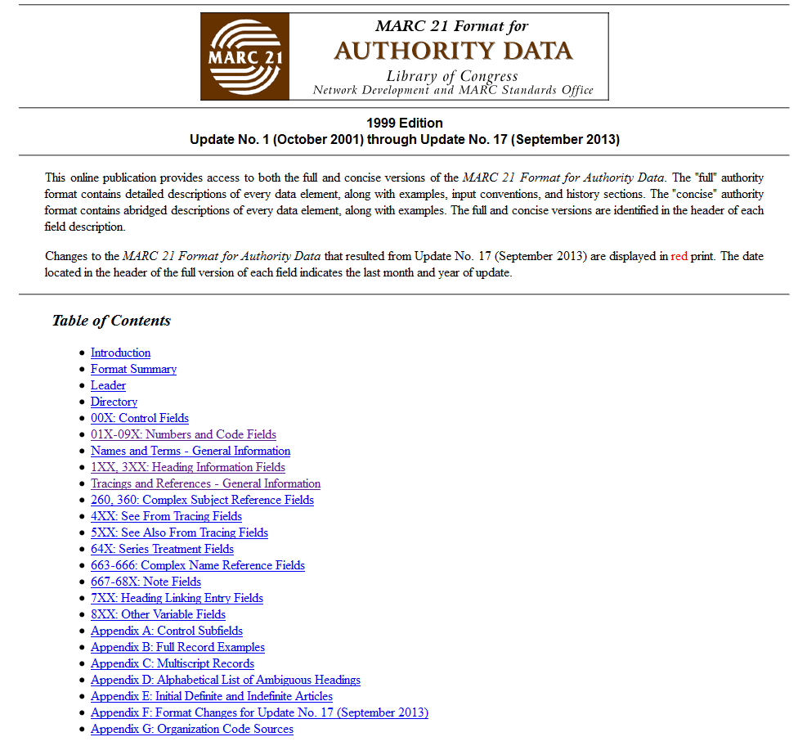

Slide 7
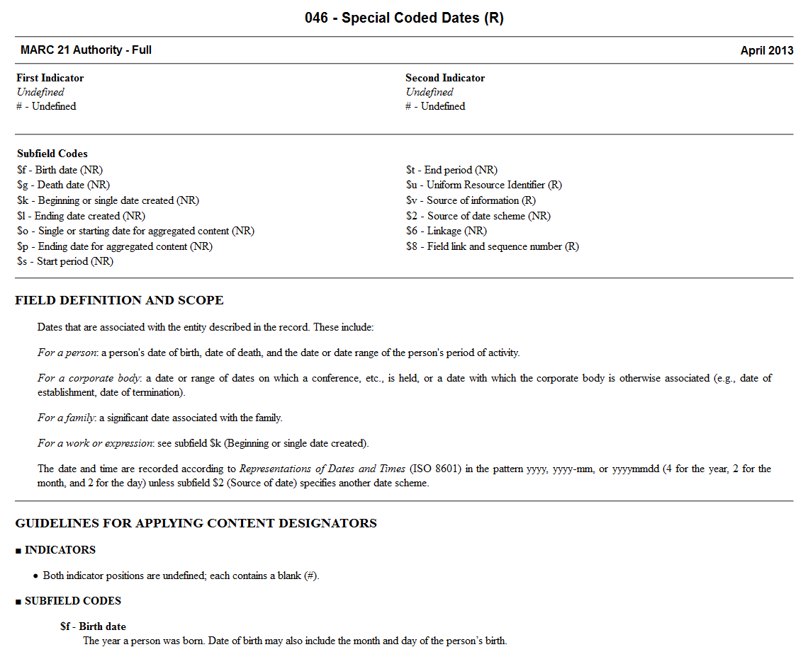

Slide 8
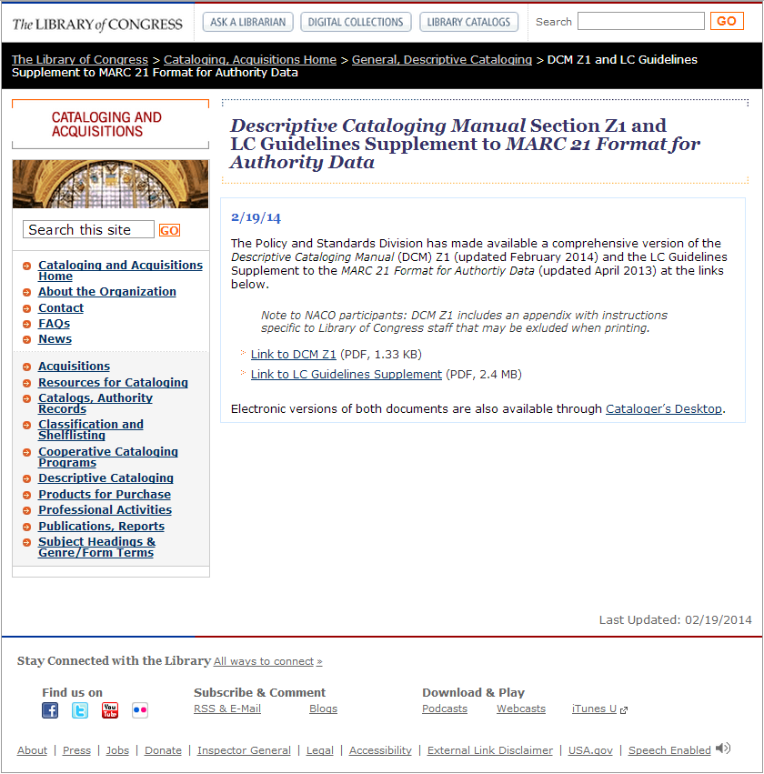

Slide 9
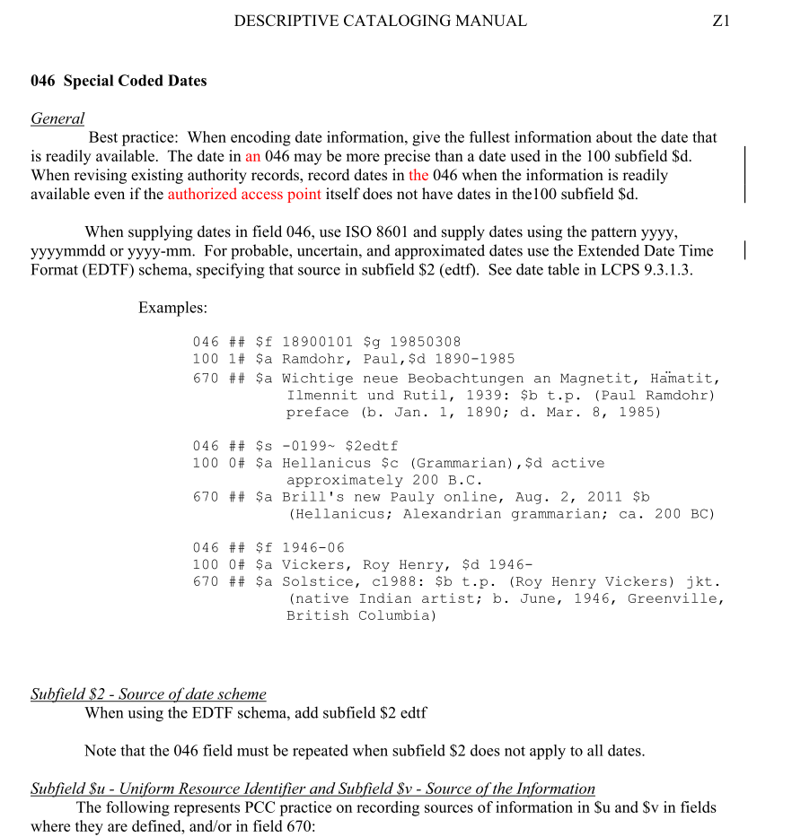

Slide 10
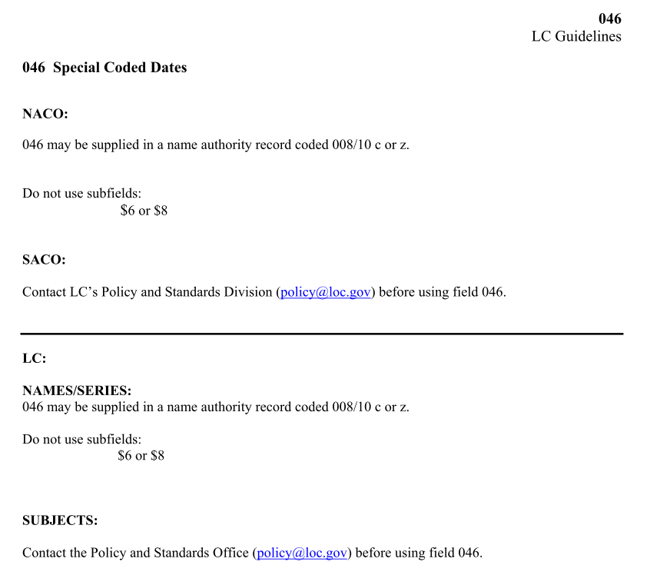

Slide 11
Documentation
LC-PCC Policy Statements
Freely available through RDA Toolkit in the “Resources” tab
http://access.rdatoolkit.org/
MARC 21 Encoding to Accommodate New RDA Elements 046 and 3XX in NARs and SARs
http://www.loc.gov/aba/pcc/rda/PCC RDA guidelines/RDA in NARs-SARs_PCC.doc
Notes:
Current Library of Congress-Program for Cooperative Cataloging Policy Statements (LC-PCC PSs) are freely available as part of the RDA Toolkit. Go to access.rdatoolkit.org and click on the "Resources" tab; a license to the Toolkit is not required. This allows fast and easy access through a single source to the most current policy information. Copies of LC-LCC PSs are also available in Cataloger’s Desktop.
The PCC has created a best practices document, “MARC 21 Encoding to Accommodate New RDA Elements 046 and 3XX in NARs and SARs.” It is available on the PCC website and NACO home page.

Slide 13
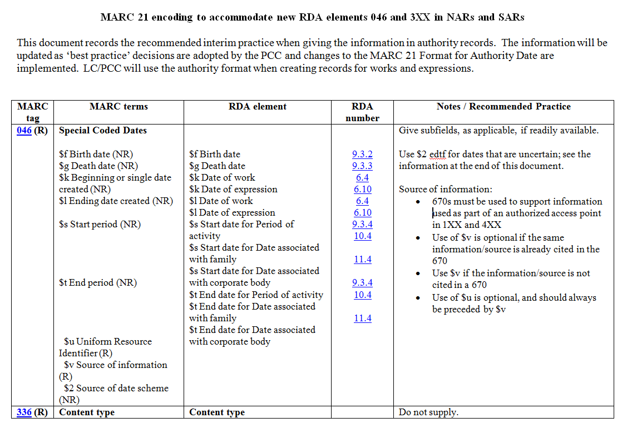

Slide 14
New MARC 21 Authority Fields for RDA
046 - Special Coded Dates
336 - Content Type
368 - Other Attributes of Person or Corporate Body
370 - Associated Place
371 - Address
372 - Field of Activity
373 - Associated Group
374 - Occupation
375 - Gender
376 - Family Information

Slide 15
New MARC 21 Authority Fields for RDA
377 - Associated Language
378 - Fuller Form of Personal Name
380 - Form of Work
381 - Other Distinguishing Characteristic of Work or Expression
382 - Medium of Performance
383 - Numeric Designation of Musical Work
384 - Key
678 - Biographical or Historical Data
*
Notes:
* The 678 is not actually a new field, but it has been given a new life and more use with RDA.

Slide 16
New MARC 21 Authority Fields for Other (Non-RDA) Attributes of Works/Expressions
Established but not yet implemented:
385 - Audience Characteristics
386 - Creator/Contributor Characteristics
Proposed (to be considered at ALA Annual 2014):
388 - Chronological Term Representing Date or Time Period of Creation or Origin of Work/Expression
Notes:
The fields on this slide are new or proposed fields that will be used to record other attributes of works and expressions beyond what is in RDA. These will be used in conjunction with the implementation in 2015 of Library of Congress Genre/Form Terms for music and literature. The 385 and 386 fields will also be used in bibliographic records. The equivalent of the 388 in bibliographic records is the 648 field.

Slide 17
Dates
Many date attributes in RDA
Persons
9.3.2 Date of Birth
9.3.3 Date of Death
9.3.4 Period of Activity of the Person
Families
10.4 Date Associated with the Family
Corporate Bodies
11.4.2 Date of Conference, Etc.
11.4.3 Date of Establishment
11.4.4 Date of Termination
11.4.5 Period of Activity of the Corporate Body

Slide 18
Dates
Works and Expressions
6.4 Date of Work
6.10 Date of Expression
6.20.2 Date of Promulgation of a Law, Etc.
6.20.3 Date of a Treaty
6.24 Date of Expression of a Religious Work

Slide 19
046 - Special Coded Dates
Indicators not defined
Subfields
$f - Birth date (NR) $g - Death date (NR) $k - Beginning or single date created (NR) $l - Ending date created (NR)
$o - Single or starting date for aggregated content (NR)
$p - Ending date for aggregated content (NR)
$s - Start period (NR) $t - End period (NR) $u - Uniform Resource Identifier (R) $v - Source of information (R)
$2 - Source of date scheme (NR) $6 - Linkage (NR) $8 - Field link and sequence number (R)

Slide 20
046 - Special Coded Dates
Dates usually recorded according to Representations of Dates and Times (ISO 8601); no $2 used when following ISO 8601
yyyy, yyyy-mm, or yyyymmdd
Year born 1911 $f 1911
Year-Month born April 1911 $f 1911-04
Year-Month-Day born April 15, 1911 $f 19110415
Early A.D. Date born 65 A.D. $f 0065
B.C. Date born 361 B.C. $f -0360
Century active 20th century $s 19
Notes:
For B.C. dates, note there is a difference of one in the coded date because the B.C. system has no year zero

Slide 21
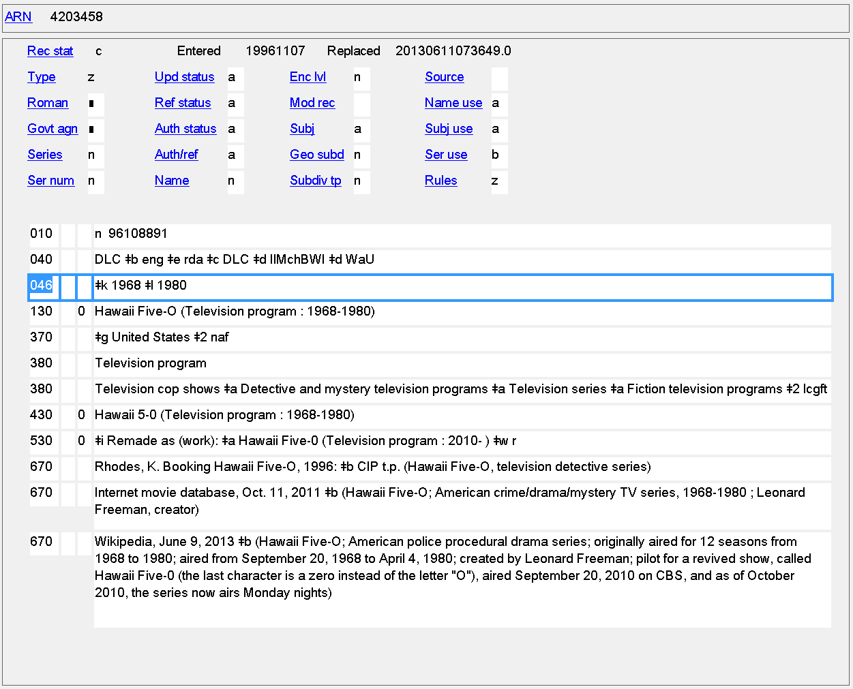
Date of Work
046 $k $l
Notes:
Dates of creation of a work

Slide 22
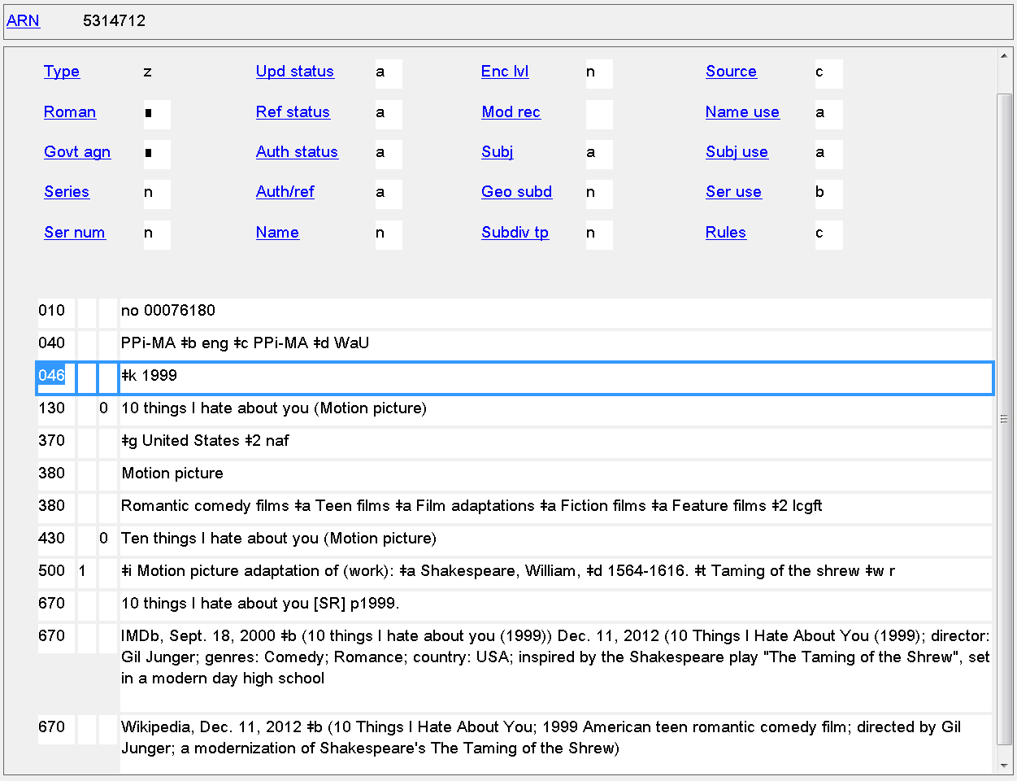
Date of Work
046 $k $l
Notes:
Date(s) of creation of work can be recorded even when the date is not part of the authorized access point.

Slide 23
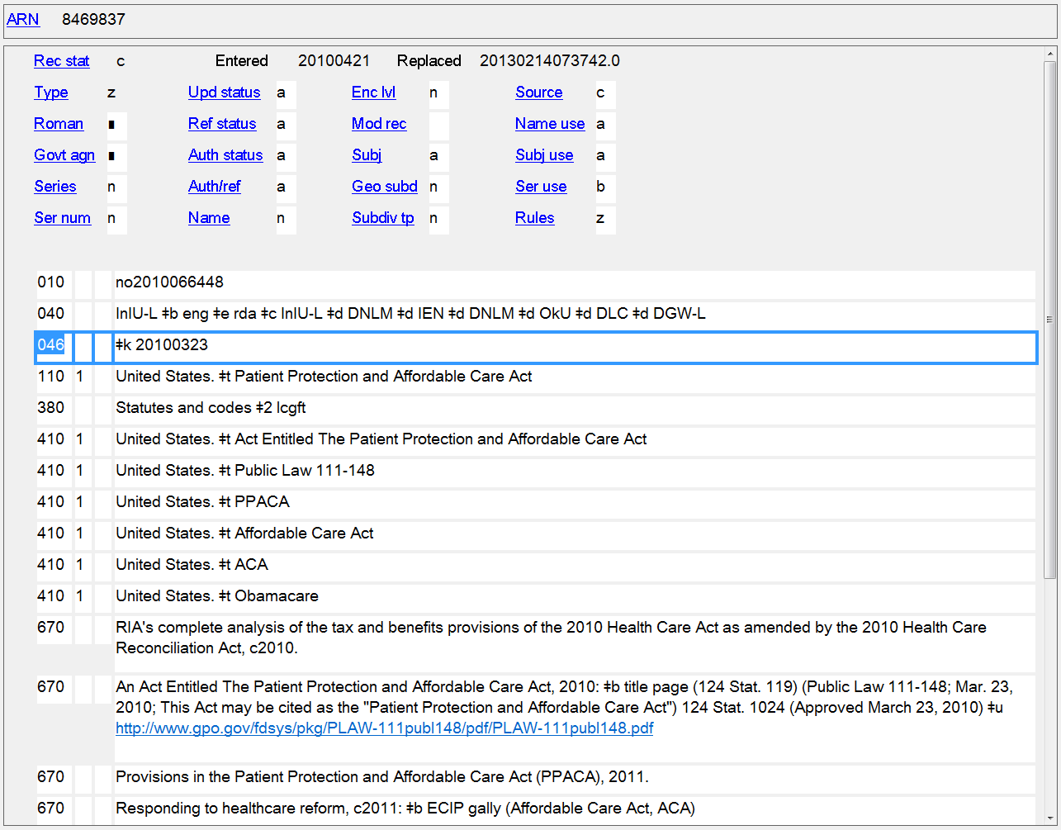
Date of Promulgation of a Law, Etc.
046 $k $l

Slide 24
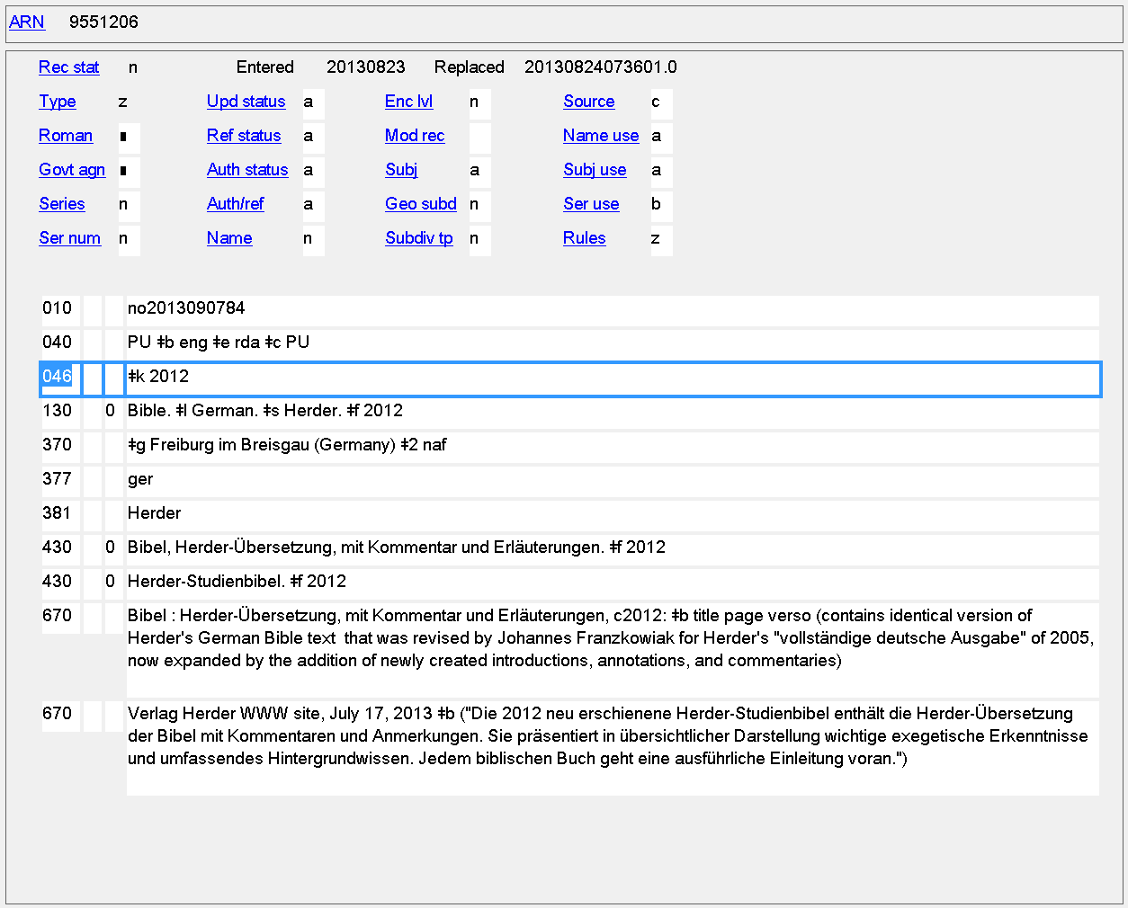
Date of Expression of a Religious Work
046 $k $l
Notes:
Date of expression.

Slide 25
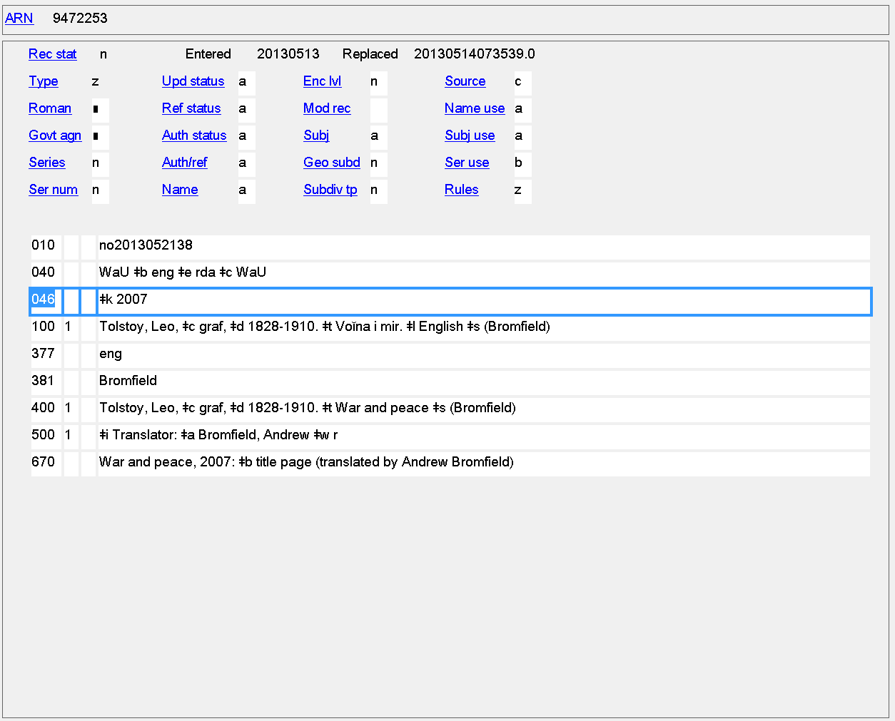
Date of Expression
046 $k $l
Notes:
Date of expression recorded even though it’s not in the authorized access point.

Slide 26
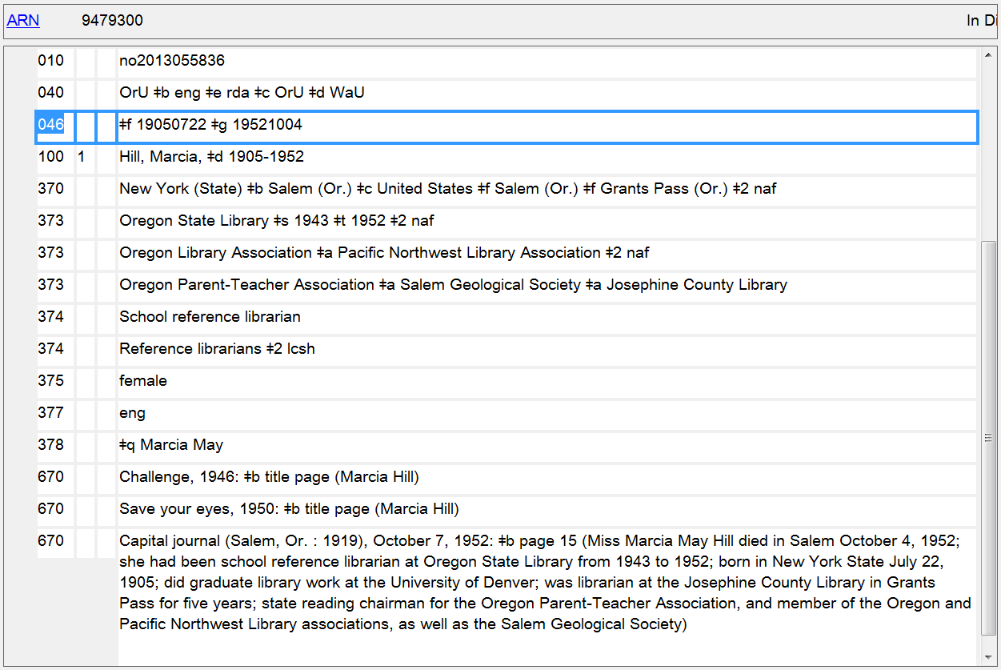
Date of Birth/Date of Death
046 $f $g
Notes:
Dates of birth and death

Slide 27
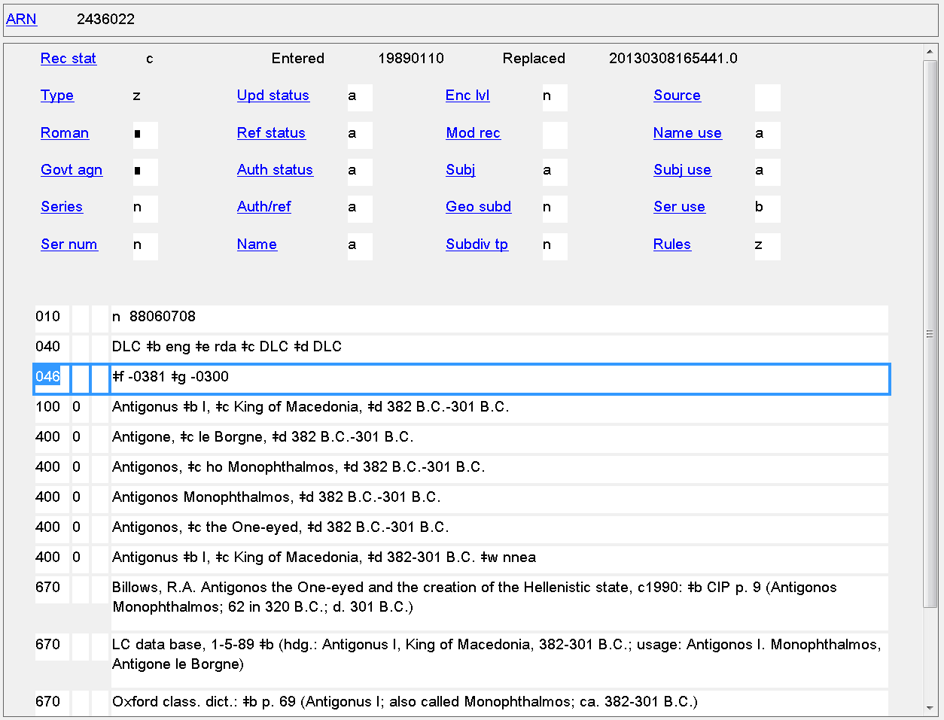
Date of Birth/Date of Death
046 $f $g
Notes:
B.C. dates of birth and death

Slide 28
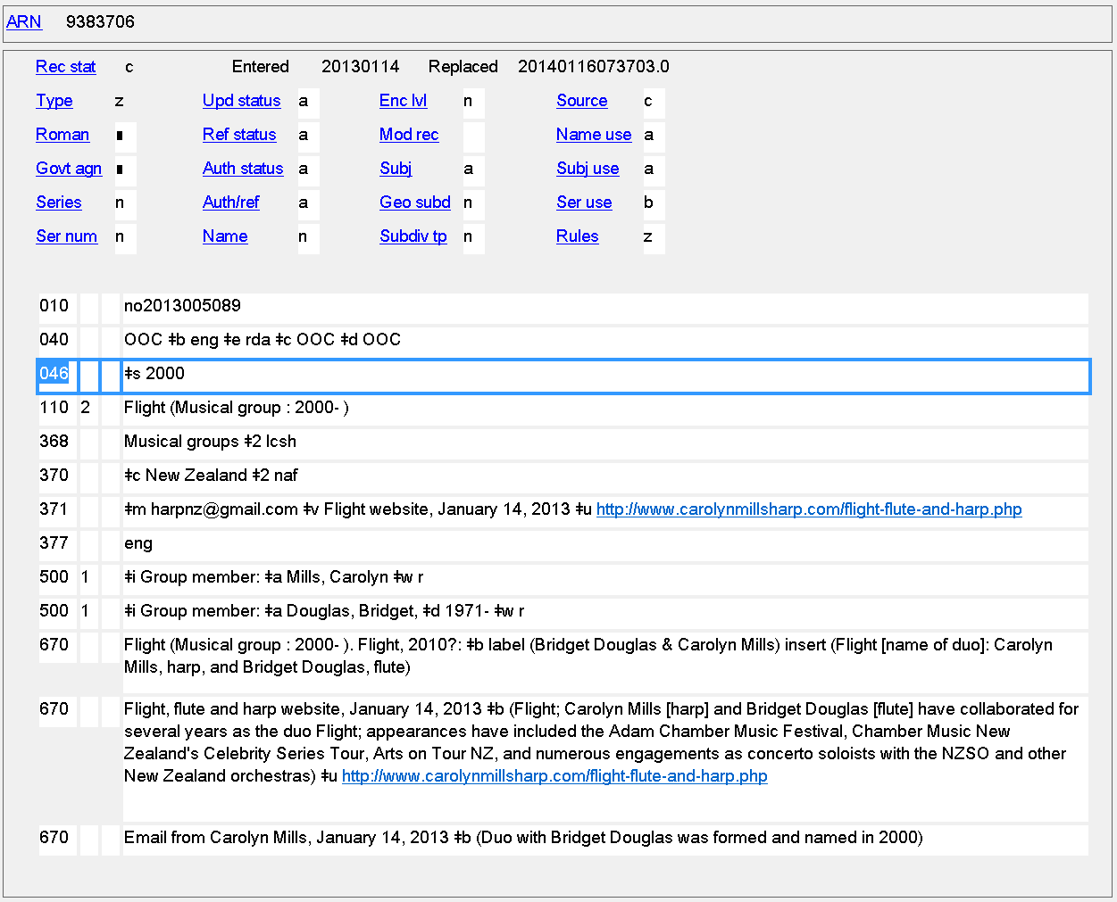
Date of Establishment
046 $s

Slide 29
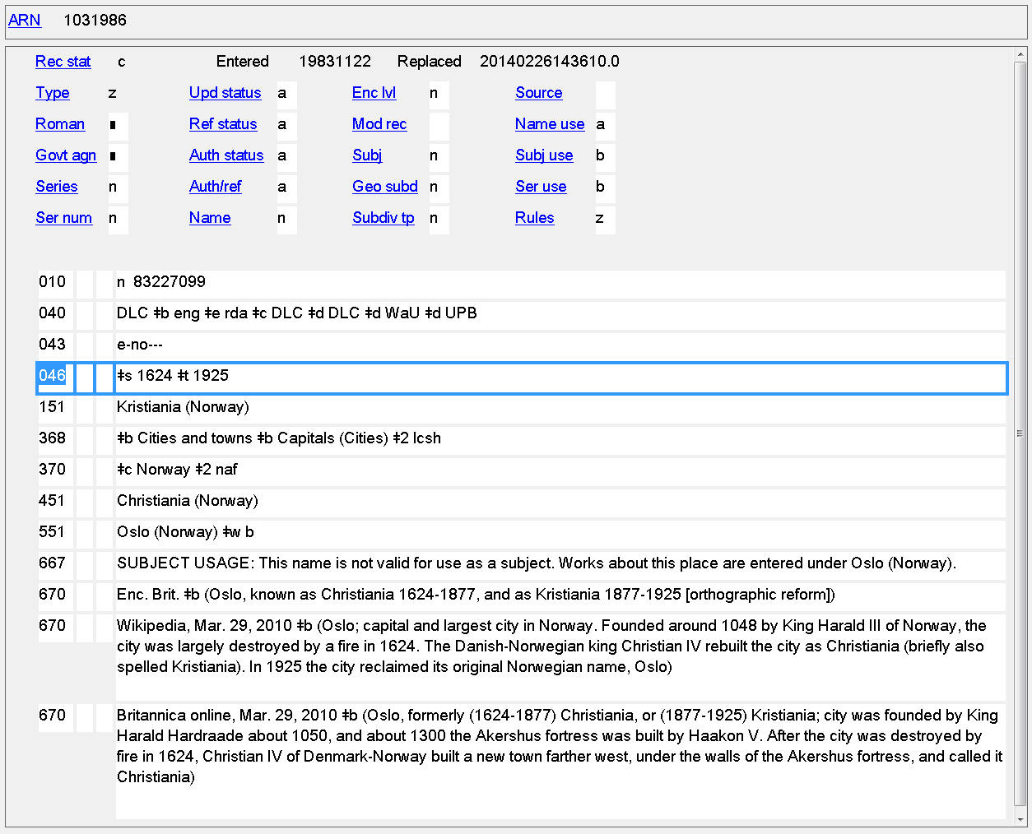
Date of Establishment/Date of Termination
046 $s $t

Slide 30
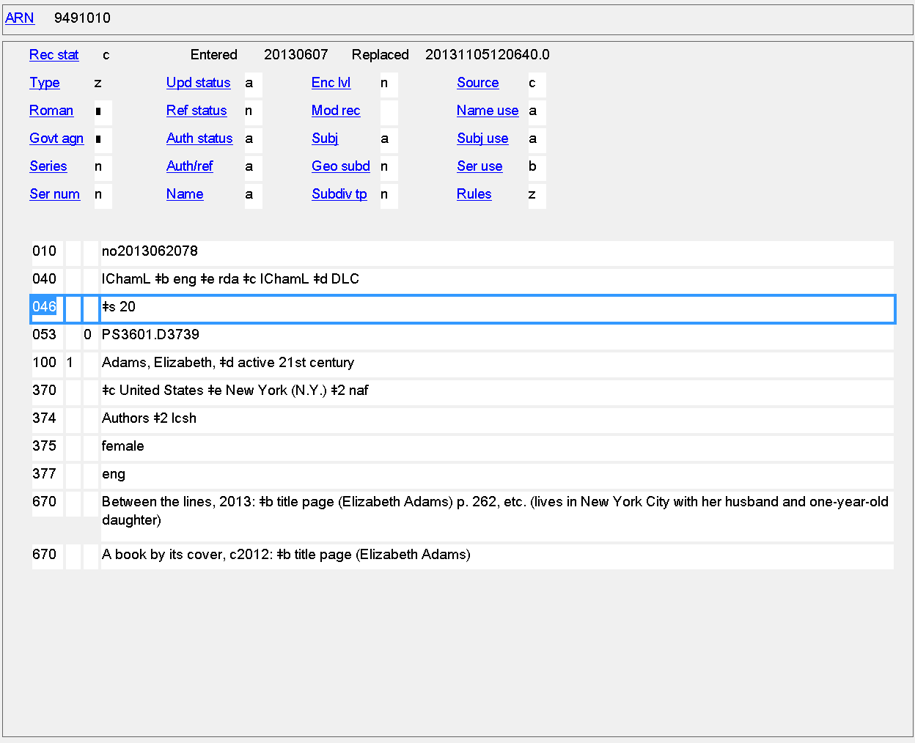
Period of Activity
046 $s $t
active 21st century = 046 $s 20

Slide 31
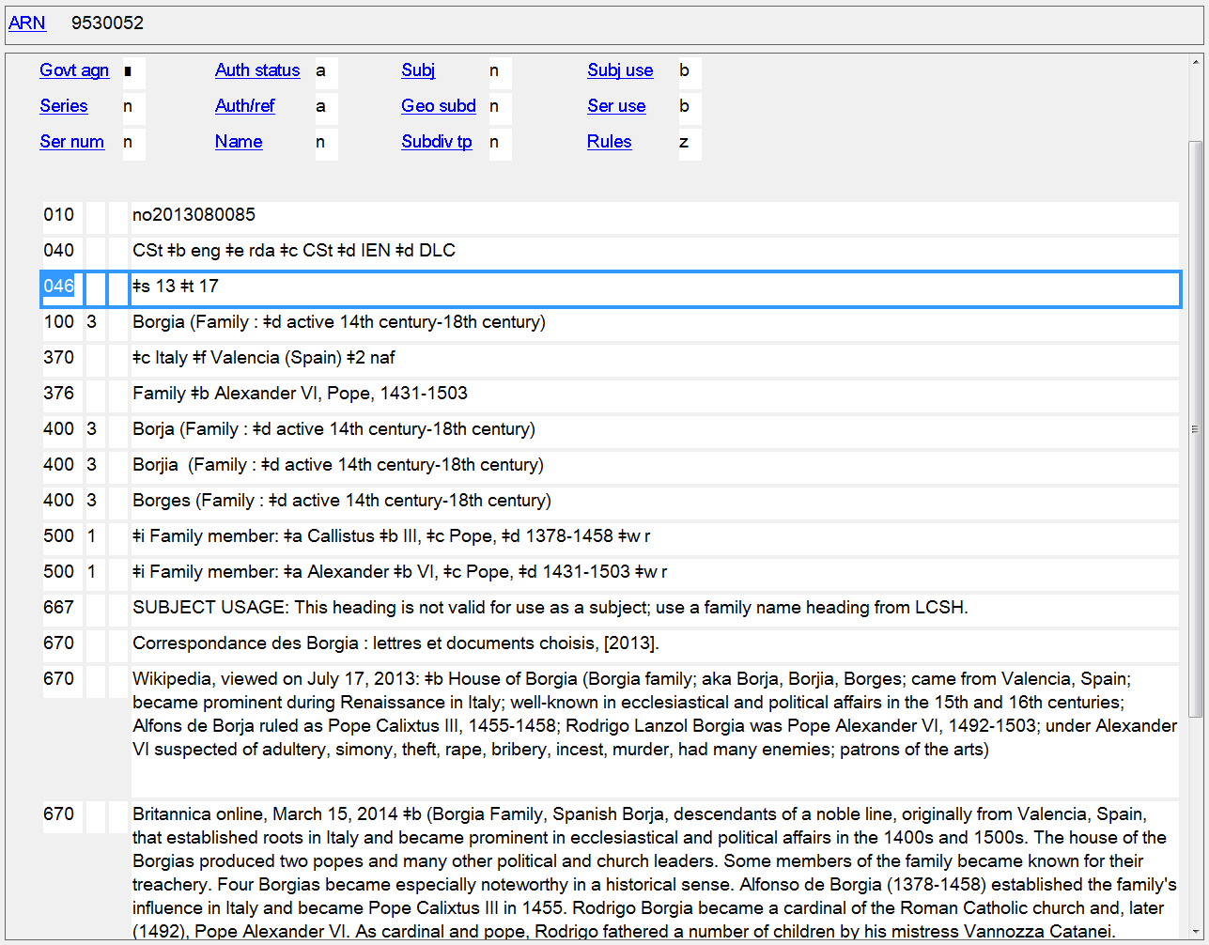
Date Associated with the Family
046 $s $t

Slide 32
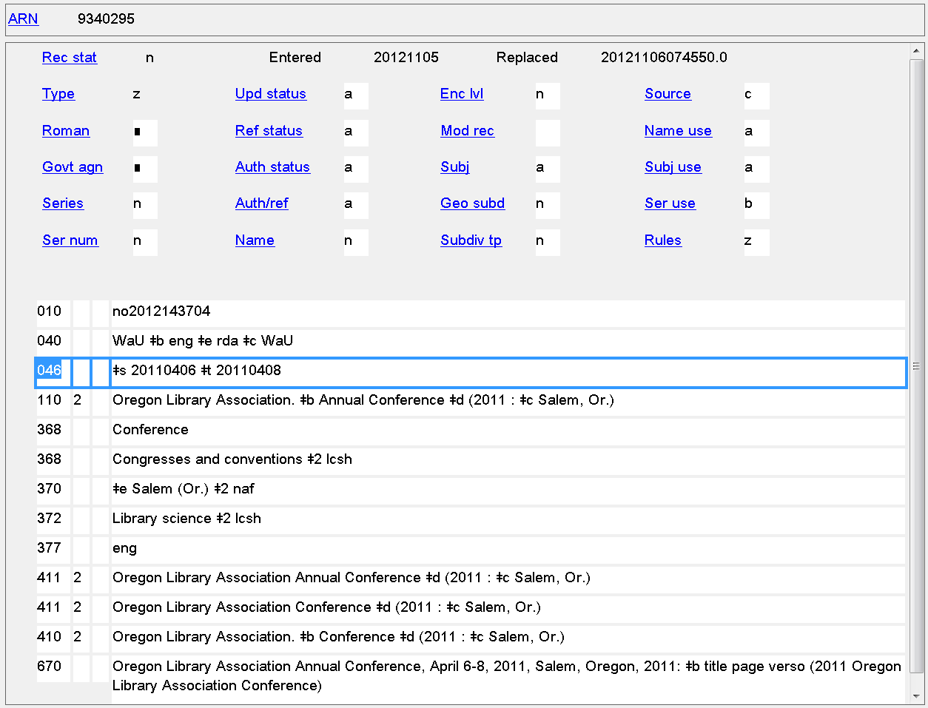
Date of Conference, Etc.
046 $s $t
Notes:
Start and termination dates for a corporate body

Slide 33
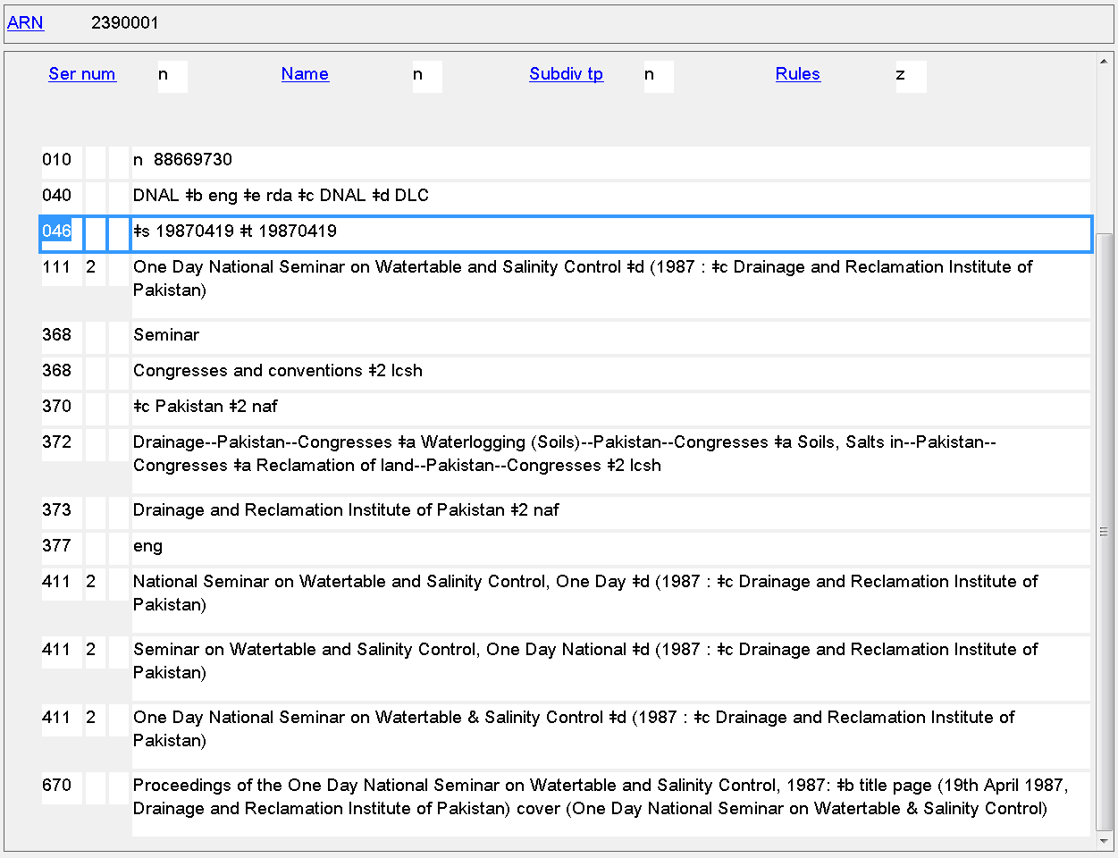
Date of Conference, Etc.
046 $s $t
Notes:
Start and termination dates also identical for an event held on one single day.

Slide 34
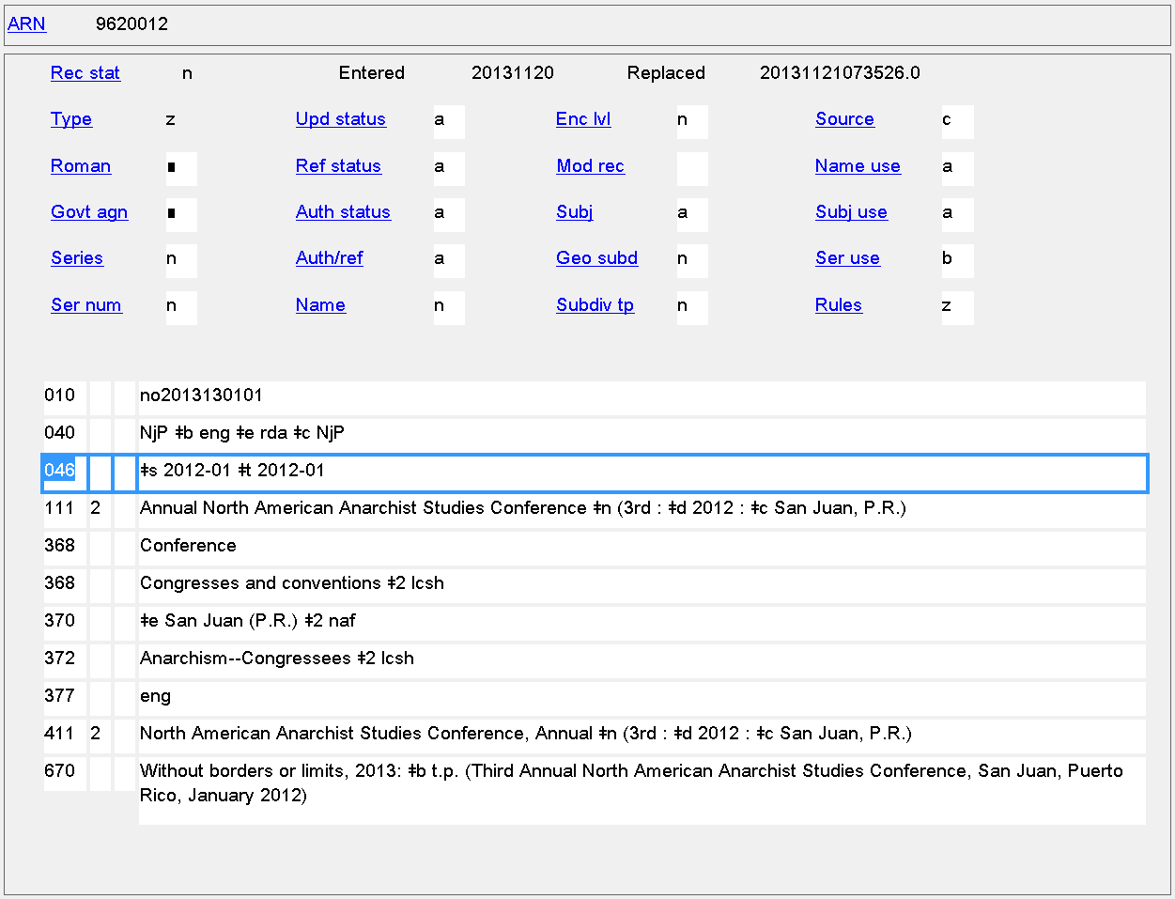
Date of Conference, Etc.
046 $s $t
Notes:
Start and termination dates are identical because all we know is that this conference started and ended in January 2012.

Slide 35
046 - Special Coded Dates
Some types of RDA dates can’t be coded with ISO 8601, e.g.
Probable dates: 1816?
Approximate dates: approximately 931
Date known to be either one of two years: 1666 or 1667
Extended Date-Time Format (EDTF) was created by LC to allow encoding more complex dates
http://www.loc.gov/standards/datetime/

Slide 36
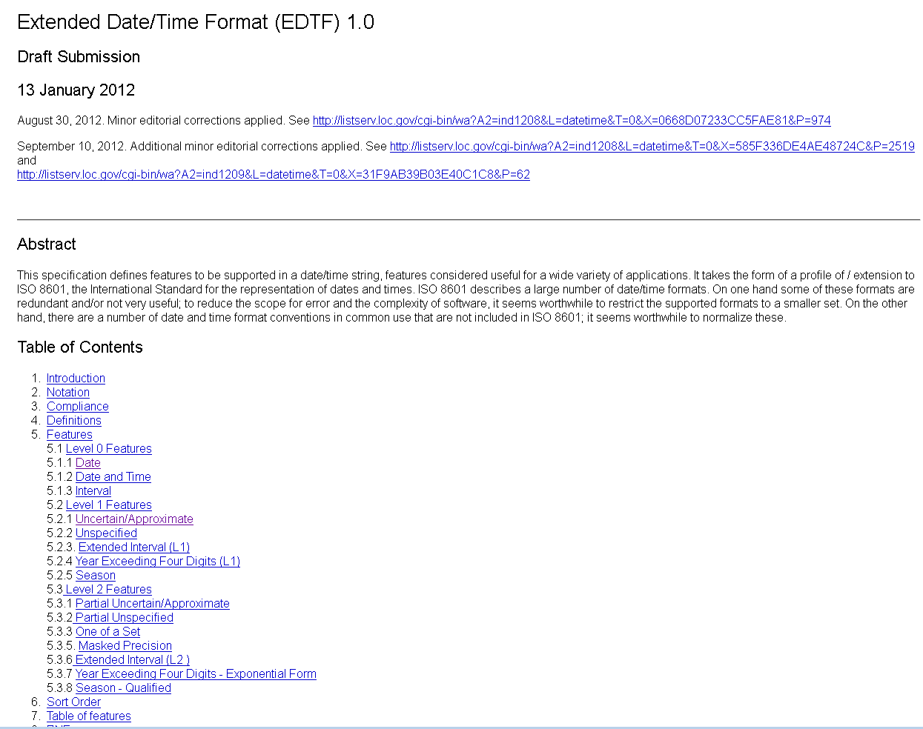

Slide 37
046 - Special Coded Dates
In EDTF, the characters ? and ~ are used to mean "uncertain" and "approximate" respectively. These characters may occur only at the end of the date string and apply to the entire date.
Square brackets surrounding two dates separated by a comma are used to mean either one of the two dates.
$2 source code is included in 046 when the standard used is anything other than ISO 8601. For EDTF, use $2 edtf
EXAMPLES
probably born 1848: 046 $f 1848? $2 edtf
born approximately 1848: 046 $f 1848~ $2 edtf
born either 1848 or 1849: 046 $f [1848,1849] $2 edtf

Slide 38
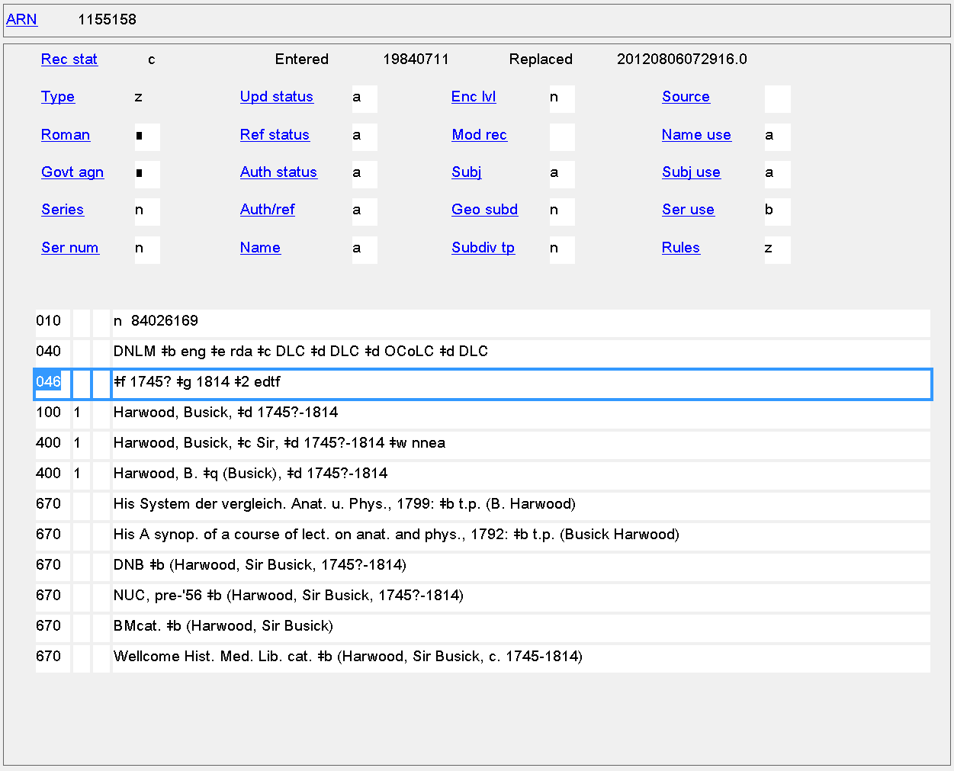
Date of Birth/Date of Death
046 $f $g

Slide 39
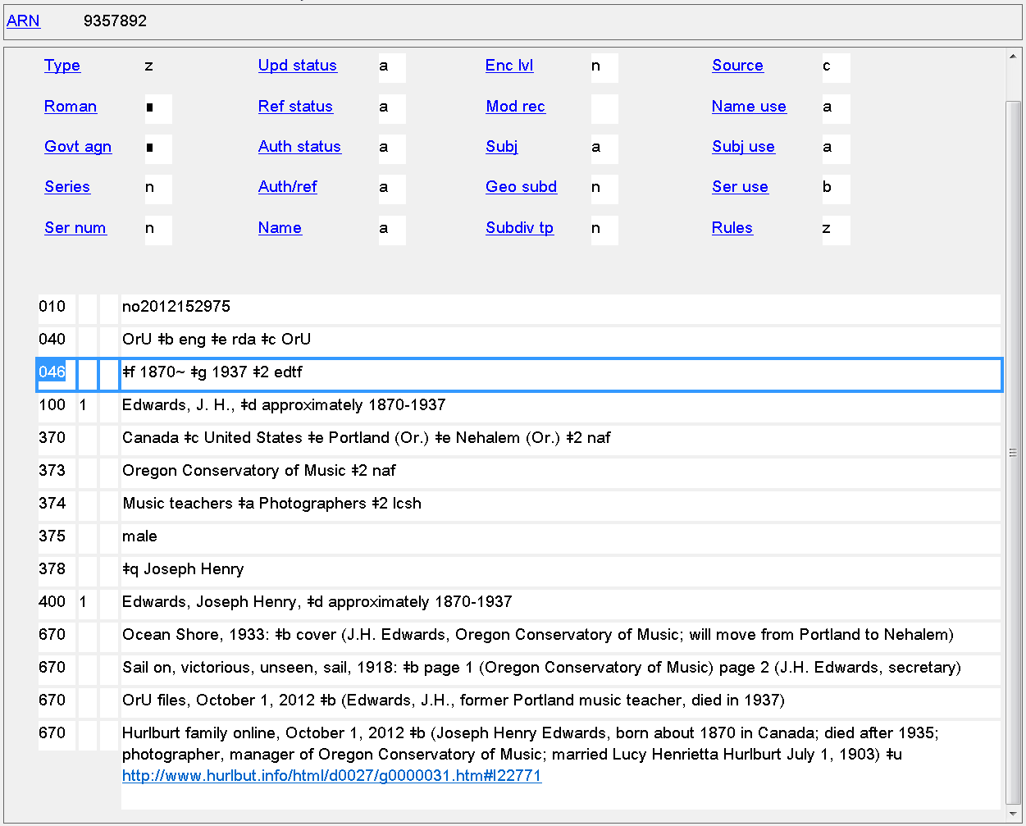
Date of Birth/Date of Death
046 $f $g

Slide 40
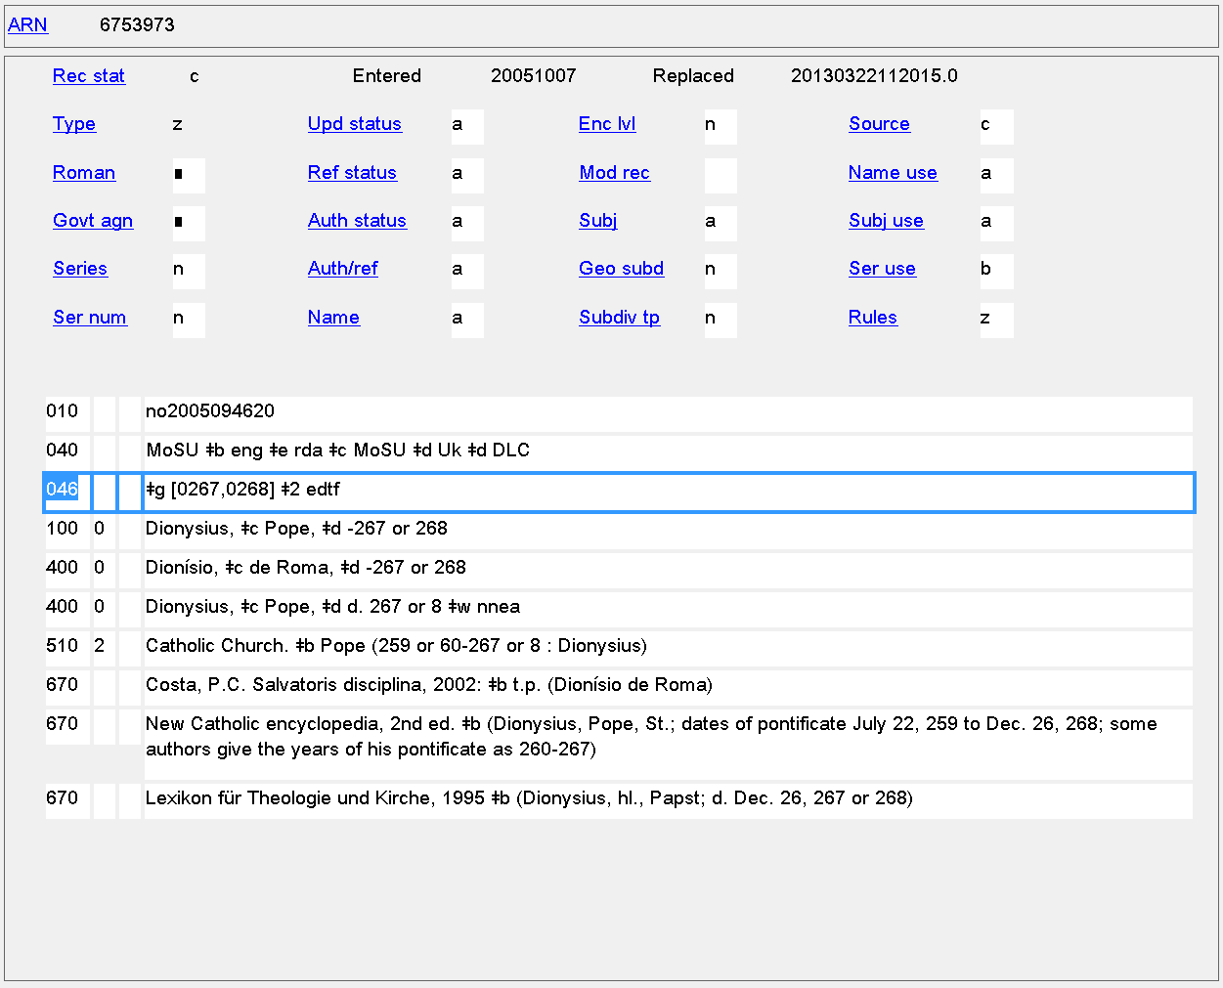
Date of Death
046 $g

Slide 41
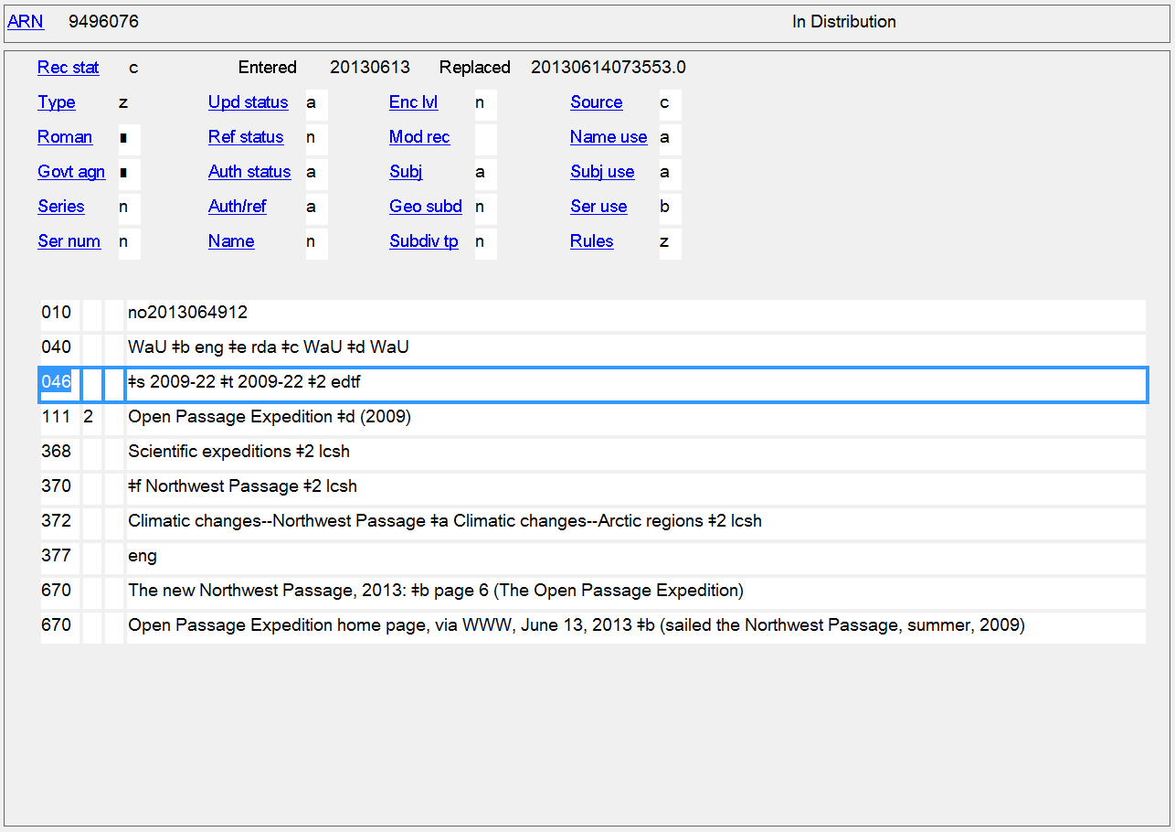
Date of Conference, Etc.
046 $s $t
Notes:
In EDTF, the values 21, 22, 23, 24 may be used used to signify 'Spring', 'Summer', 'Autumn', 'Winter', respectively, in place of a month value (01 through 12) for a year-and-month format string.
Example
2001-21 Spring, 2001

Slide 42
Places
Many place attributes in RDA
Persons
9.8 Place of Birth
9.9 Place of Death
9.10 Country Associated with the Person
9.11 Place of Residence, Etc.
Families
10.5 Place Associated with the Family
Corporate Bodies
11.3.2 Location of Conference, Etc.
11.3.3 Location of Headquarters
Works and Expressions
6.5 Place of Origin of the Work
Notes:
11.3.3 A location of headquarters is a country, state, province, etc., or local place in which an organization has its headquarters.
Alternatively, location of headquarters can be used to record the geographic area (state, province, city, etc.) in which a corporate body carries out its activities.

Slide 43
370 - Associated Place
Indicators not defined
Subfields
$a - Place of birth (NR) $b - Place of death (NR) $c - Associated country (R) $e - Place of residence/headquarters (R)
$f - Other associated place (R)
$g - Place of origin of work (R)
$s - Start period (NR) $t - End period (NR) $u - Uniform Resource Identifier (R) $v - Source of information (R)
$0 - Record control number (R) $2 - Source of date scheme (NR) $6 - Linkage (NR) $8 - Field link and sequence number (R)

Slide 44
370 - Associated Place
RDA: Record the place name as instructed in chapter 16. Abbreviate the names of countries, states, provinces, territories, etc., as instructed in Appendix B (B.11).
16.2.2.4: Precede the name of the larger place by a comma when the place name is used in the following elements:
the location of a conference, etc.
the location of the headquarters of a corporate body
the place of origin of a work
a place associated with a person, family, or corporate body
370 $a Ogden, Ill. $b Corvallis, Or.
Many places recorded in 370s still reflect the RDA instructions, but in 2013 PCC instituted a different policy from RDA

Slide 45
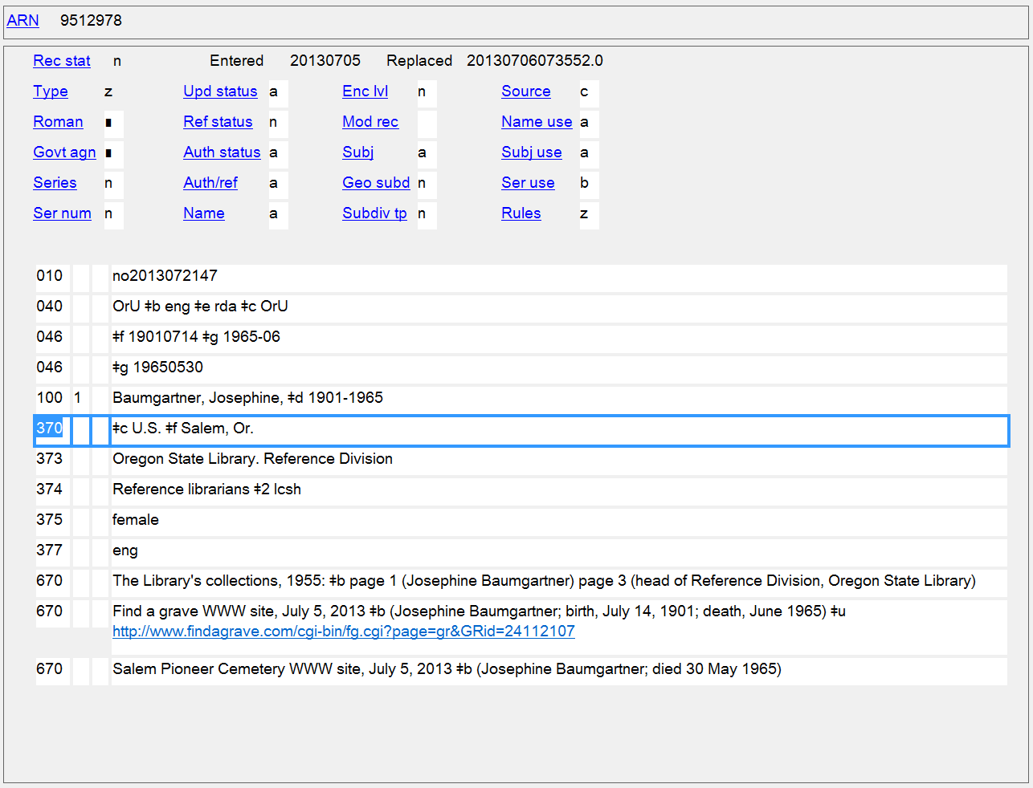
Form of places in this NAR (and many others) reflects RDA instructions. PCC policy now is to use the form exactly as found in the place name authority record.

Slide 46
370 - Associated Place
PCC policies
For jurisdictions or other place names with authority records in the LC/NAF, use the authorized access point form as found
May take non-jurisdictional place names from other controlled vocabulary, e.g. LCSH
Indicate the source of the place name if from a controlled vocabulary, using a $2 code
370 $a Salem (Or.) $c United States $2 naf
370 $g Russia (Federation) $2 naf
370 $b Auschwitz (Concentration camp) $2 naf
370 $e Sauvie Island (Or.) $2 lcsh

Slide 47
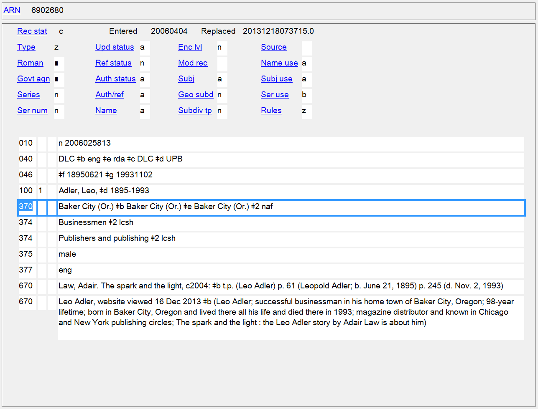
Place of Birth/Place of Death/Place of Residence
370 $a $b $e

Slide 48
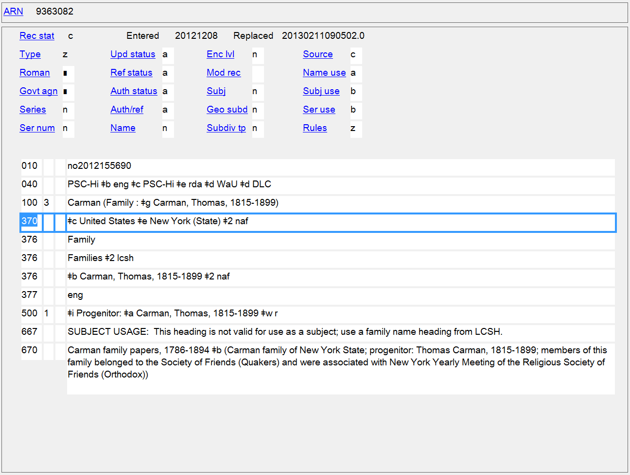
Associated Country/Place of Residence
370 $c $e

Slide 49
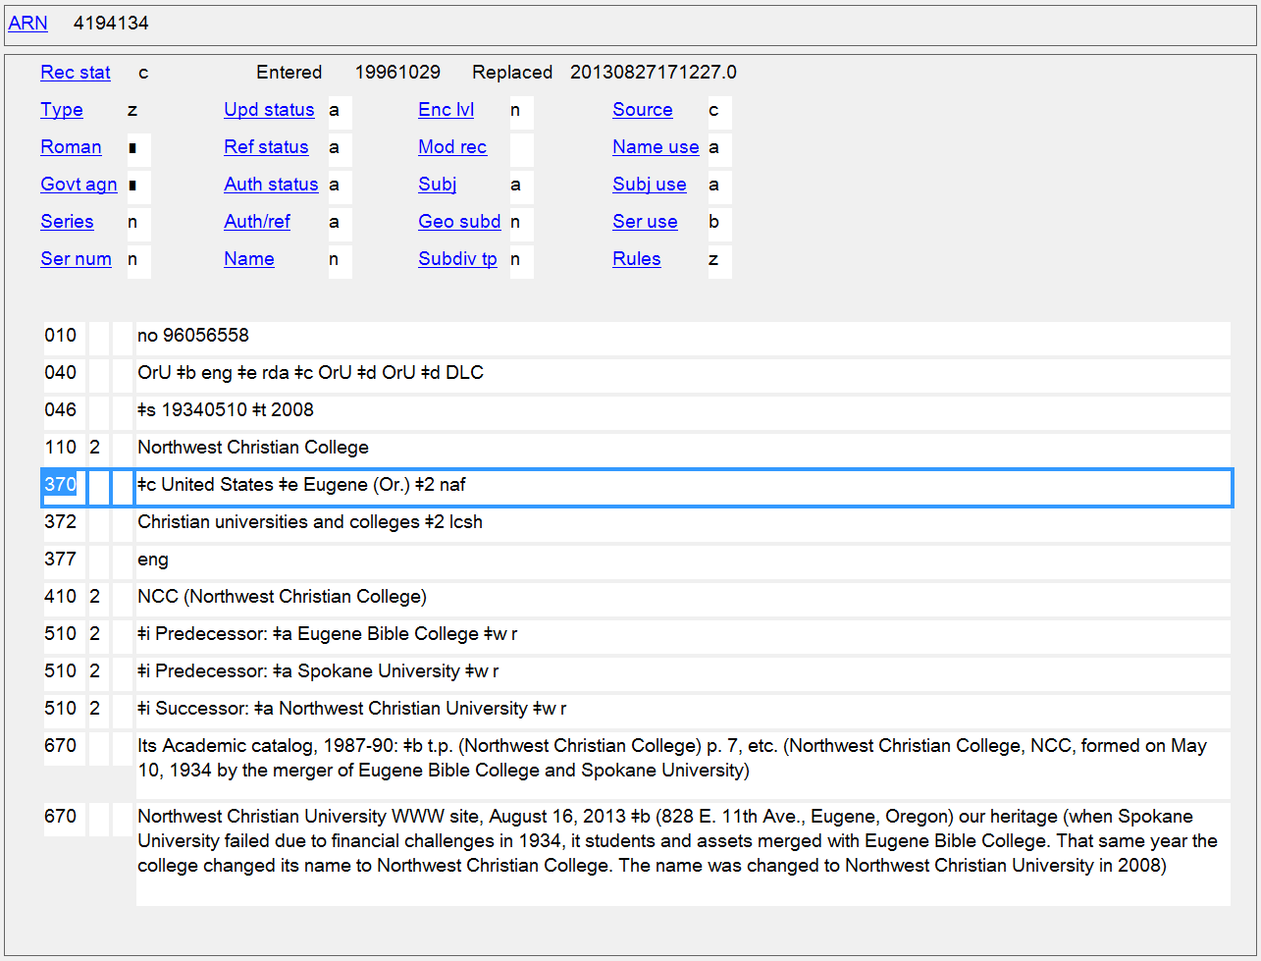
Associated Country/
Location of Headquarters
370 $c $e

Slide 50
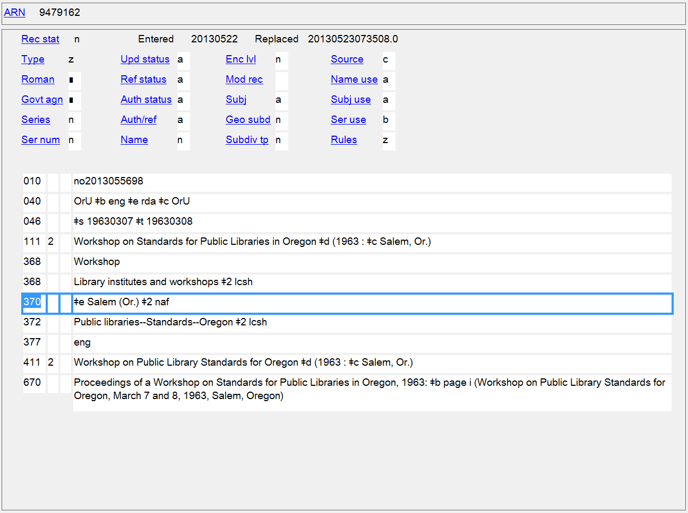
Location of Conference, Etc.
370 $e

Slide 51
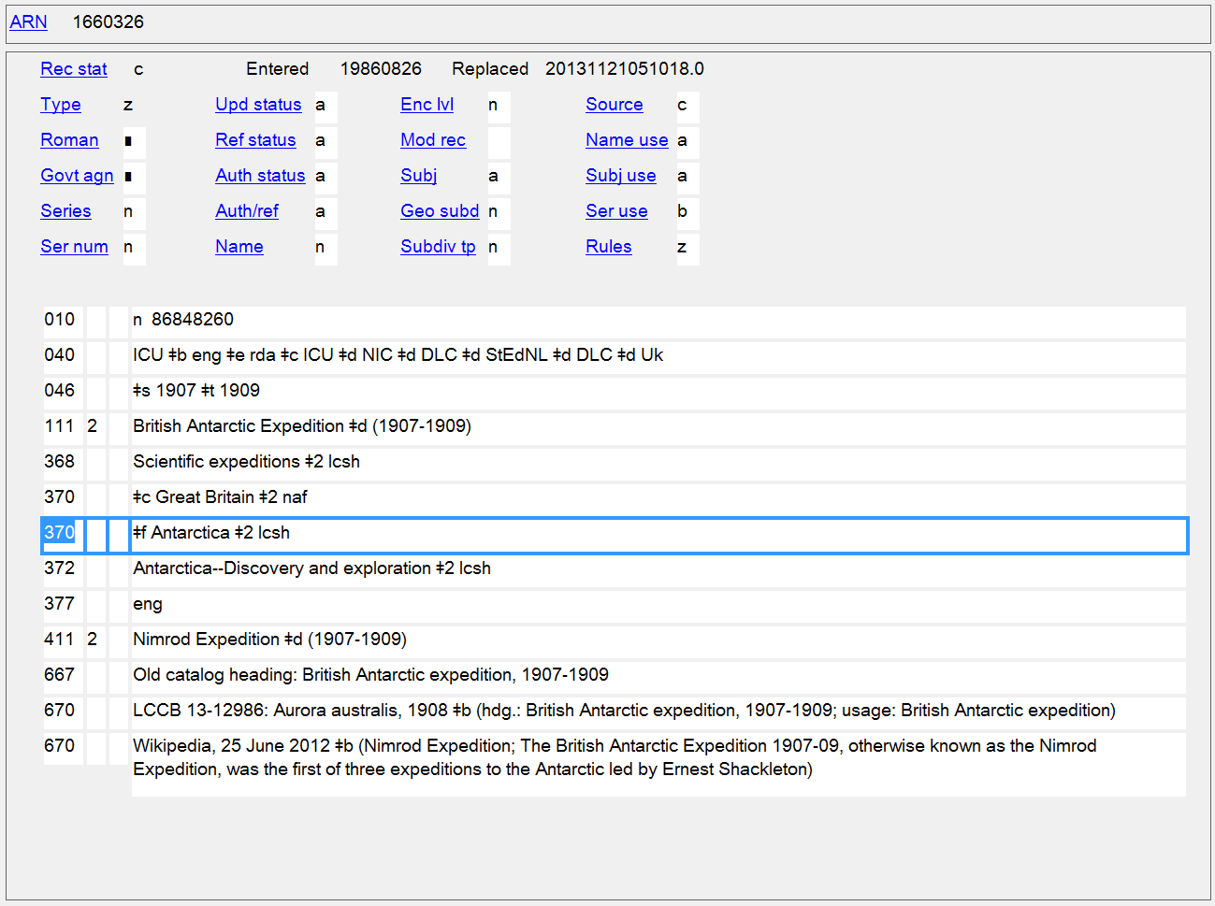
Associated Country/Location of Conference, Etc.
370 $c $f

Slide 52
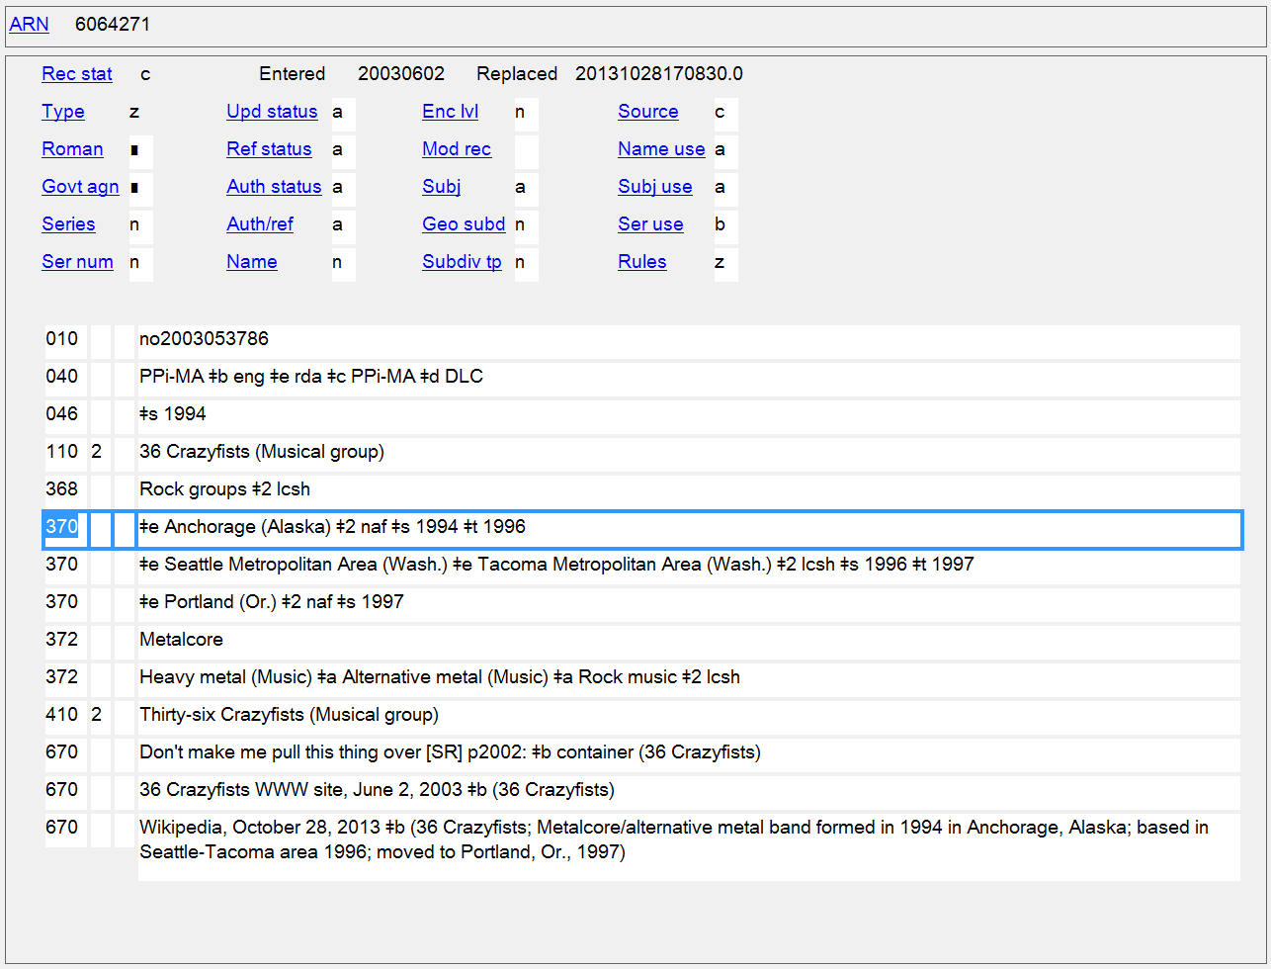
Locations of Headquarters with associated dates
370 $e $s $t

Slide 53
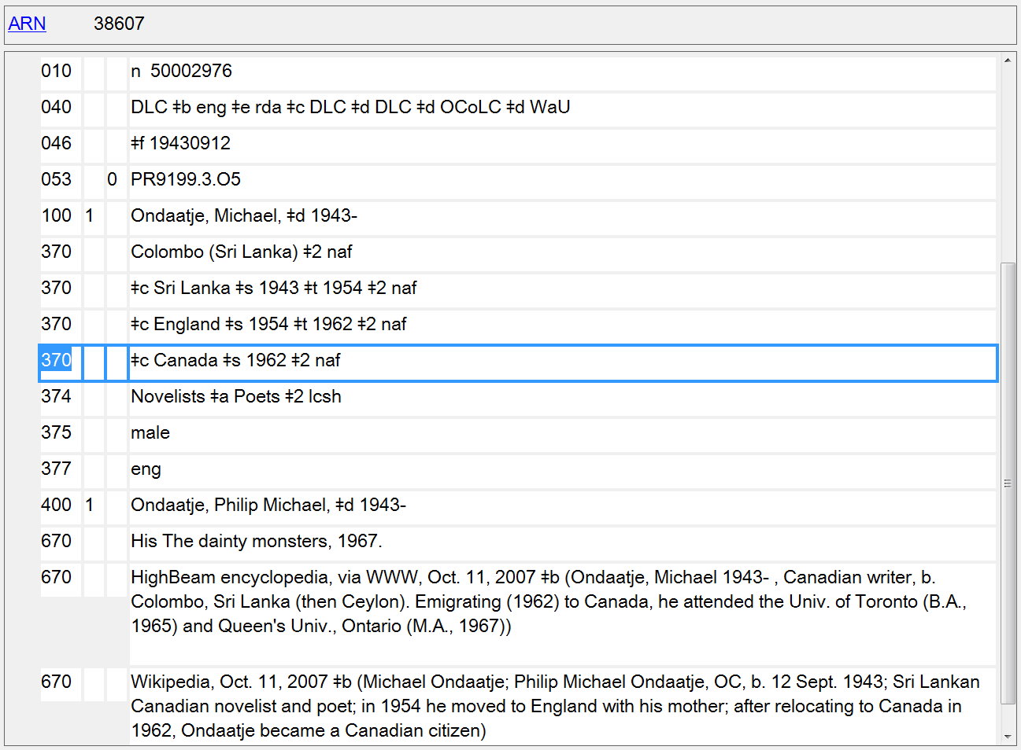
Place of Birth/Associated Countries with associated dates
370 $a $c $s $t

Slide 54
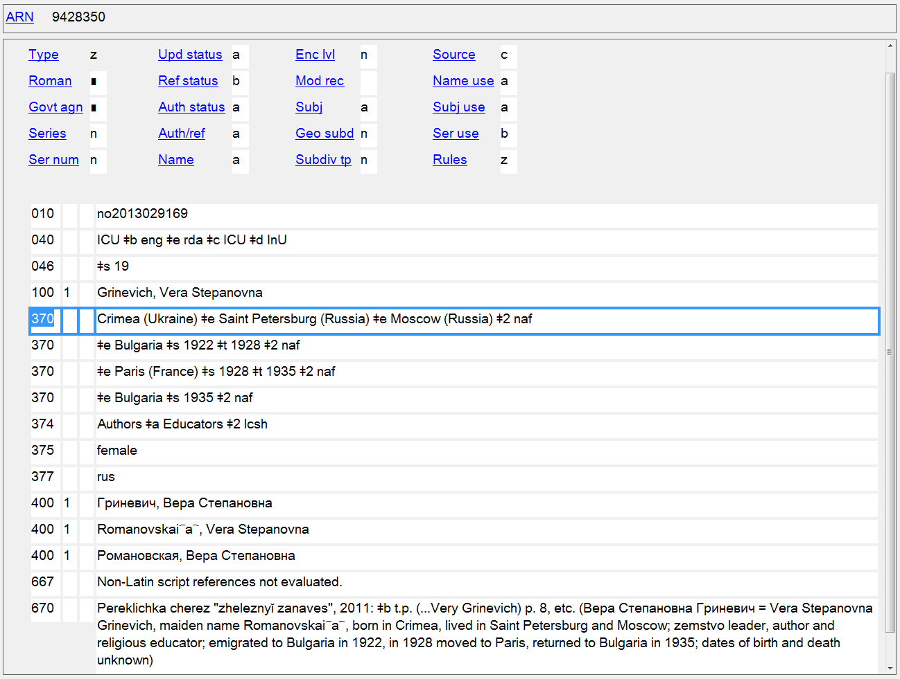
Place of Birth/Places of Residence, with associated dates when known
370 $a $e $s $t

Slide 55
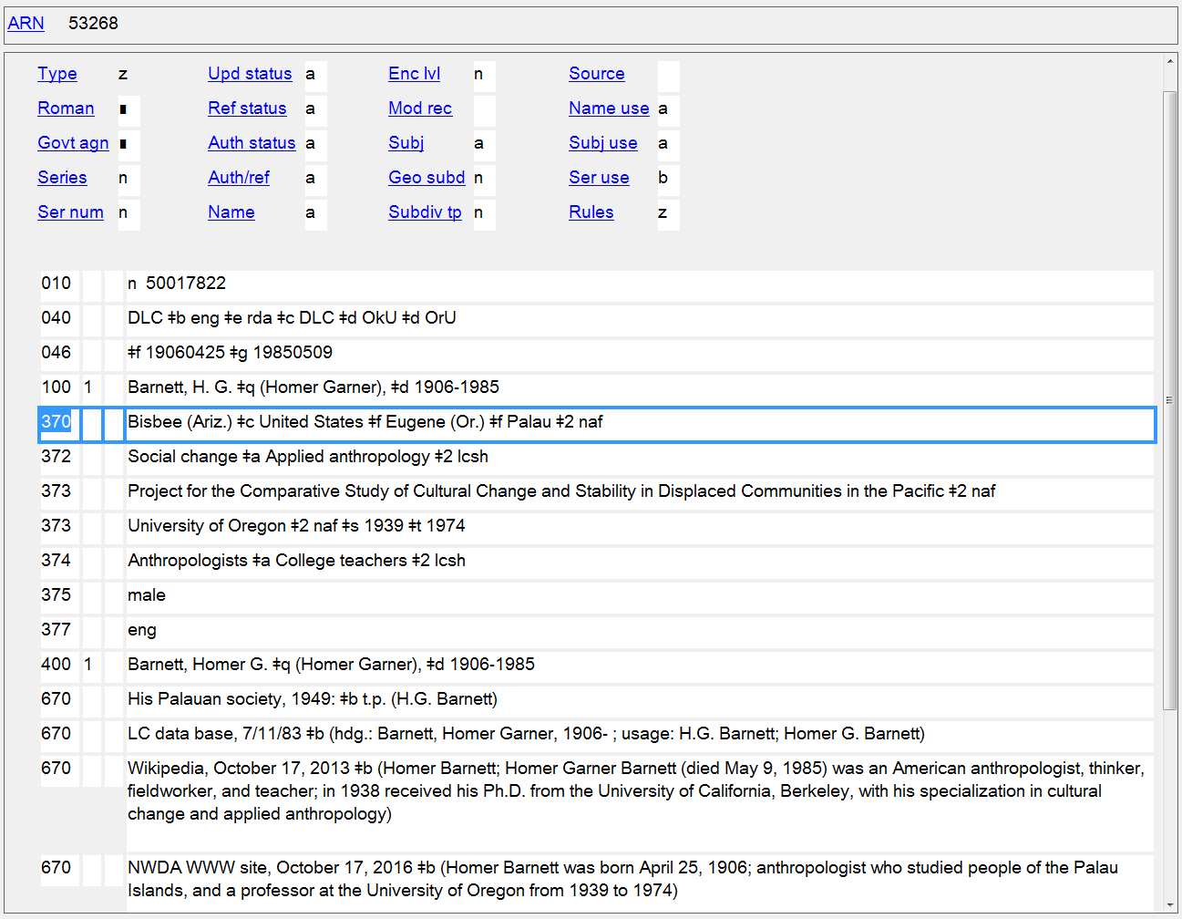
Place of Birth/Associated Country/Other Associated Places
370 $a $c $f
Notes:
$f - Other associated place
For persons, this is used for any place associated with a person other than place of birth, place of death, or residence. It’s commonly used to record a place where a person worked or studied.
9.11.1.1 Place of residence, etc., is a town, city, province, state, and/or country in which a person resides or has resided, or another significant place associated with the person other than place of birth, place of death, or residence (e.g., a place where a person has worked or studied).

Slide 56
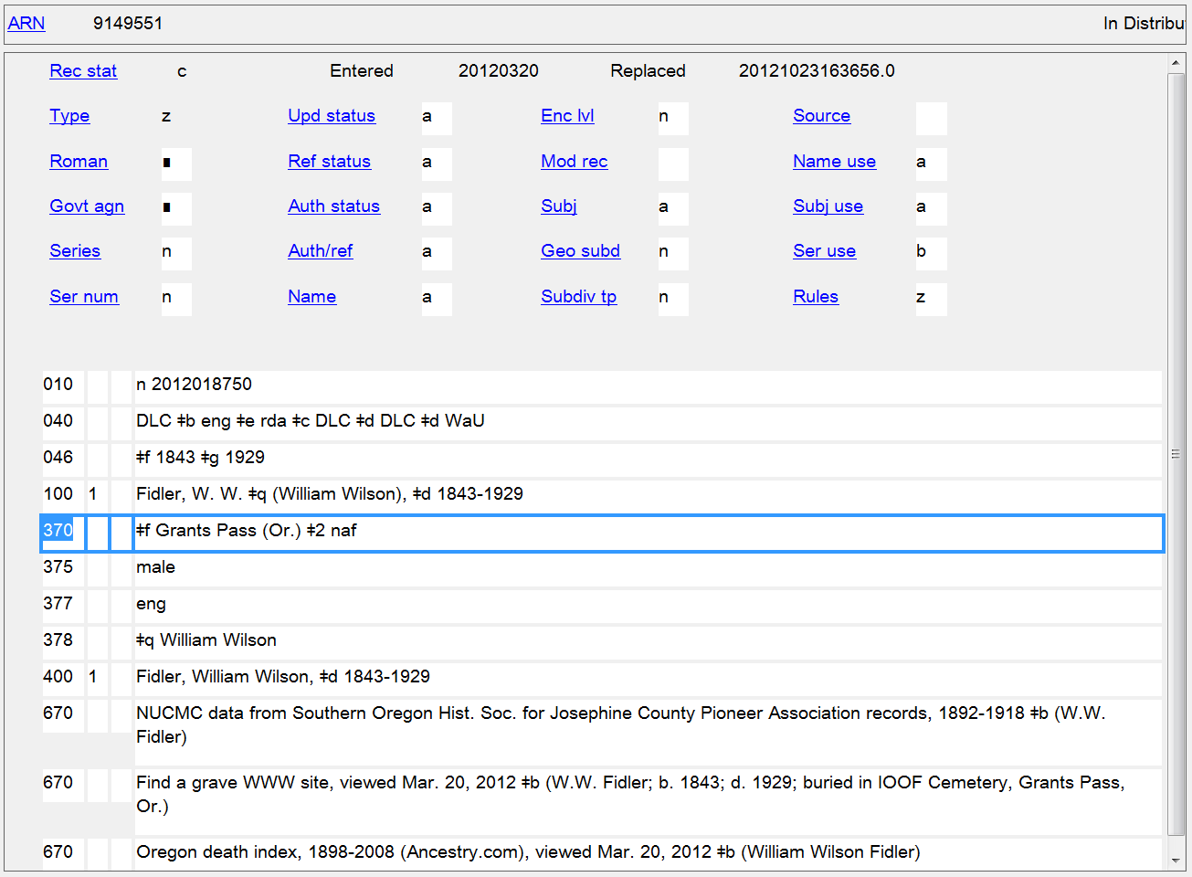
Other Associated Place (Burial Place)
370 $f

Slide 57
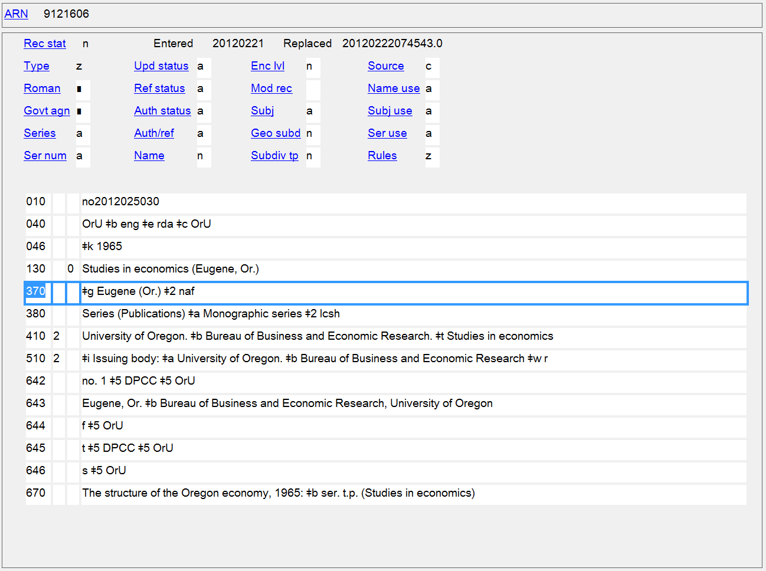
Place of Origin of Work
370 $g

Slide 58
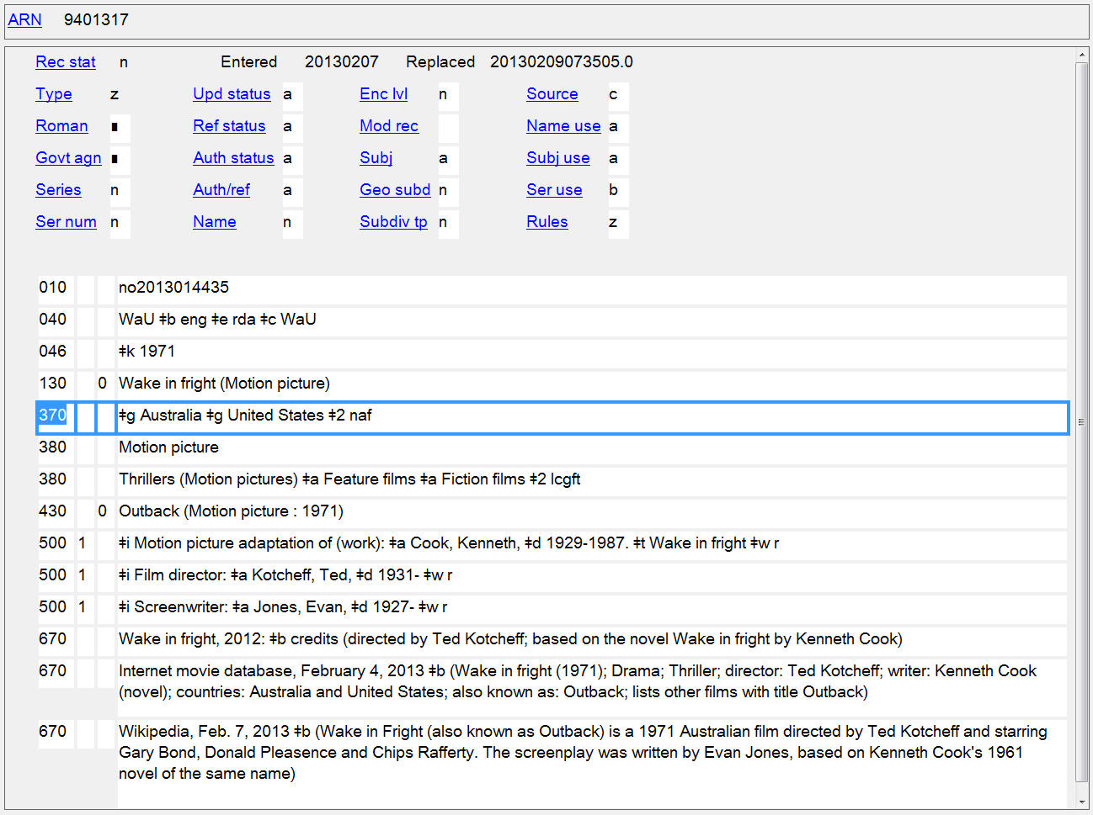
Places of Origin of Work
370 $g

Slide 59
Address
Persons
9.12 Address of the Person
Families
Nothing in RDA
Corporate Bodies
11.9 Address of the Corporate Body

Slide 60
371 - Address
Indicators not defined
Subfields
$a - Address (R) $b - City (NR) $c - Intermediate jurisdiction (NR)
$d - Country (NR) $e - Postal code (NR)
$m - Electronic mail address (R)
$s - Start period (NR) $t - End period (NR) $u - Uniform Resource Identifier (R) $v - Source of information (R)
$z - Public note (R)
$4 - Relator code (R) $6 - Linkage (NR) $8 - Field link and sequence number (R)

Slide 61
371 - Address
PCC best practices
Supply based on cataloger's judgment, if the information is readily available and not already being recorded in field 370 subfield $e (Place of residence/headquarters).
An address should have at a minimum a city ($b) or email ($m) present. Prefer field 370 $c if only a country is available.
Do not record physical addresses for living people.
Catalogers are not required to maintain address information when updating a record that contains an address.
Subfield $m should contain only an e-mail address. Do not add an internet address for the 1XX in this field

Slide 62
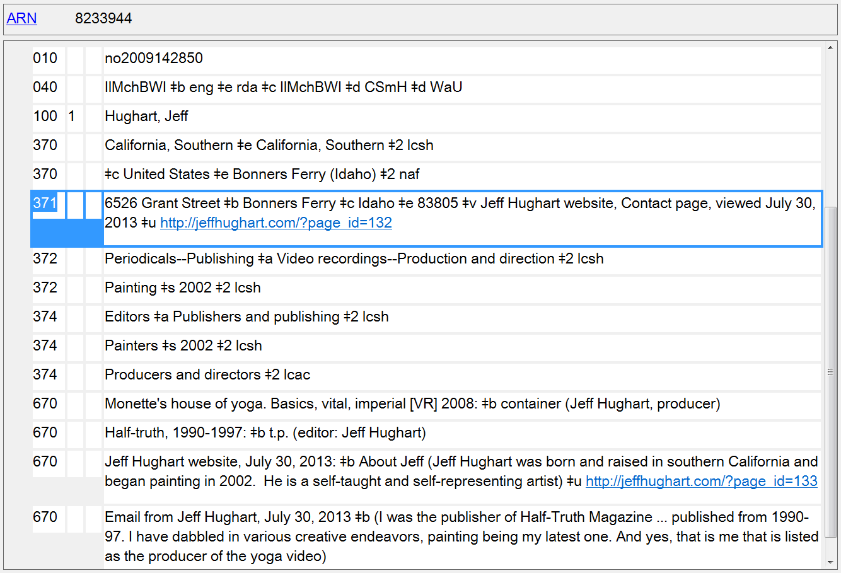
Address of the Person
371
Notes:
Despite PCC best practice of not recording addresses for living persons, many records, like this one, have it.

Slide 63
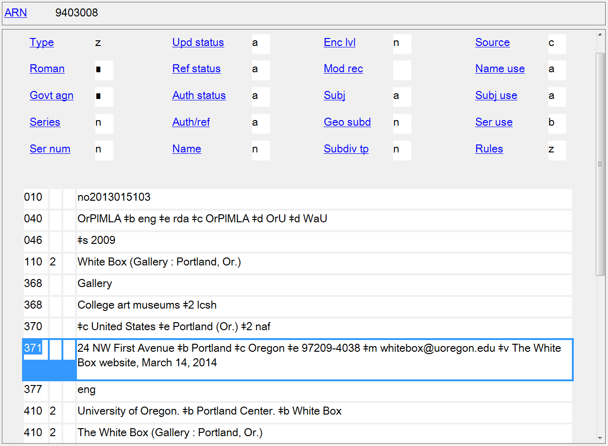
Address of the Corporate Body
371

Slide 64
Field of Activity
Persons
9.15 Field of Activity of the Person
Corporate Bodies
11.10 Field of Activity of the Corporate Body

Slide 65
372 - Field of Activity
Indicators not defined
Subfields
$a - Field of activity (R) $s - Start period (NR)
$t - End period (NR)
$u - Uniform Resource Identifier (R)
$v - Source of information (R)
$0 - Record control number (R) $2 - Source of term (NR)
$6 - Linkage (NR) $8 - Field link and sequence number (R)

Slide 66
372 - Field of Activity
PCC policies
Prefer controlled vocabulary, such as LCSH or MeSH, recording the source in subfield $2
Capitalize first word in subfield $a

Slide 67
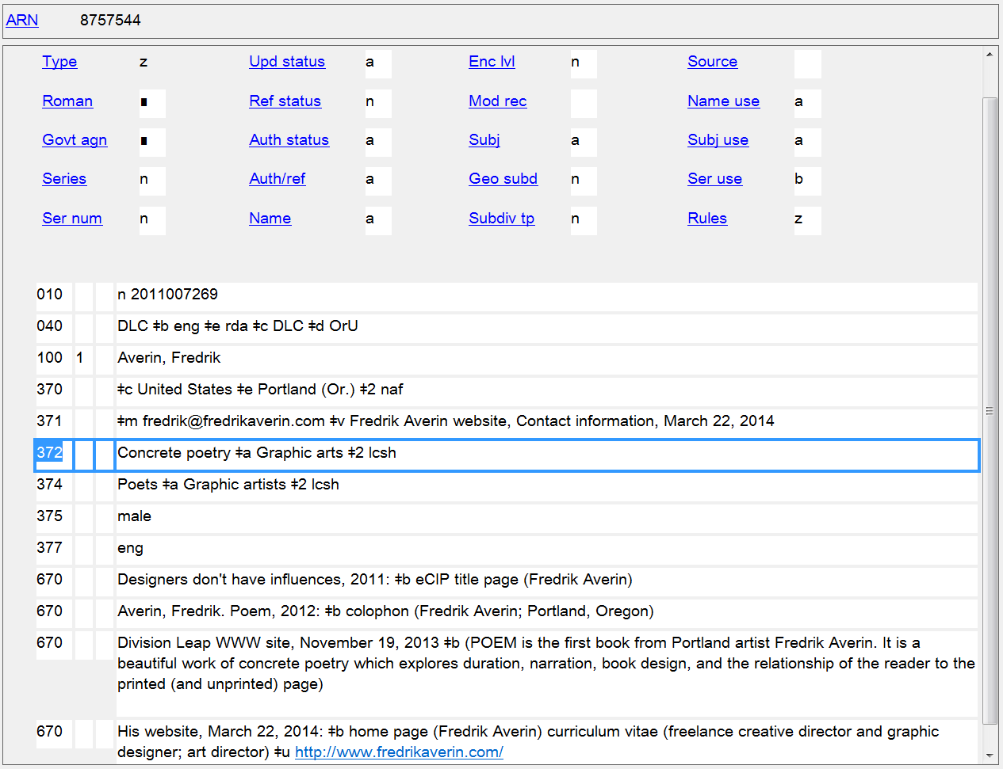
Field of Activity
372

Slide 68
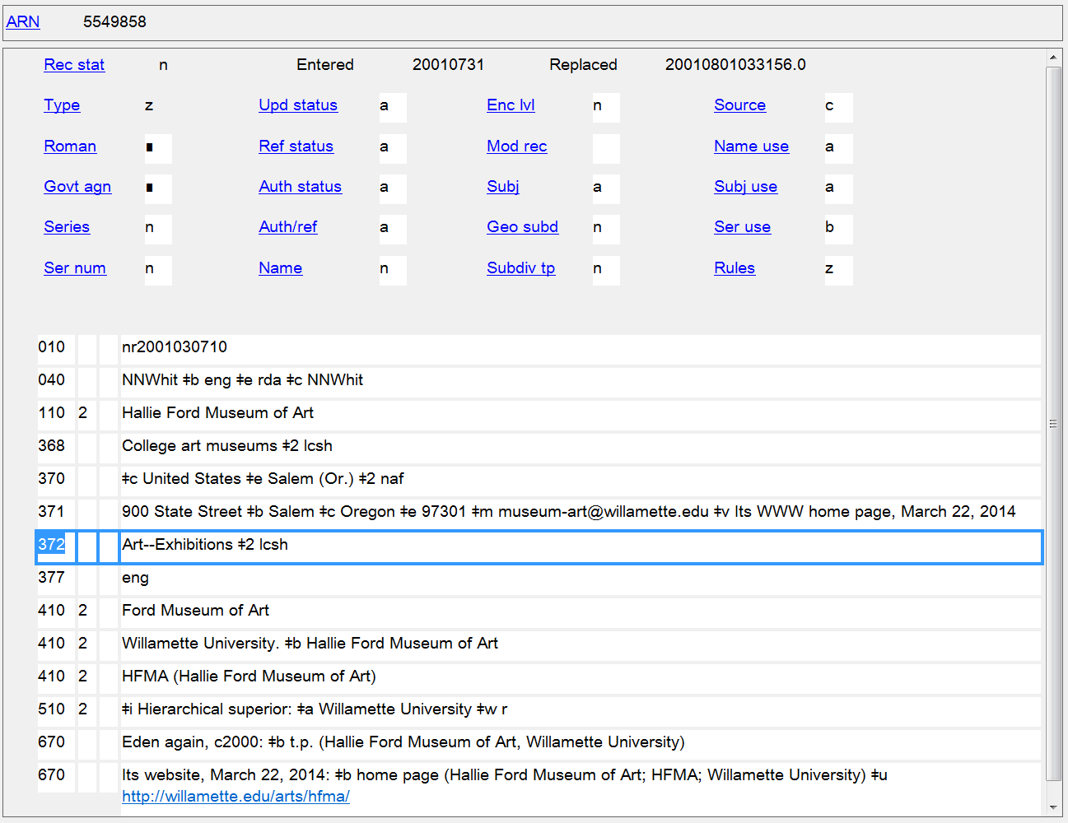
Field of Activity
372

Slide 69
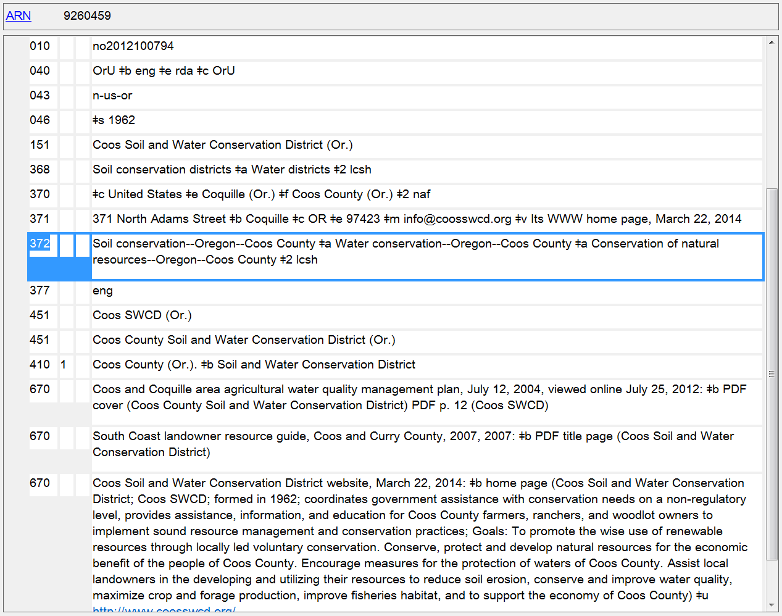
Field of Activity
372

Slide 70
Associated Group
Persons
9.13 Affiliation
Corporate Bodies
11.5 Associated Institution

Slide 71
373 - Associated Group
Indicators not defined
Subfields
$a - Associated group (R) $s - Start period (NR)
$t - End period (NR)
$u - Uniform Resource Identifier (R)
$v - Source of information (R)
$0 - Record control number (R) $2 - Source of term (NR)
$6 - Linkage (NR) $8 - Field link and sequence number (R)

Slide 72
373 - Associated Group
PCC policies
Prefer a controlled vocabulary, such as the LC/NACO Authority File, giving source of name in subfield $2
Subfields found in authorized access point in LC/NACO Authority File are removed but punctuation is preserved:
Corporate name in LC/NAF:
110 1_ $a United States. $b Congress. $b Senate
Form of name in 373:
373 __ $a United States. Congress. Senate $2 naf

Slide 73
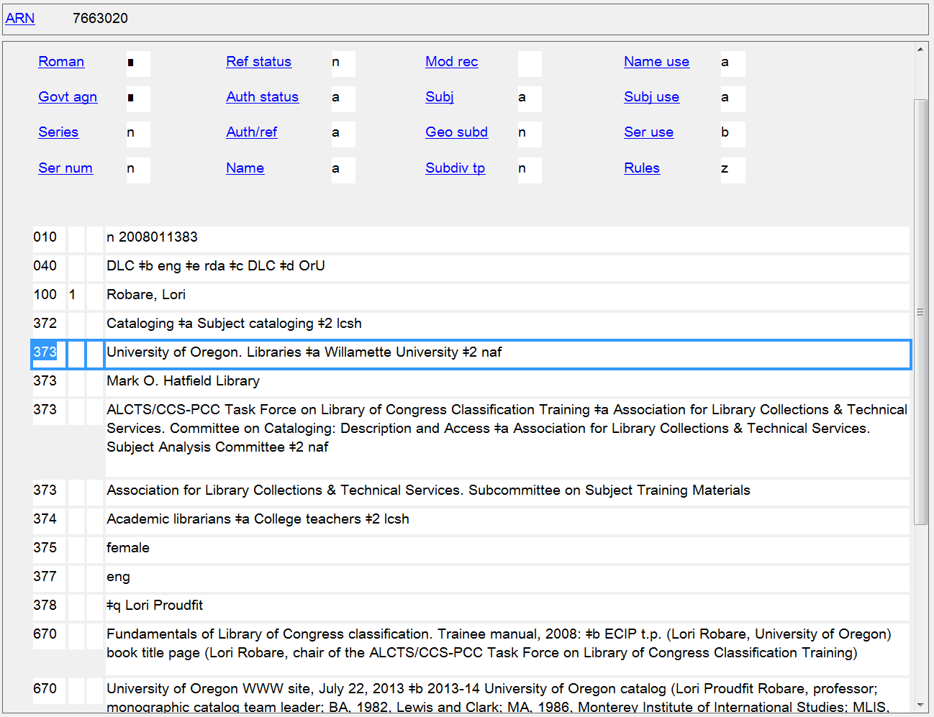
Affiliation
373

Slide 74
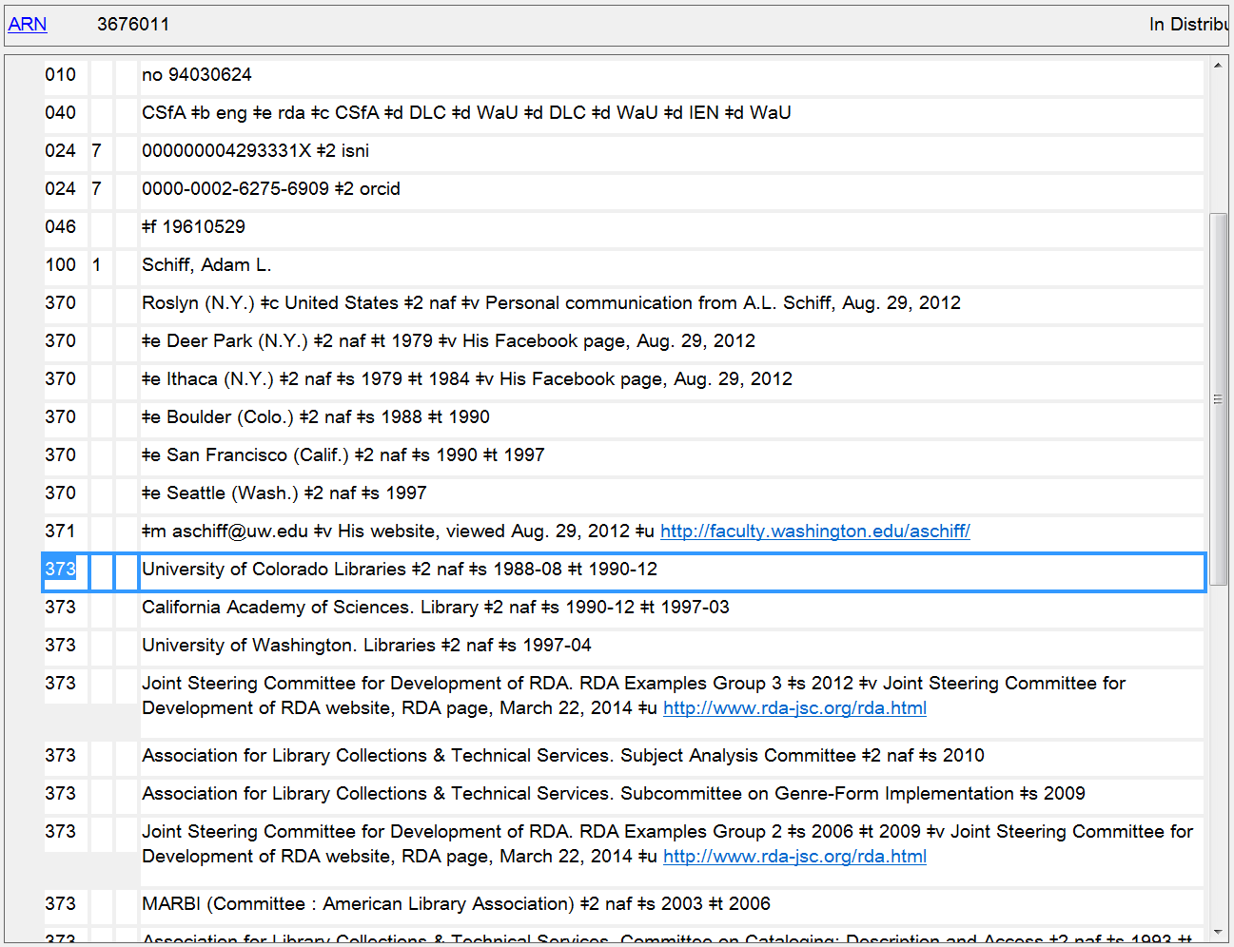
Affiliations, with dates when known
373

Slide 75
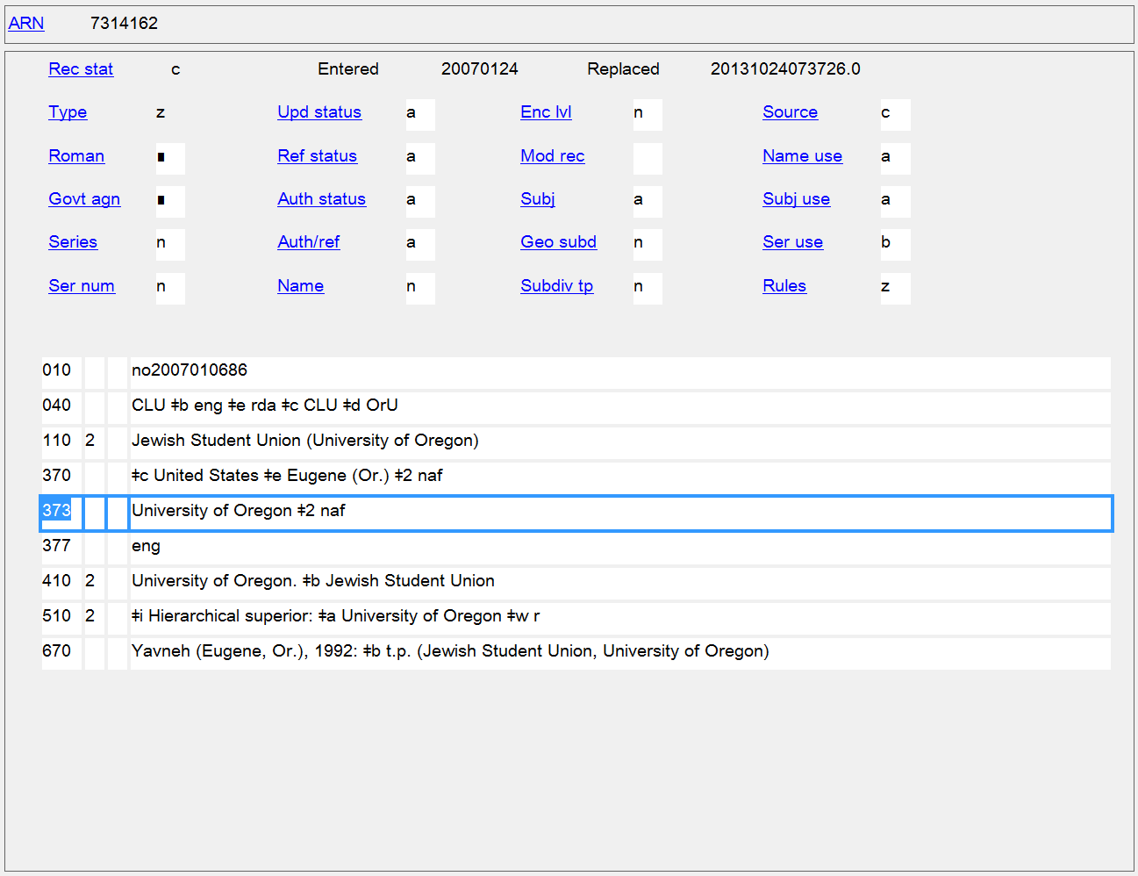
Associated Institution
373

Slide 76
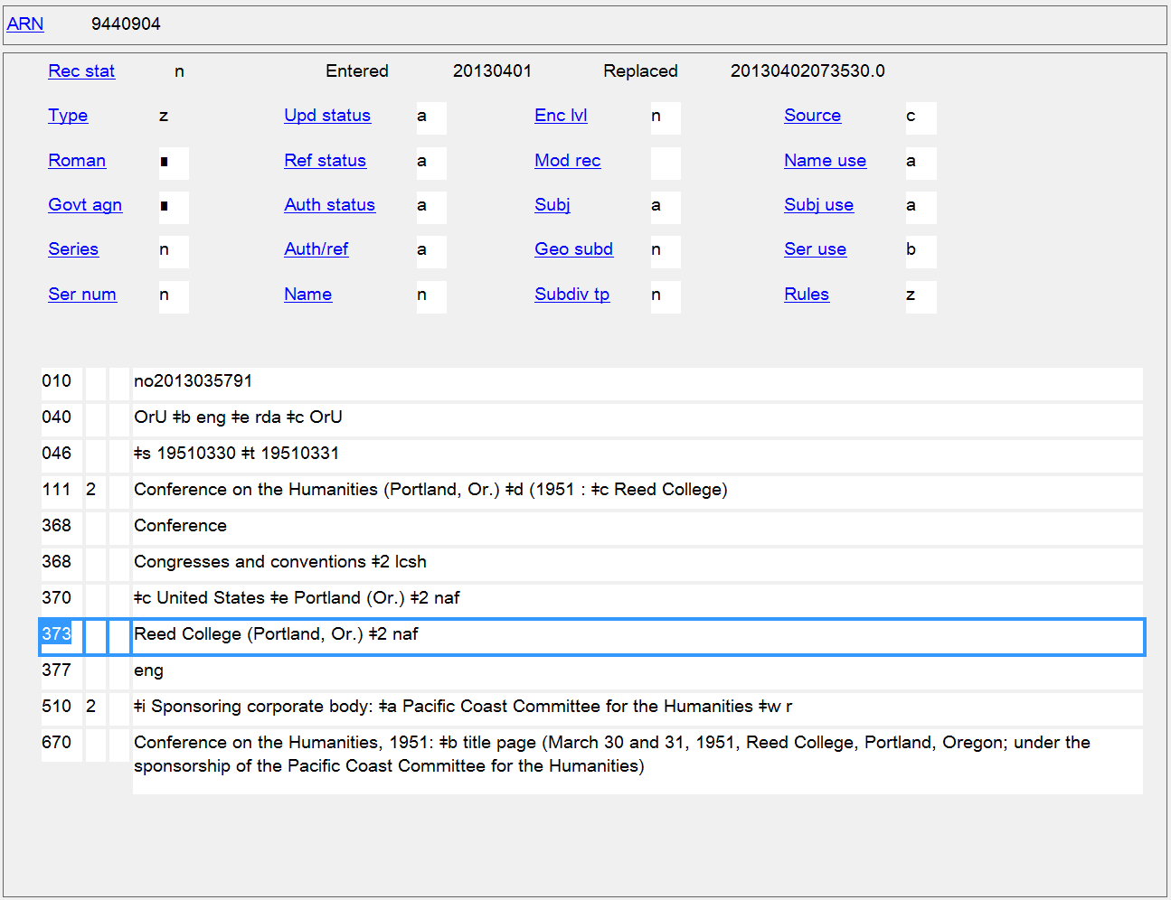
Associated Institution
373
Notes:
If you’re wondering why (Portland, Or.) is included as a qualifier after the conference name, it’s because there is a completely different conference with the same name, so the authorized access point for this conference needs to be differentiated from that one.

Slide 77
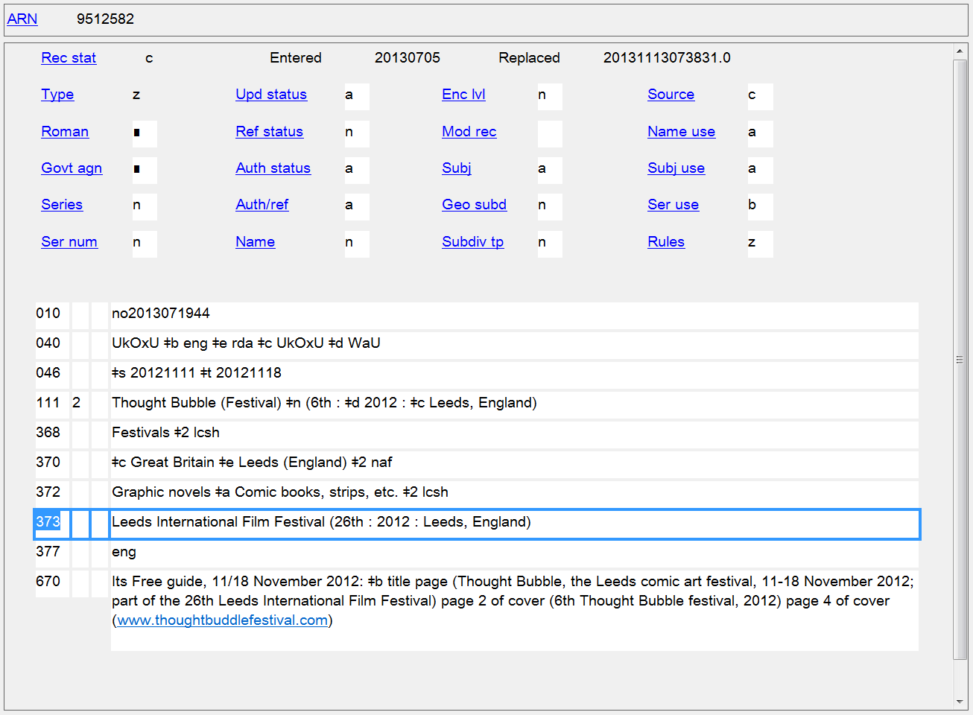
Associated Institution
373

Slide 78
Language
Persons
9.14 Language of the Person
Families
10.8 Language of the Family
Corporate Bodies
11.8 Language of the Corporate Body
Works and Expressions
6.11 Language of Expression

Slide 79
377 - Associated Language
First Indicator not defined
Second Indicator
# - MARC language code
7 - Source specified in $2
Subfields
$a - Language code (R) $l - Language term (R) $2 - Source of code (NR)
$6 - Linkage (NR) $8 - Field link and sequence number (R)

Slide 80
377 - Associated Language
PCC policies
Prefer language codes over language terms, using codes from the MARC Code List for Languages
Use subfield $l (Language term) only to provide information not available in the MARC Code List for Languages
Use second indicator value “7” and subfield $2 when a code is take from any language code list other than the MARC Code List for Languages. Source codes used in $2 are taken from the Language Code and Term Source Codes (http://www.loc.gov/standards/sourcelist/language.html)

Slide 81
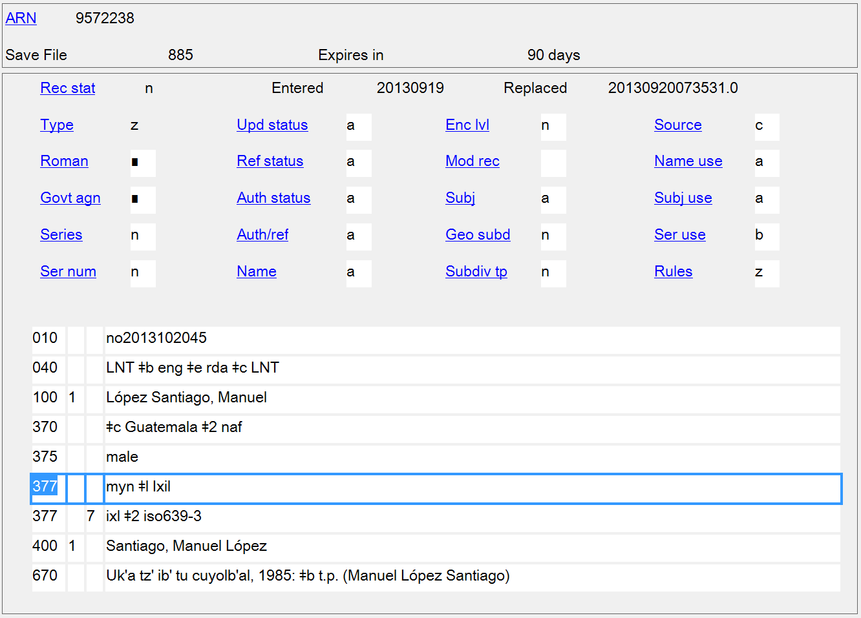
Language of the Person
377
Notes:
The MARC Code List for Languages has just a collective code for all Mayan languages, “myn”. In this case the author’s specific language is Ixil, so $l is added to the first 377 field to identify the specific language. Another code list does have a specific code for Ixil so a second 377 was added for it.

Slide 82
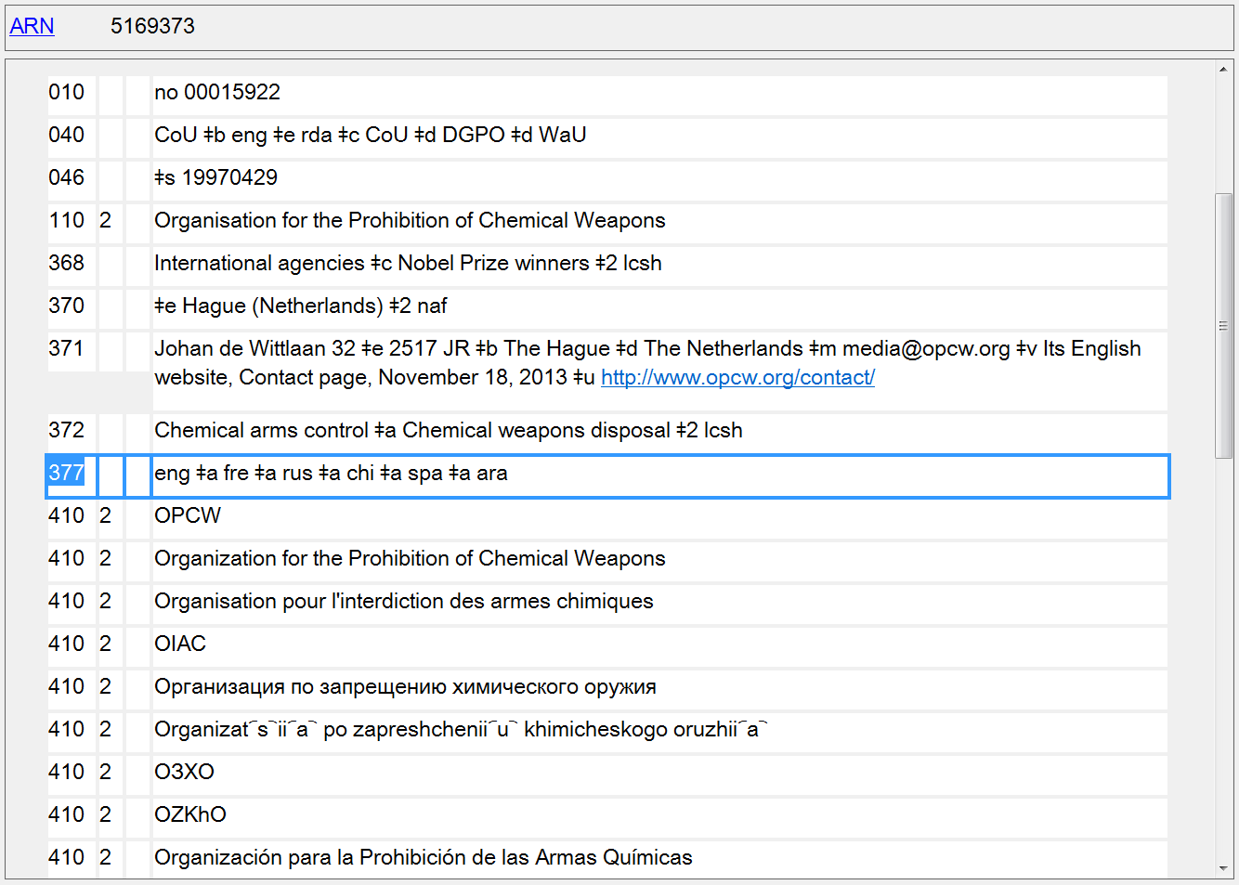
Languages of the Corporate Body
377

Slide 83
Language of Expression
377

Slide 84
Biography/History
Persons
9.17 Biographical Information
Families
10.9 Family History
Corporate Bodies
11.11 Corporate History
Works and Expressions
6.7 History of the Work

Slide 85
678 - Biographical or Historical Data
First Indicator
# - No information provided
1 - Biographical sketch
2 - Administrative history
Second Indicator not defined
Subfields
$a - Biographical or historical data (R) $b - Expansion (NR) $u - Uniform Resource Identifier (R)
$6 - Linkage (NR) $8 - Field link and sequence number (R)

Slide 86
678 - Biographical or Historical Data
PCC policies
Construct the note in concise but complete sentences, keeping in mind that the information will be used in public displays.

Slide 87
Biographical Information
678
-

Slide 88
Family History
678

Slide 89
History of the Work
678

