Slide 1
Check Out the Writer! A Model for Success in Adult Library Programming WLA/PNLA Conference - August 13, 2010
Judy Moore, Grant MacEwan University Lauralee Gilmour, Parkland Regional Library

Slide 2
Presentation Overview
Chapter 1
Backgrounder on the Library Association of Alberta, the Writers Guild of Alberta … and the opportunity
Setting the stage – the Alberta context
“Check out the Writer!” Program
Coordinating the effort
Community benefits
LAA’s first electronic publication
Next Steps … Chapter 2, “Write On!”

Slide 3
Library Association of Alberta, the Writers Guild of Alberta … and the opportunity

Slide 4
“Check out the Writer!” Program
Regional Library Systems and their Writer in Residence
Process & criteria for determining writers in each of the regional library systems
Expectations of the writer
Library support provided to the writer

Slide 5
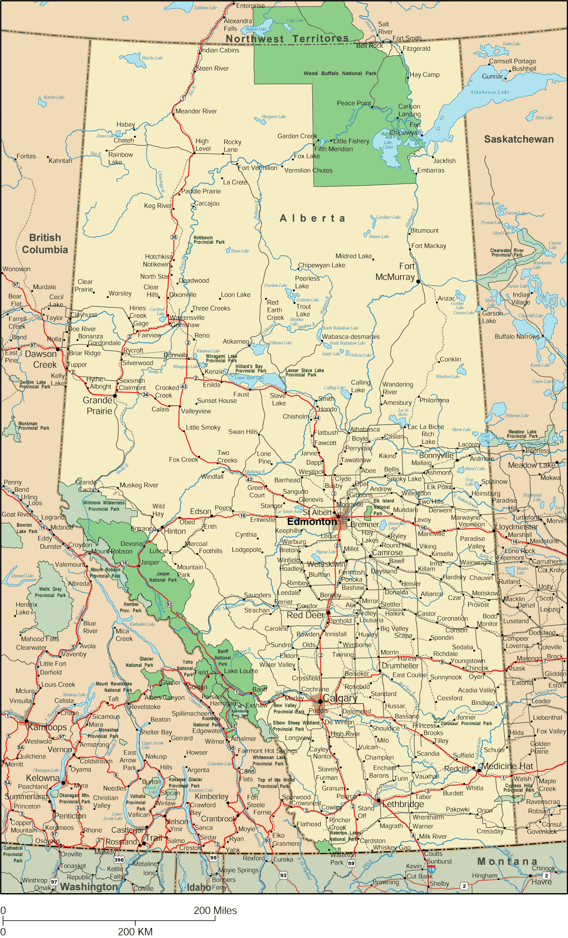
Setting the stage – the Alberta context
Seven regional library systems
serving 205 library boards,
291 municipalities, and 253
library service points not
including the large urban
centres

Slide 6
“Check out the Writer!” Program
Regional Library Systems and their Writer in Residence
Programming – manuscript reviews, workshops and readings
Budget per regional library system
“Checkout the Writer!” e-anthology
http://www.laa.ca/docs/wired_writers/E_anthology_final_2008%20small.pdf

Slide 7
“Check out the Writer!” Program
Kimmy Beach, Parkland Regional
Poet
Joan Marie Gallat, Yellowhead Regional
Non Fiction Writer

Slide 8
“Check out the Writer!” Program
Murray Greig, Northern Lights Regional Library
Journalist
Jacqueline Guest, Marigold Regional Library
First Nations – Young Adult

Slide 9
“The 12 weeks saw me roaming the northeast sector of the province like a medieval troubadour… There was something new and fresh at every stop. From Wainwright and Paradise Valley to Athabasca, Wandering River, Morinville, Ashmont, St. Paul, Cold Lake and points in between, I was consistently impressed by both the dedication and talent of writers in rural Alberta.”
Murray Greig

Slide 10
“Check out the Writer!” Program
Elizabeth McLachlan, Shortgrass Library System
History and Non-fiction
David Poulsen, Chinook Regional Library
Young Adult

Slide 11
“Check out the Writer!” Program
Diane Schuller, Peace Library System
Columnist and Short fiction
“The value of this program is
incalculable…If I had had
access to a writer in residence
when I was beginning to write,
I would have been published
years earlier…The variety and
excellent level of the work I read
gave me a great feeling as I am
sure the literary future of Albert
is alive and well…” J. Guest

Slide 12
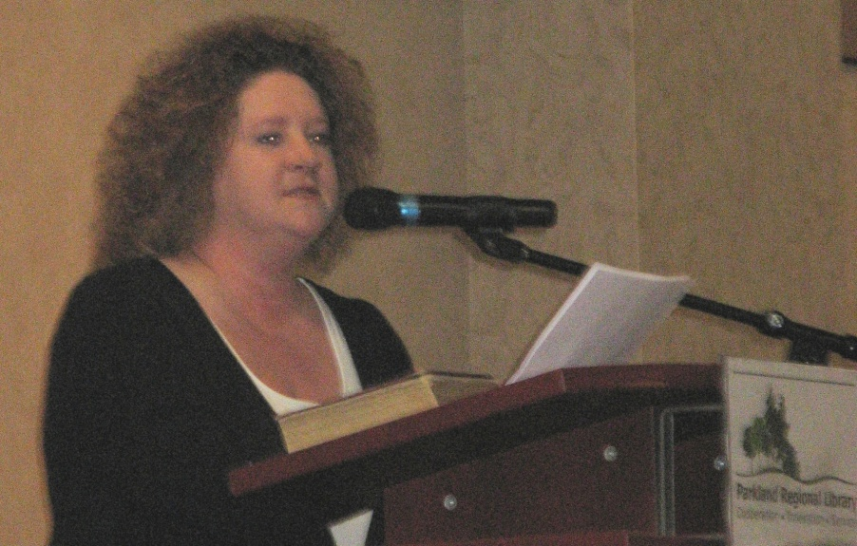
“Check out the Writer!” and Parkland Regional Library
“I Would Like to Be a Librarian Again for Another Year”
Poem commissioned for Parkland Regional Library’s 50th anniversary, 2009
Kimmy Beach reading her poem

Slide 13
Chapter 2
April 2010

Slide 14
“Write On!” Program
Fran Kimmel
Award-winning Lacombe writer

Slide 15
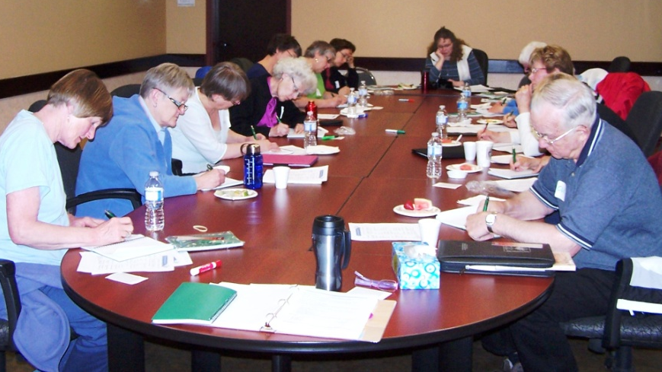
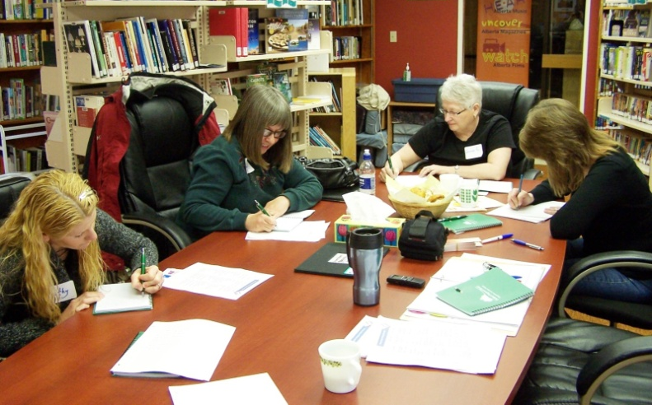
“Write On!” Program – Session Topics
Writing Your Memoir
Where Do Story Ideas Come From?
Speaking of Dialogue
Business Writing – Plain and Simple

Slide 16
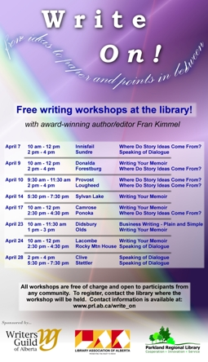
“Write On!” Program - Promotion
Website - www.prl.ab.ca/write_on
News releases – to libraries, local newspapers and community newsletters, radio stations
All member libraries received posters

Slide 17
“Write On!” Program - Statistics
1,700 km
15 Locations
124 participants -ages 9 to 90
30,000 words
500+ emails
1 box of Kleenex

Slide 18
“Write On!” Program – Participant Comments
Accessibility
Community interaction and sharing
Can we have more?

Slide 19
“Write On!” Program – Participant Comments
Positive, encouraging, inspiring, amazing, useful, wonderful, fantastic, great atmosphere, helpful, and fun!
“We have some pretty interesting stories here in rural Alberta. The things that happen here are unique to us. It’s great for us to get help to tell our stories.”

Slide 20
“Write On!” Program – Spinoff Effects
New writing groups
More writing-related programming organized by individual libraries
Alberta Arts Days

Slide 21
“Write On!” Program – Ideas to Support Local Writers
Create an area in your library for writers (a bulletin board to post stories?)
Help set up memoir or life writing groups
Host story telling evenings & author readings
Organize writing contests

Slide 22
Success!

Slide 23
Questions or Comments?

