Slide 1
AASL Lesson Plan Database & Standards
Presented by Deanna Draper and Jen Maurer
OASL Fall Conference
2013

Slide 2
Learning4Life or L4L
AASL’s initiative to promote the Standards for the 21st-Century Learner, school library program guidelines, and the school librarian’s role in helping students become lifelong learners.

Slide 3
Standards for the 21st-Century Learner
AASL’s current school library standards

Slide 4
Standards for the 21st-Century Learner
Organized under 4 strands
Inquire, think critically, and gain knowledge
Draw conclusions, make informed decisions, apply knowledge to new situations, and create new knowledge
Share knowledge and participate ethically and productively as members of our democratic society
Pursue personal and aesthetic growth

Slide 5
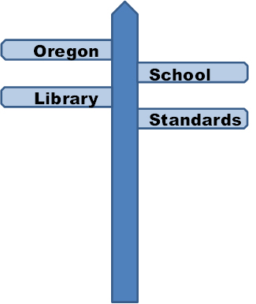
OSLIBS & CCSS
There is much in common among the AASL standards, the Oregon School Library Standards (OSLIBS), and the Common Core State Standards
OSLIBS & CCSS Crosswalk

Slide 6
AASL Lesson Plan Database
Is part of L4L
“…a tool to support school librarians and other educators in teaching the essential learning skills defined in the AASL Standards for the 21st-Century Learner.”

Slide 7
AASL Lesson Plan Database
Can search for and use lessons w/o having an account
Anyone can submit lessons; first must set up free account

Slide 8
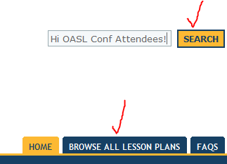
AASL Lesson Plan Database
Search the database using the search box or the options under Browse All Lesson Plans.

Slide 9
Sample Grade 4 Lesson
George Washington: Was he a responsible family man as well as a great leader (link)?
Addresses these standards and more:
AASL: 1.1.5
Evaluate info..on basis of accuracy, validity…
OSLIBS: 1.2.A Analyze and evaluate info to draw conclusions…
CCSS: EL.04.LI.08
Draw inferences or conclusions about a text…

Slide 10
Sample Grade 7 Lesson
Human Interactions with Living Systems (link)
Addresses these standards and more:
AASL: 3.3.3
Use knowledge…to engage in public conversation…
OSLIBS: 1.2.C & 4.1.H Use info to…solve real-world problems Explore digital tools to create and share works…
CCSS: 7.RI.1 Cite several pieces of textual evidence to support…

Slide 11
Sample Grade 11 Lesson
Letter Writing for Human Rights (link)
Addresses these standards and more:
AASL: 3.1.3 Use writing…to communicate new understandings...
OSLIBS: 3.3.B …and uphold the rights of others
CCSS: EL.HS.WR.24
Clarify and defend positions with…evidence…

Slide 12
You Can Be a National Star!
…by submitting your own lesson plan
You do not have to be an AASL member.
Tools to help you:
Lesson plan rubric
Lesson plan checklist

Slide 13
What’s In It For Me?
Help make a national tool more useful.
Bring attention to Oregon.
Build your resume.
AASL will send a letter of recognition to your principal.
AASL will give you an eBadge
to display on your website,
blog and email signature.

Slide 14
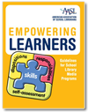
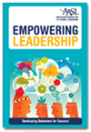
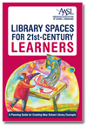
AASL Books (ILL) & Resources

Slide 15
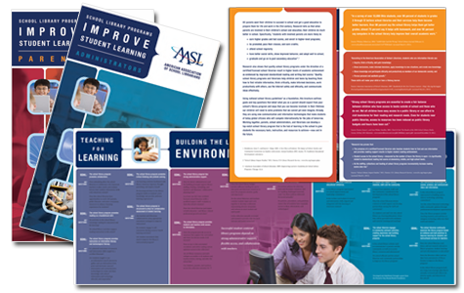
AASL Resources
Explain the AASL Standards for the 21st-Century Learner to administrators.
PowerPoint
Brochure
Explain the value of school library programs to a variety of audiences.

Slide 16
Questions? Contact the Oregon L4L Representatives
Deanna Draper
Retired School Librarian
deannadraper@gmail.com
Jennifer Maurer
School Library Consultant, Oregon State Library
jennifer.maurer@state.or.us

