Slide 1
Using Instagram @ your library

Slide 2
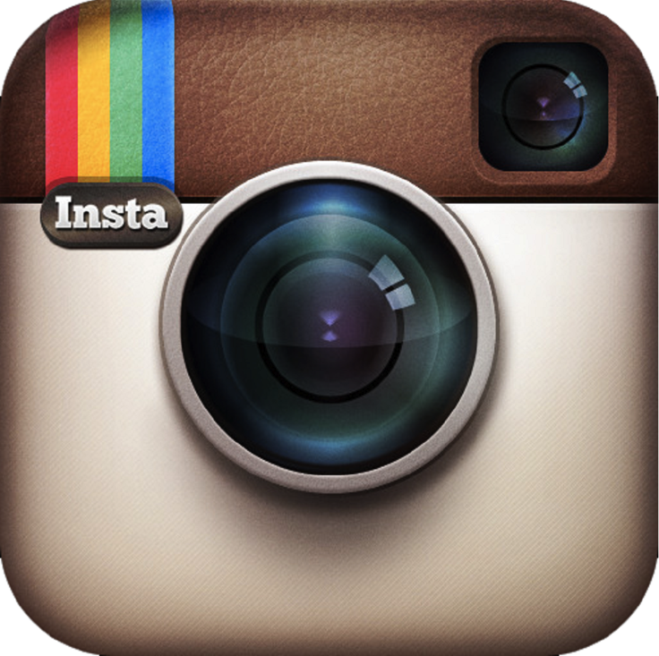

Slide 3
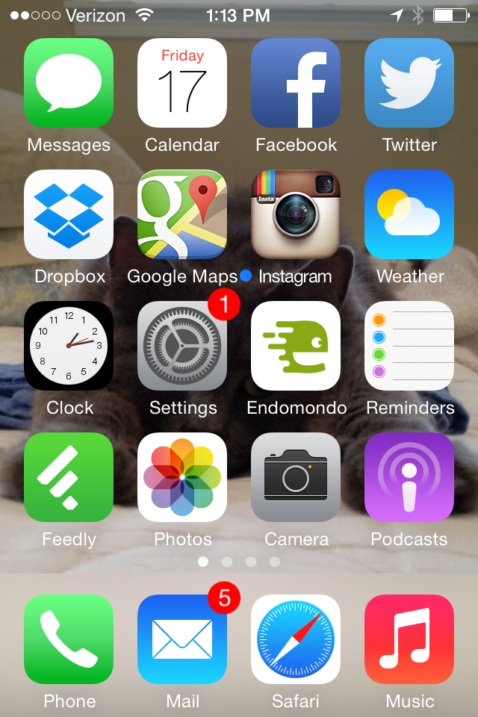

Slide 4
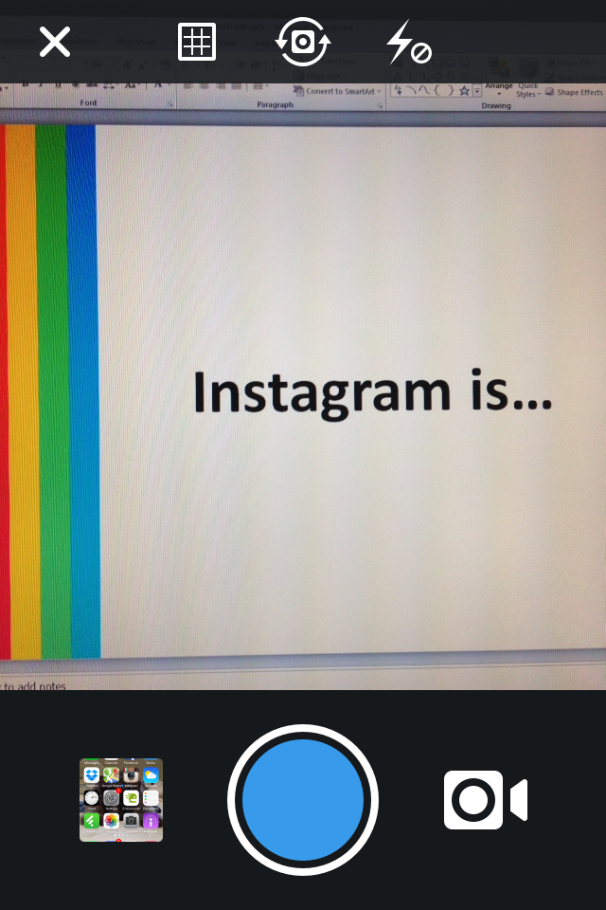

Slide 5
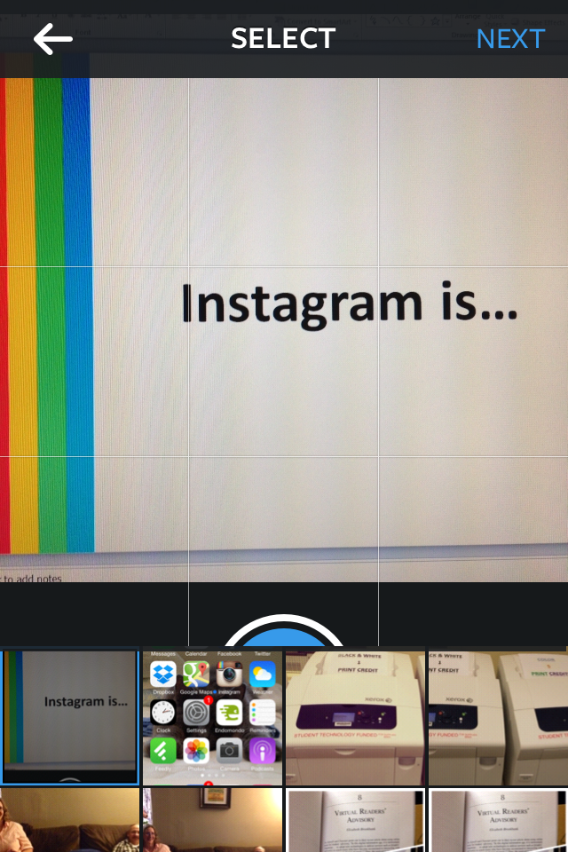

Slide 6
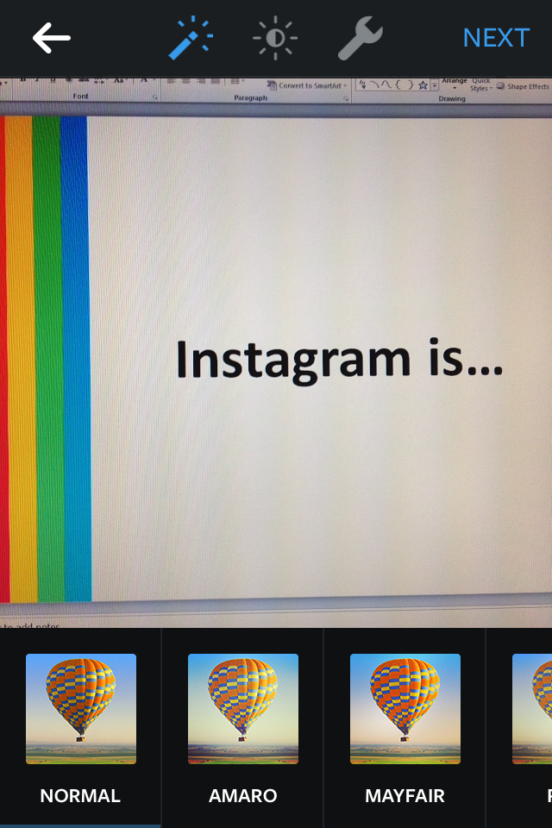

Slide 7
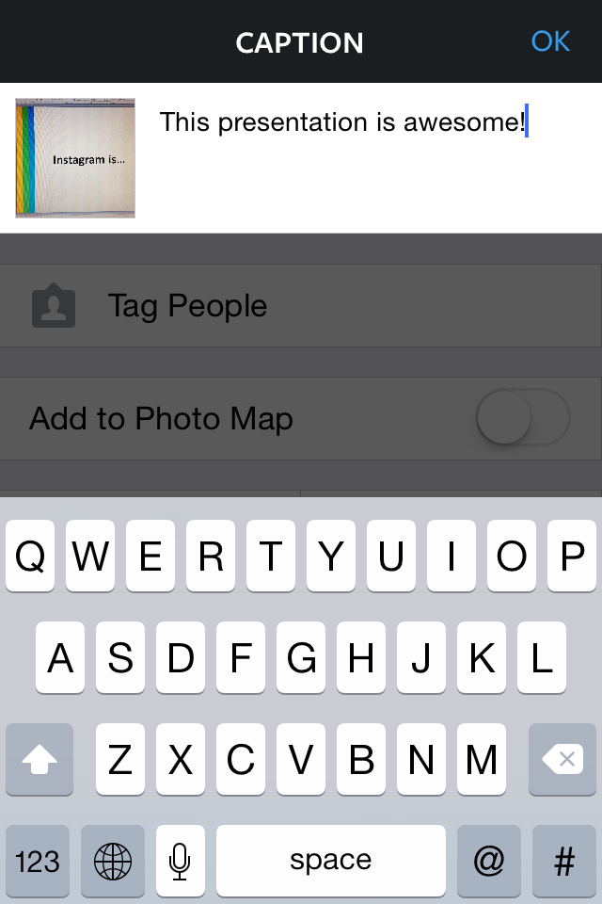

Slide 8
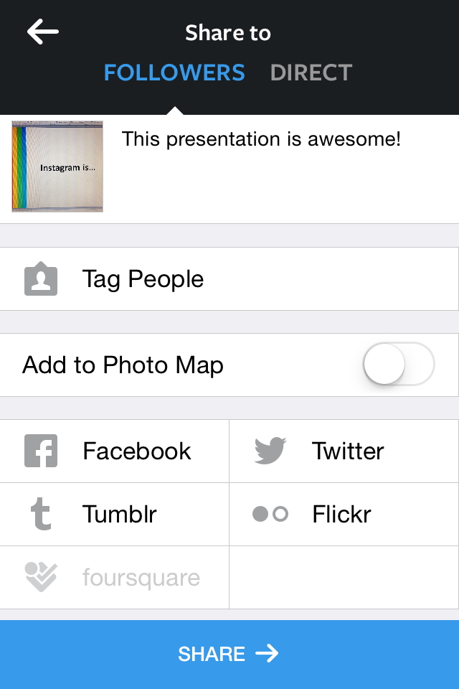

Slide 9
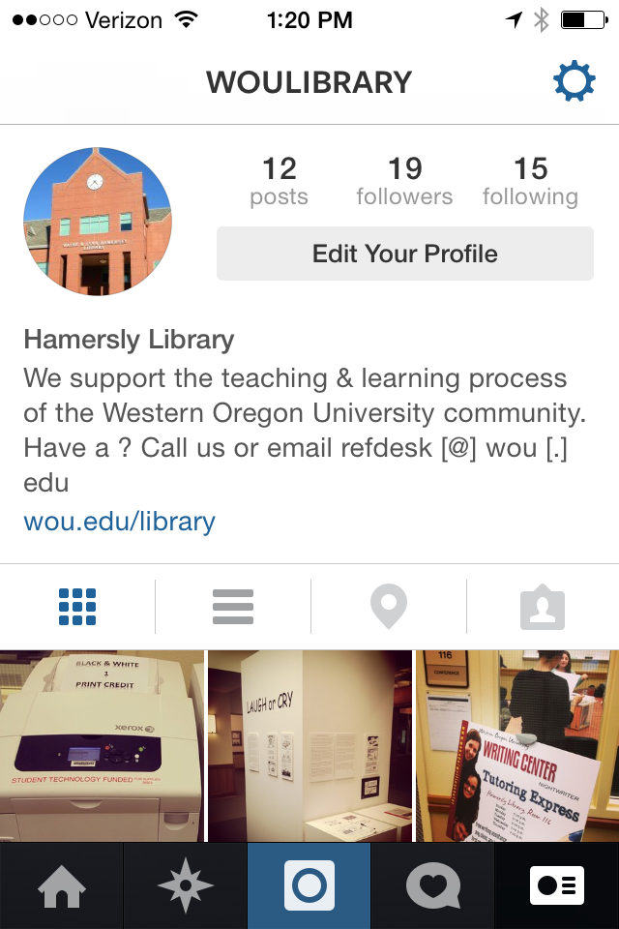

Slide 10
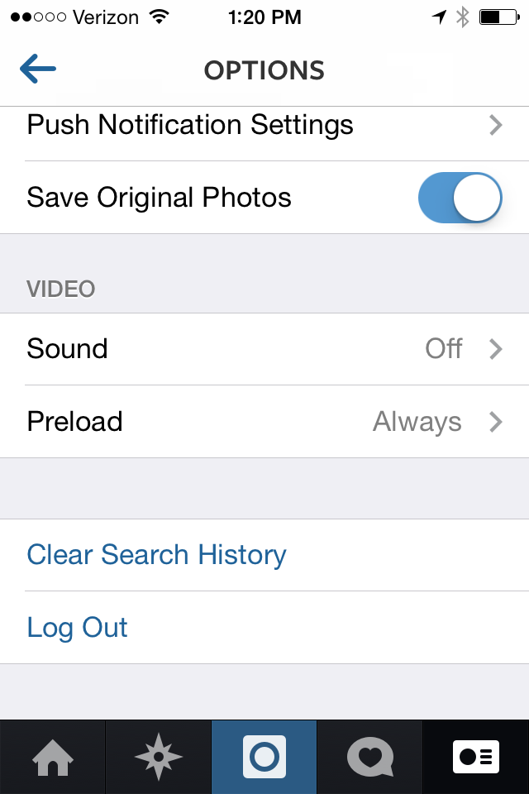

Slide 11
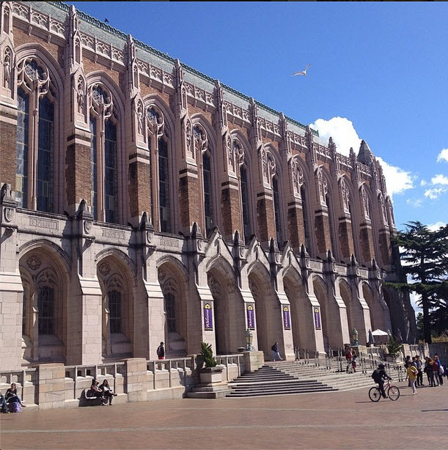
Notes:
http://instagram.com/p/ootuPEPFJl/?modal=true

Slide 12
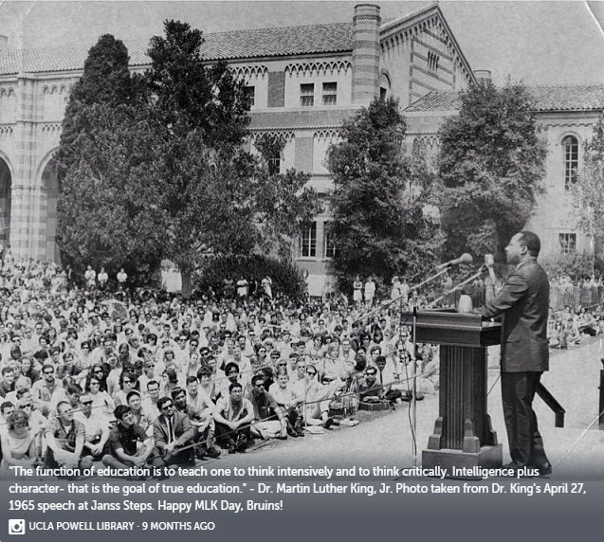

Slide 13
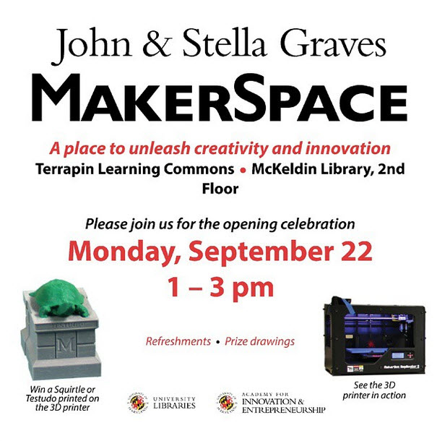
Notes:
http://instagram.com/p/tQLwP0MU-P/?modal=true

Slide 14
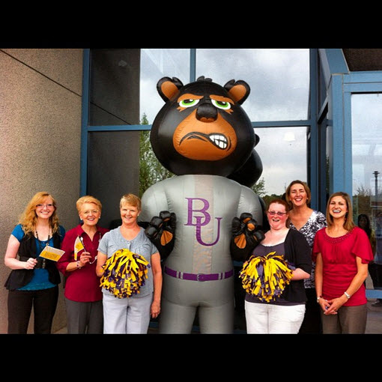
Notes:
http://websta.me/p/291390325772373851_177217418

Slide 15
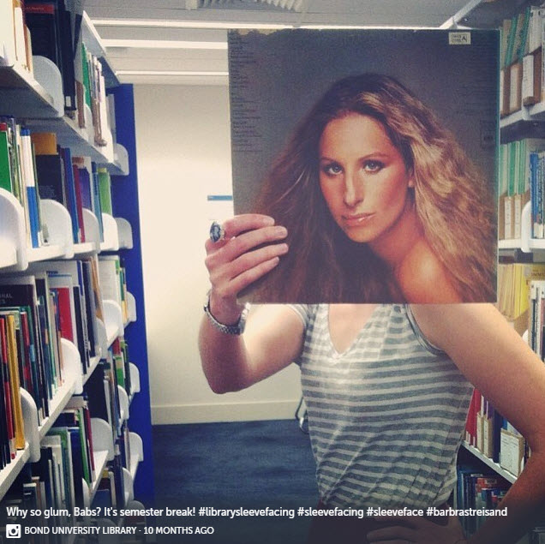

Slide 16
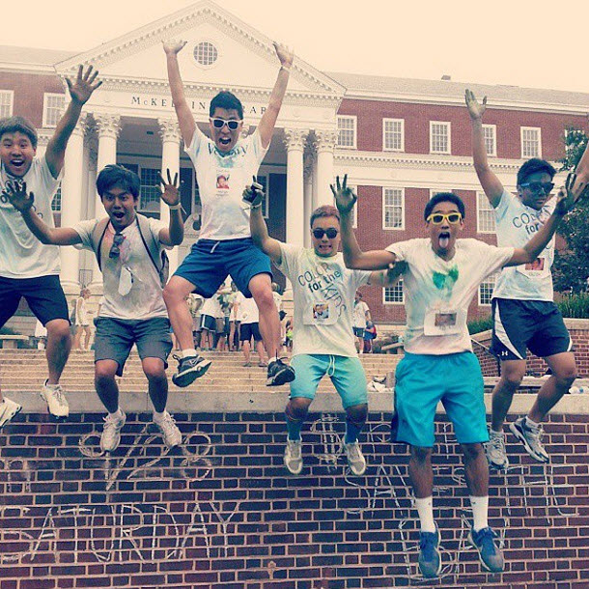
Notes:
http://instagram.com/p/tJG0q2MUws/?modal=true

Slide 17
Best practices & tips
Match all your social media usernames
Don’t ask people to follow you
Be social!

Slide 18
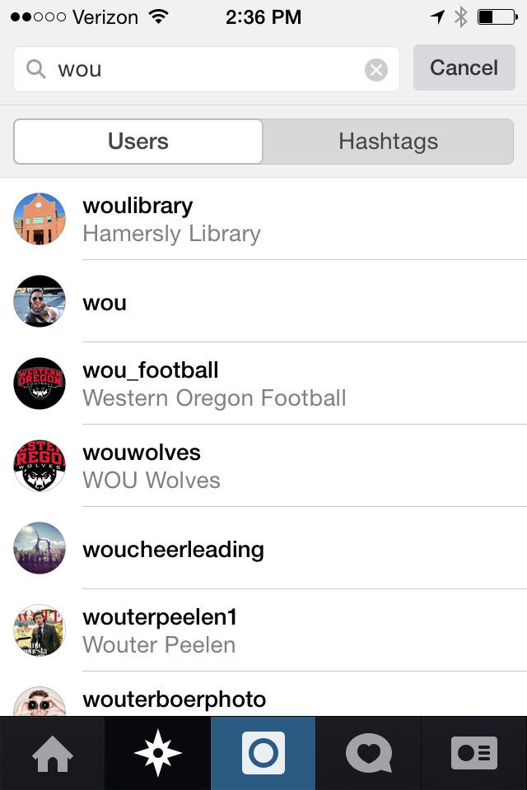

Slide 19
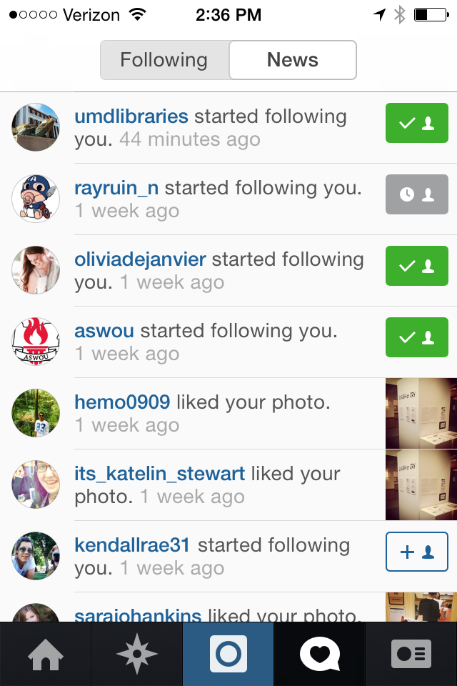

Slide 20
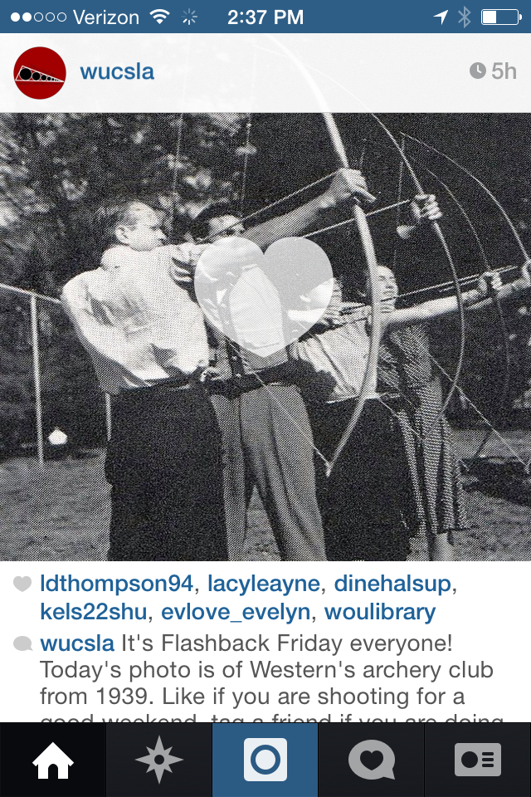
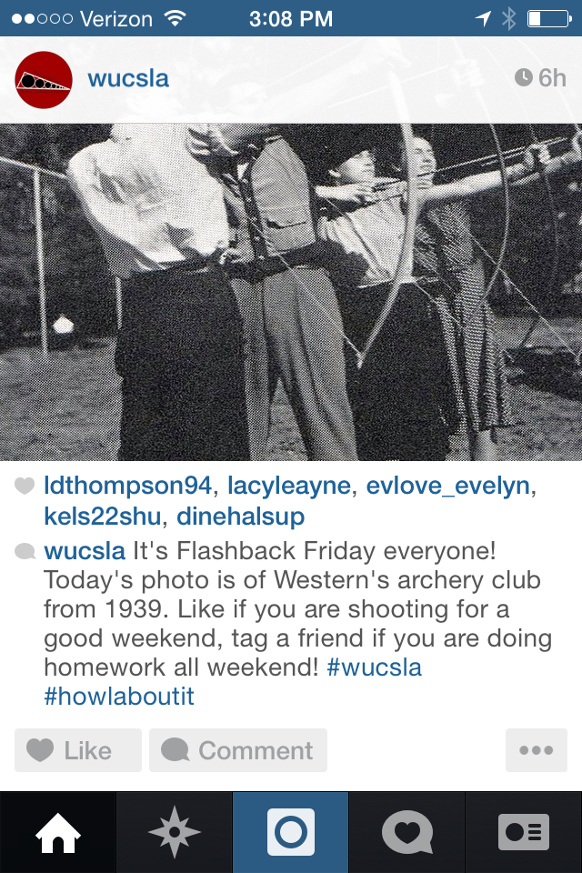

Slide 21
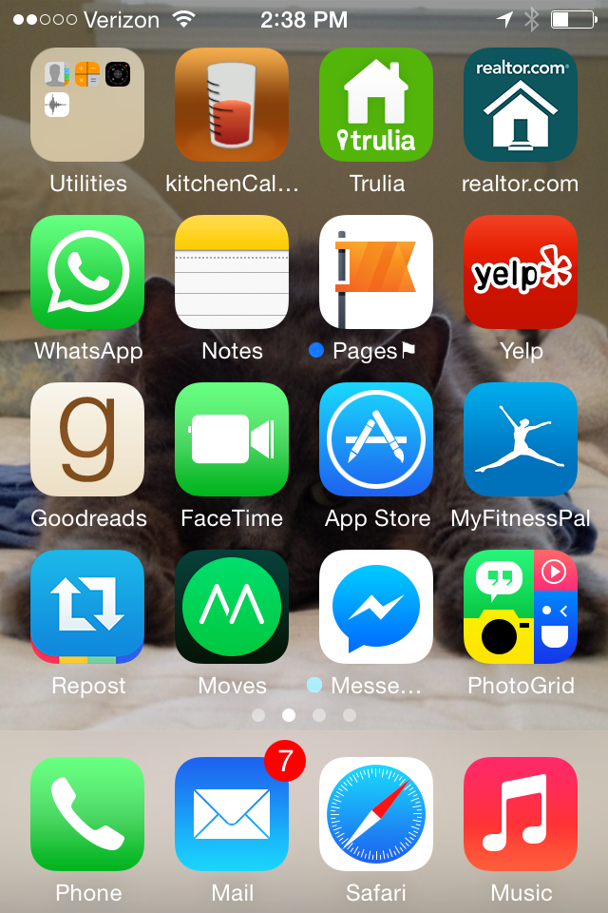

Slide 22
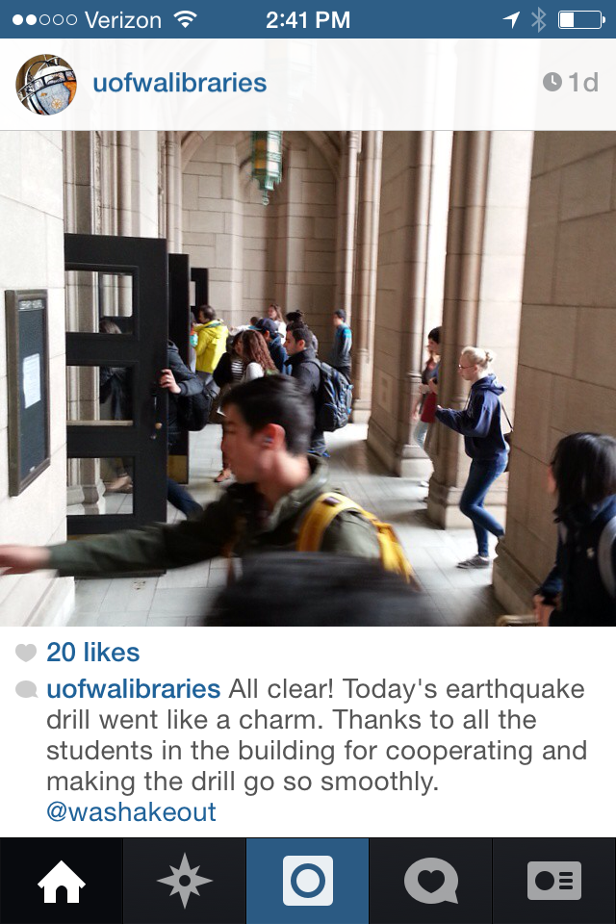

Slide 23
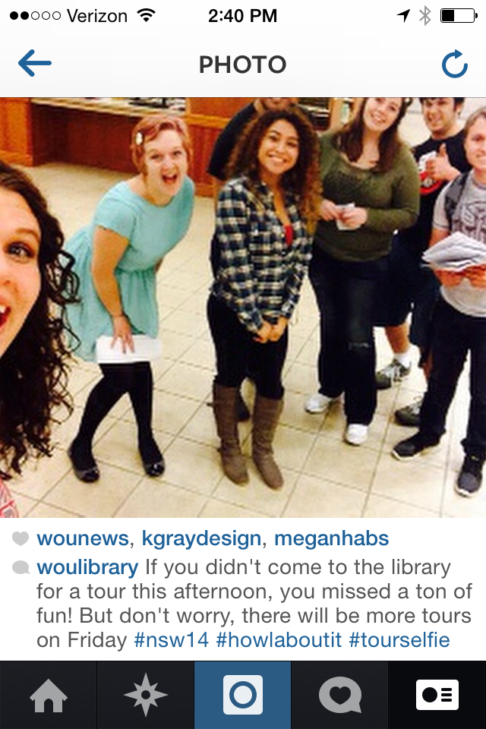

Slide 24
Best practices & tips
Match all your social media usernames
Don’t ask people to follow you
Be social!
Don’t over-like
Take good photos!
Don’t flood the feed

Slide 25
Thanks!
Contact info:
Elizabeth Brookbank, Instruction Librarian, Western Oregon University, brookbanke@wou.edu
References:
Instagram logo. (2014). Search Engine Journal. Retrieved from http://cdn.searchenginejournal.com/wp-content/uploads/2014/03/Instagram-logo-005.png
UW Libraries. (2014, May). Happy Friday! [Instagram post]. Retrieved from http://instagram.com/p/ootuPEPFJl/?modal=true
UMD Libraries. (2014, Jan). (University) Libraries on Instagram. Retrieved from https://storify.com/UMDLibraries/libraries-on-instagram
UMD Libraries. (2014, Sept). Morning Terps! At 1pm today, head to the 2nd floor of McKeldin for the opening of the new [Instagram post]. Retrieved from http://instagram.com/p/tQLwP0MU-P/?modal=true
Bellevue University. (2012, Sept 29). #librarians #bellevue #brutus [Instagram post]. Retrieved from http://websta.me/p/291390325772373851_177217418
UMD Libraries. (2014, Sept). All the best to everyone participating in @TerpThon's Color Run [Instagram post]. Retrieved from http://instagram.com/p/tJG0q2MUws/?modal=true
Popolo, M. (2012, Nov 27). Instaquette: The Dos and Don'ts of Instagram. Retrieved from http://www.pcmag.com/article2/0,2817,2412482,00.asp
Page, J. (2013, Aug 9). The 5-Minute-A-Day Instagram Marketing Plan. Retrieved from http://www.searchenginejournal.com/the-5-minute-a-day-instagram-marketing-plan/66439/
Kroski, E. (2012, Oct 4). 9 Interesting Ways to Use Instagram for Your Library. Retrieved from http://oedb.org/ilibrarian/10-interesting-ways-to-use-instagram-for-your-library/
Mollett, A., & McDonnell, A. (2014, Apr 16). Five ways libraries are using Instagram to share collections and draw public interest. Retrieved from http://blogs.lse.ac.uk/impactofsocialsciences/2014/04/16/five-ways-libraries-are-using-instagram/

