Slide 1
Lessons from 10 years of virtual reference
Caleb Tucker-Raymond
Statewide Reference Service Coordinator
Multnomah County Library
Thea Evenstad
Answerland Reference Librarian
Multnomah County Library

Slide 2
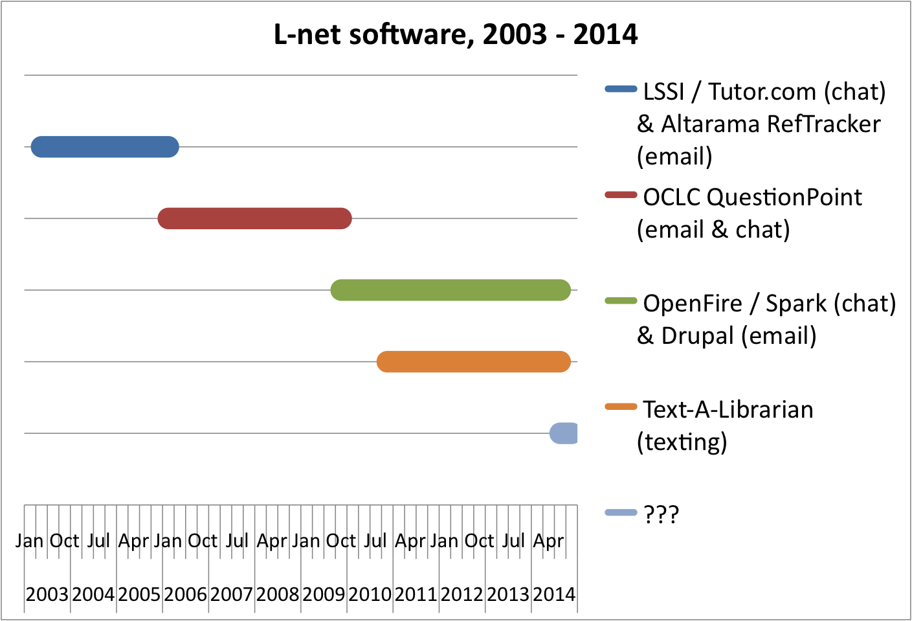

Slide 3
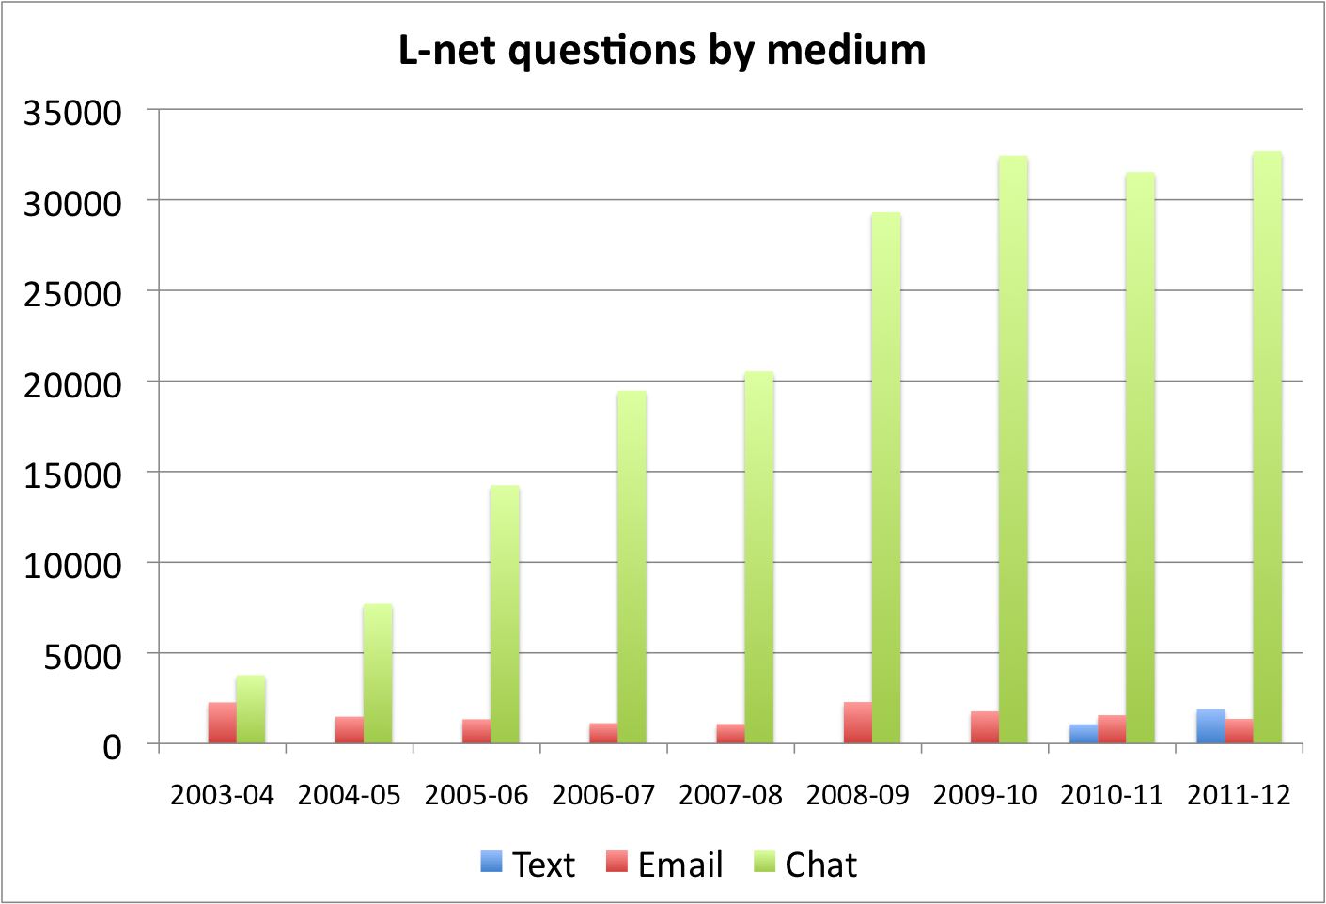

Slide 4
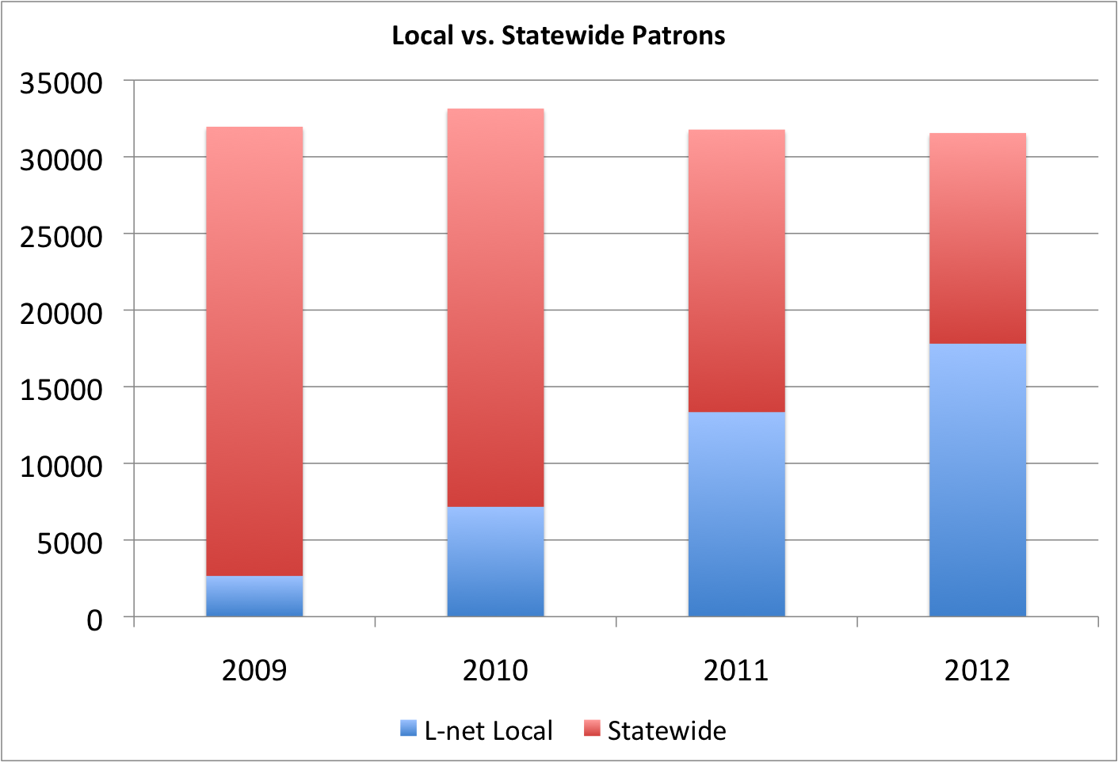

Slide 5
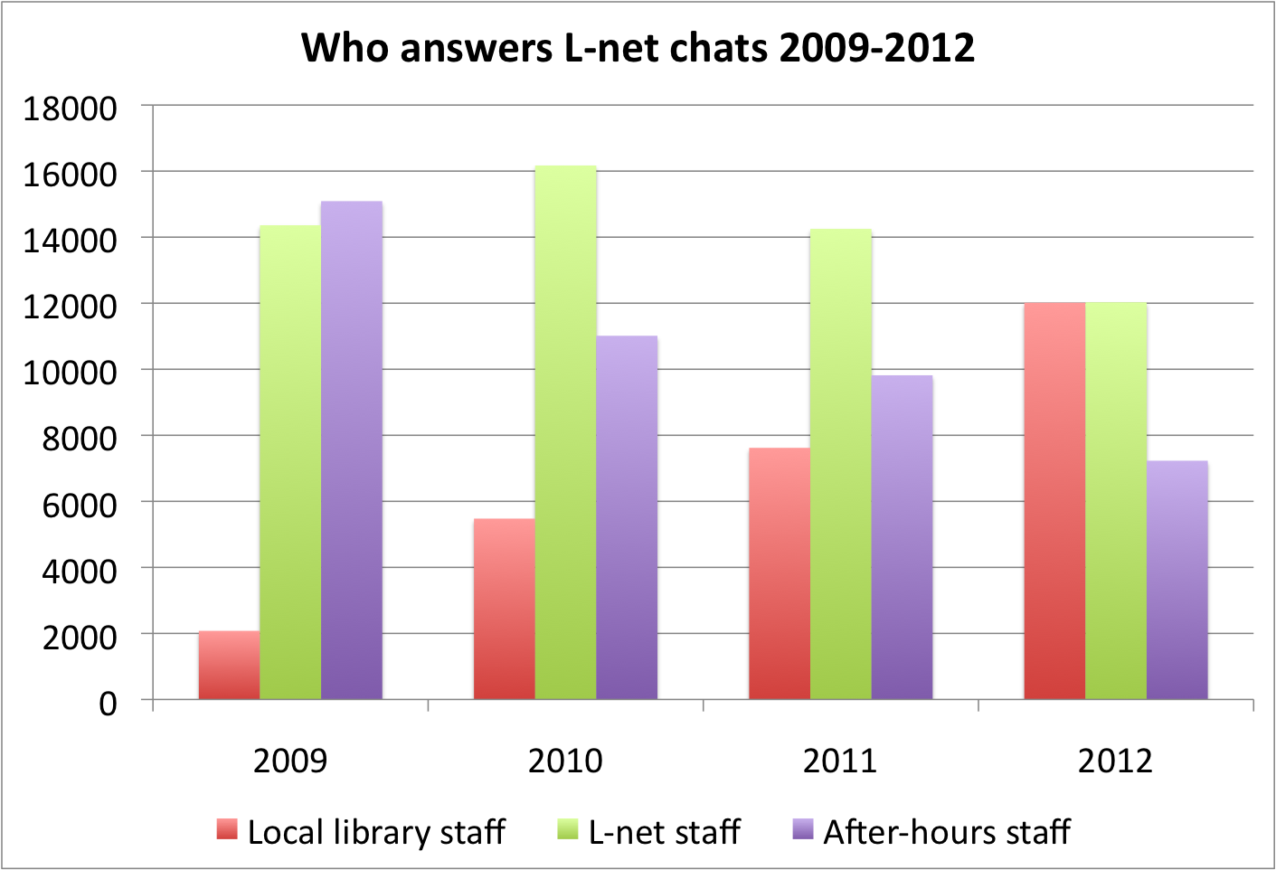

Slide 6
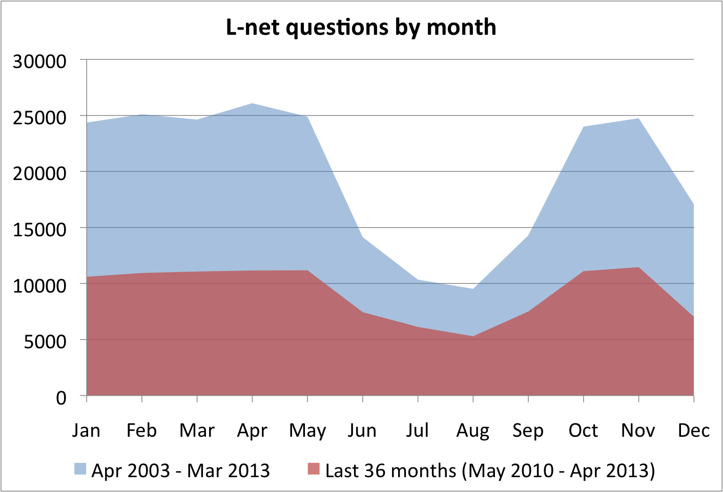

Slide 7
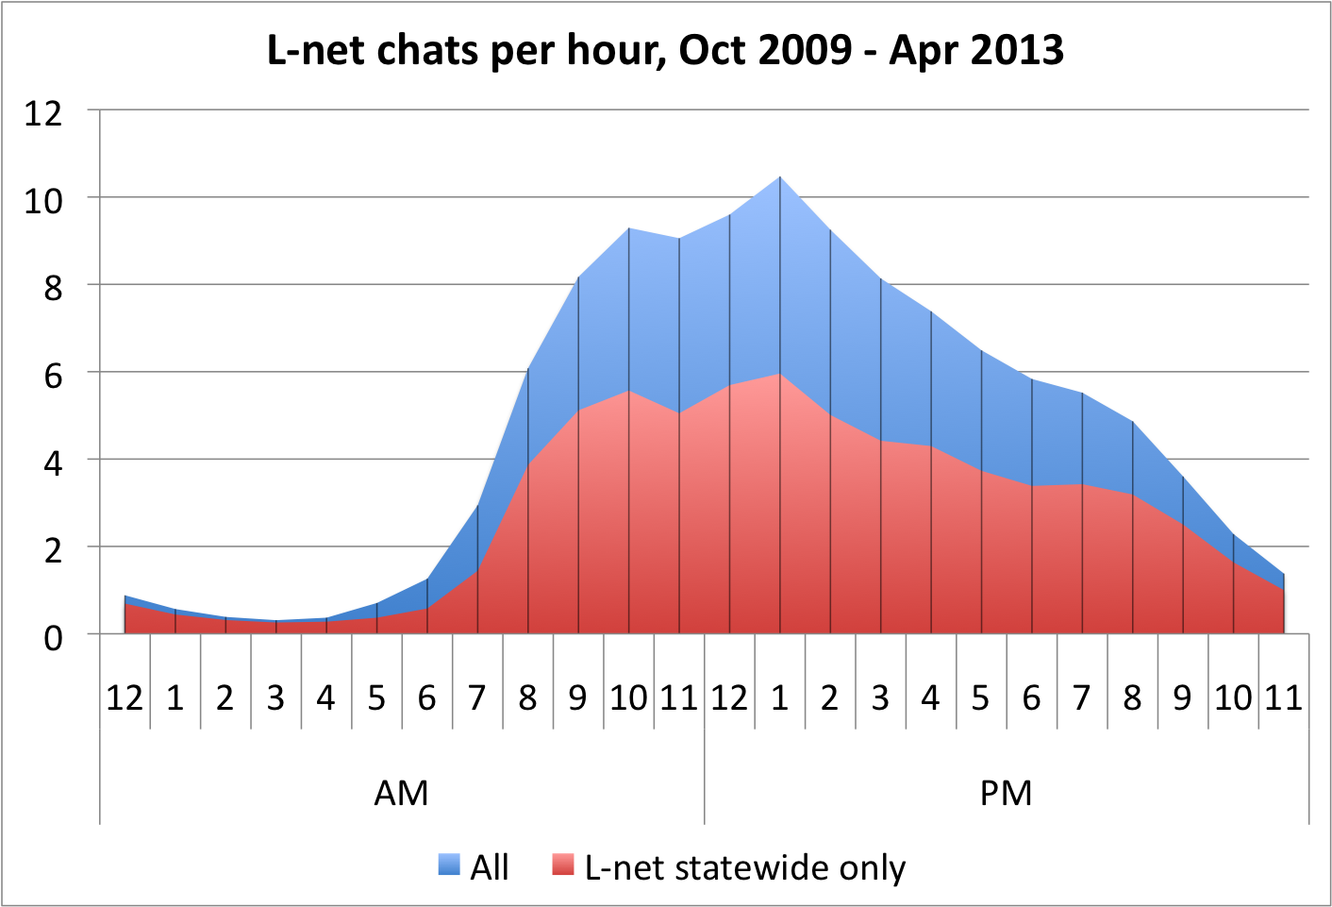

Slide 8
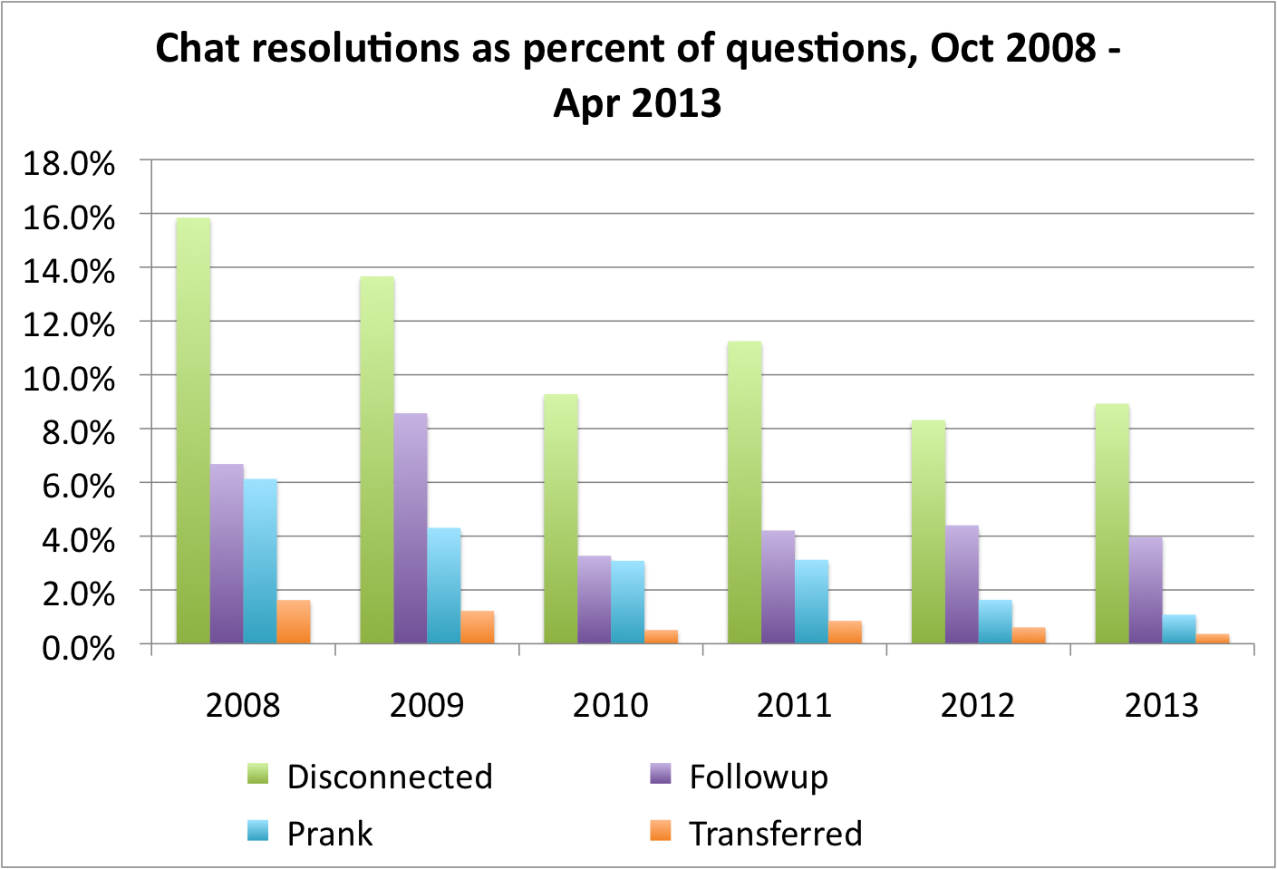

Slide 9
Prankiness formula
+1 for each percent of all chats from the IP address* are pranks (if 2 of 3 are pranks, +66)
+10 for each prank in the past 24 hours
+40 for each prank in the last hour
+25 for out-of-state IP addresses
+20 if you came to L-net via a search engine
Patrons Scores higher than 50 are routed to the administrative queue.
*IP addresses are saved for 7 days only.

Slide 10
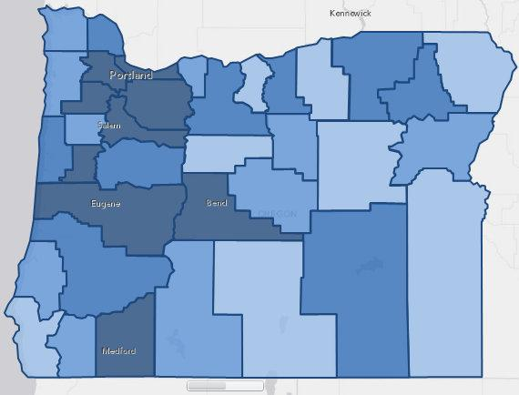
Number of L-net questions by county
See http://www.oregonlibraries.net/stats/bycounty for data table.

Slide 11
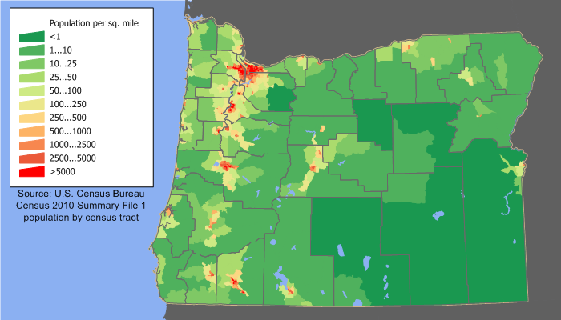
Oregon population map
Map created by JimIrwin, English language Wikipedia

Slide 12
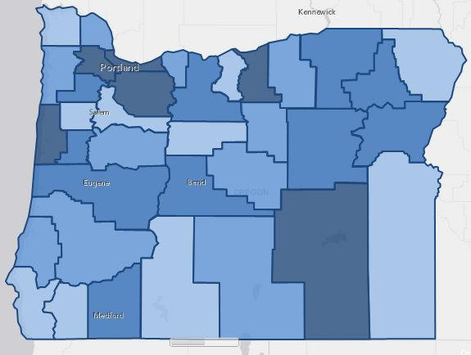
Ratio of population to number of questions

Slide 13
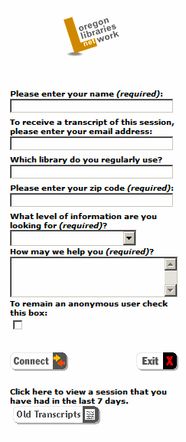
General Interest
Elementary/Middle (K-8)
High School (9-12)
College/Research
Professional

Slide 14
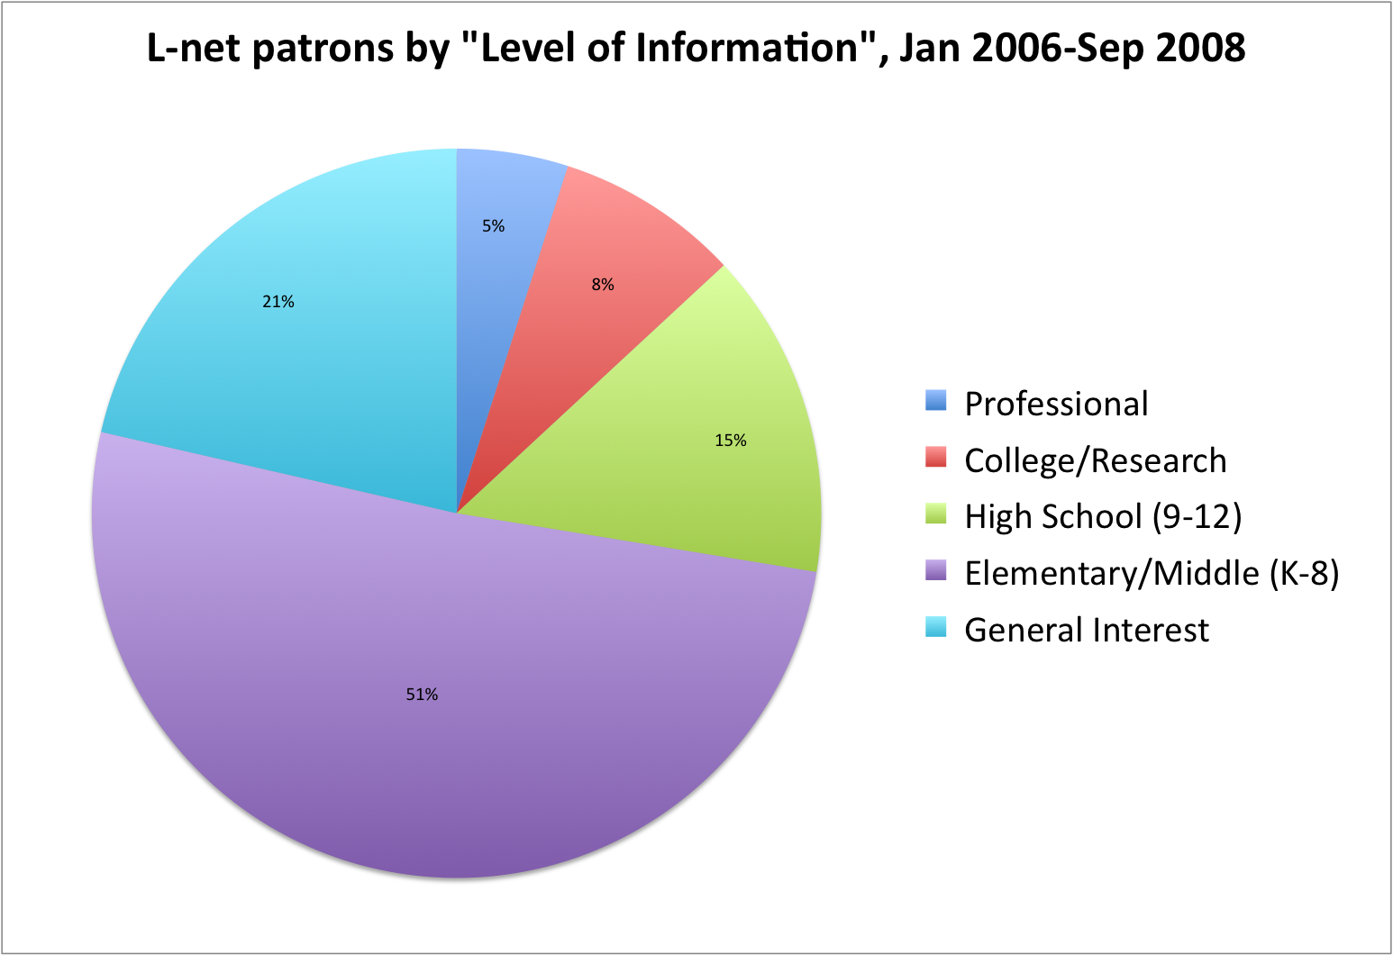

Slide 15
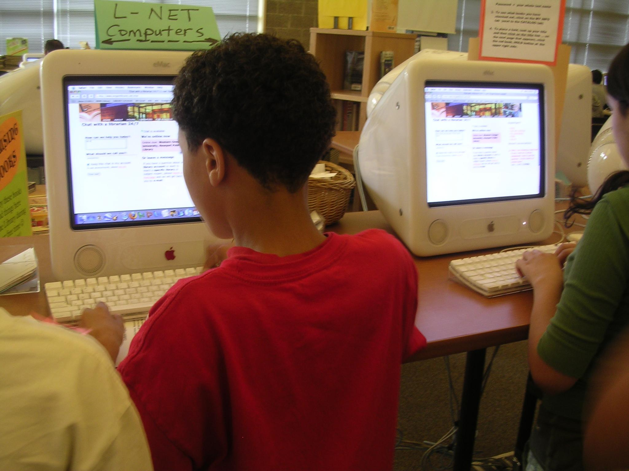

Slide 16
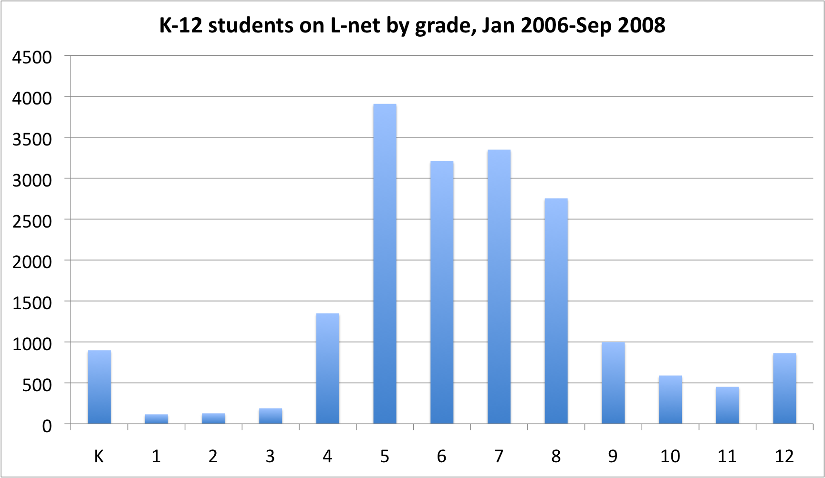

Slide 17
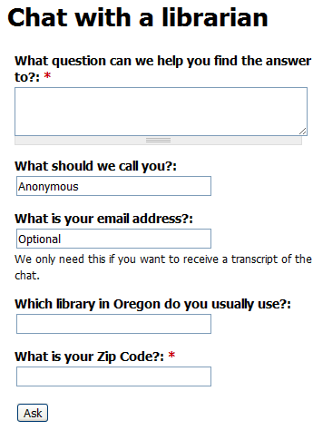
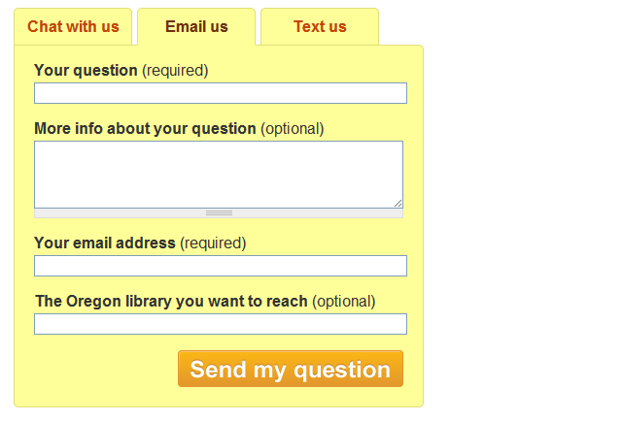

Slide 18
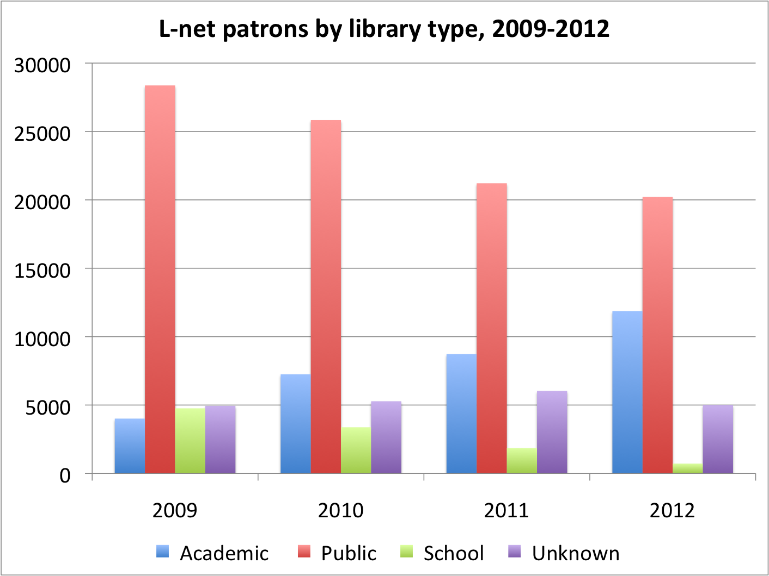

Slide 19
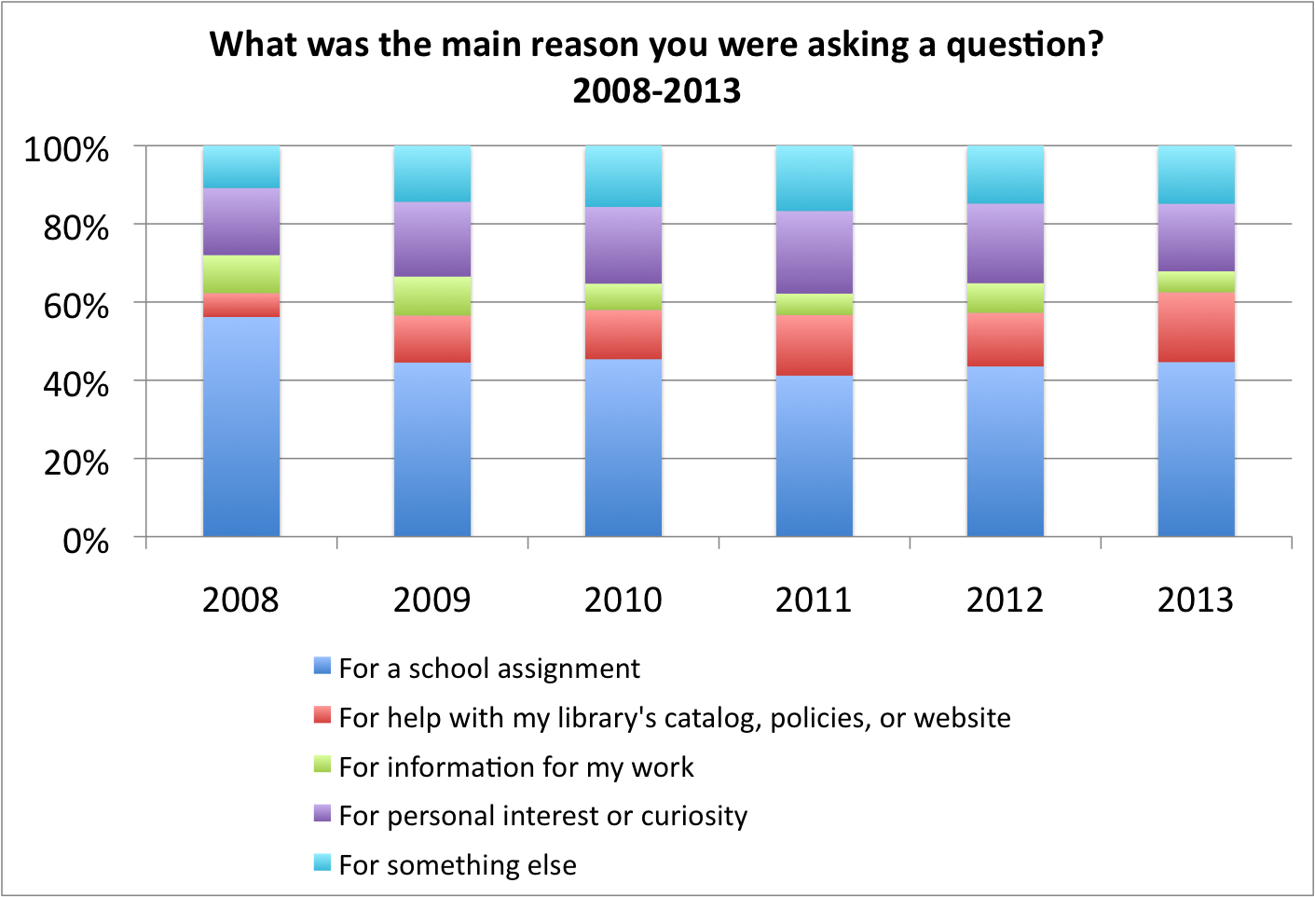
Notes:
september 2008 - april 2013

Slide 21
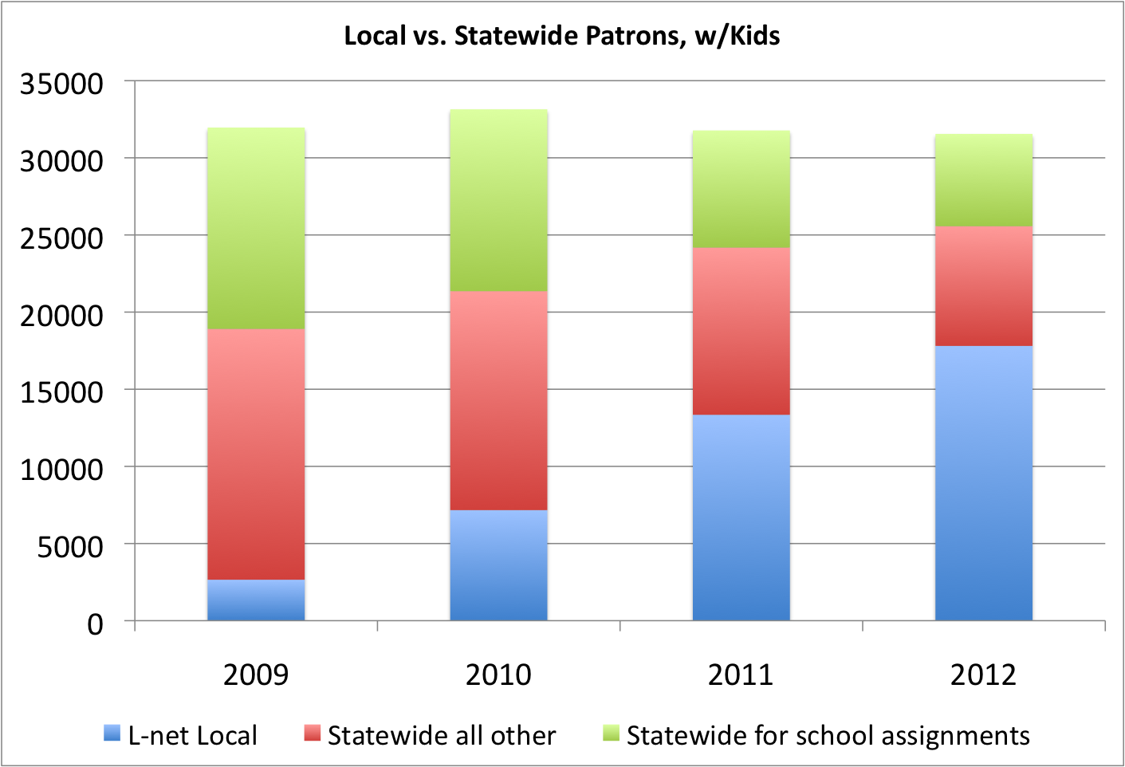
Notes:
Kids are still about 44% of statewide traffic.

Slide 22
Types of Queries
Subject Search
Ready Reference
Procedural
No Question
Holdings
Research
Inappropriate
Directional
Reader's Advisory

Slide 23
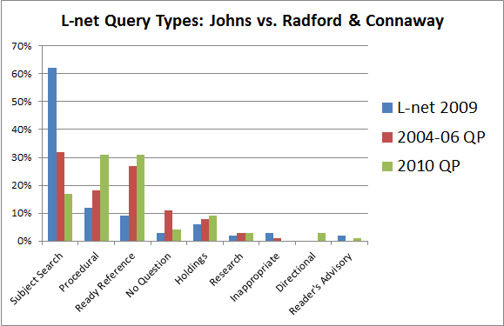

Slide 24
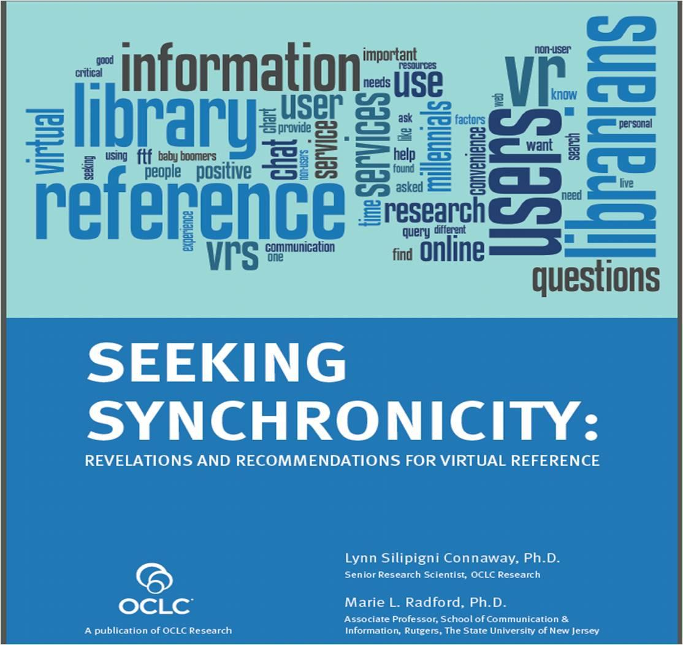

Slide 25
Connaway and Radford:
"For the VR users interviewed for our studies, a few major factors stood out as most important to them when it came to their successful VR experience:
• Convenience
• Comfort with the service
• Accuracy."
Connaway, Lynn Silipigni, and Marie L. Radford. "Seeking Synchronicity: Revelations and Recommendations for Virtual Reference". Dublin, OH: OCLC Research, 2011. http://www.oclc.org/worldwide/en_us/reports/synchronicity.html. Web. 17 April 2013

Slide 26
Luo, on why some teens would use text messaging reference:
"
They could obtain authoritative and trustworthy information from the service.
They appreciated the convenience of the service....
Texting was a communication venue they were familiar and comfortable with...."
Luo, Lili "Final Project Report". Engaging Library Users in the Age of Texting: Exploring Text Reference Service 27 August 2012. http://amazon.sjsu.edu/html-lililuo/text_reference_service/project-report.html. Web. 17 April 2013.

Slide 27
Luo, on why some teens would NOT use text messaging reference:
"
There were other preferred alternatives to ask for information assistance easily and quickly....
They felt awkward texting a librarian because of the impersonal nature and the lack of knowledge about the appropriate etiquette....
They were concerned about privacy and did not wish to have their cell phone number known.
Luo, Lili "Final Project Report". Engaging Library Users in the Age of Texting: Exploring Text Reference Service 27 August 2012. http://amazon.sjsu.edu/html-lililuo/text_reference_service/project-report.html. Web. 17 April 2013.

Slide 28
Marketing virtual reference
Worked temporarily
Featuring the service on the library website
Featuring the service in a library newsletter
Didn't work
Newspaper advertisements
Public transit advertisements
Google AdWords
Works (for texting)
Make it part of your app
Meh
Being open 24/7

Slide 29
What does work
Direct mail to Oregon schools
Tell patrons face to face
Make it as easy as possible to use

Slide 30
Connaway and Radford:
"[Establish], when possible, a link between existing relationships with librarians at physical
reference desks and VRS. That is, have librarians recommend and explain VR to users in a face-to-face (FtF) setting. This in-person introduction provides the opportunity to transfer positive associations from the real world to the virtual."
Connaway, Lynn Silipigni, and Marie L. Radford. "Seeking Synchronicity: Revelations and Recommendations for Virtual Reference". Dublin, OH: OCLC Research, 2011. http://www.oclc.org/worldwide/en_us/reports/synchronicity.html. Web. 17 April 2013

Slide 31
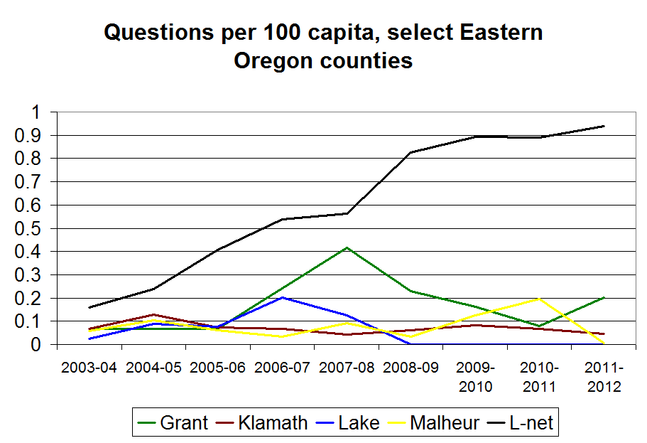
Notes:
In May of 2006, I went on a driving tour of Eastern Oregon. I started with a presentation to Klamath County Library and Klamath Community College staff, then on to Lake, Harney, Grant, and Malheur county libraries. I finished with a visit to a meeting of the Libraries of Eastern Oregon, which included staff from Hermiston, Baker County Library, Umatilla, Pendleton and La Grande - you know, the big libraries out there.
In each case, I met with staff, tried to get a sense of the local culture and context, demonstrated how L-net worked, and handed out brochures and pencils and bookmarks.
Here are L-net statistics for the county libraries I visited.
In Harney County, I also met with a local school librarian, and she invited me to give a presentation to two classes of fourth and fifth graders later that day.
This chart demonstrates the difference between telling librarians about L-net and telling patrons about L-net. In this case, telling patrons directly was about 10 times as effective as telling only librarians, and the effect lasted, to some degree, for 5 years.

Slide 32
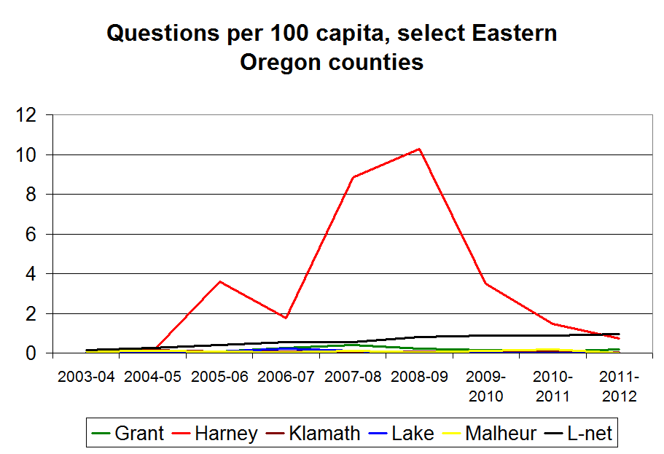

Slide 33
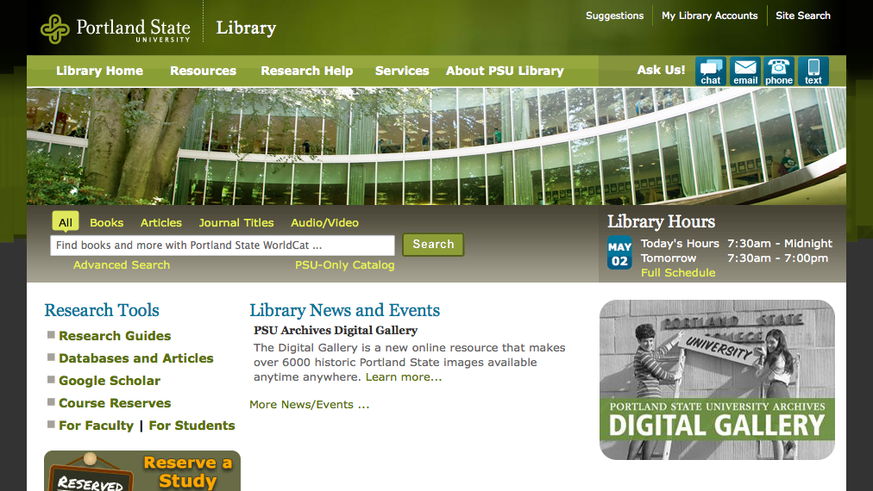
Chat widgets and convenience

Slide 34
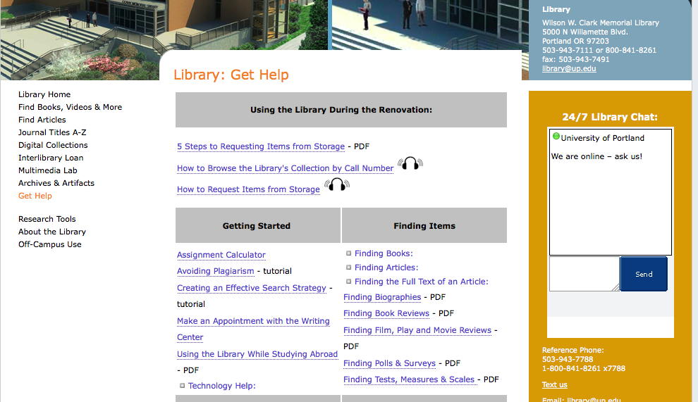

Slide 35
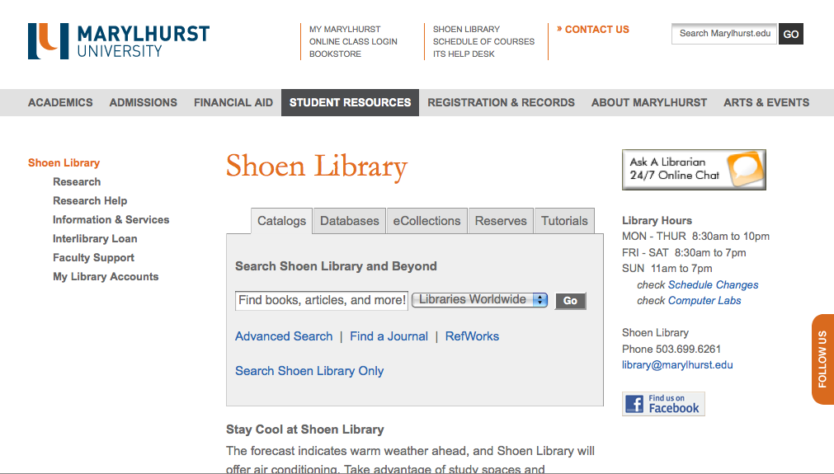
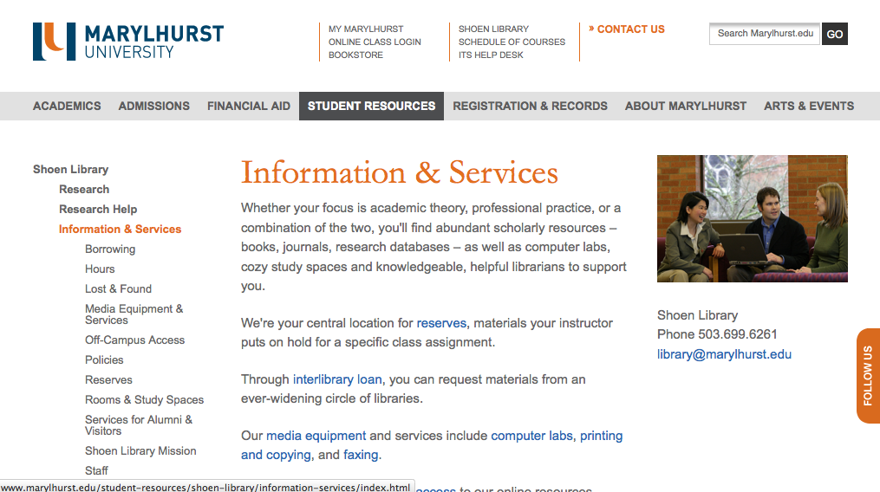

Slide 36
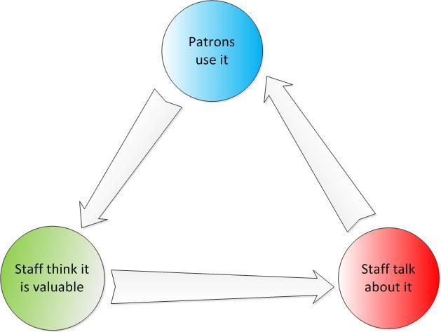
Notes:
the catch is that staff are more likely to talk to patrons about a local service if one exists. [ can i prove this? ]

Slide 38
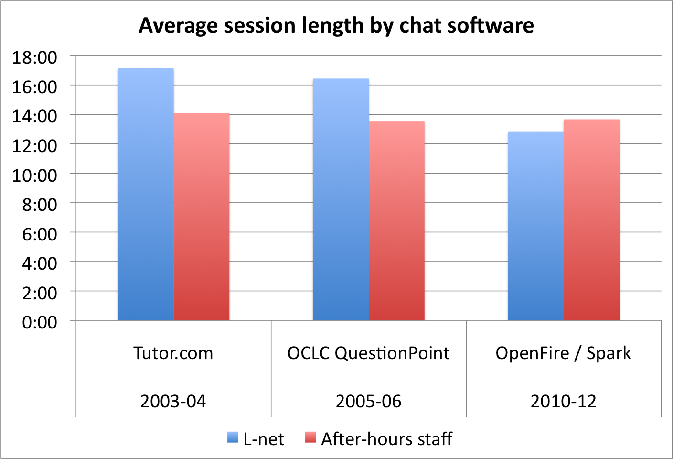

Slide 39
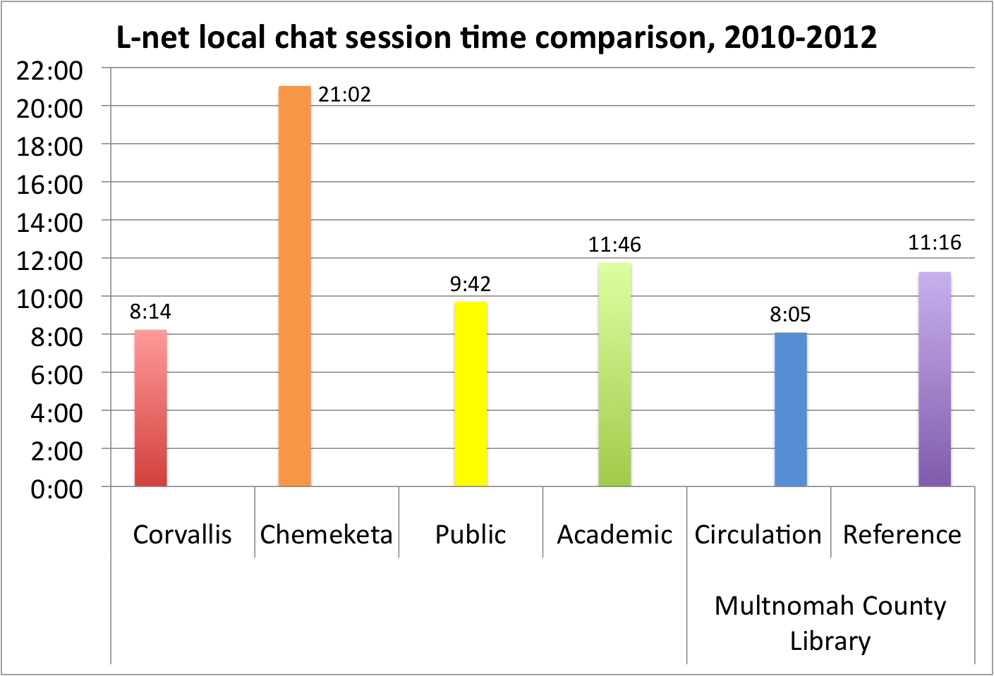

Slide 40
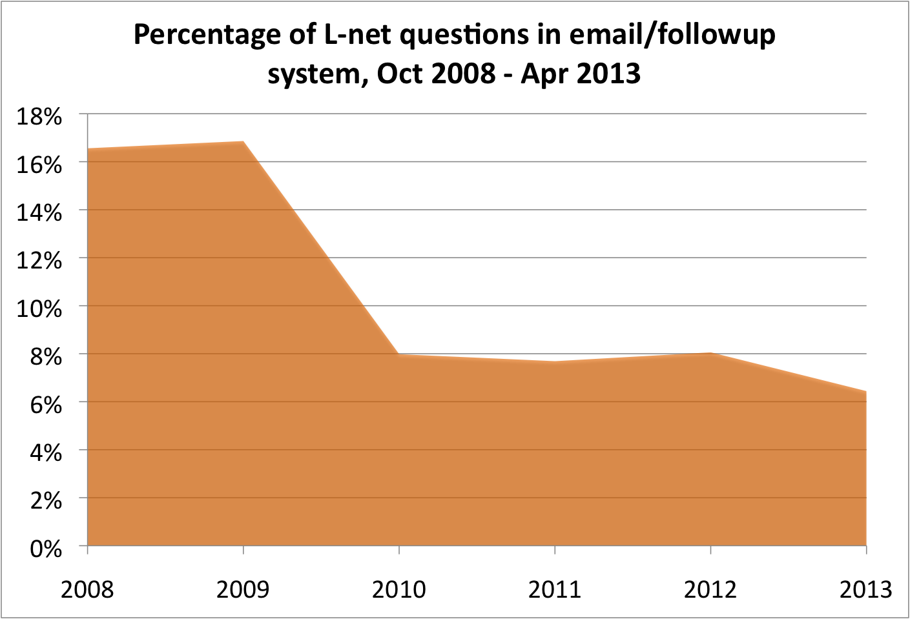

Slide 41
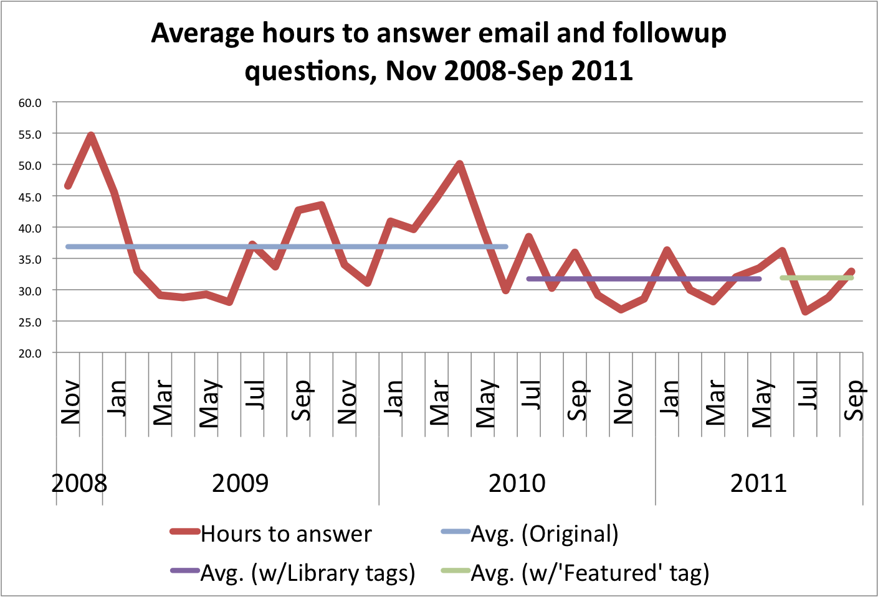

Slide 42
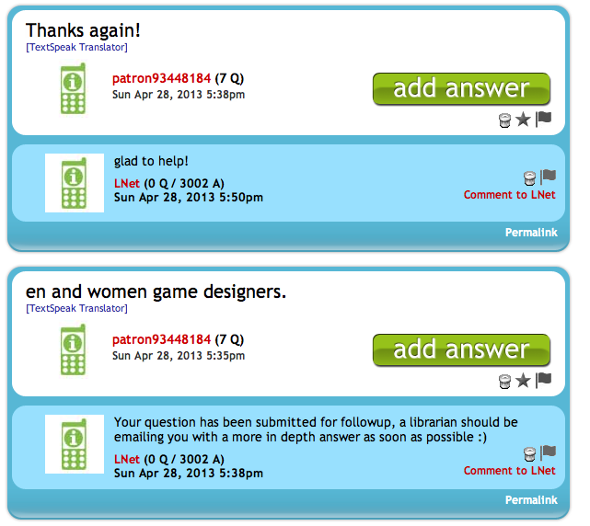
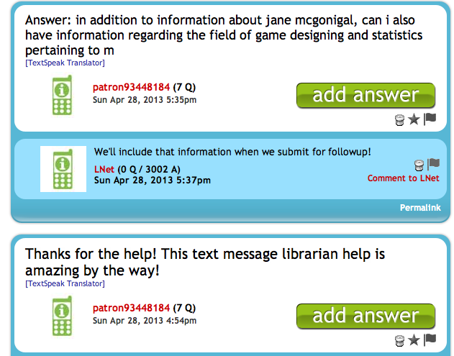
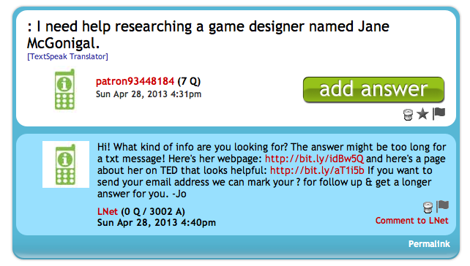
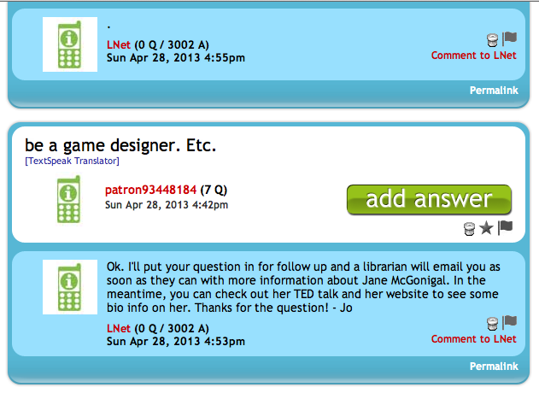
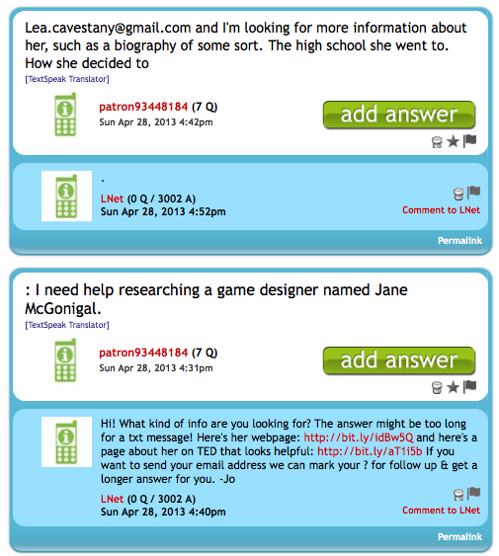

Slide 43
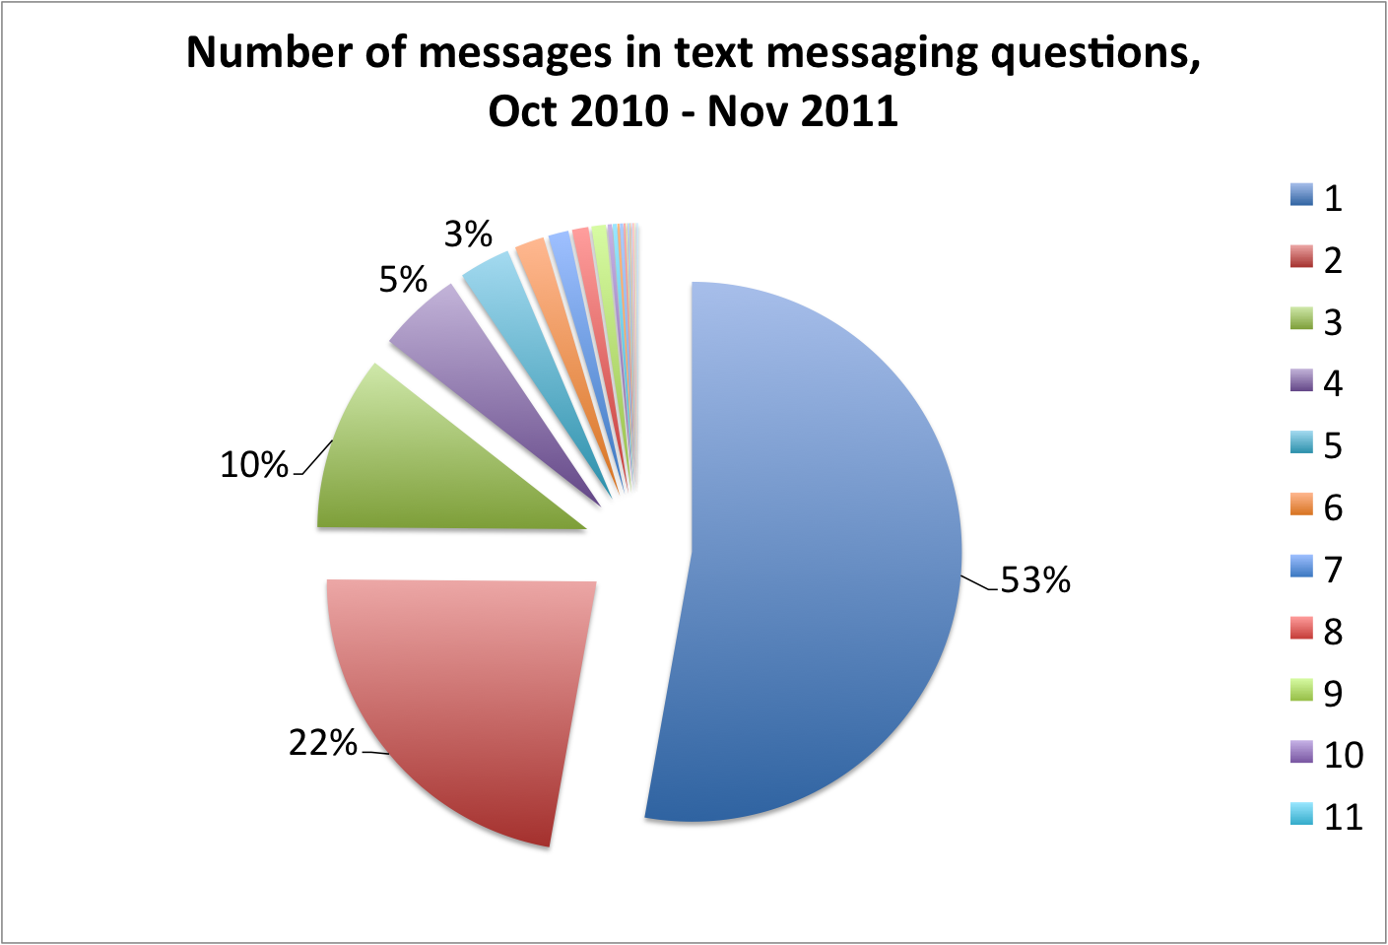

Slide 44
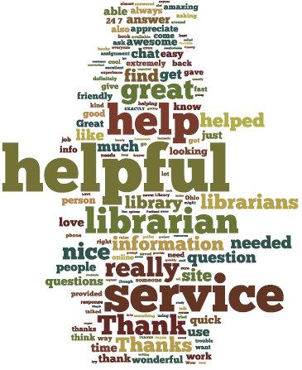
What librarians can do well:

Slide 45
L-net Quality Standards
A good reference interview that includes asking clarifying questions (Radford, Connaway, Confer, Sabolsci-Boros, & Kwon, 2011)
A cheerful, welcoming tone (Radford 2006)
Use of authoritative resources (Radford & Connaway, 2012)
Asking follow-up questions (Radford et al. 2011)
Offering more help
"Practitioners are not only answering questions, they are also building relationships in every virtual reference encounter" (Radford, 2005, p. 1055).

Slide 46
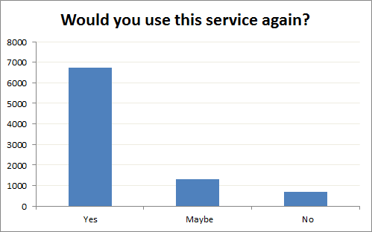
77%
15%
8%

Slide 47
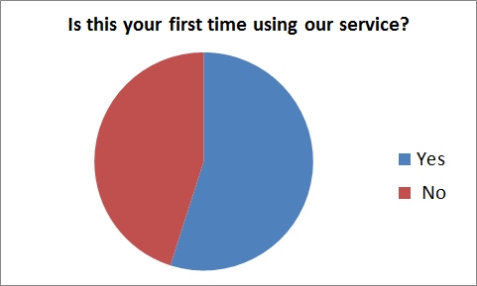
45%
55%

Slide 48
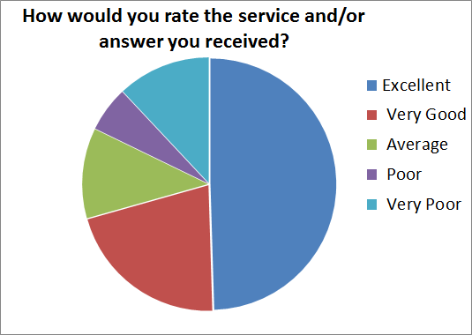

Slide 49
Thank you!
Caleb Tucker-Raymond
Statewide Reference Service Coordinator
Multnomah County Library
Thea Evenstad
Answerland Reference Librarian
Multnomah County Library

