Slide 1
Making vs Crafting
In which we ask ourselves … what is the difference?
And we conclude it is a fine line …

Slide 2
We started by asking ourselves (and each other) some key questions:
Is crafting for girls and making for boys?
No. Either can appeal to both boys and girls.

Slide 3
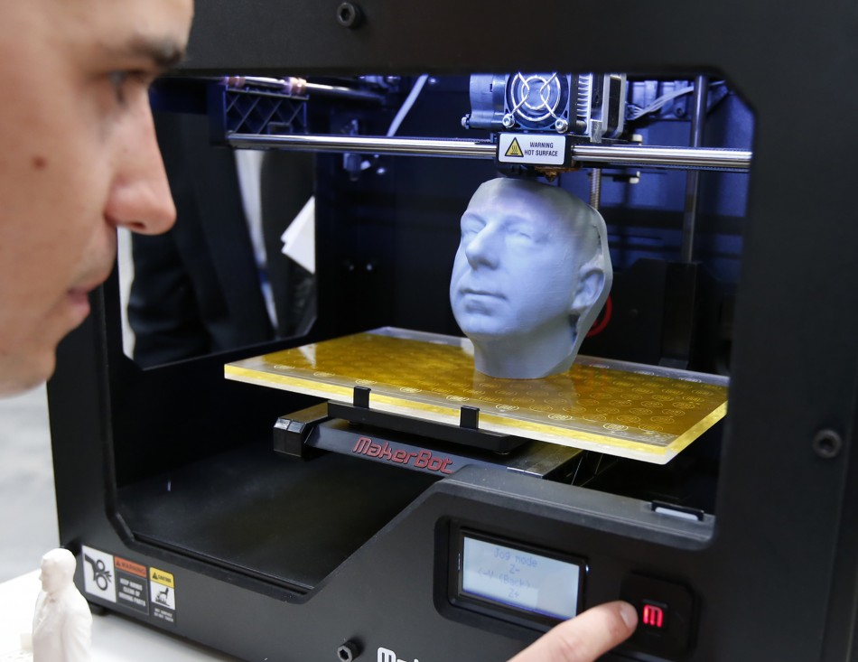
Does making always have to involve high-tech tools?
(In which case … most libraries can’t afford making …)
No. But it CAN!

Slide 4
Do you always know in advance whether you are crafting or making?
No. Because people will surprise you.
They’ll ask for directions when you thought the activity was “free-form.”
And get all creative when you thought they’d follow the instructions.

Slide 5
So, after thinking about it, here’s what we say:
Crafting is generally an activity in which participants follow prescribed steps to produce an item similar to the example given.
Making encourages the participant to engage in creative problem solving to produce an item or an experience that is not necessarily like the example.

Slide 6
Also … and this is important …
There is a place in our libraries for BOTH crafting and making.

Slide 7
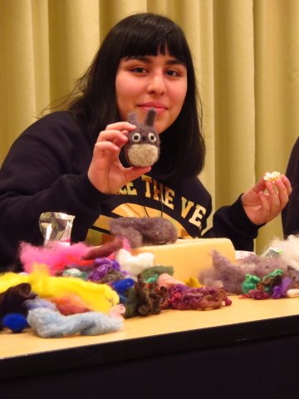
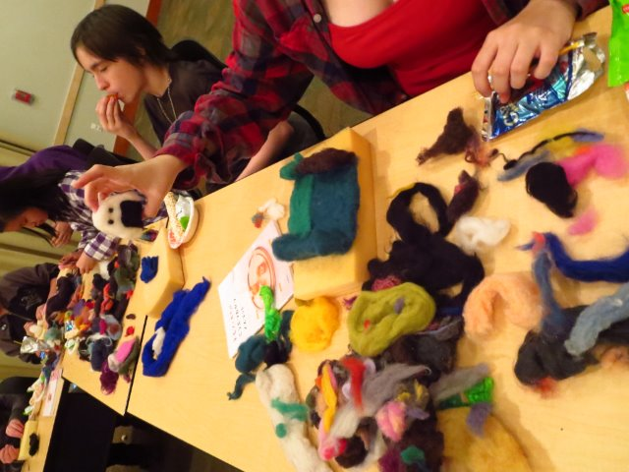
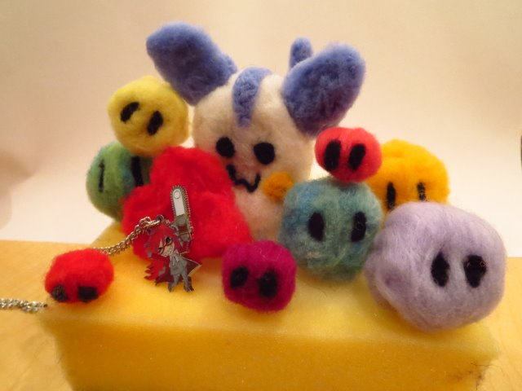
Crafting
Needlefelting Tualatin Public Library

Slide 8
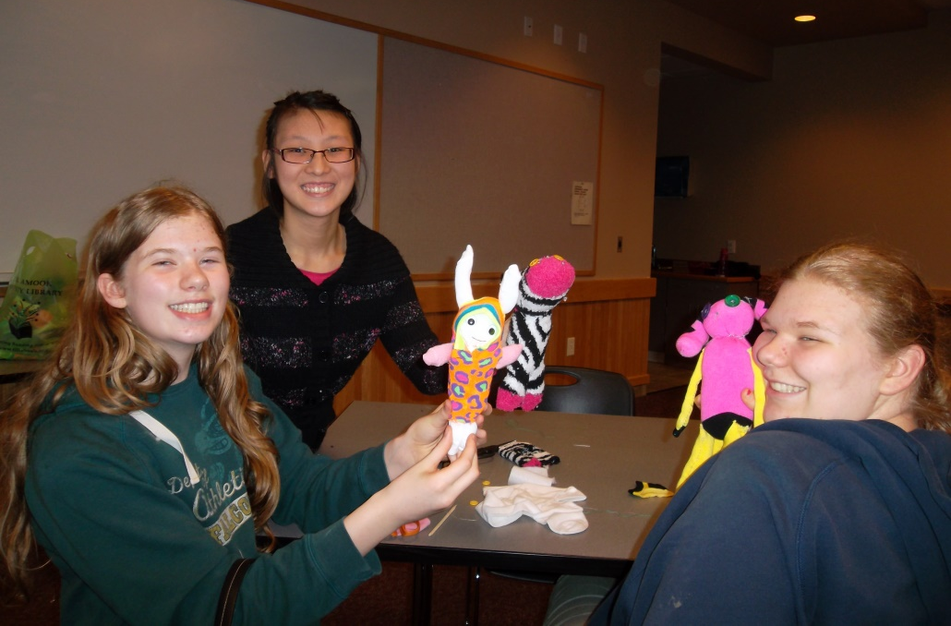
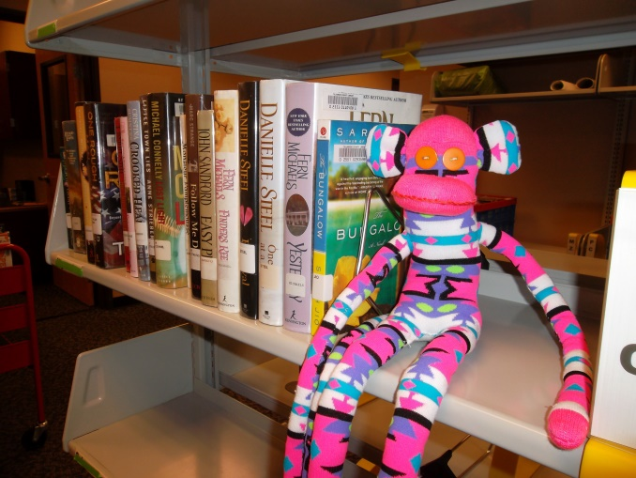
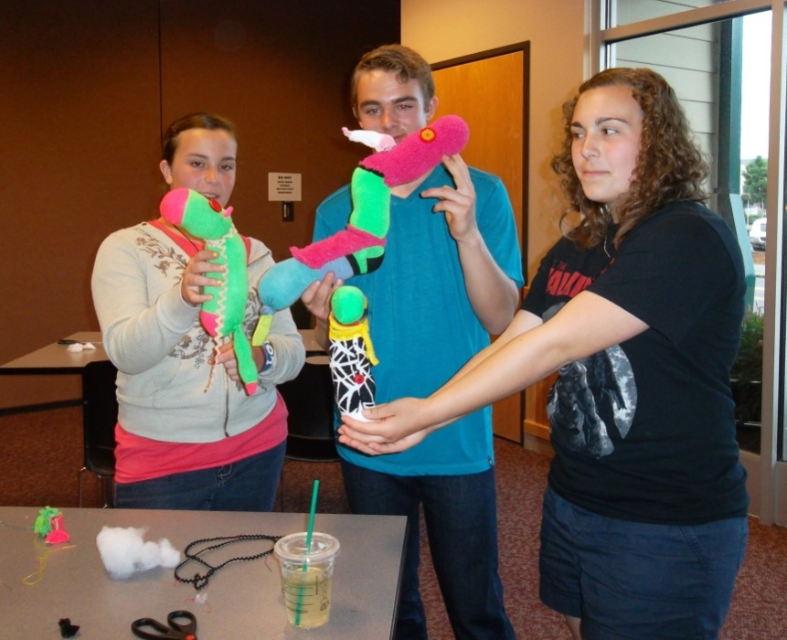
Making
Sock Animals
Tillamook Public Library

Slide 9
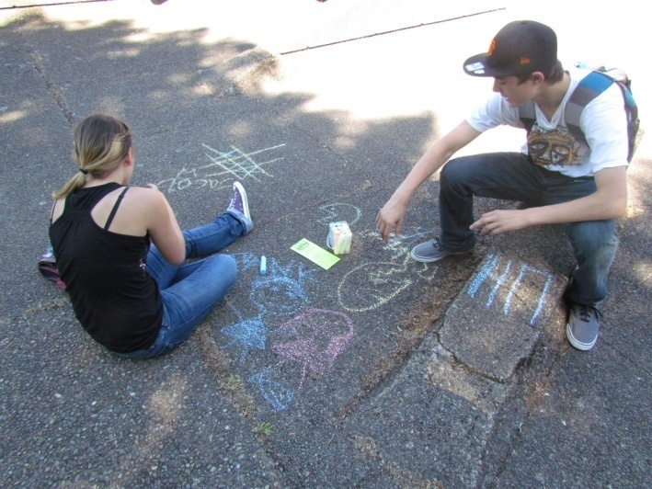
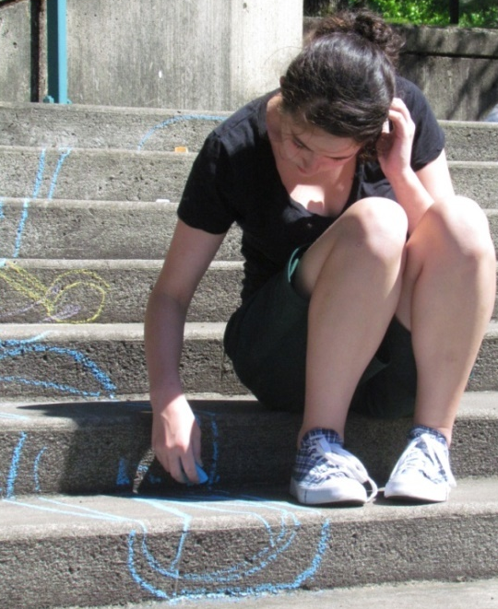
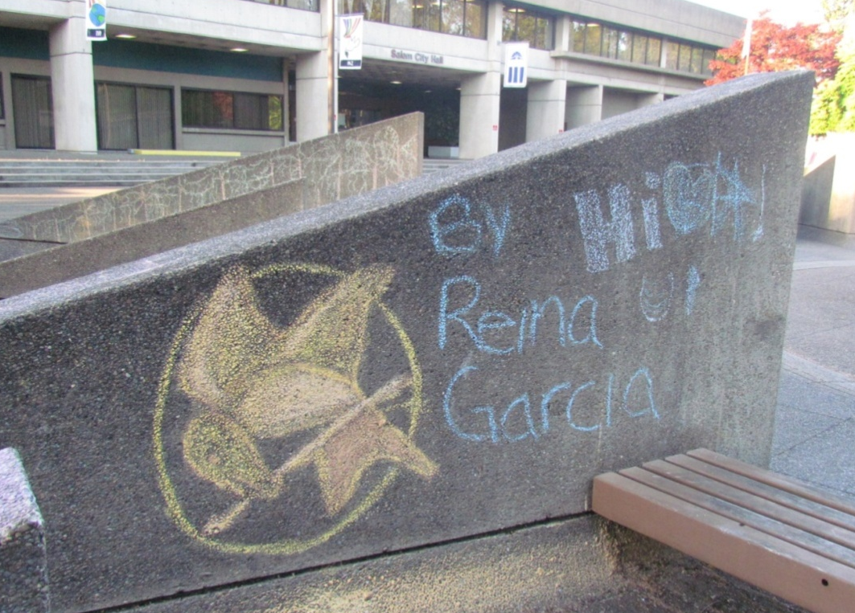
Making
Sidewalk Chalk Extravaganza
Salem Public Library

Slide 10
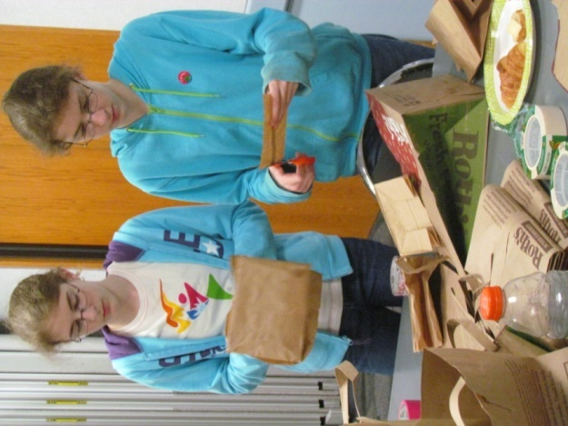
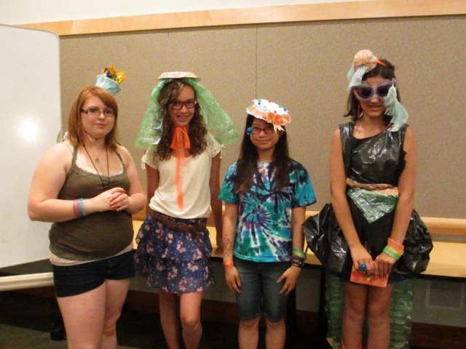
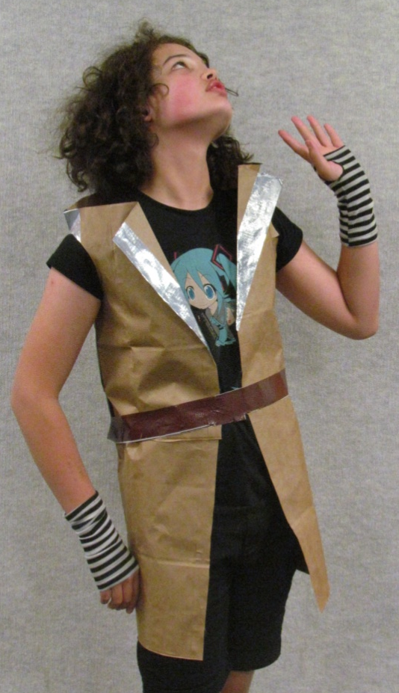
Making
Project Runway at Tualatin Public Library
Paperbag Fashions at Salem Public Library

Slide 11
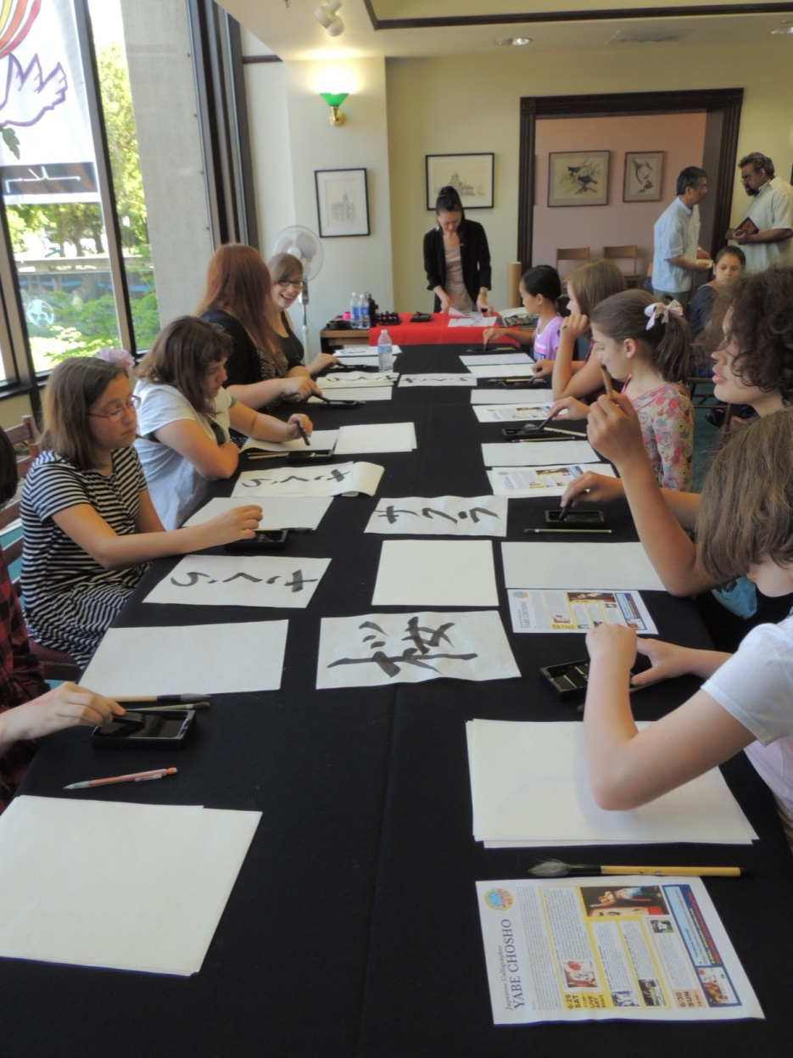
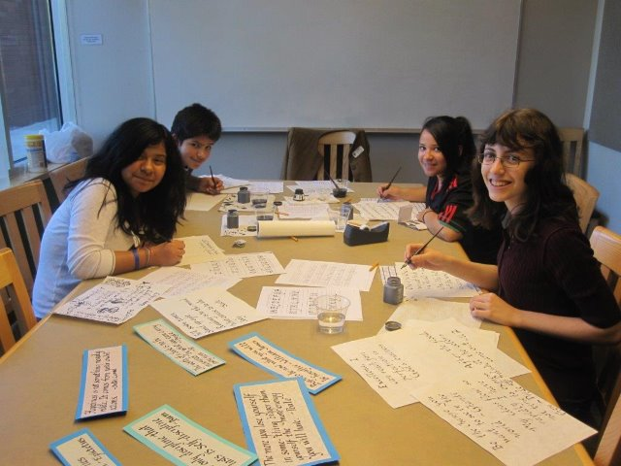
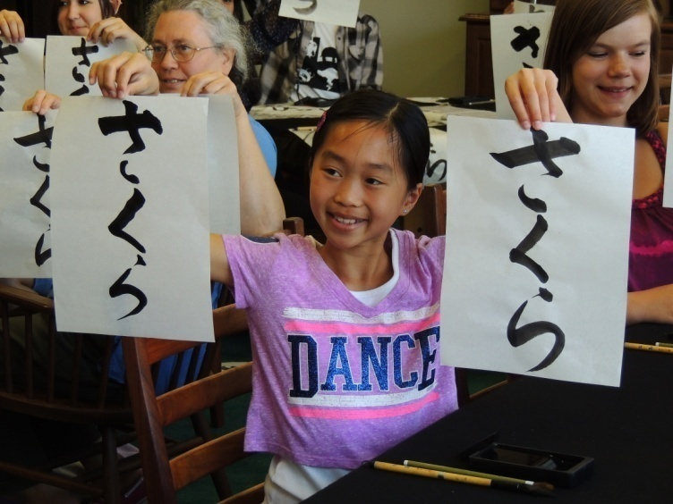
Crafting
Calligraphy
Salem Public Library & Tualatin Public Library

Slide 12
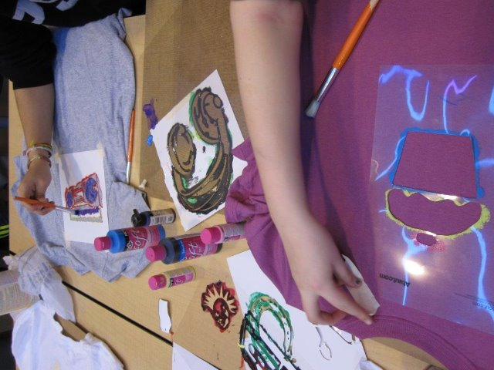
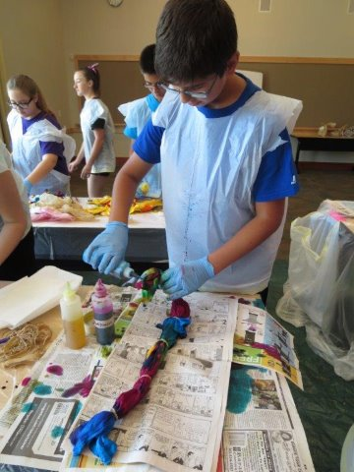
Making
T-Shirt Art & Tie-Dyeing
Tualatin Public Library

Slide 13
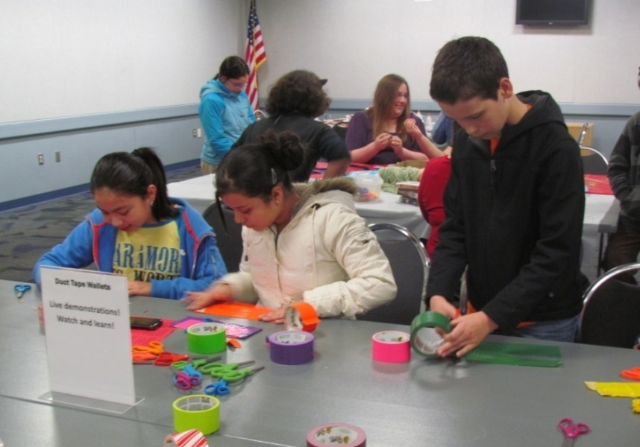
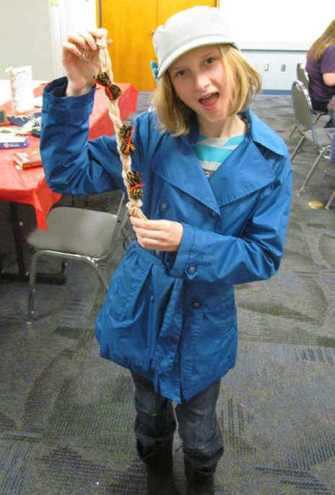
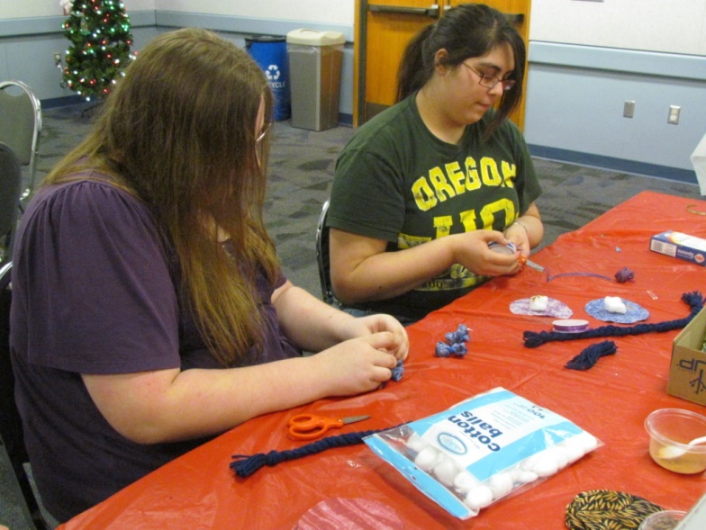
Crafting
Last-Minutes Gifts
Salem Public Library

Slide 14
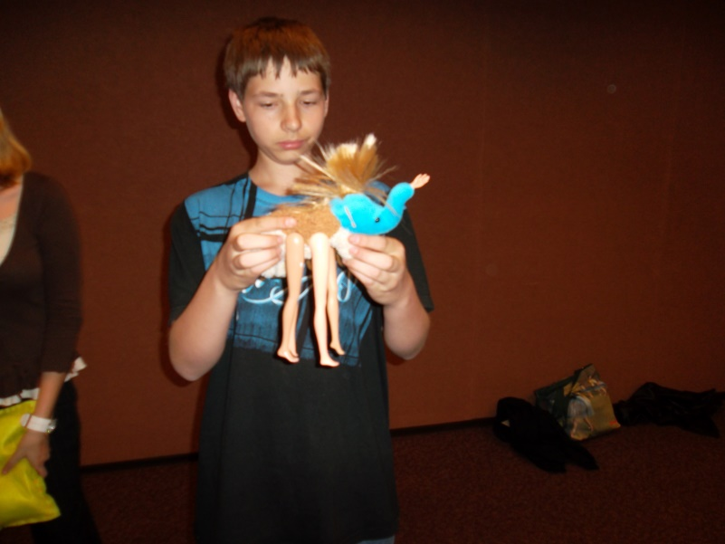
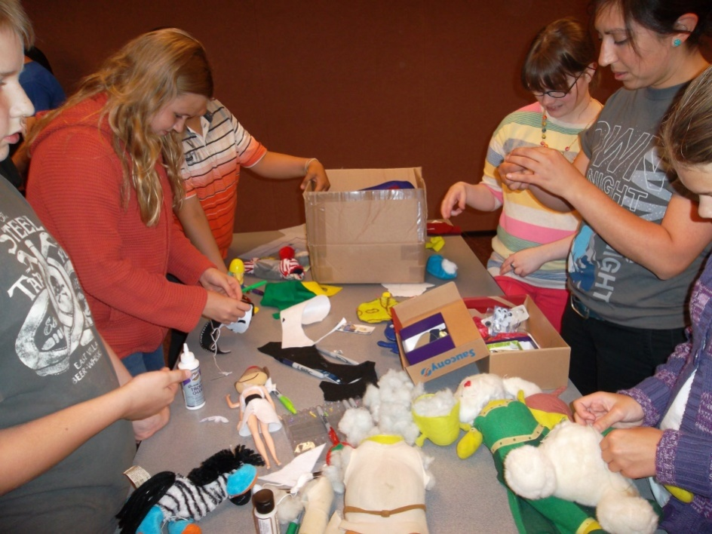
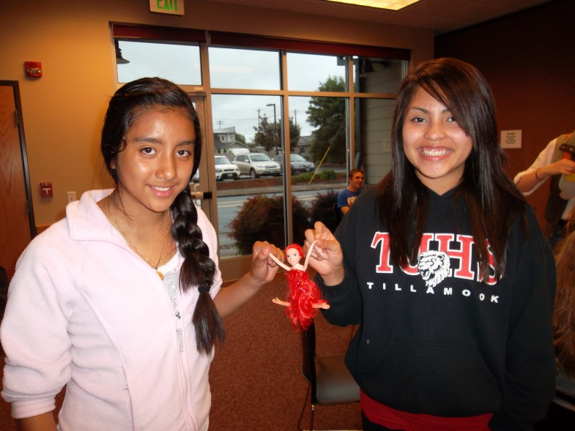
Making
Frankenmonsters
Tillamook Public Library

Slide 15
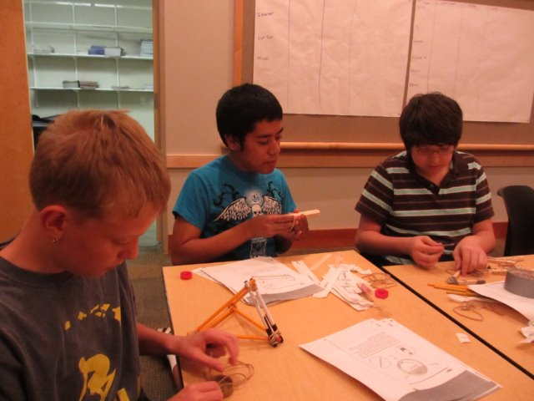
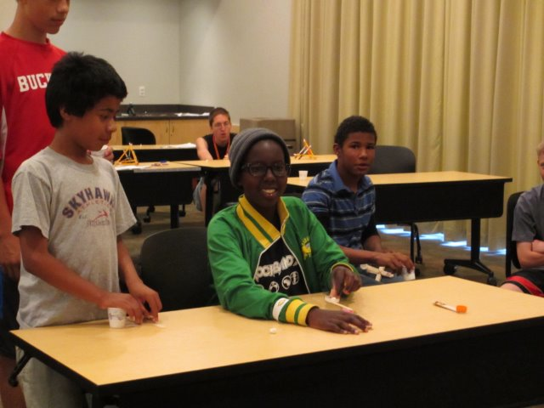
Making turned Crafting
Catapolsion!
Tualatin Public Library

Slide 16
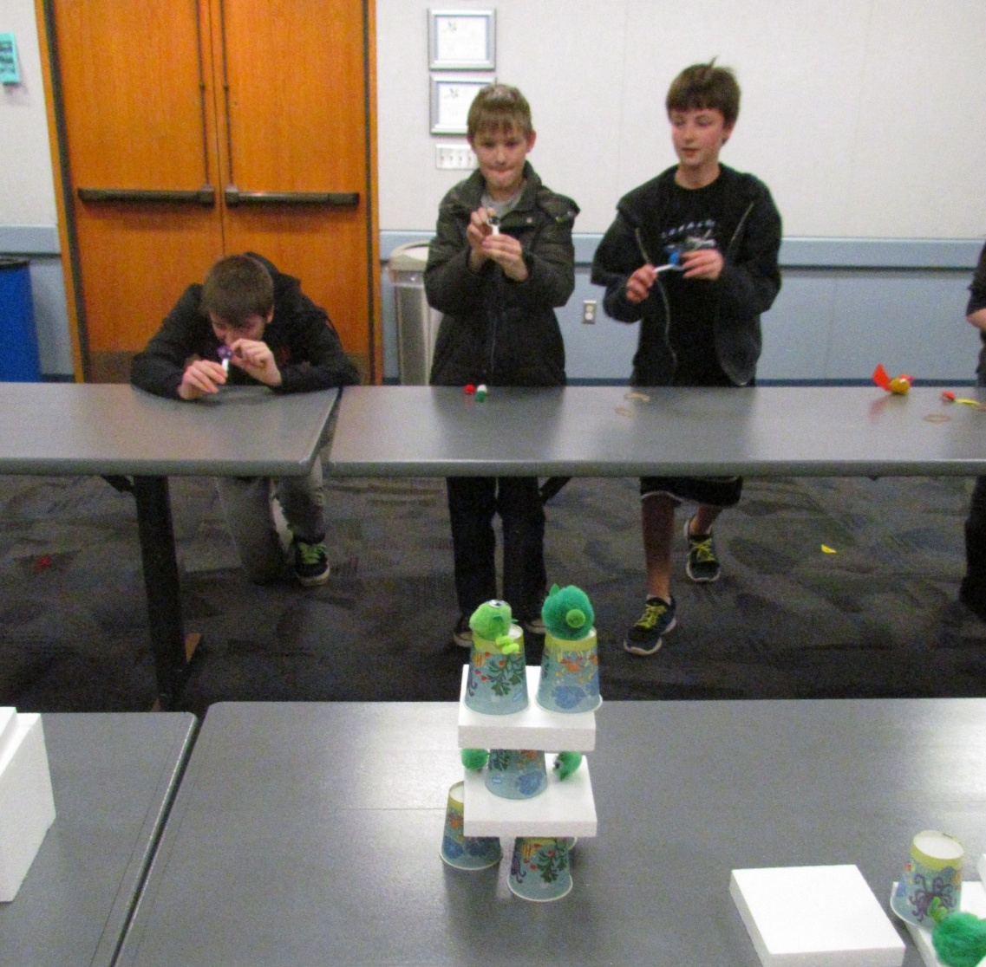
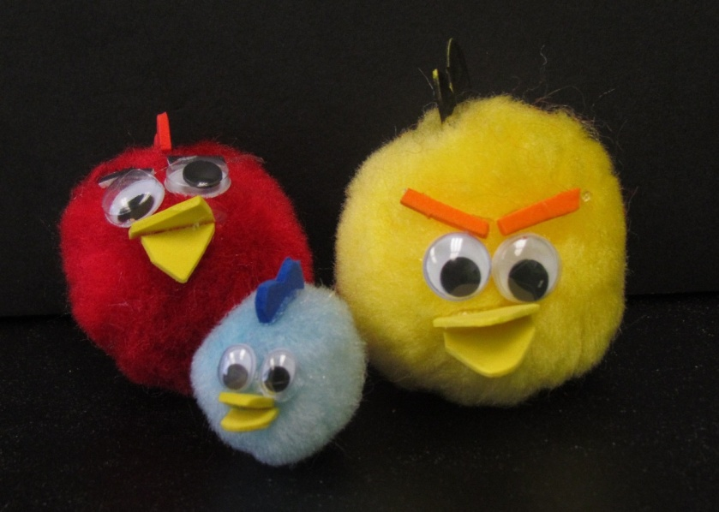
Making
Lego Mazes
Salem Public Library

Slide 17
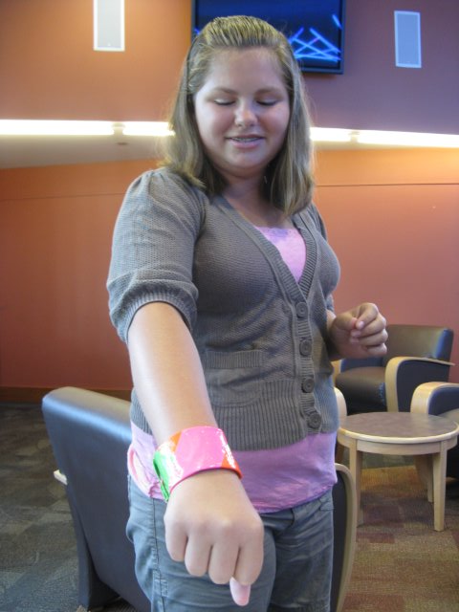
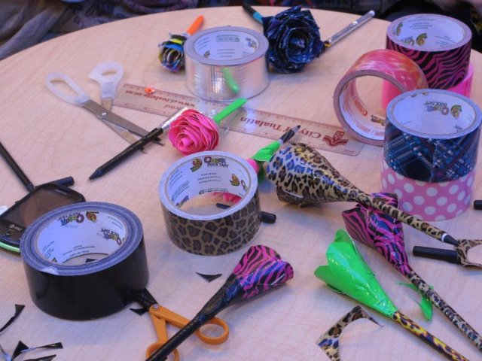
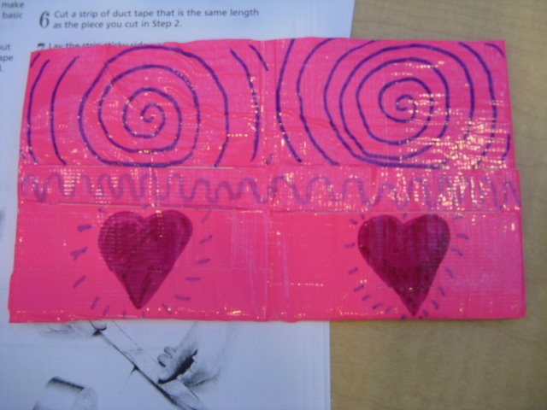
Crafting
Duct Tape Objects
Tualatin Public Library

Slide 18
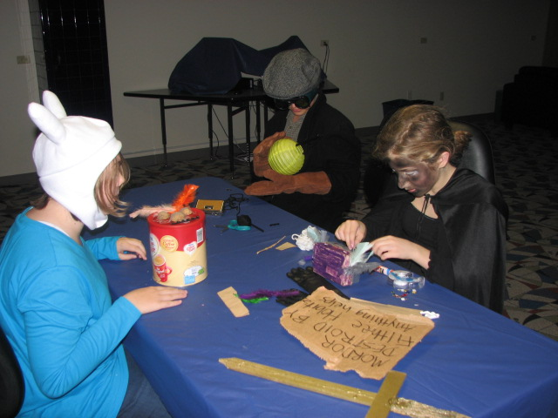
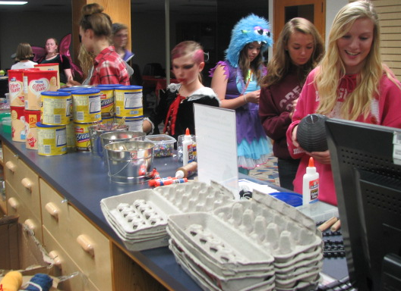
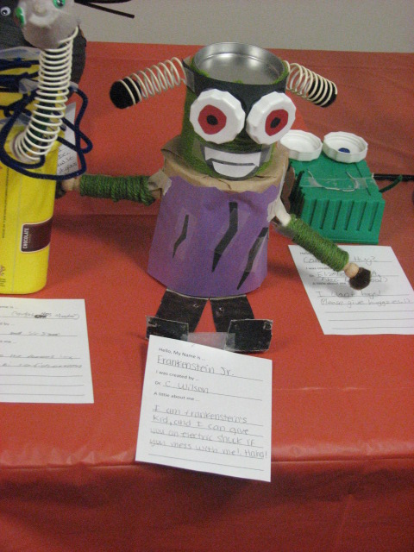
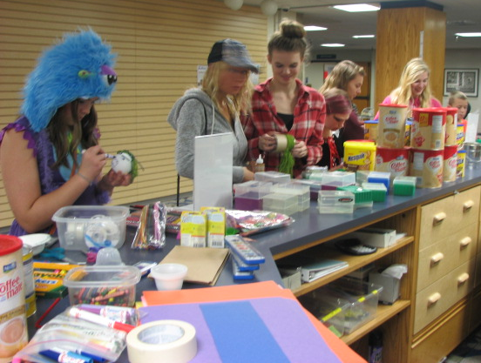
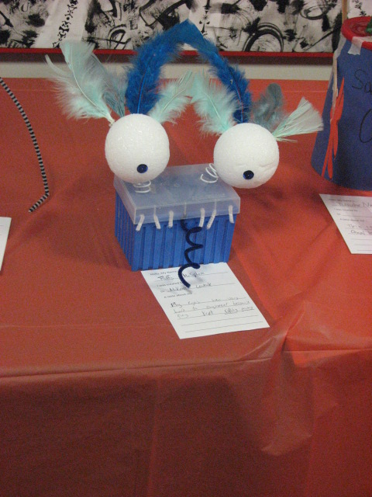
Making
Junk Monsters
Salem Public Library

Slide 19
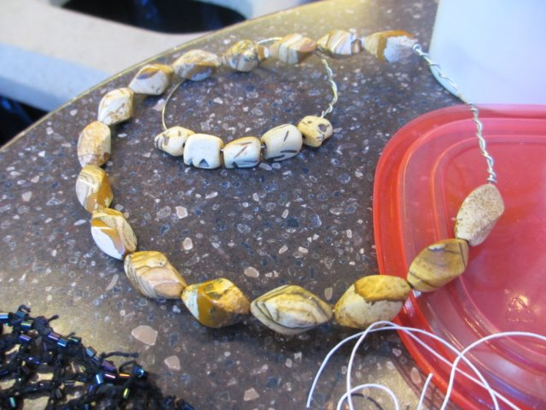
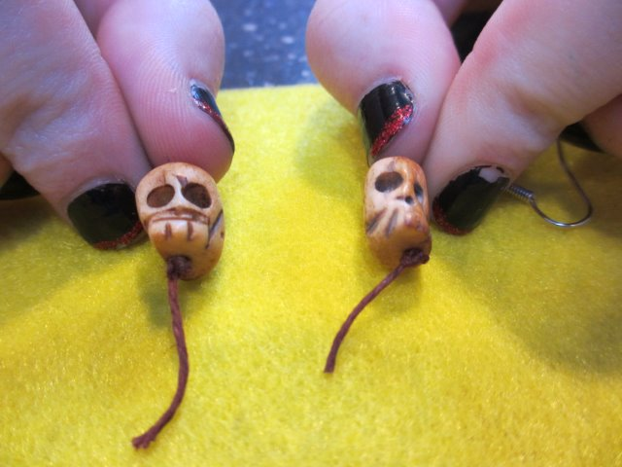
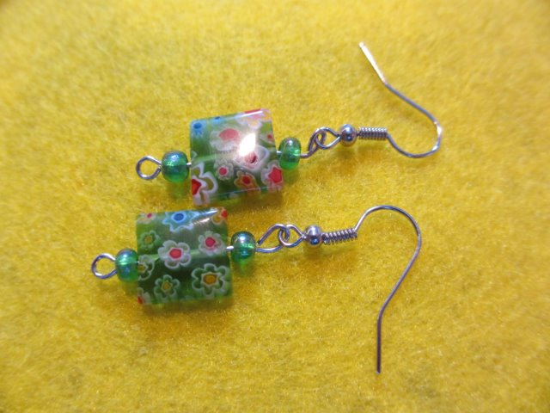
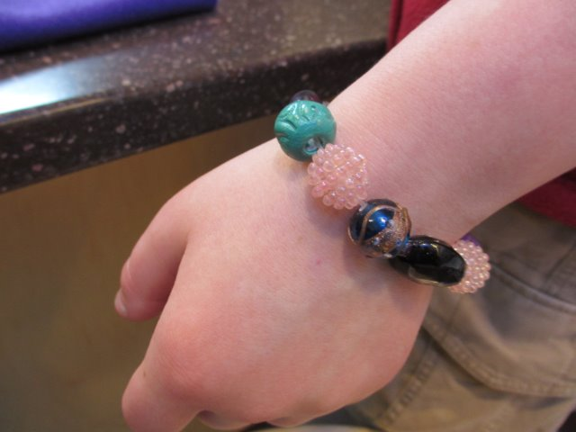
Making
Junk Drawer Jewelry
Tualatin Public Library

Slide 20
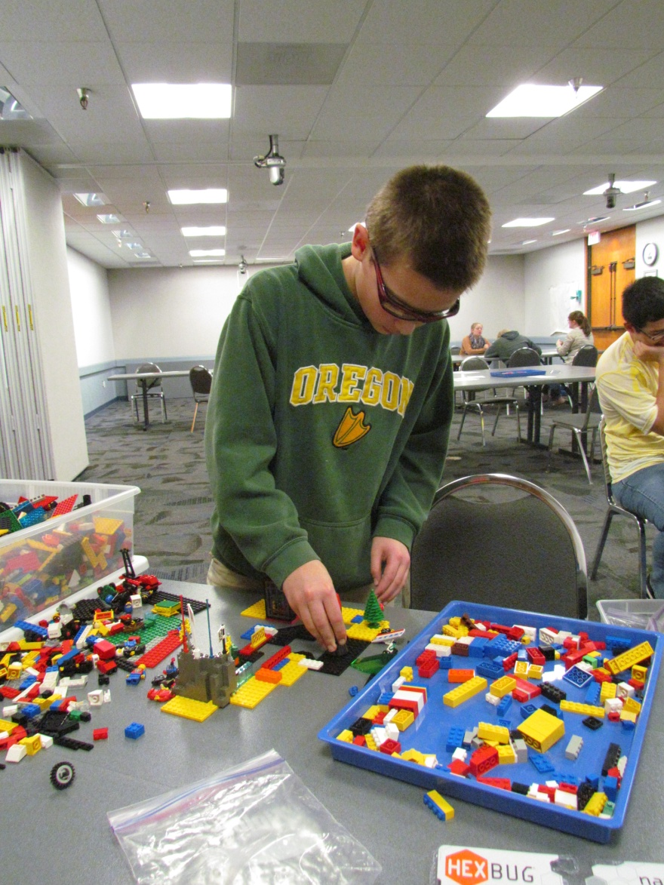
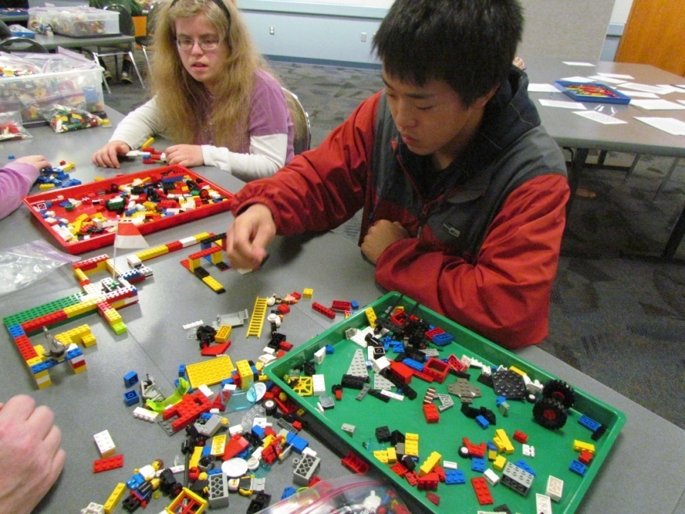
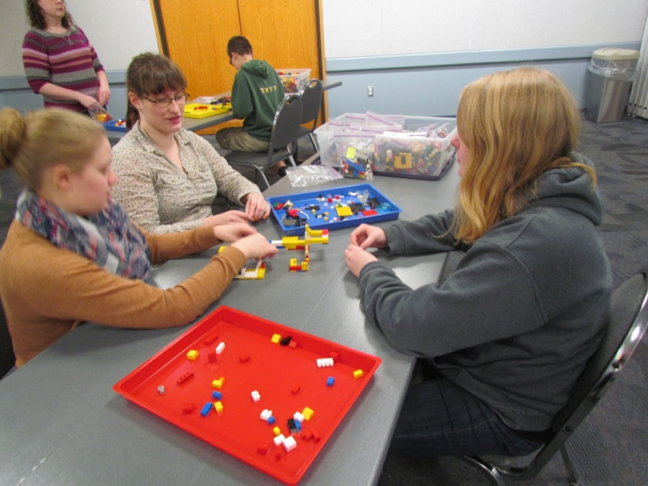
Making
Junk Drawer Jewelry
Tualatin Public Library

Slide 21
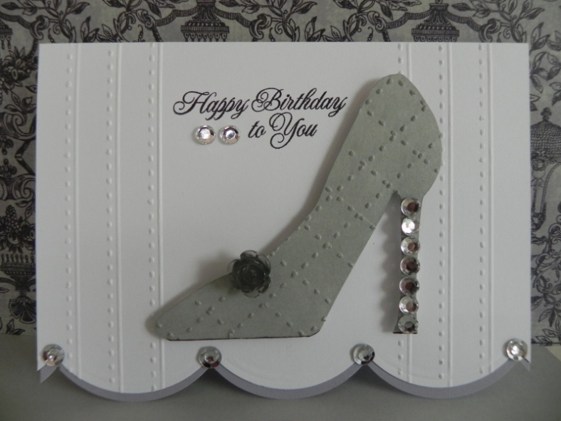
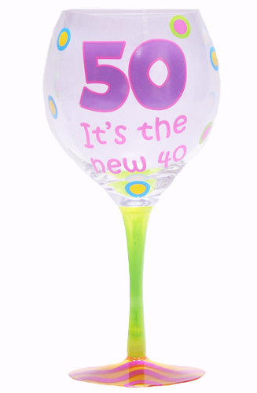
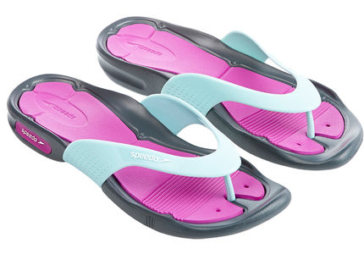
Our conclusion, just as …
Gray is the new black
And flip-flops that used to be thongs

Slide 22
Making is the new crafting.

Slide 23
Encouragement from the experts …
Our guess is that you are already making - and having fun doing it! Making has been in libraries for a long time in the form of craft programs and other activities. Now we are just taking it to another level.
You are making in your library when you work with teen patrons to create birdfeeders out of juice bottles and wooden spoons after reading John Corey Whaley’s “Where Things Come Back” in book club. You’re making when you build the tallest structure possible out of spaghetti and marshmallows because your Teen Advisory Board thinks the atrium looks empty. You’re making when you teach your Anime Club how to sew cat ears, and hopefully, one day, how to program their cat ears to rotate and twitch. You’re making when you design an update of the TARDIS and print it out in neon blue on the 3D printer. You’re making when your weekly 2-hour Makerspace consists of a plastic tub and a hot glue gun on a cart.
Remember, the best things made in library makerspaces are not the physical ones. They are the learning, friendships, confidence and sense of accomplishment achieved by the participants.
-- From the YALSA Making in the Library Toolkit

Slide 24
Just a few of the great places to get ideas …
YALSA’s Making It in the Library Toolkit
http://www.ala.org/yalsa/sites/ala.org.yalsa/files/content/MakingintheLibraryToolkit2014.pdf
Make It @ Your Library: http://makeitatyourlibrary.org/
Sortable by Age Level; Category; Cost; and Time Per Project!
The Maker Movement Manifesto: Rules for Innovation in the New World of Crafters, Hackers, and Tinkerers by Mark Hatch
Unbored: The Essential field Guide to Serious Fun by Joshua Glenn and Elizabeth Foy Larsen
Invent to Learn: Making, Tinkering, and Engineering in the Classroom by Sylvia Libow Martinez and Gary Stager
PINTEREST! (of course!)
Library MakerSpaces: Turn your library into a maker space that encourages hands-on learning: http://www.pinterest.com/cari_young/library-makerspaces/
Maker! Maker!: http://www.pinterest.com/auntytech/maker-maker/
Maker Space @ UHS: Ideas for creating a maker space at the school library:
http://www.pinterest.com/mlwl/maker-space-uhs/

