Slide 1
SSD Today & in the Future
The Support Staff Division of the Oregon Library Association

Slide 2
Who are the Support Staff of the library?
What do they do?
How are they different from librarians?

Slide 3
Library Support Staff
What’s in a Name?
sub-professional clerk
paraprofessional page
aide para-librarian
nonprofessional technician assistant

Slide 4
Library Support Staff
Roles?
Circulation Reference
Teaching Programming
Volunteers Managing
Storytime ILL
Cataloging Outreach
Weeding Budget
Collection development

Slide 5
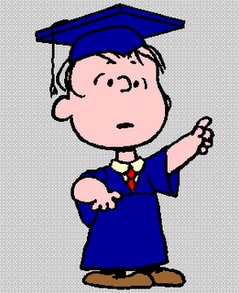
Library Support Staff
What’s the difference?
Support staff are not required to have a MLS degree.
Notes:
FROM ALA WEBSITE: Library support staff or library paraprofessionals, are involved in all library operations at all levels. They may manage libraries or they may contribute very specialized expertise in some specific field. They may engage in routine activities or supervise and direct other staff. Generalizations about them are difficult to make, and to find an all-encompassing job description, nearly impossible. The range and complexity of their duties varies with each position, the size and type of the library in which they work, and each library’s specific needs, goals, or mission.
The one distinction usually drawn between “support staff” and “librarians” is that those in the latter group typically have a Master’s of Library Science degree (MLS). In practice however, that distinction is not always clear. Staff lacking the MLS may be found in the uppermost levels of library management, and MLS holders may be found in positions that normally do not require the degree.”

Slide 6
A Few little Numbers…
28 States: Division, Interest Group, or Round Table for Support Staff*
Colleges, Universities in 13 States: Certification, Associates Degree, or Bachelor’s Degree for Support Staff*
*Statistics from the ALA website

Slide 7
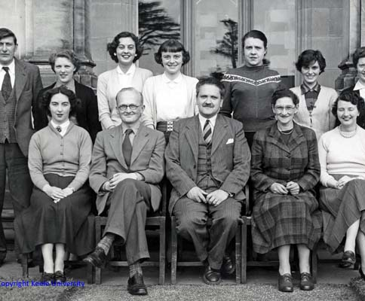
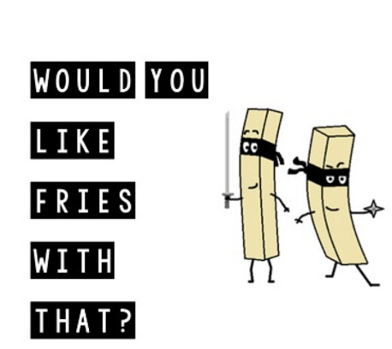
Did you know?
SSD, created by and for Support Staff, is the only non-librarian group in the Oregon Library Association with full Division status.

Slide 8
GIVE AND TAKE
Scholarships
Energy
Conferences
Expertise
SSD
YOU
Networking
Enthusiasm
Leadership opportunities
Time

Slide 9
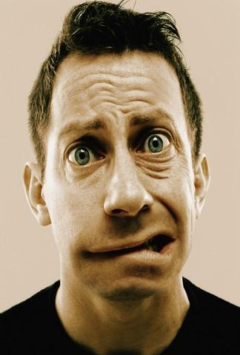
WHAT’S HAPPENING?
Hello, out there.
Can you hear me?

Slide 11
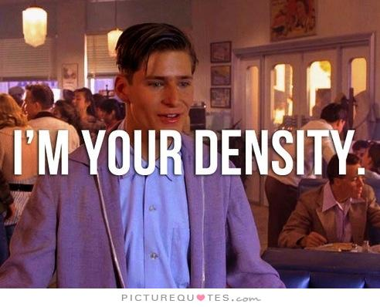
On to the future…

