Slide 1
Is Your Library Ready for Change? Facilitating Change Using the CAT
Oregon Library Association
The Inside Out Library
OREGON
LIBRARY
ASSOCATION
Notes:
Changes to library services generally involve changes to unit creativity or efficiency
The Contingency Analysis Tool (CAT) provides managers with:
Customized roadmap for optimally fitting a unit’s structures to a change in service
A checklist for ensuring that key structures are not overlooked
A rule of thumb for helping managers make the structural changes necessary to deliver a new or changed service
The advantages of adopting a CAT approach to change includes:
A controlled vocabulary for describing both (a) the change, and (b) the unit structures for facilitating change
Improves planning, communicating, and sustaining change
The advantages of applying theory:
Insight into the causes, effects, and optimization of facilitating change

Slide 2
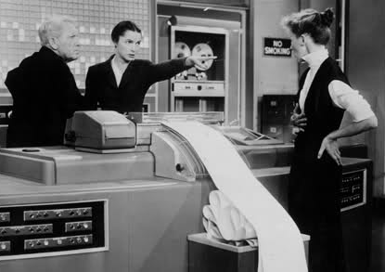
Contingency Analysis Tool: CAT
… or don’t
Do !
Unit Structures Facilitate the Delivery of Services
Notes:
Contingency Theory (Structural): There is no one optimal structure for facilitate a service, but some structures are better than others.

Slide 3
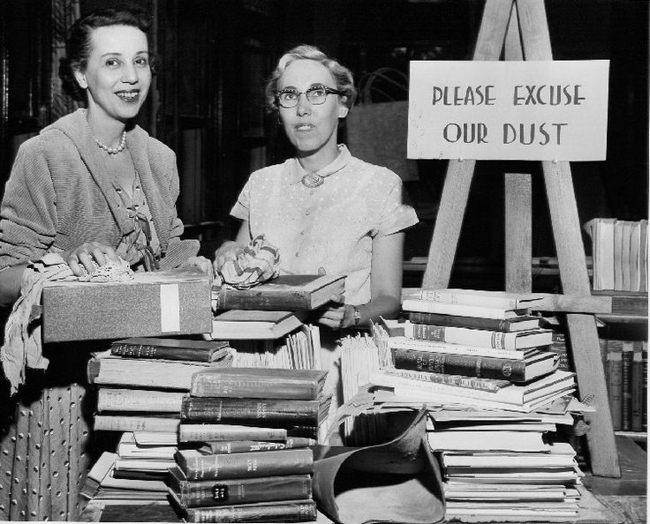
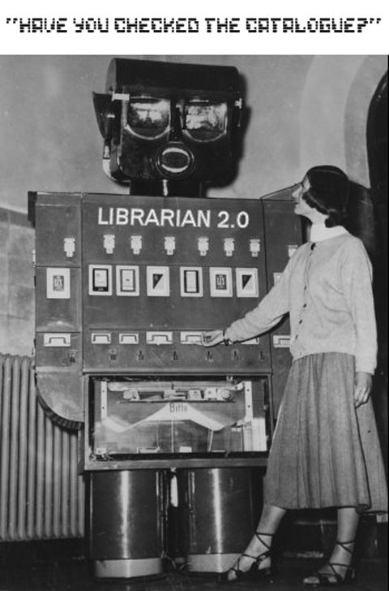
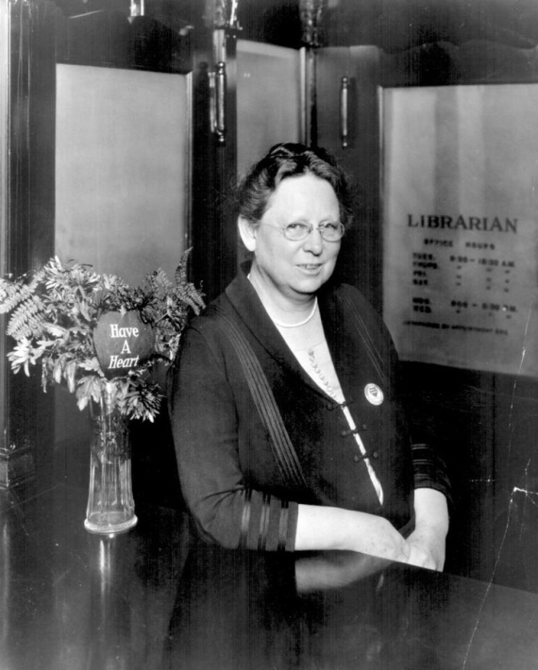
CAT: The 2 Contingencies of Service
Creativity ?
Efficiency?
Notes:
Two types of change:
Improve efficiency of an existing unit
Develop a new service

Slide 4
CAT: The 2 Types Facilitating Structure
Organic
Mechanistic
Notes:
Two types of structures:
Mechanistic structures – “Do it ! “
Organic structures – “What do you think ?”

Slide 5
CAT: Fitting Structures to Service
3
Mechanistic
Structures
Fit Line
Optimized
2
Organic
1
2
3
Task Uncertainty
Creativity
Efficiency
Notes:
Structural Contingency Theory
Under assumptions of Optimization:
Creative Services = Organic Structures
Efficiency Services = Mechanistic Structures

Slide 6
Contingency: Service Uncertainty
Variety: = uncertainty
Exceptions or frequency of unexpected issues
Work activities are largely repetitive
Analyzability: = certainty
Issue resolution through standard procedures
Tasks can be reduced to mechanical steps
Notes:
Compare circulation vs. outreach

Slide 7
Service Uncertainty: Variety
 | No | Somewhat | Yes
Are unit tasks largely routine? | 1 | 2 | 3
Does almost everyone in the unit do about the same job in the same way most of the time? | 1 | 2 | 3
Are unit members performing repetitive activities in doing their jobs? | 1 | 2 | 3
Average Variety = (a+b+c) ____*
* Higher values = Lower Uncertainty or Higher Certainty
Notes:
Break into groups

Slide 8
Service Uncertainty: Analyzability
 | No | Somewhat | Yes
Are there clearly known way to do the major types of unit tasks? | 1 | 2 | 3
Are there understandable sequences of steps that employees can follow in doing major units tasks? | 1 | 2 | 3
Can unit tasks be accomplished using established procedures and practices? | 1 | 2 | 3
Average Analyzability = (a+b+c) ____*
* Higher values = Lower Uncertainty or Higher Certainty

Slide 9
Service Uncertainty: Contingency
Average Service Uncertainty
(Average Variety ___ + Average Analyzability ___ ) / 2
1
2
3
Uncertainty
Certainty

Slide 10
Facilitating Services: Unit Structures
The structures that facilitates tasks :
Formalization
Centralization
Skill Level (division of labor)
Span of Control
Communication
Notes:
Given that we have measured the contingency of Task Technology in terms of its degree of uncertainty
The unit structures managers apply to support use of technology in accomplishment of unit tasks are often lumped under the concept of bureaucracy
For organizational theorists, bureaucracy at a unit level consists of formalization, centralization, Span of Control, and Communications
how management supports the tasks of the unit

Slide 11
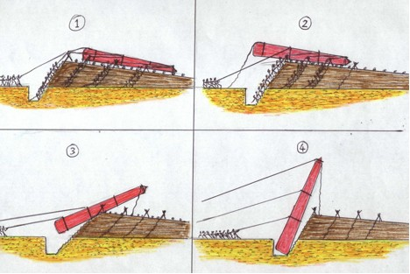
Unit Structures: Formalization
Roles & relationships independent of personal desire
Rules
Job Descriptions
Policies & Procedures
 | No | Somewhat | Yes
Are there a lot of written rules and procedures? (Formalization) | 1 | 2 | 3
Notes:
The amount of rules

Slide 12
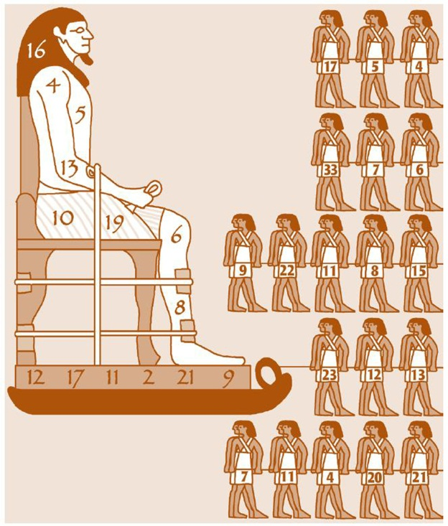
Unit Structures: Centralization
Resources are controlled by management:
Prioritization of Time
$ $ $
Resolution of issues or exceptions
 | No | Somewhat | Yes
Does the manager control most decisions regarding job tasks? | 1 | 2 | 3

Slide 13
Unit Structures: Division of Labor
Degree of Expertise Required to Perform Tasks
Education
Training
Experience
 | No | Somewhat | Yes
Do the unit’s tasks require little training or minimal experience to accomplish? | 1 | 2 | 3
Notes:
Skill level, is often referred to as Division of Labor
The more that labor is divided into specialized tasks the lower the skill level required to complete the entire task
Assembly line work

Slide 14
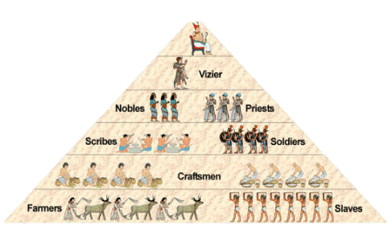
Unit Structures: Span of Control
Number of Employees Reporting to Manager
Narrow Span of Control
2-8 reports
Wide Span of Control
> 10 reports
 | No | Somewhat | Yes
Does the manager have a large number of employees who report to them | 1 | 2 | 3

Slide 15
Unit Structures: Communication
Direction and Type of Communication
Direction
Vertical (Staff Manager)
Horizontal (Staff Staff)
Type
Written (formal)
Verbal (informal)
 | No | Somewhat | Yes
Does communication largely involve written and direct communication with manager? | 1 | 2 | 3

Slide 16
Organizational Structures: Organic & Mechanistic
Formalization
Centralization
Skill Level (division of labor)
Span of Control
Communication
Avg. Unit Structures = ( a + b + c + d + e) / 5
1
2
3
Organic
Mechanistic
Notes:
Ditto re the grain elevator

Slide 17
CAT: Fitting Structures to Service
3
Mechanistic
Structures
Fit Line
Optimized
2
Organic
1
2
3
Task Uncertainty
Creativity
Efficiency

