Slide 1
Library Life Jackets? Floating Collections for One and All
OLA Conference
April 18, 2014

Slide 2
What are Floating Collections?
One library system, one collection.
Materials are shelved where they are checked in.
Materials move freely among library locations.

Slide 3
Why?
Organic flow of materials…customers decide.
Less “traveling time” means improved availability.
Materials move freely among library locations.
Increased variety of available titles
Stretch collection development dollars

Slide 4
Panel Speakers
Ty Thompson, Collection Manager,
Multnomah Public Library
Lynne Mildenstein, Assistant Director of Operations,
Deschutes Public Library
Sara Charlton, Director & Bill Landau, Branch Manager,
Tillamook County Library

Slide 5
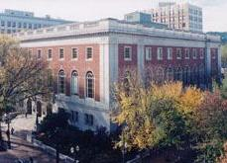
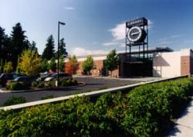
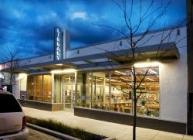
Multnomah County Library
1 Central Library with capacity of ab0ut 800,000 items
4 Neighborhood Libraries with capacity of 75,000 items
2 Neighborhood Libraries with capacity of 30,000 items
12 Neighborhood Libraries with capacity of 20,000 items
Outreach Services

Slide 6
Multnomah County Library
Materials Budget current fiscal year $6.8 Million
Centralized Selection and Collection Development
5 Full time Selectors
Adult Fiction, Adult Music CDs, Adult Spoken, Large Print
Adult Non-Fiction, Adult DVD/Blu-Ray, Periodicals, Newspapers
Juvenile and Teen, all formats
Databases
E-Content

Slide 7
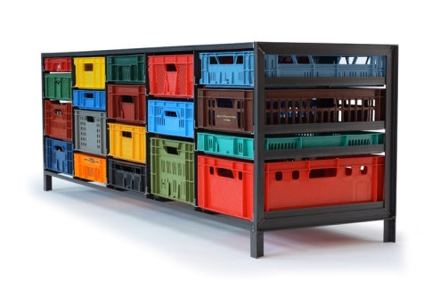
Multnomah County Library
Goal
To reduce staff workload in all locations,
including Sort Center and delivery.

Slide 8
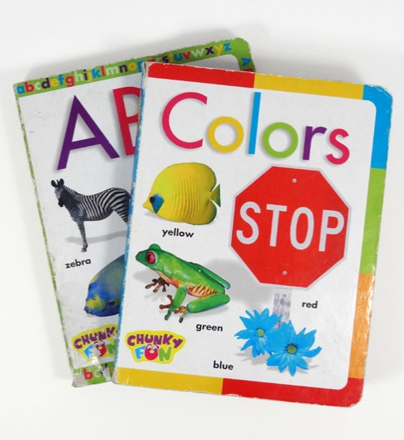
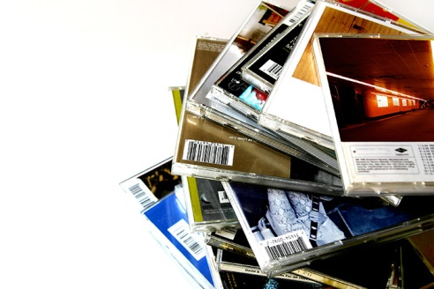
Multnomah County Library
What we float:
Large Print
Board Books
Music CDs
DVDs
Blu-Ray
CD-ROMS
Spoken Book
Lucky Day Browsing Collection

Slide 9
Multnomah County Library
Timeline
October 2002 – Began a four month trial, sharing VHS between (3) Neighborhood Libraries
VHS were shelved & available to be checked out more quickly
Patrons reported finding more variety in the 3 locations
Staff reported a reduction in materials handling
February 2003 – Began sharing VHS among all locations
VHS circulation increased during evaluation period
Number of items added to or ceded from each location’s VHS collection was acceptable
There were no insurmountable problems
All locations caught up with book drop and crate checkin
Fewer materials moving between locations
August 2003 – Added DVDs, CD-ROMs, Spoken Word CDs and Audio-Cassettes, Board Books, Large Print Books.

Slide 10
Multnomah County Library
Lessons learned:
Staff buy-in is critical; clearly define the benefits to patrons and staff.
There will be net lenders and net borrowers; have a plan in place.
Collection maintenance; define responsibilities up front and constantly talk about it.

Slide 11
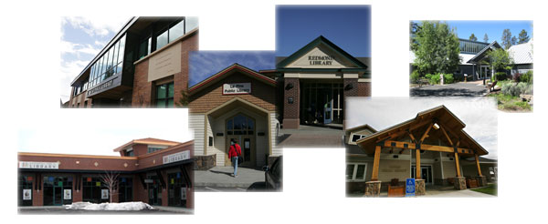
Snapshot of DPL
1 main library and 5 branches
Shared catalog with nearby public libraries (Crook & Jefferson)
Delivery program with 2 local school districts
Population served: 170,705
2.3 million physical materials circulation; 389,000 holdings
9,000+ average holds filled per week

Slide 12
Game Plan
Collection Development
Weeding & Space
ILS prep
Checks & Balances
Project Plan & Communication

Slide 13
Collection Development & Community Space
One District, One Collection
Centralized selection, acquisitions, cataloging and processing
Simplified fund structure
Which collection should float
Remove those collections that don’t “earn their spot” on the shelf

Slide 14
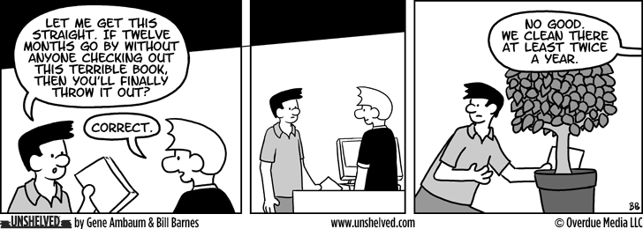
Weeding & Space
Weed, weed and weed some more
Include or communicate with all interested parties
Commit to the prep work
Identify current or future projects, space/collection problem areas

Slide 15
ILS Prep
Does current ILS have the ability to manage floating collections?
Is there in-house expertise?
Can net lending and net borrowing be tracked using ILS?

Slide 16
Checks & Balances
Items return to “home” library
Checkin from school library district
Checkin from delivery service
Checkin from selected branches
Dispatch from Technical Services
Market collections – make displays
Communicate with selectors
Empower branch staff

Slide 17
Project Plan & Communication
Pick a team that works!
Identify what success will look like
Determine how success will be measured
Have an elevator speech

Slide 18
Tillamook County Library
Notes:
Tillamook County Library system has the main library, five branches and one bookmobile. MZ and PC are flagship branches, the others are tiny hometown libraries, but deeply loved by their communities. I manage all the branches and the bookmobile and Sara is the director.

Slide 19
Tillamook County Library
Sara Charlton, Library Director
Drift back to 20 years ago, the Library had a problem
Patrons at the 6 Branches were complaining that they were not receiving enough new materials in their branches
The Staff researched and changed to the Dot System that was used by Jackson County Library.
Great Success!

Slide 20
Tillamook County Library
2011- An idea was discussed by Staff to move to floating collections.
Problem was our Network did not purchased the Floating Module
I asked the Library Staff to do research on Floating, visit libraries that used Floating and report the findings.
I was the one everyone had to convince it would work.

Slide 21
Tillamook County Library
Normally I am the one wanting to change something but this time I had concerns what could happen if it did not work!
2012- Tillamook County migrated to Innovative with the Floating Module
After drowning in discussion for months, it was time to Commit or Forget!

Slide 22
I went from this…
Notes:
Library are a second career for me, so even though I am “old” I am fresh in the business. Got my MLS in 2011 despite having 10 years experience running a library in Flagstaff, AZ prior to my degree.
But I went from this scene in Flagstaff…

Slide 23
…to this!
Notes:
…to this in Oregon. I figure it can rain all it wants as long as I don’t have to shovel it. And checking on my branches on roads like these is not a bad gig!

Slide 24
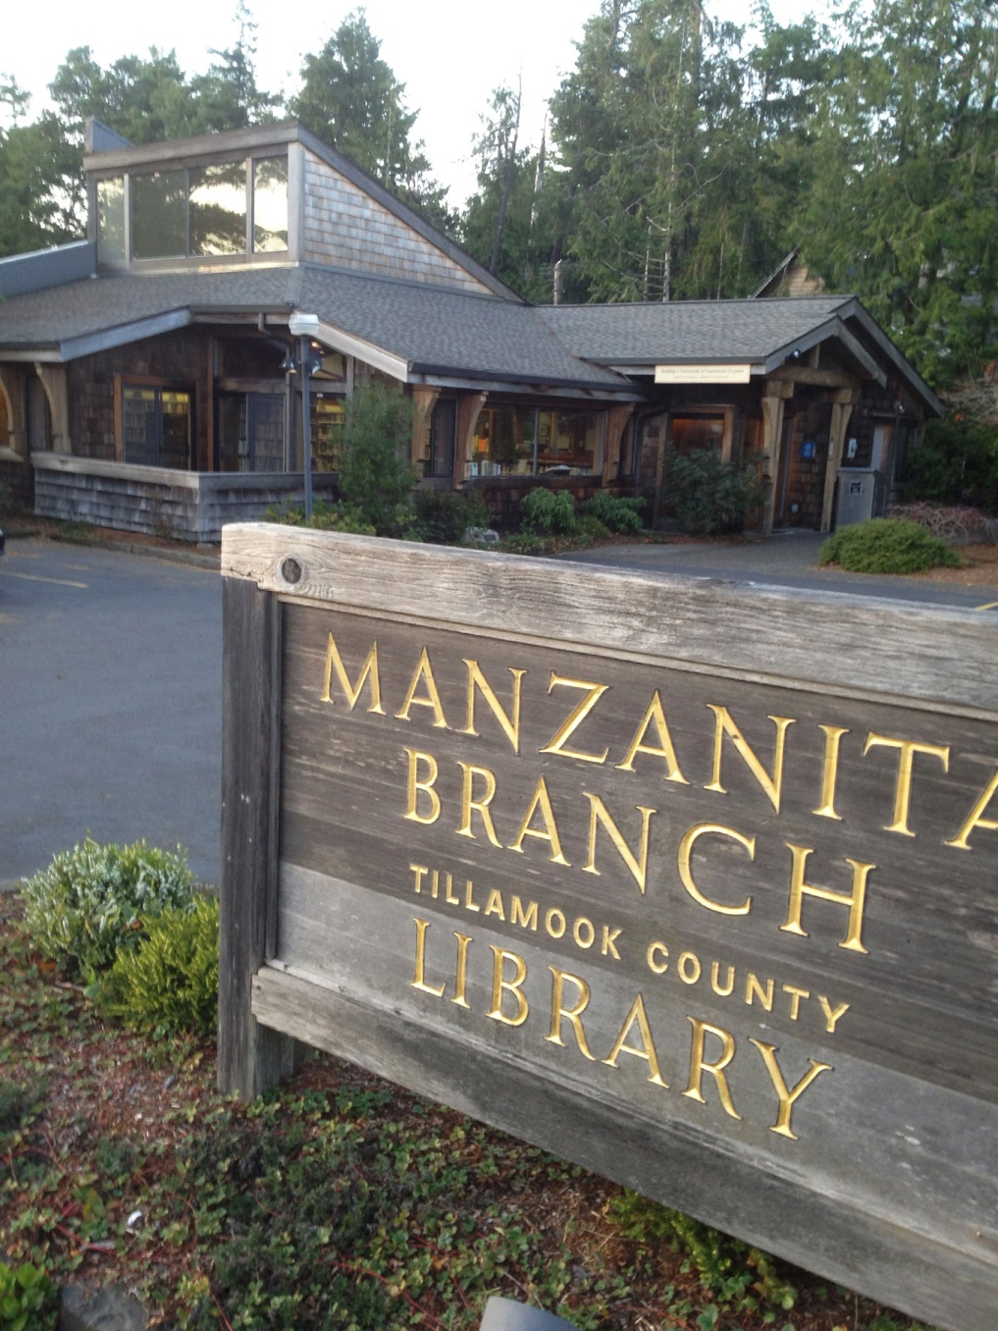
Notes:
FYI, here are the two flagship branches in MZ and PC. All buildings and utilities are provided by Friends of the Library groups, and the county library system supplies the books and the staff

Slide 25
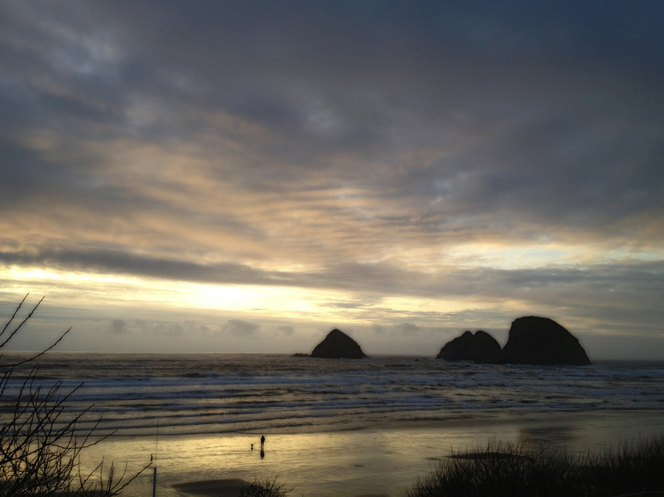
The Bookmobile
Notes:
The bookmobile is a big part of our business, visiting schools, nursing homes, shut-ins, town stops and the like. Poor us, we have to park the bus in Oceanside every week and look at this.

Slide 26
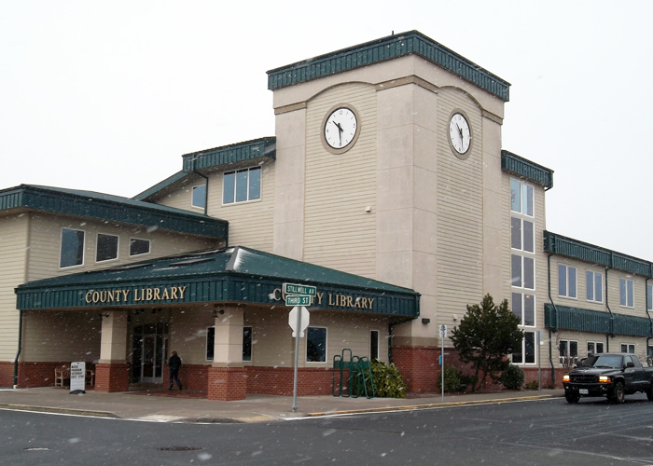
Tillamook County Library
Migrated from Sirsi to Innovative in May 2012
In September 2012, we began floating everything except magazines and reference materials
One year trial basis

Slide 27
Tillamook County Library
Main Library in Tillamook – about 115,000 items
Manzanita Library – about 12,500 items
Rockaway Beach Library – about 8,000 items
Garibaldi Library – about 7,500 items
Bay City Library – about 8,500 items
Pacific City Library – about 14,000 items
One Bookmobile – about 6,800 items
Notes:
We are small…like I said, we could find very little info on success rates for anyone our size working on a floating model.

Slide 28
Goals for Floating Collections:
Eliminate complicate “DOT” rotation system
Reduce excessive, busy workload for manager of branches, courier driver and all branch employees
Get more new books into the branch libraries
Less net borrowing from Oceanbooks consortium
Not transiting items back to their original library should eliminate transit time and reduce wear and tear on books, courier van and driver.
Satisfy patrons needs
Maximize collections funds while raising circulation

Slide 29
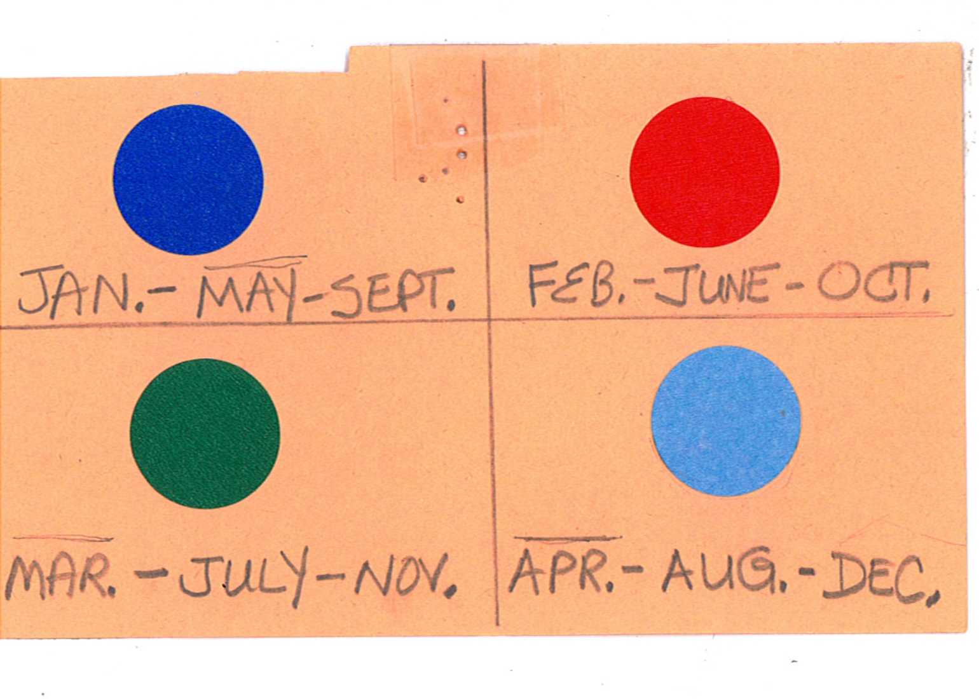
Tillamook County Library
The Dot System
Notes:
Describe…

Slide 30
Two weeks of prep for rotation
I would take all of the new books from Main that were over six months old, dot them with appropriate color, date them, change their catalog location, and bin them up for the branches.
Every book to be transferred (new and old) had to be opened and written in so we knew which library it had been at and where it was going.
Books that were over two years old were still being called “new” books.

Slide 31
Bin them up in crates like these…

Slide 32
14 – 20 bins to each library

Slide 33
More steps…
Change the location of the item in the system
Courier van transits to next location
Unpacked bins at new location
Check in at new location
Shelve at new location
All the while, these items were unavailable to patrons
Much wear and tear on books from being handled and stacked in bins
Usually a two week preparation process

Slide 34
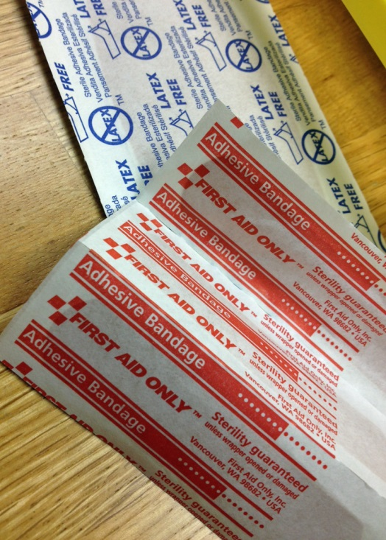
At end of all branch rotation…
Determine which were leased books and separate those for return
Remove all the dots!
Usually requires many of these…

Slide 35
Advantages of Dots
Lots of “fresh” materials coming in each month
And that’s it!

Slide 36
Something HAD to change * Much research ensued…
Read everything I could find on floating collections.
Not much info found applicable to smaller systems
Called and talked to Lynne at Deschutes Public Library
Dropped in at large and small libraries in the Multnomah County Library System
Got the blessing of my Director to try it for one year
Made huge pros and cons lists…
Move to floating accelerated by our migration from Sirsi to III Millennium and their floating module

Slide 37
The Cons…
Branch employees were skeptical
They liked their monthly influx of material
How would we know if it would work?
Patrons might not like it as many like to browse instead of place holds
We would have to remove ALL those dots!
We would have to weed and prep the branches and main library for shelves so they are “float-ready”
Would it work on the Bookmobile?
Fear of the unknown Etc, etc, etc…
Notes:
Lynne convinced me that we needed to weed ruthlessly to make sure we have anywhere from ½ to 2/3 of each shelf available for pooling

Slide 38
The Pros
Bill wouldn’t have to look for a new job!
The Manager of Branches could do managerial-type tasks instead of just flipping dots
Saved time for all employees involved in rotation
Much less wear and tear on books and the courier van/driver
Less transit time = more material available on shelves
Create a more cohesive collection by switching to centralized collections
Materials could live where they are dropped off instead of spending days in the courier van
Notes:
Last Manager of Branches only lasted six months
Basically all branch employees and many of the main library employees had lots of busy work as a result of the dots system

Slide 39
Staff buy in was crucial
The main library staff was already sold, but branch staff remained skeptical
I provided branch employees with copies of peer reviewed articles about floating
I created a “Guide to Floating” which basically provided an answer and step-by-step directions to all of their “what if” questions
I made sure I was at my phone as much as possible for the first few weeks
We made the promise that if we decided it was not working after a one year trial, we would revert back.
Notes:
Lack of branch staff buy in surprised me because I did not feel any of them had a good selection of brand new books. On average, our lease program for branches only allowed about 9 new books each month for each branch. Main would try to supplement this, but it still was meager. Their dot section was supposed to be their new books and some of them were more than two years old.

Slide 40
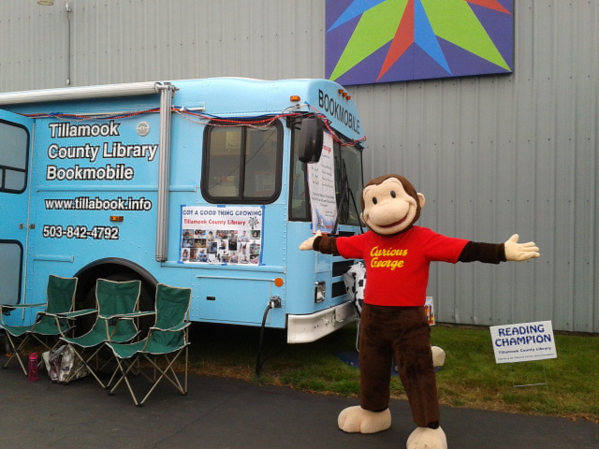
Almost two years in…
Big success! Almost perfect…
Almost 100% staff buy in because they now have a new section with NEW books
Almost 100% customer buy in
Notes:
Why almost? Because you just can’t make everyone happy no matter what you do. “It’s not like the old days…”

Slide 41
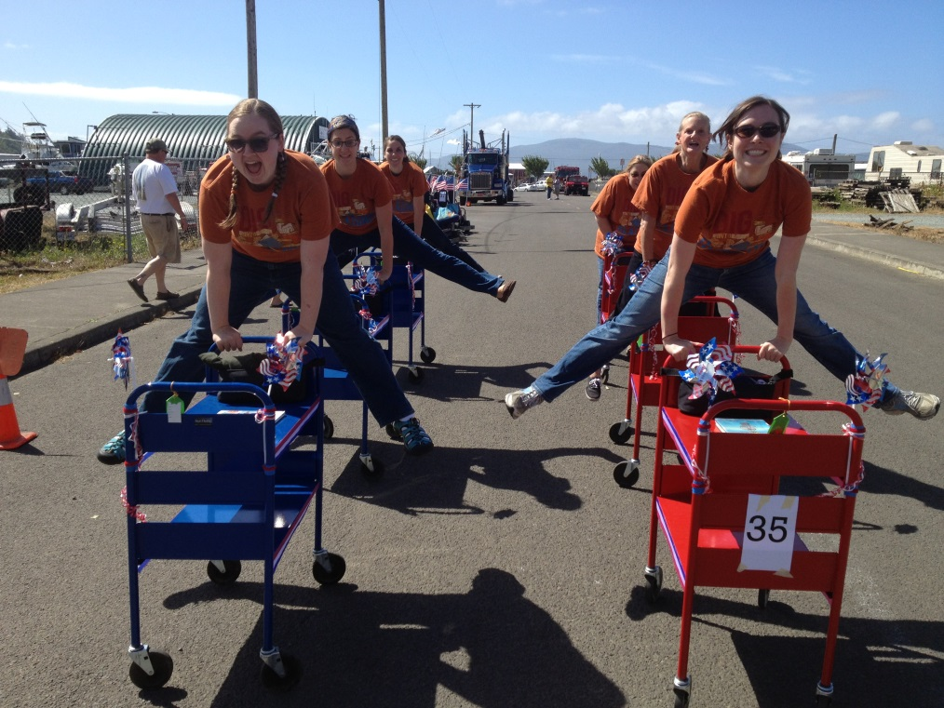
Statistics
Circulation up 12% from pre-floating
Branches now circulating more items
Our net lending from Lincoln County
Before floating – 15,000 items per year
After floating – 4,500 items per year

Slide 42
What about pooling?
Notes:
If you’ve seen FROZEN you will know what I mean when I say I am “ a HAPPY SNOWMAN!” since we’ve started floating. We worried about this more than anything else. How would we handle all of the improbable worst case scenarios we could think of…like if someone checked out all the poetry books and dropped them in one place. Or what if all the Harry Potters landed in one library? None of this happened! But we were prepared, just in case. I drew up plans that had me taking weekly trips up and down the coast to even out the collections. We were going to create an online needs and wants boards so staff could say “I need some Harry Potters” or I have too many gardening books, who needs them?” But none of this happened. Just minor moves are needed to keep the collections balanced. BUT WE PREPARED by doing the weeding first so there was room.

Slide 43
Float Management
Once every 5 or 6 weeks, I start in Manzanita and work my way down the coast to rotate 400 adult and juvenile DVDs to each library so they have a fresh supply.
During these rotations, I throw in a crate or two of some other stale collection.
One month we will rotate graphic novels, another month mysteries, etc.
Occasional email to branches calling for a “rotate 50”
“You don’t want it, send it to Main.”

Slide 44
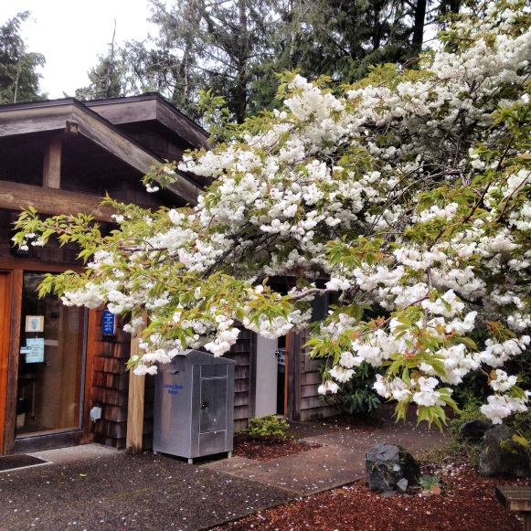
Centralized Collection Development
Much better than before
Collection is more cohesive
Less unwanted duplication than when branches and main were ordering separately.
Only Librarians doing the ordering now

Slide 45
What are staff saying?
It’s so great to be able to have a new book section that is full of NEW books
If I don’t want it, I just send it back to Main
I have a customer who wants everything we have on horses. It is easy for me to place holds on items in the system and have them brought in to my branch
I didn’t think it would work, but I’m convinced now
Thanks, Bill. You are the best boss ever and Sara should give you a big, fat raise!

Slide 46
What are the customers saying
The selection of new books and DVDs are amazing
We never used to see this much new material before
I’ve had to learn how to place holds to get my new books, but that is a good thing
I am getting my requested books much faster than before
Bill, you are amazing. Your boss should give you a big, fat raise!

Slide 47
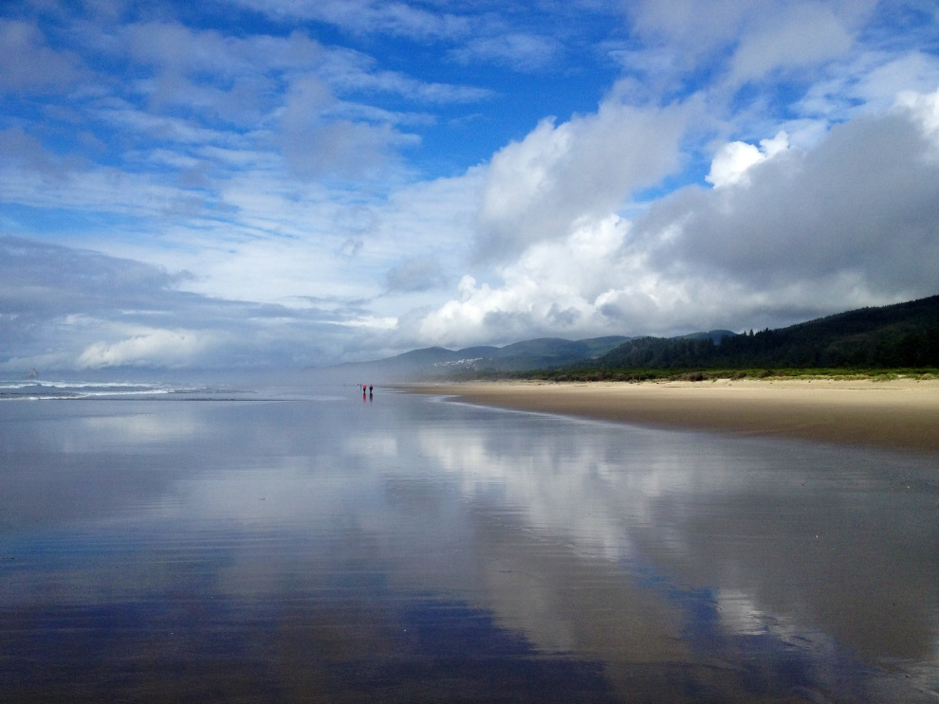
Lessons Learned
Don’t overthink it! It’s not rocket surgery ☺
There probably is no other library system just like yours to compare it to
You’re not going to know until you try.

