Slide 1
Media Maker Kits
Mark Richardson Cedar Mill Library

Slide 2
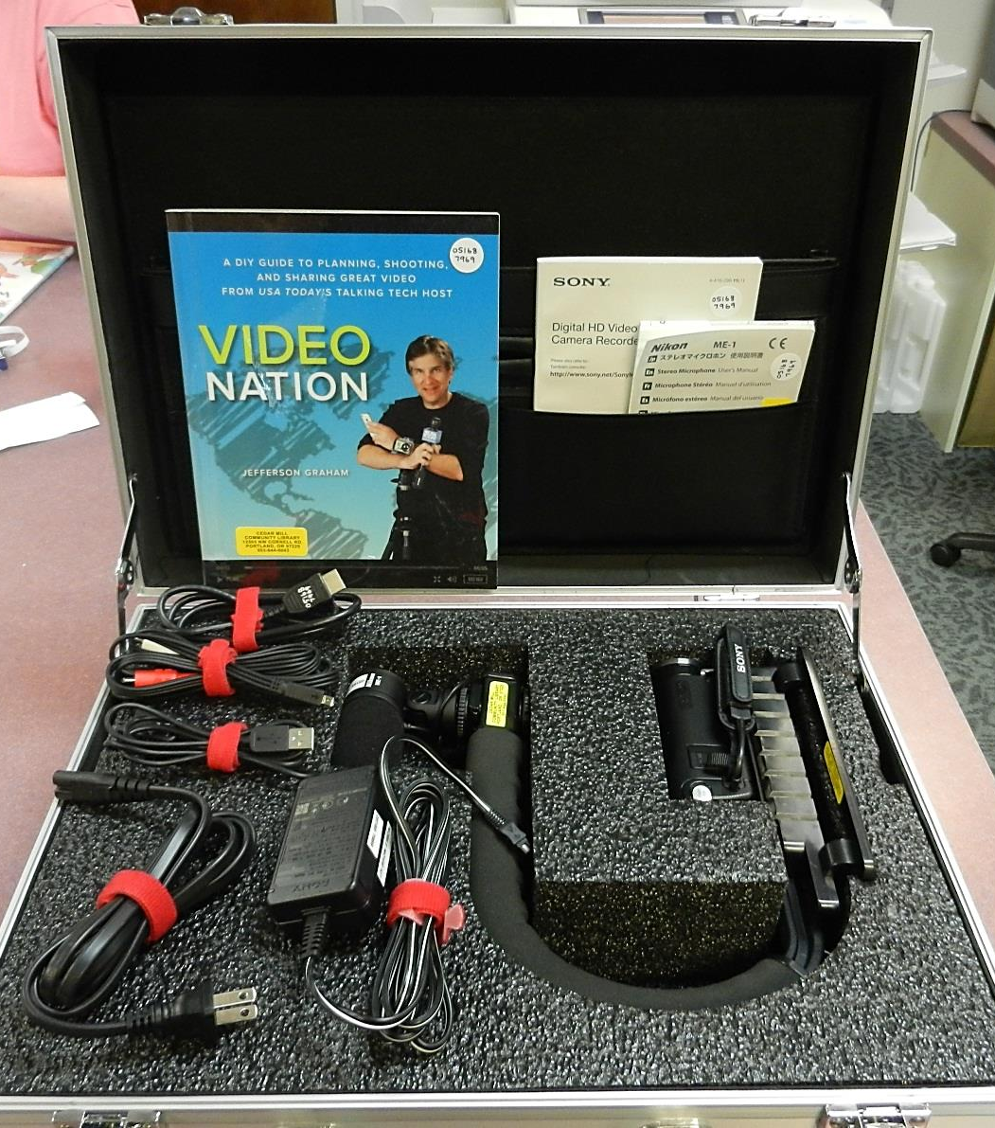
Mobile Movie Production Kit
Sony HDR-CX260V Digital Camcorder
External Microphone
Stabilizing Handle
Video Nation book
$803

Slide 3
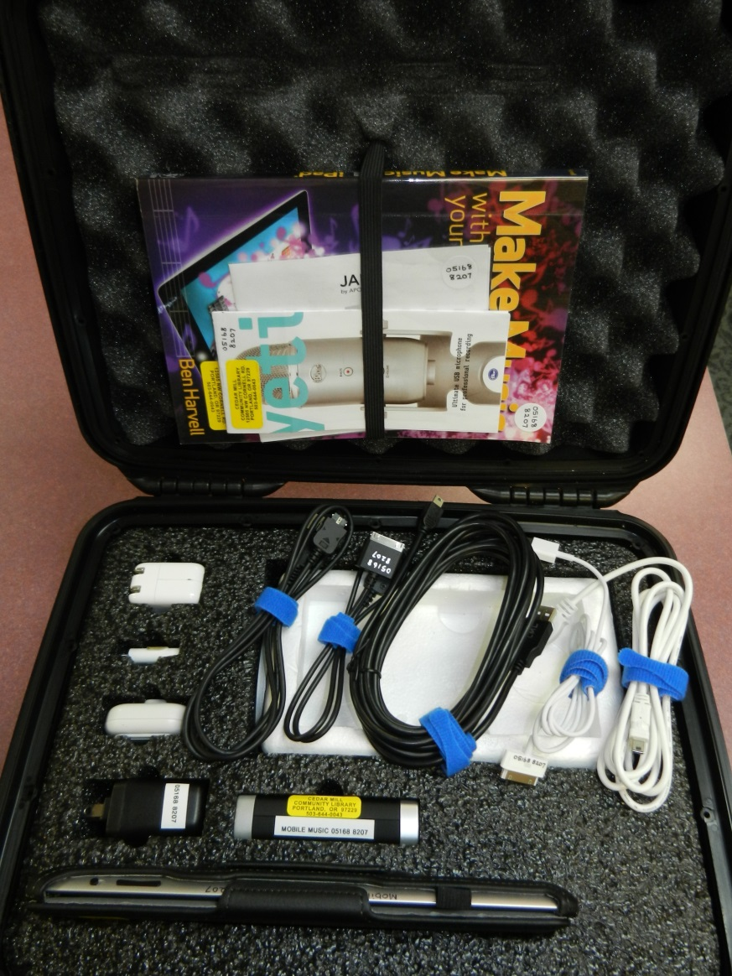
Mobile Music Production Kit
iPad
Jam Guitar Jack
Blue Yeti Microphone
Belkin USB Hub w power supply
Make Music with iPad book
$889

Slide 4
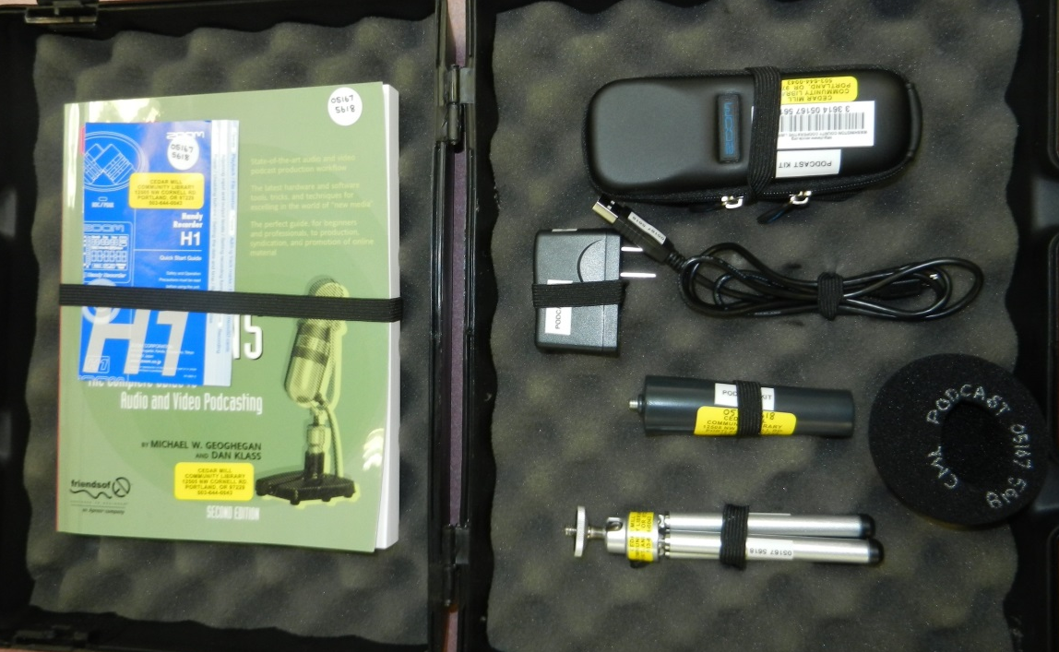
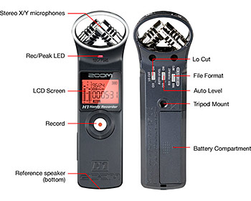
Mobile Podcast Production Kit
Zoom H1 Handy Recorder w tripod, etc.
Podcasting solutions
$143

Slide 5
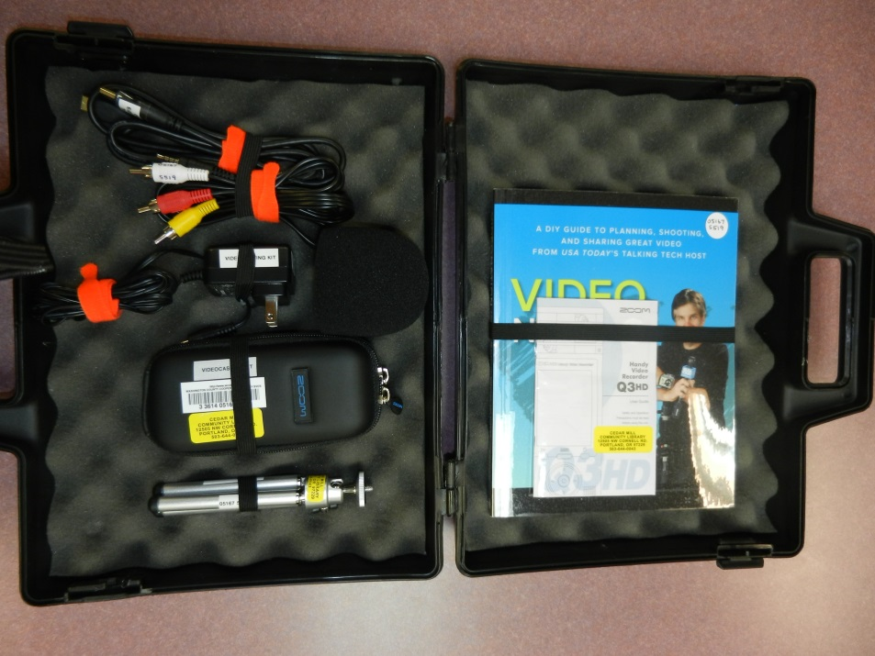
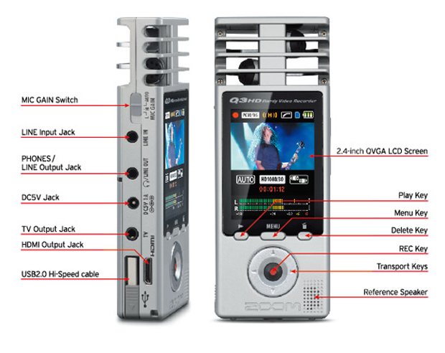
Mobile Videocasting Production Kit
Q3HD Zoom Handy Video Recorder w tripod +
Video Nation book
$402

Slide 6
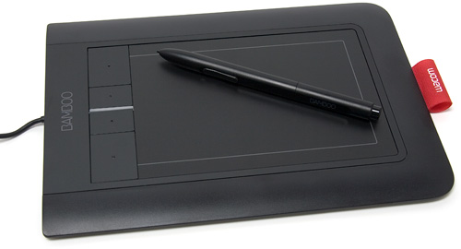
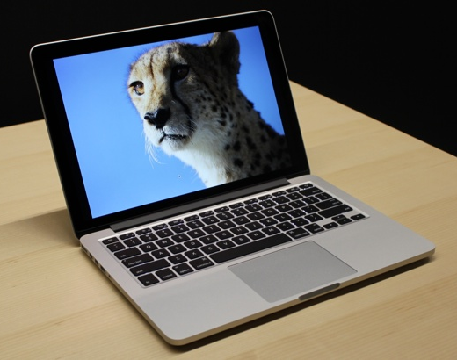
Graphics Production Kit
Apple Macbook Pro
Bamboo Graphics Tablet
Adobe Suite Software
$$$$$$

Slide 7
Troubleshooting the Launch
7 days
Adult services staff, not circ
Nothing over $1000 leaves building
No training, we can point people to resources and have books on hand.
$10 a day/stop at $30
All files deleted
$25 fine if alter apps
Yes, with signed form at 14
How long to check out?
Who gets them ready to check out?
Which ones should check out?
Who does the training?
How much for late fee?
What if someone leaves files?
What if someone alters digital materials like apps?
Do teens get to check out?

Slide 8
Circulation results (11 months)

Slide 9
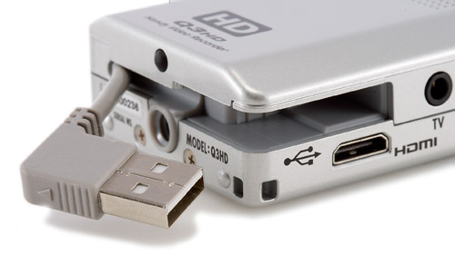
Troubleshooting the aftermath
More instruction on file transfer needed
Videocamera has complex transfer process. Needs to be plugged in when transferring.
Removing files on the videocamera was time consuming until….
Lost an iPad before the ios 7 update. Now we add a login.
When swapping out SD cards, check for software.
Low use of in house devices
Not much feedback other than use
Marketing
Check in staff intensive

Slide 10
Pleasant Surprises
Macbooks are useful to have around, especially when you have older browsers on Internet stations.
iPads as scanners
iLife programs useful for editing
Videocamera can function as video converter

