Slide 1
Library Service
and the
International Student
Laurie Bridges, OSU
Kimberly Willson-St. Clair, PSU
Uta Hussong-Christian, OSU
OLA Annual Conference, April 2014

Slide 2
Oregon and
International Higher Ed. Students
China 37%
Saudi Arabia 14%
Japan 7%
South Korea 6%
India 5%
Open Doors - 2013
Notes:
As of 2013, UofO had the most international students followed by OSU, PSU, Portland Community College, and Lane Community College. According to Open Doors report for Oregon 2013. Note: I thought public librarians might be interested in knowing about study abroad high school students in the US. This information isn’t easy to find, but organizations that coordinate the programs volunteer to include their numbers in the https://www.csiet.org/documents/CSIETStatsReport2012-13-FINAL.pdf report. According to this report, in the US, Germany was #1 for 2012-13, China #2, Brazil #3, South Korea #4, and Italy #5. Saudi Arabia not on the list of top 50.

Slide 3
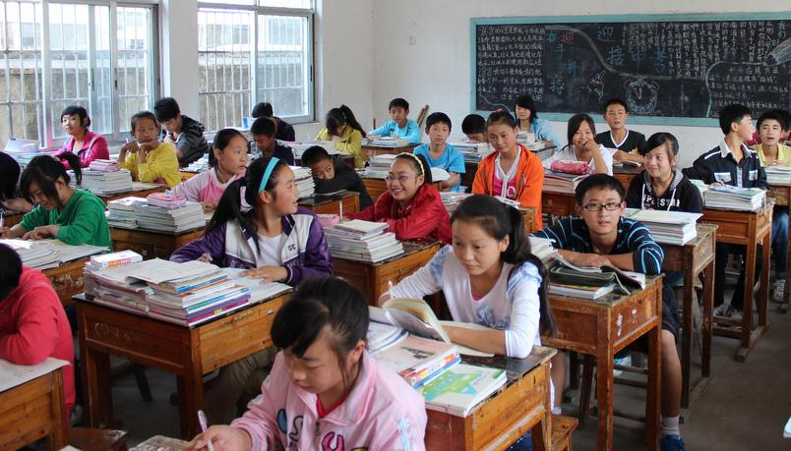
"Chinese Villages, Anhui Province" by Buster&Bubby from flickr
International Students and Classroom Culture

Slide 4
China
Chinese Student in the US
Written English may be at a higher level than spoken English
Surprised by: Relationship between professors and students “very casual, like they’re friends” *
Surprised by: Students bring laptops and smartphones to class *
Sources:
* 2014 conversation with Senior OSU student from Beijing in a 2+2 program (two years in China, two years at OSU, two bachelor’s degrees).
^ Understanding Your International Students (2003). Editor: Flaitz
Lecture based classroom, tests, memorization *^
Very little writing of papers and research and students are not encouraged to have “own ideas” *
Respect for professors; students feel “intimidated” by them *
Never did citations before coming to the US *^
More time spent in class with less homework (depends on university) *
Notes:
Notes: The book, “Harvard Girl” may be responsible for the uptick in Chinese students wanting to study in the US. When I asked the Chinese student I interviewed if she heard of the book she said, “Yes, of course. Everyone my age knows of the book.”

Slide 5
Saudi Arabia
Separate universities for men and women
Lecture based classroom, readings, tests
Lock-step curriculum with no homework
May not have done research paper in k-12
Collectivist culture: If there is a problem in class, a family member will be the go-between
Saudi Arabian student in the US
Spoken English may be at a higher level than written English
First time females talk with males outside their family
Surprised by: Instructors are very “serious”
Source:
2014 conversation with INTO OSU Arabic Language Advisor (male) and Saudi Arabian INTO OSU student (female).

Slide 6
Japan
Japanese Students in the US
Written English may be at a higher level than spoken English *
Surprised by: US Students are “eager” to speak in class and share opinions *
Surprised by: US Students interrupt instructors/professors *
Surprised by: “Five to ten times as much homework in the US” *
Sources:
* 2014 Conversation with three OSU Japanese students. Two exchange students and one with a degree from a Japanese college.
^ Previous OSU Librarian who now teaches English at a Japanese University
Lecture based classroom *
Low amount of homework or no homework depending on college and major *^
Students do not ask questions in class *^
May not have experience with citing sources, depends on college and major *
May not have word processing skills *^

Slide 7
South Korea
South Korean Students in the US
Written English may be at a higher level than spoken English ✴
Classroom is “informal and free” ^
Students share opinions in the U.S., and in South Korea unlikely to share opinion to maintain collective with classmates and not “stand out” ^
Surprised by: Frequency of compliments and praise given by professors ^ ✴
Surprised by: Students call professors by their first name ✴
Sources:
* For Expat Professors in South Korea, Students Can be the Biggest Cultural Surprise. https://chronicle.com/article/For-Expat-Professors-in-South/128951/
^ Classroom Atmosphere: Does It Reflect One’s Culture? http://spark.parkland.edu/cgi/viewcontent.cgi?article=1000&context=ant_student
✴ 2014 Email conversations with one OSU professor from South Korea and two PhD students from South Korea
High school day starts as early at 7 am and can go as late as 11 pm *
Males have compulsory military service in the middle of college
Lecture based classroom and memorization emphasized *✴
Cultural pressure is high and S.K. has the highest college suicide rate in the OECD *
Students are competitive and grading is bell curve *✴
Students generally do not interrupt lectures and save questions for after class ^✴
Notes:
Students in south Korea attend class 30% more a year than other OECD countries.

Slide 8
India
Private/Public High School
Private/Public University
1 test determines college entrance score ✴*
Lecture based classroom, some group work *
Did not learn about citations in high school and rarely wrote papers *
Grades based on tests, not “everything” *
Indian Student in the US
Surprised by: Different perception of time *
Polychronic vs. monochronic culture ^
Sources:
* 2014 conversation with junior OSU student from New Delhi who attended college in India before coming to OSU.
^ Transcending Cultural Barriers, 1994 bit.ly/timeculture
✴ Squeezed Out In India Students Turn to the US. bit.ly/indiaus

Slide 9
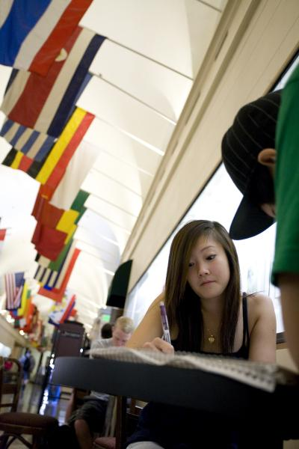
OSU
2,859 (10 %)
OSU Top 5
China, Saudi Arabia,
South Korea, India, Iran
Sources: OSU Fall 2013 & Fall 2003 Enrollment Summary,
Office of Institutional Research
“Osu-26” from OSU IMC Network
Notes:
OSU’s international student population looks very much like the state profile with one exception. Students from Iran (rather than Japan) are among the Top 5 countries represente. Our Fall 2013 enrollment data indicates that international student enrollment is at 10%. To put that in perspective, in Fall 2003, we had 1061 international students enrolled; total headcount in 2003 was 18,979). So we’ve nearly tripled our international student population over the past decade.
image: http://imcnet.ning.com/photo/osu26-1
reports: http://oregonstate.edu/admin/aa/ir/sites/default/files/enroll-fall-2013.pdf (pg. 13)
http://oregonstate.edu/admin/aa/ir/sites/default/files/enroll-fall-2003.pdf (pg. 1)

Slide 10
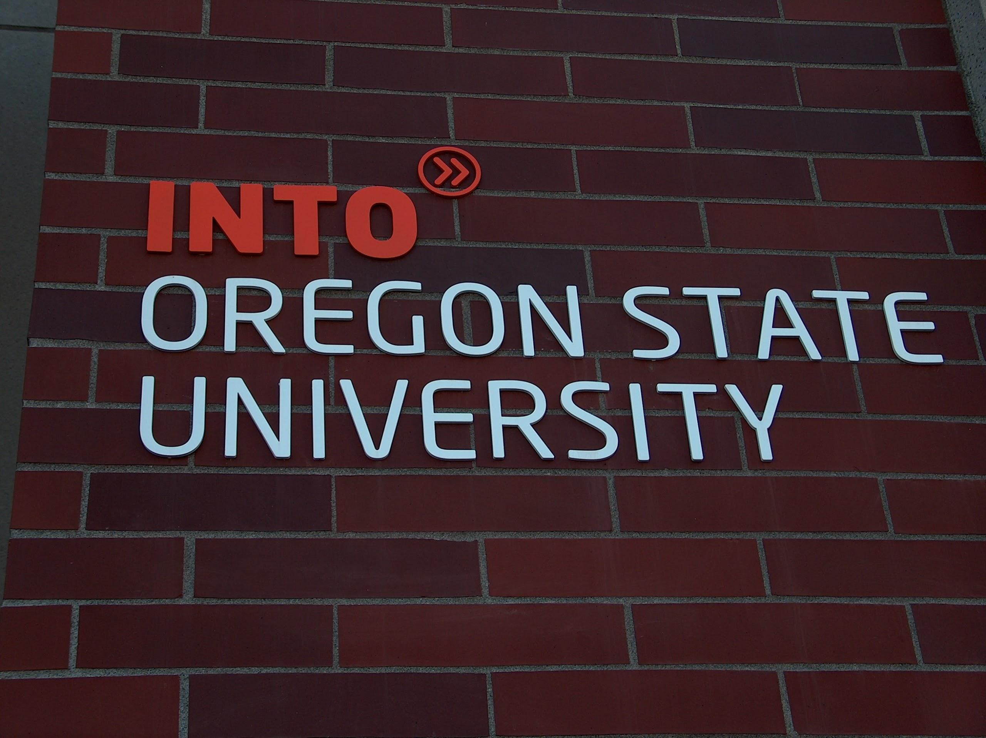
1,294 INTO Students
Public/private partnership
“Pathway” into OSU
1 of 6 US centers
Source: OSU Fall 2013 Enrollment Summary, Office of Institutional Research
take picture of ILLC entrance with INTO OSU signage
“INTO OSU” by Uta Hussong-Christian
Notes:
A significant factor in that enrollment growth has been OSU’s partnership with INTO OSU. OSU’s public-private partnership was the first of now 6 US partnerships (U South Florida, Colorado State, Marshall U, George Mason, Drew U) with the UK-based company. INTO University Partnerships Limited has higher ed academic partners also in the UK and Asia; INTO works with its higher ed partners to provides international students with intensive language training and routes or pathways to entry to the university at which the student is studying. As of Fall 2013, nearly 1300 INTO students were enrolled at OSU.
http://oregonstate.edu/admin/aa/ir/sites/default/files/enroll-fall-2013.pdf (pg. 19)

Slide 11
Portland State University - Top 5
Saudi Arabia 418
China 369
Kuwait 230
India 229
Japan 152
Source: Portland State University, Office of Institutional Research and Planning, Fact Book – Fall 2013

Slide 12
Waseda U & PSU Partnership
- OUS students attend Waseda while Waseda students attend PSU exclusively.
http://www.pdx.edu/ed-abroad/programs/ous-waseda-university
http://www.pdx.edu/transnational-programs/

Slide 13
Waseda U. Students at PSU
50 to 80 students - 3 terms with an optional fourth term.
PSU Library instruction for Waseda students for these required classes...
LOHAS - Life of Health and Sustainability
&TNP - Globalization... with either a social sciences or humanities emphasis that include film studies.
Waseda U. LibGuide - http://guides.library.pdx.edu/waseda?hs=a

Slide 14
Intensive English Language Program (IELP) at Portland State University

Slide 15
IELP- English Immersion
Level1 through the completion of Level 5 + IELP advisor recommendation = TOEFL equivalency
To be accepted into a PSU degree program
To be accepted into an English-speaking university or college
To improve English proficiency in order to interact more efficiently in the global market.

Slide 16
Instruction
Notes:
Both PSU and OSU support international students in a variety of ways. One of those ways in through instruction and the next segment of the presentation will focus on that. But to start off on this, I would like us to think more broadly than classroom instruction. And the reason why is that I think we commonly understand that many different interactions with students or library patrons are opportunities for teaching. At the Reference Desk, for example, we are not just giving out answers, we are teaching students or other members of the academic or local community to be effective information seekers.

Slide 17
English Language Proficiency Continuum
Foundation
Level 1
Level 2
Level 3
Level 4
Level 5
Level 6
simple isolated phrases/sentences
ideas communicated with appropriate/varied detail
Notes:
To help us understand the wide range of international students who may show up at our service point or in the classroom we need to know a little about the language training that some international students might be undertaking. At both PSU and OSU, there are intensive general english language programs, in addition to the regular academic programs, that attract international students. Students are placed into the appropriate level based on their language proficiency. INTO OSU uses the continuum represented here to do so and evaluates writing samples as a placement tool. So I got permission to share a handful of writing samples so that you can get a feel for the proficiency range of international students at OSU.
We’ll have you work in small groups to do a short exercise involving the writing samples. To do the exercise, break up into groups of 6. Each group member take one of the writing samples from the packet and read through it.

Slide 18
Language Rubric
Level | Criteria | Descriptor
Foundation Prep | Content (concrete) Word Use | blank or isolated words basic words misspelled
Level 1 | Content (concrete) Word Use | simple phrases/sentences basic words used correctly
Level 2 | Content (concrete) Word Use | use of basic connectors limited/repetitive vocabulary
Level 3 | Content (concrete) Word Use | weak topic sentences, no thesis some word form/choice errors
Level 4 | Content (concrete) Word use | thesis present but unclear vocabulary broadening
Level 5 | Content (concrete) Word use | clear thesis broad vocabulary/few errors
Notes:
Then as a group, rank your writing samples from lowest to highest proficiency according to rubric on screen.
A quick note about the rubric: it is much simplified from what is used by the INTO OSU staff for language level placement. Other criteria that are assessed include Content that is more abstract in nature, Organization and Structure & Grammar and Punctuation. Students are writing to address a prompting question and how well they address that question in building a thesis is assessed in Level 4 and 5.
Follow up discussion: how many of you have experience with english language learners on your campus? Do any of these language levels seem familiar among your patron base?

Slide 19
Library Instruction @ OSU
Notes:
Even though I no longer staff a reference desk, I’ve been there on several occasions when students on the lower end of that continuum have requested assistance finding items in in the library. But what Laurie and I and Kimberly are most often dealing with are students at the higher end of the continuum. And for those students, we, as librarians, support them in various ways through course-based instruction. At OSU, we’ve taken a multi-pronged approach to instruction and several of these efforts are specifically aimed at INTO students. These include:
WR 121
LibGuides
Censorship lesson

Slide 20
WR 121
INTO-specific sections (10 this spring)
assignments may vary
extended sections (110 minutes)

Slide 21
LibGuides
Academic English - Levels 5 and 6
support research-lite assignments
scalable instruction at this level
avoids multiple in-person sessions covering similar content
received well by instructors
Notes:
As word started getting out about our support for INTO students, we started getting calls from Academic English instructors to do instruction for their students, too. After responding to a few of these we got smart. The assignments are not research heavy but are similar enough to WR 121 assignments that we realized we were in trouble. There are a lot more of these courses than WR 121 (Spring 2014: Academic English Levels 5 & 6 - 11 sections; ALS INTO-specific sections for levels 5 & 6 - 19 sections). Also we didn’t want to duplicating WR 121 library session content as these students will likely come to OSU via the Pathway program. So we met with directors of instruction for the upper levels of Academic English came away with a plan to create libguides for Levels 5 & 6. These guides support both the instructors and the students doing the research-lite assignments. The instructor response was very positive and Laurie and I are happy to be able to scale instruction in a way that doesn’t make us crazy.

Slide 22
Censorship and Banned Books
5th Level General English Students
Two-Part Instruction
1. Introduction.
2. Conclusion.
Notes:
I visit the class twice, first when the book is assigned. I visit the class and tell the students why I am here and what a librarian does. I review the IFLA and ALA statements about freedom of information. I then discuss the book and controversy. For Part-Time Indian I brought a newspaper clipping about the possible banning of the book in Sweet Home Oregon.
For Part Two I come after the students have finished reading the book. I go into more detail about the Constitution, First Amendment. Have more information about the book, including a video or radio broadcast of the author speaking about the book. For Part-Time Indian we discussed the possible book banning in Sweet Home. We reviewed the district’s online procedure for banning a book and had a “mock” debate about banning the book.

Slide 23
Library Instruction at PSU Library

Slide 24
Library Anxiety- Preconceived Perceptions
Photo by KW-SC – Paris Street Art 2013

Slide 25
High Anxiety Research & Libraries
Defining “library anxiety” (Constance Mellon).
The “warmth” session (Mellon).
Creating “an environment for learner readiness” (Vidmar 82).
Mellon, Constance. (March 1986). Library Anxiety: A Grounded Theory and its Development. College and Research Libraries 47, 162-163. Vidmar, Dale. (1998). Affective Change: Integrating Pre-sessions in the Students' Classroom prior to Library Instruction. Reference Services Review, 26.

Slide 26
Tours
“...just bringing international students into the academic library for a ‘walk around’ tour can change their perception of services and make them feel more at ease about using them.”
Hickok, John. (2011). Knowing Their Background First: Understanding Prior Library Experiences of International Students. In Pamela A. Jackson & Patrick Sullivan, Eds. Internal Students and Academic Libraries: Initiatives for Success. Chicago, Illinois: American Library Association.

Slide 27
...degrees of Research Anxiety - from student research to faculty research
Photo by Jeffrey St. Clair (2012)

Slide 28
Home Base for Research
http://library.pdx.edu/

Slide 29
What the Library can do….
IELP course guide
Subject guides for graduate students
Classroom instruction & assignment support
Office hours & in-person consultations
Ask a Librarian

Slide 30
Brainstorm for Synonyms! - Pairs of students thinking about related terms together
http://lgdata.s3-website-us-east-1.amazonaws.com/docs/216/871641/thinkingtool.pdf

Slide 31
The ASE Research Model
Analyze -- Search -- Evaluate
Gross, Melissa, & Latham, Don. (2010). Attaining Information Literacy: Understanding and Responding to the Needs of Students. Retrieved from http://attaininfolit.org/

Slide 32
IELP Course Guide
a touchstone throughout their research process:
http://guides.library.pdx.edu/IELP?hs=a
Intended for undergraduate students, and can be directly linked within the D2L Library widget box upon request from the instructor.

Slide 33
Outreach

Slide 34
Office of International Students & Scholars Services (OISSS)

Slide 35
PSU Committee for the Recruitment and Retention of International Students
Mission statement:
The CIRR is a collaborative forum of professionals across colleges, departments, administrative units, and the library that advocates for international students within the University. CIRR evaluates the effectiveness of procedures and policies, making recommendations where appropriate to improve the international student experience.

Slide 36
PSU International Student Life Newsletter
Photo by Allen Hauser

Slide 37
Recommendations
(iie)

Slide 38
International Students at OSU: A Faculty Guide
Outcome of the OSU Intercultural Initiative
Brochure/guide a cross-collaboration led by librarian
Mailed to all faculty at OSU (4,500)
Highlighted library services
Notes:
I’ll bring samples.

Slide 39
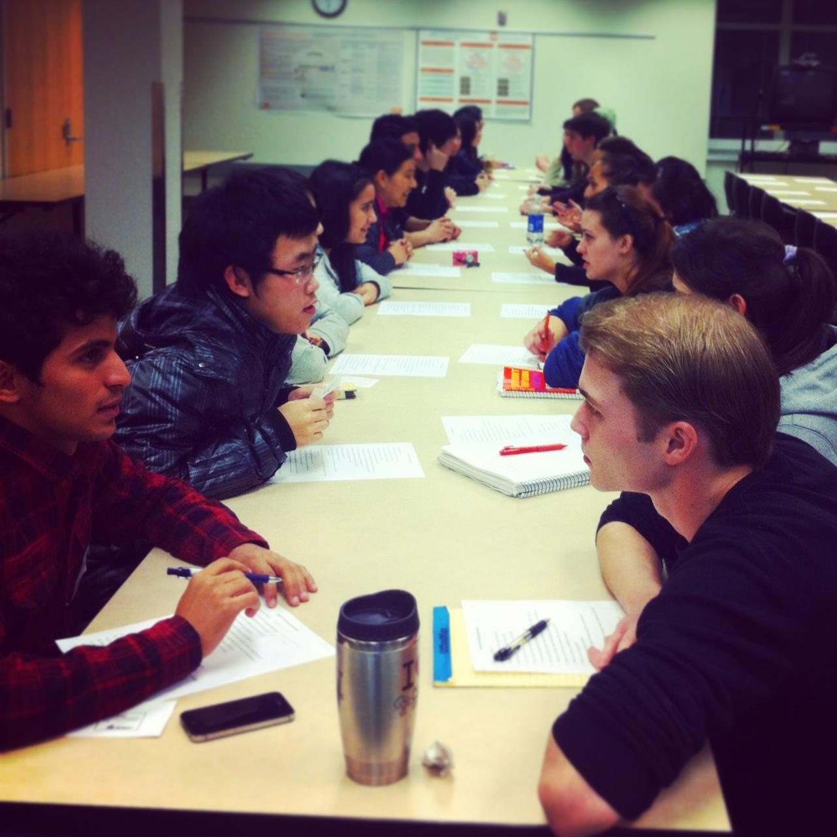
Speed Friending in the Library
Collaboration between Libraries and INTO OSU
Held in the library
Bring together students to create community in the library

Slide 40
Librarian Professional Development
Spring 2013: INTO OSU overview with INTO Academic Director
Summer 2014: Pedagogy session with INTO Academic Director
Notes:
Bob Gilmour, the Academic Director of INTO OSU speaks on campus about communicating with international students. I attended one of his seminars and subsequently invited him to speak to OSU librarians and staff, especially those who staff public service points. The session was well attended and we had good discussion.
Bob has since been presenting to academic departments about pedagogical techniques that best support international students. When I made contact to request the writing samples, he also offered to do a return visit with our staff focused on pedagogy. We’ll likely schedule this as a session for our annual Library In-Service in early September or as a session for our summer professional development Instruction Bootcamp
The point here is tap the folks you have on campus who work with international students regularly. They are great resources and it helps to build those relationships across campus that are so important.

Slide 41
Your Questions
Your Experiences

Slide 42
Laurie.Bridges@oregonstate.edu
Kimberly Willson-St. Clair, willsons@pdx.edu
Uta.Hussong-Christian@oregonstate.edu

