Slide 1
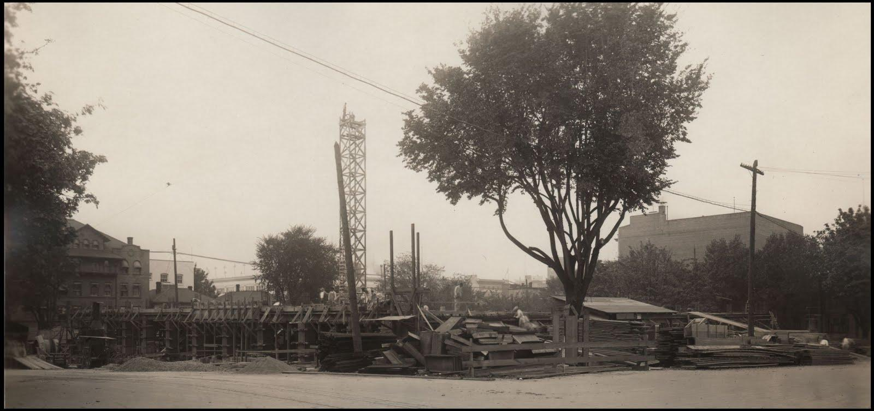
Starting from scratch with nothing
Our First Digital Collection
Rachael Short and Kate Schwab, Multnomah County Library
Notes:
Picture: Looking northeast from the corner of SW Taylor and 11th Avenue, September 21, 1912.

Slide 2
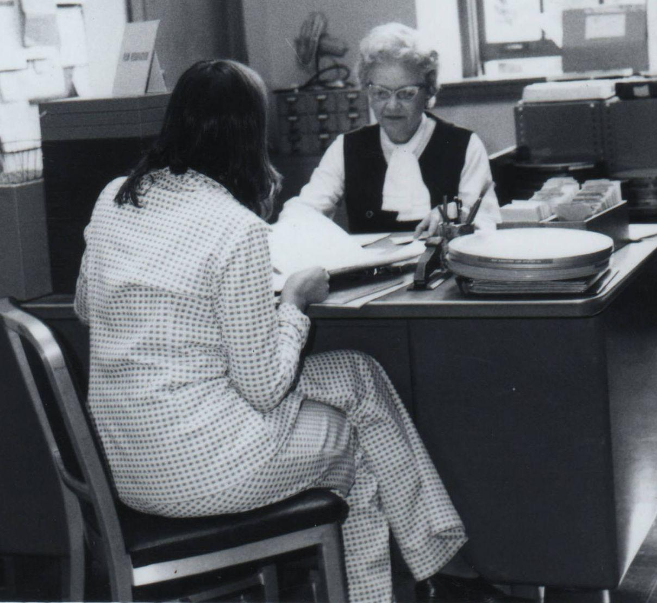
In July 2012 Multnomah County Library experienced budget cuts that led to deep reductions in staff and hours.
The Centennial of the Central Library, “Portland’s Crown Jewel,” was approaching.
A sputtering torch was grabbed by two paraprofessionals/ library school students.
Notes:
image: patron selects a film in the group services department 1974 http://cdm16493.contentdm.oclc.org/cdm/singleitem/collection/p16493coll1/id/59/rec/5

Slide 3
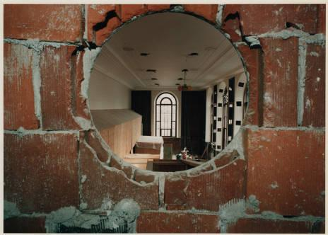
Lessons learned
Plan first, then do
Document, document, document
Use what you have
Notes:
Hole in the wall, Central Library renovation: http://cdm16493.contentdm.oclc.org/cdm/singleitem/collection/p16493coll1/id/43/rec/39

Slide 4
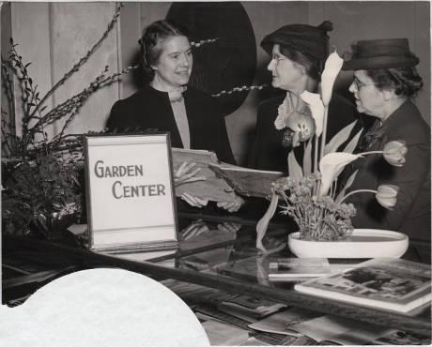
Plan first, then do
Resist the urge to “just get started”
Create a plan. Write it down.
Planning takes time. But it also saves time in the long run.
Notes:
Garden Center, Central Library: http://cdm16493.contentdm.oclc.org/cdm/singleitem/collection/p16493coll1/id/33/rec/36

Slide 5
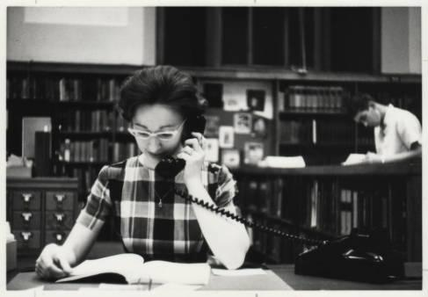
Plan first, then do
Reach out to people and orgs who have done it before.
“Borrow” and adapt documentation.
Research the easy stuff and ask about those murky questions.
Notes:
Librarian on the telephone: http://cdm16493.contentdm.oclc.org/cdm/singleitem/collection/p16493coll1/id/30/rec/1

Slide 6
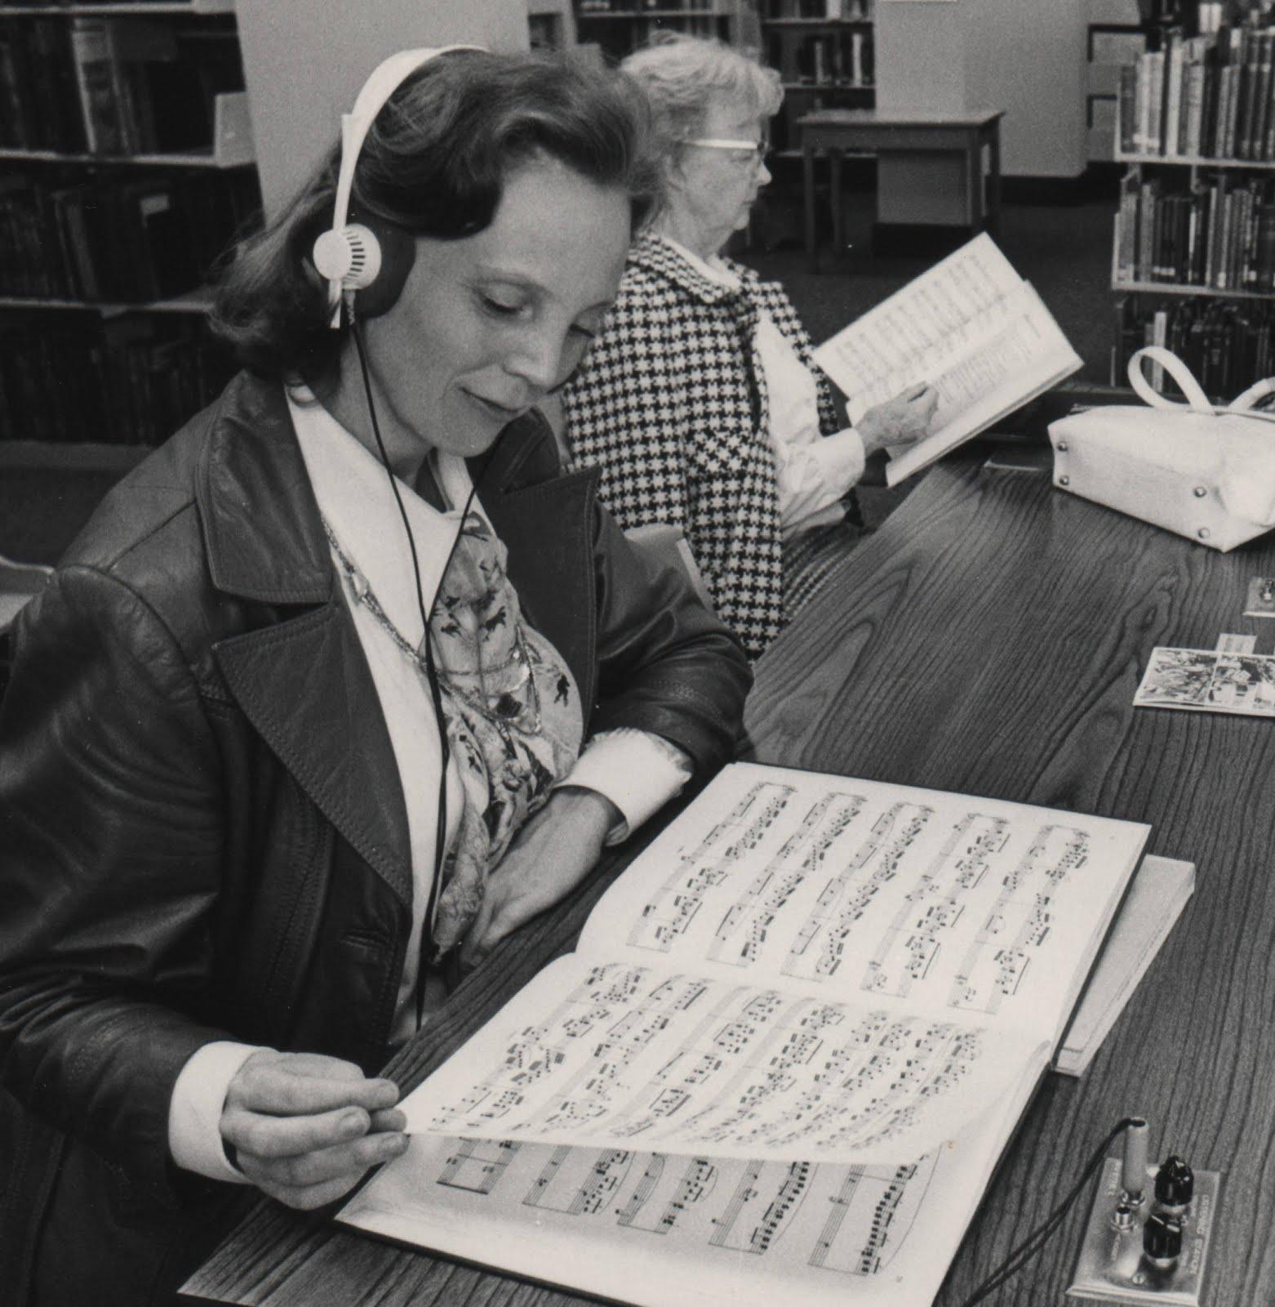
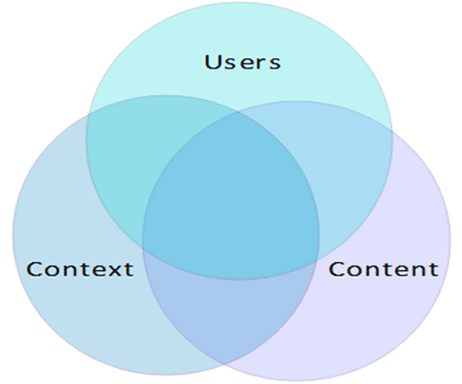
Plan first, then do
Notes:
image: Two women at listening station. 1976.
http://cdm16493.contentdm.oclc.org/cdm/singleitem/collection/p16493coll1/id/101/rec/7

Slide 7
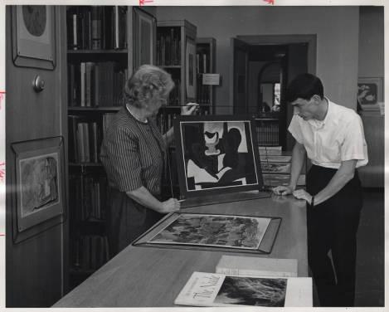
Plan first, then do
Select before digitizing.
Create selection criteria that reflect project goals.
“Selecting everything” is fine if that supports goals
Notes:
Patron and librarian view art: http://cdm16493.contentdm.oclc.org/cdm/singleitem/collection/p16493coll1/id/34/rec/59

Slide 8
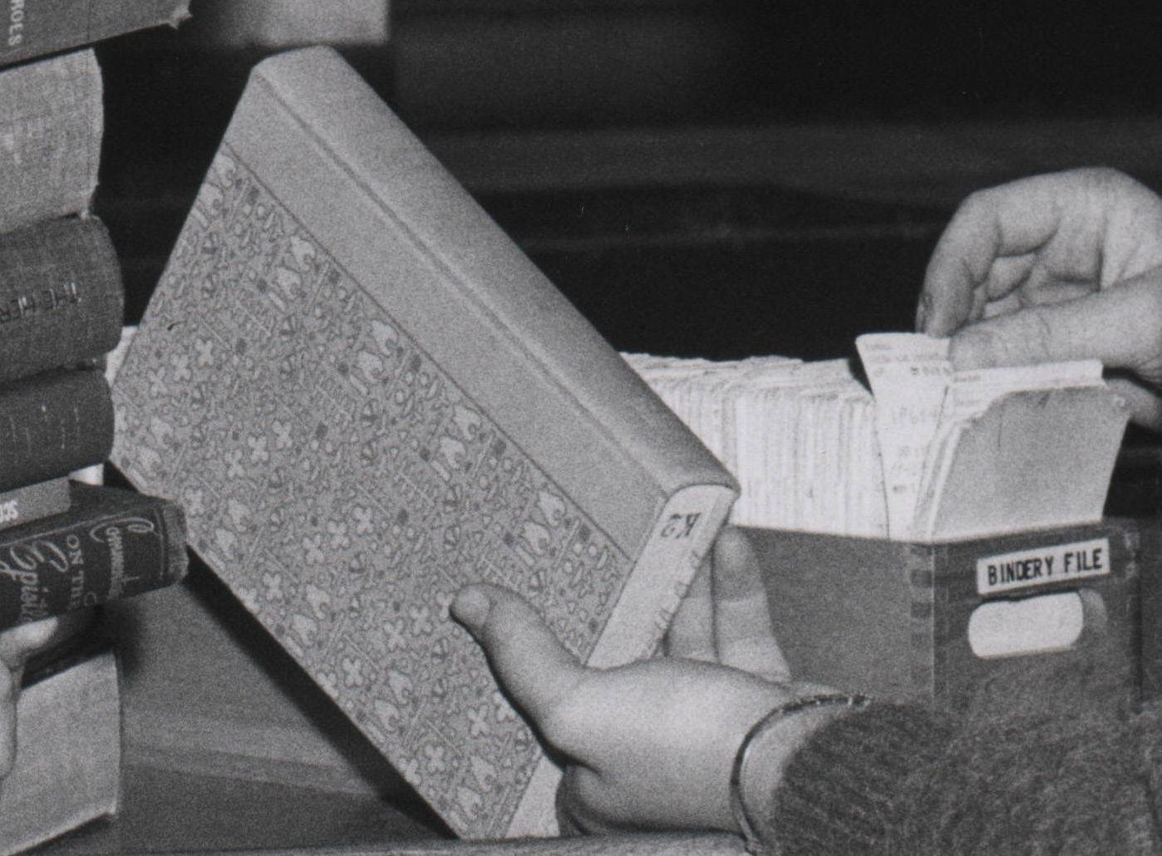
Plan first, then do
Technical specifications & Processes.
Seek out best practices.
Develop a naming convention and file organization structure.
Notes:
Image: Stack service: the way to find things is to look http://cdm16493.contentdm.oclc.org/cdm/singleitem/collection/p16493coll1/id/85/rec/1

Slide 9
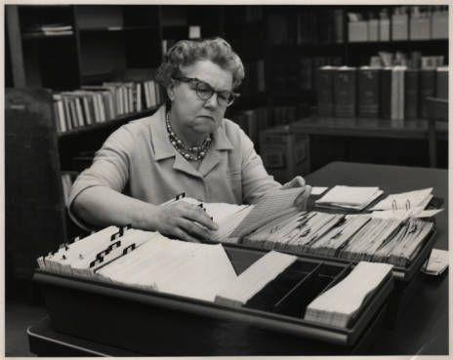
Document, document, document!
If it isn’t recorded, did it happen at all?
Not recording a decision is the first step towards not following through.
Notes:
image: Central Library Order Department http://cdm16493.contentdm.oclc.org/cdm/singleitem/collection/p16493coll1/id/75/rec/2

Slide 10
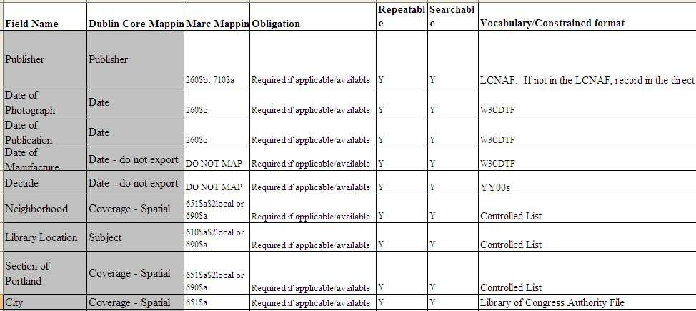
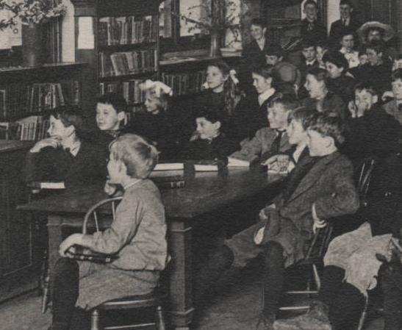
Document, document, document!
Notes:
image: Children listening to librarian http://cdm16493.contentdm.oclc.org/cdm/singleitem/collection/p16493coll1/id/88/rec/10

Slide 11
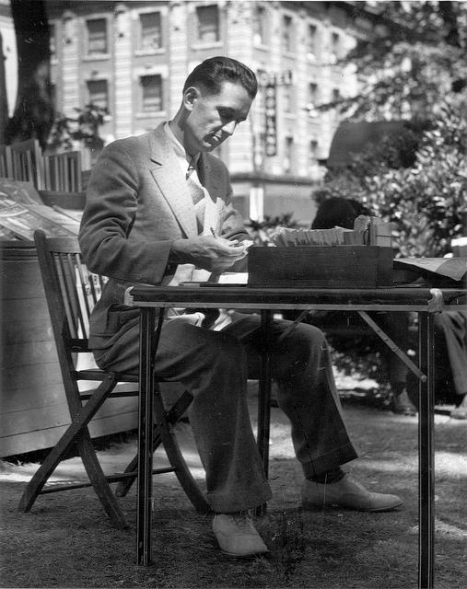
Document, document, document!
Create a manual or other guidelines for metadata creators.
Share key decisions and progress reports widely.
Notes:
Outdoor Reading Room, August 1939: https://www.flickr.com/photos/multnomahcountylibrary/5787770581/in/set-72157626687706709

Slide 12
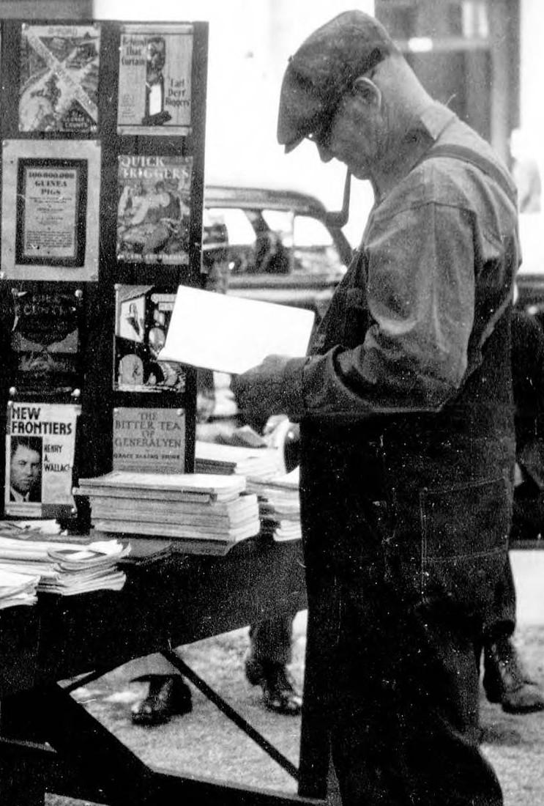
Use what you have!
Take advantage of the resources at your disposal!
Notes:
image: Patron at the Umbrella Branch http://cdm16493.contentdm.oclc.org/cdm/singleitem/collection/p16493coll1/id/50/rec/4

Slide 13
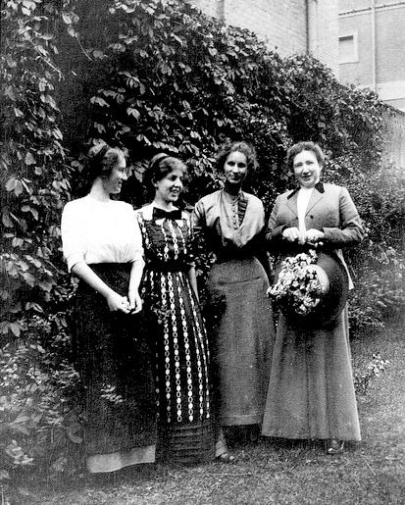
Use what you have!
Assess the skills you already have.
Spread out the work and borrow expertise.
Notes:
Library circulating department https://www.flickr.com/photos/multnomahcountylibrary/5786720451/in/set-72157626687706709/
Assess the skills you already have.
At the individual, group, and organizational level.
Knowing who has what skills in advance will help in planning. You can’t plan for something you don’t have the skills in place to do.
There are some things that training would take too long to accomplish and you may need to make choices about your project based on the skills and capacity you currently have.
Spread out the work and borrow expertise.
Assemble a team of people who are ready and willing to help with the work.
Find out what people want to work on and try to give them work that suits their strengths and interests.
Keep them in the loop even if you can’t use them right away--there should be no surprises.
The more people on your team the better your system of communication and project tracking has to be.
What can you do if you can’t assign work to your colleagues?
Asking people to contribute their expertise in small doses, focused only on what they have a direct conne
You may not be able to get one a cataloging librarian to create metadata for the entire project, but you can consult with her about best practices.
Arlene: interface
TJ: metadata experience (the only person with any real-world experience with digital libraries!)
Steph, Lucien, Andrew….
Central experts!

Slide 14
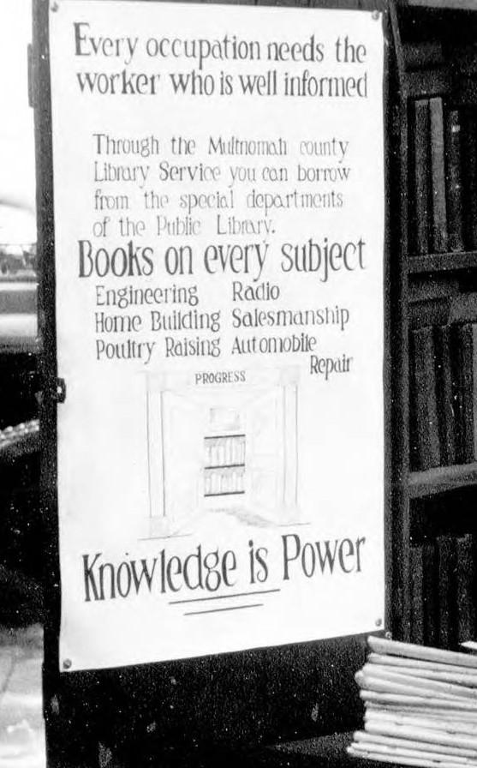
Use what you have!
We had a staff who were experts on the place we were describing!
We needed to harness all of that knowledge, so we crowdsourced descriptions.
Notes:
image: Patron at the Umbrella Branch http://cdm16493.contentdm.oclc.org/cdm/singleitem/collection/p16493coll1/id/50/rec/4

Slide 15
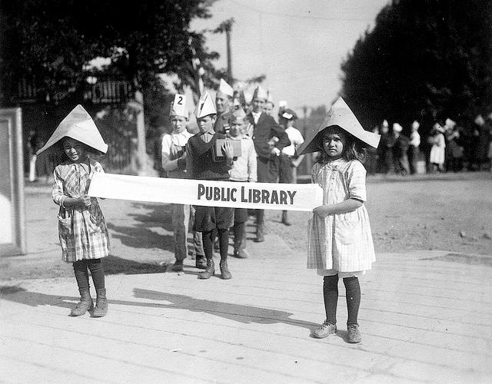
Use what you have!
Engage your community of volunteers.
Match their interests and skills to your needs.
Notes:
South Portland Library opening, 1921: https://www.flickr.com/photos/multnomahcountylibrary/5782891539/in/set-72157626687706709
Engage your community of volunteers.
Why use volunteers?
They are interested in helping with this work and will bring skills and perspectives to the table that staff won’t.
Volunteers have the time to learn something that staff may not be able to learn.
Their time won’t get preempted if they are dedicated project volunteers.
Your organization may already have a process for recruiting volunteers and support for managing volunteers.
Volunteers do need to be managed, so make sure that you make time for that.
They are there because they want to be, not because they’re being paid.
My ultimate tip for working with volunteers is to say “thank you” every time you see a volunteer and with every message you send.
Match their interests and skills to your needs.
Provide work that is engaging
The definition of engaging varies from person to person. Ask them which tasks they’d like to do or which they’d like to do first, if there is an option.
Allow them to make your process better and your work smarter.
Created a list of controlled vocabulary that we had used.
The volunteers for this project were truly an example of using what you have because all four of them were already volunteers in our library system in other capacities. Three of the four of them were either library school graduates or current students.

Slide 16
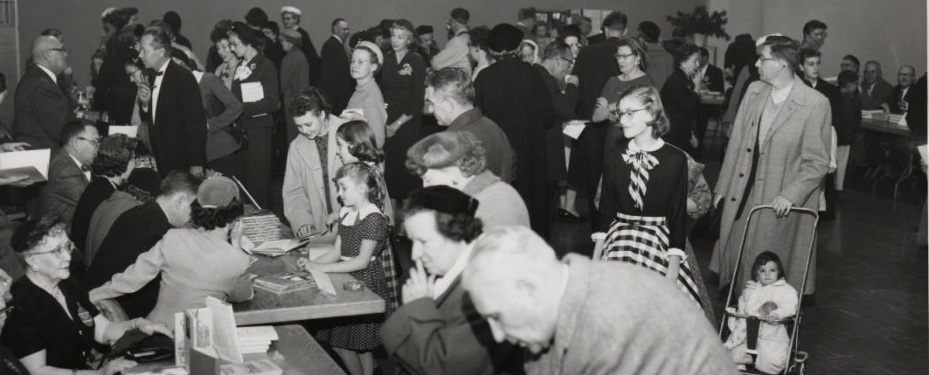
You can do this, too!
Notes:
image: National Book Week Autograph Party http://cdm16493.contentdm.oclc.org/cdm/singleitem/collection/p16493coll1/id/67/rec/1

