Slide 1
The State of Library Assessment in Oregon
2014 Oregon Library Association Conference
Sponsored by:
OLA Library Assessment Round Table

Slide 2
Presenters
Rick Stoddart
Assessment Librarian – Oregon State University
Meredith Farkas
General Education Instruction Coordinator - Portland State University
Lorie Vik
Virtual Services Librarian – Eugene Public Library
Sara Seely
Faculty Librarian – Portland Community College

Slide 3
Community of Assessment
Library assessment is…
A process to develop shared meaning.
About outcomes.
A means of communication.
Something we learn from each other.
An agent for positive change. (Libraries make things better!)
Better when shared and supported by others.
A collaborative process.
A continual process of learning and re-learning.
An inspiration for future direction.

Slide 4
Library Assessment in Oregon
OLA – Library Assessment Round Table
Started in 2013 – great momentum
LUAU - Library User-experience & Assessment Un-conference
Orbis Cascade Alliance event held in April 2014
ILAGO – Information Literacy Advocacy Group of Oregon
Information Literacy Evidence Page –
http://ilago.wordpress.com/resources/il-evidence/
Information Literacy Summit 2014 (5/5)
“Assessing threshold concepts for information literacy”
Working Session

Slide 5
State of Library Assessment
OLA Library Assessment Survey 2014
Asked:
Who you are?
What are your top two assessment priorities?

Slide 6
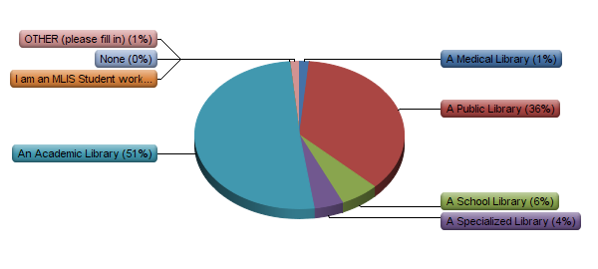
Question: Who are you?
67 responses

Slide 7
Assessment Priorities (roughly)
Assessment Related to Education (48%)
Instruction / Student Success / Information Literacy
Library Services & Programs (26%)
Reference / Resource Sharing / Outreach/ Programs
Collections (13%)
Other overall areas:
Communicating Library Value, Technology, Specific User Populations, Community Needs, Staffing
Public Library “trends”:
Community Needs, Program Evaluation, Funding

Slide 8
Community of Assessment
Panel
Each has 10 slides (or so) to show an assessment related project
Inspire – Share – Learn From
Hold your questions ASK AWAY!
We’ll have time at the end to ask questions
I have a list of my own

Slide 9
Plain and Simple Assessment at PSU
Meredith Farkas

Slide 10
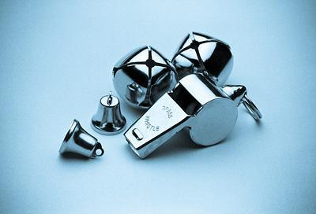
“Silencing the bells and whistles”
http://www.stokessigncompany.com/bells-and-whistles

Slide 11
My philosophy of assessment
Learning and improving are the goals
Small is beautiful
Start where the light is best
Perfect is the enemy of the good enough
Lots of little measures are usually more valuable than one big project

Slide 12
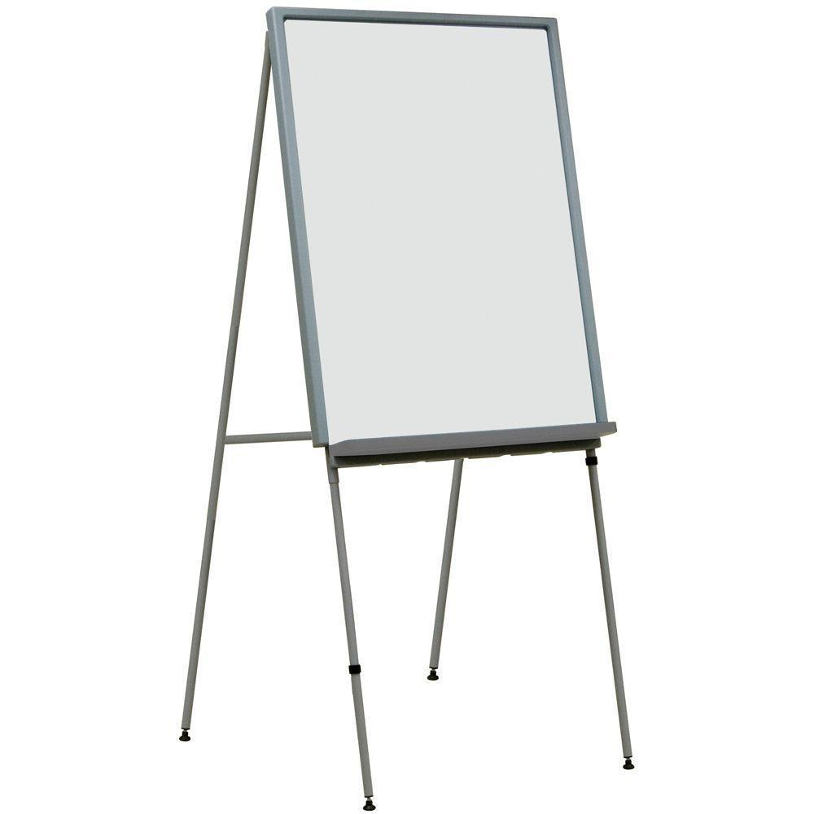
Whiteboard feedback project

Slide 13
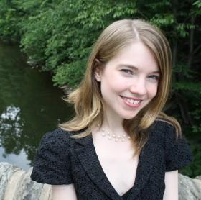
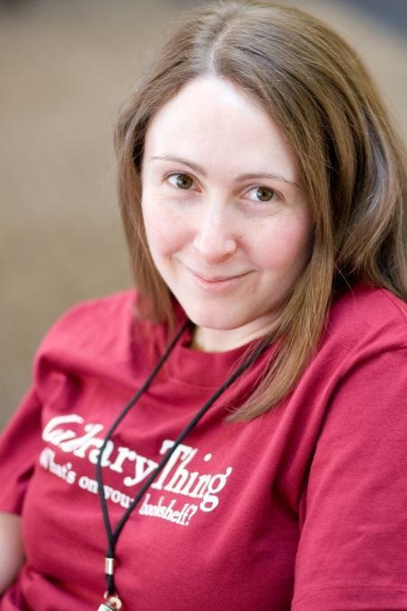
Who?
Lisa Molinelli
Meredith Farkas

Slide 14
What?
Put up whiteboard easels with giant sticky pads in three locations in the library.
Put prompts on each
Tied pens to each easel
Pretty easy, huh?

Slide 15
Our prompts
What do you like best about the library?
What did you come to the library for today and did you get what you needed?
What can the library do to better meet your needs?
Why do you come to the library?

Slide 16
One I wish we used (and will in the future)
Without the library…

Slide 17
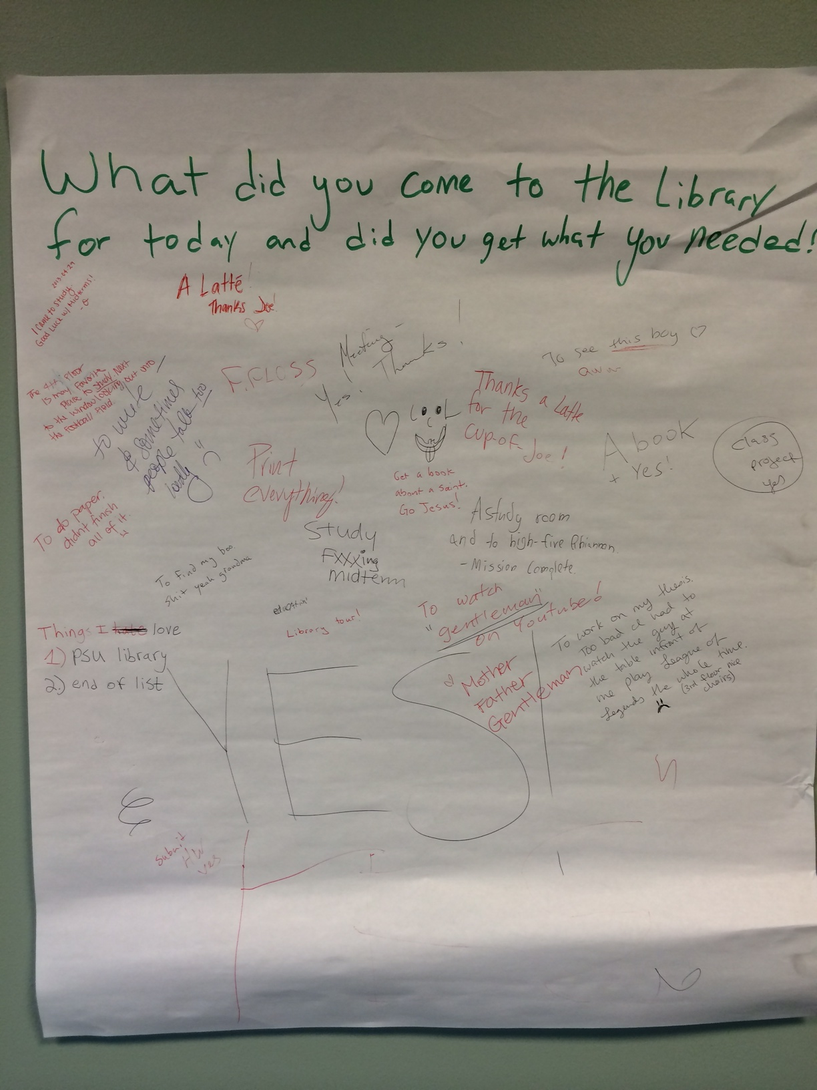

Slide 18
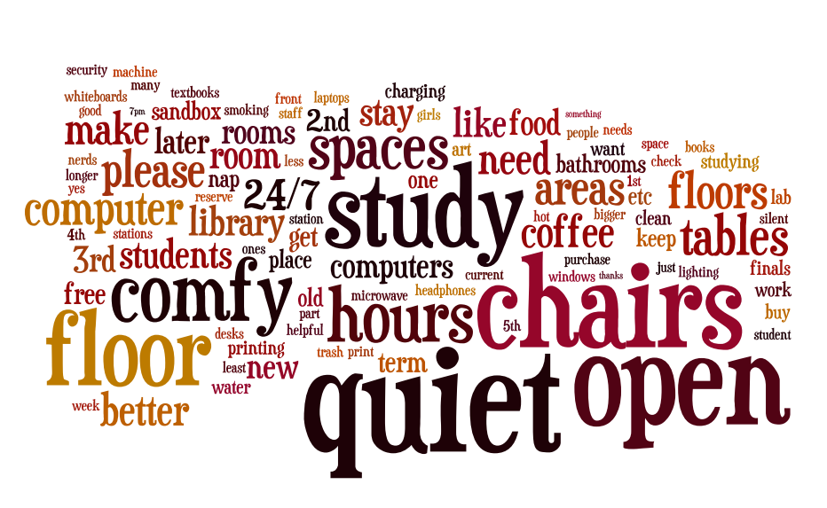
What our students want

Slide 19
Biggest surprise
https://www.flickr.com/photos/17305559@N00/176382627/

Slide 20
Other recent assessment work at PSU
Periodic usability testing
Focus groups
Assessment of individual instruction sessions
Card-sorting to reorganize our website
Ethnographic study of returning
students
LibQual

Slide 21
The Dog & Pony Show Demonstrating the Value of Your Library
Lorie Vik
Virtual Services Librarian
Eugene Public Library
lorie.a.vik@ci.eugene.or.us | 541.682.6616
OLA 2014

Slide 22
Notes:
We learned that city staff were spending money on resources the library offered for free.
Images:
R-G Article
HBR
AP Stylebook

Slide 23
Notes:
We hatched a plan we affectionately called The Dog and Pony Show.

Slide 24
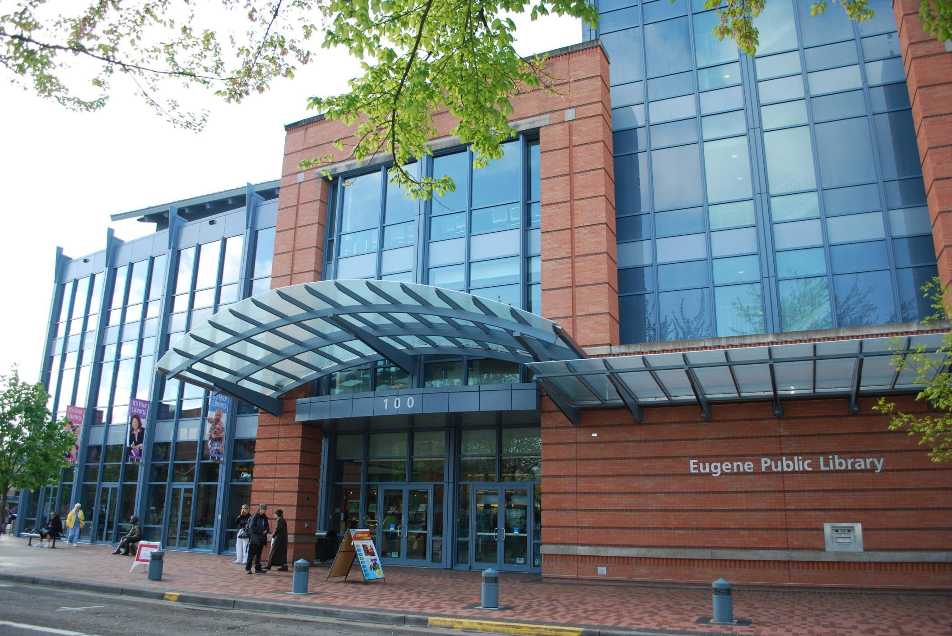
Hello!
We’re over here!
Notes:
Here we were, but there was so much about that staff didn’t know.
We had to take the show on the road and meet our users where they were.

Slide 25
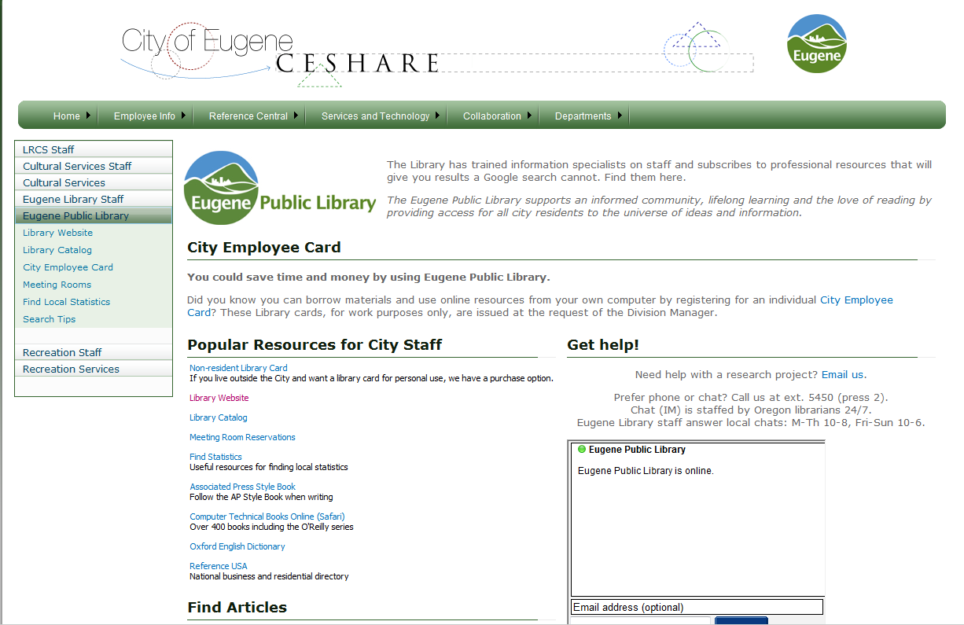

Slide 26
Adaptive Recreation
Triple Bottom Line
Goats and Weeds

Slide 27
Research Examples
Youth homelessness statistics and costs
Skate Park business consultants
Effect of exercise on the brain
Search alert in Gale databases for Eugene, Oregon parks
List of local giant “Ducks on Parade”

Slide 28
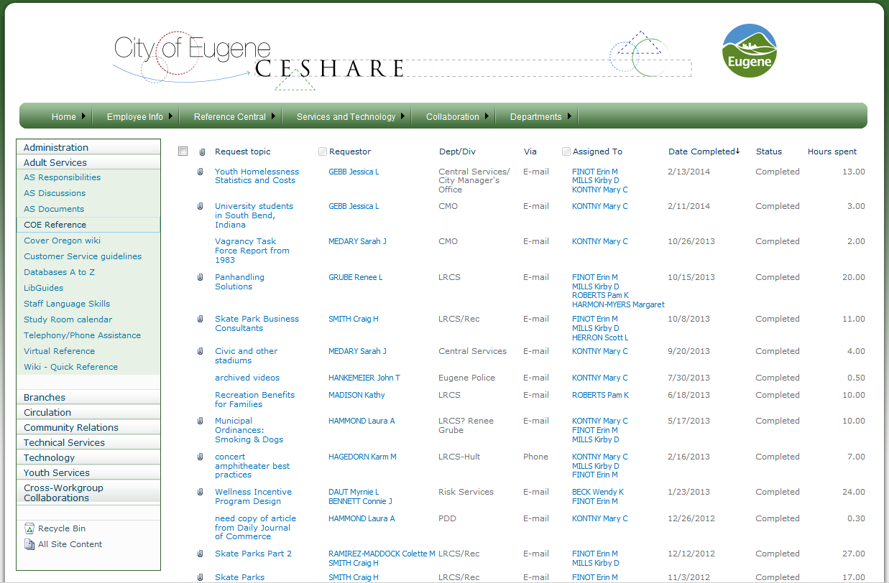

Slide 29
$2.95
$89.00
$3,000
Notes:
1 Register-Guard article - $2.95
Annual subscription to Harvard Business Review - $89.00
Third-party contract fees saved - $3,000
Knowing the library is there for you - Priceless

Slide 30
Knowing the library is there for you…
Priceless

Slide 31
Lorie Vik
Virtual Services Librarian
Eugene Public Library
lorie.a.vik@ci.eugene.or.us 541.682.6616

Slide 32
developing information literacy
Portland Community College Sara R. Seely

Slide 33
information literacy program assessment
Frameworks
PCC’s Core Outcomes & Learning Assessment Council
information literacy in
course outcomes
Inspirations
Curiosity about teaching
“To what extent do students care where their information comes from?”

Slide 34
WR 121 & WR 122
course outcomes
“Locate, evaluate and use information effectively and ethically...”
“Evaluate source materials for authority, currency, reliability, sound reasoning and validity of evidence.”
curiosity
What words do students use to describe why they select one source over another?
What do students value in a source?

Slide 35
source selection survey
winter 2013
over 200 student responses
at least 38 WR121 & WR 122 courses
~20% response rate

Slide 36
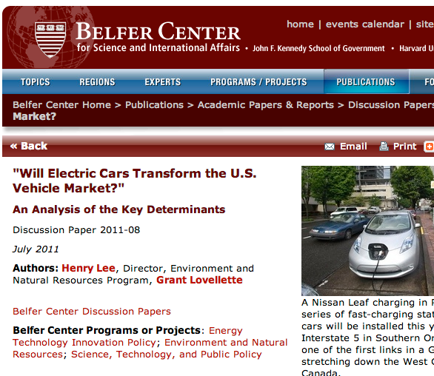
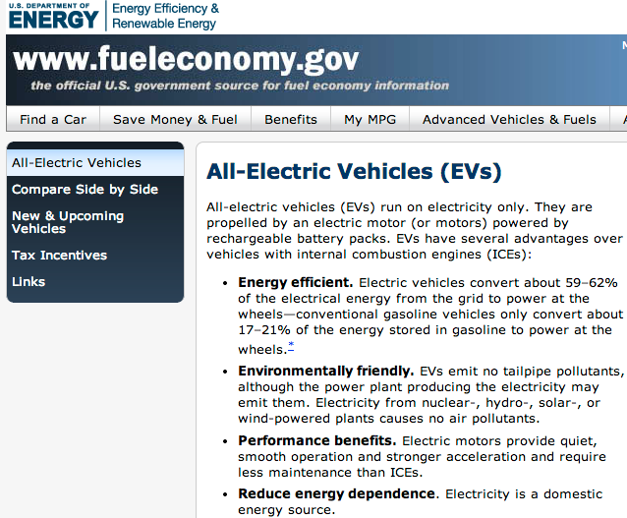
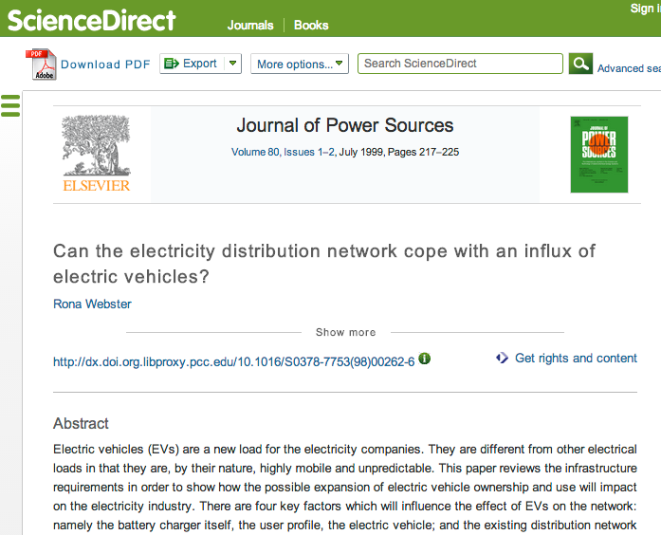
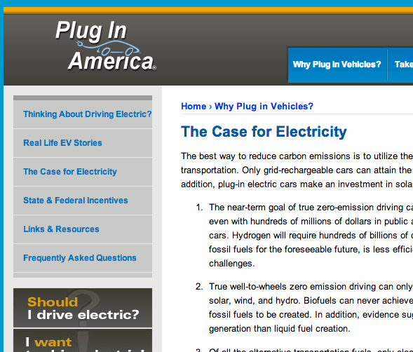

Slide 37
considerations
credibility
content
format

Slide 38
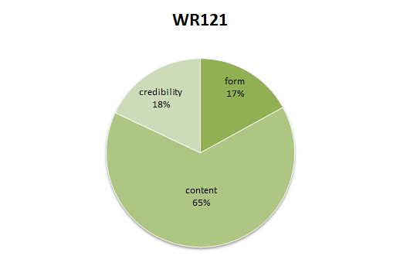
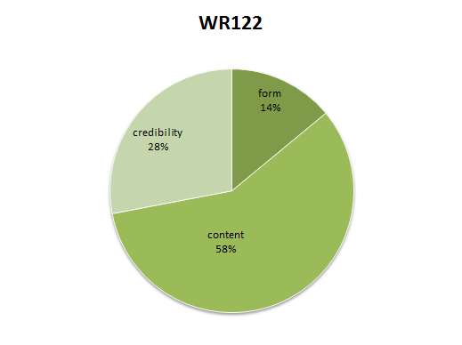
68% selected the best source

Slide 39
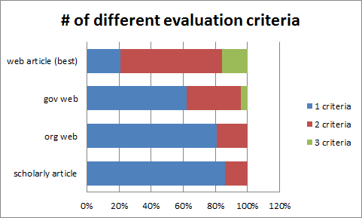

Slide 40
Notes:
so I our next step was to ask ourselves that same question - what are the key considerations we make when selecting a source?
what are the clues we look for that help us determine the format and consider credibility?

Slide 41
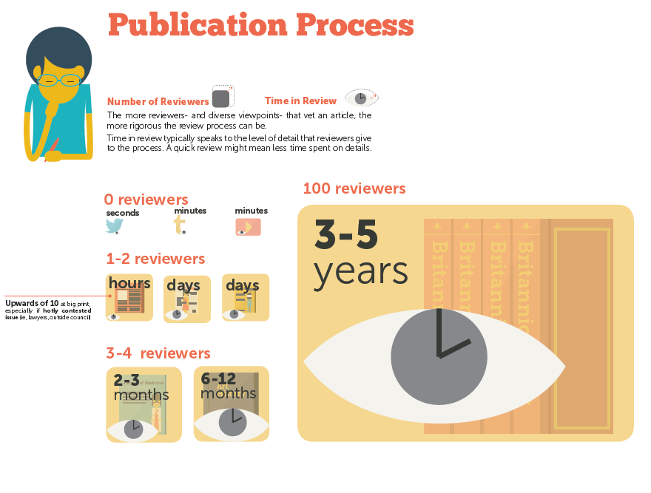

Slide 42
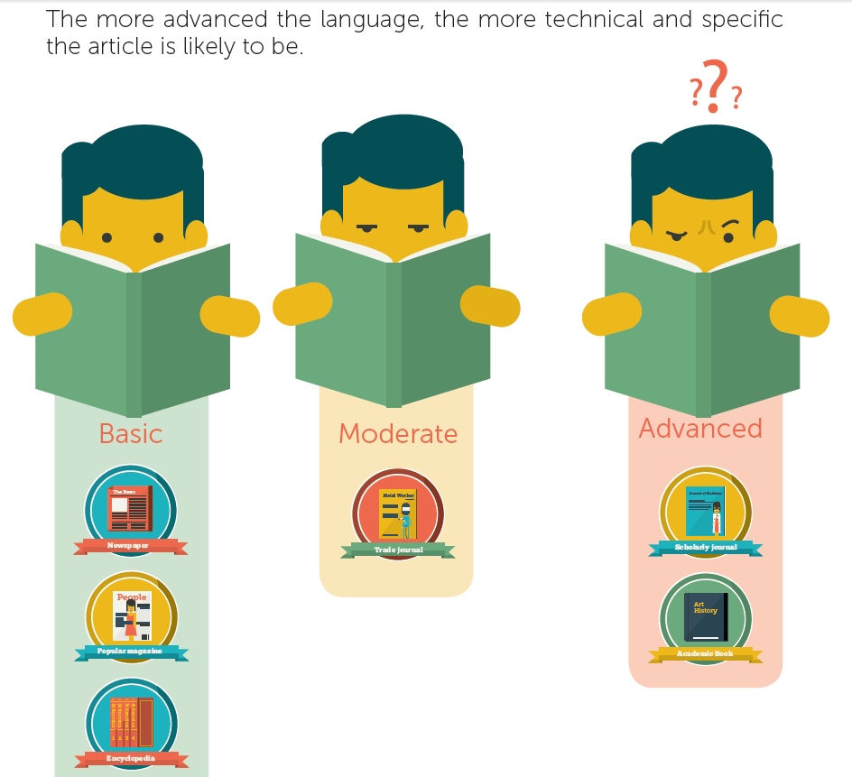

Slide 43
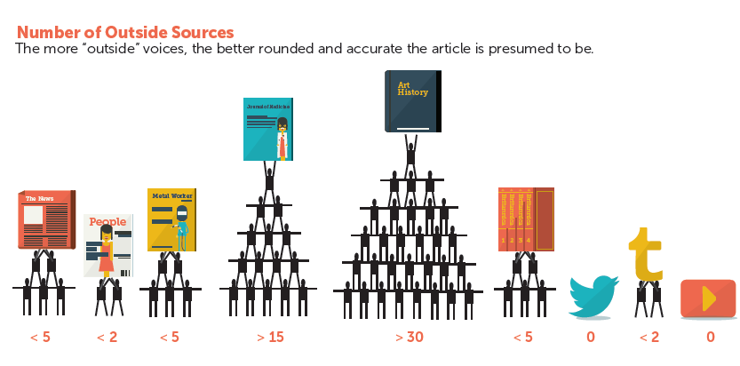

Slide 44
related work at PCC
research support framework
formative assessment of instruction sessions
building a culture of assessment
peer-review article assessment
outside the library
Assessment Learning Council
Curriculum Committee
collaborative assessment efforts

Slide 45
Questions? - Discussion
QUESTIONS? - DISCUSSION
Questions? - Discussion
Image from: http://contentbydawn.com/

