Slide 1
Brushing up on Social Services Information for Patrons
A Primer for Librarians
Holly Freewynn, MLS, MUS

Slide 2
OBJECTIVES FOR THIS SESSION:
Learn some language and wording essential when approaching social service and other agencies
Discover some eligibility criteria of the programs our patrons may navigate
Explore strategies patrons can use to access services
Learn where and how to connect patrons to the specialists in the area of interest
Take home a whopping list

Slide 3

What may worry patrons….

Slide 4
A quick note about acronyms
They are ubiquitous and change often in social services and are used ALL THE TIME between workers and agencies
There are often acronyms that have different meanings
EXAMPLE:
AR – Applicant /Recipient – from Medicaid
AR – Accounts Receivable – billing, state agencies

Slide 5
Where to start???????

Slide 6
Maybe at
Information and Referral
Where human service
inquiry often begins

Slide 7
I&A, I&R, Outreach, etc…..

Slide 8
SCENARIO
An adult daughter patron calls to find out how to access services for her elderly parent who lives in Oregon.
Possible routes to send this patron, based on an excellent reference interview:
In-home care agencies
  Medicaid office referral
    SHIBA volunteer – to understand elder’s medical coverage
        Potential home modification for physical needs

Slide 9
Information and Referral exists in most areas
Guided by evolving best practices
2-1-1 and others use a taxonomy created for human services
Oregon patrons can access social services via 2-1-1 and local entities
Local agencies have I&R workers of their own, too

Slide 10
Oregon I&R – have THIS on hand
2-1-1 can be accessed by calling 211, or at http://www.211.org/
Local human/social service agencies – can be found by calling
1-855-673-2372

Slide 11
Going more in depth
What is out there, and how do our patrons get to it?

Slide 12
SCENARIO
An elder patron who is a veteran with mobility issues lives with adult child (who works part time as a caregiver in facility ) and two minor children – one child has a developmental disability. They live in Roseburg, Oregon.
Adult daughter is inquiring about access to start looking for assistance.

Slide 13
Scenario – cont.
This family might get benefits/services from:
Veterans Administration medical and other offices
Douglas County Health and Senior Services Departments
Roseburg Public Schools – Special Education (Title I)
UTrans Direct – paratransit for disabled applicants
SNAP – nutritional help – federal program administered within the state
Case management – may be different offices depending on person being served
Low-rent program

Slide 14
Agencies and offices and services, oh my – not exhaustive!
Some categories for help:
Aging or elder issues
Domestic violence
Children’s services
Mental health and addictions
Consumer advocacy
Family services
Tribal affiliation
Legal aid
Food, nutritional support
Health, dental care
Military service
Refugee and immigration status
Transportation
Utility help
Homelessness status

Slide 15
Who are the agencies?
Federal government
State offices
County & tribal agencies
Health departments
Quasi-governmental entities
Churches /faith groups
Non-profit groups
Contract agencies

Slide 16

People to services
Bridging
the information gaps
_ _ _ _ _ _ _ _

Slide 17
Oregon Vital Statistics and Public Records

Slide 18
State of Oregon Records
  Birth certificates are the primary documents to prove identity – (then state issued identification)
  Birth certificates can be ordered by phone, mail, internet, in person
  Other records to be ordered include marriage, divorce, domestic partnership, death
  There are eligibility requirements for ordering
  Forms can be downloaded from web

Slide 19
Patron born in another state or country
Another state or territory:
This can be accomplished through the Center for Disease Control site:
http://www.cdc.gov/nchs/w2w.htm
U.S. Citizen born abroad:
Requires filling out a form, FS-240
Non-US Citizen needing documents:
Patron needs to contact consular for home country

Slide 20

Oregon Dept. of Motor Vehicles
DMV – if patrons just need a new license or ID
Fees
  For driver’s license (good for 8 years) $60.00 new, or $40.00 renewal if not past a year
  For ID card (good for 8 years) $44.50 new, or $40.50 renewal
  Disability
  placard
  DMV site has
  information
  on auto insurance

Slide 21
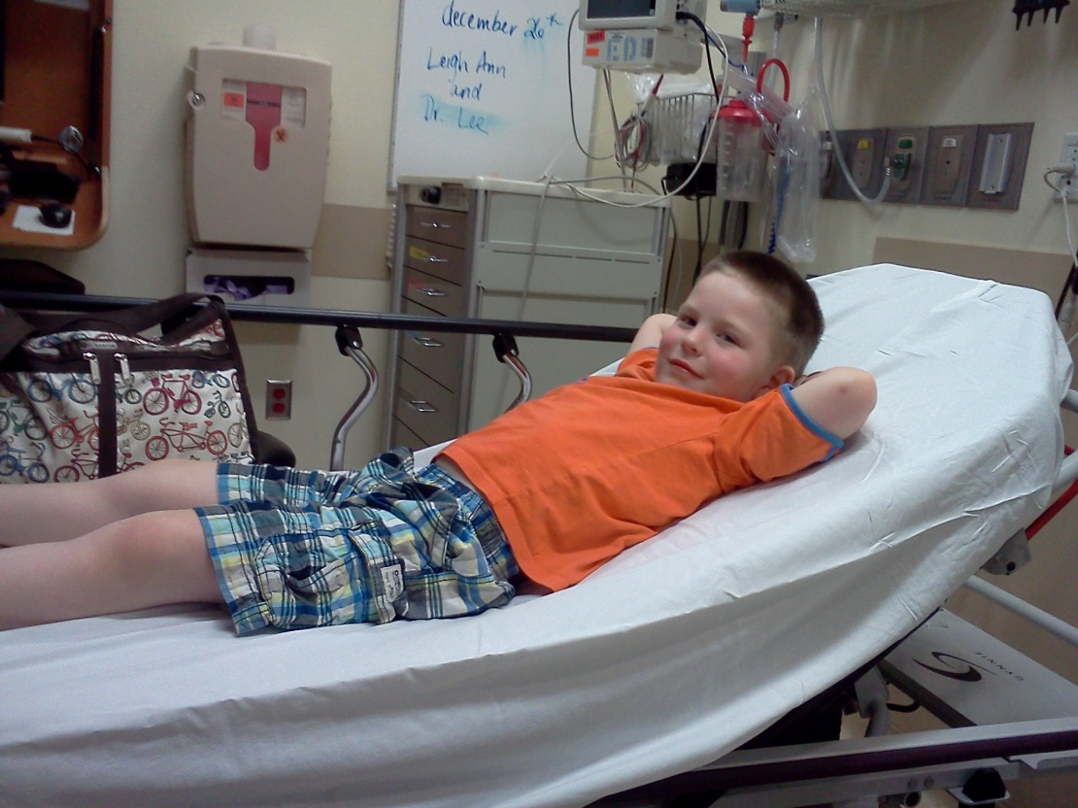
Health Care for All

Slide 22
Medicare & Medicaid –
What’s the difference?
Medicaid
Medicare
Historically, it was used by older adults to access nursing facility care
Now, more options
Income and asset based
Administered by states
Provides a wide range of health coverage
Some Oregonians get health care
Aged 65 or over, also some support for people who have disabilities
Typically covers doctor visits, limited hospital care
There are provisions to help cover Medicare premiums and co-pays

Slide 23
Health Information & Advocacy
CoverOregon
Health Advocacy
SHIBA – to help Medicare enrollees
Centers for Medicare/Medicaid Services
Condition specific agencies
Multistep process
Site is very navigable
There are trainers
Insurance agents can help

Slide 24
Income and Subsistence
Safety net and help with making up the gaps……

Slide 25
Social Security
Alphabet soup = SSB, SSD, SSI
Applying can be time consuming - some decisions = YEARS
Caveats:
    Compassionate Allowances
    Survivors of beneficiaries
    Children with disabilities
EXPLORE THE WEBSITE – www.ssa.gov

Slide 26

Oregon Unemployment
Filing can be online, by phone
There are requirements to apply for jobs, be available for work, etc.
Claimants are responsible for following the law
Can request a hearing if denied
ASK FOR HELP

Slide 27

SNAP – Formerly Food Stamps
Help buy food
Supplemental !!
Avg. monthly benefit = $235
100% benefit paid by feds

Slide 28
Veterans Benefits
Income, health care and other assistance

Slide 29


Basic VA services
Benefits for service
Burial
Cemeteries
Health care
Education
Home Loans

Slide 30
Helping Oregon veterans
County and city help for veterans
Experts on veterans law
Oregon VA site has locator
Cemeteries – 3 in Oregon

Slide 31

Transportation
INDEPENDENCE
Rural areas have special concerns
Oregon TripCheck
Consider using 211 service

Slide 32



Utilities
Public Utility Commission – administers some financial help
There is Low Income Energy Assistance Program – LIEAP – that helps with heating assistance
Oregon HEAT – program to donate oil and other help

Slide 33
Housing
Oregon Housing and Community Services
Landlord/Tenant
Advocacy
Shelter supports
Foreclosure prevention
Manufactured home park resource
Energy assistance
Weatherization
How to be a renter
Consequences of eviction -create long-term challenges
Rights of tenants
Housing discrimination
Mobile home park rules

Slide 34
Consumer Protection
Next section:
Attorney General site
Staying free of scams
Licensing help
Doing business safely in Oregon

Slide 35
Oregon Attorney General
Priorities for Oregon Department of Justice:
  Advocating for vulnerable citizens
  Support district attorneys in prosecutorial duties
  Assist in child support recoupment
  Aid victims of crime
  Fight scams and fraud, bad business practices
    Within the ODOJ, there is the Consumer Protection arm

Slide 36
OR Department of Justice - continued
Some consumer protections:
Lemon Law
Three day rescission/cancellation
Mortgage and foreclosure fraud

Slide 37
When a professional is THE problem
There are many licensing boards in Oregon
Many people who need a license to work can be searched online
Popular licenses to know about finding include contractors, landscapers, collection agencies, childcare providers

Slide 38

Financial exploitation – some tips
Prevention is better than $ $ recovery
Have a person to run things by – a money buddy
If you did not initiate, DO NOT SHARE INFORMATION
Check credit reports regularly
Learn to safeguard transactions, including online issues and identity theft

Slide 39
Final Tips
Check in with patron as you help
Consider communication challenges – hearing, language, etc.
Support patrons to be persistent and ask questions – piecemeal help
Consider training on dealing with hostile patrons
Library hosting community services - taxes, legal help, etc.
Know what adaptive equipment/software you have in your library

Slide 40
??? QUESTIONS ????

Slide 41
Thanks for sharing your time.
Holly W. Freewynn
freewynninfolit@gmail.com
971-219-8037

