Slide 1
Other Attributes of Person or Corporate Body
9.4 - Title of the Person
9.6 - Other Designation Associated with the Person
9.6.1.4 - Saints
9.6.1.5 - Spirits
9.6.1.6 - Persons Named in Sacred Scriptures or Apocryphal Books
9.6.1.7 - Fictitious and Legendary Persons
9.6.1.8 - Real Non-human Entities
9.6.1.9 - Other Designation
11.7.1.4 - Type of Corporate Body
11.7.1.5 - Type of Jurisdiction
11.7.1.6 - Other Designation

Slide 2
368 - Other Attributes of Person or Corporate Body
Indicators not defined
Subfields
$a - Type of corporate body (R)
$b - Type of jurisdiction (R)
$c - Other designation (R)
$d - Title of person (R)
$s - Start period (NR)
$t - End period (NR)
$u - Uniform Resource Identifier (R)
$v - Source of information (R)
$0 - Authority record control number or standard number (R)
$2 - Source (NR)
$6 - Linkage (NR)
$8 - Field link and sequence number (R)

Slide 3
368 - Other Attributes of Person or Corporate Body
PCC policies
Prefer controlled vocabulary for terms, recording the source in subfield $2
For consistency, capitalize the first term in each subfield $a, $b and $c
Until further notice LC/PCC catalogers are asked NOT to supply the following subfields: $d (Title of person), $s (Start period), $t (End period), $u (Uniform Resource Identifier), and $v (Source of Information)

Slide 4
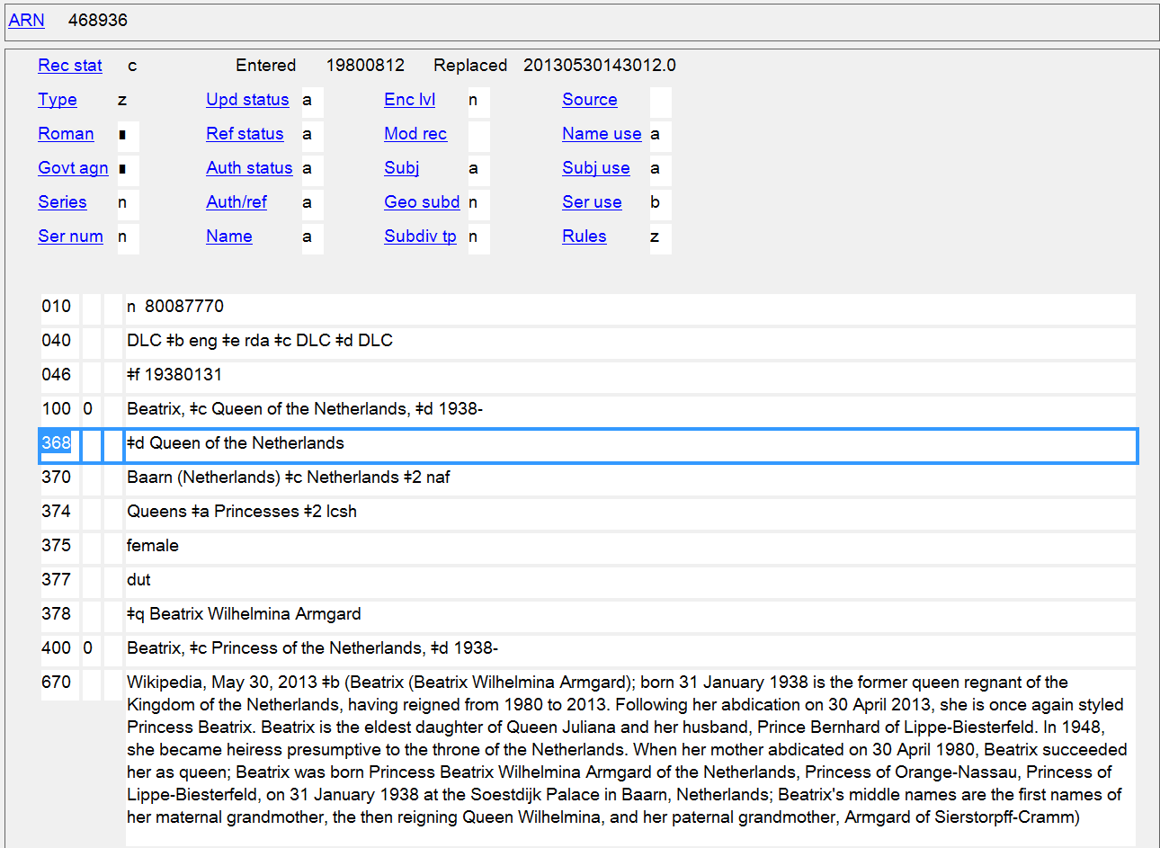
Title of the Person
368 $d
Notes:
An example of Title of the Person (368 $d). However, $d is not yet being used in name authorities.

Slide 5
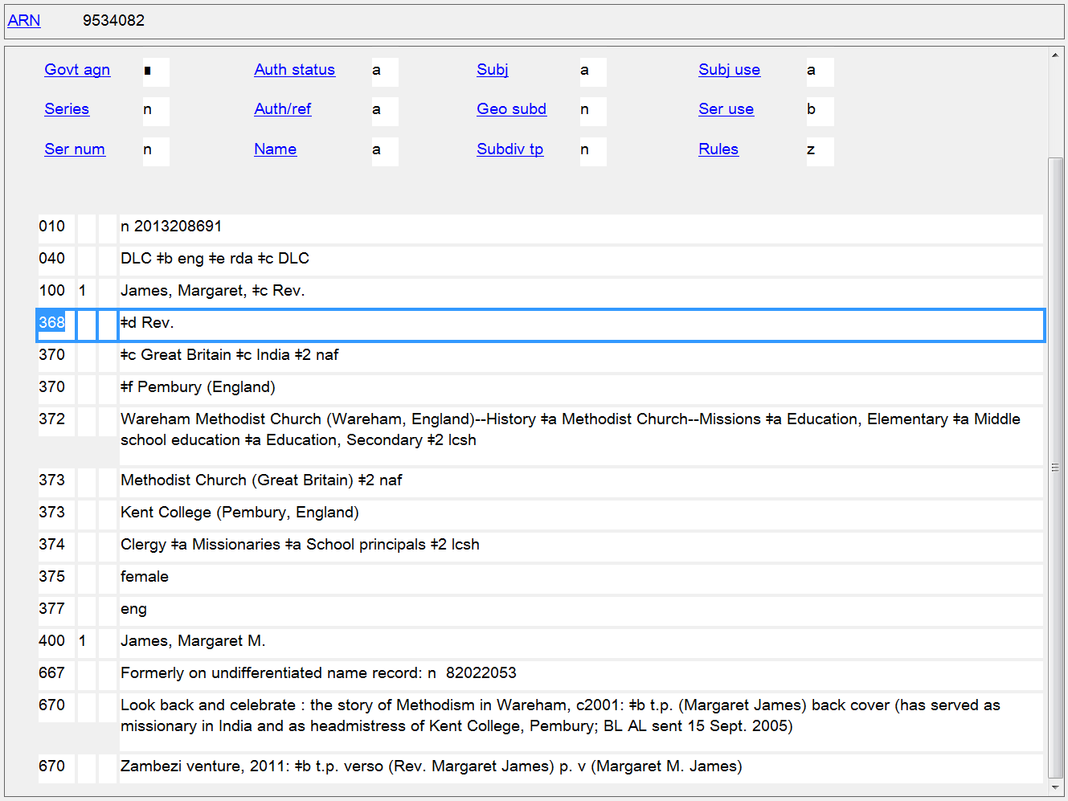
Title of the Person
368 $d
Notes:
Another example of Title of the Person (368 $d). However, $d is not yet being used in name authorities.
9.4.1.9 Other Term of Rank, Honour, or Office
Record other titles of the person indicative of rank, honour, or office if the terms appear with the name. Record the term in the language in which it was conferred or in the language used in the country in which the person resides.
EXAMPLE
Captain
Reverend
Sir

Slide 6
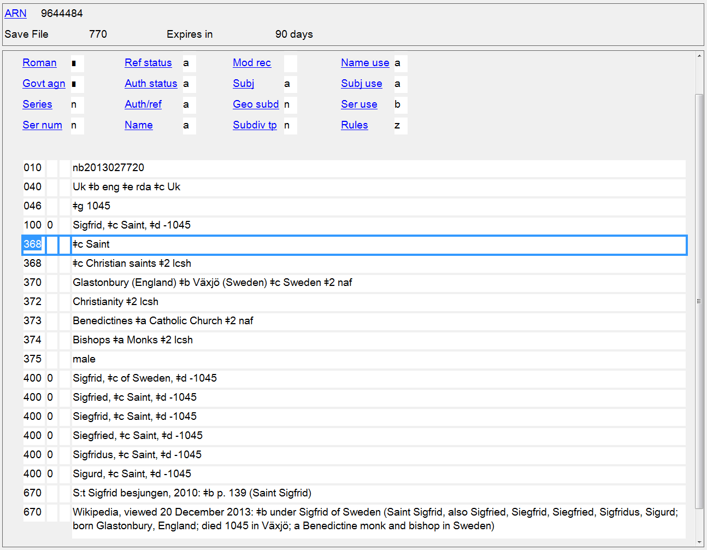
Other Designation: Saints
368 $c

Slide 7
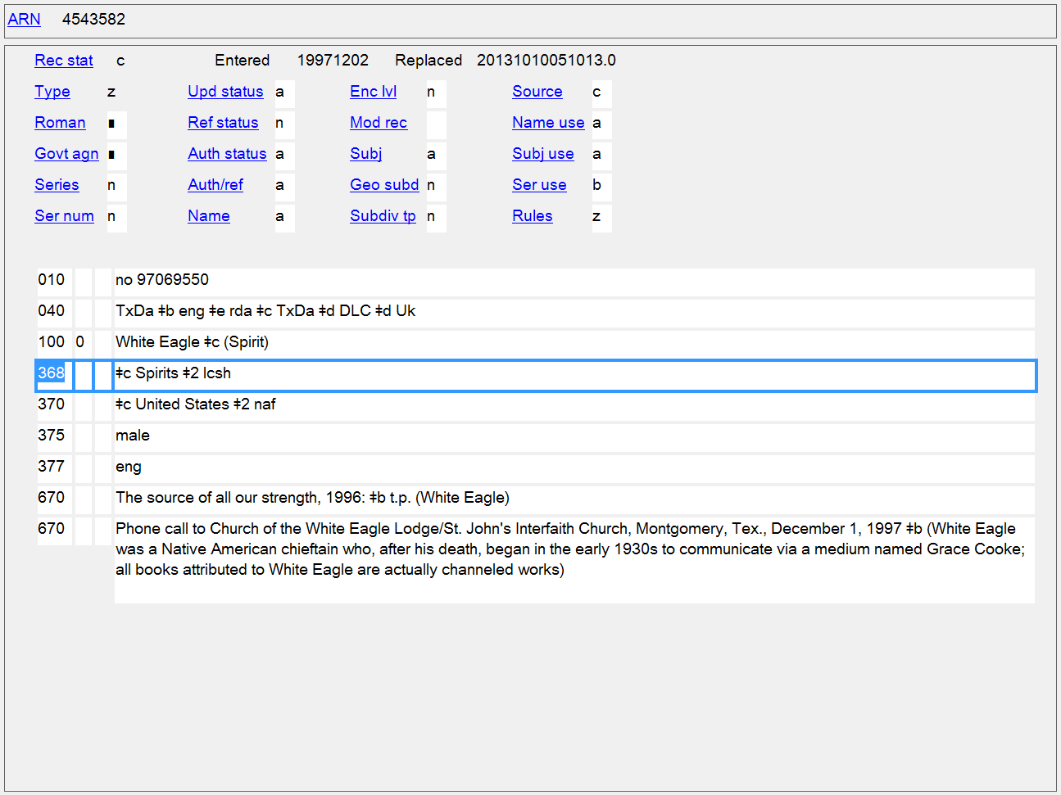
Other Designation: Spirits
368 $c

Slide 8
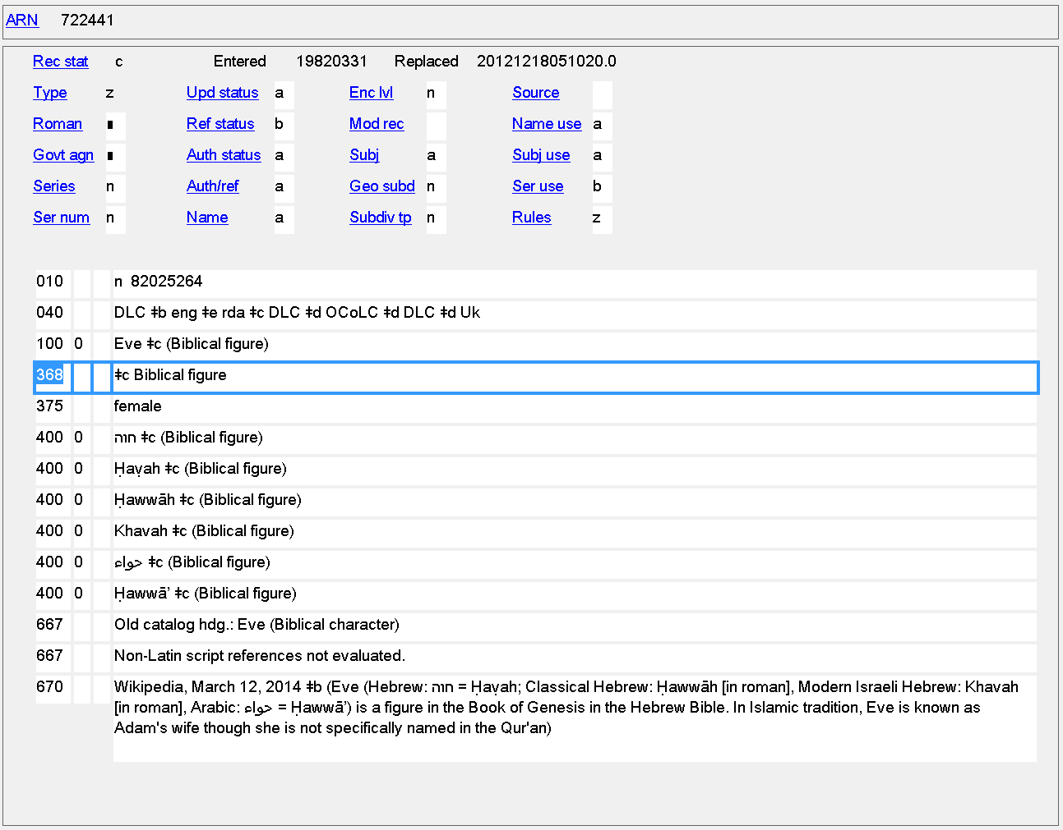
Other Designation: Persons Named in Sacred Scriptures and Apocryphal Books
368 $c

Slide 9
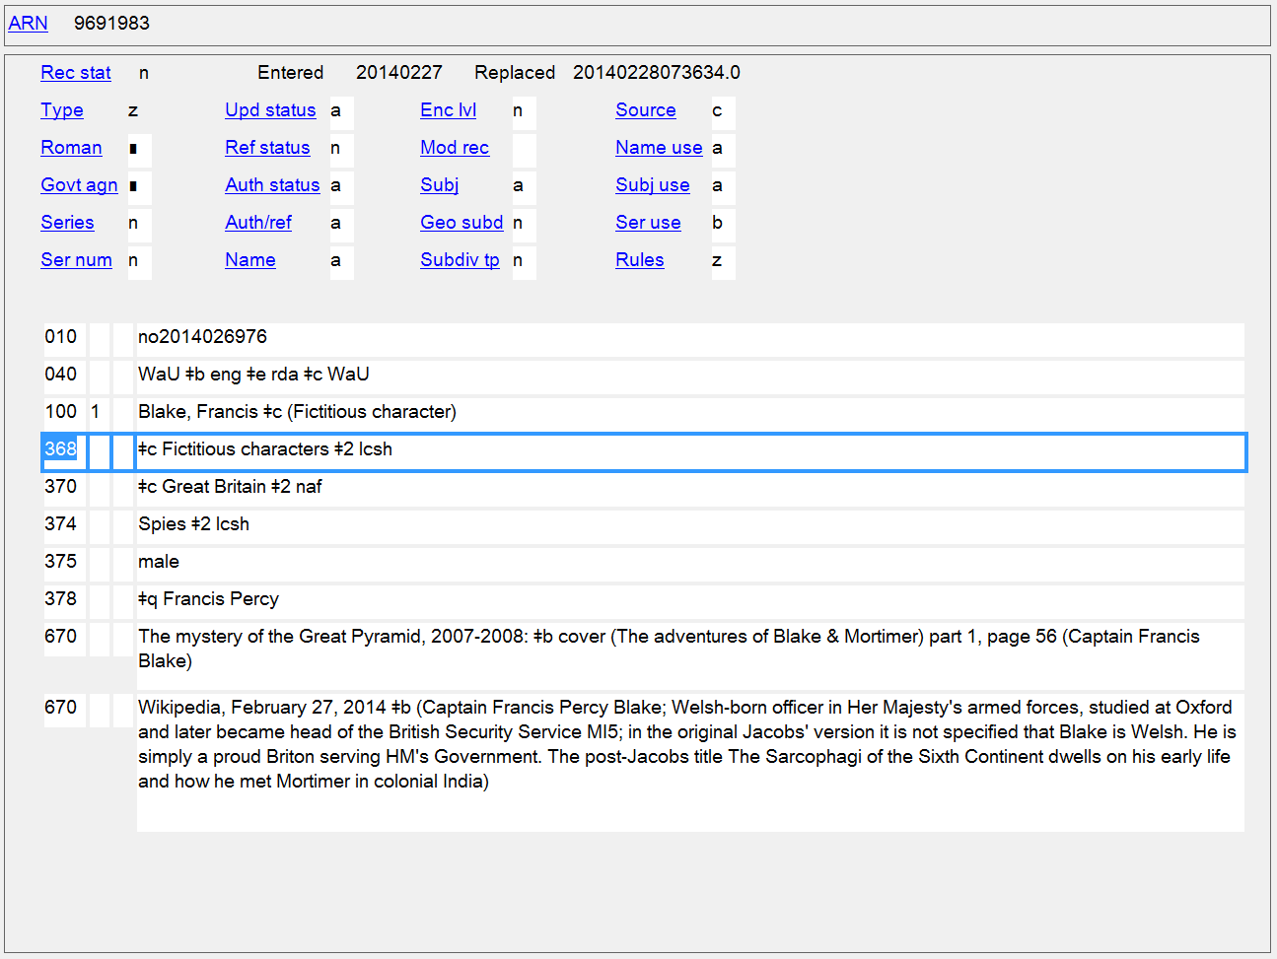
Other Designation: Fictitious and Legendary Persons
368 $c

Slide 10
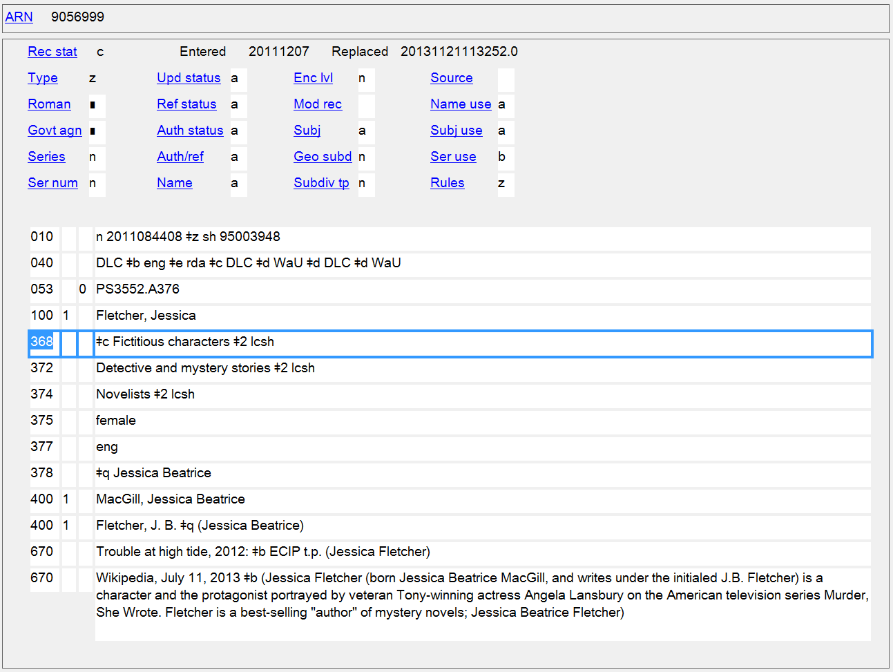
Other Designation: Fictitious and Legendary Persons
368 $c

Slide 11
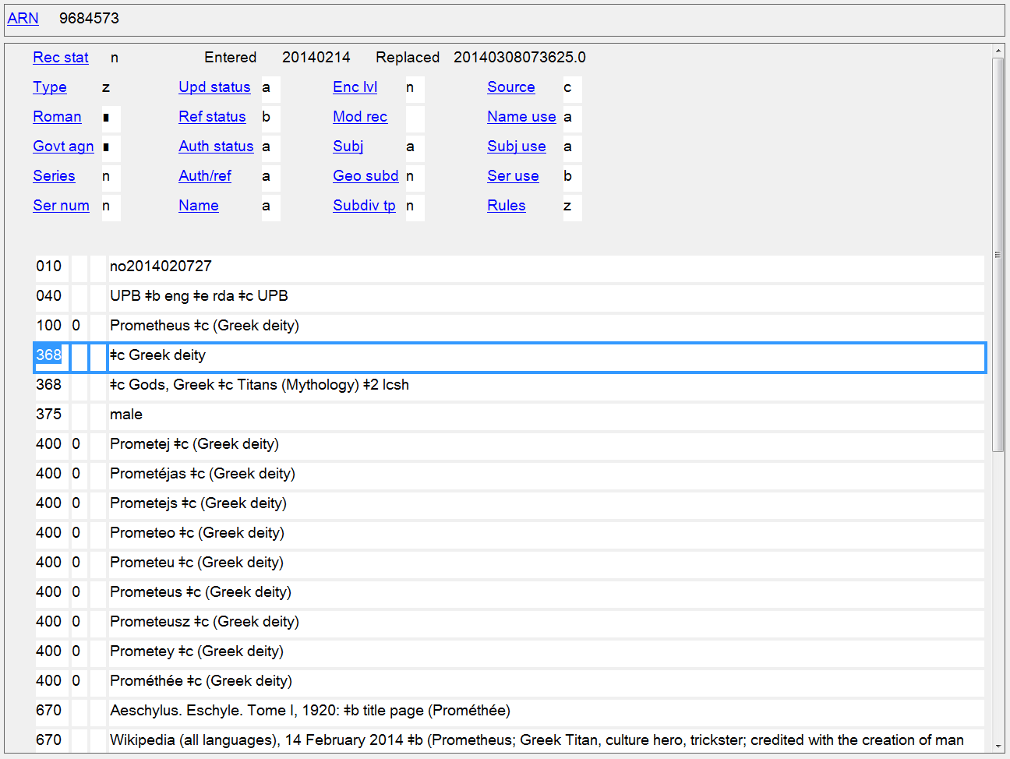
Other Designation: Fictitious and Legendary Persons
368 $c

Slide 12
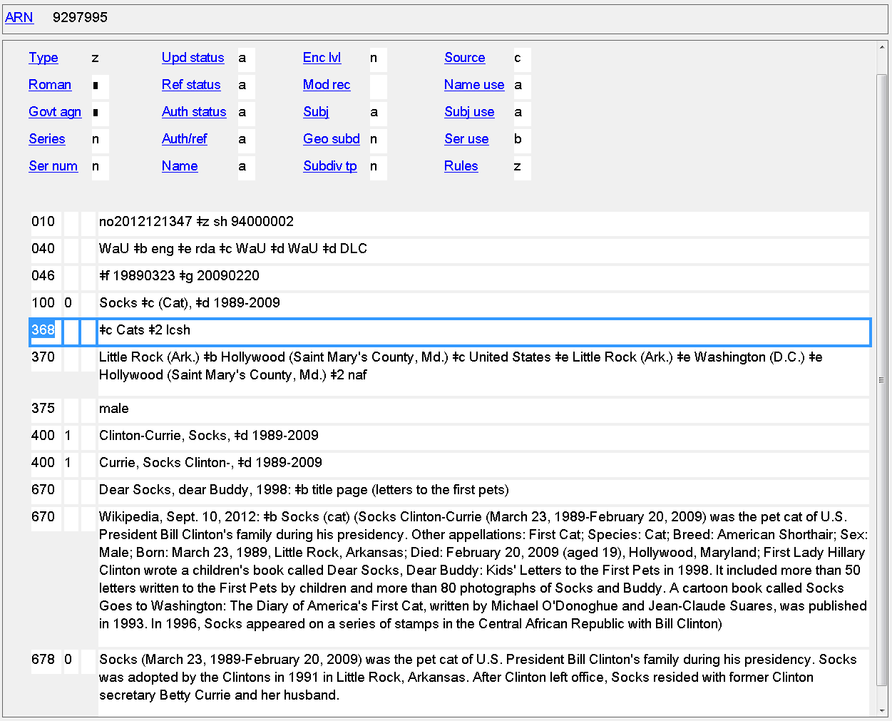
Other Designation: Real Non-human Entities
368 $c

Slide 13
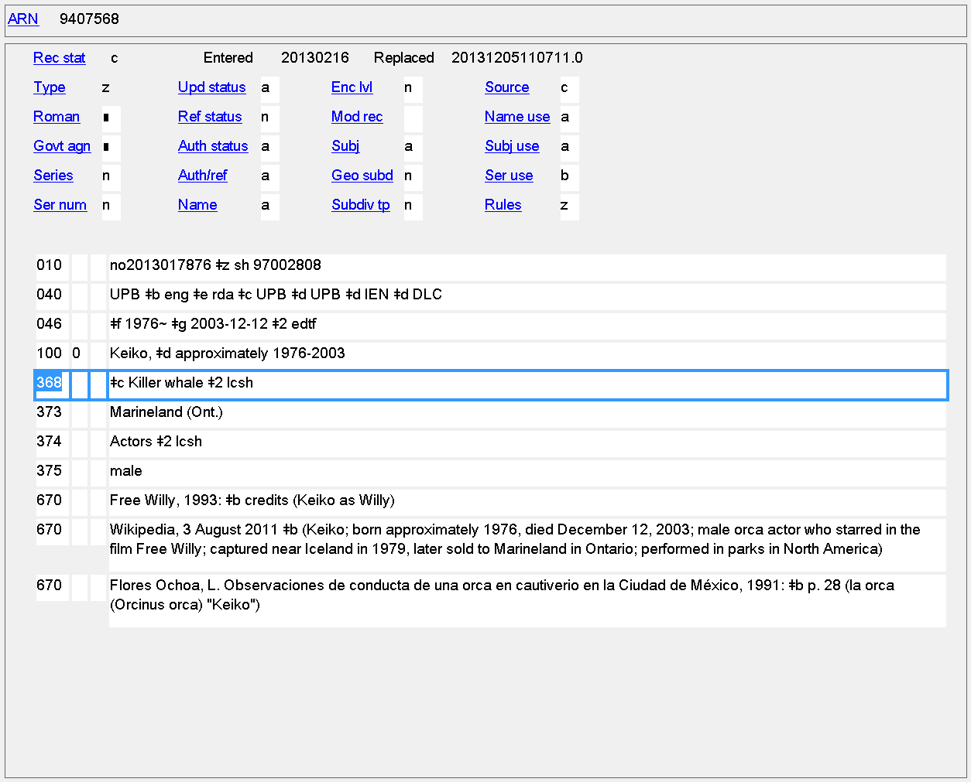
Other Designation: Real Non-human Entities
368 $c

Slide 14
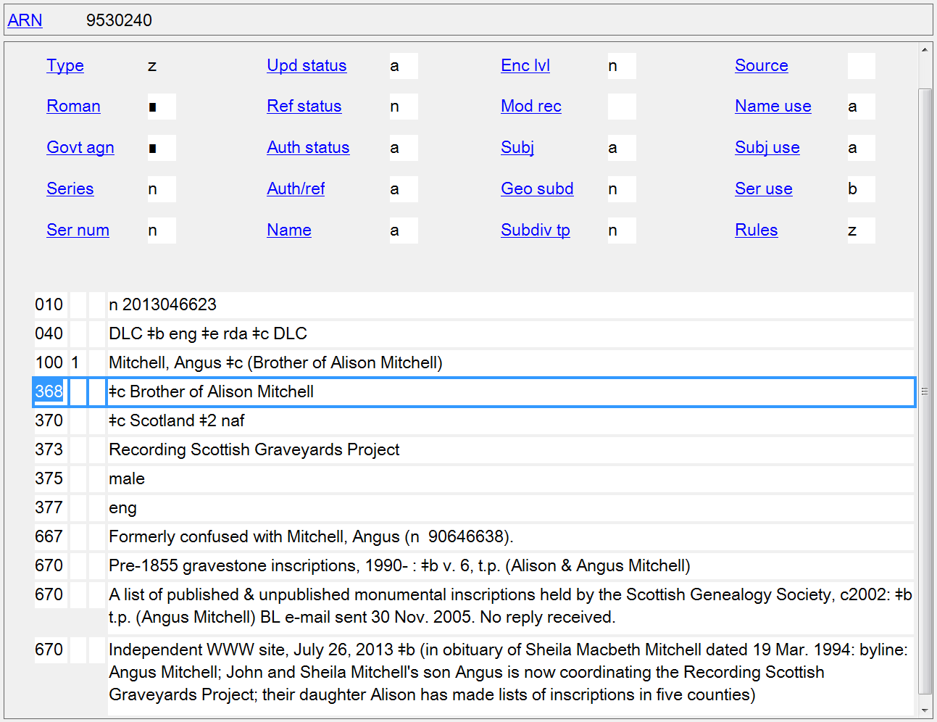
Other Designation: Any Other Designation
368 $c

Slide 15
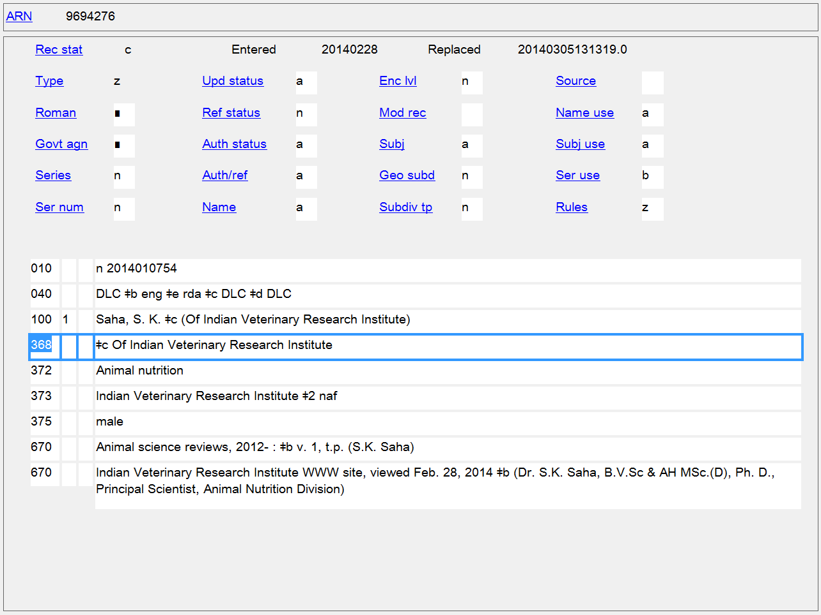
Other Designation: Any Other Designation
368 $c

Slide 16
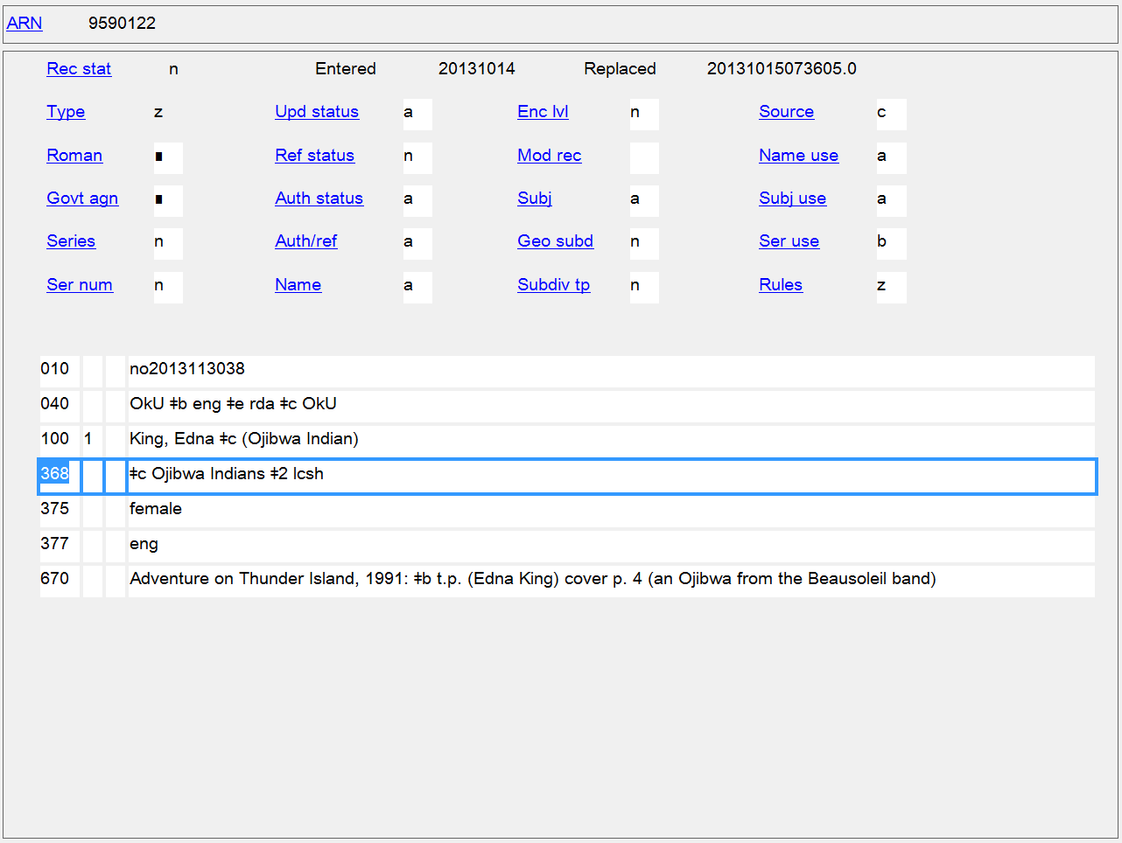
Other Designation: Any Other Designation
368 $c

Slide 17
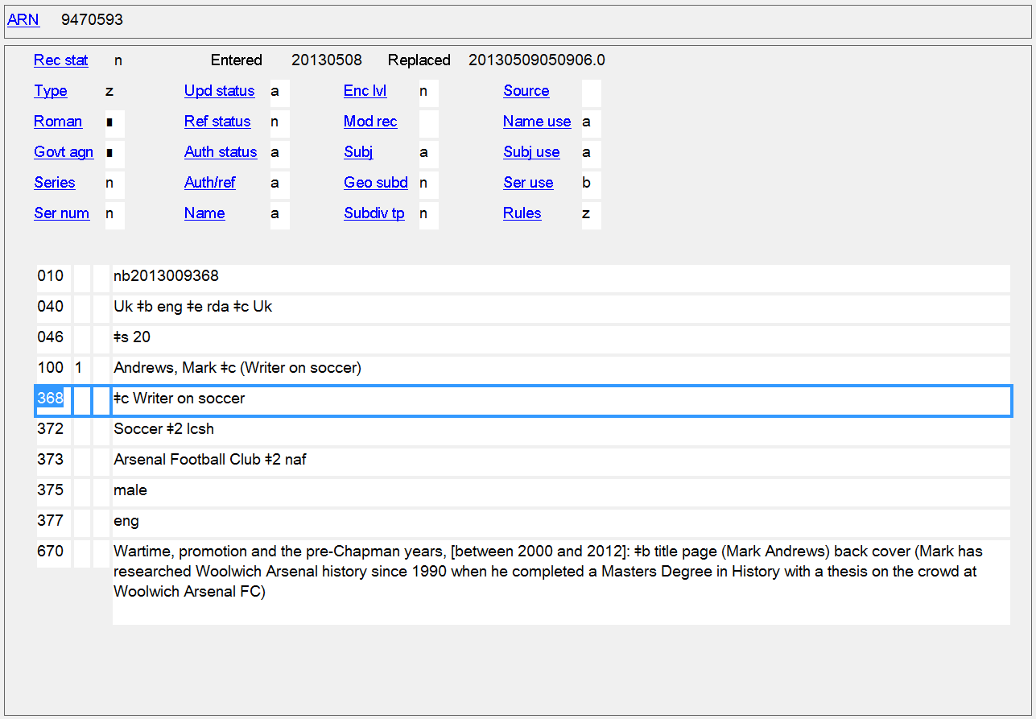
Other Designation: Any Other Designation
368 $c

Slide 18
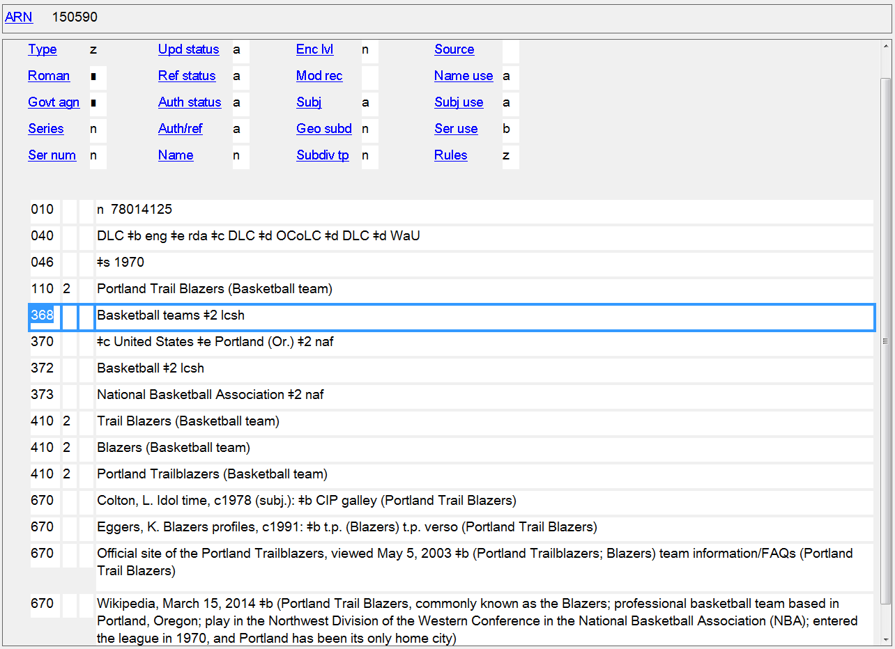
Type of Corporate Body
368 $a

Slide 19
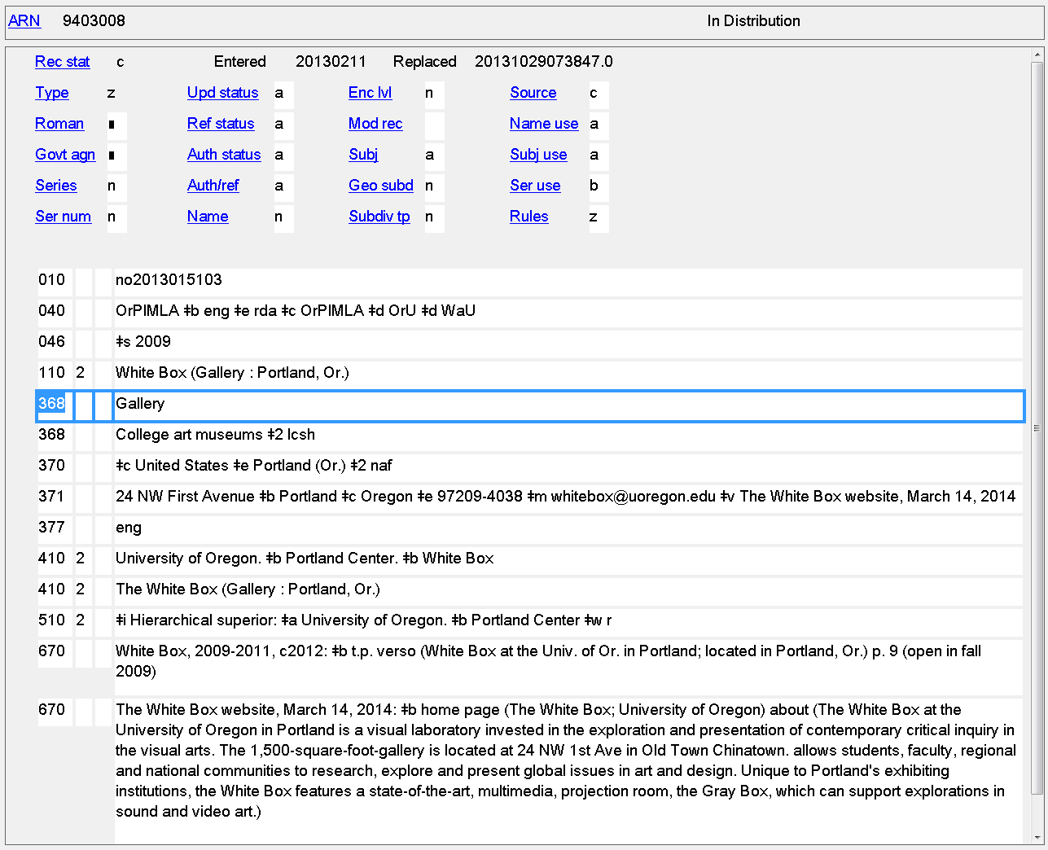
Type of Corporate Body
368 $a

Slide 20
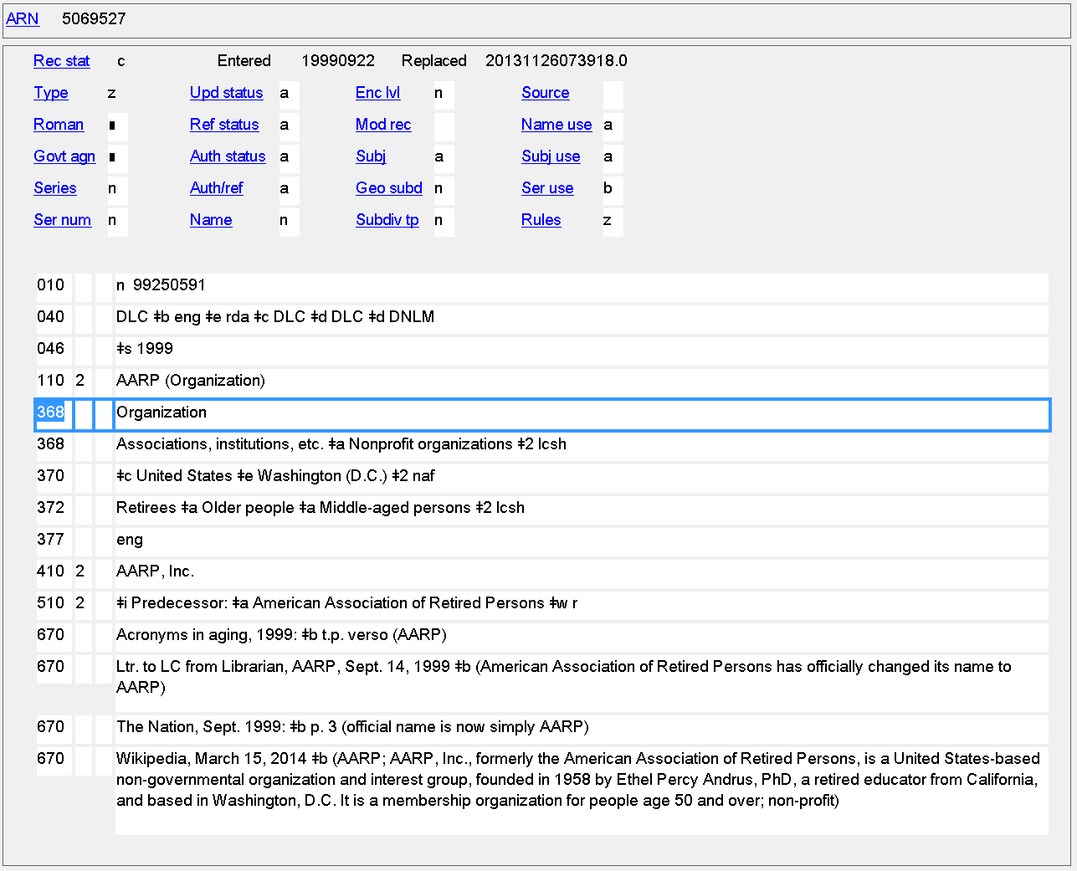
Type of Corporate Body
368 $a

Slide 21
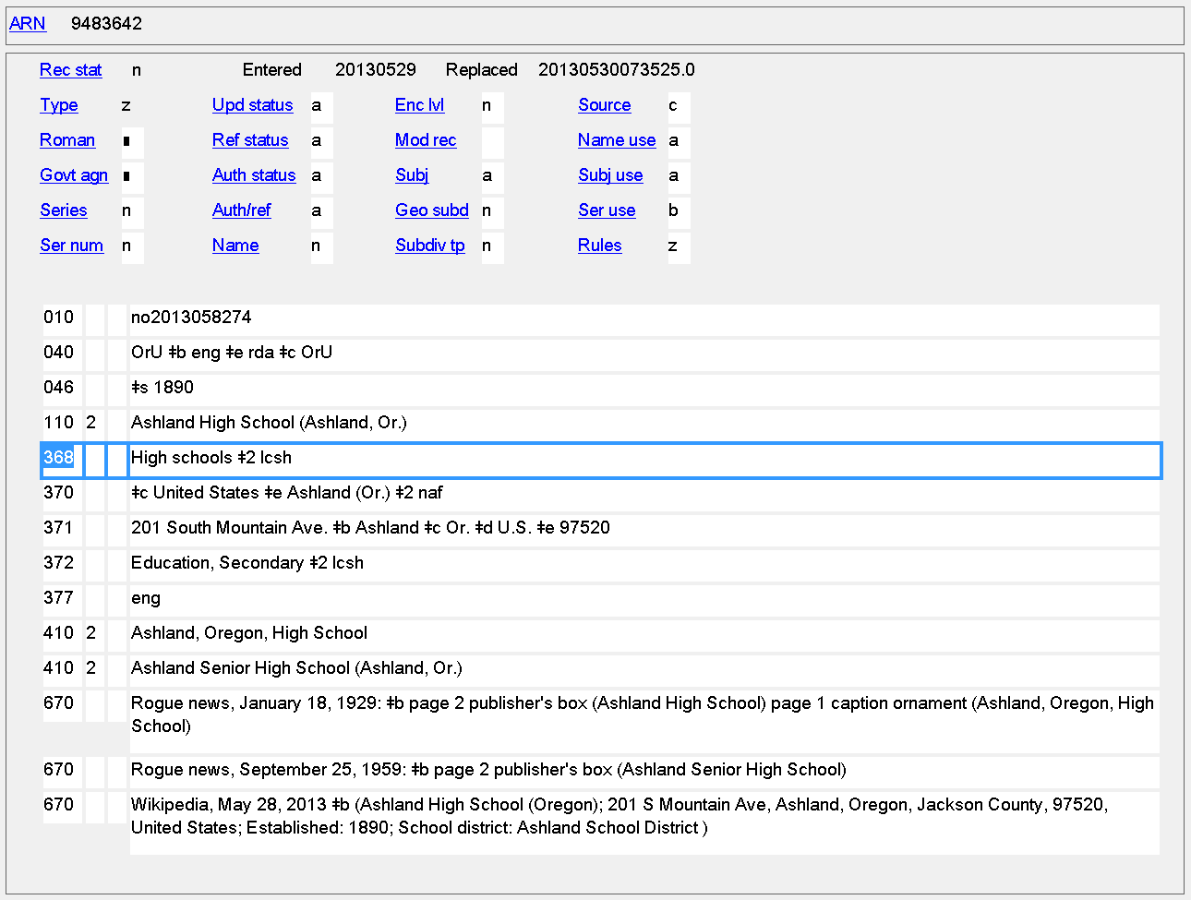
Type of Corporate Body
368 $a

Slide 22
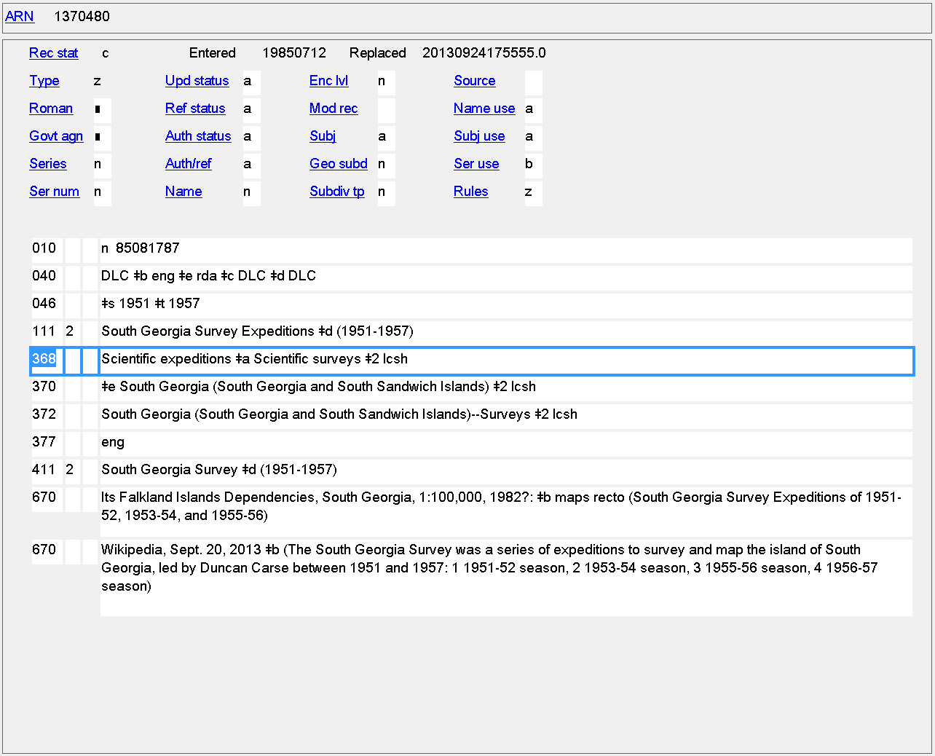
Type of Corporate Body
368 $a

Slide 23
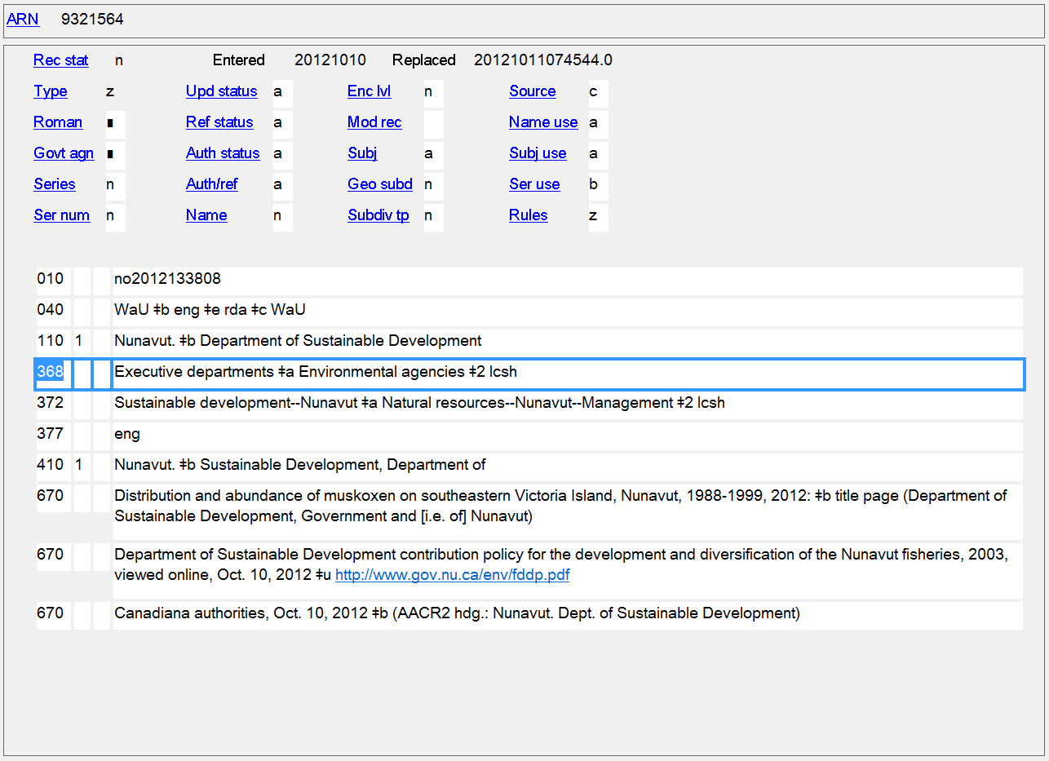
Type of Corporate Body
368 $a

Slide 24
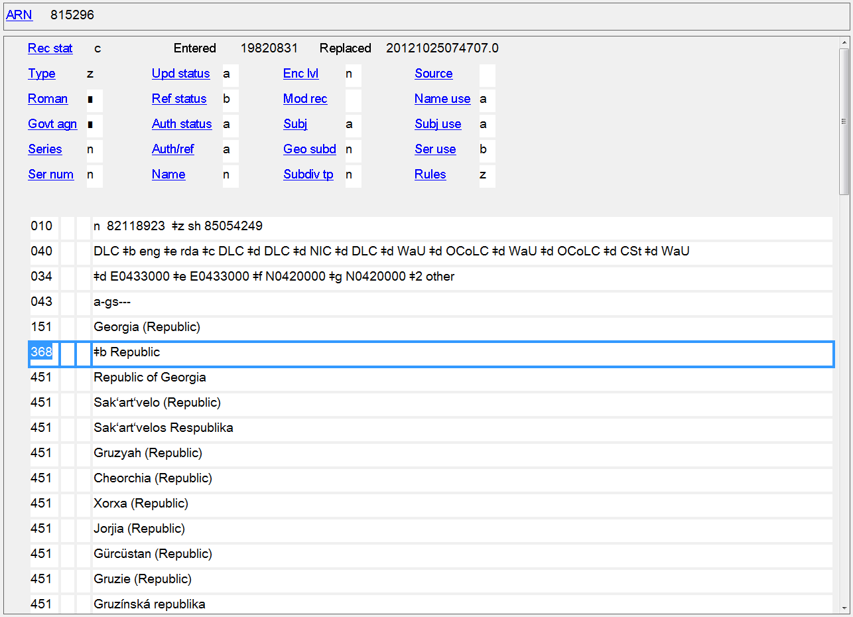
Type of Jurisdiction
368 $b

Slide 25
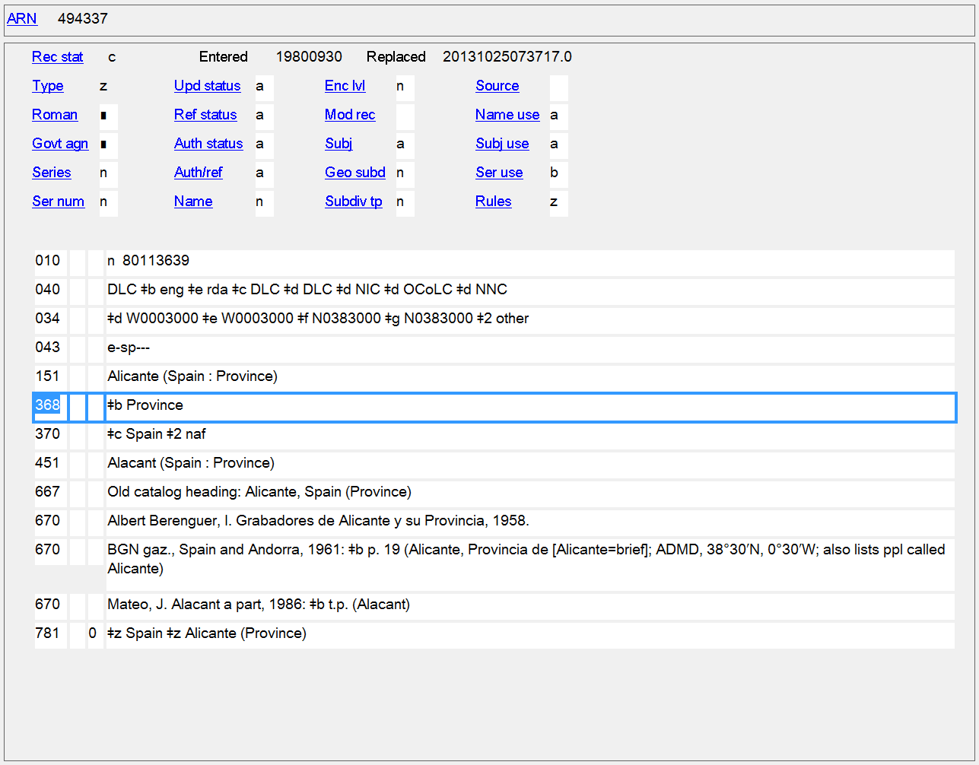
Type of Jurisdiction
368 $b

Slide 26
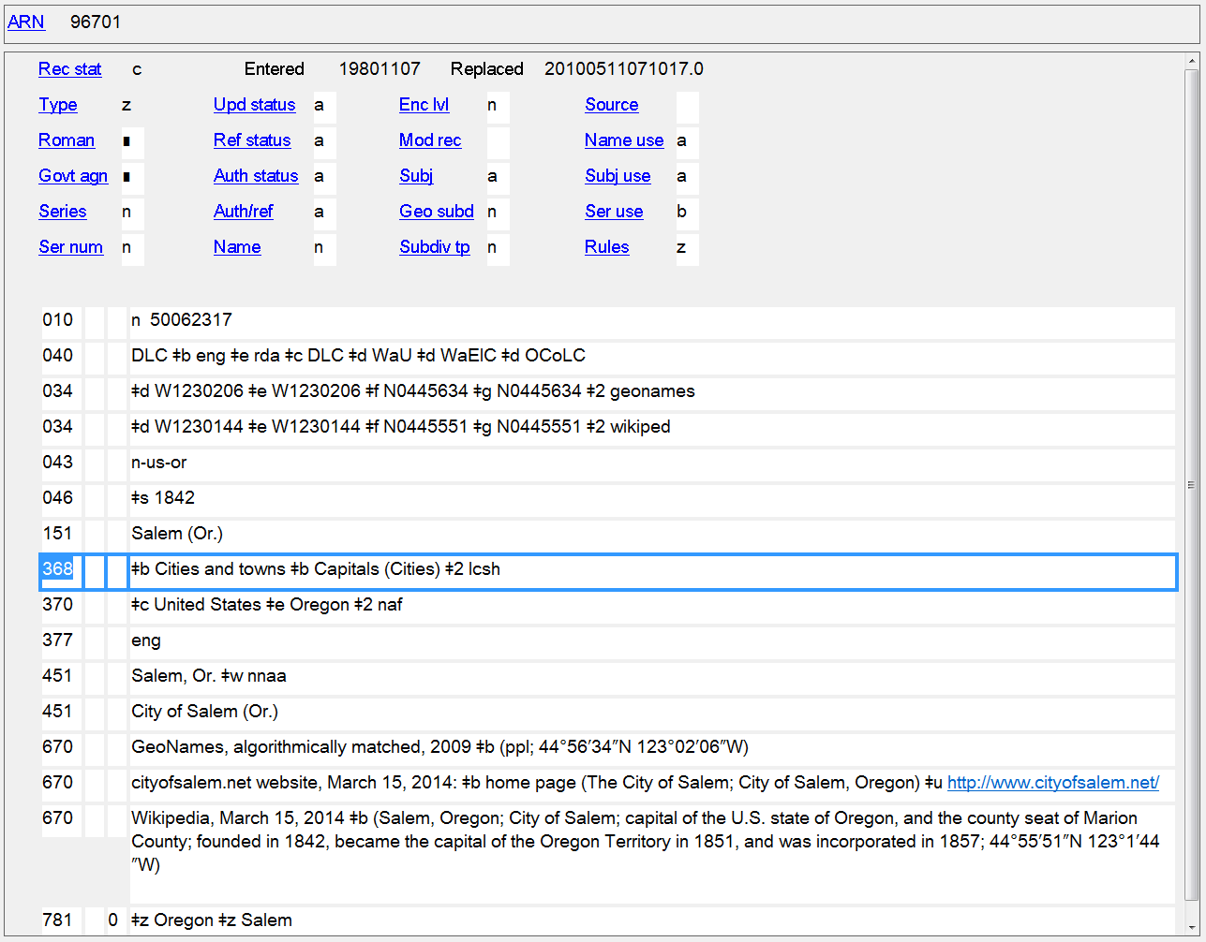
Type of Jurisdiction
368 $b

Slide 27
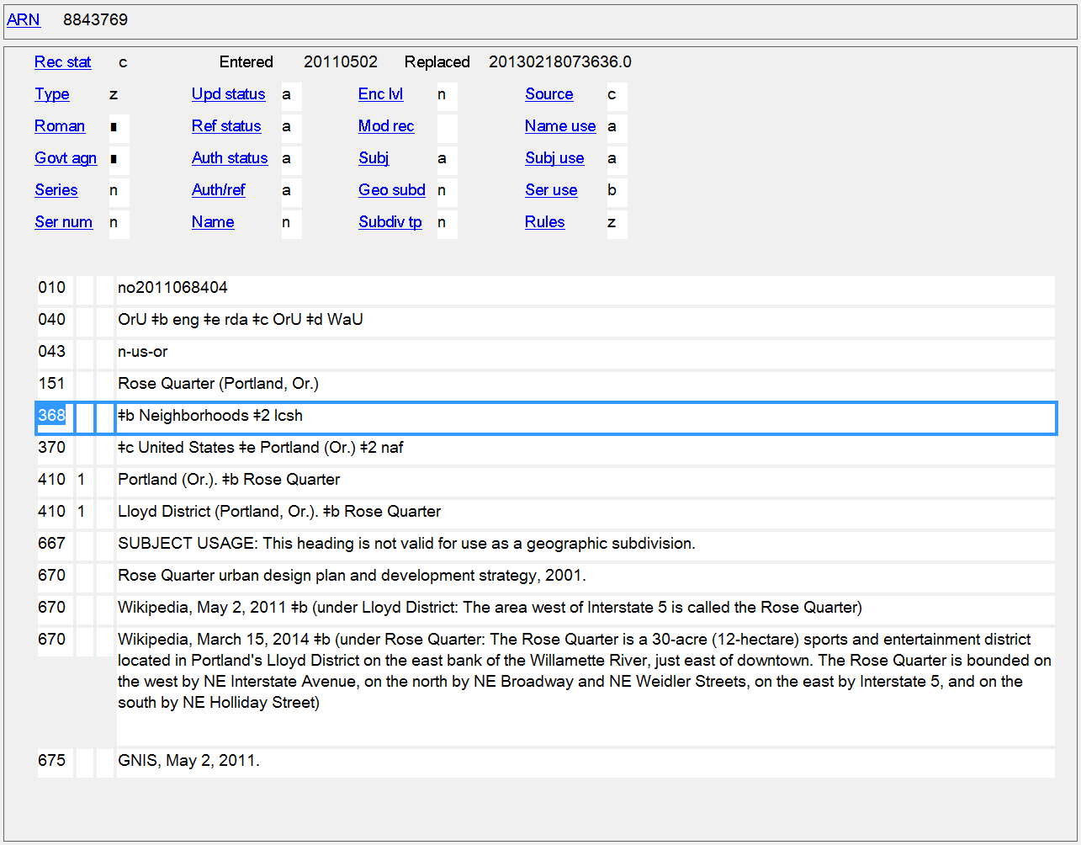
Type of Jurisdiction
368 $b

Slide 28
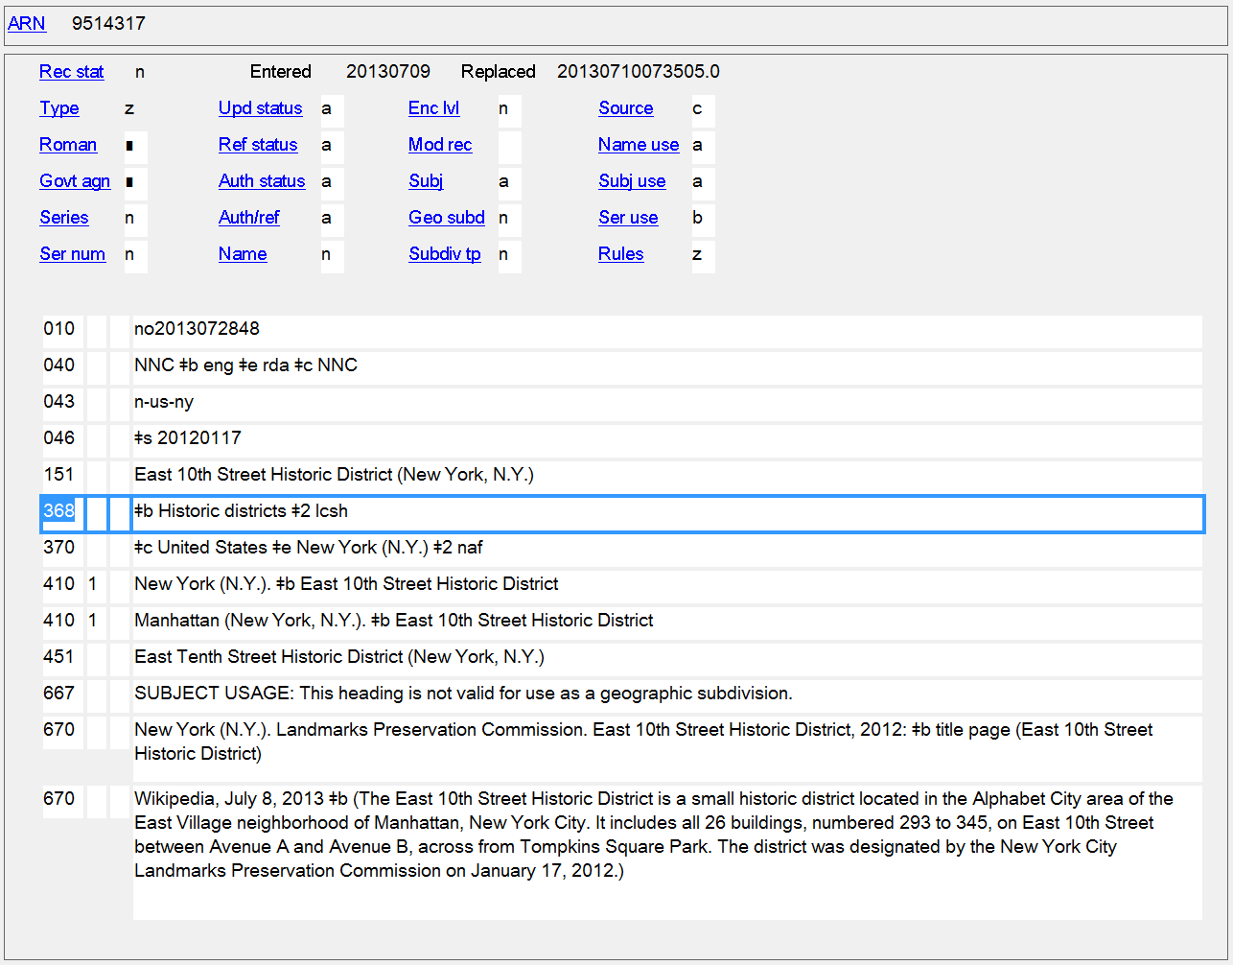
Type of Jurisdiction
368 $b

Slide 29
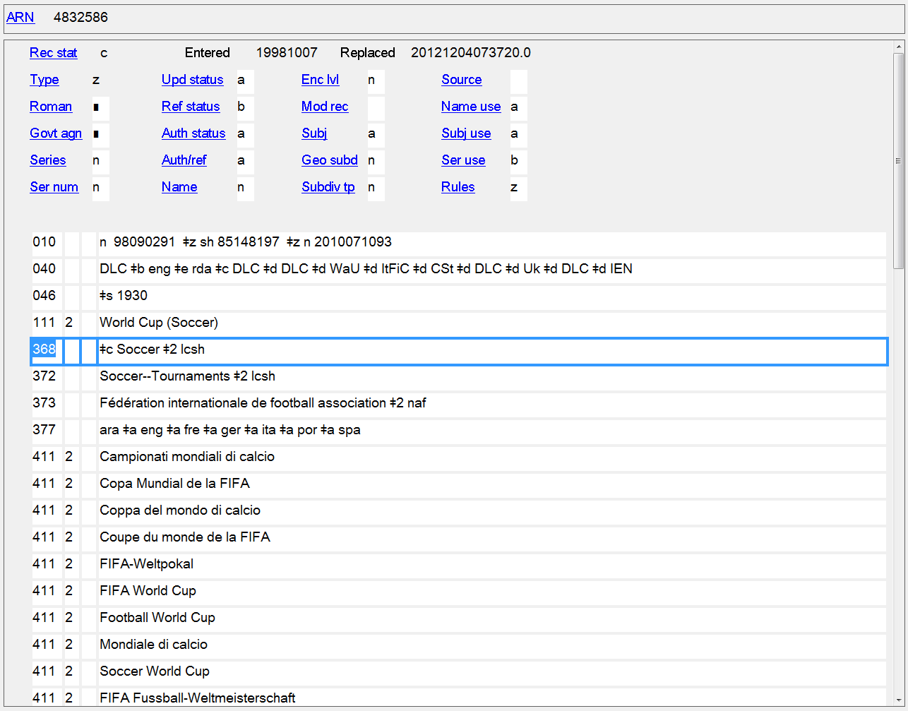
Other Designation
368 $c

Slide 30
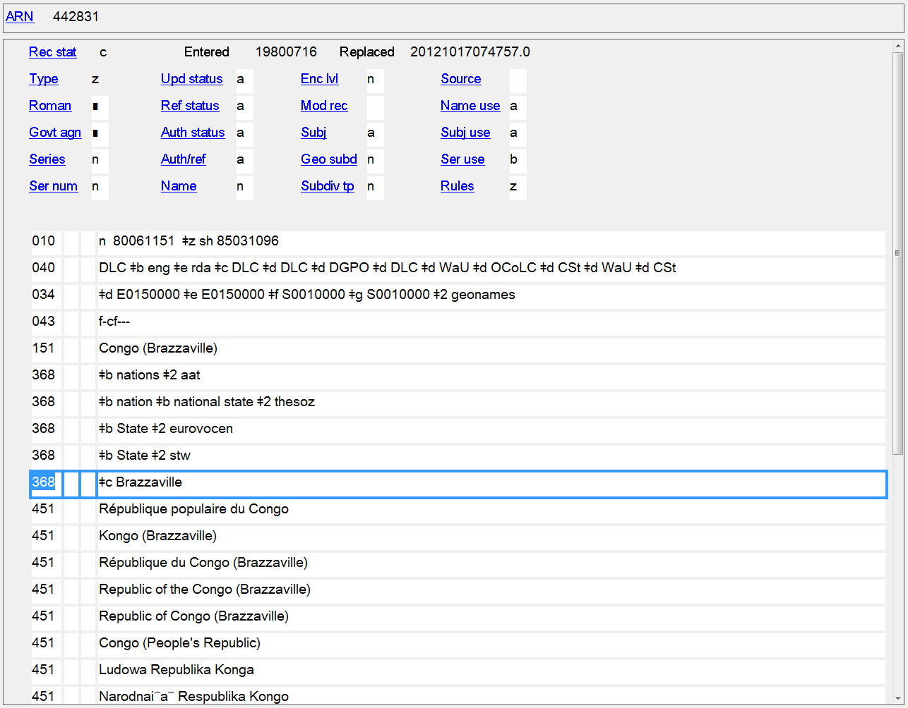
Other Designation
368 $c

Slide 31
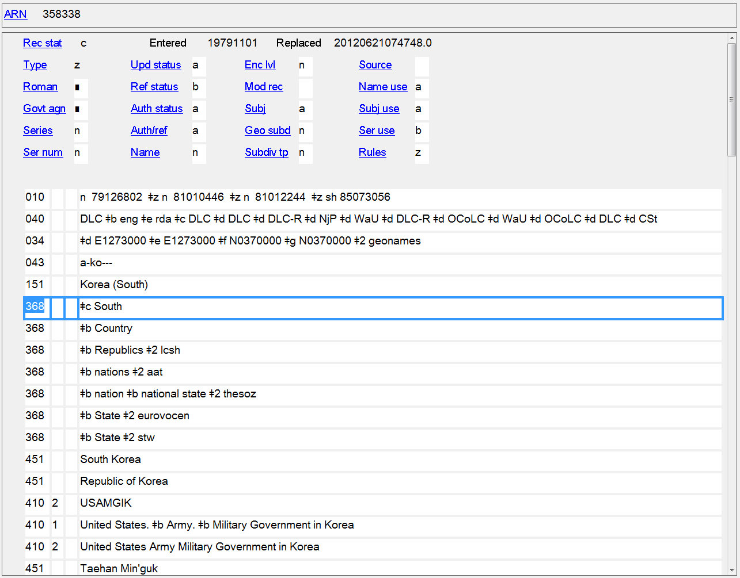
Other Designation
368 $c

Slide 32
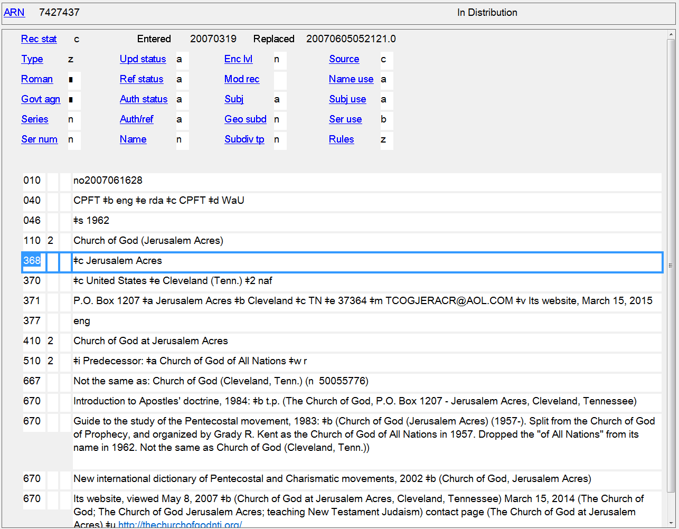
Other Designation
368 $c

Slide 33
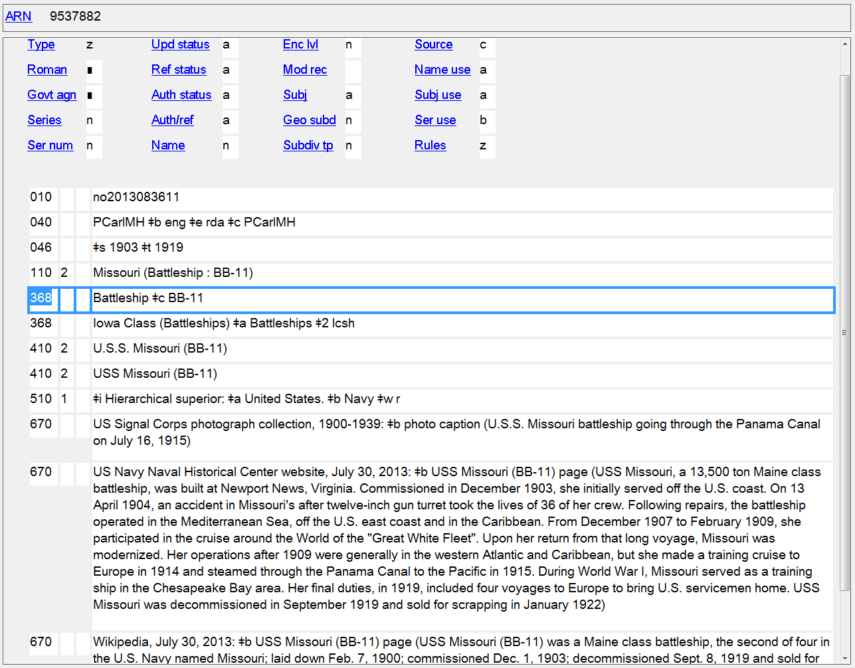
Other Designation
368 $c

Slide 34
Other Person Elements
9.5 - Fuller Form of Name - MARC 378
9.7 - Gender - MARC 375
9.16 - Profession or Occupation - MARC 374

Slide 35
378 - Fuller Form of Personal Name
Indicators not defined
Subfields
$q - Fuller form of personal name (NR)
$u - Uniform Resource Identifier (R)
$v - Source of information (R)
$6 - Linkage (NR)
$8 - Field link and sequence number (R)

Slide 36
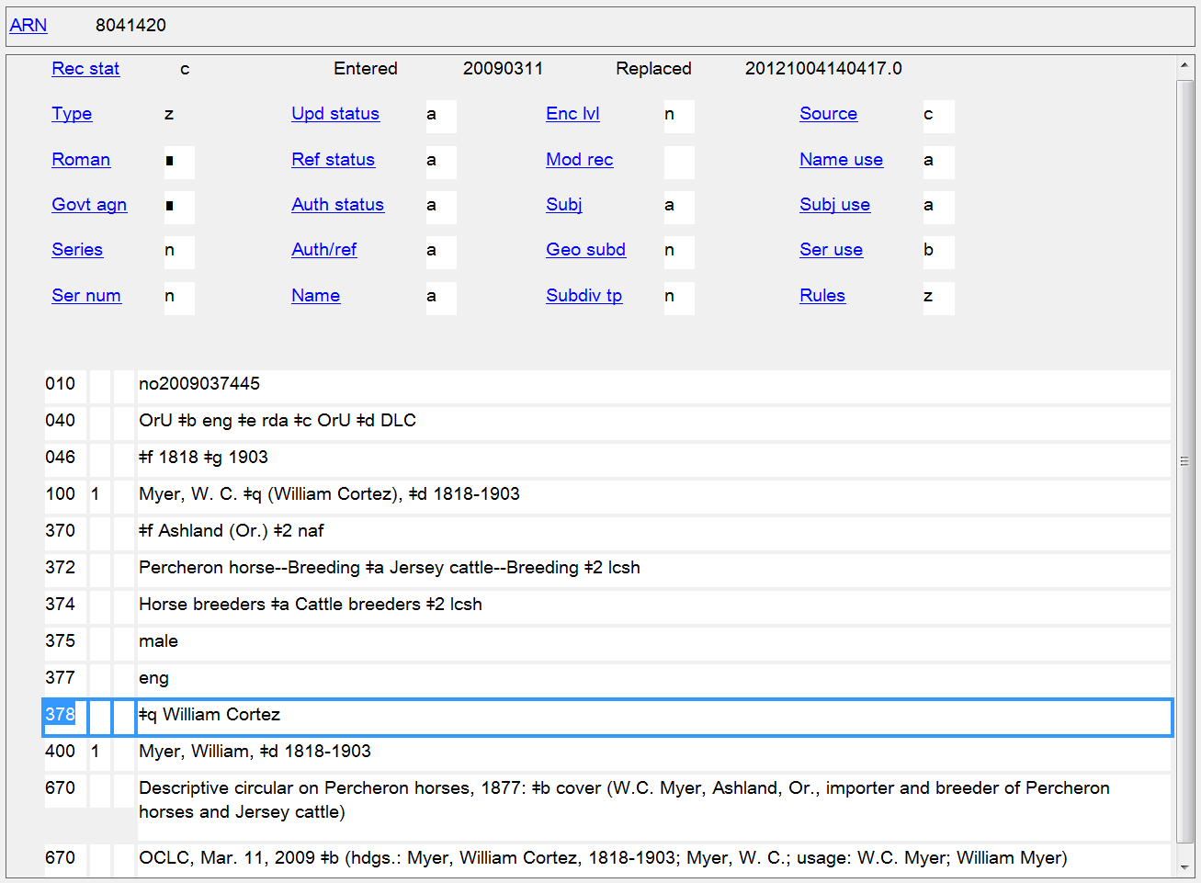
Fuller Form of Personal Name
378 $q
Notes:
In this example, the fuller form of name has be added to the authorized access point.

Slide 37
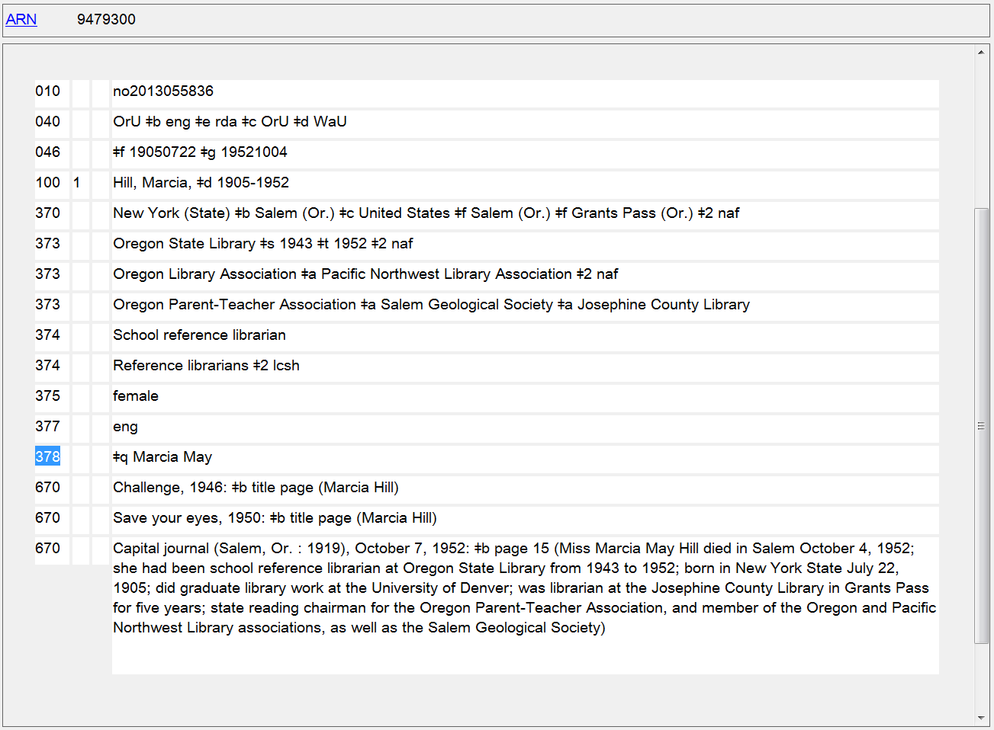
Fuller Form of Personal Name
378 $q
Notes:
In this example, the fuller form of name has been recorded as a separate element only, and is not part of the authorized access point.

Slide 38
375 - Gender
Indicators not defined
Subfields
$a - Gender (R)
$s - Start period (NR)
$t - End period (NR)
$u - Uniform Resource Identifier (R)
$v - Source of information (R)
$2 - Source of term (NR)
$6 - Linkage (NR)
$8 - Field link and sequence number (R)

Slide 39
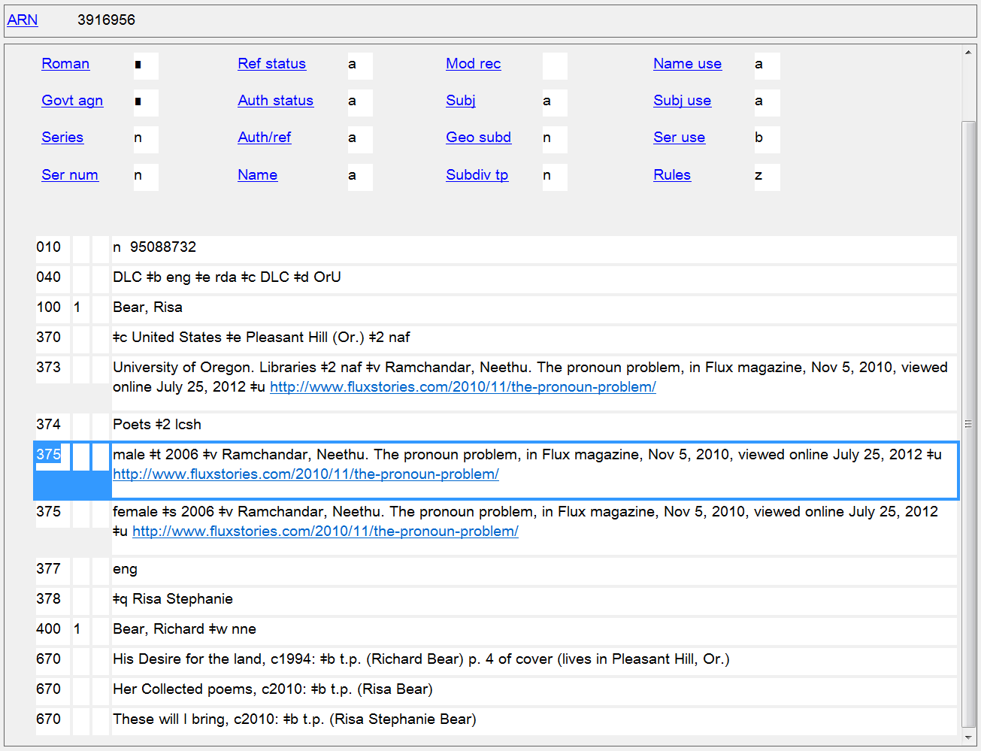
Gender
375

Slide 40
374 - Occupation
Indicators not defined
Subfields
$a - Occupation (R)
$s - Start period (NR)
$t - End period (NR)
$u - Uniform Resource Identifier (R)
$v - Source of information (R)
$0 - Record control number (R)
$2 - Source of term (NR)
$6 - Linkage (NR)
$8 - Field link and sequence number (R)

Slide 41
374 - Occupation
PCC policies
Prefer controlled vocabulary, such as LCSH or MeSH, recording the source in subfield $2
For consistency, capitalize the first term in each subfield $a
When terms do not come from a controlled vocabulary, use a singular form

Slide 42
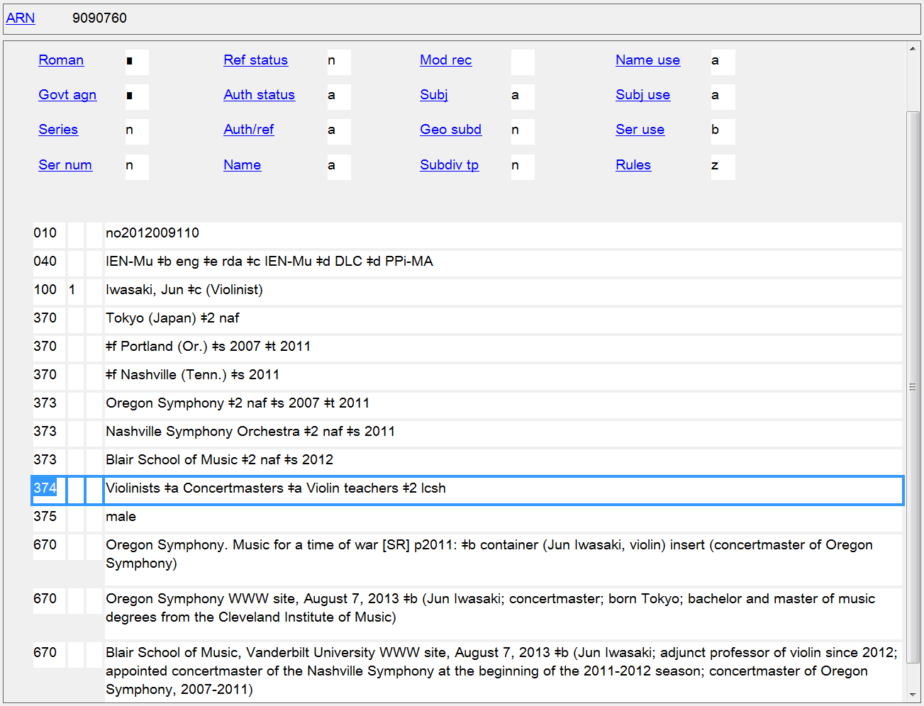
Occupation
374
Notes:
Profession or occupation has been added to the authorized access point to break a conflict with another person with the same name. As part of the access point, it will always be in the singular. As a separate element, it may be plural or singular, depending on the source of the term. If it comes from a controlled vocabulary like LCSH that uses plural terms, it will be plural. If it doesn’t come from a controlled vocabulary, it will be in the singular.

Slide 43
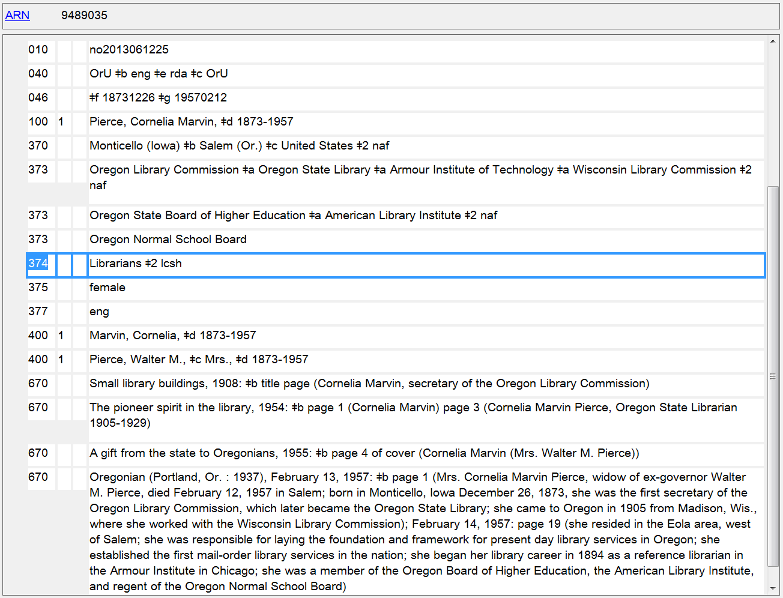
Occupation
374

Slide 44
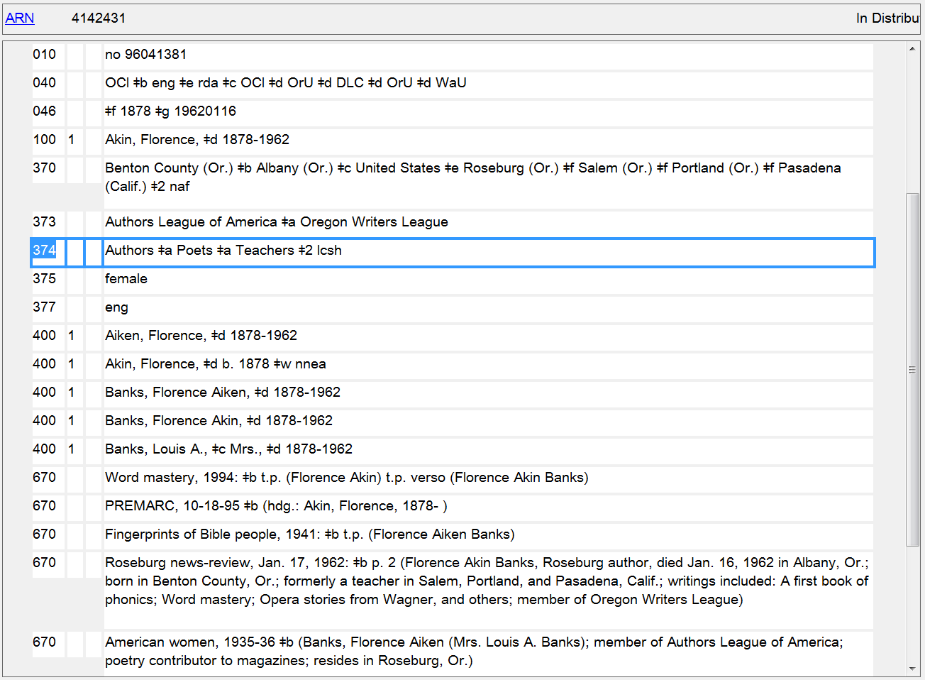
Occupation
374

Slide 45
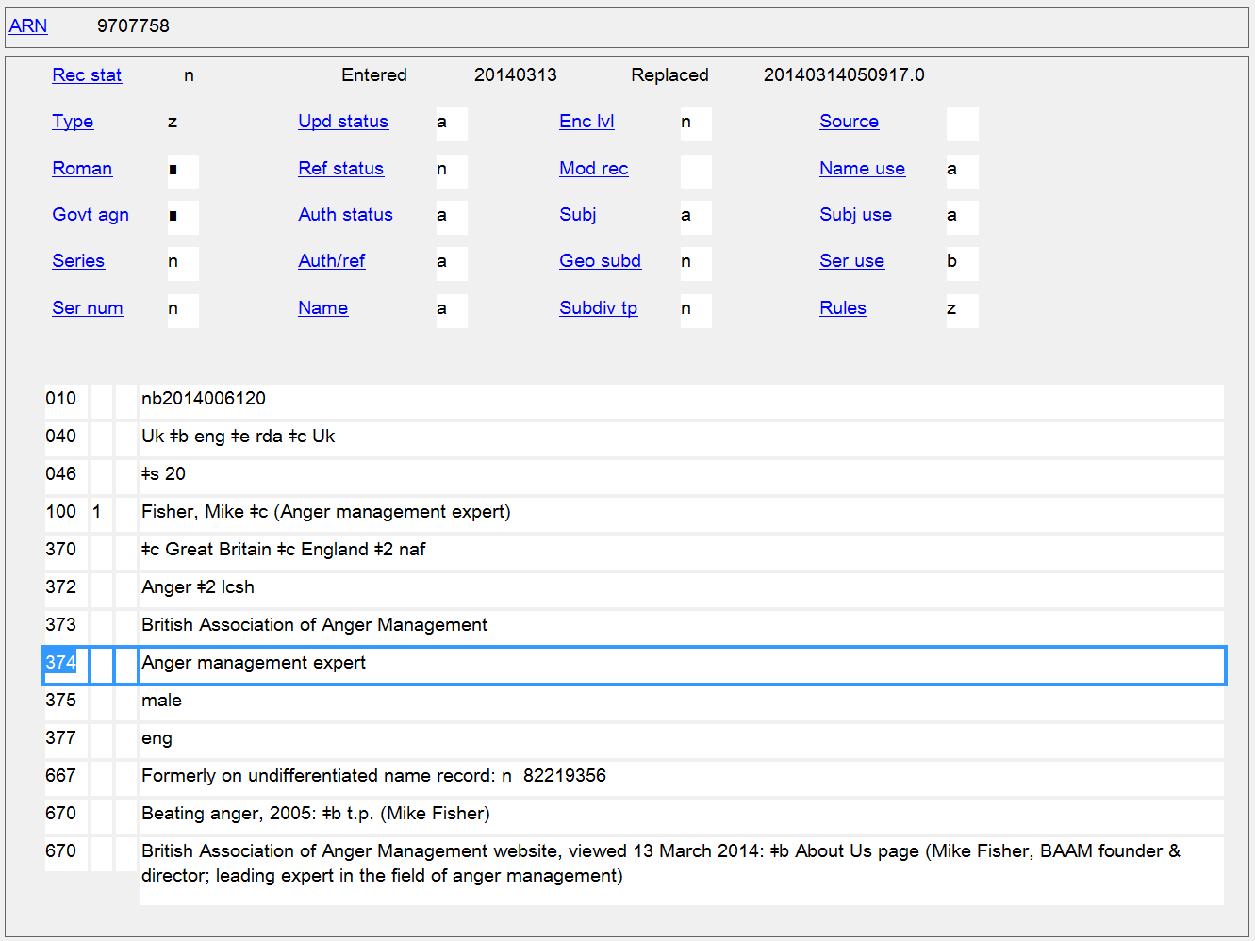
Occupation
374
Notes:
An example of an uncontrolled profession/occupation term.

Slide 46
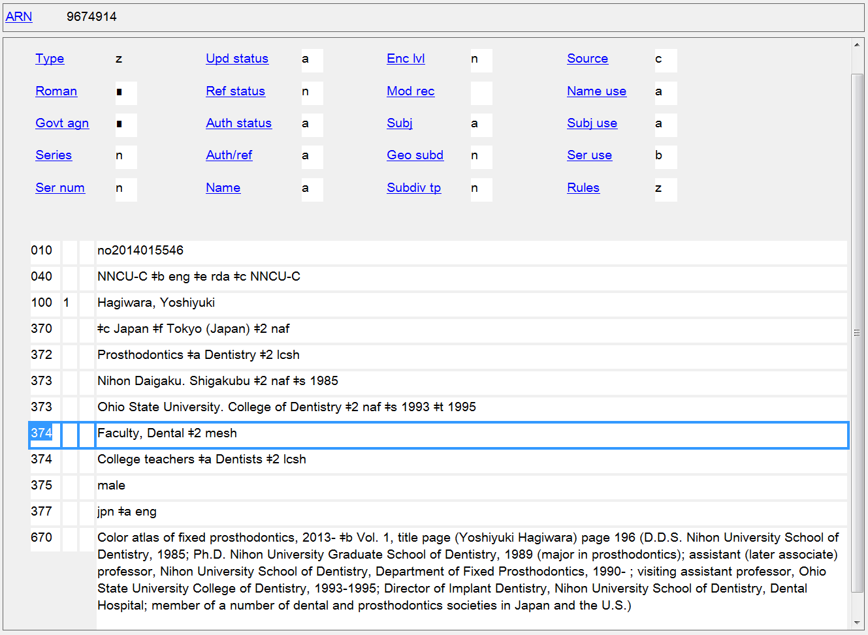
Occupation
374
Notes:
Most catalogers are using LCSH as the source of controlled vocabulary for this element, but other thesauri are perfectly valid to use as well. This record shows the use of a term from MeSH.

Slide 47
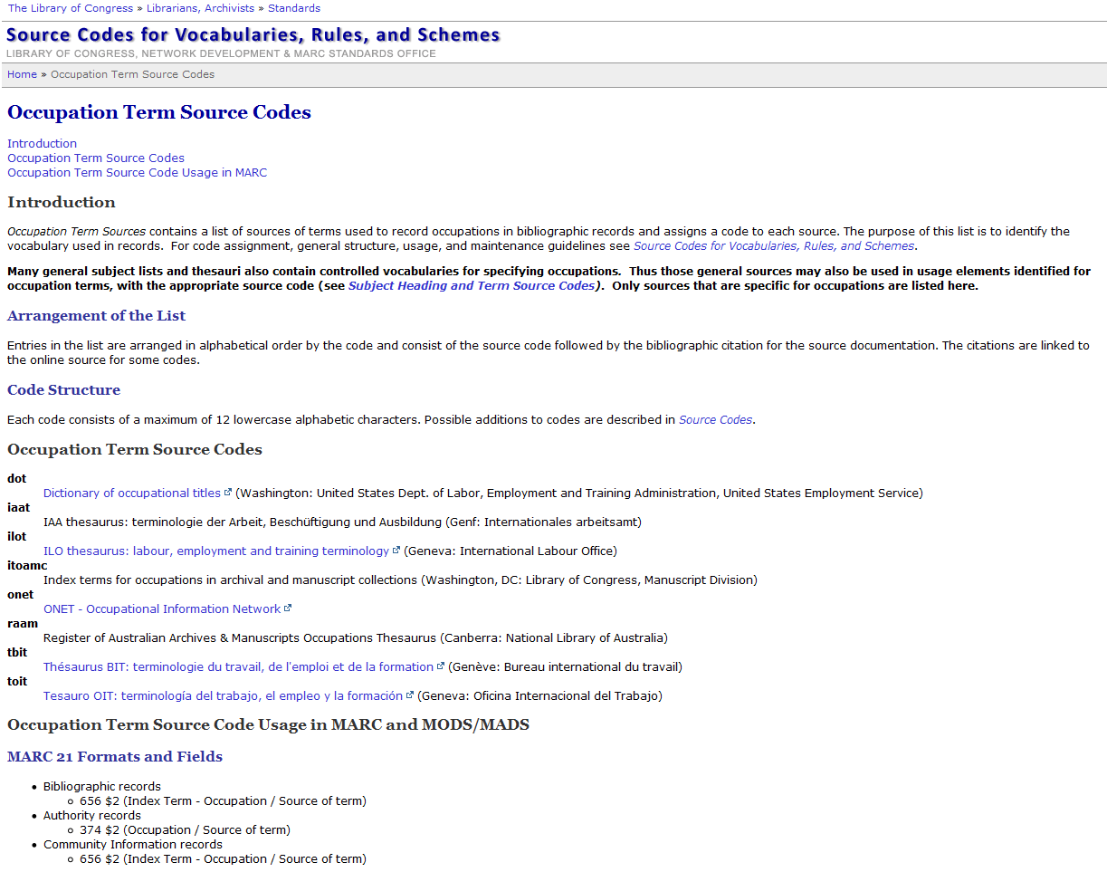
Notes:
There is a special list of Occupation Term Source Codes that could be used for field 374.

Slide 48
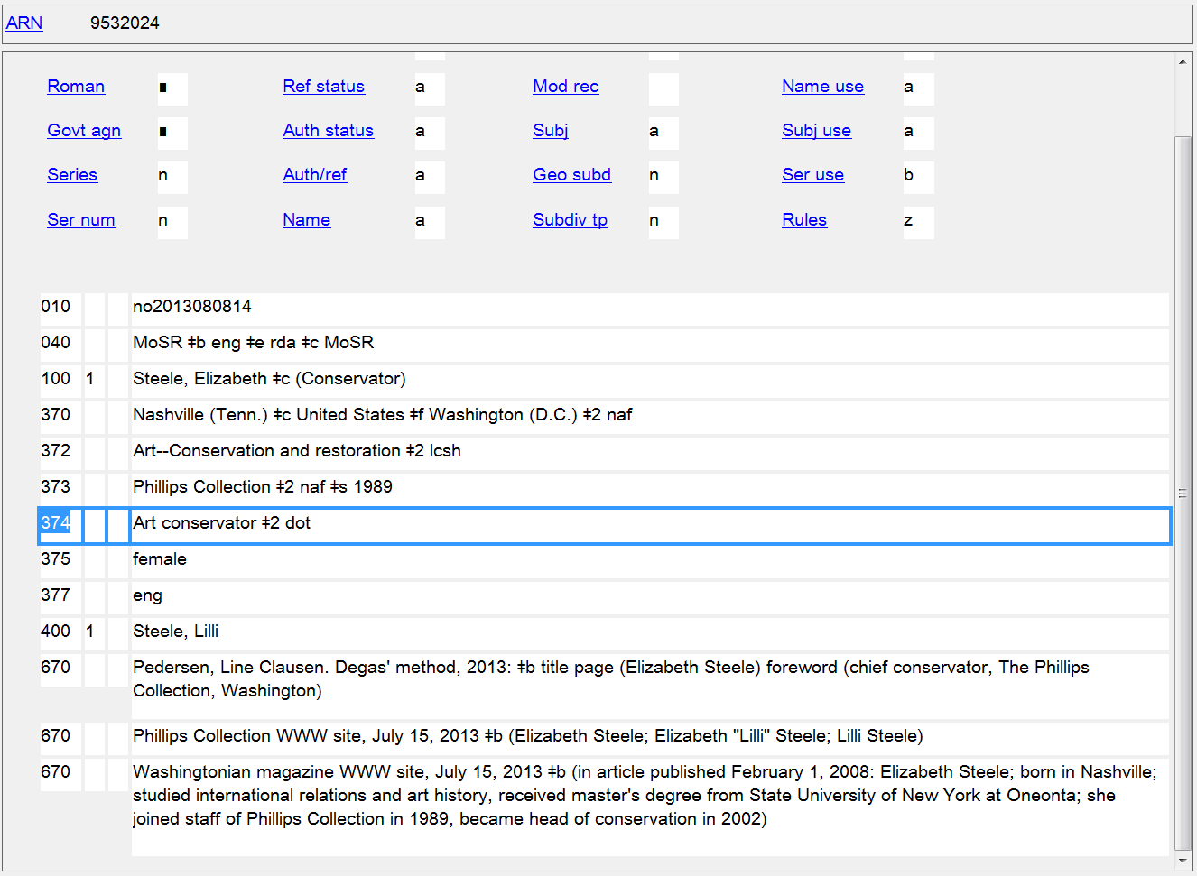
Occupation
374
Notes:
An example of a controlled vocabulary for occupations that is in the singular, the Dictionary of Occupational Titles - coded “dot”

Slide 49
Other Family Elements
10.3 - Type of Family - MARC 376 $a
10.6 - Prominent Member of the Family - MARC 376 $b
10.7 - Hereditary Title - MARC 376 $c

Slide 50
376 - Family Information
Indicators not defined
Subfields
$a - Type of family (R)
$b - Name of prominent member (R)
$c - Hereditary title (R)
$s - Start period (NR)
$t - End period (NR)
$u - Uniform Resource Identifier (R)
$v - Source of information (R)
$0 - Record control number (R)
$2 - Source of term (NR)
$6 - Linkage (NR)
$8 - Field link and sequence number (R)

Slide 51
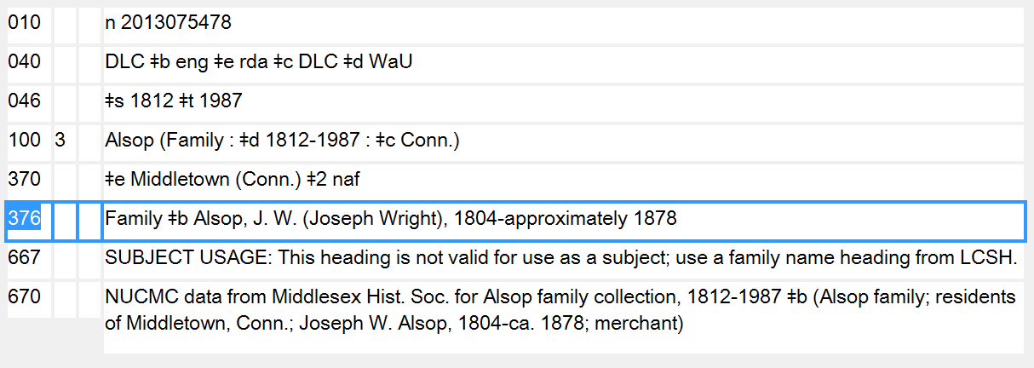
376 - Family Information
PCC policies
For names of prominent members, give the authorized access point form. Do not include any internal subfield coding in subfield $b.

Slide 52
Other Work/Expression Elements
6.3 Form of Work - MARC 380
6.6 Other Distinguishing Characteristic of the Work - MARC 381
6.9 Content Type - MARC 336
6.12 Other Distinguishing Characteristic of the Expression - MARC 381
6.15 Medium of Performance - MARC 382
6.16 Numeric Designation of a Musical Work - MARC 383
6.17 Key - MARC 384

Slide 53
Other Work/Expression Elements
6.18 Other Distinguishing Characteristic of the Expression of a Musical Work - MARC 381
6.21 Other Distinguishing Characteristic of a Legal Work - MARC 381
6.25 Other Distinguishing Characteristic of the Expression of a Religious Work - MARC 381

Slide 54
380 - Form of Work
Indicators not defined
Subfields
$a - Form of work (R)
$0 - Record control number (R)
$2 - Source of term (NR)
$6 - Linkage (NR)
$8 - Field link and sequence number (R)

Slide 55
380 - Form of Work
PCC policies
Prefer a controlled vocabulary, such as LCSH, LCGFT, or MeSH, or use a source term from the MARC Subject Heading and Term Source Codes or Genre/Form Source Codes in subfield $2 if appropriate.
For consistency, capitalize the first term in subfield $a.
When terms do not come from a controlled vocabulary, use the singular form.

Slide 56
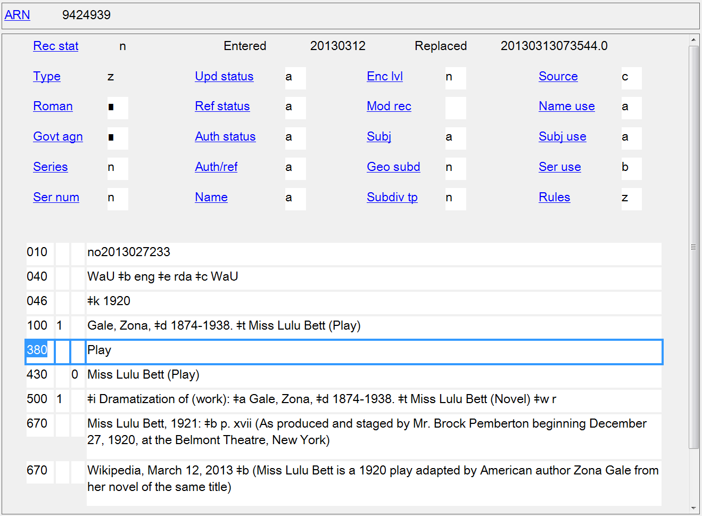
Form of Work
380
Notes:
Form of work used as a qualifier in the authorized access point to distinguish the play from the novel by the same author. Uncontrolled term in field 380.

Slide 57
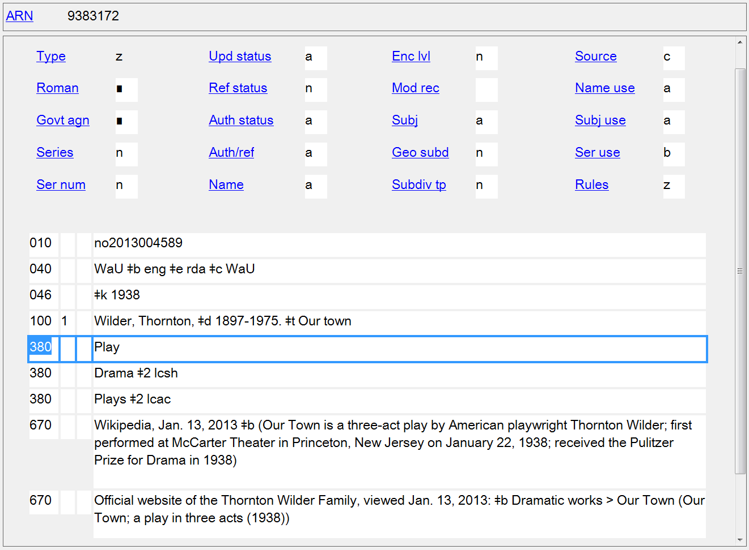
Form of Work
380
Notes:
Form of work not needed to differentiate this access point from any other, but it is recorded as a separate element anyway. Example shows an uncontrolled term in the singular and two terms from controlled vocabulary.
lcac = Library of Congress Annotated Children's Cataloging Program subject headings

Slide 58
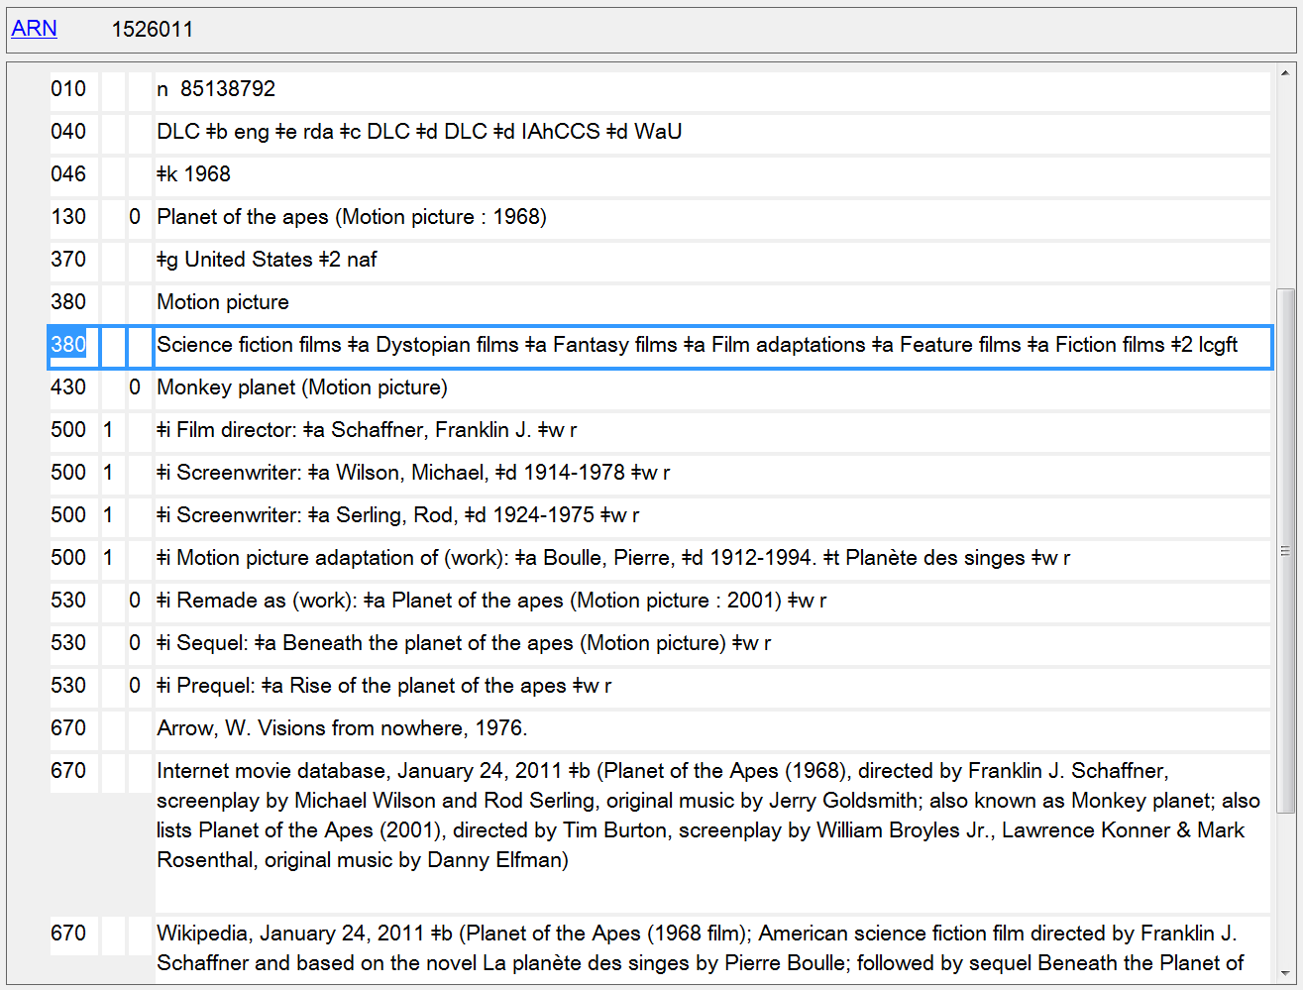
Form of Work
380

Slide 59
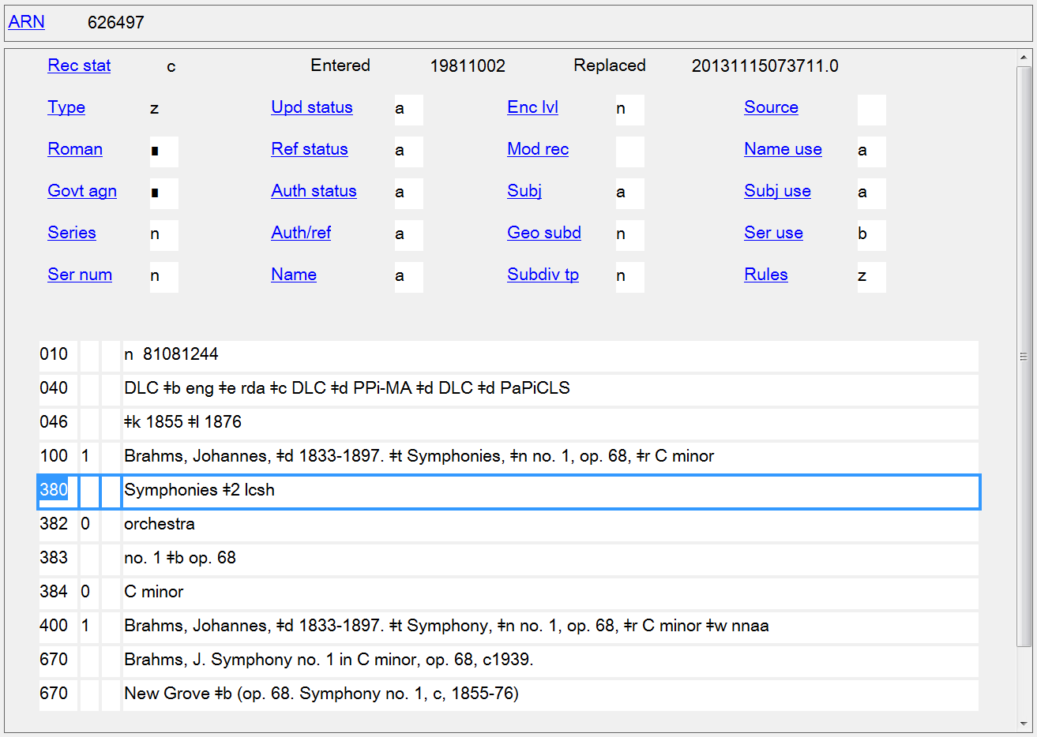
Form of Work
380

Slide 60
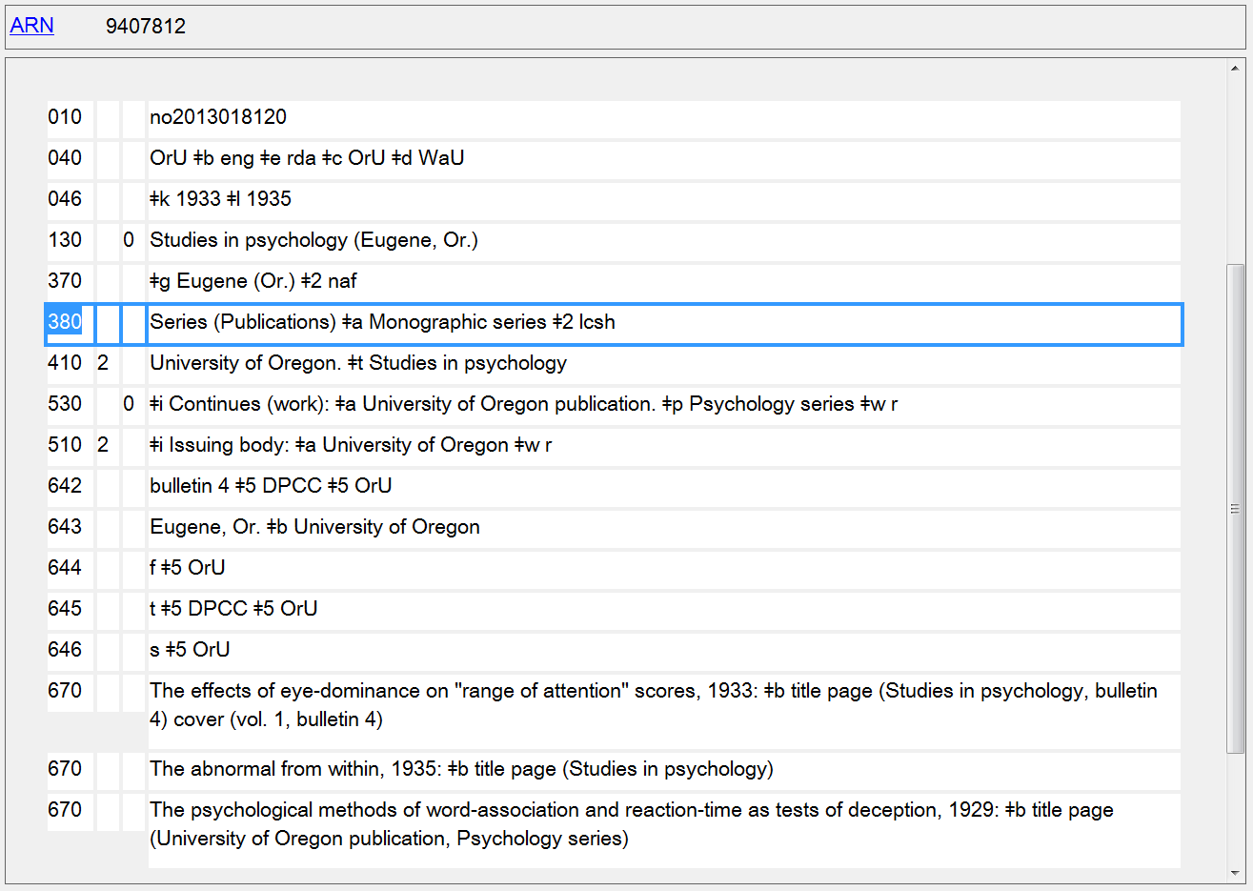
Form of Work
380

Slide 61
381 - Other Distinguishing Characteristics of Work or Expression
Indicators not defined
Subfields
$a - Other distinguishing characteristic (R)
$u - Uniform Resource Identifier (R)
$v - Source of information (R)
$0 - Record control number (R)
$2 - Source of term (NR)
$6 - Linkage (NR)
$8 - Field link and sequence number (R)
Notes:
Any characteristic that is not accommodated in a special field that serves to characterize a work or expression. Examples are an issuing body, arranged statement of music, version, or a geographic term. May be used to differentiate a work from another work with the same title.
Multiple characteristics from the same source vocabulary may be recorded in the same field in separate occurrences of subfield $a (Other distinguishing characteristic). Terms from different source vocabularies are recorded in separate occurrences of the field.

Slide 62
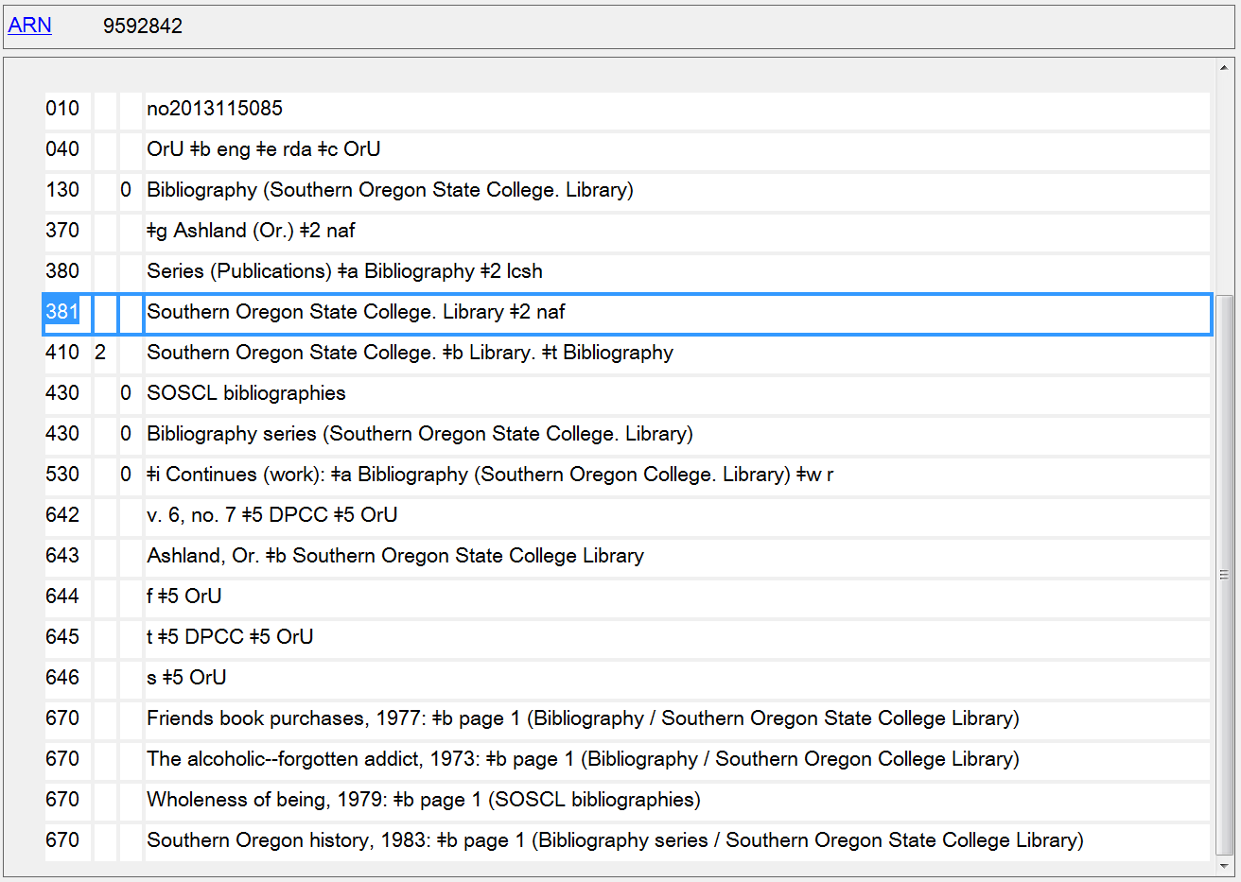
Other Distinguishing Characteristic of Work
381
Notes:
Issuing body used as a qualifier - also recorded separately in field 381.

Slide 63
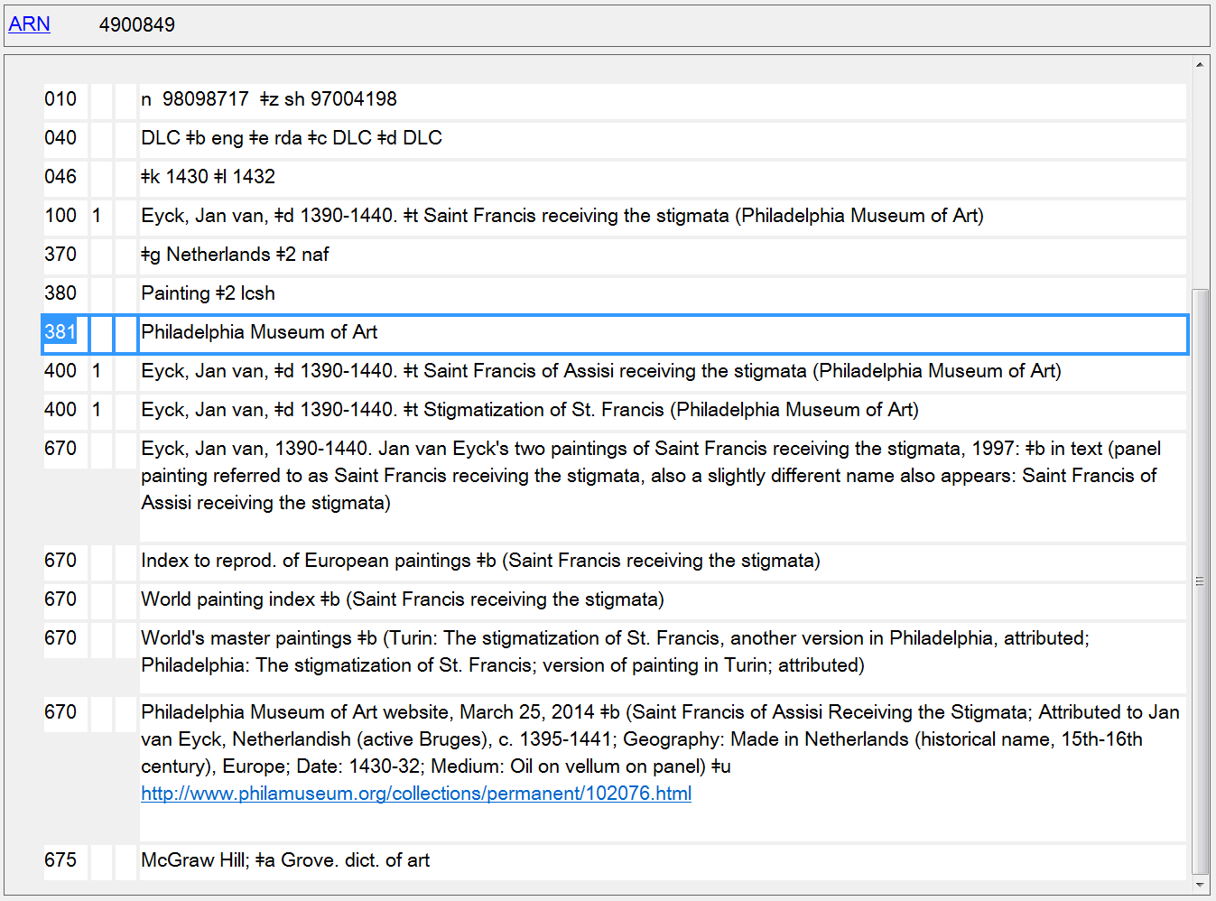
Other Distinguishing Characteristic of Work
381
Notes:
Two paintings by the same artist with the same title. Art museum owning the painting used to differentiate the two works.

Slide 64
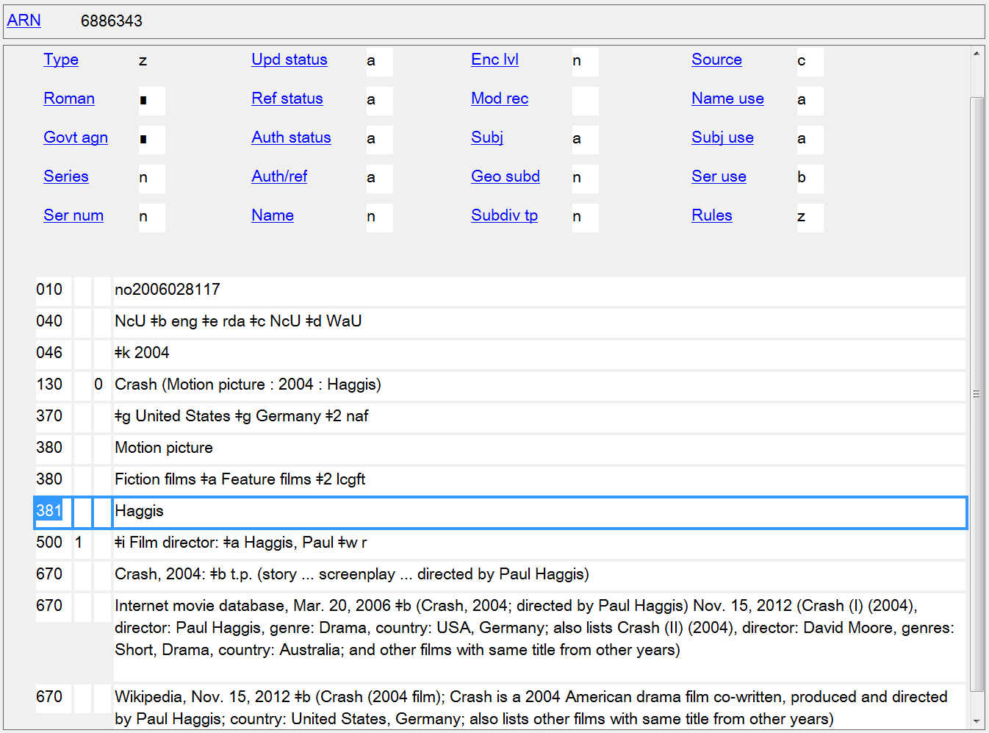
Other Distinguishing Characteristic of Work
381
Notes:
Surname of director added to access point for a film to differentiate it from another film with the same title from the same year. Surname also recorded separately in 381.

Slide 65
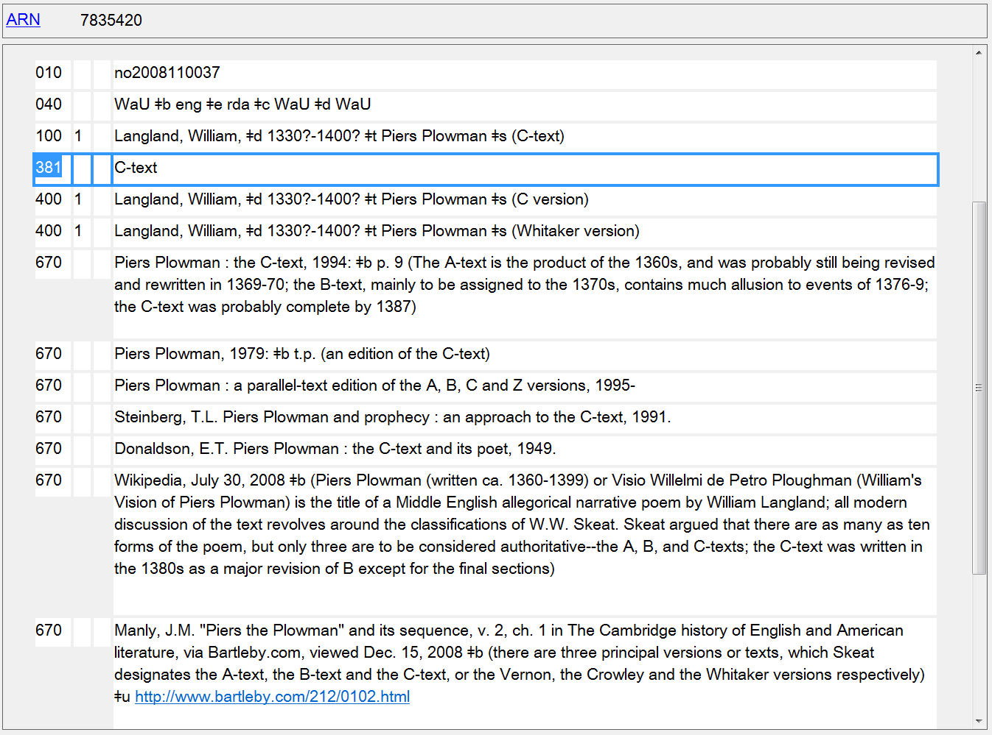
Other Distinguishing Characteristic of Expression
381

Slide 66
Other Distinguishing Characteristic of Expression
381
Notes:
Surname of translator added to access point to differentiate a specific English expression. Surname also recorded as a separate element in 381.

Slide 67
Other Distinguishing Characteristic of Expression
381

Slide 68
382 - Medium of Performance
First Indicator
# - No information provided
0 - Medium of performance
1 - Partial medium of performance
Second Indicator not defined
Subfields
$a - Medium of performance (R)
$b - Soloist (R)
$d - Doubling instrument (R)
$n - Number of performers of the same medium (R)
$p - Alternative medium of performance (R)
$s - Total number of performers (R)
$v - Note (R)
$0 - Authority record control number or standard number (R)
$2 - Source of term (NR)
$6 - Linkage (NR)
$8 - Field link and sequence number (R)

Slide 69
383 - Numeric Designation of a Musical Work
Indicators not defined
Subfields
$a - Serial number (R)
$b - Opus number (R)
$c - Thematic index number (R)
$d - Thematic index code (NR)
$e - Publisher associated with opus number (NR)
$2 - Source (NR)
$6 - Linkage (NR)
$8 - Field link and sequence number (R)

Slide 70
384 - Key
First Indicator
# - Relationship to original unknown
0 - Original key
1 - Transposed key
Second Indicator not defined
Subfields
$a - Key (NR)
$6 - Linkage (NR)
$8 - Field link and sequence number (R)

Slide 71
Medium of Performance 382
Numeric Designation 383
Key 384

Slide 72
336 - Content Type
Indicators not defined
Subfields
$a - Content type term (R) $b - Content type code (R) $2 - Source (NR)
$3 - Materials specified (NR) $6 - Linkage (NR) $8 - Field link and sequence number (R)
Terms from RDA 6.9
PCC policy: Do not supply

Slide 73
Content Type
336
Notes:
Although current PCC policy is not to supply 336, there are a handful of records with it in the LC/NACO authority file.

Slide 74
Enhancing Discovery
For catalogers
Attributes are searchable in OCLC Connexion
For patrons
Future scenarios:
Semantic Web and linked data
Notes:
These fields recording attributes of FRBR group 1 and 2 entities support the FRAD and FRBR conceptual models. Not all systems/OPACs can take advantage of these but we are working toward future scenarios such as those envisioned by the Semantic Web that depend on linked data to make, visualize and connect relationships among and between names, corporate bodies, works, expressions, etc.

Slide 75
Searching the LC/NACO AF in OCLC Connexion
rda
librarians
Notes:
RDA attributes are permitted in both AACR2 and RDA authority records. Of course all newly created NARs are now done according to RDA. To limit a search to RDA authorities, search for “rda” in Descriptive Conventions. [FIRST ANIMATION]
To search for any attribute data, use the Entity Attributes index. [SECOND ANIMATION]

Slide 78
Notes:
How about generating a list of composers from Oregon.

Slide 79
Notes:
27 authority records are retrieved from the search for composers from Oregon.

Slide 81
Notes:
How about a list of fictitious authors?

Slide 83
Notes:
Other designation associated with the person is a core element for fictitious or legendary persons (see RDA 8.3 April 2014 revision) and must be recorded as a separate element, as part of the authorized access point representing the person, or as both. In this case, the name is unique and does not need a qualifier to differentiate it. However, since the element is core, it has been recorded in the 368 $c, which makes it possible to search the authority file for fictitious persons.

Slide 84
Notes:
How about we want to find examples of real-life cats as persons associated with resources? Like our fictitious persons examples, other designation associated with the person is a core element for real non-human entities (see RDA 8.3 April 2014 revision) and must be recorded as a separate element, as part of the authorized access point representing the person, or as both.

Slide 87
Notes:
Here’s a fictitious character who is a cat. There’s also another one in our retrieval set: Meeow (Fictitious character)

Slide 88
Notes:
Generate a list of films from 2001.

Slide 89
Notes:
Only a few results returned are actually films. Several issues that need work: more attribute information needs to be added to work authority records; we need to be able to be more specific in searching for particular attributes. In this case, it would be helpful to limit our search to just the form of work attribute.

Slide 90
The Future
What poetry by Oregon authors do you have?
Do you have music by French women composers of the 19th century?
How about recordings of rock bands from Portland?
I’m looking for novels written in the 1920s by people who were doctors or lawyers by profession.
Notes:
The catalog probably cannot answer any of these questions, but in the future hopefully, with linked data between bibliographic and authority records and links to other information sources on the Web, our systems will enable users to do these kinds of searches and return results showing what a specific library or consortium holds.

Slide 92
Notes:
What we need, and hopefully will get, is a system that enables users to query authority records (though they won’t know they are doing that) for attributes of entities, and then returns bibliographic records of resources that have the access points found as a result of the initial search. Hopefully, library system developers will take advantage of the potential of linked data and all of the new information that we are including in authority records.

