Slide 1
CIVILITY IN THE WORKPLACE:
Here, there, anywhere?
Maureen Cole, Director
Oregon City Public Library

Slide 2
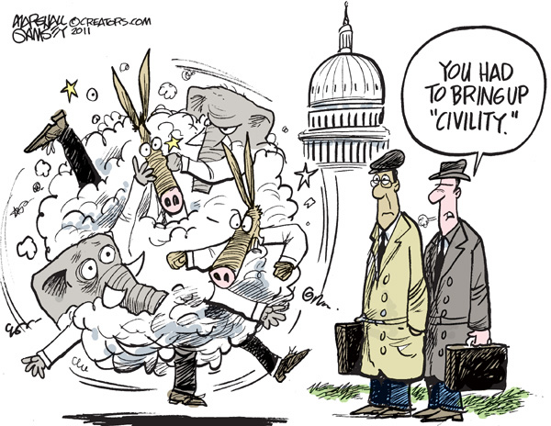
What are we here to talk about today?
Notes:
For me this topic started four years ago when I started working in Oregon City. I was the Director of a public library for the first time, and one of the requirements was that I attend every City Commission meeting. Wow, the fireworks! It really made me think about civility and civil discourse. Never mind national politics. It really made me think about how we work together, or not, when we disagree.
I eventually applied for a grant which I did not get, but I was thinking about a series of interactive lectures on government and discussion about tough topics. Eventually, we started a documentary film series, each of which has a speaker/facilitator to help discussion. Not all of the films are about serious tough topics, but many of them are.
As I mentioned I’m a director, which means I’m management, one of the few positions where you actually get paid to talk about each other. One of my concerns is making sure that staff are all working together well. The topic of civility came up again. What does it mean to be civil in the library environment? That’s what I hope to talk about with you today.
Feel free to interrupt and ask questions as we go along.
BTW, the Commissioners finally figured out how to get along but it was too late and one of them was recalled.

Slide 3
Civility: what is it?
Civility is behavior that:
Shows respect toward another
Causes another to feel valued
Contributes to mutual respect, effective communication and team collaboration
“Civility usually is demonstrated through manners, courtesy, politeness, and a general awareness of the rights, wishes, concerns, and feelings of others.”
Weeks, K. M. (2011). In search of civility: Confronting incivility on the college campus. New York: Morgan James Publishing
Another person defined it as:
Acting with Respect
Using Restraint
Seeking Refinement
Notes:
Respect is inherent in the belief that although another person’s beliefs may be different than yours, you should still honor their viewpoint and accord the other person due consideration. Taking someone’s feelings, ideas, and preferences into consideration indicates that you take them seriously and that their position has worth and value, even if contrary to your own. In so doing, you validate the other person’s individuality and right to a differing opinion. Respect is the most important step in building a relationship and reducing the potential for conflict. In an atmosphere of mutual respect, goals and concessions become easier to attain.
Restraint is simply a matter of exercising personal self control at all times. Therefore, you should know your triggers. Be aware of how your words and actions affect other people. Being aware of the things that make you angry or upset helps you to monitor and manage your reaction. Think before you act. Remember, you may not be able to control the things others say or do. But, you can control your response.
Refinement is the quest for continual cultivation and improvement of relationships in the workplace. Just as the process of Continual Quality Improvement (CQI) has come to be known as a means to improve performance and increase efficiency in an organization, refinement of thought, ways of expressing those thoughts and the practice of continuously exercising appropriate decorum when relating to others can go a long way towards enhancing workplace civility. Improving and strengthening relationships requires effort and commitment.

Slide 4
What is workplace incivility?
Notes:
So, if we now know what workplace civility is, can anyone give me some examples of workplace incivility? Specific to the library world, please?
Is it just the lack of complete civility?
Any shades of gray?
Taking credit for other's efforts • Passing blame for our own mistakes • Checking e-mail or texting messages during a meeting • Sending bad news through e-mail so that we don't have to face the recipient • Talking down to others • Not listening • Spreading rumors about colleagues • Setting others up for failure • Not saying "please" or "thank you" • Showing up late or leaving a meeting early with no explanation • Belittling others' efforts • Leaving snippy voice mail messages • Forwarding others' e-mail to make them look bad • Making demeaning or derogatory remarks to someone • Withholding information • Failure to return phone calls or respond to e-mail • Leaving a mess for others to clean up • Consistently grabbing easy tasks while leaving difficult ones for others • Shutting someone out of a network or team • Paying little attention or showing little interest in others' opinions • Acting irritated when someone asks for a favor • Avoiding someone • Taking resources that someone else needs • Throwing temper tantrums
Foregoing based on data from The Cost of Bad Behavior, How Incivility Is Damaging Your Business and What to Do About It, by Christine Pearson and Christine Porath First published in 2009 by Portfolio, a member of the Penguin Group (USA) Inc.

Slide 5
Why does it matter?
Lack of productivity when people are busy talking about each other or stressed about their co-workers
Creates a tense atmosphere which is picked up by patrons
Interferes with team work
Makes it harder to keep good employees
Interferes with our ability to be civil with patrons
Interferes with transfer of institutional knowledge from employee to employee, which is best done when good relationships are in place.
Notes:
The Cost of Workplace Incivility
Percentage of people in United States today who:
• Believe incivility is a problem: 80% • Have experienced incivility at work: 96% • Experience stress because of workplace incivility: 60%
Percentage of employees who
• Believe that they get no respect at work: 80% • Claim that they are treated uncivilly at work at least once per week: 48% • Were dissatisfied with the way their companies handle incivility: 3 out of 4 • Say that they would have career problems if they reported incivility: more than half • Have reported their uncivil treatment to HR or EAP: 9% • Left their job because they were treated uncivilly: 12%
Average price of replacing each of those employees: $50,000 (1.5 or 2.5 times their annual salaries.)
Annual cost of job stress to US Corporations: $300 billion
Amount of time Fortune 1000 executives spend resolving employee conflicts: 7 weeks per year
Percentage of workers treated uncivilly who:
• Get even with their offenders: 94% • Get even with their organization: 88%

Slide 6
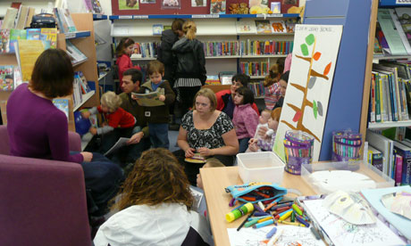
The library as workplace: what makes it challenging to civility?
Notes:
Ask for input
Colleagues:
Tired , rushed co-workers
Patrons:
People with differing expectations and needs
Long hours / overwork
“Hot” temperament
Workplace stress
Inflexibility
Passive aggression
Hurt feelings
Intolerance of individual differences

Slide 7
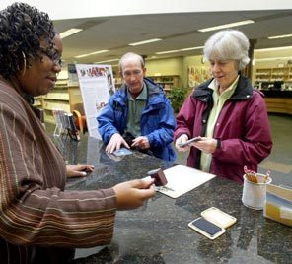
Who to we answer to?
Civility and patrons
Superior customer service, extremely valuable asset to community, star among libraries
Pleasant interchange
Unpleasant interchange
Scary interchange/security problem/negative experiences with patrons frequent
Civility and fellow workers
Incredible teamwork and staff all strongly aware of goals and going in same positive direction
Pleasant relationship and ability to work out problems
Occasional clash, corresponding drama, unnecessary time and upset
Toxic relationships, bullying, general negativity

Slide 8
Introversion and civility in the library
Introverts and extroverts need different amounts of outside stimulation to function well
Introverts and extroverts often work differently; introverts often work more slowly and deliberately than extroverts. They prefer to focus on one task at a time and can have great powers of concentration. They are often immune to the lure of fame and fortune.
Introverts and extroverts may have differing social styles. Introverts may have great social skills but still prefer to be home alone rather than a crowded party. They may feel they can express themselves better in writing than by speaking, especially extemporaneously. They tend to dislike conflict. Many have a horror of small talk.
Many are highly sensitive
High reactivity, high alert
Think and feel more deeply
What parts of being introverted might contribute to incivility in a library workplace?
Notes:
Intro:
I happen to believe that the library world is filled with more introverts than extroverts. Let’s face it-most of us get here by way of our love of reading.
Which is not to say we don’t also love to share, are not friendly, etc.
We are all complex and respond differently in different situations. Not every trait applies to every person, we are not all one thing or another; we are a complex mix of things so you may be one thing one day or one moment and another under differing circumstances.
So now lets’ compare these traits to a real world library
Stimulation: depends on what you do and where you work: childrens’ area: major stimulation, technical services-low stimulation; circ area: can be major stimulation at a check out desk-lines of people, noise, lack of control over the environment, multi-tasking needed
Lack of time to focus the way we’d like to
Forced to deal with conflict
May have to respond quickly verbally

Slide 9
Behaviors which encourage incivility
Individualism and lack of respect: if you are always thinking “I’ll do it my way”, you’ll have a hard time of thinking of others; when we end up caring little about what people think of us, we end up thinking very little of them
Inflated self-worth: more self-absorbed, other people lose their value to us
Low self-worth: people become defensive or hostile
Materialism: people who have this tendency tend to show more antisocial traits
Mental health problems: name it and they all can cause rudeness in different ways
Injustice: when we think we are being treated unfairly, or have been wronged, we can respond in ways which can make us act out in hostility
Stress: makes us more easily over-whelmed, not taking the time for politeness, makes us less tolerant of others’ behavior too
Anonymity: leads us to believe we can get away with rudeness and therefore can act with impunity
Not needing others: at least we are tricked into thinking this with the lack of personal contact; if we don’t need others, then we don’t care how we treat them
Fear:
Anger: poise of often beyond our reach when we are angry
How many of these traits might show up in patrons; in yourself?

Slide 10
Behaviors which encourage civility
Remember pleasantries • No interrupting • Be open-minded • Say what you mean • Be aware of your tone and volume • Don’t argue for the sake of arguing; Pick your battles • Be respectful, even in disagreement
Before acting, consider the impact of your words and actions on others.
Create an inclusive work environment. Only by recognizing and respecting individual differences and qualities can your organization fully realize its potential.
Self-monitor the respect that you display in all areas of your communications, including verbal, body language, and listening.
Understand your triggers or “hot buttons.” Knowing what makes you angry and frustrated enables you to manage your reactions and respond in a more appropriate manner.
Take responsibility for your actions and practice self-restraint and anger management skills in responding to potential conflicts.
Adopt a positive and solution-driven approach in resolving conflicts.
Rely on facts rather than assumptions. Gather relevant facts, especially before acting on assumptions that can damage relationships. How do you uncover assumptions? Ask yourself – do I know this, or am I just jumping to that conclusion? What questions do I need to find out?
Include others in your focus by considering their needs and avoiding the perception that you view yourself as the “center of the universe.”
View today’s difficult situations from a broader (big picture) and more realistic perspective by considering what they mean in the overall scheme of things.
"Each one influence one” by becoming a bridge builder and role model for civility and respect. Act in a manner whereby you respect yourself, demonstrate respect for others, and take advantage of every opportunity to be proactive in promoting civility and respect in your workplace.

Slide 11
Improving civility and encouraging civility in the workplace
Teach civility to everyone in the workplace. Offer training on good manners and ways to show respect to colleagues. Have the leaders at the firm kick off the training to illustrate their commitment to it.
Have zero-tolerance expectations for abrasive behaviors in the workplace. Make sure you take action otherwise you are condoning it.
Teach employees how to self-monitor their own behavior. Employees need to know what their triggers are and how to control their impulses and responses.
A certain level of conflict is important in companies, and yet employees and managers often don’t know how to express conflict in a healthy way. Make sure to examine the conflict management styles of employees and managers and teach the value of openly discussing issues.
Provide anger or stress management training in the company. Even offering tips every week can be useful for employees.
Encourage employees to consider the impact of their words and actions on others before they act. Too often, e-mails or text messages are sent out in rapid fire, which only serve to escalate a situation.
Encourage a business casual or professional dress code. Some have argued that a more casual or sloppy dress code is related to colleagues treating each other in an overly familiar and less professional manner.
Be on time. If you are late to meetings or to getting work done, at least apologize. This is not a sign of weakness, but a sign of good manners.
Help employees accept responsibility for their actions and the consequences of those actions.
Ask for feedback to learn how you are coming across to others. Listen to that feedback, and take action to improve.

Slide 12
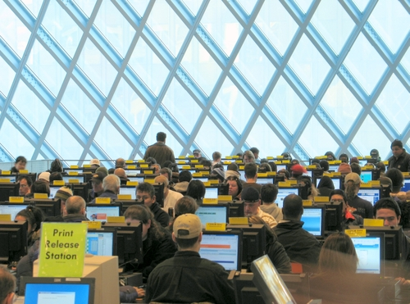
Civility and patrons and customer service
Notes:
Let’s discuss lack of civility in patrons
Let’s discuss when it topples into a security problem

Slide 13
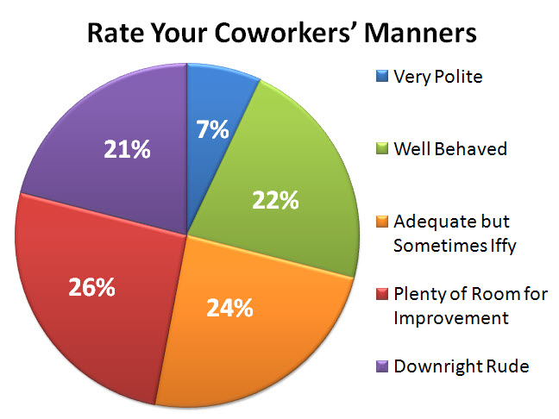
Civility and colleagues
Notes:
And 3a: What is workplace incivility? Workplace Incivility (see the anti-bullying image)
“Any self-centered behavior that is impolite…or shows a disregard for rights and concerns for others.” (Weeks, 2011, p. 7) Do List Here?? •
Incivility –Incivility is social behavior lacking in good manners, on a scale from rudeness or lack of respect to threatening behavior. –A distinguishing feature of incivility is its ambiguity and that its intent to harm or injure another is not obvious. •
What actions may constitute a lack of civility and respect? –Verbal Abuse –Physical Abuse –Sexual Harassment –Negative Behavior(s) Verbal Abuse –Profanity –Demeaning comments –Racial or ethnic jokes –Threats or intimidating language –Yelling, devaluing, discouraging
Civility & Respect in the Workplace •Verbal abuse –Condescending language or voice intonation –Impatience with questions or phone calls –Being reprimanded in front of others or criticizing others in public –Insulting the intelligence of a co-worker
Civility & Respect in the Workplace •Verbal abuse –Argumentative behavior. –Sending nasty and demeaning notes (e-mail) –Unreasonable requests –Exclusion from relevant meetings –Name calling
Civility & Respect in the Workplace •Physical Abuse –Throwing objects –Outbursts of rage or violence (hitting the wall, drawing back as if to strike someone).
Civility & Respect in the Workplace •Sexual Harassment –Comments or jokes related to gender –Touching someone without their permission –Pictures or cartoons regarding gender or sex posted in the workplace
Civility & Respect in the Workplace •Negative Behaviors –Scape-goating –Backstabbing –Complaining –Perpetuating rumors
Civility & Respect in the Workplace •Negative Behavior –Behavior whose purpose is to control, humiliate, denigrate or injure the dignity of colleagues –Being expected to do another’s work (clean up after them) –Behaviors which undermine team cohesion, staff morale, self worth and safety
Civility & Respect in the Workplace –Unethical or dishonest behavior –Repeated failure to respond to a call or e-mail –Cultural or gender biases

Slide 14
Wrap up/questions

Slide 15
Resources
http://publiclibrariesonline.org/2013/04/choose-civility-public-libraries-take-center-stage/ (Howard County Library System’s Choose Civility Campaign)
Cultivating civility in the workplace By Joyce E.A. Russell,June 17, 2012 http://articles.washingtonpost.com/2012-06-7/business/35460509_1_civility-workplace-manners
http://choosecivilitynow.org/in-the-workplace.html
Now the reasons forni says civility falls away: pg 16
Weeks, K. M. (2011). In search of civility: Confronting incivility on the college campus. New York: Morgan James Publishing

