Slide 1
BookShare: Reaching Kids in Care Cedar Mill Community Library
Early Literacy Outreach Using Volunteers
Jody Westerman, Outreach Librarian
OLA April 2012

Slide 2
BookShare: Reaching Kids in Care
Started 1996 at Cedar Mill Community Library,
Washington County, Oregon
Serving:
Family Child Care Homes
Day Care Centers
Head Start
Woodside Early Intervention/Special Education

Slide 3
Outreach Funding
Staff paid by library (outreach librarian, PT library assistant)
Books and storytime materials funded by:
Grants (Ready to Read; Oregon Community Foundation)
Small Library Budget
Dedicated Donations
Book Donations (used books in good condition)
Volunteers: donate time and mileage
Library funds luncheon meetings, training, etc.

Slide 4
BookShare currently serves, in a month:
50 child care sites with book delivery
36 family child care
14 day care centers
3880 books delivered (113 boxes)
To 1697 children and 361 adults
10 storytimes at family child care
To 113 children and 34 adults (March 2012)

Slide 5
Services to Child Care Providers
Book Delivery
Storytime
Deposit collections at Woodside EI/SE
Summer Reading Program
BookPacks (to go home for parent & child)
Early Literacy Workshops (CE Credit)

Slide 6
Book Delivery
To all child care sites: family, centers, Head Start
Monthly, rotating book collections
Box of 50 books: mixed age box
10 board books (babies & toddlers)
39 paperbacks (ages 2-5)
Fiction and non-fiction, variety of topics
1 teacher resource book
Infant/toddler box: 20 board books
No fines or fees

Slide 7
Book Delivery - Infrastructure
Money to purchase new books & replacements
Books for babies, toddlers, preschoolers, providers
Staff to select & purchase books
Staff to organize boxes, label books, create inventory lists; replace worn/damaged books
Volunteers to deliver, inventory returned books, clean & mend books, laminate books
Space to store boxes of books and inventory

Slide 8
Storytime Sites
Family Child Care
1 x each month for one year (12 visits)
Infants, toddlers, preschoolers (4-12 kids)
Head Start and Woodside Special Education
1 x each month for school year (9 visits)
Preschoolers (HS 20 kids: Woodside 8-12 kids)
No storytime at day care centers

Slide 9
Storytimes
Once a month by same volunteer (1 year = 12 visits)
Lasts 30 minutes
Includes:
age appropriate books
flannel stories
prop stories
songs, rhymes, fingerplays, movement
early literacy information
storytime outline

Slide 10
Storytime - Infrastructure
Storytime Resources:
Storyboxes, big books, flannel stories, songs etc.
$ - to purchase resources
Volunteers: to present storytimes
Staff - train & supervise volunteers
Staff - select, process, organize resources

Slide 11
Summer Reading
Family child care providers track reading
Parents invited to read at home with babies, toddlers, preschoolers & track
Each child receives a free board book or paperback (and other small prizes)
Storytime volunteers deliver SR prize books to family child care sites

Slide 12
BookPacks Backpacks with 3 age appropriate books go home from childcare site for parents & child to read together.
Deposit Collections at Early Intervention
Board books housed at EI offices.
Professionals read during home visits w/parent & child.
Early Literacy Workshops
Free workshops for child care providers on early literacy.

Slide 13
Child Care Sites - Recruitment
Oregon Child Care Division, list of registered & certified providers
Child Care Resource & Referral Agency (CCR&R)
Provider Resource Organization (PRO)
Oregon Association for the Education of Young Children (OAEYC)
Online, phone book, neighborhood signs
Word of mouth

Slide 14
Child Care Providers – Starting Services
Phone: Introduce program
Initial interview at site
Site information
Why read, early literacy
What storytime looks like
Expectations
Delivery of books at interview
Storytime scheduled at later date
Match volunteer with site

Slide 15
Volunteer Positions
Book Delivery
Storytime
Check-in
Laminator
Special Projects

Slide 16
Volunteer Recruitment
Library volunteer manager
In-library ads / flyers
Library website, newsletter (paper and e)
Articles in local newspapers
Specific organizations
Word of mouth

Slide 17
Volunteer Orientation Process
Phone contact
In- person interview w/ outreach librarian
Observe storytime at family child care sites
Attend 3 hour training
Background check
Site assigned
Plan first storytime
Present storytime

Slide 18
Volunteer Training Session
BookShare: Who we serve and why
Why Read: Why is it important to read?
Early Literacy Development : 6 skills
What to Read: Selecting books for different ages of children; selecting for mixed age groups.
Moving down the developmental ladder.
How to Read: Demonstrate using inflection, pacing
Storytime Structure: Mix reading & activities; routine
Storytime Outline: Your storytime plan
Early Literacy Focus; copy for providers, w/songs

Slide 19
Storytime Resources
Storyboxes by theme
Songs & rhymes & fingerplays
Big books
Flannel Stories
Prop Stories

Slide 20
Volunteer – Supervision & Support
Storytime Feedback Form
Monthly contact with outreach librarian
Quarterly Volunteer Meetings
Yearly on-site observations by outreach librarian
Library-wide volunteer appreciation
Volunteer appreciation by providers

Slide 21
Where to Start?
Many ways to serve children in care & support child care providers
Many models
CMCL focus: Book Delivery 1st
Where: Family Child Care, Day Care Centers
Volunteers: Deliver books, check-in
Storytime 2nd
What works for you?

Slide 22
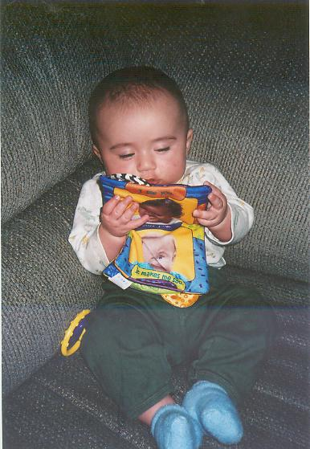
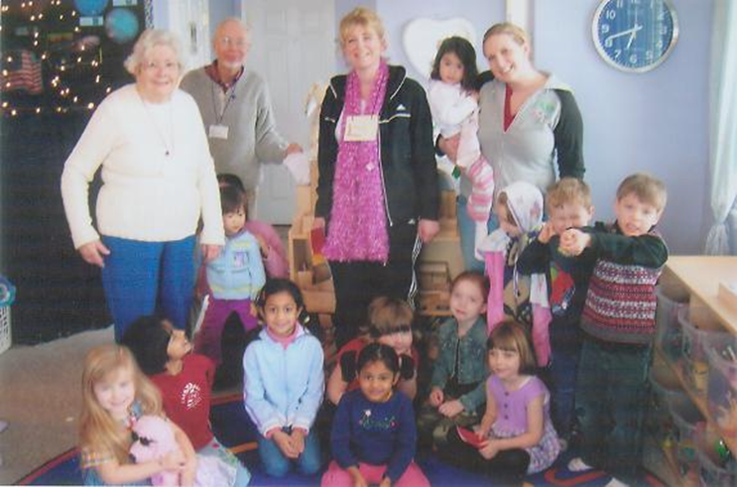
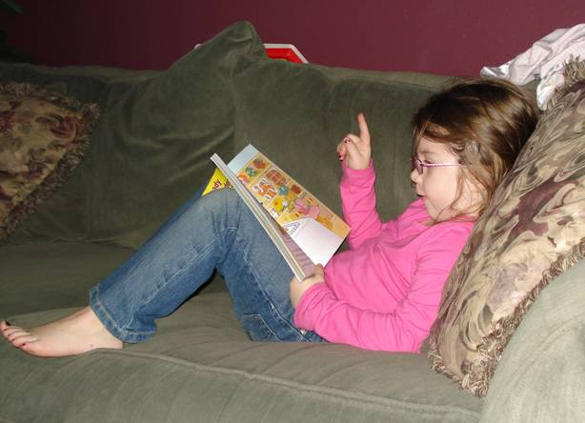
Measuring Success: Is it working?

Slide 23
What can you do?
Getting Started
Who is your audience? What types of care?
Define your service area
Define your service:
Book delivery? Storytime?
How often?
Start small

Slide 24
Planting Seeds
Write
Play
Talk
Sing
Read

Slide 25
