Slide 1
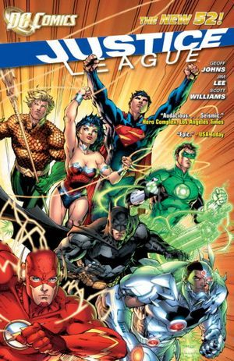
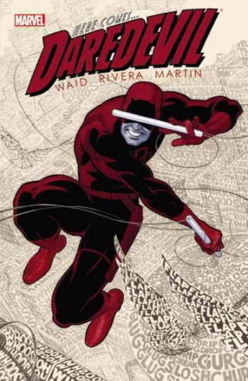


Publishing Trends in Comics
What they mean for libraries.

Slide 2
Current Issues in comics/manga
Magazine to Books
Digital
Declining readership for magazines
Fallout from Borders failure, particularly for Manga
Copying
Creator struggles
Larger corporate owners of major publishers

Slide 3
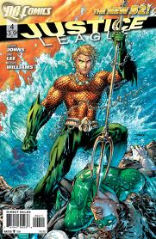
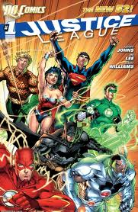
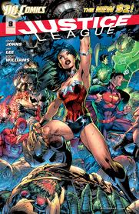
Floppies/Comic Books/Pamphlets
Comic Book Stores
Graphic Novel
$2.99/$3.99
Monthly
14.99 -24.99
2x year

Slide 4
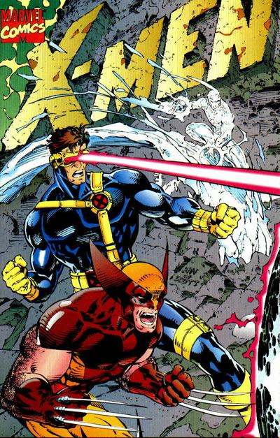
Sales comparison
1991
X-men #1 sells 8 Million copies
1995
X-men books=200,000/month (top 20 books are over 100 k)
2011
Top X-men book= 57 k in July
Top 20 books – only one over 100,000.
- Comics Chronicle
www.comichron.com

Slide 5
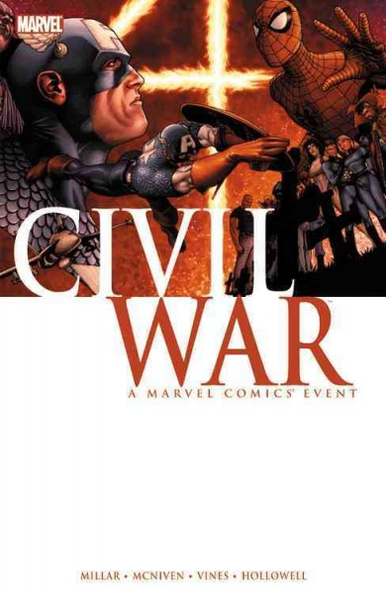
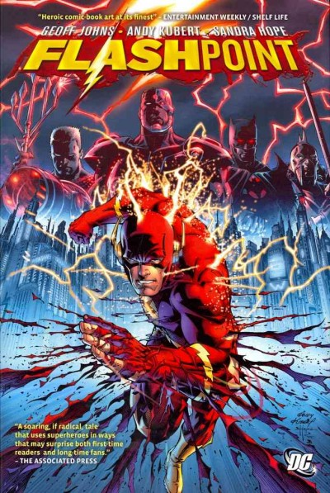
Publisher Responses
Events
Reboot (the new 52)
More team books
Double shipping
Raise prices $3.99
Develop digital strategies

Slide 6
Justice League
02/2008: Justice League #18 -- 89,803
02/2009: Justice League #30 -- 69,710
02/2010: Justice League #42 -- 57,522 --------------------------------------- 02/2011: JL of America #54 -- 46,269 (- 1.8%)
03/2011: JL of America #55 -- 50,533 (+ 9.2%)
04/2011: JL of America #56 -- 47,179 (- 6.6%)
05/2011: JL of America #57 -- 46,729 (- 1.0%)
06/2011: JL of America #58 -- 45,442 (- 2.8%)
07/2011: JL of America #59 -- 43,545 (- 4.2%)
08/2011: JL of America #60 -- 42,587 (- 2.2%)
09/2011: Justice League #1 -- 185,776 (+336.2%) [261,097]
10/2011: Justice League #2 -- 196,569 (+ 5.8%)
11/2011: Justice League #3 -- 168,679 (- 14.2%)
12/2011: Justice League #4 -- 149,314 (- 11.5%) [152,340]
01/2012: Justice League #5 -- 144,670 (- 3.1%)
02/2012: Justice League #6 -- 140,819 (- 2.7%)
-The Beat website

Slide 7
Wonder Woman
02/2007: Wonder Woman #4 -- 69,860
02/2008: Wonder Woman #17 -- 41,948
02/2009: Wonder Woman #29 -- 33,237
02/2010: Wonder Woman #41 -- 25,354 ------------------------------------02/2011: Wonder Woman #607 -- 33,053 (- 1.6%)
03/2011: Wonder Woman #608 -- 32,540 (- 1.6%)
03/2011: Wonder Woman #609 -- 31,421 (- 3.4%)
04/2011: Wonder Woman #610 -- 31,002 (- 1.3%)
05/2011: -- 06/2011: Wonder Woman #611 -- 30,874 (- 0.4%) 06/2011: Wonder Woman #612 -- 30,690 (- 0.6%)
07/2011: Wonder Woman #613 -- 29,720 (- 3.2%)
08/2011: Wonder Woman #614 -- 29,223 (- 1.7%)
09/2011: Wonder Woman #1 -- 76,214 (+160.8%) [95,902]
10/2011: Wonder Woman #2 -- 79,060 (+ 3.7%)
11/2011: Wonder Woman #3 -- 65,621 (- 17.0%)
12/2011: Wonder Woman #4 -- 57,675 (- 12.1%)
01/2012: Wonder Woman #5 -- 57,626 (- 0.1%)
02/2012: Wonder Woman #6 -- 54,190 (- 6.0%)
The Beat website

Slide 8
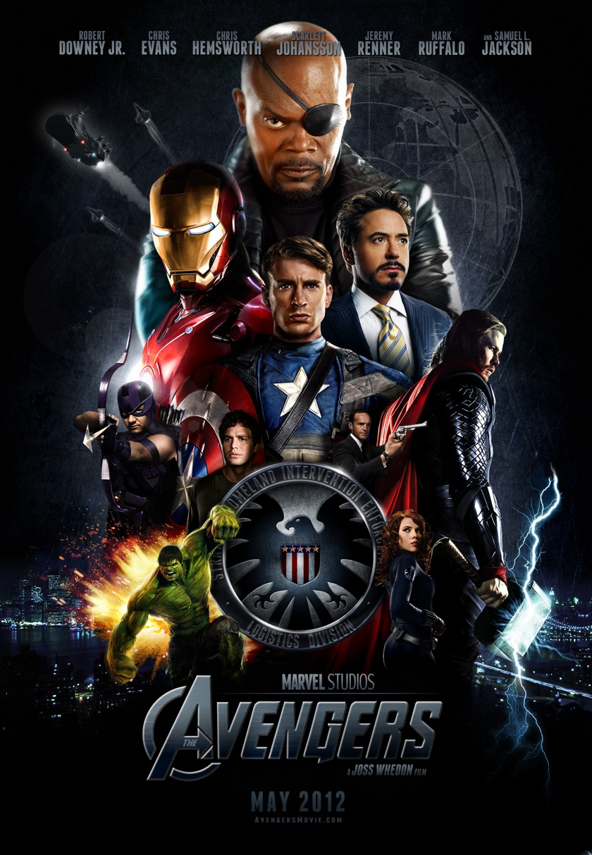
R&D
Disney & Warner Brothers
Research & Development
Character licensing

Slide 9

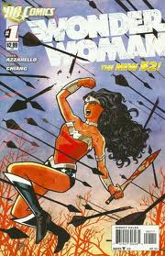

Library Response
Question what we’ve been doing
Hot Creators
Best new superhero comics
Jonathan Hickman
Scott Snyder
Rick Remender
Mark Waid
Wonder Woman
Batman
Animal Man/Swamp Thing
Flash
Daredevil
FF
Notes:
Do we need to collect older comics?
Who is the audience for these books?
Have they abandoned teens? Are they trying to reach them in other ways (DVD, movies)
How do we arrange them on the shelf?
Follow creators, buy good stories

Slide 10
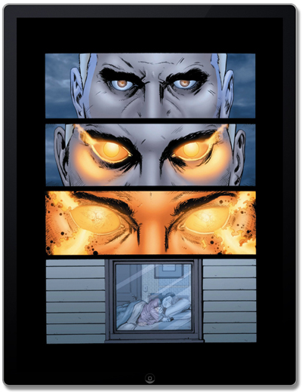
Digital
Ipad, Kindle Fire
Access to a wider audience.
Changes to art
Changes to pricing

Slide 11
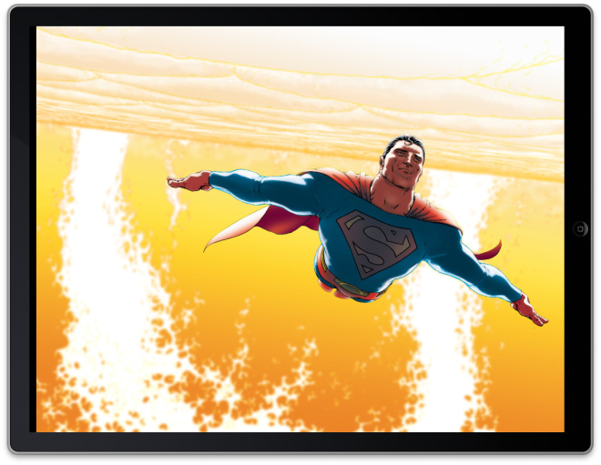

Slide 12
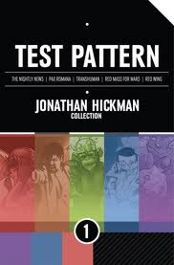
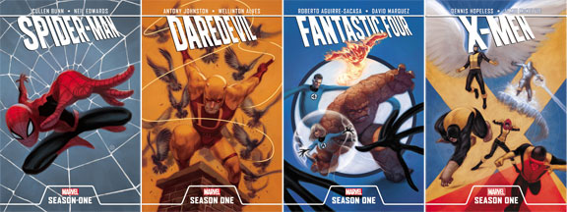
Publisher & Creator Responses
Day and Date
Little change in price, though some drop after a month
Digital code with some physical comics/floppies
No sales info
Experimentation
Notes:
“It's possible for comics to reach… considerably more consumers (with digital), but those same consumers have nearly infinite array of choices when they open their smart phone/ tablet/ computer. And most of those choices they have they are already familiar with the form and the medium. Why do they pick comics over all other media, without showcases, without curators, without ambassadors?
What we need are more embassies, not just being another leaf in the wide river of the internet.
Every day, in every way we should be using digital to help forge links and relationships between publishers and retailers and customers -- the retailer is the embassy to the entire world of comics”
Brian Hibbs

Slide 13
“It's possible for comics to reach… considerably more consumers (with digital), but those same consumers have nearly infinite array of choices when they open their smart phone/ tablet/ computer. And most of those choices they have they are already familiar with the form and the medium. Why do they pick comics over all other media, without showcases, without curators, without ambassadors?
What we need are more embassies, not just being another leaf in the wide river of the internet.
Every day, in every way we should be using digital to help forge links and relationships between publishers and retailers and customers -- the retailer is the embassy to the entire world of comics”
Brian Hibbs, Comic Book Resource

Slide 14
Library Responses to Digital
Library as that embassy to entire world of comics too.
Access to digital in Library2Go pretty limited
Circulate devices with comics

Slide 15

What about Manga?
Notes:
Still popular but massive piracy is hurting
Borders closing hurt manga sales and may have been a significant factor in Tokyopop’s failure.
US Sales down 43% since 2007, many publishers have shut down.
Cheap ink & paper makes manga ripe for scanlation, moreso than Graphic Novels with glossy paper and colored art.

Slide 16
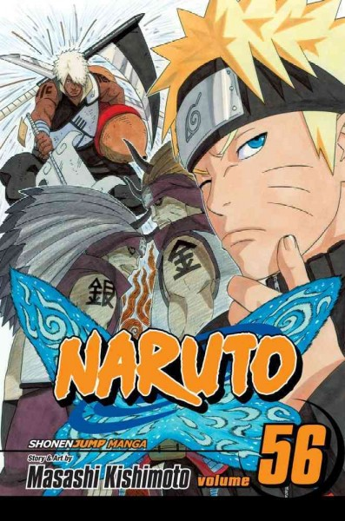
Publisher Response
Cheaper digitally
Poor access digitally
Focus on a few top sellers
Self publishing rising
-Jason Thompson, Io9 website
Notes:
Digital prices are cheaper but access limited
No unified, concerted effort to give readers an alternative to scans.
Translations still lagging
Little effort to meet international demands
More reliance on biggest sellers like Naruto & One Piece
Self publishers rising online

Slide 17
Library Response
Stock what we can
Keep an eye out for new, original titles
Preview, especially online stuff, strong ew factor.
Teaching opportunity to show teens the cost of piracy

Slide 18
Creators
Low pay, hard work, little security
Little control over work for hire still
Some creators doing very well, many languishing.
Notes:
“Being a cartoonist is a great way to make a living — it’s a lot of fun, but it doesn’t pay for college,” says Millionaire, 56, thinking ahead for his two daughters, both still in grade school. “I can’t save. I have to strike gold. Soon.”

Slide 19
“Being a cartoonist is a great way to make a living — it’s a lot of fun, but it doesn’t pay for college,” says Millionaire, 56, thinking ahead for his two daughters, both still in grade school. “I can’t save. I have to strike gold. Soon.”
Tony Millionaire, cartoonist, artist

Slide 20
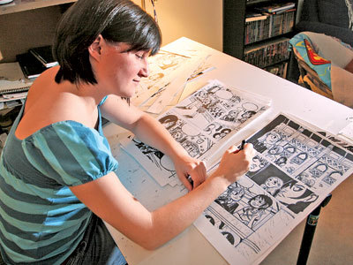
Faith Erin Hicks
Notes:
Drawing comics full time
for 4 years now.
Working with an advance
Also a grant
2010 most successful year, $30,000 – then it dropped to half that in 2011.
Canadian Health Care allows her to work in comics.
Lives very frugally.

Slide 21
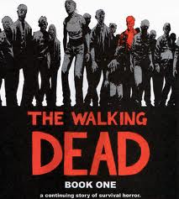
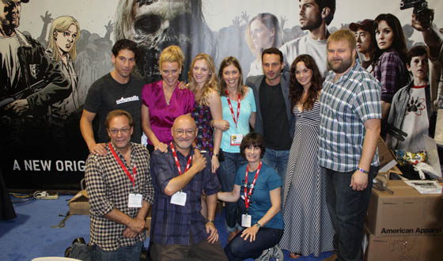
Creator Responses
Notes:
More creator owned, indie initiatives – especially with digital & web comics.
Some work for hire, some creator owned (equivalent of blockbuster movie roles vs. independent roles for actors)
Rise of Image Publishing
Kickstarter
Everyone looking for the next Walking Dead which made Robert Kirkman a very wealthy man.

Slide 22
Library Response
Follow creators
Watch what Image is publishing
Participate in Graphic Rave
Try some programs
Embrace our teaching role

Slide 23
References
Brian Hibbs, Tilting at Windmills
http://www.comicbookresources.com/?page=article&id=37735
Faith Erin Hicks
http://www.friendswithboys.com/2012/01/page-175/
Jason Thompson
http://io9.com/5874951/why-manga-publishing-is-dying-and-how-it-could-get-better/
Comichron - http://www.comichron.com/monthlycomicssales/1991.html
The Beat - www.thecomicsbeat.com
iFanboy – www.ifanboy.com

