Slide 1
Doing Business @ Your Library:
Small Business Information Sources and Services
Presenters
Scott Herron - Adult Services Librarian, Eugene Public Library
Heidi Senior - Reference and Instruction Librarian, W. W. Clark Memorial Library, University of Portland
Glenna Rhodes - Community Services Manager, Deschutes Public Library System
Beth Wickham - Director, Small Business Development Center Central Oregon Community College
Target Audience
Our discussion will primarily focus on recommendations that support understaffed and underfunded public libraries. (Example: libraries with few or no business subscription databases)
Public services staff with limited business experience.
We Will…..
Explore print sources, websites, and databases that support those starting or growing small business.
  Oregon Statewide Database Licensing Program
Review strategies for developing outreach services to your business community.
Examine business advisory support services offered by organizations such as SCORE and Oregon’s Small Business Development Centers.
Three Important Business Support Organizations
Service Corps of Retired Executives (SCORE) - http://www.score.org/
SCORE members are trained to serve as counselors and mentors to aspiring entrepreneurs and business owners.
SCORE Online: Choose a mentor or ask your business questions with the click of a mouse.
Small Business Development Centers - http://www.sba.gov/content/small-business-development-centers-sbdcs
Small Business Development Centers (SBDCs) are partnerships primarily between the government and colleges/universities. The program is administered by the Small Business Administration and offers educational services for small business owners and aspiring entrepreneurs. SBDC services include, but are not limited to, assisting small businesses with financial, marketing, production, organization, technical problems and feasibility studies.
Small Business Administration - http://www.sba.gov/
SBA sets the guidelines for business loans, which are then made by its partners (lenders, community development organizations, and microlending institutions). The SBA website also offers a wealth of information for those starting or growing a small business.

Slide 2
Doing Business @ Your Library:
Small Business Information Sources and Services
Most of us wear many hats during our workday. When my business librarian hat is on, I am generally addressing five tasks.
How do I offer viable business services in a time of shrinking budgets and competing demands?
  To develop a structurally balanced budget by FY14, the City will capture $4.4 million in savings in FY13 and an additional $2.6 million in FY14. In FY 13, Library services will be reduced by $600,000.
Business Collections
Databases
Web Guides
Displays
Sustainable Budget
Staff Time
Competing Demands
Group and Individual Business Instruction,
Tours
Staff Training
Business Programs
Outreach

Slide 3
Doing Business @ Your Library:
Small Business Information Sources and Services
Offering business programs has increased demand for our resources and helped position the library as an indispensable resource for starting and growing a small business in our community.
Business Programs – FY 2012
Workshops on both starting and growing a business
Franchising 101
Worker Classification
Boost Business Web Traffic
Operating a Restaurant or Food Business
Profit From Your New Product Idea
Running a Side Business
HR Essentials For Business Owners
How To Write a Business Plan
Market Research For Your Small Business
Is Your Business Ready For Business
Financing Your Business Venture
Fraud Prevention In Small Business
Ready To Start Your Own Business?
Social Media and Your Small Business
Greening Your Business
Starting an Import/Export Business
Write Your Own Business Plan
Small Business Clinic
Home Business Basics
Starting an Online Business
Business Workshop Partners
Chamber of Commerce
Universities and Colleges
SCORE and Small Business Development Centers
State and Local Governments
Private Sector
Programming ideas: New York Public Library, Science, Industry and Business Center - http://www.nypl.org/locations/tid/65/calendar
No SCORE/SBDC offices in your area? Consider teaming with government groups, the local chamber, and members of your business community.
Private Sector Example
Marketing Bites - Monthly Talks featuring Michael Stearns, HEROweb Marketing & Design.
Kick Starting Your e-Commerce Business - (February, 2012)
Search Engine Marketing to Boost Your Website Traffic - (March, 2012)
Running Profitable Paid Marketing Campaigns - (April, 2012)
Effectively Managing/Monitoring Your Google Analytics - (May, 2012)
Results:
Marketing library resources
  Increased database use, materials checkout frequency
  Example: FranNet Workshop
Leverage resources - Business information network
  SCORE and SBDC staff
  University of Oregon
Improved service to constituents – guides, reference
Demonstrate value by positioning the library as an important business resource in our community

Slide 4
Doing Business @ Your Library:
Small Business Information Sources and Services
Small Business Startup Guides
A Very, Very Informal Survey – EPL Business Patron
38% use our small business resources to grow an existing business. (This has increased with additional programming.)
62% use our small business resources to start a business, explore buying an existing business, franchise, etc.
  Most patrons in this second group visit the library with little or no knowledge of SCORE/SBDC services.
  Many are exploring low-risk entrepreneurship.
MBA Crash Course in Small Business
Question: What do those who want to start an online gift basket business have in common with those starting a chiropractor practice?
Answer: Both know a lot about their specialty, but they may not know how to operate a business. Market research, financial plans, bookkeeping, Google analytics and operating expense ratios have little to do with baskets or backs.
Help basket makers and chiropractors… and everyone in between… get started with these general guides:
ONLINE GUIDES
Corporation Division, Secretary of State Business Information Center: How to Start a Business in Oregon
http://filinginoregon.com/
Lane County Economic and Community Development Department: Doing Business in Lane County
http://www.lanecounty.org/Departments/CAO/EconomicDevelopment/Documents/Doing%20Business%20in%20Lane%20County.pdf
Michigan Economic Development Corporation: Starting and Operating a Business
http://misbtdc.org/small-business-team/small-business-tools/new-venture-guide-to-starting-a-small-business/
University of North Carolina Business and Technology Development Center: Business Start-up Guide
http://www.sbtdc.org/resources/publications/business-startup-guide/
WEBSITES
Small Business Administration - http://www.sba.gov/
Lane Business Link - http://www.lanebusinesslink.com/
BOOKS AND DATABASES
How To Really Start Your Own Business – SCORE
Small Business For Dummies – Eric Tyson
Entrepreneur Magazine and Self-Counsel Press Startup Guides
30-Day MBA Guides – Kogan Page Publishing
Small Business Resource Center – Gale

Slide 5
Doing Business @ Your Library:
Small Business Information Sources and Services

Slide 6
Doing Business @ Your Library:
Small Business Information Sources and Services
“What do I need to do and what comes first? That’s the question most often asked by people thinking about starting a business. There is a logical sequence of actions and a process for starting a business.
Brilliant!
Business Idea
Write a Business Plan
Write an outline
Write a draft narrative
Finalize startup costs
Project monthly operating costs
Project sales
Complete a cash flow statement
Income and expense statement
Finalize business plan narrative
Write executive summary
Add supporting documents
Startup Checklist
Name availability
Legal structure
Licensing requirements
Tax registrations
Register for EIN
Intellectual property protection
Business insurance
Zoning and local requirements
Employee consideration
Image and branding
Self Assessment
Research
Industry
Market, Customers
Competition
Startup Cost Analysis
Identify location/site
Startup needs/costs
Identify resources needed
Identify Your Management Team (Lawyer, Accountant, etc.)
Obtain Financing
START your business!

Slide 7
Doing Business @ Your Library:
Small Business Information Sources and Services
“What do I need to do and what comes first? That’s the question most often asked by people thinking about starting a business.
There is a logical sequence of actions and a process for starting a business.
There Ain’t No Good Italian Restaurants in Eugene!
Business Idea
Write a Business Plan
Write an outline
Write a draft narrative
Finalize startup costs
Project monthly operating costs
Project sales
Complete a cash flow statement
Income and expense statement
Finalize business plan narrative
Write executive summary
Add supporting documents
Startup Checklist
Name availability
Legal structure
Licensing requirements
Tax registrations
Register for EIN
Intellectual property protection
Business insurance
Zoning and local requirements
Employee consideration
Image and branding
Self Assessment
Anthony
From Brooklyn
Research
Industry
Market, Customers
Competition
Startup Cost Analysis
Identify location/site
Startup needs/costs
Identify resources needed
Identify Your Management Team (Lawyer, Accountant, etc.)
Obtain Financing
START your business!
The great debate: do you need a business plan and engage in the planning process?
The business planning process forces us to take an objective, critical, unemotional look at our idea and abilities. The processes forces people to itemize the risks involved and develop strategies to manage those risks.
Financing/Oregon Angel Investors: over $17 million in startup cash in 2011.

Slide 8
ENTREPRENURIAL ASSESSEMENT AND FEASIBILITY ANALYSIS
Entrepreneurial assessment and feasibility analysis tools help potential business owners determine if they are ready to start a business and refine their ideas to minimize risk.
An Entrepreneurial Assessment will help Anthony evaluate whether he possess the characteristics most common to entrepreneurial success:
Identify Personal Objectives
Identify Personal Skills and Experience
Identify Personal Financial Resources
WEBSITES
Small Business Readiness Assessment Tool
http://web.sba.gov/sbtn/sbat/index.cfm?Tool=4
Self-Assessment Questionnaire
http://www.potentielentrepreneur.ca/client/instructionsen.asp
Is Business Right For You
http://toolkit.smallbiz.nsw.gov.au/checklist/question
BOOKS
Steps to Small Business Start-Up – Linda Pinson
Small Business for Dummies – Eric Tyson
Small Business Bible – Steven Strauss
Personal Strengths and Weaknesses: Financial, Business Skills.
If Anthony faces challenges managing his personal finances, how will he manage his business finances? How confortable is he with competition, change, red tape, and possible failure?
Options: Partnership, Franchise.
What revenue streams does Anthony have available while getting his business going? Does he have the startup capital or will he be relying heavily on loans? If the money is lost, how will it affect his family?
Options: Build Savings, Start with Part-Time Business.
Does Anthony have experience in the industry and the skills required to operate a business?
Options: SBDC courses, SCORE, Gain Experience Working in the Industry, Buy an Existing Business, Invest in Someone Else's Business, Outsourcing.

Slide 9
ENTREPRENURIAL ASSESSEMENT AND FEASIBILITY ANALYSIS
Entrepreneurial assessment and feasibility analysis tools help potential business owners determine if they are ready to start a business and how to refine their ideas to minimize risk.
It’s not enough for Anthony to want to run his own business. He needs to assess whether his products and services will generate profits and support his personal objectives. A feasibility analysis will help Anthony identify and avoid the pitfalls that many new small businesses encounter – and learn how he can avoid them.
Upon completing a feasibility analysis Anthony should be able to:
Identify industry trends and support resources.
Evaluate risk levels and identify strategies to minimize risk (regulatory, legal, market/economic volatility).
Assess the financial feasibility of his idea, alternative funding options, and start-up/operating costs.
Profile potential competitors and identify niche markets.
Make an informed choice about whether or not his idea is still practical.
The analysis will help Anthony answer these questions:
Is there a market for my products/services? Who are my customers and why will they buy my product/service instead of those offered by my competitors’?
Can I make a reasonable profit?
What business structure works best (full-time/part-time/franchise/partnership/sole ownership, etc.)?
Who are my competitors and how successful are they?
What niche will I fill to remain competitive?
BUSINESS SUPPORT ORGANIZATIONS
Service Corps of Retired Executives (SCORE) – http://www.sba.gov/content/score (cash-flow worksheet, financial projections template, budget worksheet, etc.)
Small Business Development Centers - http://www.sba.gov/content/small-business-development-centers-sbdcs
Chamber of Commerce –
http://www.uschamber.com/
WEBSITES
Starting A Small Business - The Feasibility Analysis
http://msuextension.org/publications/BusinessandCommunities/MT199510HR.pdf
Business Blueprints - Is Your Business Idea Feasible
http://asbdc.ualr.edu/consulting/feasibility.pdf
BOOKS
Best Practices for Small Business – Gina Adubi
DATABASES
Small Business Resource Center
Market Research Examples, Business Plans, Industry Trends
General Business File ASAP
Gale Business and Company Resource Center

Slide 10
Doing Business @ Your Library:
Small Business Information Sources and Services
Buon appetito
Anthony explores business databases offered through the
Oregon Statewide Database Licensing Program
General OneFile
This general periodical database holds over 12,000 periodicals, newspapers, reference books and multimedia sources.
Anthony will find articles on various small business topics, including: consumer trends, industry profiles, loan options and marketing. For example, Anthony can find articles on restaurants doing innovative things to attract customers, recipes, and Italian food products.
Business Economics and Theory Collection
The Collection offers access to 450 full-text academic journals.
Anthony can explore information on starting a business, marketing a product and analyzing trends in his industry. For example, Anthony can find business case studies and articles on business management.
General BusinessFile ASAP
Includes articles on: Finance, Acquisitions and Mergers, Money Management, New Technologies & Products, Local and Regional Business Trends, and Investments and Banking. The database also includes directory listings for over 150,000 companies as well as investment analysts' reports on major companies and industries.
For example, Anthony can explore restaurant forecasts and trends, laws and regulation, finance issues, market research strategies, and regional restaurant news.
Business & Company Resource Center
The content of this database is divided into three main categories: company research, industry research, and articles about business. The database includes financial data, business rankings, company histories, and industry overviews. The following Gale directories are included: Brands and Their Companies, American Wholesalers & Distributors Directory, Ward’s Business Directory of U.S. Private and Public Companies. Eight thousand records from Gale’s Encyclopedia of Associations are also included.
For example, Anthony can search by SIC/NAICS or subject to learn about franchising, outsourcing, product development, target marketing. He can also examine company reports (with some including a SWOT analysis), company financial statements, product information, brand information and industry data.
Small Business Resource Center
The Small Business Resource Center is designed for entrepreneurs and small business owners. The database offers a wealth of information on a wide range of topics: financial planning, market analysis, business plan creation, startup funding, small business accounting, marketing, personnel management, legal and regulatory requirements and much more. The database also includes information on starting or growing a specific type of small business.
Let’s take a look…..

Slide 11
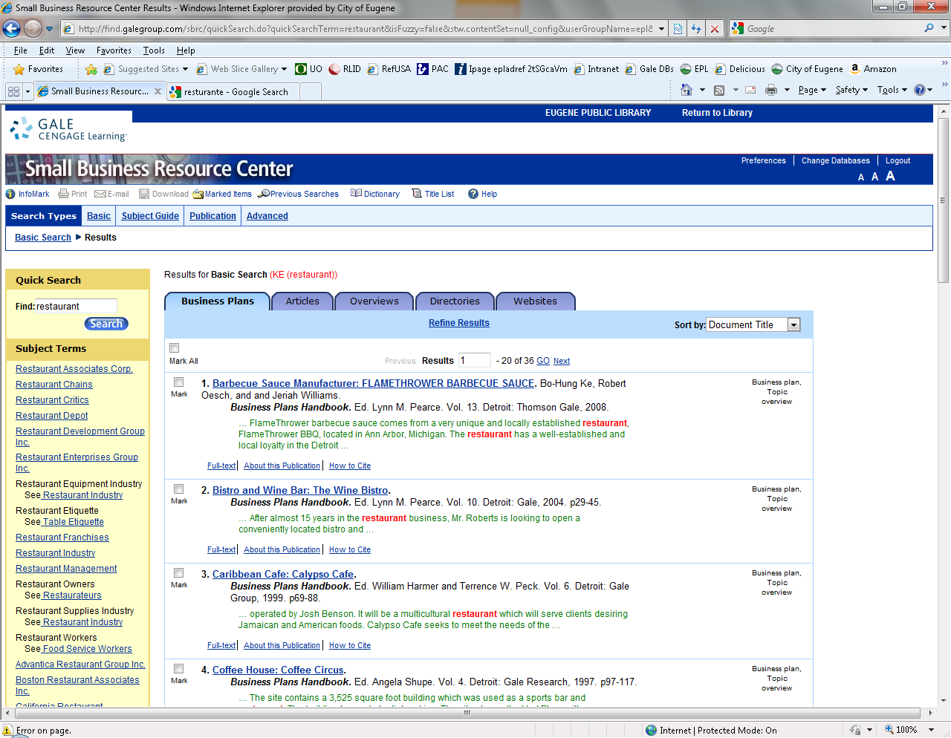
Small Business Resource Center
Cooking up a good example…..Italian style
Anthony wants to start an Italian restaurant in Eugene. Conducting a search in the Small Business Resource Center offers access to:
Sample Business Plans.
Marketing examples from the restaurant industry.
Industry trade show information for restaurant owners.
Contact information for restaurant industry associations.

Slide 12
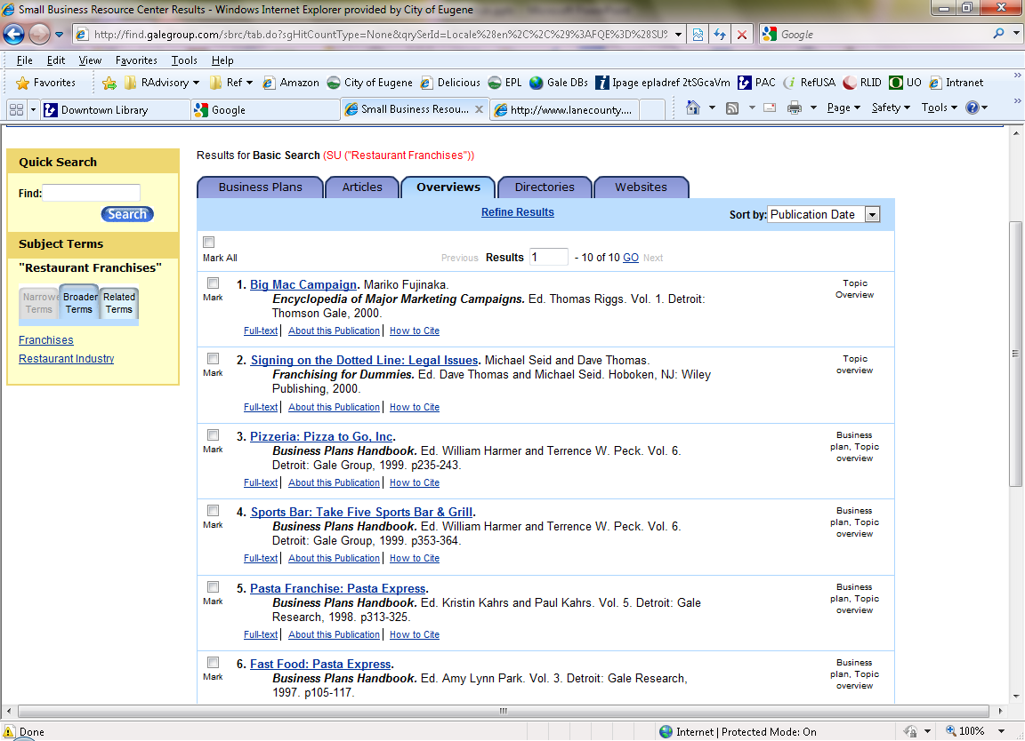
Small Business Resource Center
Overview and Articles Tab
Other SBRC Collections
Encyclopedia of Major Marketing Campaigns.
Encyclopedia of Small Business.
Encyclopedia of Business Information.
Encyclopedia of Management.
Books and nearly 200 business journals.
The Overviews and Articles tabs offer information on business tasks, such as planning capital financing, industry analysis, market share information, statistical tables and more.

Slide 13
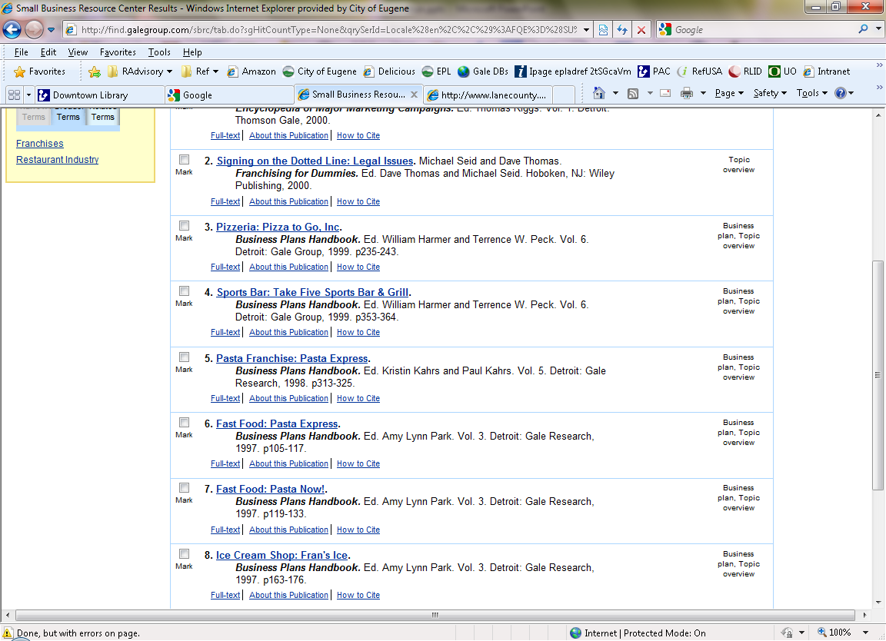
Small Business Resource Center
Sample Business Plan
Italian Restaurant
SBRC contains the complete Gale Business Plans Handbook.
Anthony can learn a lot by reading business plans written by those who have started successful Italian restaurants.
Objectives and mission statements.
Market analysis.
Target market strategy.
Industry analysis.
Competitive Edge.
Sales forecast.
Management Summary.
Financials.
Perhaps Anthony should explore franchise opportunities, buy an existing business or start online bottling that famous marinara sauce.

Slide 14

Market Needs: Product
Tangible and intangible benefits
product/service performance, features, and functionality
Time / Money / Emotional
Academic OneFile, Small Business Resource Center: Look for Product reviews –
Limit to Document Type: Product / Service Evaluation
Also reviews in local papers, web sites, blogs. These can be a great way to find out what’s wrong with current products so that your company can improve upon them.

Slide 15
  Market Description, 1:
  Market Demographics
age, gender, nationality, education, household composition, occupation, and income for a specific market.
Trade Associations will sometimes have this type of data.
For example The Entertainment Software Association or National Needle Arts Association.
Web search: [industry] association.
Also try [industry] demographics.

Slide 16
  Market Description, 2:
  Market Geographics
where your customers are physically located.
American FactFinder: Search by Geographies and enter a business address to see various geographic locations around that address – zip code tabulation area (ZCTA), census block, census tract, county or county subsection, school district, etc. View a whole report for that geography, or limit to specific demographic characteristics using the Topics search.

Slide 17
  Market Description, 3:
  Market Psychographics
Lifestyles and personality attributes.
PRIZM: Search by zip code to receive a narrative profile of populations.
Business & Company Resource Center: Articles about consumer psychology; use these subjects:
consumer behavior consumer preferences
market surveys marketing research
motivation research

Slide 18
  Market Trends:
changes in demographics, changes in customer needs, that may influence purchasing behavior.
Pew Research Center: Find reports on Demography, Social Trends, Internet & Technology
Census and American Community Survey: Compare different years of data

Slide 19
  Market Description:
  Overall Market, 1
Market segments, history and projected future, consumption patterns.
Business & Company Resource Center:
  Encyclopedia of American Industries for “detailed, comprehensive information on a wide range of industries in every realm of American business.” (Gale website)
  Encyclopedia of Emerging Industries

Slide 20
  Market Description:
  Overall Market
Market segments, history and projected future, consumption patterns.
Yahoo! Industry Center: The industry index allows you to browse all industries by sector or by alphabet.
The industry browser allows you to gauge the overall health of an industry (according to the companies Yahoo! has associated with it) by performance rankings.
Contains industry news, financial analysis, and links to company profiles.

Slide 21
  Market Description:
  Overall Market, 2
Market segments, history and projected future, consumption patterns.
Census Bureau Economic Census reports by industry sector: All reports for an industry sector, at all available intervals from monthly to every 5 years
Oregon Business Information Center: economic, demographic, and workforce information for each county in Oregon, by industry sector.

Slide 22
Macro-environment:
Economic Indicators
broad macro-environment trends that may affect your company’s ability to generate revenues.
Census Bureau Economic Indicators Briefing Room: Look here for latest Economic Indicator releases. Select the indicator you want to see, note at a glance the change from last month.
Economics and Statistics Administration Blog : narrative presentation of some of the more interesting recently-released indicators.

Slide 23
Macro-environment:
Economic Indicators
broad macro-environment trends that may affect your company’s ability to generate revenues.
Oregon Economic Forum Economic Indicators:
UO Index of Economic Indicators and the Oregon Measure of Economic Activity

