Slide 1
Library2Go
“State of the union”
&
Hands-on HELP/DEMOS

Slide 2
Presentation Outline
ODLC structure and funding
Library2Go usage stats
Current challenges and responses
Overdrive evolution
Q&A / discussion / demos

Slide 3
About the ODLC

Slide 4
The Consortium - ODLC
Oregon Digital Library Consortium (ODLC)
Statewide Database Licensing Advisory Committee (SDLAC)

Slide 5
Overview of Current Funding

Slide 6
Library2Go Statistics

Slide 7
Library2Go Statistics
To date, over 122,000 unique patrons checking out titles
Current Library2Go collection
 | Titles* | Copies
Audiobooks | 10,263 | 18,644
Ebooks | 16,677 | 25,721
Videos | 1,273 | 1,288
TOTAL | 28,213 | 45,653
*Max Access titles included

Slide 8
Library2Go Statistics

Slide 9
Library2Go Statistics
Total checkouts last 12 months = 756,338

Slide 10
Library2Go Statistics
 | 1-year % chg | 2-year % chg
Audiobooks | 17% | 59%
Ebooks | 105% | 585%
Video | (20%) | (24%)
ALL | 49% | 159%
Gadzooks!

Slide 11
Library2Go Statistics

Slide 12
Library2Go Statistics

Slide 13
Library2Go Statistics

Slide 14
Library2Go Statistics
2011 holidays
Kindle
availability
2010 holidays

Slide 15
Challenges & Responses

Slide 16
Challenges
Limited participation of ‘Big 6’ publishers in the library ebook market.*
*info current @ 4/18/2012

Slide 17
Challenges
Problematic ebook licensing/pricing
Ebook titles can only be circulated 26 times; additional circulations require additional license(s).

Slide 18
Challenges
Problematic ebook licensing/pricing
Previous | $26 | $27 | $8.99
Current | $78 | $81 | $44.85

Slide 19
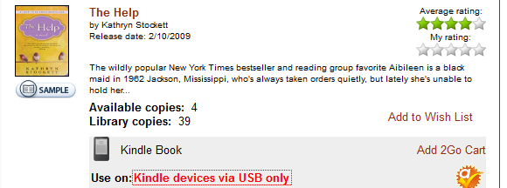
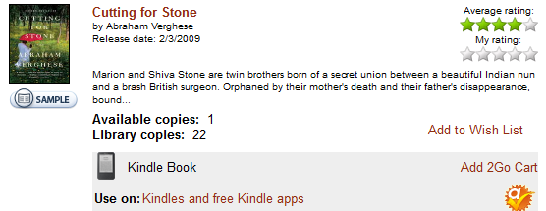
Challenges
Problematic ebook licensing/pricing
Titles licensed before Penguin’s withdrawal from library market remain in L2G collection, but can only be transferred via USB to physical Kindles (no wifi, no Kindle apps)

Slide 20
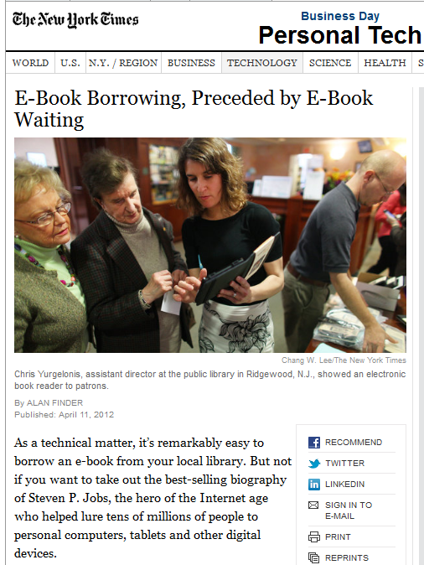
Challenges
Increasing patron demand
All circs up 159% over 2 years
All holds up 251% over same period
Ebook circs up 585% over 2 years
Ebook holds up 991% over same period

Slide 21
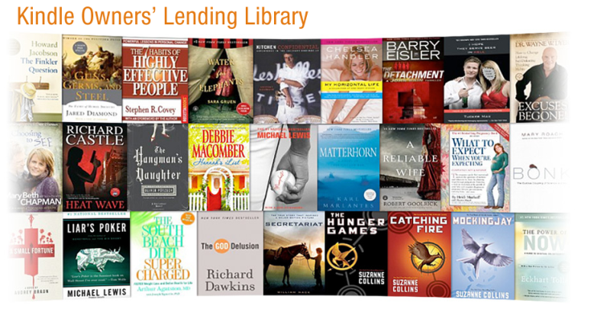
Challenges
Competition from consumer-oriented buying/lending services

Slide 22
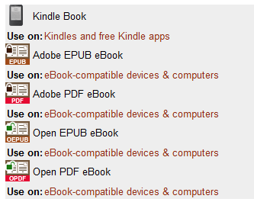
Challenges
Proliferation of formats, devices, operating systems

Slide 23
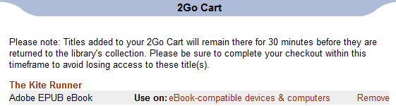
Responses
Make Library2Go website easier to use
Shorter-term: user interface changes
confusing
confusing

Slide 24
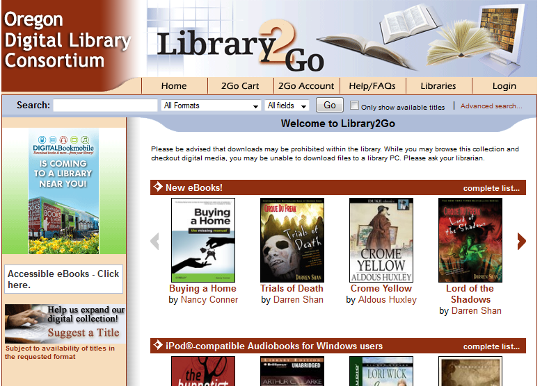
Responses
Make Library2Go website easier to use
Longer-term: site redesign

Slide 25
Responses
Information/resource sharing
emedia-or listserv
Library2Go yahoo group
MyHelp (more coming up!)
Library2Go presentations/updates (like this one!)
Longer-term, creation/distribution of standardized, up-to-date literature/tutorials

Slide 26
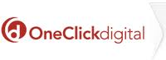
Responses
Analyzing other vendors
Are these vendors viable for our consortium?
How do they compare to OverDrive?
OverDrive contract negotiations

Slide 27
Responses
Pursuing grants

Slide 28
Overdrive Evolution

Slide 29
Overdrive Evolution - Formats
WMA Audiobooks January 2006
Videos May 2008
MP3 Audiobooks December 2008
iPod-compatible WMAs June 2009
EPUB eBooks March 2010
Kindle eBooks September 2011

Slide 30
OverDrive Evolution - Features
Advantage Program - Oct 2009
Mobile Apps
For audiobooks - Spring 2010
For eBooks - Dec 2010
For iPad - Feb 2011
My Help - Feb 2011
OverDrive Help (FAQ facelift) - Feb 2012

Slide 31
OverDrive Evolution
OverDrive Help
My Help
OverDrive Advantage
Booki.sh
WIN Catalog
BIN - Buy it Now
Recommend to library (patron driven acquisition)
Book and Author impressions

Slide 32
Discussion and Q&A

Slide 33
ODLC Survey
http://goo.gl/QENmk
1. Would your library consider allocating additional funds to ODLC for digital content?
2. Does your library currently have a local digital media collection?
3. If you answered "No" to Question #2, are you considering adding a local digital media collection in the next 12 months
4. If you answered "Yes" to Questions 2 and/or 3, please share information about the media type(s) in your local collection, vendor(s) used, and budget amounts allocated.
5. Should ODLC boycott Random House?
6. Should ODLC continue to boycott HarperCollins?
7. What can ODLC do to better serve member libraries?
8. Please provide the name of your library.

Slide 34
Pew Survey
Pew Research Center would like your help
Survey for public library staff
https://www.rationalsurvey.com/s/3307 Email: [Your preferred email] Password: PEWLIBS
Survey for patrons

Slide 35
Questions
Open Q&A/discussion/demos/troubleshooting help

