Slide 1
Measuring Now for Tomorrow
OLA 2012
presented by:
Deschutes Public Library
Wylie Ackerman
Kevin Barclay
Lynne Mildenstein

Slide 2
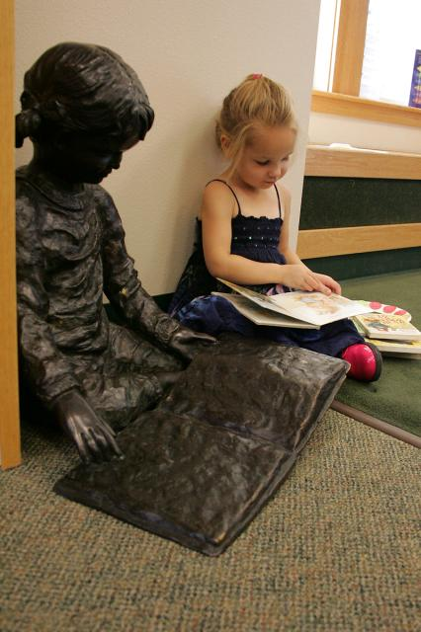
Introduction—Why We Measure
State and National Reporting
Appropriate allocation of staff and resources
Advocacy
Efficiencies
Awareness of Trends
Notes:
Presenter: Kevin
State and National Reporting—we are “required,” or strongly encouraged, to report specific statistics to the State Library and PLA for National Statistics
Resource Allocation—not necessarily how libraries typically use statistics but it should be…
Advocacy—Library statistics help us argue for increased revenue or the maintenance of current funding in a poor economy
Efficiencies—process analysis (e.g. how many books can your staff check-in and shelve in an hour)
Trend Awareness—helps us indicate trends and hopefully do more than react

Slide 3
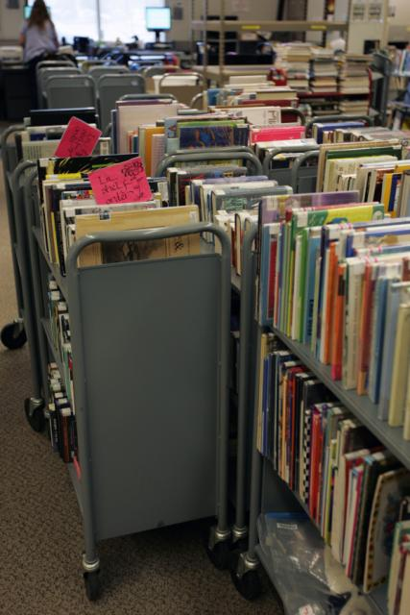
Introduction—Why We Don’t
Think experience is good enough
Time
Lack reliable data source
Lack in-house expertise
Intangibles
Notes:
Presenter: Kevin
Librarians seem to trust their guts more than their numbers.
Good data research takes time many managers cannot afford.
Data sources, such as your ILS, make it difficult or cumbersome to extract meaningful data
How many of you took a statistics class in your MLS program?

Slide 4
Measuring Excuses and Emily Rosa
Notes:
Presenter: Kevin
Youngest published author in peer-reviewed JAMA
Simple test on effectiveness of therapeutic touch practiiioners
Practitioners were right 44% of the time—guessing would have been more successful
Emily demonstrates that useful observations are not necessarily complex, expensive, or even, as sometimes claimed intangible

Slide 5
Scenarios
Budget Reductions
Operations—Appropriate Allocations of Resources
Review of collections
Notes:
Presenter: Kevin
Here are the main scenarios we will review during our talk

Slide 6
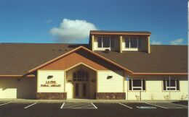
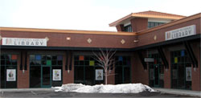
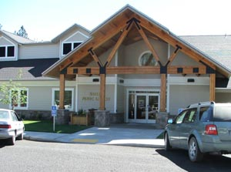
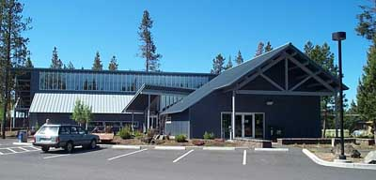
DPL

Slide 7
Collections Statistics—Traditional
Circulation
Turnover
Fill Rate
Notes:
Presenter: Lynne
Floating collections; 375,000 items, circulation combined almost 2.5 million Popular materials library…when you start looking at your stats, it helps if you know the library’s collection development policy or mission.

Slide 8
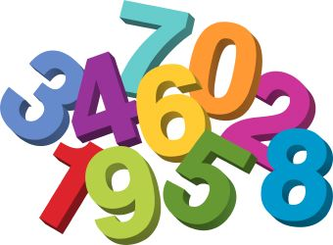
Circulation Statistics
Methodology –
Count and separate widgets
Count by “audience” types
Count by format
Analysis
Compare national, state, local
Notes:
Presenter: Lynne
Counting widgets…OSL has reports of Adult Circ & Children’s Circ but that’s it. So think about what you want to collect that will help you strategize.

Slide 9
DPL Circulation by Audience
Notes:
Presenter: Lynne
A piece of puzzle was added last fiscal year, Teen materials have been counted separately so we created new item types for teen materials

Slide 10
DPL Circulation by Format
Notes:
Presenter: Lynne

Slide 11
Turnover
Methodology
Total circulation ÷ Total holdings = Turnover Rate
National average 3.5
What about first time use vs. total circulation?
Analysis
Break it down by format
Compare from year to year
Notes:
Presenter: Turnover rates are general done on a very broad scale. Total circ and total holdings = turnover rate….but think. Total circ is usually kept…but not always the holdings. Holdings are deleted so when are they deleted and to what extent?

Slide 12
DPL Turnover Rate - Adult
 | FY 2010-11 | FY 2009-10
BOOKS TOTAL | 3.80 | 3.06
Fiction | 4.31 | 3.24
Non-Fiction | 2.39 | 2.09
Large Print | 4.69 | 3.86
MUSIC CD TOTALS | 7.21 | 5.76
BOOKS ON CD TOTALS | 7.33 | 6.05
DVD TOTALS | 16.99 | 10.04
Notes:
Presenter: Lynne Also need to think about, on average, if something was checked out always, how many unique circs could it have. Depends on your loan but for us it would be 12 except for DVDs… which could be anywhere from 24-36

Slide 13
DPL Turnover Rate – Juvenile
 | FY 2010-11 | FY 2009-10
BOOKS TOTAL | 4.03 | 3.28
Non-Fiction | 2.33 | 1.93
Fiction | 2.67 | 2.28
Bridging Fiction | 4.17 | 3.12
Picture Books | 5.01 | 4.02
Easy Readers | 5.97 | 5.03
MUSIC CD TOTALS | 3.45 | 3.50
BOOKS ON CD TOTALS | 4.32 | 4.07
DVD TOTALS | 11.87 | 7.34
Notes:
Presenter: Lynne

Slide 14
DPL Turnover Rate - Downloads
 | FY 2010-11 | FY 2009-10
eBOOKS TOTAL | 5.70 | N.A.
eAUDIOBOOKS TOTALS | 8.58 | N.A.
Notes:
Presenter: Lynne

Slide 15
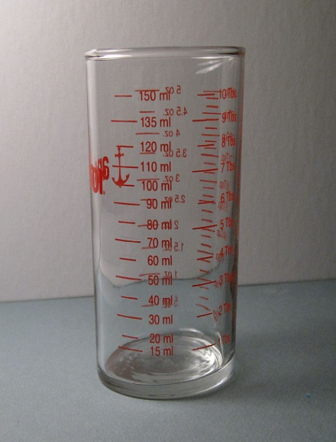
Fill Rate Survey
Measures satisfaction with collections
Title
Author or Subject
Browsing
Why are you at the library?
Programs, Internet, Pick up Hold?
Length of stay
Notes:
Presenter: Lynne We’ll be doing a digital fill rate survey this fall but Pew survey is looking for participants and those questions are pretty good…so may use that for survey. But keep in mind it’s only good if survey is done similarly year after year.

Slide 16
DPL Fill Rate Survey
Notes:
Presenter: Lynne
Overall in District, fill rate shows that customers are finding what they want when the visit.
TITLE: When customers come to the library looking for a specific title, they find it 74% of the time (up from 6% in 2010) This is the most significant increase from last year and previous years.
AUTHOR/SUBJECT: Looking for a specific author or subject is the same as last year.
BROWSING: has gone up 3%. So 93% of the time when a customer just comes in to “shop”, they find something

Slide 17
How does it fit?
Increase or decrease in circulation….why?
Turnover low? Fill rate low? Why?
Notes:
Presenter: Lynne We’ll be doing a digital fill rate survey this fall but Pew survey is looking for participants and those questions are pretty good…so may use that for survey. But keep in mind it’s
only good if survey is done similarly year after year.
Circulation goes up when customers are happy. They are happy when they can find what they want on the shelves (fill rate survey) and when items are in constant use.

Slide 18
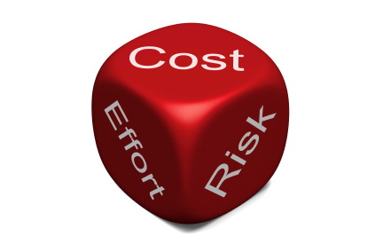
Collection Statistics—Non-traditional
Circulation/Visits Ratio
Weeding Statistics
Circulation per capita
Collections per capita
Notes:
Presenter: Lynne Tell which libraries are most active and impacts staffing levels etc.

Slide 19
Circulation/Visit Ratio
First time checkout / attendance
Notes:
Presenter: Lynne
People are finding more of what they want and are checking it out. Works well with traditional statistics. But don’t inflate by using renewals…these don’t count for a real visit.

Slide 20
Weeding
Add vs. weeded
FY 09/10 DPL withdrew 30% more materials than were added
FY 10/11 DPL withdrew 44% more materials than were added
“A good library collection is like a good haircut. It’s not what you cut—it’s what you leave”
Anne Felix, Grand Prairie (Texas)
Public Library System
Notes:
Presenter: Lynne We weed a lot! We had to and the results show this in a rise in fill rate, checkout per visit ratio and turnover. This year we’re only on track to withdraw 12-15% more than added.

Slide 21
Per Capita Statistics
Library | Collections per Capita FY 2010-11
Tigard | $9.77
Lake Oswego | $9.29
Multnomah | $9.03
Corvallis-Benton | $8.91
Deschutes | $6.71
Beaverton | $5.90
Eugene | $5.66
Hillsboro | $4.99
Jackson County | $3.07
Salem Public | $2.17
Library | Circulation per Capita FY 2010-11
Lake Oswego | 35.35
Multnomah | 32.50
Beaverton | 24.09
Tigard | 22.02
Hillsboro | 20.77
Corvallis-Benton | 19.29
Eugene | 18.30
Deschutes | 15.81
Jackson County | 7.84
Douglas County | 6.13
Notes:
Presenter: Lynne
We know where materials are being checked out and who is busy and who might not be. But doesn’t tell us what’s on the shelves at any given time. Last checked, 27% of District materials were checked out….which is good. But what’s the magic number?

Slide 22
Staffing and Service Statistics
Service Desk Tally
Staffing Standards
Check-ins
Visit/hour
Self-check percent
Notes:
Presenter: Kevin

Slide 23
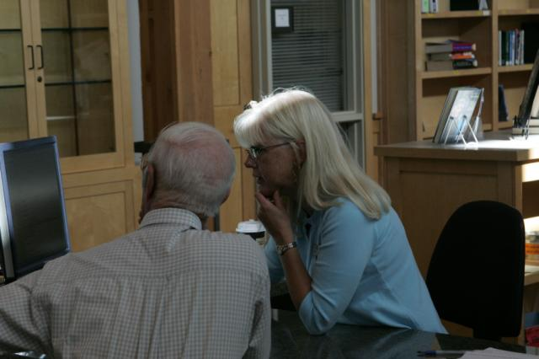
Service Desk Tally—Customer Transactions
Methodology
Analysis
DPL Approach
Notes:
Presenter: Kevin

Slide 24
Customer Transactions I

Slide 25
Customer Transactions II

Slide 26
Customer Transactions III

Slide 27
Customer Transactions IV—Staff Interact/Visit

Slide 28
Staffing Standards I—Minutes/Check-in and Service Minutes/Visit
Notes:
Presenter: Kevin

Slide 29
Staffing Standards II—Volunteer MH percentage

Slide 30
Staffing Standards III—Branch Staff Time Allocations

Slide 31
Visits/Hour I
Notes:
Presenter: Kevin

Slide 32
Visits/Hour II

Slide 33
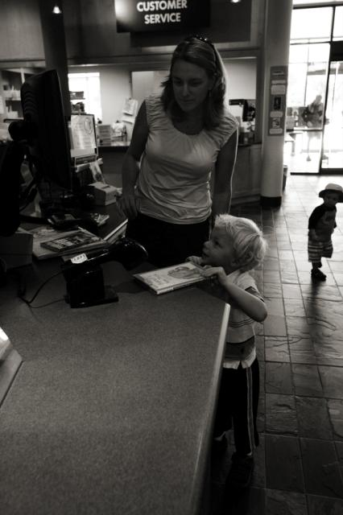
Self-Check Percent
Methodology
Analysis
DPL Approach
Notes:
Presenter: Kevin

Slide 34
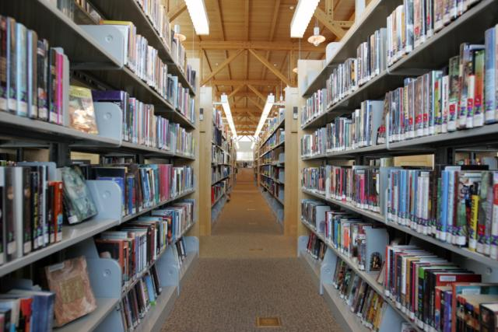
Facilities Statistics
Facility per Service Area Capita
Computer Usage
Hourly Circulation Activity
Cost/square foot
Cost/Service Area Capita
PC/Internet/Wireless usage/Cost
Notes:
Presenter: Kevin

Slide 35
Facility per Service Area Capita—Or “How to define FAIR”
Notes:
Presenter: Kevin

Slide 36
FAIR II—Library Square Feet per Service Area Capita

Slide 37
FAIR III—Library Hours per Service Area Capita

Slide 38
FAIR IV—Library Personnel Costs per Service Area Capita

Slide 39
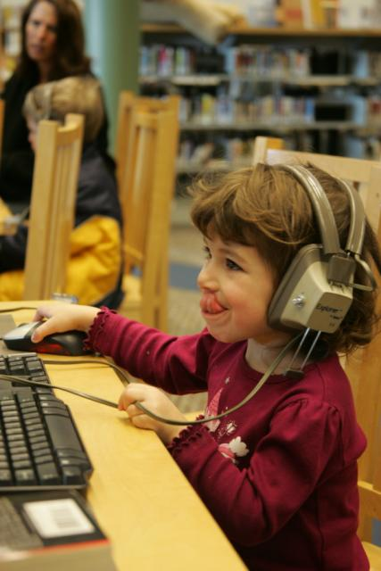
Computer Usage
Methodology
Analysis
DPL Approach
Notes:
Presenter: Kevin
From LJ’s Patron Profiles (Oct 2011) we find that Power Patrons (visit the library at least once/week) are only 20% of the respondents, yet they contribute to almost 80% of our visits
DPL Visits are used in conjunction with other statistics to determine public service staffing needs, facility demands, display and access success

Slide 40
Cost/Circulation
Notes:
Presenter: Kevin
Methodology includes cost/sq ft; cost/pc and personnel costs/branch
King County example—our costs range from $2--$5 per item

Slide 41
Cost/Square Foot

Slide 42
Cost/Service Area Capita

Slide 43
PC/Internet/Wireless Usage and Cost
Methodology
Analysis
DPL Approach

Slide 44
Now What?—What do these numbers tell you about your staffing and facilities?
Allocation (Right staff for the right job)
Open Hours
New facilities
Outreach vs Inreach

Slide 45
eServices
Digital
Subscription Databases
Web
Social Media
eServices Users
Notes:
Presenter: Wylie

Slide 46
Digital OverDrive
What useful data do we have access to?
What does it tell us?
What data are we missing?
Notes:
Presenter: Wylie
Note: FY 11/12 data includes the first nine months the current FY (July – June)

Slide 47
Digital OverDrive
Notes:
Presenter: Wylie
Note: FY 11/12 data includes the first nine months the current FY (July – June)
New Users – comparable to new library cards issued
Tell us – whether or not there is interest in the service and/or whether or not people are aware of it
OverDrive Report = View New Patron Registrations

Slide 48
Digital OverDrive
Notes:
Presenter: Wylie
Note: FY 11/12 data includes the first nine months the current FY (July – June)
Users - % of users checking out items that had not used the system before
Tell us – what stage of adoption we’re in
At some point the % will drop – at that point we’ll want to determine whether it is due to saturation or lack of marketing
OverDrive Report = View New Patron Registrations and View Patron Activity Charts

Slide 49
Digital OverDrive
Notes:
Presenter: Wylie
Note: FY 11/12 data includes the first nine months the current FY (July – June)
Circulation – comparable to physical circulation
Tells us – one measurement of collection usage, also what formats are most used
Many factors at play here: collection size, depth, loan periods, hold ratios, etc.
OveDrive Report = View Activity Charts

Slide 50
Digital OverDrive
What else can you measure?
% of collection out at any given time
Number of holds/requests
Turnover rate
Title Statistics (which titles are most popular)
Notes:
Presenter: Wylie
Note: FY 11/12 data includes the first nine months the current FY (July – June)
Additional Data Available

Slide 51
Digital OverDrive
What’s missing or difficult to determine?
Circulation breakdown by audience
Who’s checking out what
Where checkouts are occurring
Notes:
Presenter: Wylie
Note: FY 11/12 data includes the first nine months the current FY (July – June)
What is difficult to see or unavailable

Slide 52
Subscription Databases
What to measure (what can we measure)?
Searches
Page views
Visitors
Other?
Notes:
Presenter: Wylie
Look for trends over time
Is a high number of searches a good thing?
GVRL increase due to addition of search widget

Slide 53
Subscription Databases
Challenges
Marketing to the public and staff
Ease of use (i.e. Google, Wikipedia)
Cost per use
Notes:
Presenter: Wylie
Public isn’t always aware of all resources available at the library
Training and promotion to staff is important
The public is often willing to sacrifice reliability/accuracy for convenience
Do we drop resources that aren’t getting used?

Slide 54
Web
How we’re measuring
What to measure
Visits
Unique visitors (new vs. returning)
Content – popular pages
Notes:
Presenter: Wylie

Slide 55
Web
Free to set up an account with Google
Uses a Javascript supplied by Google on your web pages
Reports can be accessed online and exported
http://www.google.com/analytics/
Notes:
Presenter: Wylie

Slide 56
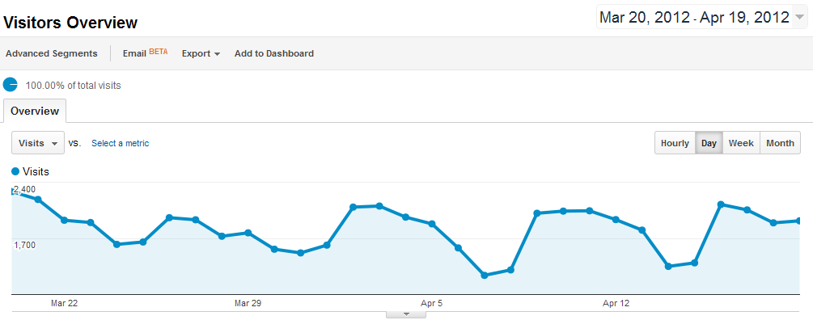
Web
http://www.google.com/analytics/
Notes:
Presenter: Wylie
Visitors - Look for trends in visits over time
Busiest day(s) – our is Monday – when should you post important content?

Slide 57
Web Google Analytics
http://www.google.com/analytics/
Notes:
Presenter: Wylie
Unique Users
Are you attracting new users?

Slide 58
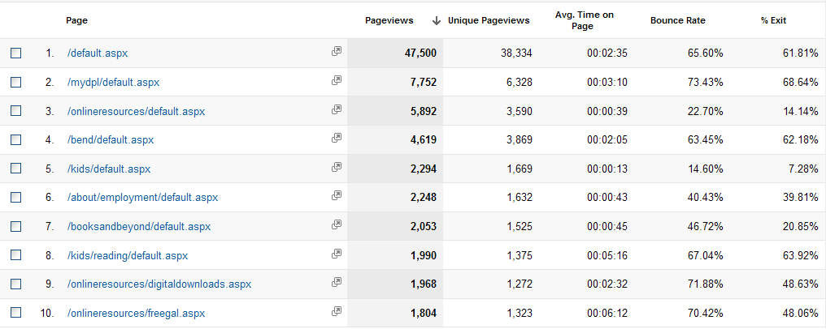
Web
http://www.google.com/analytics/
Notes:
Presenter: Wylie
Page Popularity – Where to put the content you want to be seen
Page trends
Bounce rate (leaving the site) – OK in many cases when you are directing them to a subscription resource or a different site (i.e. your catalog)

Slide 59
Web
What else can you measure?
Paths users take through your site
Browsers (and operating systems) used
Mobile use
Referrals – links to your site
Search engine terms and referrals
http://www.google.com/analytics/
Notes:
Presenter: Wylie

Slide 60
Social Media
Notes:
Presenter: Wylie

Slide 61
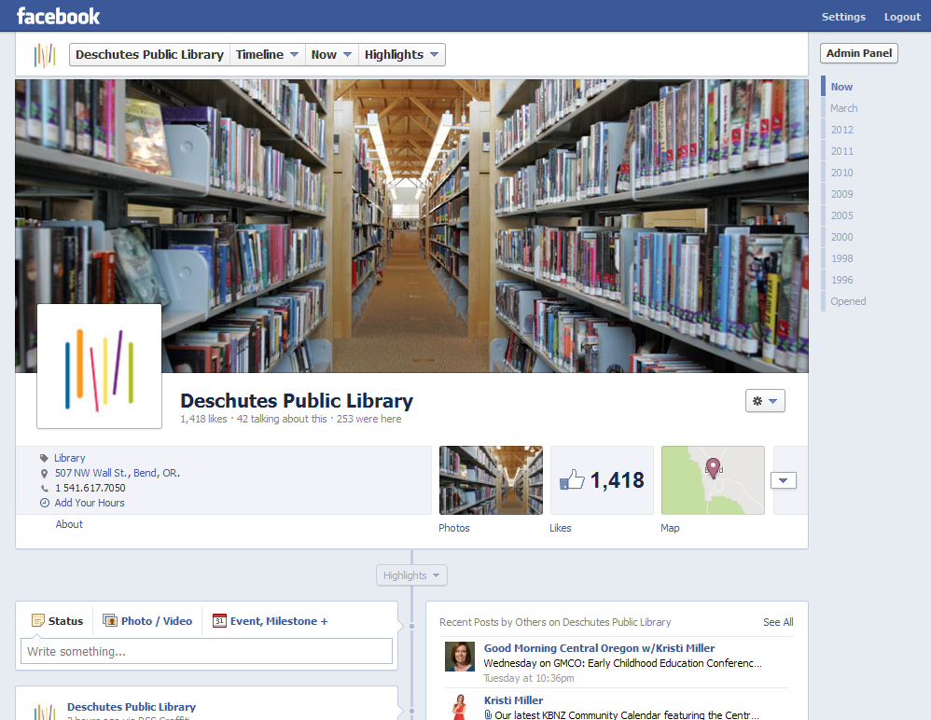
Social Media
Insights
New users
Reach
Engagement
Demographics
Notes:
Presenter: Wylie
Work in progress
One main Facebook page for all libraries
Currently we primarily track likes, but we’re also looking at responses to posts
We’re working on a strategy to generate more engagement

Slide 62
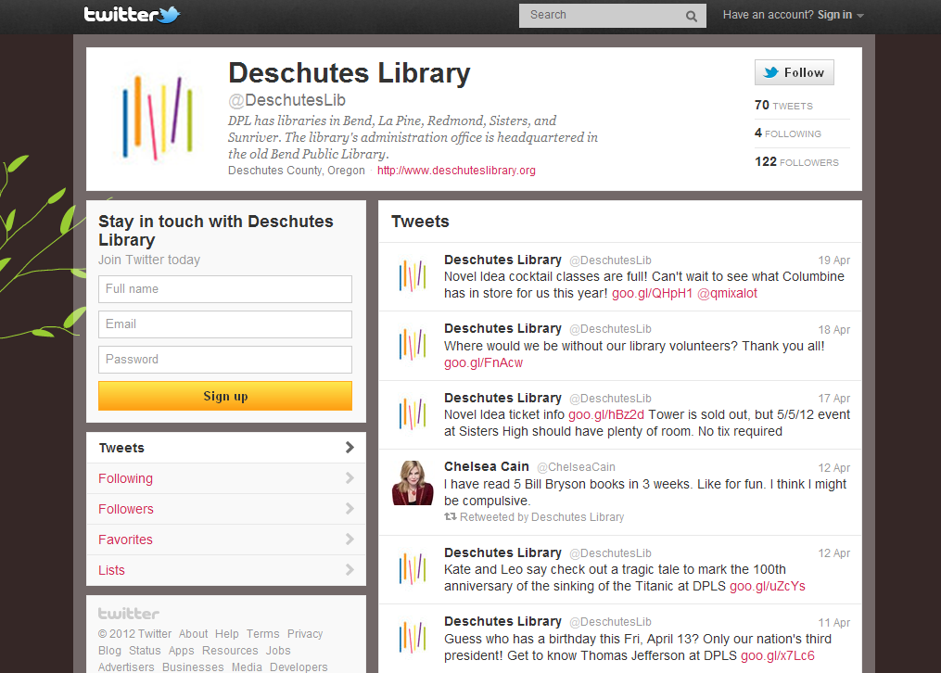
Social Media
Followers
Mentions
Retweets
Notes:
Presenter: Wylie
Work in progress

Slide 63
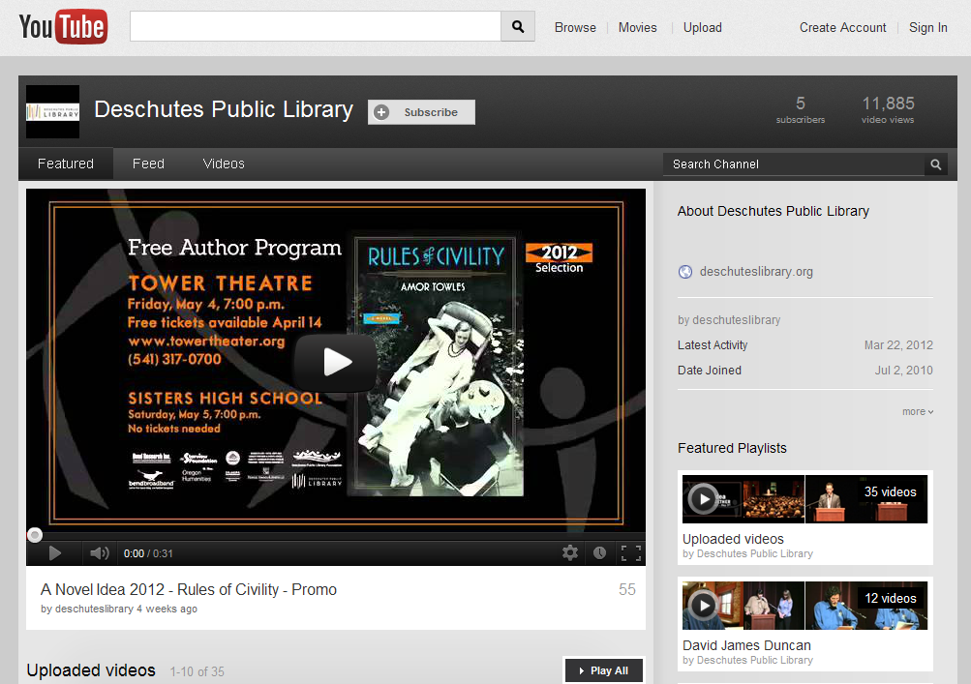
Social Media
Views
Comments
Subscribers
Notes:
Presenter: Wylie
Work in progress

Slide 64
eServices’ Users
Who uses electronic services from the library?
Measurement and analysis are a work in progress
Notes:
Presenter: Wylie

Slide 65
eServices’ Users
Who uses electronic services from the library?
Data mine your web reports - locations, operating systems, web browsers, mobile, etc.
Social Media - demographics
Notes:
Presenter: Wylie
Extrapolate from what you do know
Web reports – find out where your users are coming from, what OS and/or browser they’re using
Facebook provides good demographic information (age, gender, location)

Slide 66
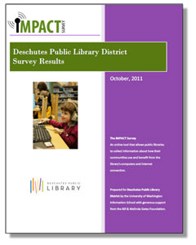
eServices’ Users
Surveys
Notes:
Presenter: Wylie
In-house surveys or participate in national/regional surveys
Impact Survey

Slide 67
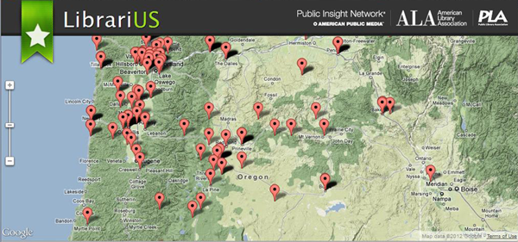
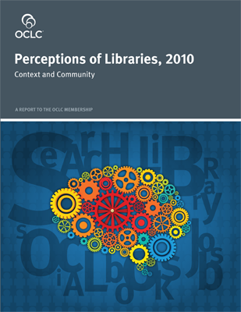
eServices’ Users
Notes:
Presenter: Wylie
Extrapolate from national surveys
Other Resources: LibrariUS, Patron Profiles, OCLC Perceptions of Libraries, Pew Research

Slide 68
Challenges
Comparing Apples to Oranges to Bananas
Outputs vs. Outcomes
Navel gazing
Wonky statistics
Educating Governing Bodies, Foundations and Public

Slide 69
Conclusions
Use them, don’t just study them
Budget reductions and measurements
Long range planning and statistics
Other applications of measurement studies
Why we need to measure.

Slide 70
Contact Information
Collections & Circulation
Lynne Mildenstein lynnem@deschuteslibrary.org
Staffing & Facilities Considerations
Kevin Barclay kevinb@deschuteslibrary.org
eServices & Social Media
Wylie Ackerman wyliea@deschuteslibrary.org

Slide 71
Sources
Oregon Public Library Statistics, Library Development Services. http://www.oregon.gov/osl/LD/Pages/statsploregon.aspx
U.S.Census Bureau, State & County Quick Facts. http://quickfacts.census.gov/qfd/states/41/41017.html
Institute of Museum and Library Services, Research, Data Sets. http://www.imls.gov/research/default.aspx
Patron Profiles, published by Library Journal. http://www.thedigitalshift.com/research/patron-profiles/?utm_source=lj&utm_medium=web&utm_campaign=PAT

Slide 72
Sources (cont.)
Greiner, Tony and Bob Cooper. Analyzing Library Collection Use with Excel. Chicago: American Library Association, 2007. Print.
Mayo, Diane and Jeanne Goodrich. Staffing for Results: A Guide to Working Smarter. Chicago: American Library Association, 2002. Print.
Nelson, Sandra. The New Planning For Results: a Streamlined Approach. Chicago: American Library Association, 2001. Print.
Smith, Ted. Collecting and Using Public Library Statistics. New York: Neal-Shuman Publishers, 1996. Print
Zweizig, Douglas and Eleanor Jo Rodger. Output Measures for Public Libraries: a Manual of Standardized Procedures. Chicago: American Library Association, 1982. Print.

