Slide 1
Budget
Total Project Cost: $30,450
Library In-kind Contribution 2,600
Pledge from Cascade President/DOI 5,000
Total request from GIF $22,850.

Slide 2
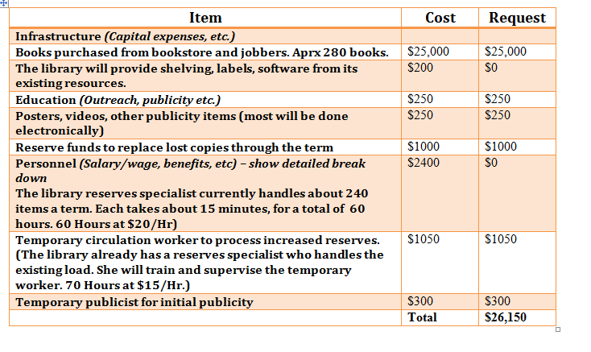
Initial Budget Request

Slide 3
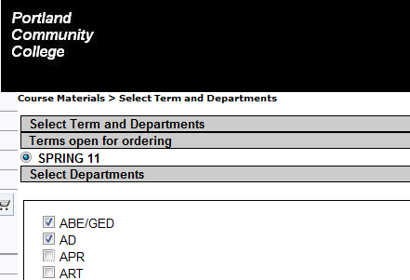

Slide 4
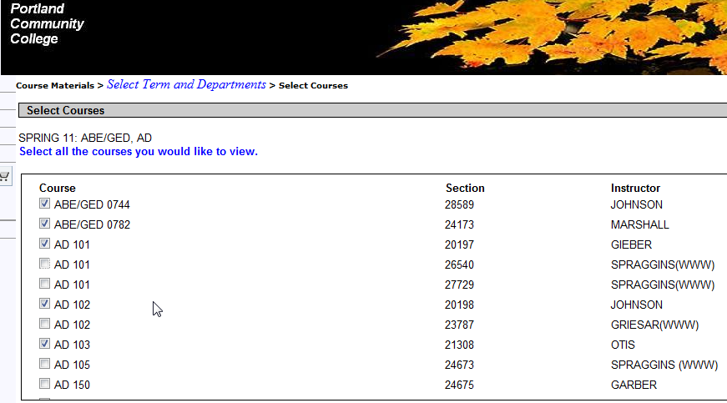

Slide 5
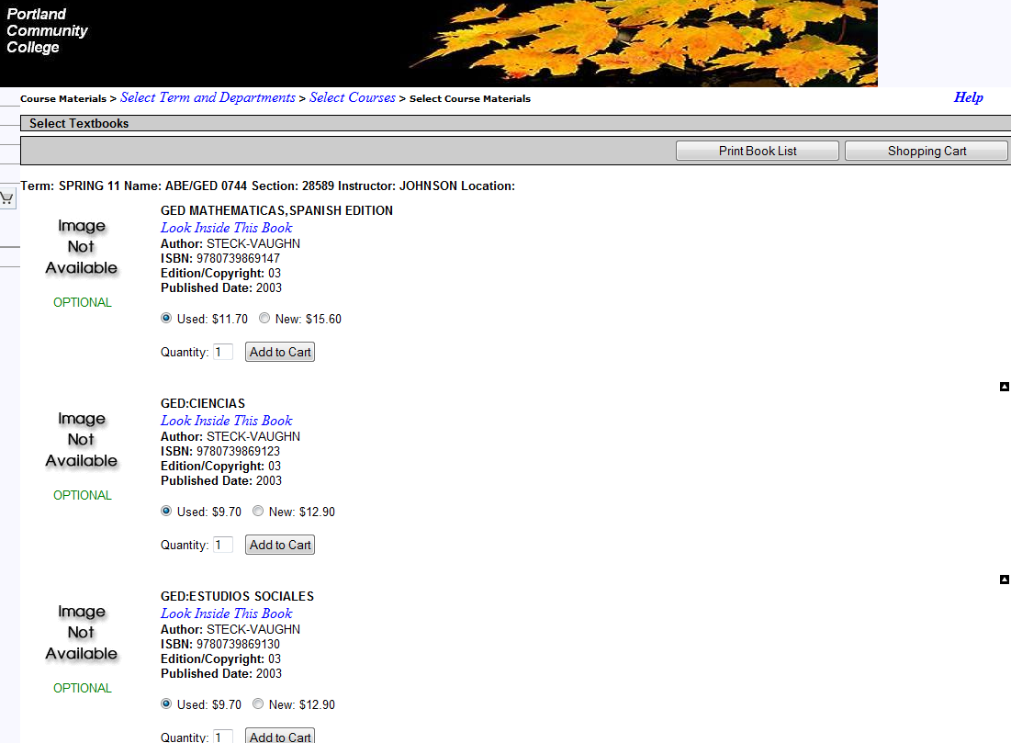

Slide 6
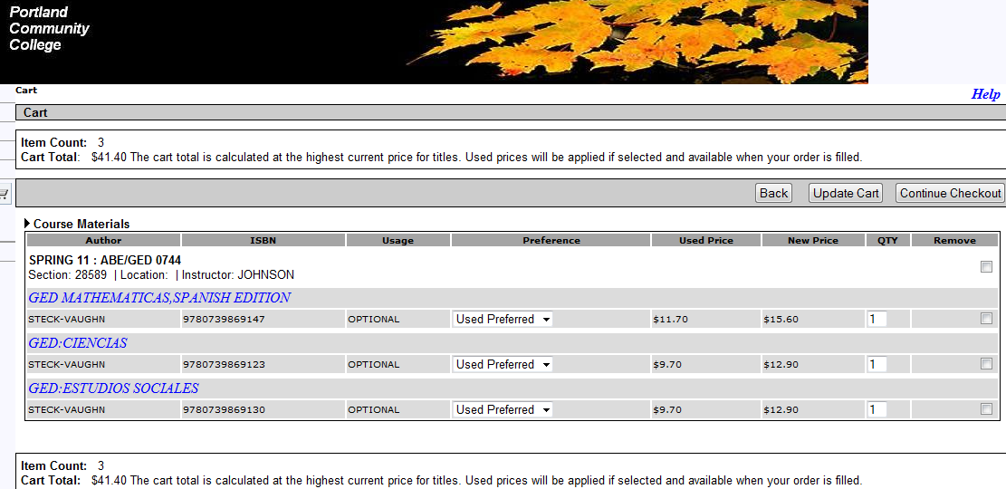

Slide 7
Course | Text |  |  | Reason |  |  | Note
AD 103 | Toward a new psychology of women |  |  | Not received yet.
AD 150 | Basic Counseling Skills |  |  | Workbook |  |  | Check!
AD 152 | Participant Manual |  |  | Workbook |  |  | Check!
AD 152 | Groups: Process and Practice |  |  | Not received yet. |  |  | We need to buy 2010, 9780495600763
AD 153 | Theorey and Practice of Counseling |  |  | Not received yet. |  |  | 9780495102083
AD 154 | Being Logical (McInerny) |  |  | Available as ebook in library catalog
AD 154 | Applying ASAM DVD |  |  | Not received yet. |  |  | 9780785478454
AD 250 | You Just Don't Understand |  |  | Library owns, but course not listed in catalog
APR 101 | Oregon Adminsitrative Rules |  |  | online | http://arcweb.sos.state.or.us/banners/rules.htm
APR 101 | Oregon Revised Statutes |  |  | online | http://www.leg.state.or.us/ors/
APR 201 | Electric Motor Control |  |  | Not received yet.
APR 224 | Understanding the NEC v1 |  |  | Workbook |  |  | check!
APR 224 | NEC 2008 Fast Tabs |  |  | National Electrical Code is found online in NFPA. Check with Librarian
ART 213 | History of Modern Art |  |  | Out of stock in bookstore- Distance ed. Class
ATH 103 | Katun: Twenty Year Journey… |  |  | Out of stock in bookstore- Catalog says 'available' but NOS
ATH 103 | Absolutely True Diary |  |  | Mislabeled as ART 103. In process of being re-labeled.
BA 211 | Accounting Custom Edition ISBN 9780558506834- |  |  | New edition we don't yet have. 9780558506834
 |  |  |  | Old edition, used in some classes is available.

Slide 8
2-Hour Reserves Use, Sept

Slide 9
2-Hour Reserves Use, October

Slide 10
2-Hour Reserves, November

Slide 11
2-Hour Reserves, Dec

Slide 12
2-Hour Reserves, Fall Quarter

Slide 13
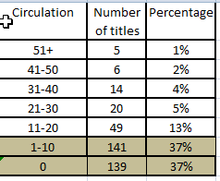
Circulation per Title- Grant texts only

Slide 14
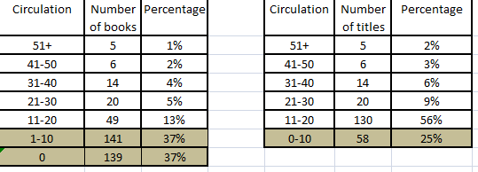
“Sustainable” use, adjusted for errors

Slide 15
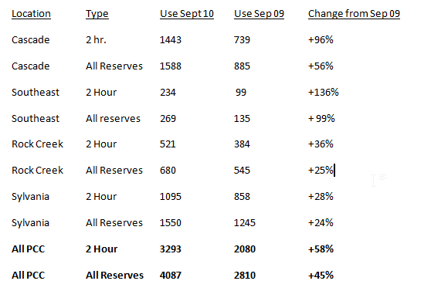
All Reserve Use at all Campuses rose

Slide 16
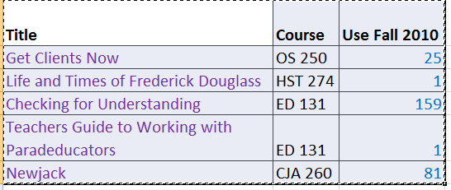
E-Books that were Required Texts

Slide 17
Lessons learned in Purchasing
85% of titles were known by the bookstore by the federal deadline of June.
Money was difficult to track and transfer from ASPCC to Library to Bookstore.
Poor communication led to overspending by about $1400
Underestimated time to process- let acquisitions do it next time.

Slide 18
Physical Processing
Hard to plan workflows- be flexible
Start as early as possible
Bookstore schedule and workflow doesn’t always jibe with library schedule and workflow
Library errors complicated bookstore staff’s life
Bookstore errors complicated library staff’s life
Finding temporary labor with reserves processing skills could be a problem

Slide 19
Things Learned the Hard Way
Start as early as possible
Keep everyone informed (silos came into play)
Have acquisitions done by acquisitions
Define exclusions beforehand
DEFINE SUCCESS BEFOREHAND

Slide 20
Success or Failure?

