Slide 1
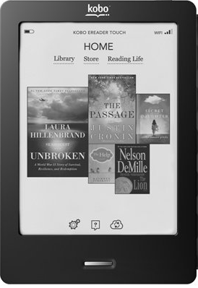
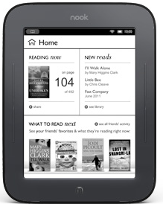
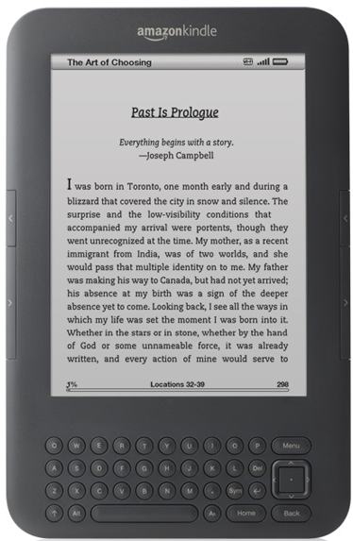
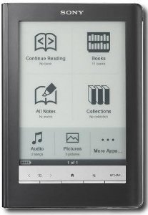
Oh the Choices We’ll Make! Reading in the Digital World
Uta Hussong-Christian
Jane Nichols
Oregon Library Association Annual Conference
April 27, 2012
Notes:
UTA
Thanks very much for joining us this morning to spend some time taking a closer look at reading. Jane and I, along with two other colleagues, have had numerous conversations about this topic related to a study you’ll hear more about in just a bit. So this presentation was an opportunity to examine the behavior we’ve been seeing with our study participants and frankly examine the choices that my colleagues and I have personally made when comes to reading, whether using print technology or some type of connected device.
We presume that as you read the title you might reflect on reports forecasting the demise of the printed book or maybe you’re more visual and something like this comes to mind…

Slide 2
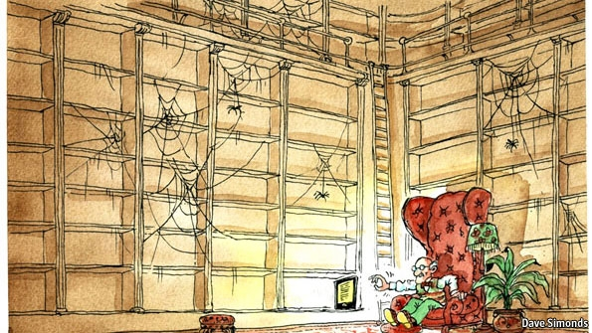
Dave Simonds, 2011
Notes:
UTA
This graphic went along with a September 2011 article in the Economist about how e-books are changing publishing and it certainly helps prompt some questions that we allude to in our presentation title.
Teasing apart publication data is complicated but in general it shows that print publishing sales are down across almost all categories while ebook publishing sales continuing to increase, and at a fairly dramatic rate. Ebook sales rose 117% for 2011 while print sales fell in all print trade categories. Declines ranged from 4.7% to 36% (AAP Estimates, 2012). Add to that the demise of retailers like Borders, it’s no wonder that graphic artists are portraying the state of the publishing industry in this way…but we need to keep in mind that print is still the predominant format for now and the predominant revenue source. Bookstore shelves, college bookstores and our own bookshelves are not empty and won’t likely be for quite some time.
But even while print is still the predominant format, the rise in ebook publishing clearly tells us that readers are making deliberate choices to read in non-print formats. We choose ereading or print reading for a variety of reasons and today we’ll explore some of those reasons and examine what this means for supporting patrons no matter what reading technology they choose to use.
So Jane, what’s going on with this explosion in eBooks?

Slide 3
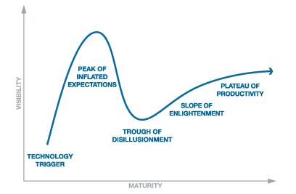
Hype Cycle
Notes:
JANE
Well, in order to understand the hype around ebooks I think it might be helpful to look at the hype around ereading technology and to understand that we can talk a bit about hype cycles. Have you ever gotten a new toy—especially a new tech toy that you’re really excited about only to experience that pang of disappointment and envy when you’re friend comes along with a seemingly better one? Well—you’re not alone in this experience of excitement and disappointment. This experience is well documented and is part of what is known as the hype cycle. Part of what drives our choices about ereading and whether we choose to read in print or with ereading technology is influenced by where a device falls on this curve. But discerning where in this cycle a device or technology falls can be tricky. So a few things to note about this cycle. It was developed out of research done at the IT research and advisory company called Gartner. This cycle’s purpose is to help organizations inform their decisions around when to adopt or how to respond to a given technology, product, process, practice or idea.
As you can see this model presents a technology’s life cycle & includes five key phases
At the beginning there is a Technology or Innovation Trigger: where a potential technology breakthrough kicks things off. Early proof-of-concept stories and media interest result in significant publicity. Note that often at this stage usable products do not exist and commercial viability is unproven.
In the Peak of Inflated Expectations phase: success stories begin receiving publicity and at the same time a number of failures become apparent.
Next we hit the Trough of Disillusionment: where Interest wanes as experiments and implementations fail to deliver and as you can imagine a true shake out of the technology occurs.
Then comes the Slope of Enlightenment: where greater understanding of the technology’s benefits starts to crystallize and becomes more widespread. Also, second- and third-generation products start appearing.
Last we come to the Plateau of Productivity: where mainstream adoption starts to take off because the technology’s benefits become widely recognized—and the risk to adopt is low.
So in looking at this where might you expect ebooks to fall? What about dedicated e-readers? Tablet devices?

Slide 4
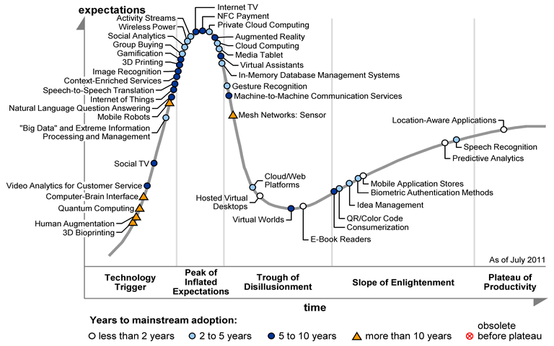
Emerging Tech Hype Cycle
Notes:
JANE
Source: Gartner (July 2011)
Figure 1 Hype Cycle for Emerging Technologies, 2011
I wanted to share this cycle from July 2011 because it gives a good sense of where various ereading technology devices land---and in context with many other technologies. I think this can help us understand why it’s challenging to decide when to jump into acquiring a technology or how a library might go about developing services centered around a technology. So did ereaders and tablets land where you thought they might? Also take a look at the years to mainstream adoption less than 2 years for ebook readers but 5-10 for tablets. Given that this was published 9 months ago, do you think this timeframe still holds true? Now that you have a sense of the stages a technology goes through on its way to mainstream adoption, let’s get a sense of your reading practices.

Slide 5
Notes:
UTA
[OLA session attendees…these are the actual poll results]
Along the way we want to actively engage you in this conversation. So we going to stop for a minute and have you think about how YOU read. Think about the reading you do for work, school, pleasure…any reading that doesn’t involve email. What technology do you use to do the majority of that reading? We’re including print as a technology as for all of us, it was our original reading technology.
We realize that this is not an easy question to answer as one technology may not dominate. But do your best.
This is a live poll so you will see responses as they come in (I have to confess that I went the cheap route and used the free version will allows up to 40 responses. So not all of your answers might be reflected). Anyway, there are two ways to respond to the poll. Either text the code that corresponds to your reading format to the number at the top of the screen or go to the url listed and submit the code that corresponds to your reading format.
We anticipated that reading in print and reading on the computer might dominate and we see this is the case from your answers. While print is the single dominant format, we have done this poll with other audiences where ereading formats combined exceeded print reading. But it will be some time before print is no longer in the mix.

Slide 6
Kobo
Nook
Kindle
4 eReaders
9 months
23 librarians
Sony
Notes:
UTA
As I noted ealier, we got started on the question of the technology choices we make for reading because of a study we are conducting at our library. With 2 other colleagues we received an internal grant to conduct a year-long longitudinal study exploring factors that influence eReader adoption among library faculty and press staff when the barrier of purchasing an ereader is removed. The data we present you today is focused just on the librarians participating in the study. The grant enabled us to purchase the Readers and develop the study. Last summer we distributed 4 different ereaders and have subsequently held 3 interviews with each participant. The first was held when we delivered the ereaders to their new owners, the second one month later and the third after six months. The fourth and final interview will be conducted in August and September of 2012. These are the readers we distributed, which include the Kindle, Kobo, Sony and Nook. Of course newer editions have since come out as well as several tablet devices and we recognize that this change in availability of devices has significantly affected options for ereading.
Because we needed a framework to understand our participants’ eReader adoption process; we decided to use Rogers’ (2005) Innovation-Decision Model which uses a five-step process to describe innovation adoption. The five steps include: knowledge, persuasion, decision, implementation, and confirmation.
As we held the first three interviews, debriefed afterwards and generally talked about our experiences with eReaders some common observations and questions started to arise about our changing ereading and reading practices and about the adoption of ereaders. So let’s start with a few of our findings.

Slide 7
Previous eReader and eBook Experience
Notes:
UTA
We asked our participants to describe their past experiences with eReaders or eBooks –and we see that brand awareness dominates the “mind set” of our participants. Reviewing responses we see that our participants could not talk about eReaders without referencing the Kindle even though other products are on market and have been for a long time. Just a quick note - the word “One” generally refers to eReader.
People’s experiences were mostly limited to a particular device: kindle, iphone, ipod touch; and for many it was limited to just playing around w/ ebooks and ereaders and most of that was using it for a couple minutes. Some participants had downloaded the apps for iphone and ipod touch. Some used the Kindle from our library’s lending program or their spouse’s Kindle to read books.

Slide 8
Prior eReader Ownership
(55%)
Notes:
UTA
We asked our participants whether they owned an ereader prior to the study. Of those who did, most owned Kindles.
Gathering prior ownership data was important as one of the long-term objectives of the study is to determine how can we develop informed library services which is hard to do without personal knowledge of the devices and related technology?

Slide 9
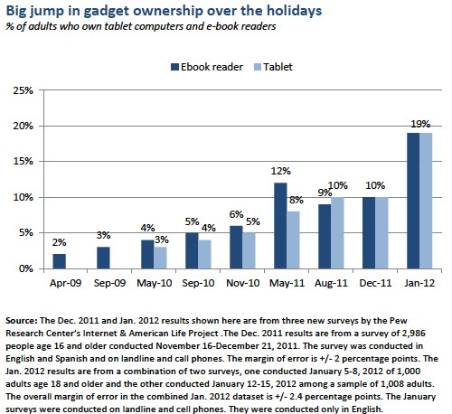
needed
Notes:
JANE
Putting our participants experience and ownership in a larger context we pulled on a Pew study which tracked ownership prior to our study through January. Here we see that when we started our study Pew found that 9% of adults owned an eReader. After the 2011 holiday season that ownership along with tablets grew to 19% each. So while headlines may heavily focus on the growth of eReader adoption there’s still a ways to go before a majority of people adopt ereading devices. Which could mean this gives us time to develop the experience needed to create informed services.
So if you’re like me you may be wondering how ownership of e-readers went up in May 2011 followed by a drop just a few months later. I emailed The Pew and asked. Kathryn from The Pew said “questions about device ownership rarely result in a clean, steady line of upward growth. There are many possible issues, including various quirks of sampling, that could cause a few peaks and valleys in the data, most of which usually fall within the margin of error for that survey (usually around 2-3%).” So there you have it, straight from The Pew.

Slide 10
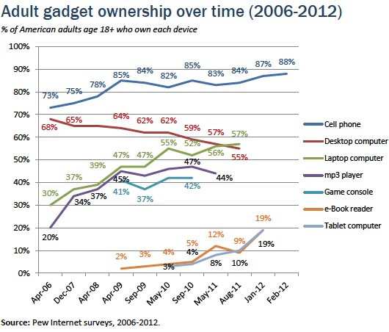
Notes:
JANE
One more contextual slide also from The Pew. This shows ereaders and tablets in context of several gadgets. I find it fascinating to see the steady decline in desktop ownership while laptops experienced a healthy uptick along with cell phones. While game consoles have leveled off check out mp3 players---especially in comparison to ebook readers and tablets which are in the midst of a sharp upswing. The other thing to take away from this is the ownership rate. At 19% clearly we are not yet at the point where a majority of people use an ereader or tablet as their device of choice for ereading.
As a group we’ll be doing an activity later on where we look more closely at some of these technologies for e-reading.

Slide 11
Factors Preventing eReader Purchase
Notes:
JANE
When asked librarians what factors prevented them from purchasing an ereader, it became clear that our participants just prefer physical books. Other reasons included no clear need to adopt a new technology or to change their current habits–their current needs were met with print books.
A quick note that the “something” you see refers generally to technology and the idea that it keeps changing. This is reflected in some of the other reasons for not purchasing an ereader which included wanting multipurpose ereading technology such as an iphone or ipod. Others were stymied about how to choose a device. For them it was unclear when to buy an ereader to avoid challenges that early adoptors can face. These folks wanted to hold off in case improvements to ereasers came along such as touch screens and some wanted to see if ereader technology as a whole would stick. There was also apprehension expressed at that time about the cost of buying an ereader vs. a tablet as well as concern about the cost of ebooks—remember this was prior to Kindle participating in Overdrive.
It is interesting to see that some of these concerns have been addressed with the recent release of the Kindle Fire and the Nook Tablet and significantly reduced prices of dedicated ereaders.

Slide 12
Librarians’ Reading Technology
57%
Notes:
JANE
Similar to the poll question we asked you, we asked our participants to parse out, by format, all of the non-email reading they do. While print is still the single dominant format, if you total all the eReading formats, then eReading does have the edge. One thing we did not ask our participants to do was break out work and pleasure reading. So we don’t know if the paper reading is largely reading for pleasure or reading for work and same with the eReading formats. We have revised the questions to our remaining interview to see if we can parse this out.
As I was preparing for this session, it occurred to me that once thing we didn’t look at is whether people are reading the same content in multiple formats such as print and electronic or the same content on multiple devices (tablet and eReader).

Slide 13
Average Downloads by Material Type
Notes:
JANE
Now let’s take a look at how the study participants are using their ereaders. While these downloads don’t specify which were for work and which were for leisure, through conversation we learned that participants wanted to use their eReaders for both and clearly tried. However reading success really only came with leisure reading of ebooks and you can see that shift over time.
Two things to keep in mind about these numbers.
1) The document downloads were mostly pdf articles. In the first month a handful of participants downloaded really large numbers of pdfs– on the order of 20-40 and in one case 70, so this skewed the numbers upward. Through conversation we learned that the articles were combination of both work and pleasure reading. You can see there was a big drop over time, and the major reason cited was because pdfs are hard to read on 3 of the ereaders. Only the Sony offers a reflow feature…and that applies only to non-scanned pdfs.
2) For ebooks bear in mind that the Overdrive-Amazon deal was not finalized until the week prior to our second set of interviews so that is reflected in the low number of downloads. And OSU Libraries main ebook providers EBL, & ebrary, are not compatible with the Kindle – which is also reflected in the low number of downloads. We are thinking that OSU Libraries number is low because participants seemed to prefer to not read for leisure or to not read at all.
From this snapshot we can see changes over time in the choices people are making about when and what they will eread.

Slide 14
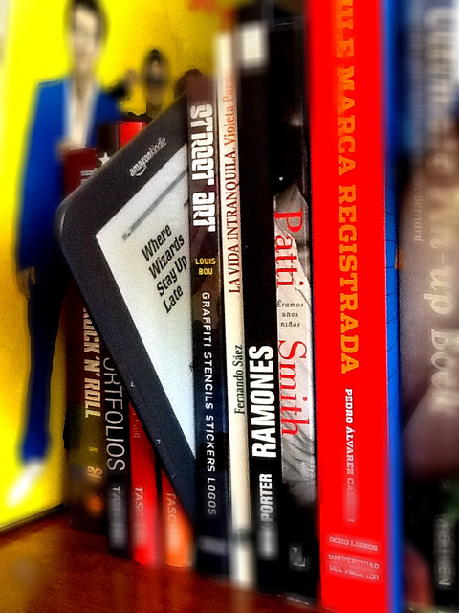
Why DO we make the choices we make?
Image: flickr user aguayoki
Notes:
UTA
Why DO we make the choices we make? What drives us or influences us to choose one technology over another, including print, for the types of reading we do? The data from our study indicates that for OSU Libraries, content plays a role in the choices we make. While our colleagues are choosing to engage in pleasure reading on their eReaders, they are making specific choices not to use their eReaders for academic reading. We also know that some of us are using other multifunctional devices that have reading applications (I am specifically referring to tablet devices or even laptops) to do that academic reading that we are choosing not to do so on our dedicated eReaders). And let’s not forget about all that print reading that is still happening (think back to how you responded to the poll a few minutes ago).

Slide 15
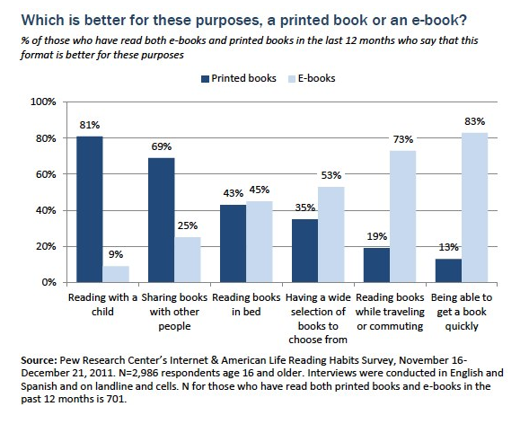
Notes:
UTA
Along with content, reading context is important. We go back to PEWs excellent and interesting data on eReading and eReaders (Raine, Zickuhr, Purcell, Madden & Brenner, 2012) and look at report released earlier this month that was focused on eReading (not just eReaders). Included was this chart which highlights context choices for print or e-reading. This is also interesting in that the data here reflect the publishing sales data I referenced early on. The smallest print sales declines were for childrens/YA lit while the largest were for mass market paperbacks.
But we want to take you beyond content or context

Slide 16
“Because technology has increased the intensity and complexity of literate environments, the twenty-first century demands that a literate person possess a wide range of abilities and competencies, many literacies.”
NCET, 2008
Notes:
UTA
In order to examine the shift in behaviors that we’re seeing, the choices we seeing being played out, we need to revisit literacy. Being a literate individual now means more than just being able to read and write. We now talk about information literacy, or technology literacy or media literacy. In 2008, the National Council of English Teachers Executive Committee adopted this definition of 21st century literacies (emphasis is mine) as an expansion their framework for curriculum and assessment. It is no longer good enough to have literacy, we need many literacies and this is what underpins the choices we currently make with reading.

Slide 17
Transliteracy
Notes:
UTA
Sue Thomas of Dumont University and her colleagues ( as cited in Ipri, 2010) have another term for this same concept: “transliteracy” and their definition might help us understand this more clearly in light of the various reading technologies we are talking about:

Slide 18
Transliteracy: the ability to read, write and interact across a range of platforms, tools and medias…
Dumont as cited in Ipri, 2010
Notes:
UTA
They define transliteracy as the ability to read, write and interact across a range of platforms, tool, and medias. The definition is broad and includes much of what we do online and with social media. At this point you might be wondering how this ties into choices in reading technology and I want to propose that transliteracy has everything to do with our choices. We need to be able to translate the skills we have in the print world to how we work in the digital world. Take skimming for example…it is so easy to skim a print text. But it is not easy for me, at least, to do this in the digital world.
There is absolutely no doubt that improvements in the various reading technologies can help us get past the difficulties we encounter. But I also think there is a very real chance that I may not be able to completely replicate that particular task. Our current literacies (or lack thereof) are certainly influencing the reading technology choices we make. If I don’t make the leap to learning the equivalent of “skim” in the digital world and always default to print because of this (if that task is important to me) then I am missing out on so many other really great features …and that can be debilitating in the long run.
I want to go back to the definition of transliteracy for a moment and highlight the “interact” bit of the definition because I think this is a key element in the rationale for developing transliteracy. Brian Mathews of the Ubiquitous Librarian blog and Associate Dean at Virginia Tech libraries has focused much of his writing on the user’s experience of libraries but has recently started writing about ebooks and ereading. In an early April post on social reading he made this comment:

Slide 19
“I want to do stuff with
my information,
not just read it.”
Mathews, 2012
Notes:
UTA
“I want to do stuff with my information, not just read it.” He was relating the experience of reading a pdf file via a reading app on his tablet but could not annotate the document or interact with the content in the way has become accustomed to because the document wasn’t in the format that the app needed to allow for this type of functionality. For Brian, even though he had access to the content, it was essentially useless to him because he wanted to do more than read, he wanted to do stuff with his information. What does this ultimately mean for Brian…next time he chooses to read a pdf, he may use a different app (which may mean developing new skills to work with that app) or perhaps he chooses a different reading technology to read that pdf (this is pretty unlikely). Either way, the content he’s reading and the context in which he is doing that reading will influence his reading technology choices.
I’ve got one more quote for you:

Slide 20
“What I love about print books is the fact that the required operating system never changes. I need only rely on what is inside of my skull to decode the print on the page. If the battery fails, well, I’ve got much bigger issues.”
CCReader, 2012
Notes:
This illustrates the challenges we all face in keeping our literacies up to date. But as we grow accustomed to connected devices being our default reading technology, hopefully this type of concern diminishes. We’re already becoming used to that with rapid updates cycles for the various technologies we already use.

Slide 21
Activity
Form groups of about 5 people.
Choose a reading technology.
Discuss the questions on the card.
Done? Tape the card to the poster.
Share with large group.
Background
Rachael is assigned a final research paper for her Into Writing class. She has chosen to explore themes of social inequality in The Hunger Games. The 3-5 page paper is due in 2 weeks and she needs to cite 5 scholarly sources using MLA style.
Image: flickr user rachel_titiriga
Notes:
http://www.flickr.com/photos/pocait/2235981139/
JANE
Since we are being challenged to develop new skills we wanted to give you an opportunity to begin thinking through some of the functional skills that help our users successfully use e-reading technology when they need to complete a project. So we have a small group activity that we want to ask you to do. We suggest forming groups of about 5 people. Each group will be asked to start with one assigned task which you’ll be asked to report back on—then you’re free to choose which of the others to do next. There are a total of 5 tasks but we don’t expect you to get through them all and if you want you can take this activity back with to go through with your colleagues.
Uta and I will provide an example of what we are looking for in just a second.
There are a couple of things you’ll need to know before you start. First is this background set up about Rachael a student who has...

Slide 22
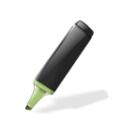
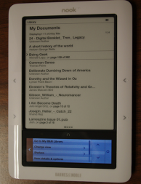
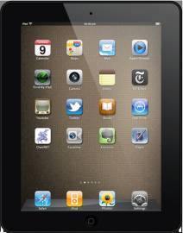
Task Technology
Image: flickr user believekevin
Image: flickr user sandburchick
Image: flickr user zenobia_joy
Image: flickr user expertcomp
Image: flickr user lameazoid
Image: flickr user einsteindesigns
Notes:
JANE
Now that you have a little bit of background. Here are the rest of the details:
Along the top are tasks we expect Rachael will want to do as she completes her assignment: annotating and highlighting; bookmarking; copying and pasting, searching and skimming.
Each group will get an envelope with a task associated with reading on the front. (Hold up envelope so people can see.) Pick a reading technology (laptop, tablet, ereader). Look inside the envelope for the questions about your task. Discuss.
Go on to the next task.
Done? Tape cards to the poster.
Share with large group.
So I’ll give a quick example.
Say Uta & I are in a group with 3 other people. We have our packet. Our 1st task to discuss is annotate. We’re going to choose a printed book as our reading technology. The question we are to discuss is how well or not does a printed book support Rachael in annotating. So I might say, it supports her well because she can write in the book exactly where she needs to. Uta might say you’re crazy –it’s not all that ---what if she can’t mark up her book or if she can then she has to transfer her notes from print to her computer. Takes too much time. Once we’re done we’ll tape our card to the poster & move on to Bookmarking, then Copy and Paste, Search and Skimming. When you do this we’ll ask you to note some key points of the discussion & at the end we can see what everyone came up with.
Questions?
Ok, get started.

Slide 23
Are we living in this world?
The e-reader bookmark
American Libraries, 2012
Notes:
UTA
I present this image to you not just to make you laugh, but to put emphasis on the kind of thinking you were just doing regarding the reading technologies and the reading tasks. Some of us may feel like this is the point we’re at right now and some of our patrons are here with us. But others most definitely are well beyond this. Part of our job as librarians is to help our patrons develop literacies…and as we discussed earlier, this really means transliteracy, then we need to be prepared ourselves to help our patrons get beyond this point. I’m curious, how many of you engaged in your discussion questions feeling hampered because you don’t have as much or enough experience with a technology as you’d like? Go on, raise your hands?
It is this very idea that gets us back to why we wanted to do our study in the first place. One of goals of the study was to influence our own staff’s thinking about this technology hoping it would lead to enhanced library or Press services. And to some extent this has begun to happen. But we also hope to influence you. If you have not yet begun to think about services to your eReading patrons, I’m hoping that this will help spur you to action.

Slide 24
Notes:
UTA
Your colleagues in various Oregon libraries are already thinking about how they serve eReading patrons. At the February Online Northwest conference we polled the audience about the services they currently provide to patrons who eRead. It is obvious from the responses that programs are in place to help our patrons develop their transliteracy skills. But we need to get these kinds of efforts going in all libraries and so we hope you leave this morning thinking about the skills and experiences that YOU need to make this happen.

Slide 25
“…a rise in one innovation does not mark the end of another.”
Bauer, 2011
Notes:
UTA
In closing I want to leave you with this final quote. Sarah Bauer (2011) notes in her recent article on the rapid adoption of eReaders that the rise of one technology, does not mean the end of another. While the shift she is referring to is the transition from print to digital, this also describes the situation we will find ourselves in from here on out. Transliteracy will be less an end goal but instead simply the mode in which we operate. We will be continually striving to translate current skills to the newest technology in our rapidly evolving digital environments. We saw from the poll a moment ago that Oregon librarians are already involved in efforts to help our patrons develop the skills they need to read in the digital world. And this is excellent news because transliteracy moves us past choices based on limitations (I can’t do that so I have to choose this) to choices that exploit a wide range of possible options. It allows us all to fully engage with and get the most our of content we encounter in our digital world.
Thank you.

Slide 26
?
Notes:
Uta
If folks want to stay for the remaining 10 minutes, please do so…Q&A

Slide 27
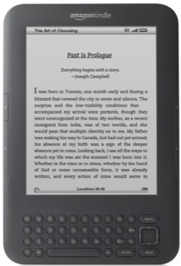
uta.hussong-christian@oregonstate.edu
jane.nichols@oregonstate.edu

Slide 28
References
AAP Estimates: E-book Sales Rose 117% in 2011 as Print Fell (2012, February 27). Publishers Weekly. Retrieved from http://www.publishersweekly.com/pw/by-topic/industry-news/financial-reporting/article/50805-aap-estimates-e-book-sales-rose-117-in-2011-as-print-fell.html.
Device ownership (2012). Washington, D.C.: Pew Research Center. Retrieved from http://http://pewinternet.org/Static-Pages/Trend-Data/Device-Ownership.aspx
Bauer, Sarah. (2011, November 18). Lessons in perception: ebook technology and the fast train it runs on [Blog post]. Retrieved from http://www.kelownawebdesigns.com/miscellaneous/lessons-in-perception-ebook-technology-and-the-fast-train-it-runs-on/.
CCReader (2012, February 23). Ebooks vs print [blog post comment]. Retrieved from http://americanlibrariesmagazine.org/columns/wills-world/coolness-factor.
Fenn, J., & Raskino, M. (2008). Mastering the hype cycle: How to choose the right innovation at the right time. Boston: Harvard Business Press.
Gartner, Inc. (2012). Research methodologies : Hype cycles. Retrieved from http://www.gartner.com/technology/research/methodologies/hype-cycle.jsp.
Gartner, Inc. (2011, August 10). Gartner newsroom: Gartner's 2011 hype cycle special report evaluates the maturity of 1,900 technologies. Retrieved from http://www.gartner.com/it/page.jsp?id=1763814.
How will we read: An interview with @stevenbjohnson from the @findings blog [blog post]. (2012, February 12). Retrieved from: http://blog.findings.com/post/17661615384/how-we-will-read-an-interview-with-stevenbjohnson
Ipri, T. (2010). Introducing transliteracy: What does it mean to academic libraries? College &Research Libraries News, 71 (10): 532-567. Retrieved from http://crln.acrl.org/content/71/10/532.full.

Slide 29
References
Mathews, Brian. (2012, April 3). The (social) reader’s dilemma: Content + container = context [blog post]. Retrieved from http://chronicle.com/blognetwork/theubiquitouslibrarian/2012/04/03/the-social-reader%E2%80%99s-dilemma-content-container-context/
National Council of Teachers of English. (2008, February 2008). 21st century literacies. Urbana, IL: http://www.ncte.org/governance/literacies.
Pugh, A.K. (1978). Silent reading: An introduction to its study and teaching. London: Heinemann Educational Books.
Raine, L. (2012). Tablet and e-book reader ownership nearly double over the holiday gift-giving period.
Washington, D.C.: Pew Research Center. Retrieved from http://pewinternet.org/~/media//Files/Reports/2012/Pew_Tablets%20and%20e-readers%20double%201.23.2012.pdf.
Raine, L.., Zickuhr, K., Purcell, K., Madden, M. , & Brenner, J. (2012, April 4). The rise of e-reading.
Washington, D.C.: Pew Research Center. Retrieved from http://libraries.pewinternet.org/2012/04/04/the-rise-of-e-reading///Files/Reports/2012/Pew_Tablets%20and%20e-readers%20double%201.23.2012.pdf.
Rogers, E.M. (1995). The diffusion of innovations (4th ed.). New York: The Free Press.
Schcolnik, M. (2002). Are e-readers viable instruction delivery systems? Journal of Instruction Delivery Systems, 16 (4), 6-17. Retrieved from http://www.salt.org/jidstoc.asp.
Thayer, A., Lee, C.P., Hwang, L.H., Sales, H., Sen, P., & Dalal, N. (2011). The imposition and superimposition of digital reading technology: The academic potential of e-readers. Proceedings from CHI '11: The Annual Conference on Human Factors in Computing Systems. New York: ACM.
Thomas, S., Joseph, C., Laccetti, J., Mason, B., Mills, S., Perril, S. & Pullinger, K. (2007). Transliteracy: Crossing divides. First Monday, 12 (12). Retrieved from http://firstmonday.org/htbin/cgiwrap/bin/ojs/index.php/fm/article/viewArticle/2060/1908.

