Slide 1
We’re All Documents Librarians Now
Presentation at Oregon Library Association, Riverhouse Convention Center, Bend, Oregon. April 27, 2012
Valery King
Oregon State University, Corvallis
Dotty Ormes
Southern Oregon University, Ashland

Slide 2
Who uses government information?
Scientists/Researchers
Social Scientists
Lawmakers
Policy makers
Economists
School kids making reports
College students writing papers
Teachers
History buffs
Farmers
Family history researchers
Job seekers
Grant seekers
Employers
Consumers
People doing their taxes
People seeking benefits (Social Security, Medicare, Disability, Military & Veterans, etc.)
Immigrants seeking citizenship
Homeowners and renters
Visual Artists
Performing Artists
…pretty much everyone!

Slide 3
Document phobia!
Traditional view:
Limited to special libraries (depositories)
Gov info specialist help essential
Difficult to find
Hard to access
Complicated finding aids
Today:
90% or more new gov info freely available online
Older content being digitized at fast rate
Easy-to-use tools and websites
Specialists still available for tough stuff

Slide 4
A New way of thinking about…
Government Documents
GOVERNMENT INFORMATION

Slide 5
You have choices…
Content management systems (FDsys)
Catalogs (CGP, Agricola, PubMed/Medline)
Federated searching (MetaLib)
Portals (USA.gov, kids.gov, science.gov)
Browse lists (FDA, CDC, Browse Topics)
Databases (American FactFinder, Data.gov)

Slide 6
Content Management
FDSys:
Federal Digital System
www.gpo.gov/fdsys/

Slide 7
www.gpo.gov/fdsys

Slide 8
catalogs
Catalog of U.S. Government Publications
AGRICOLA
PUBMED/MEDLINE

Slide 9
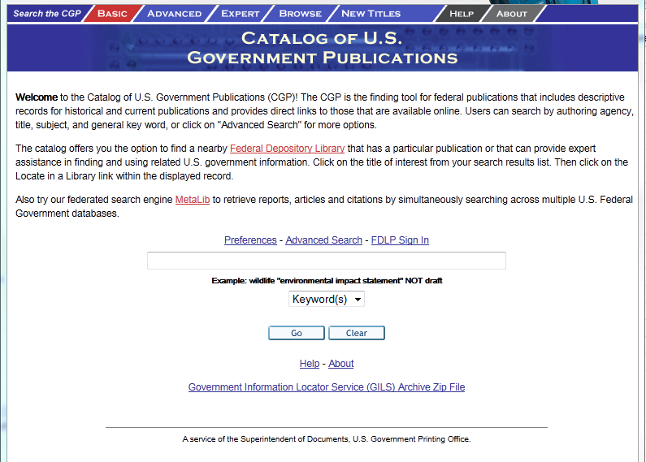
CGP: Catalog of U.S. Government Publications http://catalog.gpo.gov/

Slide 10
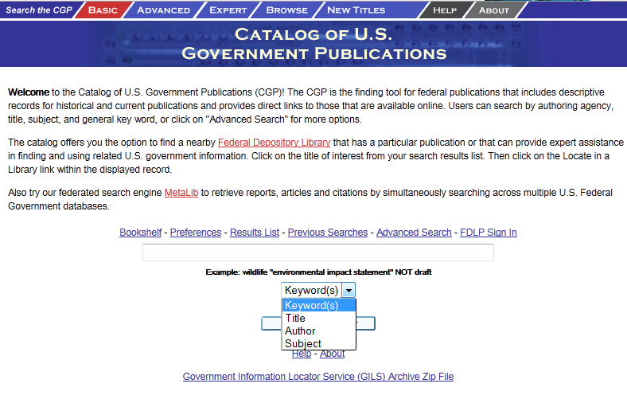
Basic Search Page

Slide 11
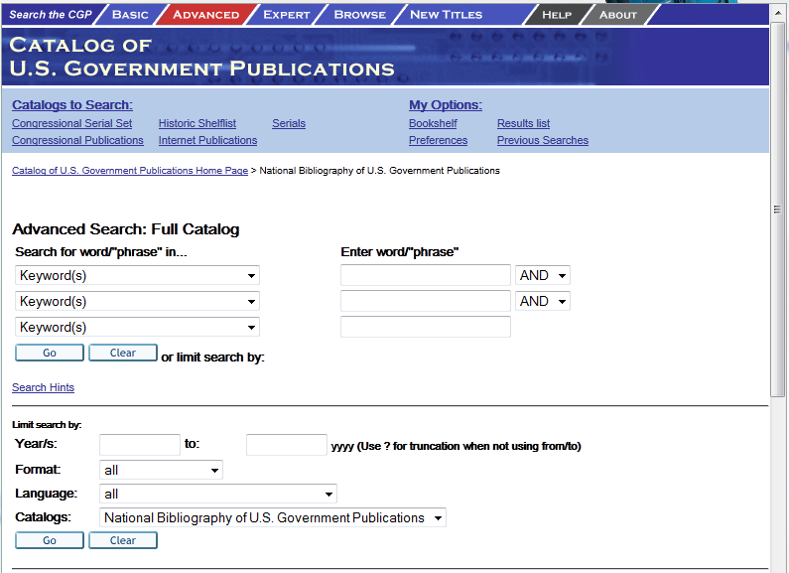
Advanced search page

Slide 12
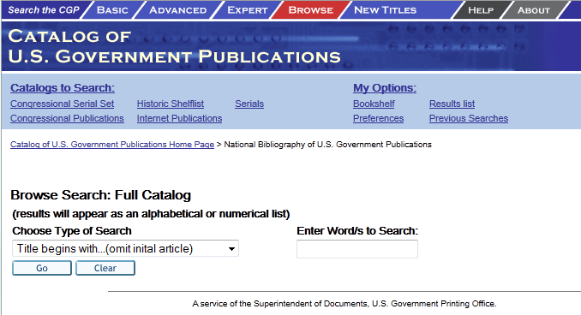
Browse search page

Slide 13
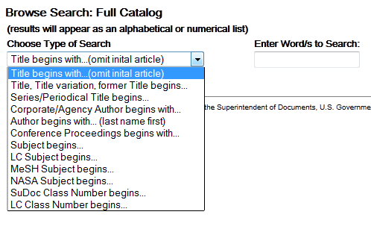

Slide 14
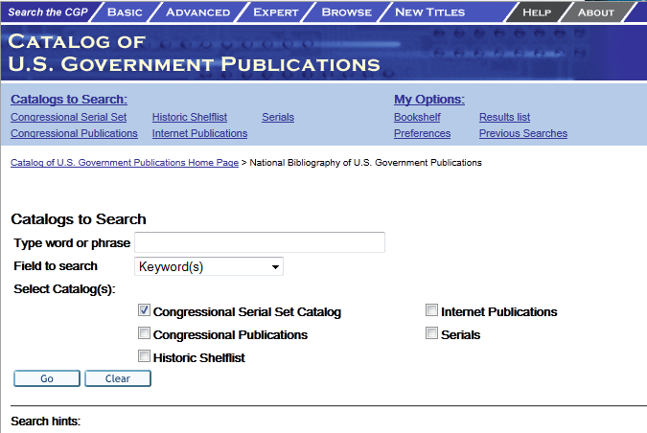
Pick a catalog…

Slide 15
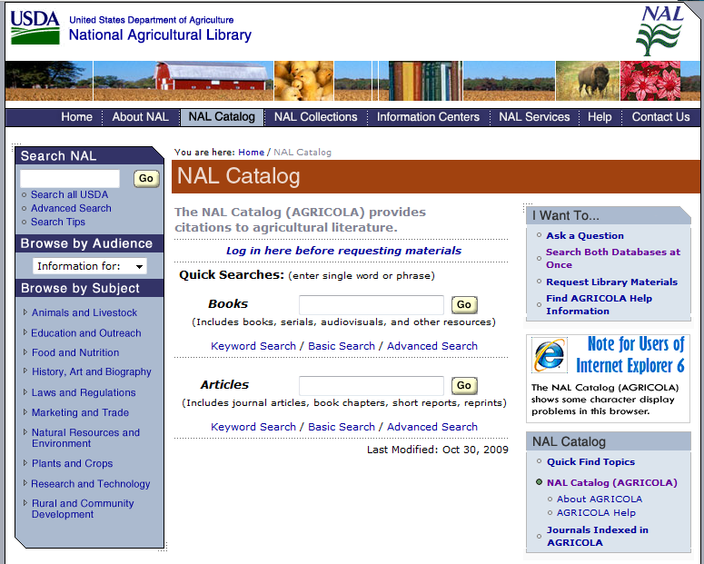
AGRICOLA/nal catalog the national agricultural library http://agricola.nal.usda.gov

Slide 16
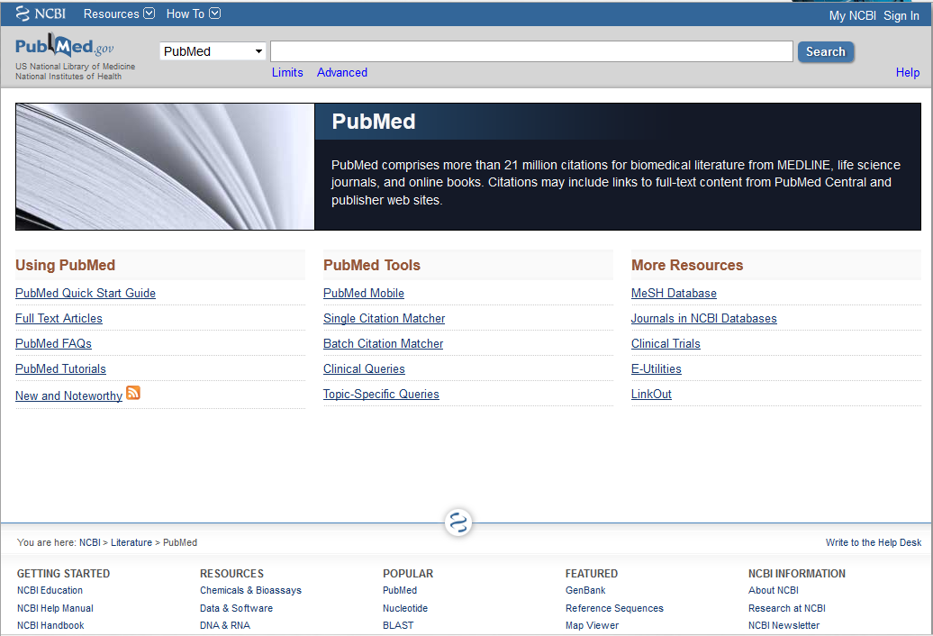
Pubmed/medline http://pubmed.gov

Slide 17
Portals/search engines
USA.gov
science.gov
benefits.gov

Slide 18
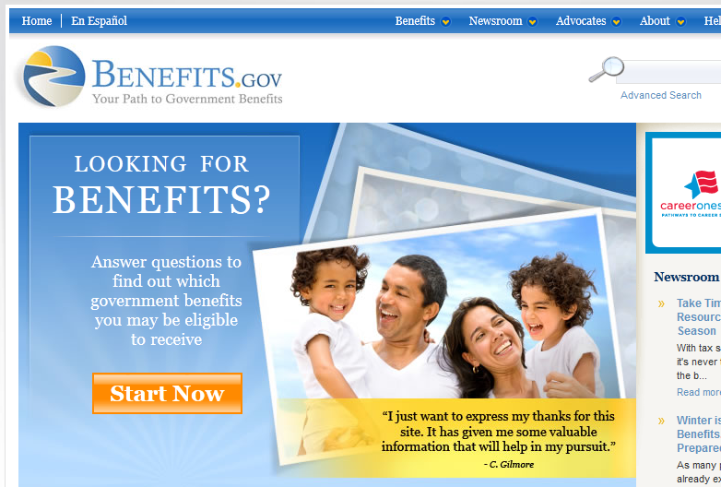
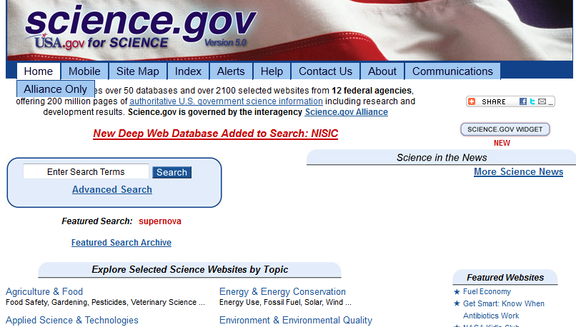
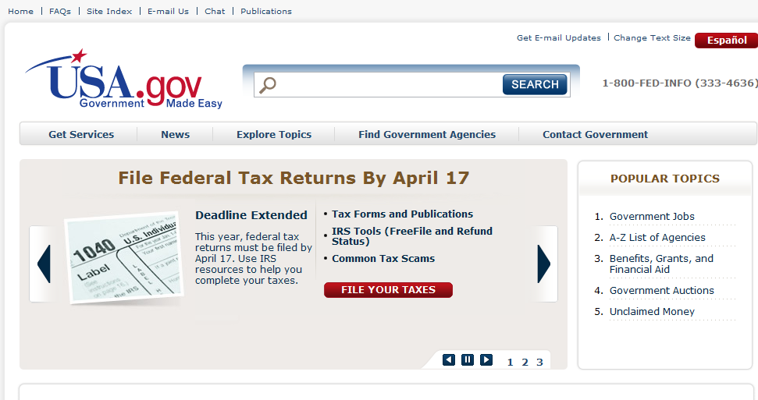

Slide 19
Websites for Kids/students teachers & parents too
KIDS.GOV
BEN’S GUIDE
Free.ed.gov
Various Agency Websites for Kids

Slide 20
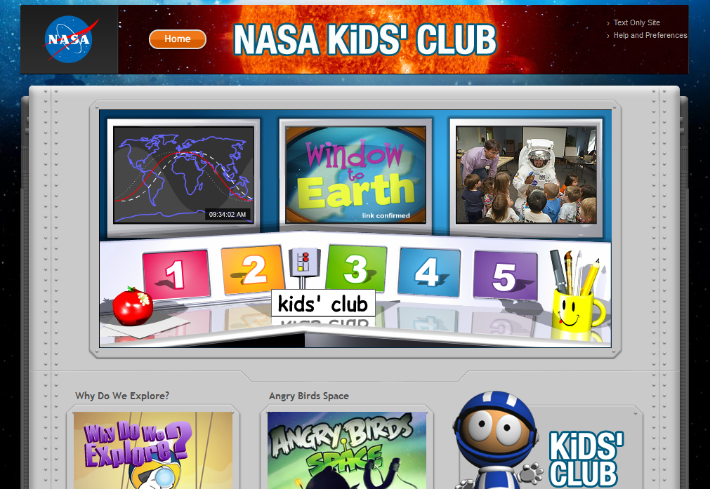
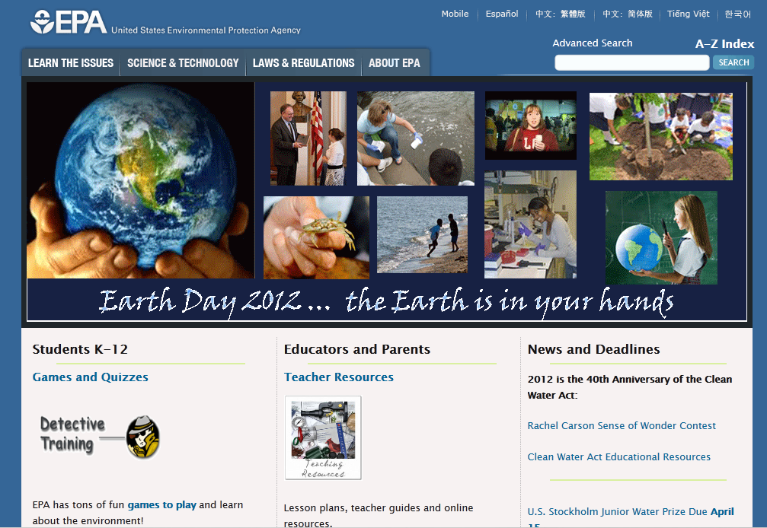

Slide 21
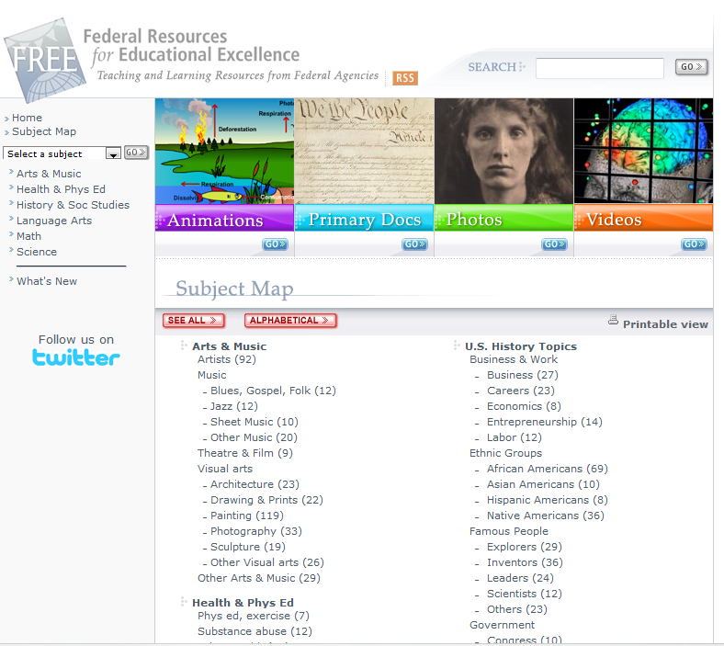
http://free.ed.gov

Slide 22
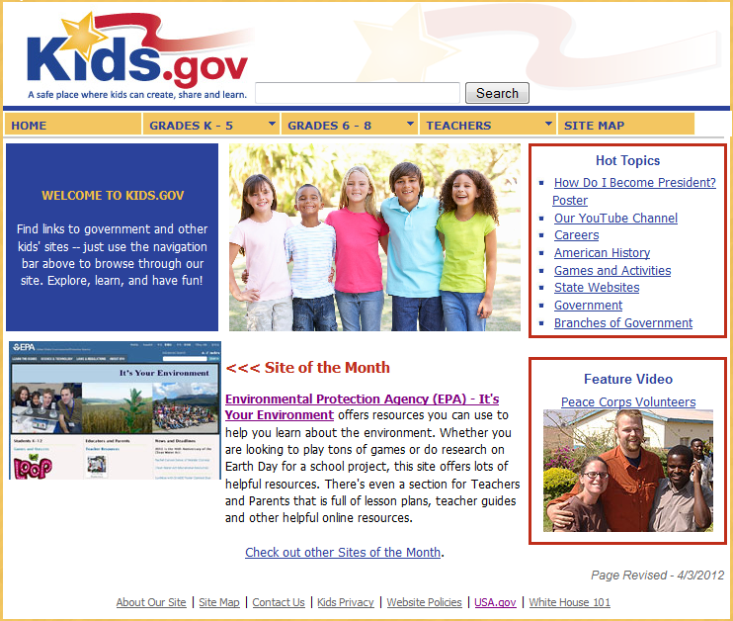
http://Kids.gov

Slide 23
Browse Lists
Food & Drug Administration (FDA)
Centers for Disease Control and Prevention (CDC)
Social Security Administration
American Memory Project
Browse Topics

Slide 24
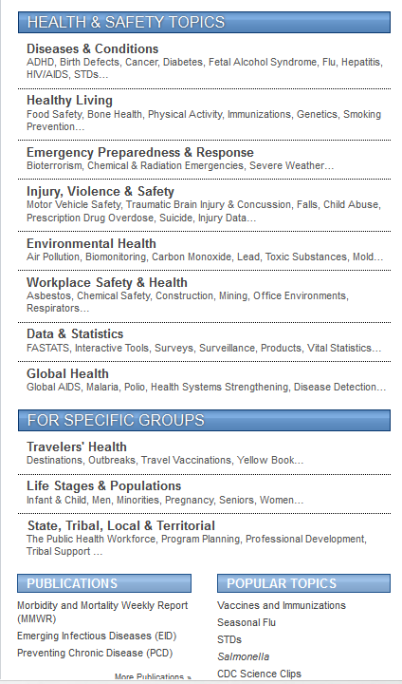
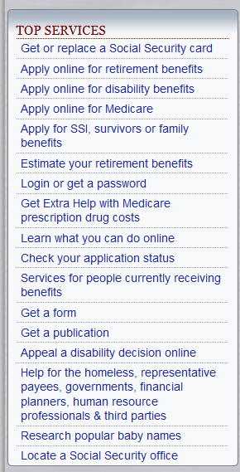
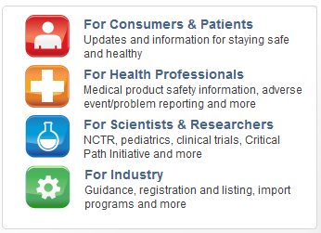

Slide 25
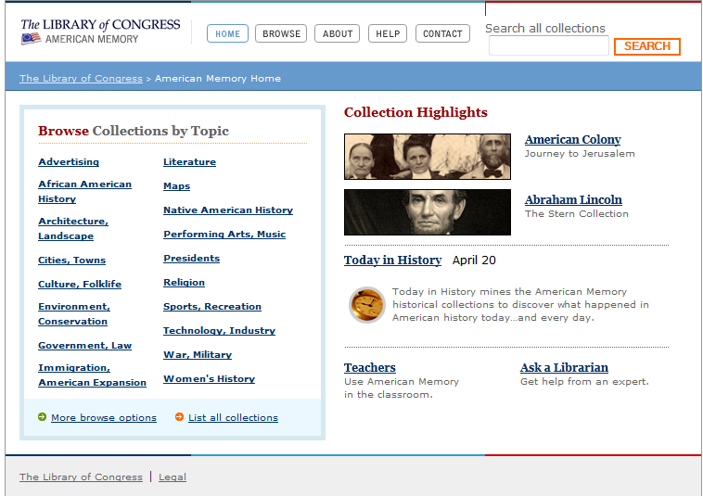
American memory project http://memory.loc.gov/

Slide 26
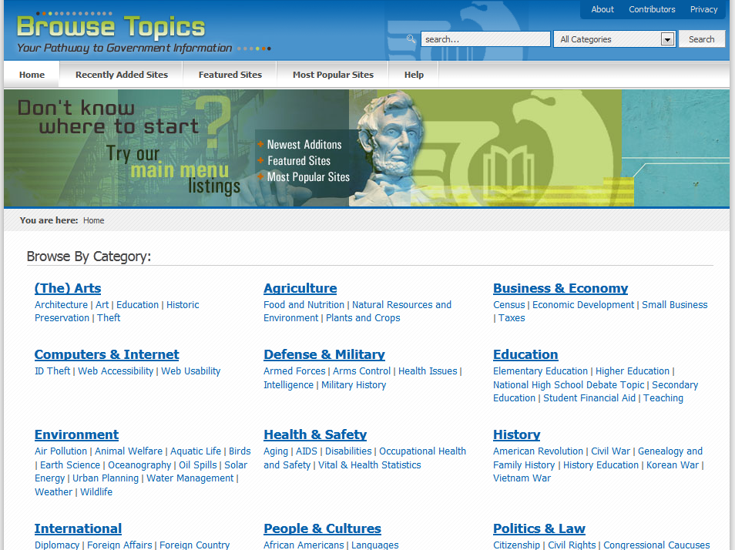
Browse topics http://www.browsetopics.gov

Slide 27
Data sets
American Factfinder
Data.gov

Slide 28
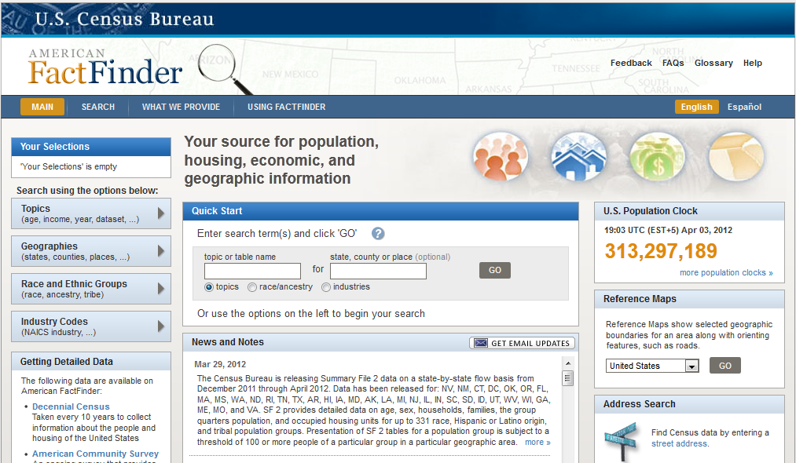
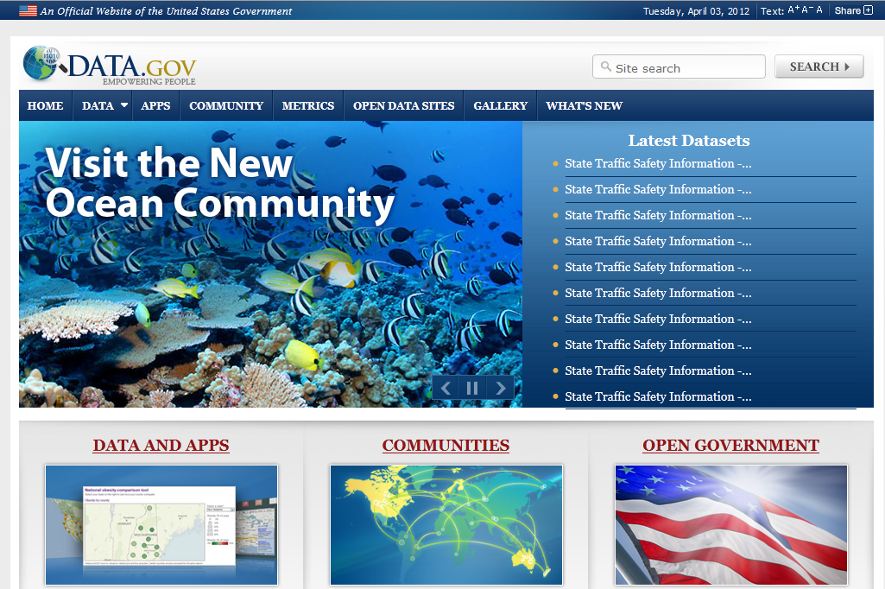

Slide 29
Federated searching: metalib
LINK ON CGP HOME PAGE;
http://metalib.gpo.gov

Slide 30
MetaLib
CGP’s federated search engine
Searches across 54 US federal government databases
Use to identify/obtain reports, articles, citations, data sets
Basic, advanced, expert
A-Z resource list
?

Slide 31
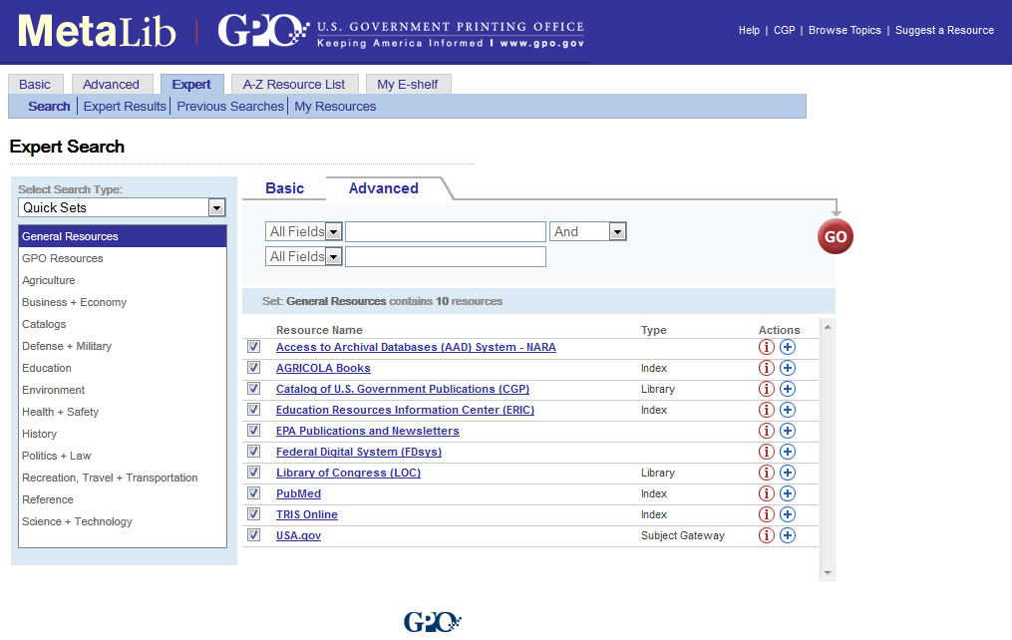
http://metalib.gpo.gov/

Slide 32
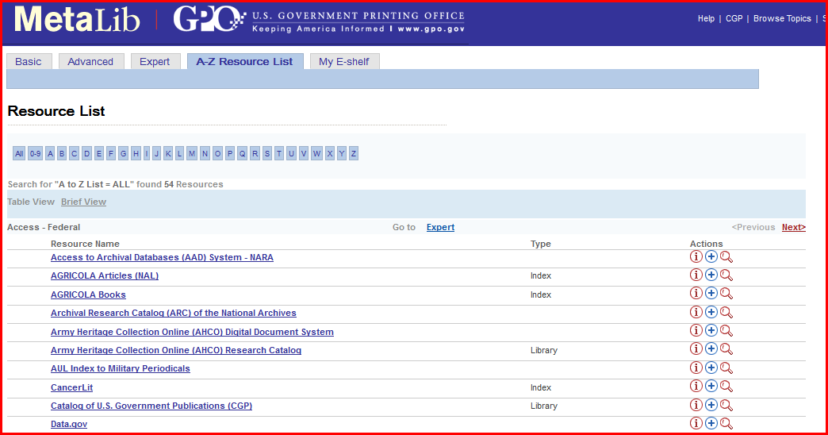

Slide 33
Metalib “quick sets”
General Resources
GPO Resources
Agriculture
Business + Economy
Catalogs
Defense + Military
Education
Environment
Health + Safely
History
Politics + Law
Recreation, Travel +Transportation
Reference
Science + Technology

Slide 34
So, to summarize…
The Federal Government has valuable information freely available to all
Easier accessibility and usability than ever before
Covers all subject areas—NOT just regulations and laws, or benefits and services
…and we’ve barely scratched the surface!

Slide 35
Questions?
Valery King,
Oregon State University
valery.king@oregonstate.edu
http://ica.library.oregonstate.edu/subject-guide/286-Government-Information
Dotty Ormes,
Southern Oregon University
ormesd@sou.edu
http://libguides.sou.edu/federal/

