Slide 1
Serials & E-Books in RDA
Renette Davis
With thanks to Judith Kuhagen, Library of Congress, and Steve Shadle, University of Washington
Oregon Library Association
April 6, 2011
Last updated: April 9, 2011
1
1
Notes:
1
1
1

Slide 2
View and download the PowerPoint slides at http://www.nwcentral.org.
View and download the PowerPoint slides with speakers notes at http://www.renettedavis.com

Slide 3
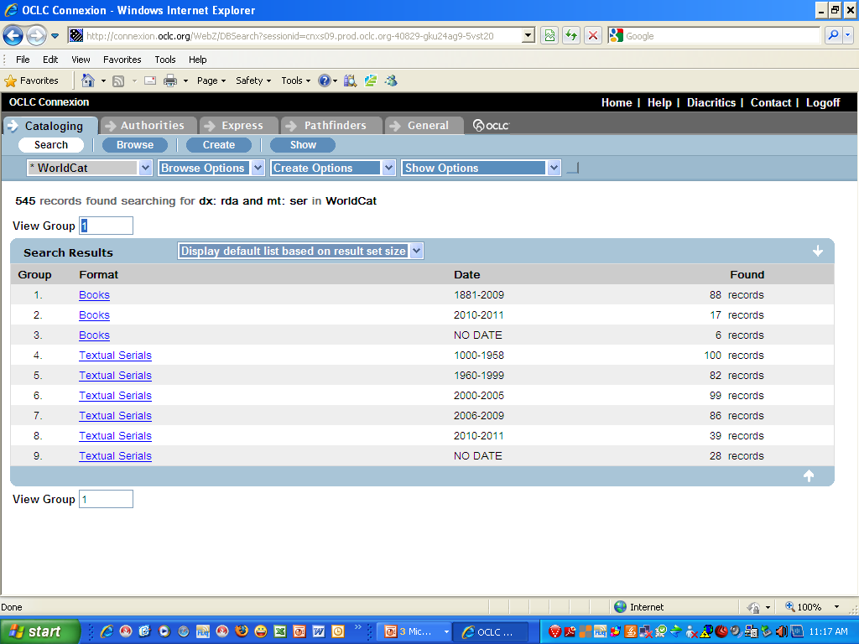
Finding RDA records in Connexion dx:rda/ser
3
3
Notes:
3
3
Thank you very much for inviting me to speak to you today. I have recently retired from The University of Chicago Library, which was one of the institutions participating in the official RDA test. When we were preparing for the test, we created some sample RDA records in our local catalog, which many of you have probably seen. However, you can now look at real RDA records in OCLC. To find the serial records in Connexion, do a command line search dx:rda/ser. When I did this search about a month ago, there were over 500 RDA serial records. This is a shot of the screen in the Connexion browser showing the results of my search. The category called Books is actually e-serials.

Slide 4
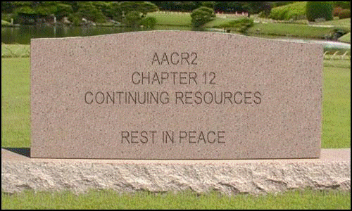
Transition from AACR2 to RDA
4
4
Notes:
4
4
Steve Shadle gave an excellent Webinar sponsored by ALCTS last month called “RDA and Serials Catalogers: Will Our Work Really Change?” I thought this was a wonderful slide and Steve kindly let me use it for this presentation. As serials catalogers, we are used to finding all of the rules that we need in one place in AACR2, but it’s not like that in RDA. RDA is organized around the tasks of “identify” and “relate”, which means that instructions for cataloging serials are scattered throughout RDA.

Slide 5
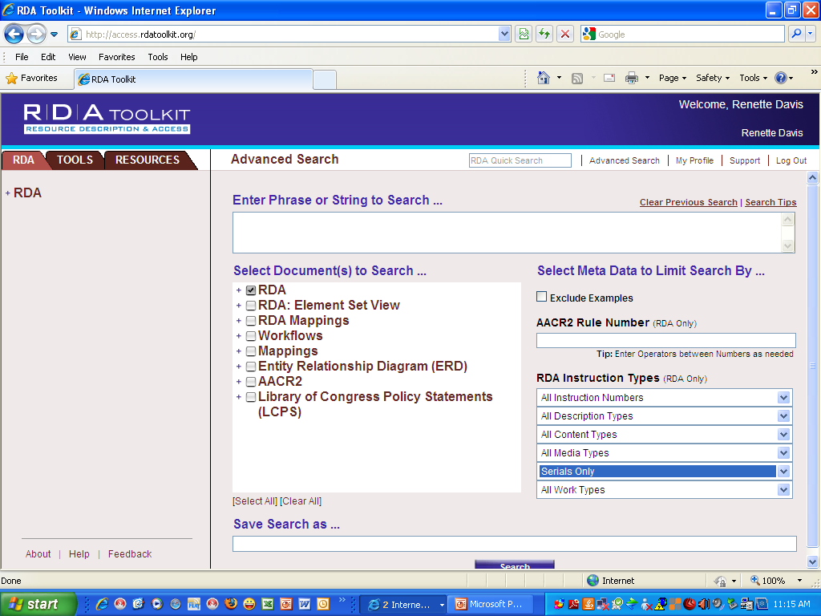
Searching in RDA Toolkit
5
Notes:
5
However, you can find all of the instructions relating to serials by doing an Advanced search in the RDA Toolkit and selecting “Serials only” under the RDA Instruction Types. If you leave the box under “Enter Phrase or String to Search” blank, as I have done here, then you will get all of the instructions that are specifically about serials.
You can also search the toolkit by AACR2 rule number if you want to know what happened to rules that are familiar to you.

Slide 6
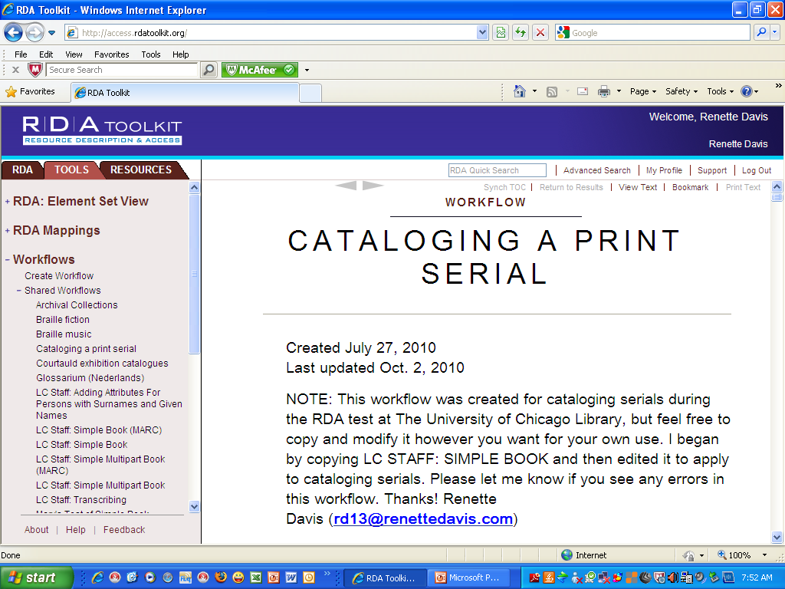
RDA Workflows
6
6
Notes:
6
6
After the RDA Toolkit was released, I started creating my first real RDA record and found it difficult navigating the rules. I had been involved in the development of RDA, serving on several committees that reviewed and commented on drafts, and I figured it must be even harder for those who did not have any familiarity with RDA, so I decided to create a workflow called “Cataloging a Print Serial”. It was created for the RDA test at The University of Chicago Library so it includes decisions that we had made about alternatives and options.
If you would like to create a workflow with your own decisions, feel free to copy this one and then edit your copy to fit your own needs.
6

Slide 7
Full RDA Serial Record
Type a Elvl I Srce d Gpub Ctrl Lang eng BLvl s Form Conf | Freq | Mrec Ctry miu S/L 0 Orig EntW Regl | Alph Desc i SrTp Cont DtSt c Dates 2009, 9999 040 CGU ǂb eng ǂc CGU ǂe rda ǂd CGU 090 PN6727.D33G8 100 1 Davis, Guy, ǂd 1966- ǂe author. 245 10 Guy Davis artworks / ǂc Guy Davis. 260 [Michigan?] : ǂb [publisher not identified], ǂc [2009]- , ©2009- 300 ǂb illustrations (some color) ; ǂc 28 cm 336 still image ǂ2 rdacontent 336 text ǂ2 rdacontent 337 unmediated ǂ2 rdamedia 338 volume ǂ2 rdacarrier 362 1 Began with #1 (OCT 2009). 588 Description based on: #1 (OCT 2009); title from masthead. 588 Latest issue consulted: #1 (OCT 2009). 600 10 Davis, Guy, ǂd 1966- 650 0 Cartoonists. 650 0 Comic books, strips, etc. 856 42 ǂu http://www.guydavisartworks.com/
7
7
Notes:
7
7
Here is the first RDA record that I created from scratch. It's kind of a weird serial, so not only was I unsure about some things relating to RDA but I was also unsure about a number of things related to cataloging this resource. I did not make it a CONSER record because of these uncertainties, even though we were allowed to create CONSER RDA records during the test.
A little bit later, we will be looking at the individual RDA elements in this record but for now let me just point out that RDA does prescribe using a personal name as part of the authorized access point representing the work, if a person is the creator, just like AACR2 did.
7

Slide 8
Terminology
Title of a work – a word or character or group of words and/or characters by which a work is known.
Preferred title of a work – title or form of title chosen as the basis for the authorized access point representing the work.
Based on title proper of first manifestation
If varies on later manifestations, title by which work has become known
8
8
Notes:
8
8
With the last slide I threw out the words “authorized access point representing the work” but I didn’t explain what it meant. I really had a hard time with this new terminology when I started looking at RDA, so I thought it would be good to go over some definitions.
A title of a work is just a word or character or group of words and/or characters by which a work is known. A work can have a number of different titles.
The preferred title of a work is the title that is chosen as the basis for the authorized access point representing the work. It is based on the title proper of the first manifestation. If the title proper varies on later manifestations, it is the title by which the work has become known.

Slide 9
Terminology (cont’d)
9
9
Access point – name, term, code, etc. representing an entity.
Authorized access point – standardized access point representing an entity.
Authorized access point representing a work – preferred title for the work preceded by the authorized access point representing a person, family, or corporate body responsible for the work, if appropriate. May include additional elements if necessary to distinguish one work from another.
Notes:
9
9
An access point is just a name, term, code, etc., representing an entity. There could be a number of access points for an entity. For example, my name is Elizabeth Renette Davis. In an authority record for me, there might be access points for Elizabeth Davis, Renette Davis, or E. Renette Davis, which is how I frequently sign my name.
An authorized access point is the standardized access point representing an entity. In our current MARC structure, it would be the 1XX in an authority record.
And now, finally, we get to the authorized access point representing the work. It is the preferred title for the work, preceded by the authorized access point representing a person, family, or corporate body responsible for the work, if appropriate. It can also include additional elements if necessary to distinguish one work from another, which we will discuss later.

Slide 10
Basis for Identification of the Resource
If issues or parts are sequentially numbered, use the lowest numbered issue or part available.
If issues are unnumbered or not sequentially numbered, use the issue or part with the earliest date of issue.
10
10
Notes:
10
10
Now let’s talk about the “Basis for identification of the resource”, or what we currently call “Description based on”. For resources issued in more than one part, RDA says that if the issues or parts are sequentially numbered, we are to choose a source of information identifying the lowest numbered issue or part available. This is the same as what we do now in AACR2.
It also says that if the issues or parts are unnumbered or not sequentially numbered, we are to choose a source of information identifying the issue or part with the earliest date of issue. This is different than what we do now if the issues are not sequentially numbered. Now we choose the earliest issue based on the number rather than the date.

Slide 11
Preferred Source of Information for resources with pages, leaves, etc.
Title page
If there is none, use the first of the following that bears a title:
Cover
Caption
Masthead
Colophon
If none of these have a title, use another source within the resource, giving preference to sources where information is formally presented
11
11
Notes:
11
11
Let’s also look at the “Preferred source of information”, or what we now call the “Chief source of information”. RDA says that for resources consisting of one or more pages, leaves, sheets, or cards (or images of any of those), we are to use the title page if there is one. If there is no title page, we are to use the first of the following sources that bears a title: cover, caption, masthead, and then colophon. If none of these sources have a title, then we use another source within the resource, giving preference to sources where the information is formally presented.
There is an alternative that says if the resource consists of microform or computer images, we can use an eye-readable label instead of the image of the title page. The LCPS for the RDA test said to use the alternative for direct access electronic resources but not for microforms. There is also an exception for early printed resources and different instructions for other types of resources, such as moving images, which we won’t go into here.

Slide 12
How to identify an RDA record
Type a Elvl I Srce d Gpub Ctrl Lang eng
BLvl s Form Conf | Freq | Mrec Ctry miu
S/L 0 Orig EntW Regl | Alph
Desc i SrTp Cont DtSt c Dates 2009, 9999
040 CGU ǂc CGU ǂe rda ǂd CGU
Note: Language of cataloging may be included in 040 ǂb but it is not required
12
12
Notes:
12
12
Let’s look at some RDA examples now and see what’s different from AACR2. We’ll start with the basic information on how to identify RDA records. You may have noticed in the record for Guy Davis artworks that the Leader/18 byte for Descriptive Cataloging Form, or “D e s c” in this mockup of a record from OCLC, is i for ISBD.
The 040 also looks a little different. The subfield e, description conventions, is rda. You may also see some RDA records that have a subfield b, language of cataloging, in the 040. The language of cataloging is not an RDA element, but it is in MARC and LC included it in their RDA test records. The University of Chicago also included it.

Slide 13
Relationship of person, family, or corporate body to resource
100 1 Davis, Guy, ǂd 1966- ǂe author.
110 1 California, ǂe enacting jurisdiction.
110 2 Friends of the Bodleian, ǂe author.
110 2 World Health Organization. ǂb Country Office for Eritrea, ǂe author, ǂe issuing body.
13
13
Notes:
13
13
You may have noticed in the record for Guy Davis artworks that there was a subfield e, author, after the name in the 100 for that record. Relationships are very important in RDA, although they are not core elements.
We decided to include relationship designators for the test at the University of Chicago, mainly to get a feel for how it would work. A number of the other records that I looked at in OCLC also include relationship designators in the 1XX field.
In the examples on this slide, the relationship designator shows the relationship of the person or corporate body to the resource being described. In the last 110 example, the cataloger felt that this body had 2 relationships to the resource, one as author and one as issuing body, so both were included.

Slide 14
Relationship of person, family, or corporate body to resource (cont’d)
110 1 Wisconsin. ǂb Department of Commerce, ǂe issuing body.
111 2 Appita Annual Conference and Exhibition, ǂj issuing body.
Note: Relationship designator for 111 is in ǂj instead of ǂe because ǂe is for subordinate unit.
14
14
Notes:
14
14
These two examples show how a corporate body can be used as part of the authorized access point for the work, even though the bodies are not responsible for the artistic or intellectual content of the work. RDA, like AACR2, specifies that for certain types of resources, the authorized access point for the work includes the name of the corporate body.
Note that department is spelled out in the first example on this slide. This is actually a change that should have been made with AACR2 but wasn’t.
Note also that the second example includes the word “Annual” in the name of the conference. That would have been omitted in AACR2. You may also have noticed that the relationship designator for the 111 is in subfield j instead of in subfield e as it is in the 110. That's because subfield e for 111 is subordinate unit so a different subfield had to be used for relationship designator. The same would be true for a 711.

Slide 15
Title & statement of responsibility
100 1 Davis, Guy, ǂd 1966- ǂe author.
245 10 Guy Davis artworks / ǂc Guy Davis.
245 00 Women’s surf style magazine.
110 2 United Nations Environment Programme, ǂe author.
245 10 Evaluation synthesis report / ǂc UNEP, United Nations Environment Programme, Evaluation Office.
245 00 Tantric studies.
15
15
Notes:
15
15
The title proper of the manifestation is a core element in RDA. In our current MARC environment, the 245 serves as the title proper of the manifestation. It also sometimes serves as part of the authorized access point representing the work. MARC does not prevent us from using a 240 or 130 for the preferred title of the work if it’s the same as the title of the manifestation, but we currently do not do that by policy.
The statement of responsibility relating to the title proper is also a core element in RDA. The CONSER Standard Record for AACR2 says that it is not required to transcribe a statement of responsibility, and I imagine this is something that CONSER will look at if RDA is adopted.

Slide 16
Authorized access point for the work
If two or more works have the same or similar preferred title and the same authorized access point representing the person, family, or corporate body responsible for the work (if there is one), add an element or elements such as form of work, date, place, or other distinguishing term to construct the authorized access point representing the work.
130 0 World peace (Brookings, Or.)
245 10 World peace / ǂc On the Rainbow Publishing.
16
16
Notes:
16
16
There are times when the title proper of the manifestation, along with the authorized access point for the person, family, or corporate body responsible for the work, is not enough to serve as the authorized access point representing the work. If two or more works have the same preferred title and the same authorized access point for the entity responsible for the work, we are instructed to add an element or elements, such as form of work, date, place, or other distinguishing term to construct the authorized access point representing the work.
If you’re thinking this sounds like the uniform titles that we have been using for serials with AACR2, you are exactly right. The CONSER Standard Record for AACR2 now says that it is not required to add a uniform title except for monographic series and generic titles, so I imagine CONSER will also look at this if RDA is adopted.

Slide 17
Changes in transcribing title
AACR2
110 2 Friends of the Bodleian.
245 10 Annual report ...
111 2 Capture and Transportation Working Group Workshop.
245 10 Annual capture working group workshop proceedings.
RDA
110 2 Friends of the Bodleian, ǂe author.
245 10 ... Annual report ...
111 2 Capture and Transportation Working Group Workshop.
245 10 … Annual capture working group workshop proceedings.
17
17
Notes:
17
17
Let’s look now at some changes in RDA relating to transcribing the title. In AACR2, we are used to seeing marks of omission in the middle of the title, or at the end of the title, but not at the beginning of the title. In RDA, we will also have marks of omission at the beginning of the title. In the first example here, the title is First annual report 1925-26, so we have the marks of omission at both the beginning and end of the title.
The question came up in Steve’s webinar about how you would code the number of non-filing characters in the 2nd indicator of the 245 when using the marks of omission at the beginning of the title, so I checked to see what people have been doing in OCLC, and I found records done both ways. Some had a 2nd indicator of zero and some had a 2nd indicator of 4. I was able to find the titles in Connexion either way, but the 2nd indicator of zero is actually the correct coding according to MARC.
17

Slide 18
Capitalization in title
RDA 1.7.2 – Follow Appendix A.
245 00 English housing survey. ǂp Housing stock report.
Alternative at RDA 1.7.1 – Follow in-house guidelines or published style manual. LCPS said take what you see or follow Appendix A.
245 00 Leadership in SPORT.
245 00 Baltic Journal of ART HISTORY.
245 00 Korean Automobile Industry : ǂb … Annual Report / ǂc Karna, Korea Automobile Manufacturers Association.
245 10 kiwi : ǂb the magazine of kosher cooking.
18
18
Notes:
18
18
The general rules on transcription at RDA 1 7 2 say to follow Appendix A for capitalization, which is basically the same as what we do now. However, there is an alternative at 1 7 1 that says if the agency creating the data has established in-house guidelines or has designated a published style manual, use those guidelines or style manual instead. The LCPS for the RDA test said to take what you see on the resource or follow Appendix A.
The first example on this slide looks the same as it would have under AACR2. In the next 2 examples, some of the words were probably all caps on the resource, so the catalogers transcribed them that way in the records. In the Korean Automobile Industry example, the first letter of every word is capitalized, possibly because that’s the way it was on the resource or maybe the cataloger was following a standard that said to do it that way. In the kiwi example, it may have been all lower case on the resource so the cataloger transcribed it that way.

Slide 19
Capitalization in title (cont’d)
Another alternative at RDA 1.7.1 – If data comes from digital source, use without modification. LCPS said make adjustments as judged appropriate.
245 10 AMERICAN VAMPIRE / ǂc Scott Snyder, Stephen King, Writers ; Rafael Albuquerque, Artist ; Dave McCaig, Colorist ; Steve Wants, Letterer.
245 04 THE ESTONIAN JOURNAL OF ENGLISH STUDIES.
245 10 LEADING ECONOMIC INDICATORS / ǂc REPUBLIC OF KENYA, CENTRAL BUREAU OF STATISTICS, MINISTRY OF PLANNING & NATIONAL DEVELOPMENT.
19
19
Notes:
19
19
There is another alternative at 1 7 1 that says if the data comes from a digital source of information, such as by harvesting embedded metadata, use the data without modification. The LCPS for that alternative says to make adjustments to the supplied information as judged appropriate.
In these 3 examples, the title may have all been capitalized on the resource, or the data may have come from a digital source.
At the University of Chicago, we decided not to transcribe or accept everything in caps like these examples because many of our users pull records into citation software, and our public services staff did not think they would want titles that were all in caps.

Slide 20
No supplied other title information
AACR2
111 Conference on Tax Planning for 501(c)(3) Organizations.
245 Conference on Tax Planning for 501(c)(3) Organizations : ǂb [proceedings].
RDA
111 Conference on Tax Planning for 501(c)(3) Organizations, ǂj author.
245 Conference on Tax Planning for 501(c)(3) Organizations.
500 Proceedings of the conference.
20
20
Notes:
20
20
In AACR2, if the title needed explanation, such as when it consisted only of the name of a corporate body or conference, a brief addition was supplied in brackets as other title information. RDA has no provision for that, so there is no subfield b [proceedings] in the RDA record.
In lieu of that, we can give the RDA element "Nature of the content“ as a 500 note, which we have done here.
20

Slide 21
Errors still corrected for serials
Serial
245 ǂa Housing starts.
246 ǂi Misspelled title on volume 1, number 1: ǂa Housing sarts
Monograph
245 ǂa Teusday’s tasks.
246 ǂi Corrected title: ǂa Tuesday’s tasks
21
21
Notes:
21
21
You may have heard that misspelled words are no longer corrected in the title in RDA, and that is true for monographs. However, for serials, there is an exception which says to correct obvious typographical errors. So, in the serial example here, we have corrected the spelling of starts, even though in the monograph example, the spelling of Tuesday was not corrected.

Slide 22
Other title information – more or less?
AACR2 – Transcribe other title information if considered important. Always transcribe if acronym or initialism of title or includes statement of responsibility or name of publisher. Supply if title proper consists only of name of corporate body, etc.
AACR2 CSR – Not required in 245 unless provides clarification to title proper that otherwise might be misleading.
RDA – Record if appears on same source as title proper. Core for LC during RDA test.
22
22
Notes:
22
22
AACR2 said to transcribe other title information if considered important, but we tended not to do that very much for serials unless the other title information fell into one of the categories where it was required.
The CONSER Standard Record for AACR2 says it is not required to transcribe other title information in the 245 unless it provides clarification to the title proper that otherwise might be misleading.
RDA says to record other title information if it appears on the same source as the title proper. It is not a core element, but it was core for LC during the RDA test.
I don’t know if we are going to see more or less other title information if RDA is adopted, but I did see quite a few records for serials with other title information that would not have been required under AACR2 or the CONSER Standard Record when I looked at RDA records about a month ago.

Slide 23
Parallel titles
AACR2
245 00 Shi chao.
246 14 Poetry waves
Note: English title appears on cover only.
RDA
245 00 Shi chao = ǂb Poetry waves.
246 31 Poetry waves
In RDA, parallel title can come from any source within resource.
23
23
Notes:
23
23
In AACR2, the prescribed source of information for a parallel title was the same as the title proper, but in RDA, the parallel title can come from any source within the resource. In this example, only the Chinese title appears on the title page. The English title appears on the cover. In the AACR2 record, the English title is not included in the 245, but it is included in the 246 with indicators 14 for cover title.
In the RDA record, the English title is included in the 245 because it does appear within the resource. In the 246, the indicators are 31 for parallel title from the 245.
23

Slide 24
GMD replaced by content type (RDA 6.9), media type (RDA 3.2) and carrier type (RDA 3.3)
AACR2
245 Scandinavian cardiovascular journal ǂh [electronic resource].
RDA
245 Scandinavian cardiovascular journal.
336 ǂa text ǂ2 rdacontent
337 ǂa computer ǂ2 rdamedia
338 ǂa online resource ǂ2 rdacarrier
Content types: http://metadataregistry.org/concept/list/vocabulary_id/45.html
Media types: http://metadataregistry.org/concept/list/vocabulary_id/37.html
Carrier types: http://metadataregistry.org/concept/list/vocabulary_id/46.html
24
24
Notes:
24
24
One big difference between AACR2 and RDA is that in RDA, there is no longer a GMD like [electronic resource] or [microform] as part of the 245. Instead there are three new elements: Content type, Media type and Carrier type.
Content type reflects the fundamental form of communication in which the content is expressed. Media type reflects the general type of device that is required to use the resource, and carrier type reflects the specific format of the storage device that is required.
The terms to be used, along with their definitions and other language equivalents, are listed on the Open Metadata Registry Website at the URLs given on this slide.
Note that the 336-338 fields do not have to be displayed to users in the OPAC, or if they are displayed, they do not have to be called content type, media type, and carrier type. At The University of Chicago, the public services staff decided on Content type, Medium, and Format for the displays. They can also be used to generate icons or to limit searches instead of or in addition to actually being displayed.
24

Slide 25
Edition statement as on resource
AACR2
If not abbreviated on resource:
250 Western ed.
If abbreviated on resource:
250 Western ed.
RDA
If not abbreviated on resource:
250 Western edition.
If abbreviated on resource:
250 Western ed..
Note: extra full stop after ed. is ISBD, not RDA.
25
25
Notes:
25
25
In AACR2, we abbreviated edition in the edition statement, but in RDA we will spell it out if that's the way it is on the resource. If it is abbreviated on the resource, then we would use the abbreviation. We would also have an extra period after the "ed" because under new ISBD guidelines, when an element or area ends with a full stop, the full stop for prescribed punctuation is also added.
25

Slide 26
Place of publication as on resource
AACR2
245 ǂa Information Moscow.
260 ǂa San Francisco, Calif. : ǂb U.S. Information Moscow, ǂc c1987.
245 ǂSalem mercury.
260 ǂa Salem [Mass.] : ǂb Dabney & Cushing, ǂc 1788-1789.
RDA
245 ǂa Information Moscow.
260 ǂa San Francisco, California : ǂb U.S. Information Moscow, ǂc [1987?], ©1987.
245 ǂa Salem mercury.
260 a ǂSalem : ǂb Dabney & Cushing, ǂc 1788-1789.
26
26
Notes:
26
26
In RDA, we will no longer use abbreviations in the place of publication unless the place is abbreviated on the resource. You'll notice that California in the 260 subfield a is not abbreviated in the first RDA record because it is spelled out on the piece. If it had been abbreviated on the piece, it would have been abbreviated in the 260.
In RDA we will also no longer supply a higher jurisdiction for the place of publication. In the second example, Mass has been added in brackets in the AACR2 example, to indicate that this is Salem, Massachusetts rather than Salem, Oregon or some other Salem. However, that has not been done in the RDA example.
26

Slide 27
Publisher as on resource
AACR2
245 ǂa Filmfare annual.
260 ǂa Mumbai : ǂb Bennett Coleman & Co.
245 ǂa Defense news.
260 ǂa Springfield, Va. : ǂb Army Times Publ. Co., ǂc 2010-
RDA
245 ǂa Filmfare annual.
260 ǂa Mumbai : ǂb Bennett Coleman & Co. LTD
Note: Company is abbreviated on resource.
245 ǂa Defense news.
260 ǂa Springfield, Va, : ǂb Army Times Publishing Company, ǂc 2010-
Note: Publishing Company is spelled out on resource.
27
27
Notes:
27
27
In AACR2, we gave the name of the publisher in the shortest form in which it could be understood, but in RDA we will transcribe the publisher as it appears on the source of information, although there is an option to omit levels in a corporate hierarchy. In the first example, we have added LTD to the publisher's name since that's the way it appears on the piece. Company was abbreviated on the piece, but if it had not been, we would have spelled it out in the RDA record.
In the 2nd example, Publishing Company was spelled out on the resource, so it was spelled out in the RDA record.

Slide 28
Capitalization in publication information
245 Baltic Journal of ART HISTORY.
260 Tartu, ESTONIA : ǂb Published by Institute of History and Archaeology of the University of Tartu, ǂc [2009]-
245 THE ESTONIAN JOURNAL OF ENGLISH STUDIES.
260 Tartu : ǂb TARTU UNIVERSITY PRESS, ǂc 2010-
28
Notes:
28
We saw earlier that the 245 can contain capitalization as found on the resource. The same is true for any transcribed element, so you might see 260s in RDA records that look like these.

Slide 29
No more [S.l. : s.n.]
AACR2
245 ǂa A Journal of natural philosophy, chemistry and the arts / ǂc by William Nicholson.
260 ǂa [S.l. : ǂb s.n., ǂc 1797-1813]
RDA
245 ǂa A journal of natural philosophy, chemistry and the arts / ǂc by William Nicholson.
260 ǂa [Place of publication not identified] : ǂb [publisher not identified], ǂc [1797-1813] ; ǂe (London : ǂf Printed by W. Stratford for the author)
Note: Separate square brackets is ISBD, not RDA.
29
29
Notes:
29
29
In AACR2, we used [S.l.] if there was no place of publication on the resource and [s.n.] if there was no publisher. RDA says to give a probable place of publication, and if that is not possible, use [Place of publication not identified]. If there is no publisher, we will use [publisher not identified].
If the place of publication is not available, then we are supposed to give the place of distribution, and if that is not available, we are supposed to give the place of manufacture. Similarly, if the publisher is not available, then we are supposed to give the distributor, and if the distributor is not available, we are supposed to give the manufacturer.
We are encouraged to guess at a place of publication, even if it is just a country, in order to avoid having to add [place of publication not identified] and having to find the place of distribution or place of manufacture. In this case we had the place where it was printed and the printer readily available, so we added those to the record in subfields e and f.
Notice that each subfield in the 260 is now in its own set of brackets. That’s not actually an RDA change, but an ISBD change.
29

Slide 30
Supply place of publication and publisher if possible
245 TEEAP journal.
260 [Waynesburg, Pennsylvania] : ǂb Technology and Engineering Education Association of Pennsylvania
245 Great Colleges to Work For.
260 [Washington, D.C.] : ǂb [Chronicle of Higher Education]
130 Kiwi (Targum Press)
245 kiwi.
260 [United States?] : ǂb Targum Press
30
Notes:
30
Here are some examples where the place of publication has been supplied.
In the second example, the publisher came from outside the resource, so that’s why it is in brackets. RDA doesn’t say to give a probable publisher like it does for place and date.
In the last example, the probable country of publication has been supplied. Usually you can guess at the country of publication, even if you can’t come up with anything more specific.

Slide 31
Publication vs. copyright date
AACR2
245 ǂa Information Moscow.
260 ǂa San Francisco, Calif. : ǂb U.S. Information Moscow, ǂc c1987.
RDA
245 ǂa Information Moscow.
260 ǂa San Francisco, California : ǂb U.S. Information Moscow, ǂc [1987?], ©1987.
MARC Discussion paper no. 2011-DP01 http://www.loc.gov/marc/marbi/2011/2011-dp01.html
31
31
Notes:
31
31
In AACR2 if there was no date of publication, but there was a copyright date, we could use the copyright date preceded by c in lieu of the publication date. In RDA, we would not do that because the copyright date is a separate element. If there is no publication date, RDA encourages supplying a probable date of publication. If we can't do that for serials, we just don't give the date. In other words, we don't have to use [date of publication not identified] for serials.
The possibility of adding a new field or subfield for copyright date was discussed by MARBI at ALA Midwinter, as part of Discussion paper 2011-DP01. There was support for adding a new field for copyright date in the 26X block of fields, and a proposal will probably be presented at ALA next summer reflecting this.
31

Slide 32
Fewer abbreviations in 300
AACR2
245 ǂa Filmfare annual.
300 ǂa v. : ǂb col. Ill., ports. (some fold-out) ; ǂc 28 cm.
245 ǂa Federal orrery.
300 ǂa 5 v. ; ǂc 43-47 cm.
RDA
245 ǂa Filmfare annual.
300 ǂb colored illustrations, portraits (some fold-out) ; ǂc 28 cm
245 ǂa Federal orrery.
300 ǂa 5 volumes ; ǂc 43-47 cm
32
32
Notes:
32
32
In RDA, extent is a core element only if the resource is complete or the total extent is known. In the first example, we don't have a 300 $a in the RDA record because the publication has not ceased and we didn’t think it was helpful to users to just have the word volumes there.
We were still including 300 subfield b and subfield c even though they are not required for the CONSER Standard Record, so we continued to include them in the RDA test, even though they are not core elements. In RDA, however, we will no longer abbreviate colored illustrations as col. ill., or portraits as ports.
In the second example, the title has ceased, so we have included extent in the RDA record. Note that it is “5 volumes” instead of “5 v period”. Note also that there is no period after cm in the 300 $c in the RDA records. That is because cm is considered a symbol instead of an abbreviation. However, if there had been a series statement in one of the records, we would have included the period after the cm in that record because the series area is preceded by a full stop in ISBD.
There are still a few abbreviations in RDA, such as “min.” for minutes and “in.” for inches.

Slide 33
Fewer abbreviations in 362
AACR2
245 ǂa Federal orrery.
362 ǂa Vol. 1, no. 1 (Oct. 20, 1794)-v. 5, no. 4 (Oct. 31, 1796).
RDA
245 ǂa Federal orrery.
362 ǂa Began with volume 1, number 1 (October 20, 1794); ceased with volume 5, number 4 (October 31, 1796).
Note: The source had volume , number, and the months spelled out in full.
33
33
Notes:
33
33
In the numbering area for serials, captions and months are to be transcribed as they are on the piece. If they are abbreviated on the piece, they would be abbreviated in the 362, but if they are spelled out on the piece, they would not be abbreviated as they would have in AACR2.
Numerals can be recorded according to the policy of the agency or as they are on the piece. An exception to recording numbers as they are on the piece is that numbers expressed as words are converted to numerals. That includes ordinal numbers such as first, second, etc.
RDA allows an unformatted note for Began with and Ceased with, even if we have the first or last issue in hand, as in the CONSER Standard Record.
33

Slide 34
Fewer abbreviations in 362 (cont'd)
AACR2
362 0 ǂa Vol. 10, no. 1-
362 0 ǂa Vol. 1, no. 1-
362 0 ǂa Jan. 2010-
362 0 ǂa -n.s., v. 5.
RDA
362 1 ǂa Began with volume X, number 1.
362 1 ǂa Began with Vol. 1,
No. 1.
362 1 ǂa Began with:
January 2010.
362 1 ǂa Ceased with: new series, volume 5.
34
34
Notes:
34
34
Here are some more examples of changes in the way volume and date information may be represented in RDA. Since RDA says that numerals can be recorded as they appear on the resource or according to the policy of the agency, and we decided at The University of Chicago that this would be cataloger's judgment, the first example shows volume X, number 1, which is how it is on the piece.
In the second example, volume and number were abbreviated and capitalized on the piece. The LCPS for the RDA test said that for capitalization, the cataloger could either "take what you see" on the resource or follow Appendix A, so the cataloger recorded what was on the resource.
RDA does not specify whether to use a colon or not in the unformatted 362, so I have shown examples both ways here. Remember that RDA is a content standard but not a display standard while AACR2 is both.
34

Slide 35
Recording inclusive dates
AACR2
110 ǂa Friends of the Bodleian.
245 ǂa Annual report ...
362 ǂa Began with 1st (1925/26).
RDA
110 ǂa Friends of the Bodleian, ǂe author.
245 ǂa ... Annual report ...
362 ǂa Began with 1st (1925/1926).
Years appear on source as 1925-26. Exception in RDA 2.6.1.4 says to substitute a slash for a hyphen and RDA 1.8.4 says to repeat 19 in 2nd part of date.
35
35
Notes:
35
35
When recording inclusive dates and other inclusive numbers in RDA, both the first and last number are to be recorded in full. In this example, the date actually appeared as 1925 hyphen 26 on the piece. AACR2 allowed us to replace the hyphen with a slash, and RDA tells us to do that as well. RDA also tells us to repeat the 19 in the second part of the date.
35

Slide 36
Related works
772 0 ǂt Leadership (Cape Town, South Africa)
780 00 ǂt Australian & New Zealand apparel
785 00 ǂt Morren Galleries journaal
787 08 ǂi Preliminary report issued as: ǂt English housing survey. Headline report
787 08 ǂi Complemented by (work): ǂt English housing survey. Household report
36
Notes:
Serials people have always known how important relationships are, and that importance is now reflected in RDA. This first example indicates that the work being described is a supplement to another work, and the second and third examples show earlier and later works. No relationship designator is needed because the MARC tag number and indicators tell what the relationship is.
In the last two examples, subfield i has been added to indicate what the relationship is because the 787 just means other relationship. In the last example, the relationship designator was taken from RDA Appendix J, but it is not required that the relationship designators come from there.

Slide 37
Related expressions and manifestations
245 00 Korean Automobile Industry : ǂb … Annual Report / ǂc Kama, Korea Automobile Manufacturers Association.
775 0 ǂt Han’guk ui chadongch’a sanop
776 08 ǂi Issued also in print: ǂt Scandinavian cardiovascular journal
776 08 ǂi Also issued in print: ǂt Proceedings of the … Western Dairy Management Conference
776 08 ǂi Also issued online: ǂt Bone bouquet
37
Notes:
The first example here shows a related expression, or other language edition, and the last three examples show related manifestations, or other formats. These are all familiar to us as serials people.

Slide 38
Reproductions
AACR2
245 ǂa Federal orrery ǂh [microform].
260 ǂa [Boston] Mass. : ǂb Weld & Greenough, ǂc 1794-1796.
300 ǂa 5 v. ; 43-47 cm.
310 ǂa Semiweekly
533 ǂa Microfilm. ǂb New Canaan, Ct. : ǂc Readex, ǂd 1983. ǂe 1 microfilm reel ; 35 mm.
RDA
245 ǂa Federal orrery.
260 ǂa New Canaan, Ct. : ǂb Readex, ǂc 1983.
336 ǂa text ǂ2 rdacontent
337 ǂa microform ǂa rdamedia
338 ǂa microfilm reel ǂ2 rdacarrier
776 ǂi Reproduction of original print version: ǂt Federal orrery ǂd [Boston] Mass. : Weld & Greenough, 1794-1796. ǂh 5 v. ; 43-47 cm. ǂn Semiweekly
38
38
Notes:
38
38
For reproductions, RDA says to describe the reproduction instead of the original resource. AACR2 actually also said that, but there was an LCRI for preservation reproductions which said to describe the original and make a note about the reproduction. This was a response to what libraries wanted at that time. For the RDA test, LC decided to follow RDA, so we created a record to see what it would look like. You'll notice that the 260 information is for the reproduction instead of for the original. There is a 776 field pointing to the original, which includes all of the subfields that we could in order to give information about the original resource.
We didn’t really like this record because we thought the users were more interested in the date of the original publication than the date that it was reproduced. Same for the place of publication and publisher. We also felt like too much information about the original publication was jammed into the 776 which cannot easily be parsed out, especially the place of publication, publisher, and date.
No decision has been made yet on what LC will do about reproductions, so we said we really don't have to worry about this yet, although many of our catalogers and public services staff did express concern about this approach.
38

Slide 39
Full RDA Serial Record
39
39
Type a Elvl I Srce d Gpub Ctrl Lang eng BLvl s Form Conf | Freq | Mrec Ctry miu S/L 0 Orig EntW Regl | Alph Desc i SrTp Cont DtSt c Dates 2009, 9999 040 CGU ǂb eng ǂc CGU ǂe rda ǂd CGU 090 PN6727.D33G8 100 1 Davis, Guy, ǂd 1966- ǂe author. 245 10 Guy Davis artworks / ǂc Guy Davis. 260 [Michigan?] : ǂb [publisher not identified], ǂc [2009]- , ©2009-
Notes:
39
39
Now let’s take a look again at my full RDA Serial Record. Notice the i in the fixed field D e s c and the subfield e rda in the 040. Notice also the relationship designator in the 100.
There is no real title page, and the title does not appear on the cover, but only in the masthead, where it appears as GUY DAVIS ARTWORKS in all caps.
Since we decided at the University of Chicago not to “take what we see” if everything is capitalized in the title, I didn’t use all caps in the 245. You’ll see on the next slide, though, that I did use all caps in the 362 and 588s.
You’ll notice that I took a guess as to where this was published. That was based on information in the resource that said Guy Davis was from Michigan. If I hadn’t done that, I would have had to say, “place of publication not identified” and I would have had to try to find the place of distribution. You’ll also notice I used [publisher not identified] instead of [s.n.] as we would do in AACR2.
I also took a guess at the date of publication, based on the copyright date. The copyright date is not a core element unless the date of publication or date of distribution is not available, and the LCPS for the RDA test only made it core for single volume monographs, so I wouldn’t have needed to include it here, but I had the information and thought it might be useful.
39

Slide 40
Full RDA Serial Record (cont’d)
40
40
300 ǂb illustrations (some color) ; ǂc 28 cm 336 still image ǂ2 rdacontent 336 text ǂ2 rdacontent 337 unmediated ǂ2 rdamedia 338 volume ǂ2 rdacarrier 362 1 Began with #1 (OCT 2009). 588 Description based on: #1 (OCT 2009); title from masthead. 588 Latest issue consulted: #1 (OCT 2009). 600 10 Davis, Guy, ǂd 1966- 650 0 Cartoonists. 650 0 Comic books, strips, etc. 856 42 ǂu http://www.guydavisartworks.com/
Notes:
40
40
You’ll notice there is no 300 subfield a since the publication has not ceased. You’ll also notice that I spelled out everything in the 300 subfield b. There is no period after cm in the subfield c because cm is a symbol instead of an abbreviation and there is no series statement in the record.
There are two 336 fields for content type because this publication contained a lot of comic book art work in addition to text. The media type is unmediated because someone can use this resource without any kind of device, and the carrier type is volume.
I decided to record the 362 and 588 information exactly how it was on the resource because I think that is the easiest thing to do. You may notice that I do not have a colon after the “Began with” in the 362 but I do have one after the “Description based on” and “Latest issue consulted” in the 588s. There are no rules for this. I just did it the way most people seem to prefer.
You may also have noticed that I used the old wording “Description based on” instead of the wording “Identification of the resource based on” which is shown in some of the RDA examples. The wording in the examples is not prescriptive, so either way is ok. I also combined the “Description based on” note with the “source of title” note, even though RDA doesn’t say to do that. This is something else that CONSER may address if RDA is adopted.
40

Slide 41
E-Books
100 1 Pellow, Thomas, ǂd 1704- ǂe author.
245 14 The adventures of Thomas Pellow, of Penryn, mariner : ǂb three and twenty years in captivity among the Moors / ǂc Written by himself, and edited with an introduction and notes by Dr. Robert Brown.
Chicago : ǂb University of Chicago Library, ǂc [2009].
300 1 online resource (379 pages) ǂb frontispiece (portrait) 8 plates
text ǂ2 rdacontent
337 computer ǂ2 rdamedia
338 online resource ǂ2 rdacarrier
41
Notes:
41
Let’s take a minute now and look at e-books. Just as cataloging serial reproductions according to RDA is different than what we now do, cataloging reproductions of books is also different. This example is for a book that was originally published in 1890. You’ll notice, however, that the 260 information is for where it was digitized, who digitized it, and when it was digitized. In the University of Chicago online catalog, the date which will display in a search results list is 2009.
There is also a problem with the library’s faceted browser, which takes information from the 008 bytes 7-10 for the date facet. In this example, the type of date is coded as reproduction, and the date in bytes 7-10 is the date of reproduction. We think users are most interested in the original date of publication, so if RDA is adopted and strictly followed for reproductions, we may have to do something in our systems in order to accommodate these records.

Slide 42
E-Books (cont’d)
506 No restrictions ǂf Unrestricted online access ǂ2 star ǂ5 ICU
538 Master and use copy. Digital Master created according to Benchmark for Faithful Digital Reproductions <snip> ǂ5 ICU
583 digitized ǂc 2009 ǂh University of Chicago Library ǂl committed to preserve ǂ2 pda ǂ5 ICU
776 ǂi Reproduction of (manifestation) ǂa Pellow, Thomas, b. 1704. ǂt Adventures of Thomas Pellow, of Penryn, mariner. ǂd London, T.F. Unwin; New York, Macmillan & Co., 1890 ǂk Adventure series ; 4. ǂw (DLC) 06019826 ǂw (OCoLC)3732346
42
Notes:
42
This is a Registry of Digital Masters record, so it includes a 506, 538, and 583 with information on who digitized it and what specifications were followed. You’ll notice that all of the information about the original resource is in the 776 field. We have gone back and forth on whether this should be reproduction of (item) or reproduction of (manifestation). The University of Chicago bookplate from a particular item is clearly visible in the reproduction, but Judy Kuhagen’s opinion is that this is not enough to say that others don’t have the same copy. If, however, the book had annotations from an owner or pages missing from the text, then it would be reproduction of (item).
As with the serial reproduction, we did not think having all of the original information in the 776 was very useful because it cannot easily be parsed and used by systems, particularly the publication information, which is all in subfield d.
Because of these issues, the University of Chicago catalogers are still using the AACR2 LCRI for cataloging preservation reproductions, even though they are using RDA for pretty much everything else. If RDA is adopted, the Provider-Neutral E-Monograph MARC Record Guide from the PCC and the Registry of Digital Masters Record Creation Guidelines from the Digital Library Federation, will need to be revisited.

Slide 43
Thank you!
For questions or comments, send email to: renettedavis@gmail.com
43
43
Notes:
43
43
Thank you again for inviting me to speak with you today. I will be posting my presentation on the Northwest Central Website. Feel free to use it anyway you want.
43

