Slide 1
Oregon's Past becomes Present: Digitizing Historical Records
Oregon Library Association Conference
April 8, 2011

Slide 2
Overview
Origins of the Project
Partnering with Ancestry
Working with Ancestry
Selecting our Materials
How the Process Works

Slide 3
Partnering With Ancestry
Heard of State Partnership Program at a conference
Initial contact to learn about program
Sample documents (from California partnership)
Internal inventory of possible collections
Ancestry visit
Finalize agreement

Slide 4
Partnering With Ancestry
Ancestry’s Mission: To help everyone discover, preserve and share their family history
World’s largest online community of people interested in their family history
A company of individuals passionate about helping others to discover and share the stories of their past
12 years online
4 Billion records/8 billion names
A leader in the family history market for over 20 years

Slide 5
Partnering With Ancestry
Archives and repositories hold many of the records that comprise the collective written story of the past, the documents of our existence
It is largely through these records that individuals are able to discover and tell the story of their ancestors.
Core to Ancestry.com’s mission is to make available and easily searchable, as many of these crucial, story telling documents and records as possible
Ancestry spends millions each year to help in the preservation and access of records on the National, State, and Local level.

Slide 6
Partnering With Ancestry
ACCESS
  Better serve patrons
  1 million Ancestry.com subscribers
  10 million/month unique Ancestry.com visitors
  Make your records available worldwide
  Free access to state residents

Slide 7
Working With Ancestry
Agreement negotiated
Documents prioritized through negotiation
Ancestry hires digitizer
Ancestry provides equipment
State Library inventories and controls documents
Digitized documents to Ancestry for OCR and indexing
State Library gets images and indexing to share with patrons

Slide 8
OSL’s Genealogical Resources
  A variety of genealogical materials available at the State Library

Slide 9
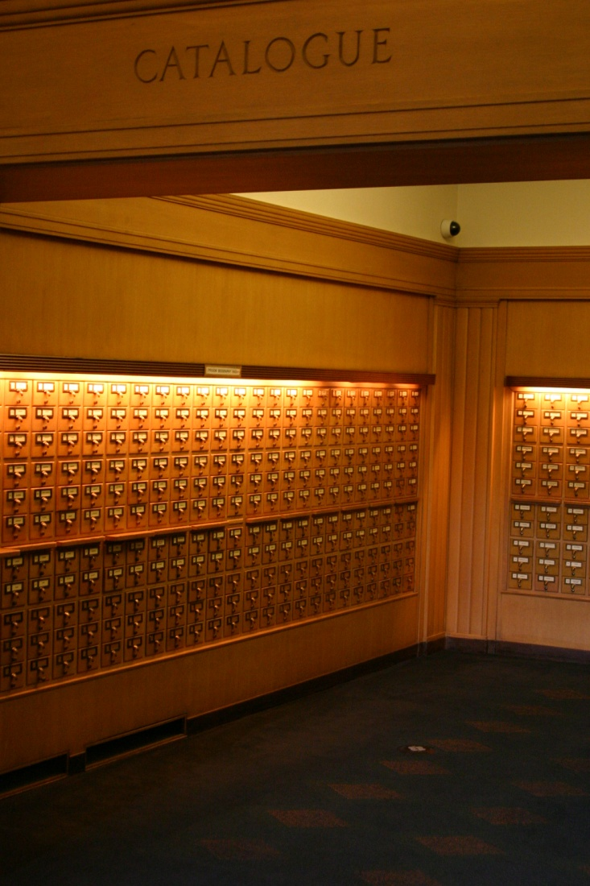
Oregon Biography Index

Slide 10
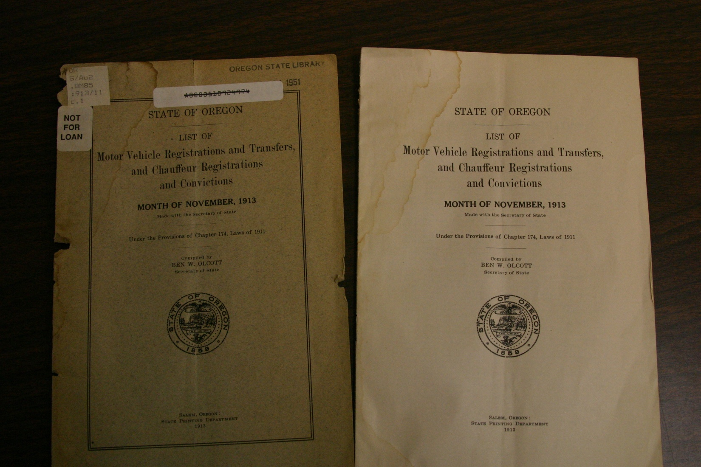
Motor Vehicle Registrations

Slide 11
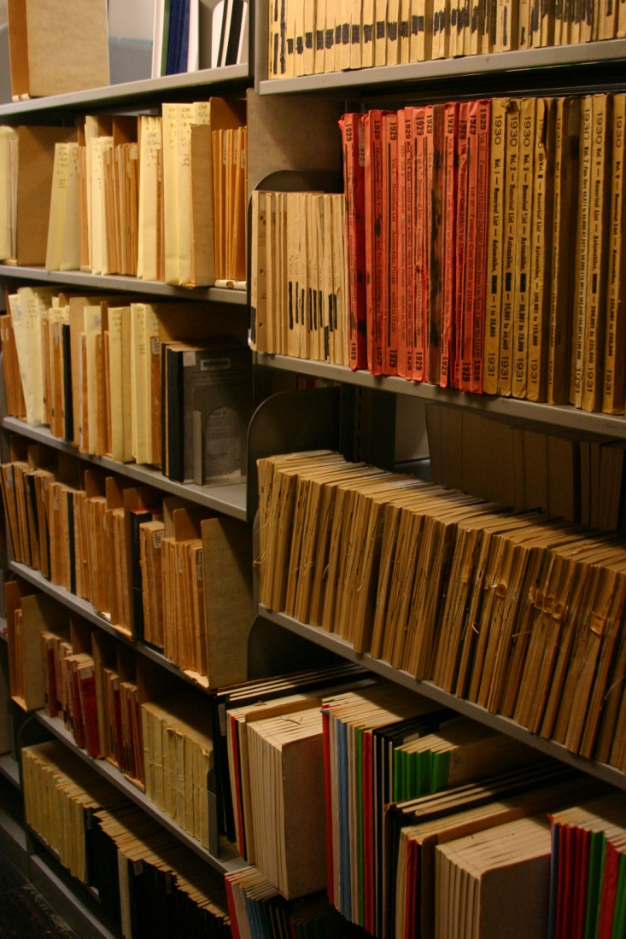
Lots of them!

Slide 12
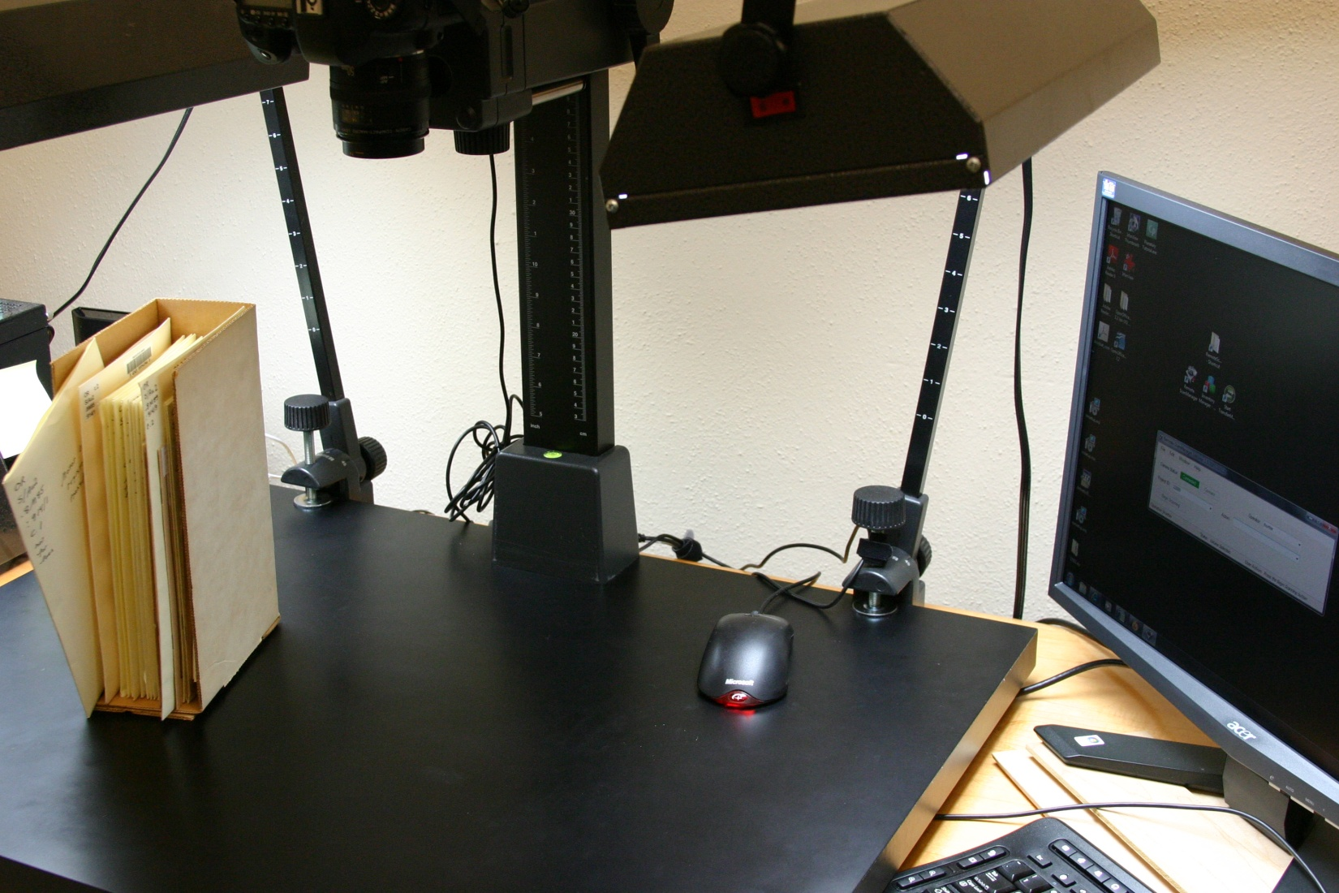
The set-up

Slide 13
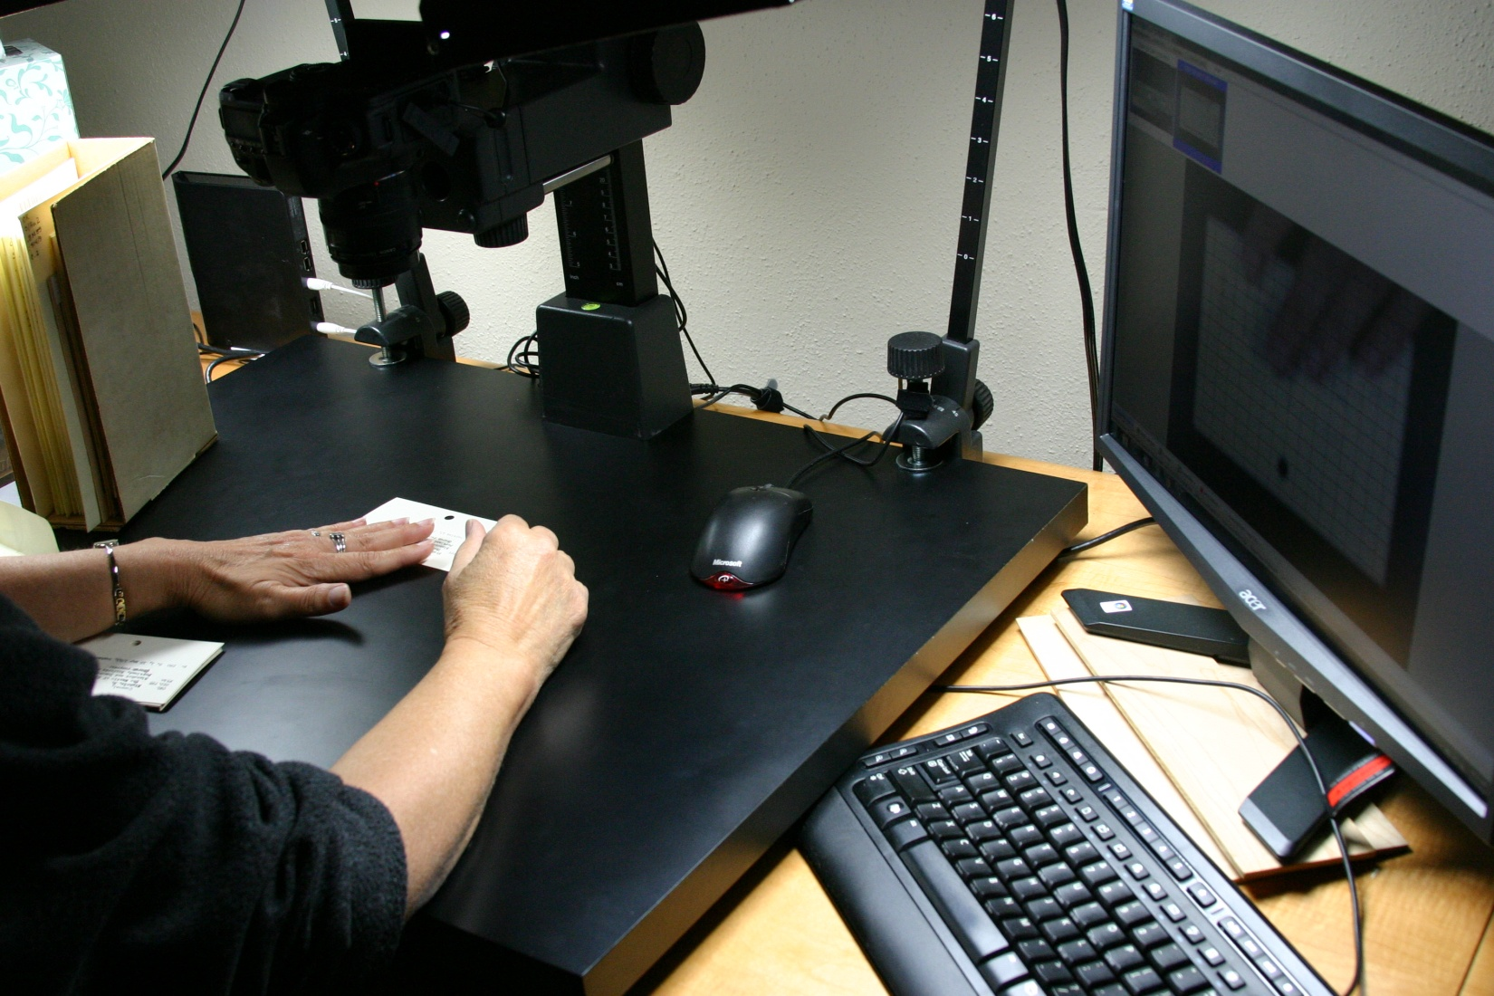
Scanning cards

Slide 14
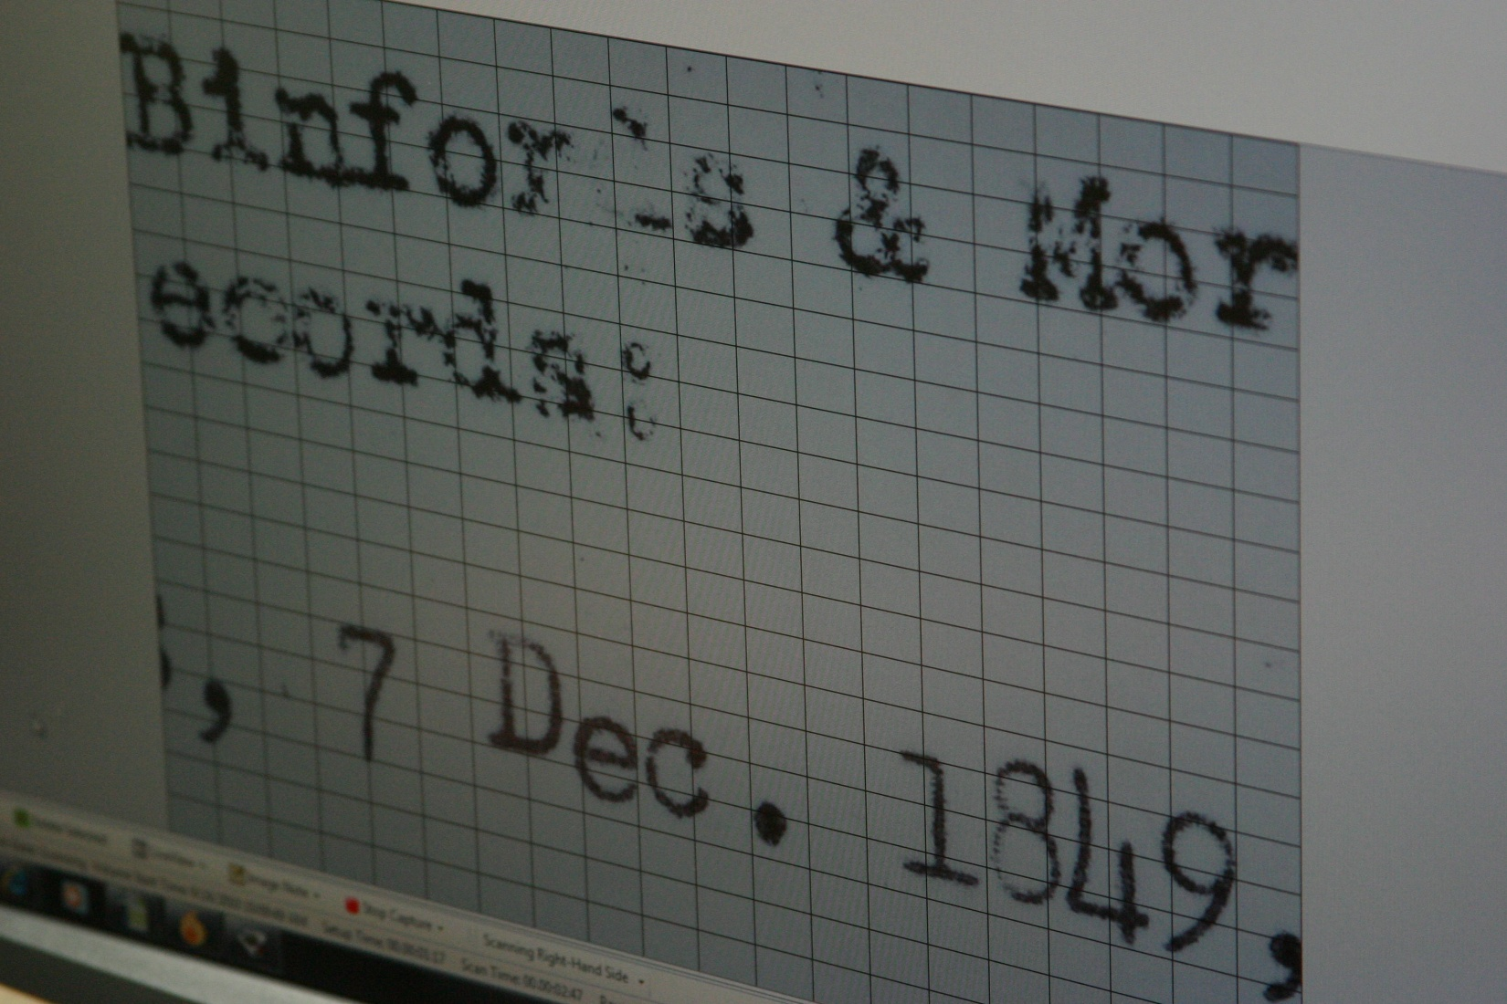
All cards are not created equal

Slide 15
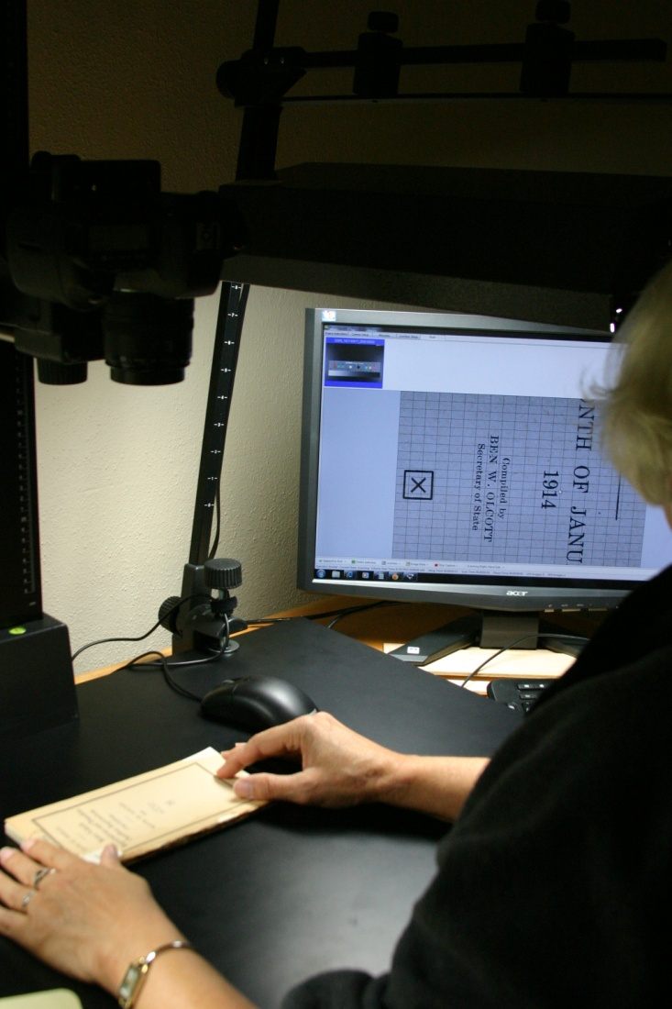
Scanning motor vehicle registrations

Slide 16
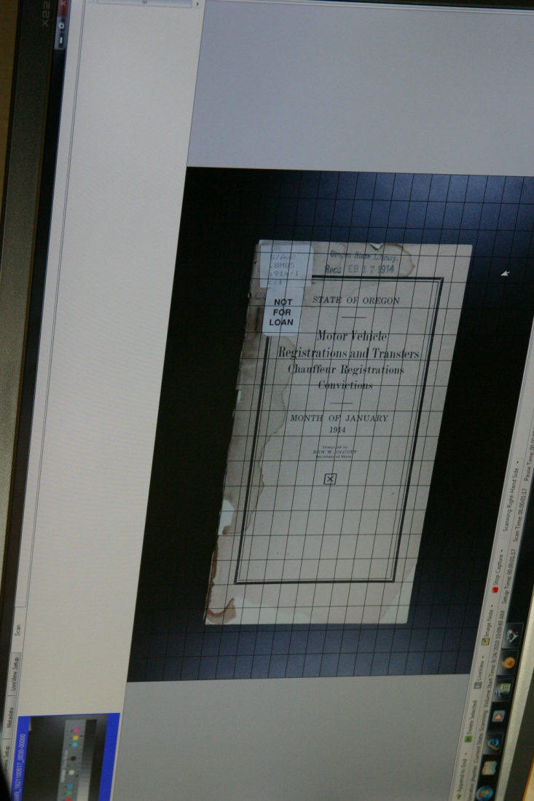
Lining up the image

Slide 17
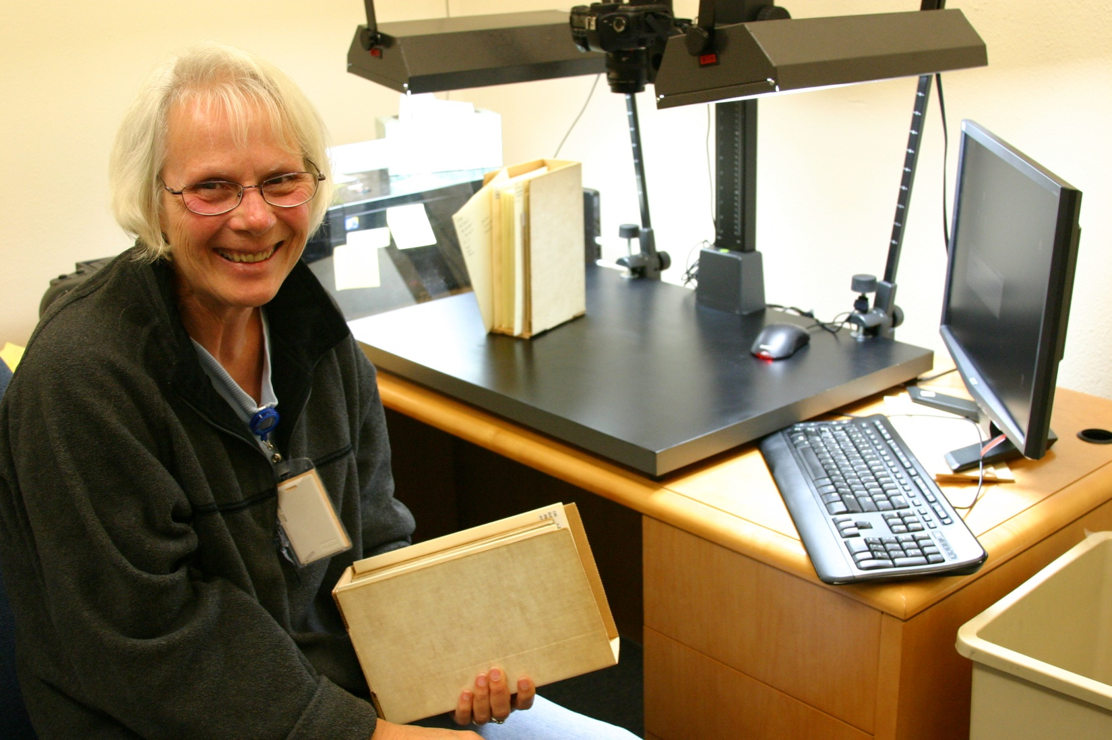
Still smiling after half a million images

Slide 18
Oregon State Library contacts
Robert Hulshof-Schmidt
Alice LaViolette
Jey Wann

