Slide 1
Strategic Planning on a Shoestring
Plan Now to Save Later
Notes:
Hello- thank you for attending- there are a few housekeeping items I need to address:
1- Evaluations will be distributed by OLA conference committee member. Please take time to fill one out.
My name is Diane Satchwell, Library Director at West Linn Public Library. Mini background--

Slide 2
Disclaimer
This is about
Reducing costs
Saving time
Simplicity
Notes:
The strategic plan you develop will be SP-Lite. You could hire a consultant for $25,000 or more. I was appointed to a Deputy position consisting of 30+ libraries and they just spent $92,000 and never got a strategic plan out of the process. If you decide to use a consultant be sure to have specific expectations and deliverables. This is about a staff powered SP. This is just a basic format that will provide the beginning of a plan for your library. It is hard work and will require a large commitment from everyone.

Slide 3
Overview
Why we plan
Vision statement and Mission statement
Guiding principles
Achievements and Demographics
Trends and best practices
Goals and objectives
Planning process
Next steps
Notes:
Outline- feel free to ask questions as we go along… I have a strategic planning worksheet you can use to make notes and capture your thoughts.

Slide 4
Why We Plan
Road map
Keep focus in times of crisis
Budget support
Transparency
Notes:
Keeps the library in the spotlight.
Demonstrates value seen by public and stakeholders.
Adopted and becomes part of the jurisdiction.
Aligns resources with goals and objectives.

Slide 5
What you need before you plan
Engaged staff
Stakeholder buy in
Support from governing body
Your commitment
Identify reason for planning
Notes:
Take the time to figure this out. Who are your change agents?
Begin the conversation as to why you feel it is important.
Jot down some ideas why you want to plan for your library’s future.

Slide 6
Sample Ideas Why You Plan
Enable the West Linn Public Library to make better decisions
Improve customer’s lives and realize their full potential
Put the budget to words and plan for the numbers
Good planning helps the Library manage the future rather than the future to manage the Library
Reinvent and revitalize the Library
Transform: a never-ending change in the form, structure, character and appearance of the Library to assure it continues to be responsive to the community we exist to serve
Contribute to the success of the community and its residents
Build on current successes while looking for new, more effective and efficient ways to meet customer needs
Planning results in achieving positive results
Notes:
These are just a few of the reasons we used at WL to explain the importance of planning.

Slide 7
Pitfalls to Avoid- Don’t
..Think you know all there is to know about your community and their needs/wants
..Limit the vision to the future
..Over promise
..Ignore doing measurements
..Set unrealistic timelines
..Use LibrarySpeak
..Think stakeholders will be 100% on board
Notes:
Don’t assume you know your community.
Don’t limit your vision to the future- you can always do an annual assessment for changes. Capture successes you are doing now.
Do not write more goals than you can manage or have resources. Opportunity to share with governing body the demand from the public, but restricted by staffing and money.
Constantly evaluate measurements and check in on progress.
Provide a glossary of terms or use language familiar to the public. Circulation- things checked in and out.
You need to constantly sell your plan.

Slide 8
Timeline
The process takes 4-6 months
Does it require adoption from Council?
Work backwards
Give plenty of prep-time
Constant check in
Notes:
Create a grid to include month, task or planning activity to complete. LET’S BEGIN…

Slide 9
Planning Process- Month 1
Create Timeline
Design planning process
Start planning process
Identify partners
Library Advisory Board, FOL, Foundation
Local organizations
Get email addresses
Notes:
For this exercise, I have chosen a five month planning process. Be realistic when designing the timeline; keep it tight and remind everyone to stay focused on the timeline.
The more partners you gather- the more emails you can collect for your survey

Slide 10
Planning Process- Month 2
Research by staff
Identify Community Needs
Survey- ask colleagues
Stakeholder forum
Select Service Responses
Review survey responses
Review forum responses
Share responses
Start to develop graphs/charts
Notes:
There have been many surveys taken over the past few years for a variety of reasons within our profession.
Survey monkey is a great source- free, compiles results and you can then tell your story in graphs, charts, percentages, etc.
You don’t need to have the survey up for months. Decide on a window. Have the survey live at the stakeholders forum; tabletoppers around the library.
Stakeholder Forum can be hosted by your Board or a group you feel can provide guidance.
Prepare a handout that helps the participants navigate the forum. This helps reduce staffing the forum and keeping things simple.
Prepare 4-5 questions: place each at a table with post its. Each person

Slide 11
Branding
Notes:
Spend time determining your colors, your font, any pictures that scream MY LIBRARY. And keep using them over and over. Does your library have a logo? Your governing body?

Slide 12
Branding Continues
Notes:
Brochure for stakeholders. This was for the strategic plan. I am now using this exact format for my Parking Forum.

Slide 13
Acheivements
Brag
Collect data to demonstrate value
Showcase your successes
State report
Notes:
Think of other ways your library has been recognized.
HAPLR

Slide 14
Demographics
2010 census
Capture in survey
What does your community look like?
Look in banks, grocery stores, laundromats
Notes:
Use as many different ways to figure what your community looks like.
Opportunity to see who is the non-user.
An exercise I use with staff is to send them out in the community. Look to see who is in the various types of services in the area. Do they look like our customers?

Slide 15
Trends and Best Practices
Opportunity to engage staff
Let them do research
Find studies to support your choices
Ex: Case studies
What works within your budget?
Examine financial philosophies
Notes:
This is a good exercise to engage staff and have them contribute professionally.
Case studies have been written about best practices in libraries.

Slide 16
Planning Process- Month 3
Prepare for Change
Call in change agents
Write Vision & Mission Statements
Keep them handy
Guiding Principles
Pick and write
Write Goals and Objectives
Spokes
Identify Organizational Competencies
This can be an objective- time consuming
Notes:
This is a tough month with lots to do- email works great for communicating and editing.
You may want to take two months. Again, I caution you that you need to work hard. You can evaluate in one year.
Share the information and have other staff present the ideas
Make the vision and mission statement available
Organizational competencies- performance, skills, information, culture- What are our strengths as a whole

Slide 17
Vision Statement
What we want to be
Clear, motivating, memorable and customer related
Focus for identifying key strategic statements
Notes:
Consider what the Library could be
Attainable, but still a reach
Reflect idealism
Coordinate with budget
Qualitative phrases (measure the quality)

Slide 18
Sample Vision Statement
Wordle
Engage – Connect – Inspire
Google “public library vision”
Notes:
There are a variety of ways to capture a vision.
Wordle can be found www.wordle.net- populate repetition of words. The more a word is used, the larger the word becomes. I used it for the cover of the SP.
Look at other vision statements. The most important thing to remember is keep it brief. You can use in marketing and branding your library.

Slide 19
Wordle
Notes:
Staff was asked to send me 3 words they felt described the library. I populated all the words in wordle. Each time you add the same word it makes the word bigger. We looked at the image and chose ENGAGE, CONNECT, INSPIRE for our vision statement. Again, notice the colors.

Slide 20
Mission Statement
Ask yourself “Why we exist”
Whom do you serve
What roles do you play in the lives of your customers
What are you trying to accomplish
Notes:
Create a framework for SP
Focus for the library’s business model
Ties resources with critical strategies
Clearly defines purpose for partners
Most important- “reflects values, beliefs, philosophy and culture of the Library”
You can spend an entire session on writing a mission statement. Use tools- many books are written about SP and there is considerable time spent on mission statement.

Slide 21
Sample Mission Statement
“The mission of the West Linn Public Library is to engage, connect and inspire our community and to be a resource for information, knowledge, and artistic and literary expression, providing the best in traditional services, new technologies and innovative programs.”
Notes:
We decided to use our vision statement to open the mission statement. Goes back to our consistent messaging- branding, marketing, etc.

Slide 22
Guiding Principles
Also known as core values
Standards to measure our success
Shape the culture and climate of the library
Standards of behavior
Notes:
Create an organizational climate that encourages and supports consistent treatment and behavior.
Beliefs in how the organization should operate that set standards for behavior.
Define the character of an organization describe what organization stands for
Core priorities of the organization’s culture.
Use terms such as quality service, quality of life, respect, personal dignity.

Slide 23
Examples of Principles
Accountability
Transparency
Children and Teens
Technology
Stewardship
Community
Gathering Place
Diversity
Customer focused
Excellent Service
Capacity and Access
Privacy
Communication
Collaboration
Intellectual Freedom
Services
Programs
Notes:
Do not limit yourself to any of these but strive to define your LIBRARY!
Google ideas

Slide 24
More About Principles
Identify and validate
Universal
How we treat others/treat ourselves
Attributes of the Library’s culture
Stay true to mission and vision
Notes:
Think about the specific principle.

Slide 25
Sample Guiding Principles
Principle 1: Community Gathering Place
The WLPL is a community gathering place that cultivates reading, thinking, conversing, learning, and teaching in a welcoming and sustainable facility, online and in the community.
Principle 2: Customer-Focused
The WLPL is customer-focused with services that anticipate and respond to community interests and the city’s changing demographics through its collections, programs and services.
Notes:
WLPL developed 6 guiding principles. Here are two examples.

Slide 26
Goals and Objectives
Goals- broad statements that create the roadmap
Objectives- strategies that are specific and short term; measurable
Notes:
Be clear on the differences between these.
I will share an example later in the presentation.

Slide 27
Spokes
Staff
Collection Management
Funding
Excellent Customer Service
Programs and Services
Facility
Partnerships and Collaborations
Technology
Marketing and Community Relations
Notes:
I use spokes in my planning
Each of these spokes combine to create excellent customer service
This helps me wrap my brain around our goals and objectives
Before we get into actual examples, let’s layout the planning…

Slide 28
Sample Spoke to Goal
Strategic Initiative One: Staffing
Goal: Manage workforce development to allow staff to grow professionally, to maximize staffing efficiency and effectiveness, and to identify diverse and creative ways to use volunteers. In doing so, we will remain committed to guiding principles of community gathering place, customer-focused values, lifelong learning, children and teens, state of the art technology and access to information, and partnerships.
Notes:
I don’t want to get ahead of myself. But I want to illustrate how the spokes start to frame and design your strategic plan. It is a simple way to develop your plan.

Slide 29
Sample Goal to Objective
Year One: Explore various organizational structures to promote a team environment through cross training and team-building exercises. Maximize the potential of staff and integrate services. Create a staff organizational chart, satisfy job titles and job descriptions to match the programs and services within the strategic plan.
Notes:
Then you can begin to identify the one year, three year, five year objectives. It starts to fall into place.

Slide 30
Planning Process- Month 4
Writing Your Strategic Plan
Outline
Simple
Edit
Stakeholder review
Final Draft
Staff for final check
Notes:
Remember- this first one is not the last one. It can be modified after your first year assessment. But make it a document that you and the stakeholders can defend.

Slide 31
Three Parts
Reflections
Observations
Opportunities
Notes:
Let’s take a minute to think about writing the plan and how that looks. Think of your plan in three parts as you construct it.

Slide 32
Reflections
City Council and City Manager
Planning Team
Mission and Vision Statements
Guiding Principles
Achievements
Planning Process
Notes:
Reflections is a summation of who helped, overview (mission, vision, GP), your accomplishments to date and how you planned.

Slide 33
Tag Line for Leaders
City Council
The West Linn Public Library enjoys support from our community’s elected officials. They promote and encourage literacy, attend events at the Library and provide guidance during our planning process.
Notes:
Showcase governing body. They adopt the plan. You can point to the plan when challenged with difficult choices. This is why YOU plan.

Slide 34
Mayor’s Quote
“The library is my window to the world. In the library I find the history of mankind; how new things are visualized and created; how the earth, plants and animals have evolved; how ideas originate, are tested and how they impact on our lives. From the library I gain knowledge.”
Notes:
We placed all councilors with their pictures and a quote at the front of our document.

Slide 35
Observations
Library Trends and Best Practices
Our Community
Survey and Forum Results
Notes:
Observations shares what you discovered in your process.

Slide 36
Opportunities
Strategic Initiative One: Staff
Strategic Initiative Two: Collection Management
Strategic Initiative Three: Programs and Services
Strategic Initiative Four: Partnerships and Collaborations
Strategic Initiative Five: Technology
Strategic Initiative Six: Community Relations and Marketing
Strategic Initiative Seven: Funding
Strategic Initiative Eight: Facility
Notes:
Finally- your goals and objectives. Revisit of my spokes.

Slide 37
Another Sample Spoke
Collection Management
Goal: The collection is the foundation of the library and at the core of commitment to freedom to read, view and inform in a democratic society. We will create a community of readers and learners by maintaining easily accessible collections that educate, entertain, challenge, empower and respond to the needs and interests of a dynamic community.
Objective: Write a collection management manual
Objective: Assess all collections for relevance, currency and value.
Notes:
One sample of eight spokes. Each has a goal and many objectives to achieve the goal. The workplan has measurements/indicators, target, lead, progress/timeline and status.

Slide 38
Planning Process- Month 5
Submit
Governing authority
Get Board support
Adopt
Council or appropriate agency
Post
Library’s website
Notes:
Ask the Board to recommend adoption of the plan.
It is critical to have your governing body adopt the plan.
This has been a very quick course in strategic planning. Let me demonstrate one spoke and how it was developed to give you one example.
Refer to the SP whenever you are stretched for resources or your resources are being considered in the reduction pile.

Slide 39
Next Steps
Work plan
Make your strategic plan available
Every staff person must read it
Evaluate in one year
Notes:
Create a workplan to use as a tool to update your boss.

Slide 40
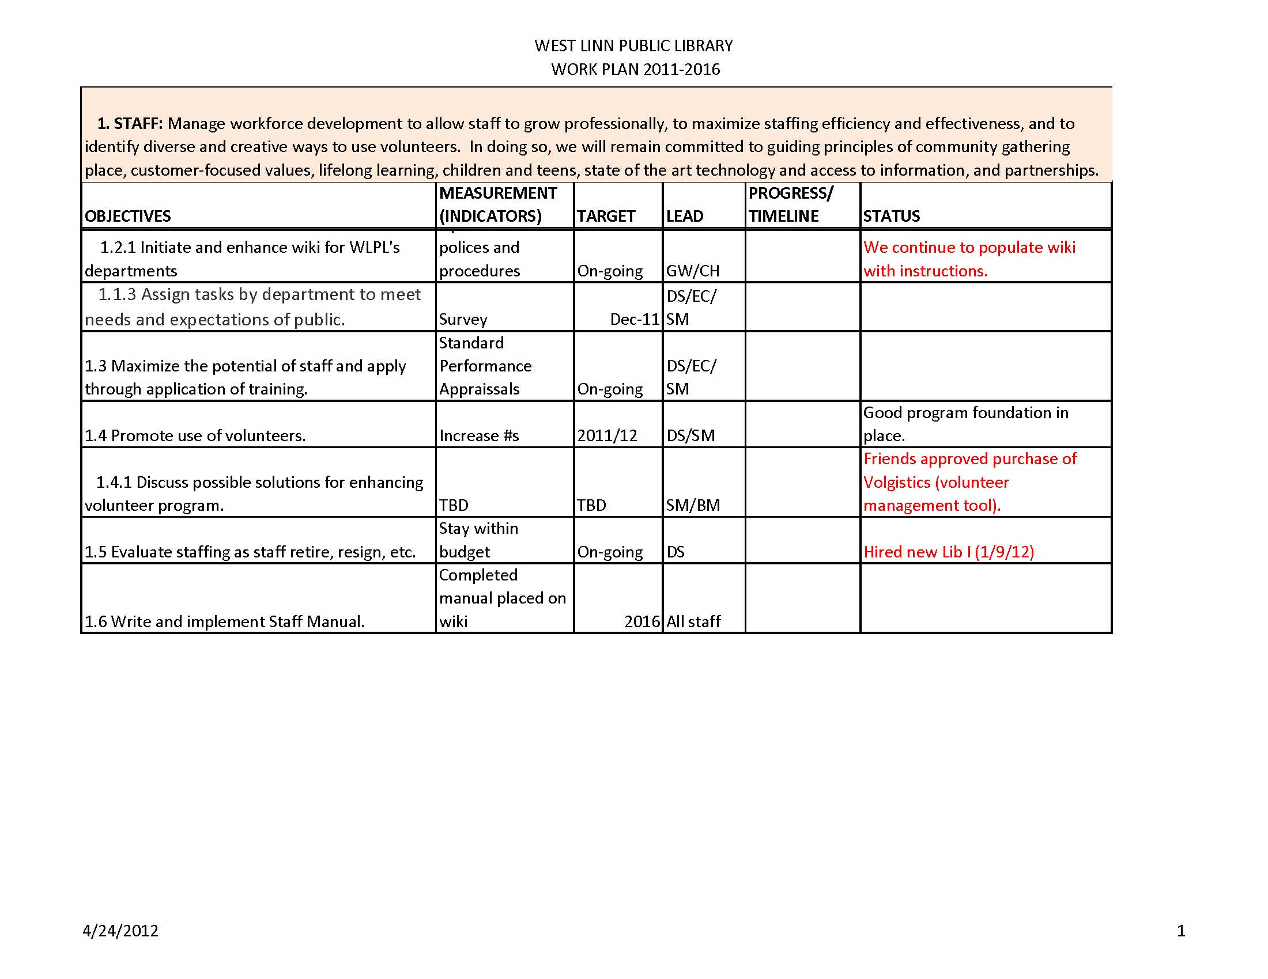
Work Plan
Notes:
The work never ends. Now you populate your goals and objectives in excel. I send this to the City Manager and Asst CM every other month. It tells them what the library is doing and accomplishing. It keeps us on the City’s radar in a positive way.

Slide 41
A Culture of Alignment
“If organizational competencies are used systemically through the business to drive decisions about strategy execution and allocation of resources, the consequence is a culture that fosters clear alignment of the team around those competencies that are critical for the organization’s success.” Cullen Coates from Organizational Competencies
Notes:
Keep focused that all these pieces together help in the design of your road map.

Slide 42
If all else fails….
Resources
Creating and Implementing Your Strategic Plan
Strategic Planning and Management for Library Managers
Strategic Planning for Results
Call me
503-742-8584 or visit www.westlinnoregon.gov/library/strategic-plan
Notes:
Let me just conclude with- it is hard work, it is frustrating. Feel free to talk to colleagues. Remember there are consultants that are paid considerable amounts of money to do a strategic plan.

