Slide 1
Will RDA Kill MARC?
Kelley McGrath
University of Oregon
kelleym@uoregon.edu
Oregon Library Association
April 2012
Flickr: Ashimjara

Slide 2
I don’t know, but I hope it will…
at least for most purposes
Flickr: scottobear

Slide 3
Why is MARC the wrong tool today?
Technological: Built under the technological constraints of a different time
Data storage was very, very expensive
Data was stored on tapes that had to be read sequentially
Functional: Built for a different purpose
Designed to print cards not for computerized searching or to supply machine-actionable data

Slide 4
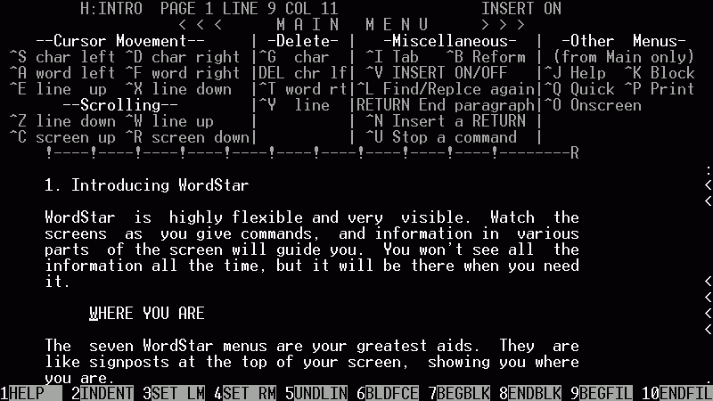
Should we do the equivalent of building a better word processer for DOS & a black and white lo-res monitor?

Slide 5
Red herrings
Tools to work with MARC
MARCXML
Arcane numbering, labeling scheme
Crosswalk to labels?
Still have to understand meaning and context
However, the procrustean limits of field numbers and tags limits the flexibility and expandability of MARC
Flickr: Laurel L. Russwurm

Slide 6
The real problem is structural
A couple examples in the context of RDA’s aims
RDA data elements
FRBR and relationships

Slide 7
RDA data elements
Intended to be atomistic and independent of storage and display
Many have controlled vocabulary lists
Intended to be used by humans and computers
Machine-actionable data is ultimately for the good of people

Slide 8
How easy is it to get machine-actionable data elements out of MARC?
Example from OLAC experiment:
Can we teach a computer to identify widescreen and full screen videos?
Open Clip Art Library: rg1024

Slide 9
Free text terms to search for
Full screen
Fullscreen
Full-frame
Standard format
Widescreen
Wide screen
Letterboxed
Wikipedia: Jerzy Jalocha N

Slide 10
MARC fields to look in
250 Edition statement
538 System requirements note
500 Physical description note
505 Contents note (when disc has both versions)
440/830 Series (widescreen)
Where the computer stumbles:
500 General note: Special features … widescreen to fullscreen comparison

Slide 11
Modify MARC?
Difficult, but maybe possible
New MARC fields for carrier attributes:
344 Sound characteristics
345 Projection characteristics of projected media
346 Video characteristics
347 Digital file characteristics
Why go to all that effort when it wouldn’t be easier than starting over with a more modern format?

Slide 12
Discrete elements → Flexible display
300 $a 1 computer optical disc : $b sd., col. ; $c 4 3/4 in.
300 $a 1 CD-ROM : $b sound, color ; $c 12 cm
Open Clip Art Library: netalloy

Slide 13
Still need free text
Transcribed information
IMDb example: Laurence Fishburne (as Larry Fishburne)
Stuff that can’t be controlled data, such as summaries and contents note
Explanatory notes for controlled data
Stuff that doesn’t quite fit: square pegs, penguins, and ostriches
Open Clip Art Library: Anonymous
Open Clip Art Library: rpzboray

Slide 14
Relationships & hierarchies in MARC
Not easy to represent in a machine-actionable way
Open Clip Art Library: liftarn

Slide 15
Relationships between records
$w in 7xx linking fields is for the control number of the related record
$0 in controlled fields
100 $a Bach, Johann Sebastian. $4 aut
$0 (DE-101c)310008891
Isn’t clear how it would work if you want to control two elements in one field
Many discussion papers at MARBI on describing Works and Expressions in MARC

Slide 16
Relationships within records
Humpty Dumpty problem:
common with musical recordings, but happens with videos, other materials, too.
$8 linking subfield
not widely implemented or used
Open Clip Art Library: Leslie L. Brooke / FunDraw_dot_com

Slide 17
All the pieces, but all the computers in the world can’t put them back together again…
511 Cyrus Stevens, violin (1st work) ; Pamela Dellal, mezzo-soprano (2nd work)…
518 The 1st and 3rd works recorded at the Sonic Temple, Roslindale, MA, Dec. 5 and 14, 2001, respectively…
505 Sonata for violin and piano (17:54) -- A packet for Susan (19:59)…
650 Sonatas (Violin and piano)
650 Songs (High voice) with piano…
700 Boykan, Martin. Sonatas, violin, piano.
700 Boykan, Martin. Packet for Susan…

Slide 18
What’s the point?
Why do we want atomistic, machine-actionable data and machine-interpretable relationships?
OLAC prototype as a possibility
Open Clip Art Library: nicubunu

Slide 19
Movie (mostly work) facets

Slide 20
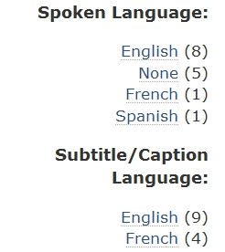
Version (expression/manifestation/ item) facets

Slide 21
Hit List
Results focused on movie (work)
Fulfillment options
below (expression,
manifestation, item)

Slide 22
Slicing and dicing data: horror film directors
Open Clip Art Library: Oscar S.R. / miutopia

Slide 23
Data-driven
What can be made into computer-comprehensible data, should be
$a A short /
$c directed by John J. Smith. Mr. X. makes a short / directed by J. Johnson, Jr. and Anna Allen.
$a1 A short
$c1 directed by John J. Smith
$a2 Mr. X. makes a short
$c2 directed by J. Johnson, Jr. and Anna Allen

Slide 24
Data-driven
DVD release of the 2005 motion picture
OriginalYear = 2005
Better for …?
Search
Limit
Sort
Display (flexible):
Charlie and the Chocolate Factory (2005)
Original Release Year: 2005

Slide 25
Data-driven
DVD release of the 2005 motion picture
→ OriginalYear = 2005
→ OriginalFormat = motion picture
Not so hard for a computer to figure this out, but how about…

Slide 26
Data-driven
Originally produced as motion picture in 1947 and restored in 1956
1999 videodisc release of a series of cartoons released between 1943- and 1946
Originally produced in the 1930s and 1940s
Originally telecast Oct. 23, 1958 (Aida) and Oct. 3, 1982 (concert)
Premiered on PBS stations on November 5 and 12, 2003

Slide 27
Data-driven
Not everything fits neatly
IMDb: Ivan the Terrible, Part II (1958)
AllRovi: Ivan the Terrible: Part 2 (1946)
“Although filmed shortly after Part One in 1946, the film was suppressed and was not released until 1958”—AllRovi.com

Slide 28
Data-driven
Possible ways to deal with odd situations
Use more specific data elements
OriginalYearProduction = 1946
OriginalYearRelease = 1958
Pick one and make a note to explain
(what AllRovi did)

Slide 29
Data-driven
Balance between
Desirability and power of controlled data
Cost of controlling the infinite variety that exists in the real world

Slide 30
Relationships
WITHIN A FIELD
$0 or $2 can’t refer to specific subfields
600 10 $a Abbey, Edward, $d 1927-1989 $x Criticism and interpretation
$0 http://id.loc.gov/authorities/names/n78093802.html
$0 http://id.loc.gov/authorities/subjects/sh99005576.html

Slide 31
Relationships
WITHIN RECORDS: TWO MOVIES
Roy Rogers collection. 1 (DVD)
500 DVD release of the 1939 (Days of Jesse James) and 1943 (King of the cowboys) motion pictures.
505 Days of Jesse James / director, Joseph Kane … (54 min.) -- King of the cowboys / directed by … (71 min.)
508 Photography, Reggie Lanning, William Bradford ; art directors, Russell Kimball, Paul Youngblood …

Slide 32
Relationships
WITHIN RECORDS: TWO MOVIES
Roy Rogers collection. 1 (DVD)
511 King of the cowboys: Roy Rogers, Smiley Burnette.
511 Days of Jesse James: Roy Rogers, George "Gabby" Hayes.
520 In Days of Jesse James, Roy proves that Jesse James ... In King of the cowboys, Roy infiltrates …

Slide 33
Relationships
WITHIN RECORDS: TWO MOVIES
Roy Rogers collection. 1 (DVD)
Western films.
Feature films.
Fiction films.
Rogers, Roy, 1911-1998. $4 act
Hayes, George, 1885-1969. $4 act
Burnette, Smiley, 1911-1967. $4 act
Kane, Joseph, 1894-1975. $4 drt

Slide 34
Relationships
WITHIN RECORDS: A BETTER APPROACH
Roy Rogers collection. 1 (DVD)
1. Days of Jesse James (1939, 54 min.)
Director: Kane, Joseph, 1894-1975
Cast: Rogers, Roy, 1911-1998 Hayes, George, 1885-1969
Summary: Roy proves that Jesse James ... (more info)
2. King of the cowboys (1943, 67 min.)
Director: Kane, Joseph, 1894-1975
Cast: Rogers, Roy, 1911-1998 Burnette, Smiley, 1911-1967
Summary: Roy infiltrates ... (more info)

Slide 35
Relationships
BETWEEN RECORDS
Anna Karenina (Motion picture : 1967)
Based on the novel by Leo Tolstoy
Tolstoy, Leo, graf, 1828-1910. Anna Karenina
http://id.loc.gov/authorities/names/no2009034643
http://rdvocab.info/RDARelationshipsWEMI/motionPictureAdaptationOfWork
http://id.loc.gov/authorities/names/no2009049512.html

Slide 36
Relationships
WITH OTHER DATASETS
King Kong (Motion picture : 2005)
http://id.loc.gov/authorities/names/no2005102675.html
http://www.freebase.com/view/en/king_kong_2005
http://www.imdb.com/title/tt0360717/

Slide 37
Relationships
WITH OTHER DATASETS: King Kong from Freebase to elsewhere on the web
Wikipedia
IMDB Title Page
Netflix
Rotten Tomatoes
Metacritic
Japanese Wikipedia
Allocine Canada - Movie
Beyazperde - Movie
Review of King Kong by Liam Lacey at The Globe and Mail
Review of King Kong by James Berardinelli at ReelViews

Slide 38
Can we get there from here?
Challenges for development
With what $?
Who?
Wikimedia Commons; Open Clip Art Library: SRD
Open Clip Art Library: johnny_automatic

Slide 39
Can we get there from here?
Challenges for implementation
Coordination of
interdependent systems
$$$ again
Open Clip Art Library: nicubunu
Open Clip Art Library: johnny_automatic

Slide 40
LC’s Bibliographic Framework Transition Initiative
The Library of Congress is launching a review of the bibliographic framework to better accommodate future needs. A major focus of the initiative will be to determine a transition path for the MARC 21 exchange format in order to reap the benefits of newer technology while preserving a robust data exchange that has supported resource sharing and cataloging cost savings in recent decades.

Slide 41
LC’s Bibliographic Framework Transition Initiative
Spontaneous comments from participants in the US RDA Test show that a broad cross-section of the community feels budgetary pressures but nevertheless considers it necessary to replace MARC 21 in order to reap the full benefit of new and emerging content standards.

Slide 42
LC’s Bibliographic Framework Transition Initiative
Were the limitations of the MARC standard lifted, the full capabilities of RDA would be more useful to the library community. Many of the libraries indicated that they had little confidence RDA changes would yield significant benefits without a change to the underlying MARC carrier. Several of the test organizations were especially concerned that the MARC structure would hinder the separation of elements and ability to use URLs in a linked data environment.

Slide 43
LC’s Bibliographic Framework Transition Initiative
Seeking funding
Collaborative process
Advisory group to provide long-term guidance, monitor costs, and ensure that libraries’ managers are informed about the Initiative as it progresses
Technical group will develop the new framework in modules

Slide 44
LC’s Bibliographic Framework Transition Initiative
Website: http://www.loc.gov/marc/transition/
Forum: http://listserv.loc.gov/listarch/bibframe.html

Slide 45
Related resources
Jason Thomale’s “Interpreting MARC: Where’s the Bibliographic Data?”
http://journal.code4lib.org/articles/3832
OLAC’s experiment with extracting data from MARC:
Code4Lib Journal: http://journal.code4lib.org/articles/775
OLAC report: http://www.olacinc.org/drupal/capc_files/archived_docs/MIW_4.pdf
Task force web page: http://www.olacinc.org/drupal/?q=node/27
OLAC prototype discovery interface:
http://blazing-sunset-24.heroku.com/

