Slide 1
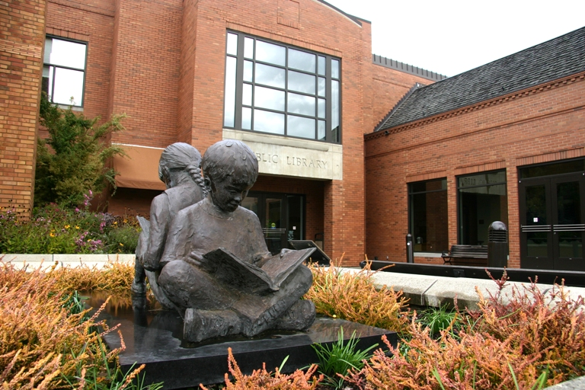
Circulating E-Readers in Corvallis
Why did we start the program?
Which readers do we circulate?
How did we publicize it?
4. How do we package the readers?
5. How do we circulate them?
6. Challenges we’ve had

Slide 2

Why did we start?
Already circulated mp3 players
Supporting new Library2Go service
Funding provided by Friends group
Started in April 2010

Slide 3
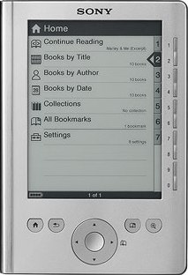
Which readers do we circulate?
Sony PRS-300
(Reader Pocket Edition)

Slide 4
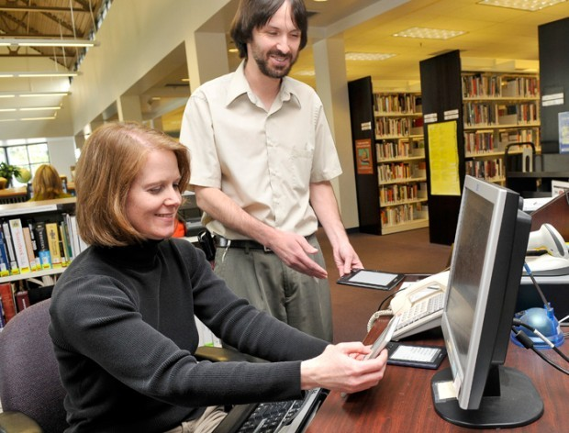
How did we publicize it?
Press release to local media
See the Corvallis Gazette Times (3/23/10): http://bit.ly/eEaAn5

Slide 5
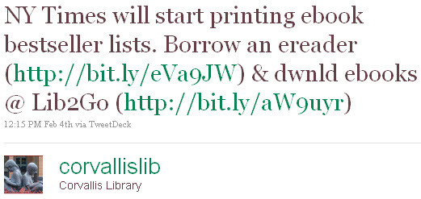
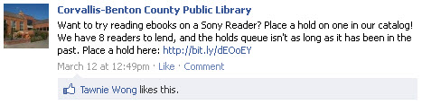
How did we publicize it?
Social media
Spotlights on our homepage
Word of mouth marketing at public service desks

Slide 6
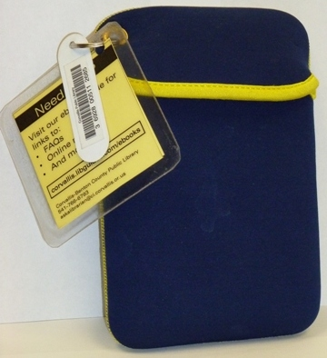
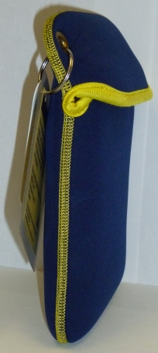
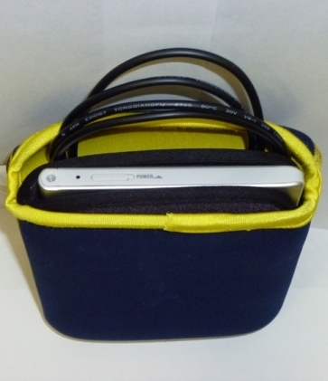
Packaging readers for circulation
Concern #1: Protecting the reader

Slide 7
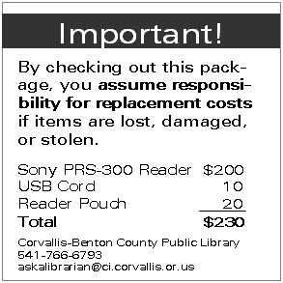
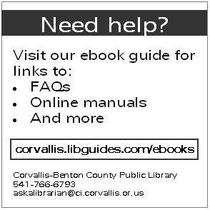
Packaging readers for circulation
Concern #2: Informing patrons
Double-sided tag

Slide 8
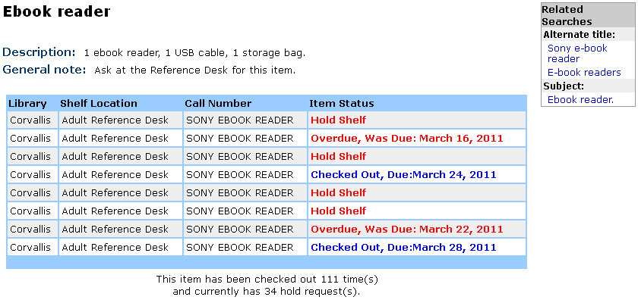
How do we circulate the readers?

Slide 9
How do we circulate the readers?
Using Adobe Digital Editions:
De-authorize reader
Delete any Library2Go ebooks
Using Calibre (http://calibre-ebook.com/):
Clear the reader of books
Upload 10 public domain epub books
Upload two support documents in epub format
All on a non-networked computer (for security)

Slide 10
Challenges
Steep learning curve for patrons
Can’t be done on library computers
Damage (has not been an issue so far)
Financial risk (also not an issue so far)

Slide 11
Challenges
Big learning curve for staff
Staff time spent on tech support
Developing procedures for clearing the readers at check-in, training staff
However:
Very positive feedback from patrons
Example: patron-added tags to the catalog record for the Sony Readers -

Slide 12
Want more information?
Christopher Rumbaugh, ebook guru
(AKA Adult Services Librarian)
Corvallis-Benton County Public Library
http://corvallis.libguides.com/ebooks

