Slide 1
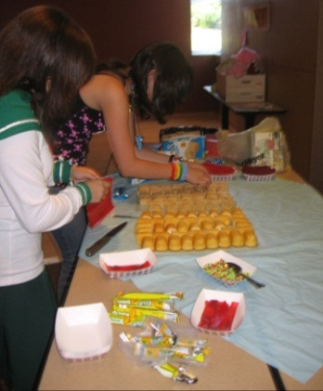
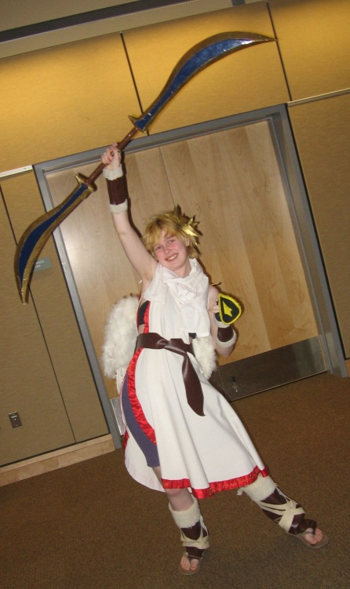
Anime Fest
Twinkies, rice crispy treats, nerds, fruit roll-ups, gummy fish, candied ginger and chocolate “soy” sauce= Ingredients for disgusting sweetness.
Candy Sushi
Cosplay
Folks of all ages love to dress up as manga, anime, video game and J-pop characters.
Set a theme for your Fest and let the revelers be the judges of the best costumes.
Cosplay * Manga-thon * Manga Match Game * Candy Sushi * Calligraphy * NaniBirds * Button Making
Manga Corner
Designate a quiet space to read.

Slide 2
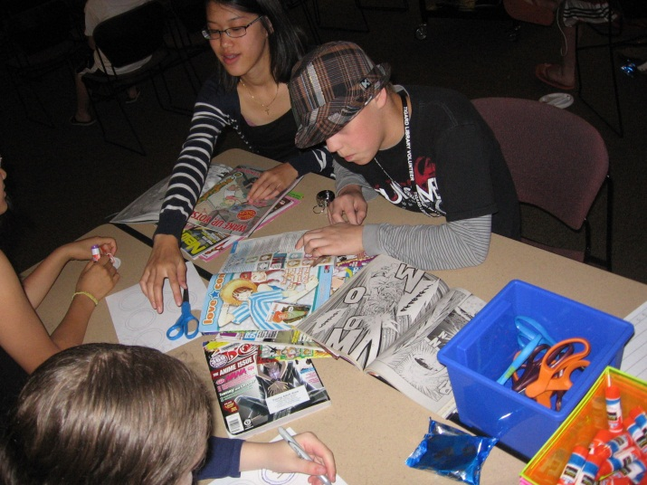
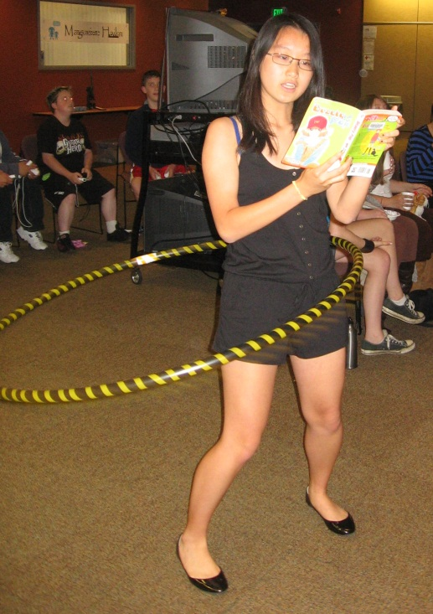
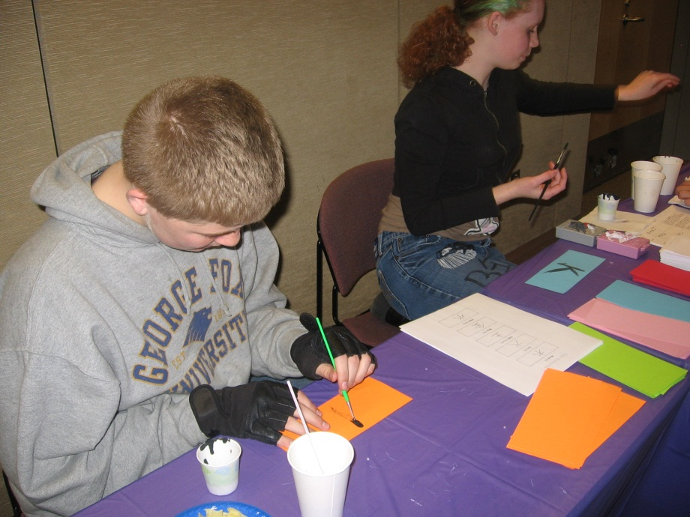
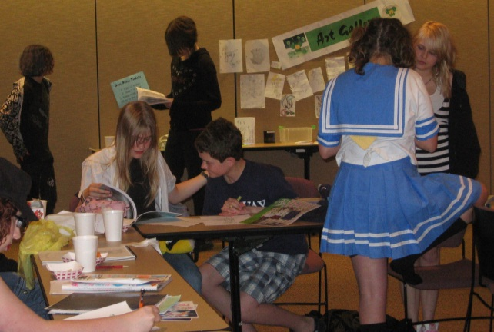
Manga-thon
Button Making
Never pass up a chance to torture your teens!
Teens compete to finish the triathlon with the best time, hooping, doing push-ups and running in place, all while reading aloud.
A button-maker is essential! Manga fans can design their own buttons using discarded manga and old magazines like Shonen Jump and Otaku USA.
Calligraphy
All you need is paint, brushes, paper and print-outs of the Japanese alphabets.
Designate an area for drawing. Manga readers love to create their own characters and fan art. Set up an art gallery where they can share their work.

Slide 3
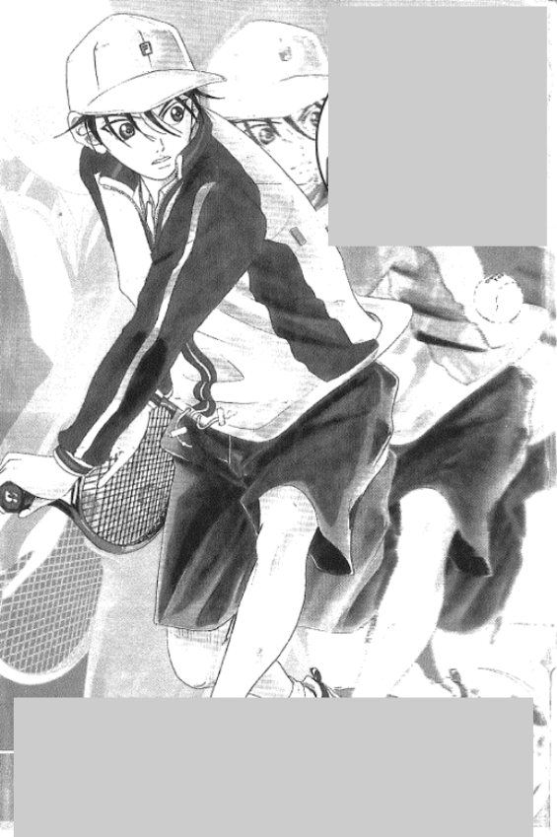
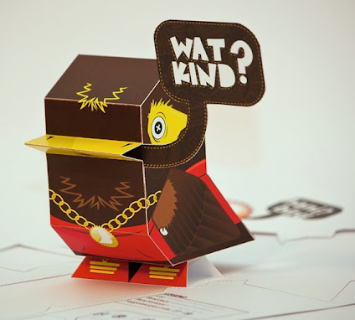
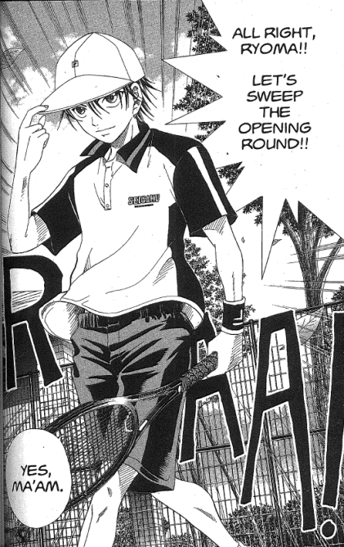
Manga Match Game
NaniBirds
Visit www.nanibird.com to print out free color templates for these fun, foldable birds. “Nani” is Japanese for “What?”
Copy manga covers and block out the titles and volume numbers. Copy pages from the manga. Voracious readers will have a great time guessing the titles, authors and volume numbers as well as matching pages to the covers. You will be impressed with the level of obsession!

Slide 4
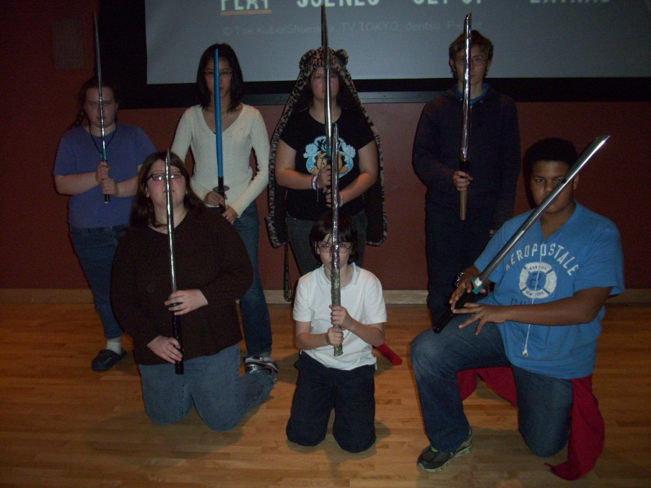
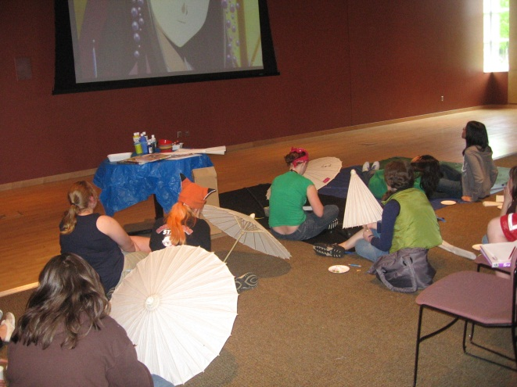
Otaku Teens
How It Works
Ask your Friends group for $ to give away the first volumes of classic manga series. Have a book discussion with related activities, then watch the anime that goes with the manga.
Duct Tape Ninja Swords
Otaku (n): Japanese definition- Young people who are highly skilled in or obsessed with computer technology to the detriment of their social skills.
American definition- People who are well-versed in all things J-Pop to an obsessive degree. This can be both detrimental and beneficial to their social skills.
This is a great craft to pair with almost any action manga. This group enjoyed making their swords will discussing and viewing Bleach.
Paper Parasols
These parasols are among the nicer items offered by Oriental Trading. Participants can design their own using sharpies and/or paint.

Slide 5
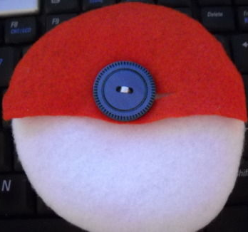
PokéParty
Set up a table with dice and scratch paper for cards, encourage people to bring their Nintendo DSs to battle each other, and consider picking up a copy of Pokémon Battle Revolution for the Wii.
Battle Arenas
Set up a Super Smash Bros, Brawl tournament using one of the Pokémon battle stages.
Felt Poké Ball Craft
This simple sewing craft uses felt and a button to create a pouch worthy of capturing any tiny Pokémon.
Invite Pokémon fans of all ages to this celebration!
Pikachu Origami
Make a Monster
A Google search will reveal a variety of different patterns for Pokémon origami, and the Pikachus are usually the simplest.
Encourage participants to create their own Pokémon then have them “battle.”

Slide 6
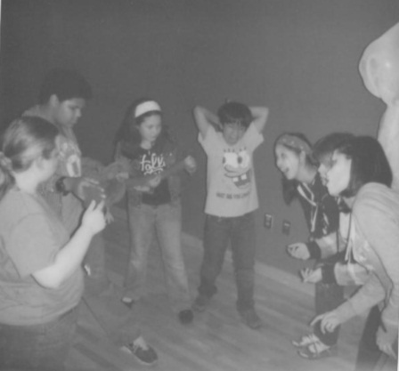
Stand Alone
Photo Narrative
Write a story with your group and take pictures, then arrange them into a photographic comic book. The bizarreness to your left was from a hand-made horror comic inspired by Vera Brosgol’s Anya’s Ghost.
Alternative Endings
Laika by Nick Abadzis, is about the first dog to be sent into orbit. It did not go well for her. Plan a book discussion and have participants create a comic that re-imagines her fate.
Don’t forget to select graphic novels for your book groups. Books like Plain Janes, American Born Chinese, Laika, and Anya’s Ghost generate fascinating discussions and have great potential for tie-in activities.
Guerilla Art
Read Cecil Castellucci and Jim Rugg’s Plain Janes, then plan a guerilla art project to bring some joy to your library, or to subvert something. My group enjoyed making bookmarks with positive messages and planting them throughout the library. For more ideas, check out The Guerilla Art Kit by Keri Smith.
Notes:
Read Scott McCloud’s Understanding Comics for inspiration! This essential text provides an introduction to comics - their history and their methods – that can make any novice feel like an expert. You can pick up comic and/or manga paper at an art supply store and instruct your group on the basics, like using non-photo blue pencils for a rough draft and inking over it, using lots of black, and considering scale when drawing larger comics to shrink down.

Slide 7
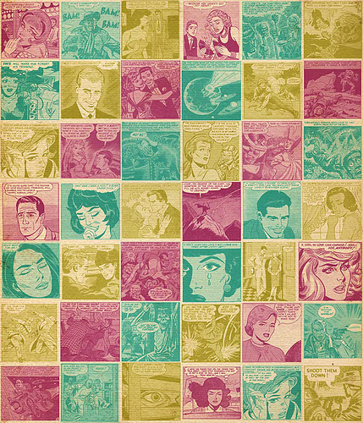
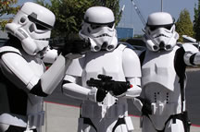
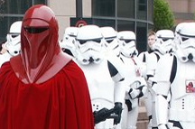
Beaverton City Library’s ‘Comics Fests’
A visit from Portland’s ‘Darkside Troopers.’ http://www.darksidetroopers.com
A comics drawing workshop by Manga & comic artist Emily Wing.
http://www.emily-wing.com/
Background Courtesy Jason Garratley on Flickr.
Notes:
The Comics Fests at the Beaverton City Library were opportunities for us to use a program to further promote a popular collection – not only do we have graphic novels, but we also have a newer browsing collection of single-issue comic books. Our two comics fests included a visit from Portland’s Darkside Troopers, Star Wars enthusiasts with elaborate, professional-quality costumes who will come to events for free photo opportunities. We also had a comics drawing workshop by local artist Emily Wing, who has sinced moved back to Boston. She taught attendees the basics of planning and drawing a story using comics.

Slide 8
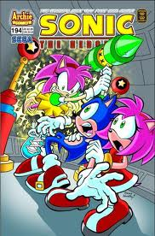
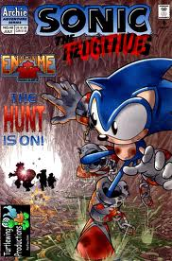
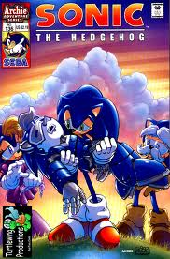
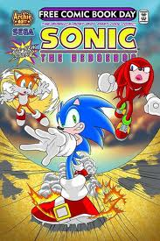
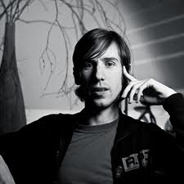
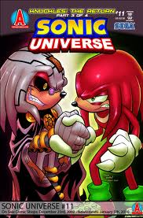
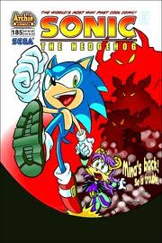
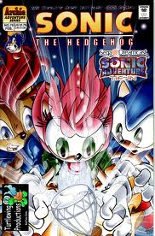
Sonic Comics Artist Ben Bates
Official Web site:
http://www.bbates.com
Notes:
Ben Bates is a Portland-based comic artist who is best known for his work on the Sonic the Hedgehog comic books, starring the popular videogame character. This series holds enormous appeal with tween audiences. The Beaverton City Library got Ben to do an hour-long chat and drawing tutorial. We had about 30 3rd to 7th graders in attendance, many of them boys. The kids were thrilled to see the original uncolored storyboards that they recognized from the comics. After the chat, Ben Bates even hung around for an extra half hour or so to sign autographs and answer questions! He seemed eager to visit other libraries, and his fee was very small.

Slide 9
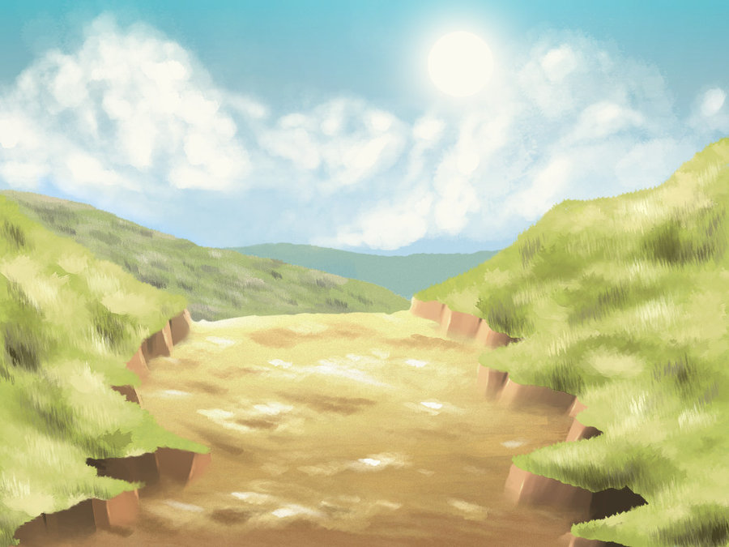
Anime Club @ Beaverton
Activities have included:
Drawing contests – talented artists are encouraged to draw an Anime Club mascot, which can then be used on library promo materials.
Karaoke Nights
Japanese food activities (sushi)
Talent Shows
Anime Trivia Contests
Film viewings (Miyazaki movies are a great first choice)
COSplay (Anime Costume) contests
Notes:
The Beaverton City Library has run a successful Anime Club on the second and fourth Tuesdays of each month for the past 6-7 years. Each meeting, 25-35 kids (sometimes topping 40 in the summer) meet to enjoy Japanese snacks like Pocky and Hello Panda, draw, and watch Anime movies. There are also activities such as dance parties, karaoke, talent shows, Anime trivia contests, drawing contests, COSplaye contests and more! Manga fans often prove to be your most devoted patrons – having an Anime Club can help you get feedback on “hot and nots” in the world of Japanese Anime / Manga. This is also a natural choice for a “teen-run” activity – appoint a few teens to lead it!

Slide 10
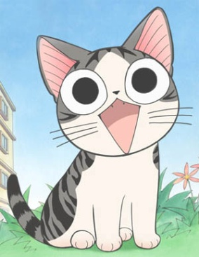
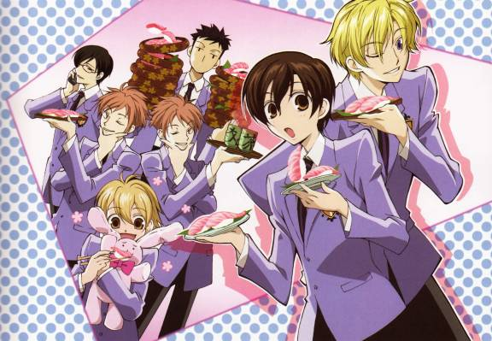
Tualatin Public Library Animanga Club
Meet monthly.
20+ teens involved (or over 9000 if you ask Amber).
Every other month do something besides watch anime-crafts, AMV, trivia, etc.
Asian snacks and beverages.

Slide 11
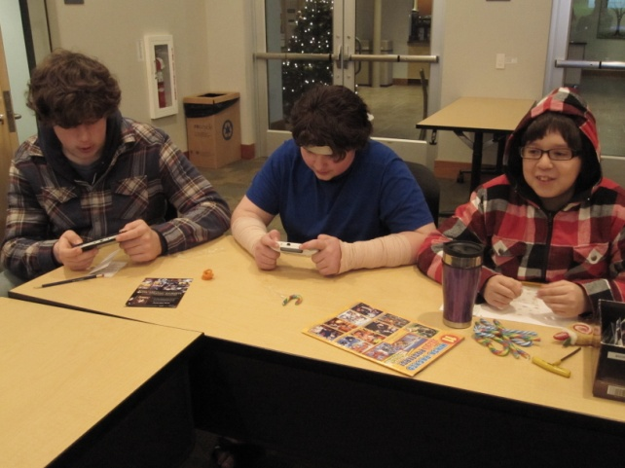
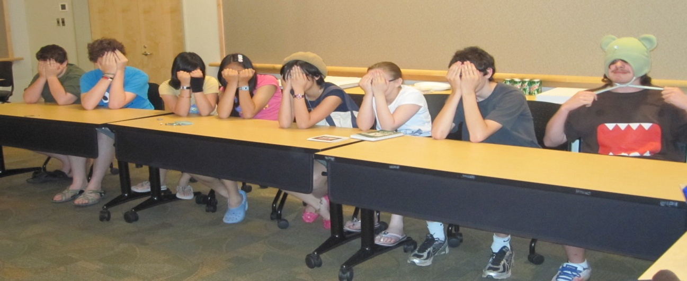
Quotes from REAL live Otakus!
“It’s fun. And free food. And watch anime. And talk a lot about anime and manga.”
“Special place where we can be ourselves and goof off a lot. But we can’t be too loud because Aimee gets mad.”

Slide 12
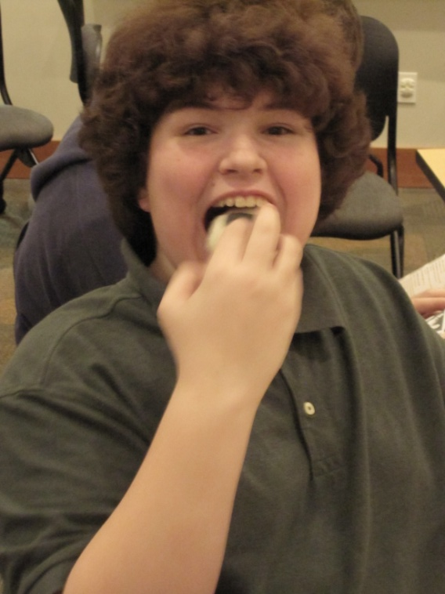
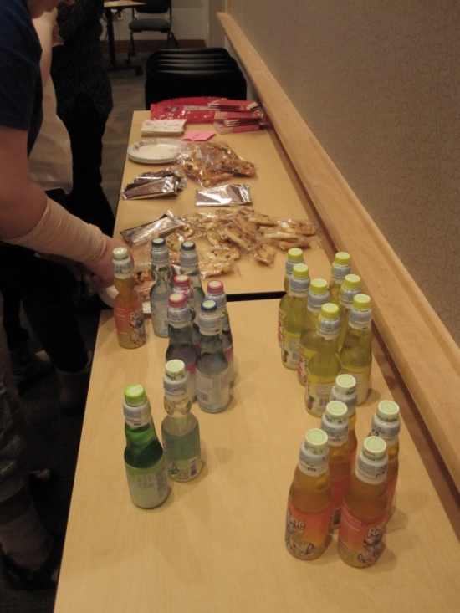
Food is imperative!
Asian snacks add variety and fun!

Slide 13
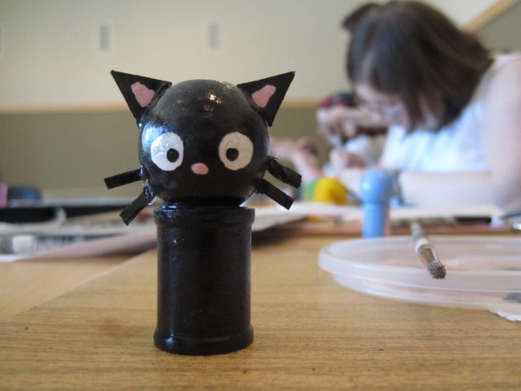
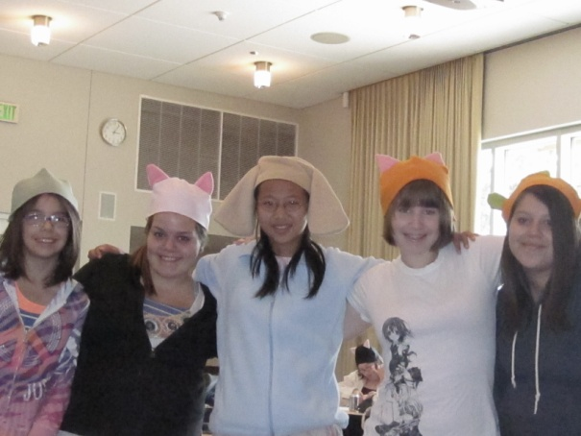
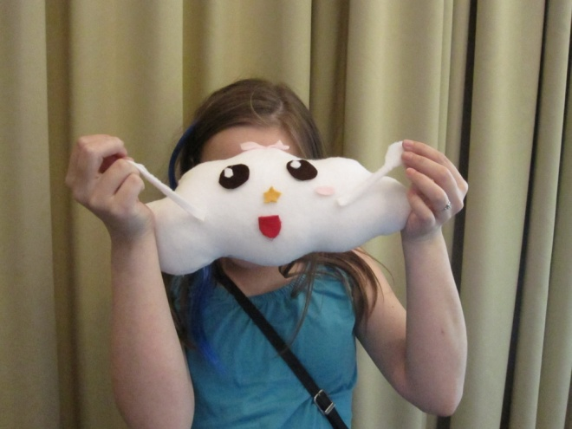
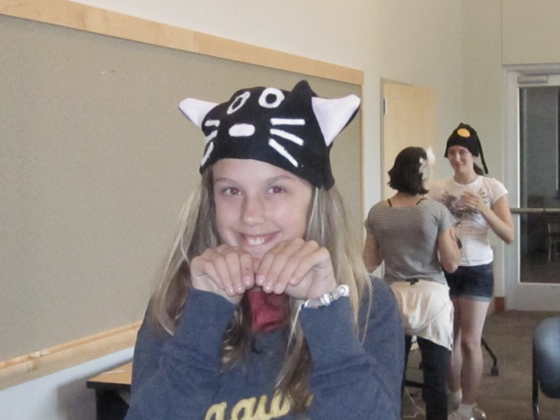
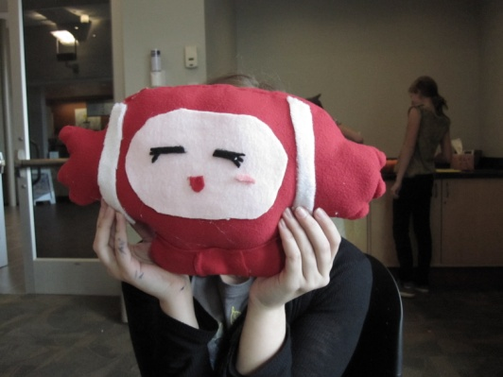
We craft!
Kokkeshi
Cosplay Hats
Ugly Dolls

Slide 14
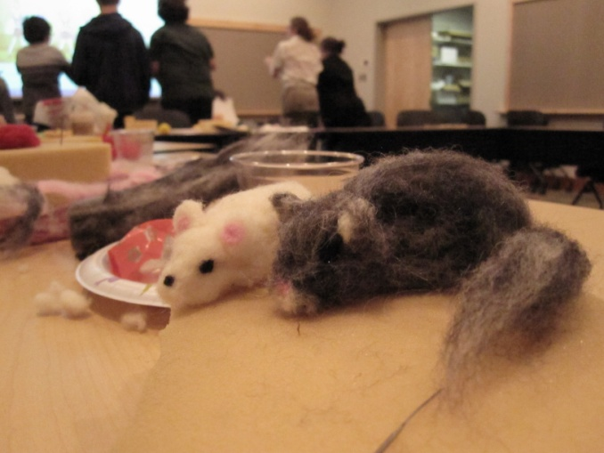
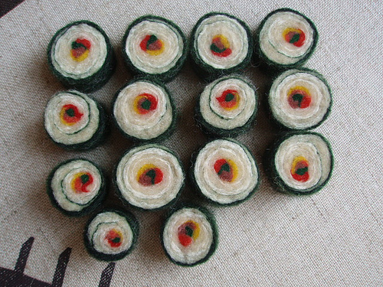
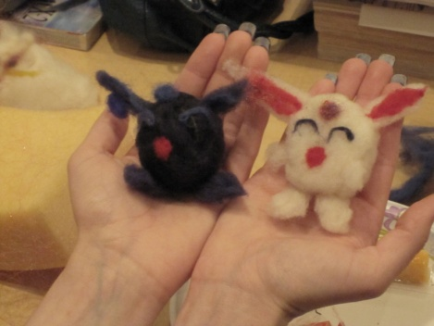
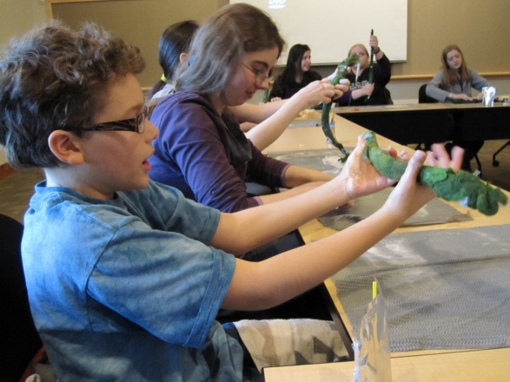
Felting is Fun!

Slide 15
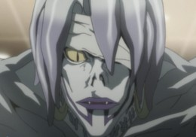
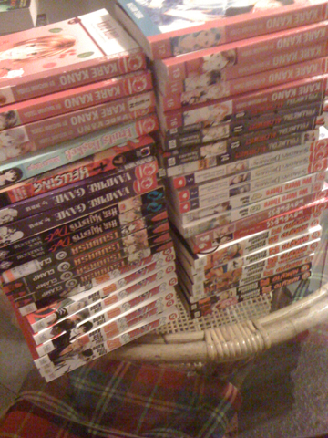
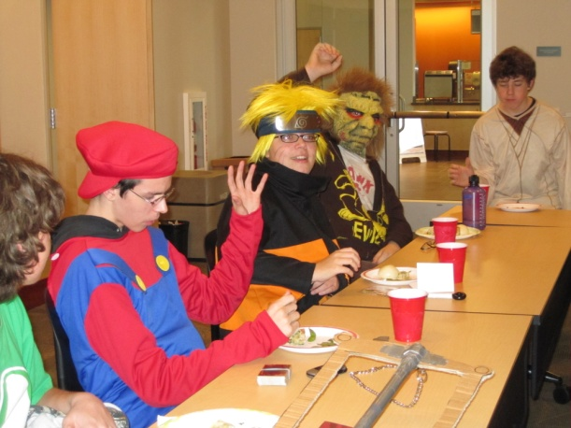
And Other Stuff…
Trivia Contests
AMV
Swap
Cosplay
Trivia
AMV Contests
Cosplay Contests
Swaps

Slide 16
Free Comic Book Day
Saturday, May 5th, 2-3pm - All Ages
Talk about your comics with other artists!
Graphic Artist Dylan Meconis will be here to share her art!
...and?
...and?
Well...umm... and have fun?
Draw your own comics with our free art materials!
...and?
sigh
...AND GET A FREE COMIC!

Slide 17
Questions?

