Slide 1
Metadata for Digital Preservation
by Friday Valentine, MLS
friday.valentine@chemeketa.edu

Slide 2
Overview
Why I’m passionate about the subject
Digital object life-cycle
A bit of history regarding preservation metadata
Overview of two major standards
Discussion

Slide 3
Short Survey:
Metadata Experience

Slide 4
As a descriptive cataloger,
I want to know what
data/fields/information
are essential to
digital preservation

Slide 5
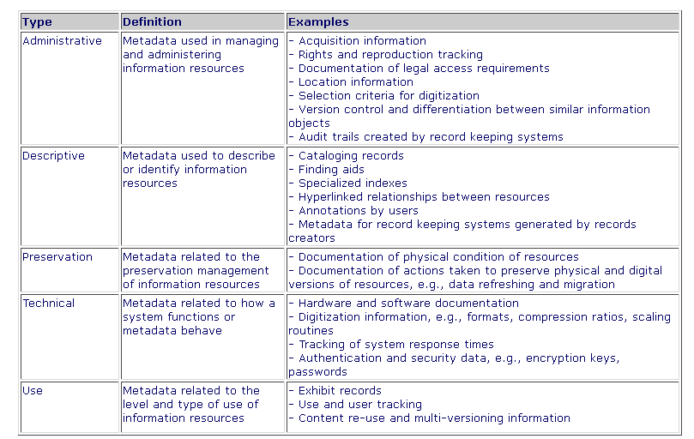
Types of Metadata
http://www.getty.edu/research/publications/electronic_publications/intrometadata/setting.html

Slide 6
What Objects Need Preserving?
Historical importance
Provenance
Decide: Short use / long use / keep permanently
We can’t always know for sure, “best guess”
Some fields do double duty with regards to preservation information. Example: “Description” should not only describe the object but why the object is important for preservation.

Slide 7
What is Preservation Metadata?
Information that is essential to ensure long-term accessibility of digital resources
Must be able to exist independently from the systems which were used to create them (extractable/shareable)
Dappert, 2008

Slide 8
Another Definition
Preservation functions can vary from one repository to another, but will generally include actions to ensure that digital objects remain viable (i.e., can be read from media) and renderable (i.e., can be displayed, played or otherwise interpreted by application software), as well as to ensure that digital objects in the repository are not inadvertently altered, and that legitimate changes to objects are documented.
http://www.loc.gov/standards/premis/understanding-premis.pdf

Slide 9
Preservation metadata is
intended to store
technical details on the format, structure and use of the digital content
the history of all actions performed on the resource including changes and decisions
the authenticity information such as technical features or custody history
the responsibilities and rights information applicable to preservation actions
Dappert, 2008

Slide 10
Technical information
Why should catalogers use limited time to recreate technical metadata?
What should the digital object be able to tell us about itself?
Encourage system vendors to extract as much info as possible from the digital object into the system!

Slide 11
With limited time and resources, what is the best use of staff time
re: metadata
to support
preservation efforts?

Slide 12
Why is digital preservation so difficult?
Fragile state of technology
Competing needs
Staff
Time
MONEY

Slide 13
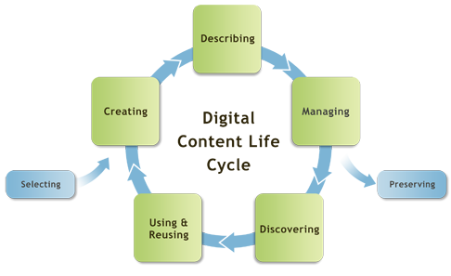
Digital Object Lifecycle
DigitalNZ: http://makeit.digitalnz.org/

Slide 14
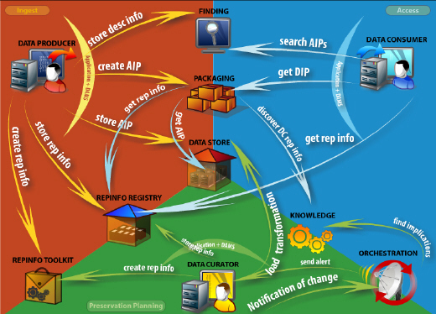
Preservation Look @ Digital Object Lifecycle
http://www.casparpreserves.eu/other-caspar-products/caspar_workflow.jpg

Slide 15
Big Picture Reality Check
What METADATA is important to the preservation process?
Try not to get overwhelmed by the Technical Models (file formats, storage/backup, wrappers/carriers, etc.)

Slide 16
RLG, May 1998
Date Watermark Transcriber
Resolution Producer Compression
Source Capture Device Capture Details
Color Change History Color Management
Encryption Validation Key Color Bar/Grayscale Bar
Control Targets

Slide 17
MARC preservation (2009?)
Field 583
http://www.loc.gov/marc/bibliographic/pda.pdf
80 page document that is both “instructional guidelines and a data dictionary”

Slide 18
(some) Dublin Core fields
DC.Creator.PersonalName: [Author or creator of intellectual content] DC.Contributor.CorporateName: [Agency to which digitization was outsourced] DC.Publisher: [Institution responsible for digitization] DC.Date: [date digital preservation copy created--YYYY-DD-MM] DC.Description: [Color Bar/Gray Scale Bar; Control targets] DC.Identifier: [URL of document if metadata not carried in header] DC.Relation.Type: IsVersionOf DC.Relation.Identifier: [e.g., catalog record no. for original]

Slide 19
OCLC’s Digital Archive
Digital Archive record identifier
Digital Archive record language
Digital Archive save file number
Encoding standard Event Expires in
Functionality changes Harvested on Ingested on
Logical object size Object type Operating system
Original functionality Peripherals Relation
Standard identifier Administrative elements

Slide 20
Do It Yourself
Mountain West Digital Library, DC Application Profile, Section IV
“Parsed Preservation Elements about Master Archival Files (Optional)”
http://mwdl.org/docs/MWDL_DC_Profile_Version_2.0.pdf
masterChecksum, masterFormat, masterCompression, etc.

Slide 21
Preservation Standards
OAIS
(Open Archival Information System)
PREMIS
(PREservation Metadata: Implementation Strategies)

Slide 22
OAIS Preservation Metadata
• Representation Information: information necessary to render and understand the bit sequences constituting the archived digital object.
• Preservation Description Information: information that supports and documents the preservation of the archived object, including:
Reference information
Context information
Provenance information
Fixity information
• Packaging Information: information that binds all components of an
information package into a single logical unit.
• Descriptive Information: information that supports the discovery and
retrieval of the archived object by the repository’s users.

Slide 23
OAIS metadata expression
Content Data Object Description (partial list)
Underlying abstract form description
Structural type
Technical infrastructure of complex object
File description
Installation requirements
Size
Quirks

Slide 24
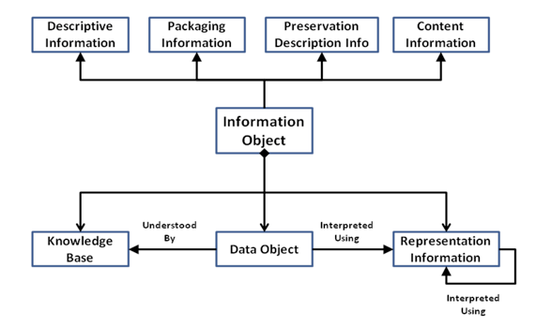
OAIS 2.0 Model
http://www.dlib.org/dlib/september11/shaon/09shaon.print.html

Slide 25
PREMIS (PREservation Metadata: Implementation Strategies)
The Data Dictionary provides detailed descriptions of metadata associated with the Object, Event, Agent, and Rights entities
www.loc.gov/standards/premis/v2/premis-2-1.pdf

Slide 26
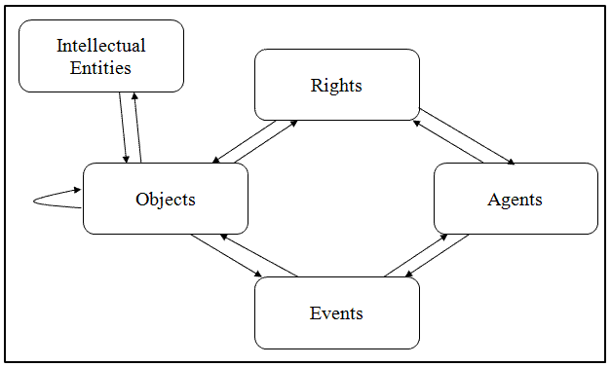
PREMIS 2.0 Data Model
http://www.dlib.org/dlib/may08/lavoie/05lavoie.html

Slide 27
PREMIS uses “semantic units”
1.1 objectIdentifier (M, R)
1.1.1 objectIdentifierType (M, NR)
1.2 objectCategory (M, NR)
1.3 preservationLevel (O, R) [representation, file]
1.3.1 preservationLevelValue (M, NR) [representation, file]
1.3.2 preservationLevelRole (O, NR) [representation, file]
1.3.3 preservationLevelRationale (O, R) [representation, file]
1.3.4 preservationLevelDateAssigned (O, NR) [representation, file]
1.4 significantProperties (O, R)
1.4.2 significantPropertiesValue (O, NR)
1.5 objectCharacteristics (M, R) [file, bitstream]
1.5.1 compositionLevel (M, NR) [file, bitstream]

Slide 28
PREMIS
PREMIS fields describe:
a unique identifier for the object (type and value),
fixity information such as a checksum (message digest) and the algorithm used to derive it, the size of the object,
the format of the object, which can be specified directly or by linking to a format registry, the original name of the object, information about its creation, information about inhibitors, information about its significant properties,
information about its environment , where and on what medium it is stored, digital signature information, relationships with other objects and other types of entities.
PREMIS DTD

Slide 29
PREMIS expressed in XML
http://www.loc.gov/standards/premis/understanding-premis.pdf

Slide 30
Do the best you can do
for your collections

Slide 31
Links to References
http://www.oclc.org/research/activities/past/orprojects/pmwg/presmeta_wp.pdf
http://www.loc.gov/standards/premis/FE_Dappert_Enders_MetadataStds_isqv22no2.pdf
http://www.oclc.org/support/documentation/pdf/da_metadata_elements.pdf
And big kudos to Angela Dappert of the British Library for offering her presentation “Preservation Metadata” under Creative Commons license 2.0 UK/Wales (2008): http://www.google.com/url?sa=t&rct=j&q=&esrc=s&source=web&cd=2&ved=0CCwQFjAB&url=http%3A%2F%2Fwww.digitalpreservationeurope.eu%2Fpreservation-training-materials%2Ffiles%2FPreservationMetadataPart1.ppt&ei=e2qYT_C8GM3WiAKa6tjVDw&usg=AFQjCNGqUjgPNSwqZmCqq2VjDiSwM2jRdg&sig2=rQOZEtIt9nLzusOSLU61tA

Slide 32
Thank you!
Friday Valentine
friday.valentine@chemeketa.edu

