Slide 1
Nwcentral.org
Continuing education network for library staff in the Pacific Northwest

Slide 2
Who we are
Northwest Central is a free, community-driven online clearinghouse for library continuing education and collaboration serving library staff in Oregon, Washington, and beyond. The goal of Northwest Central is to provide a ‘one stop shop’ for library continuing education.

Slide 3
How it all started
NWC was created in 2005 using LSTA funds administered by the Oregon State Library.
Portland Community College provides hosting and administrative support

Slide 4
What we offer
- Learn about trainings, conferences and meetings in your community or online
- Find web links, tutorials, handouts, and presentations on a range of library topics
- Share your resources and publicize your events

Slide 5
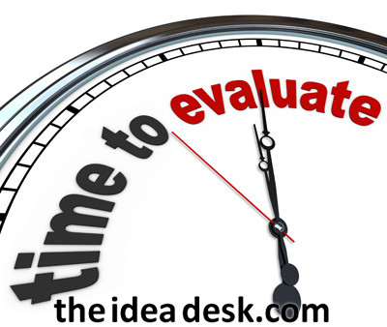
assessment
Is it well-used?
Is the content helpful?
Should we change anything about the interface?
What else?

Slide 6
Join the conversation!
We are seeking input from the library community via survey.
Help steer our course!
Visit http://nwcentral.org/
to take our survey!

