Slide 1
Does Oregon need a Librar* Revolution?
Presented by Emily Ford
Urban & Public Affairs Librarian
Portland State University
For the 2013 Oregon Virtual Reference Summit
Notes:
Please forgive me in advance for giving you my yearly five minute spiel based on theory and introspection.
Does Oregon need a library/librarian/libraries/librarianship revolution?
You may be wondering why I would even ask that question and what relevance it has to virtual reference. I think it has quite a lot to do with our virtual reference work, which I hope to unpack for you in my short five minutes.
Recently I’ve been spending a lot of time thinking about the idea of revolt and how both revolutions and the act of revolting cause changes, or at least changes of thinking in our communities.

Slide 2
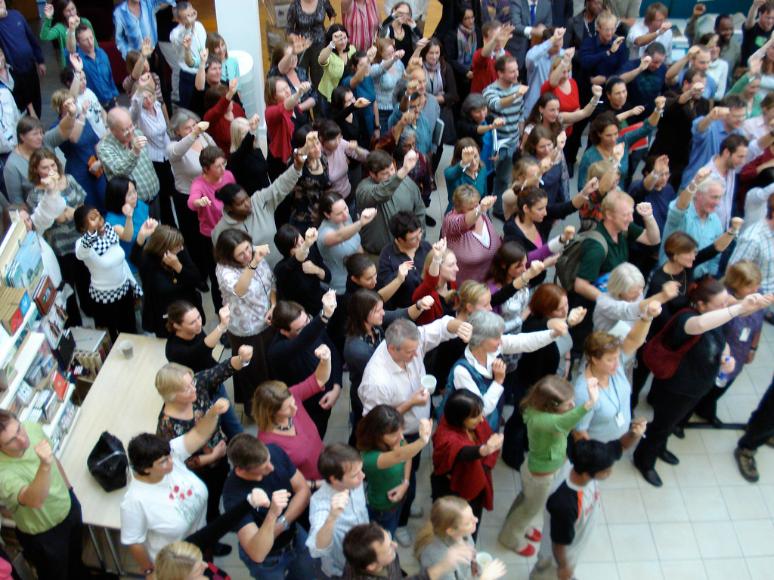
Client revolt
Haug, M. R., & Sussman, M. B. (October 01, 1969). Professional Autonomy and the Revolt of the Client. Social Problems, 17, 2, 153-161.
http://www.flickr.com/photos/wheatfields/1614979200/ - CC- by-nc-sa
Notes:
One of the theories that has crossed my path--thanks to Rory Litwin--appeared in a 1969 article by Marie Haug and Marvin Sussman. In it they outline a theory regarding “client revolt” and the “new careers movement.” To over-simplify, client revolt is a social phenomenon when clients, as a group, reject the expertise of professionals. Instead, the clients “do it themselves” forming “new careers.”

Slide 3
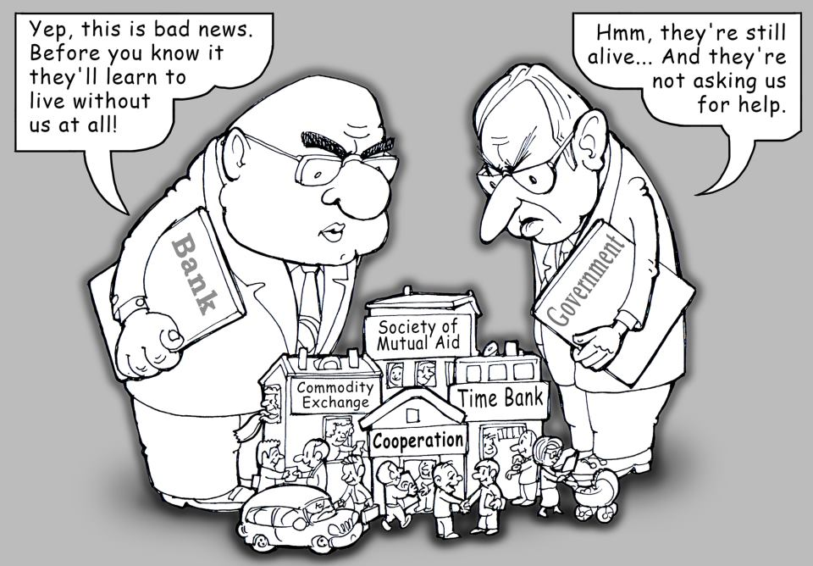
Image courtesy of Michael Gonopolsky’s Facebook page.
https://www.facebook.com/michael.gonopolsky
Notes:
This political cartoon is a great example of the theory. One of the reasons clients may revolt is because they are no longer satisfied with the institutions providing them services. Although Haug and Sussman discuss social services, health care, and higher education professions, I see client revolt as applicable to libraries.

Slide 4

Loss of autonomy
clients
professionals
institutions
loss of autonomy
Notes:
One of the things to note is that when clients revolt, professionals practicing within institutions experience a loss of autonomy, as exemplified here. [CLICK NOW.]
I’m not arguing that our clients are going away and that we aren’t serving patrons and that we don’t care about them. I’d just like to take this theory a little bit further. Professionals are also clients. I’m a client of Portland State University, the system of higher education, and academic libraries.

Slide 5
Librarians as clients
clients
professionals
institutions
Notes:
Public librarians might be clients of city or county government, the state library, and the public library. Law librarians, similarly, are clients of their counties and the state legislature. Most of us here are also clients of Answerland, and Answerland is, until 2014, a client of Multnomah County Library and the State Library.

Slide 6
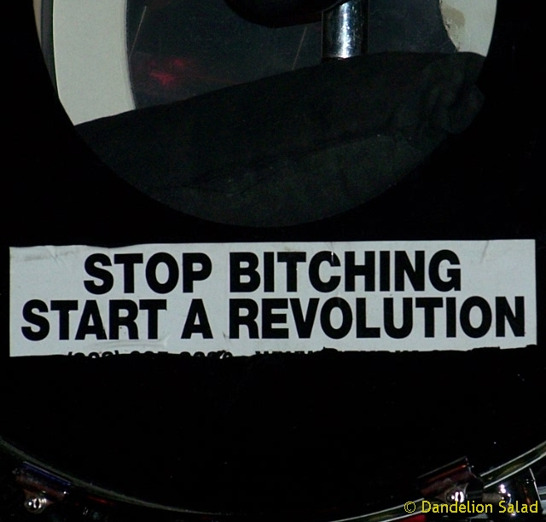
http://www.flickr.com/photos/lorri37/4261104525/ - CC-by-nc-sa
Notes:
In Oregon we are facing tumult and change. Our institutions face budgetary and subsequent visioning, reorganization, and prioritization challenges. Our institutions will no longer be able to serve us in the way that we need. So what will we librarians do when our institutions can no longer serve us? Of course we will REVOLT.

Slide 7


“Every profession is being radicalized [L. radix-root: searching for the root of the matter] as its practitioners refuse to draw any “conflict of interest” line between their lives and their work. Naturally, this displeases the hierarchs and the sachems. Librarians with personal commitment, a “code,” do not play follow the leader. They do not hold orders as hacks, apologists, or nitpickers. Their responsibility is not to any power structure at all, but to the patron and to the profession. True professionalism implies evolution, if not revolution; those who “profess” a calling have certain goals and standards for improving existence, which necessarily means moving, shaking, transforming it.” – Celeste West, 1972
Notes:
In her 1972 introduction to Revolting Librarians Celeste West wrote:
True professionalism implies evolution, if not revolution; those who “profess” a calling have certain goals and standards for improving existence, which necessarily means moving, shaking, transforming it.”
I couldn’t be more pleased to see this happening in Oregon. Earlier this week, on May Day, a Task Force charged with examining our statewide virtual reference services convened. Undoubtedly its membership--some of whom are with us today-- is a tiny microcosm of the energy, dedication, passion, and revolutionary thought and action that exists amongst the Oregon library community. These individuals will move, shake, and transform Oregon’s Virtual Reference Services, just as every single person here today has the ability to move, shake, and transform our profession and our institutions.

Slide 8
We don’t need a librar* revolution, we already have one.
Notes:
So my answer to the question--does Oregon need a librar* revolution?-- is no. No. We don’t need a revolution, because we already have one. It could be stronger. It could be bigger.

Slide 9
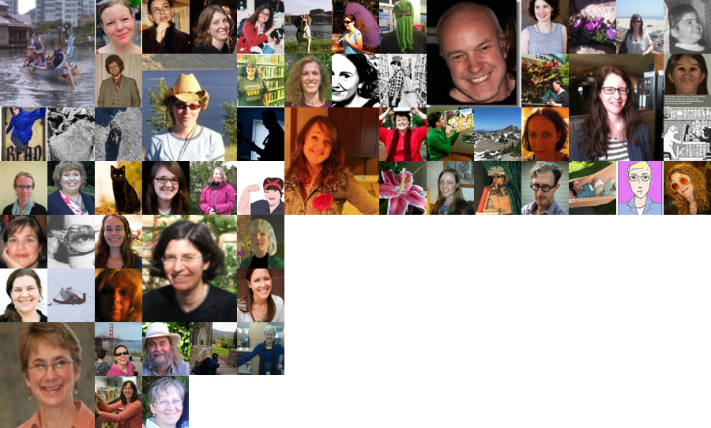
Oregon library revolutionaries
Notes:
We already have revolutionaries moving and shaking and transforming our profession and our institutions. I just want us all to move faster, shake harder, and transform more creatively. In the end it is OUR clients who will benefit.

Slide 10
What will we—individually and collectively—do to move, shake, and transform our communities?
Notes:
I leave you with one more question: When we return to our respective libraries on Monday, and for that matter every day thereafter, what will we--individually and collectively--do to move, shake and transform our communities?

Slide 11
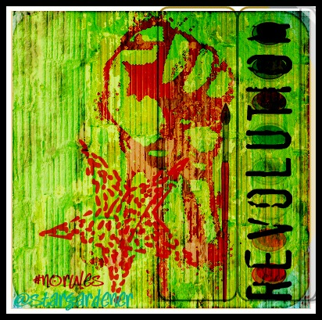
Thank you
Presented by Emily Ford
Urban & Public Affairs Librarian
Portland State University
forder@pdx.edu
2013 Oregon Virtual Reference Summit
http://www.flickr.com/photos/stargardener/7037360553/ - CC- by-nc-nd
Notes:
Thank you.

