Slide 1
Intellectual Freedom Issues in Oregon A brief overview of your newest resource
OLA/WLA Conference 2013
Judy Anderson
member of the Oregon Intellectual Freedom Committee

Slide 2
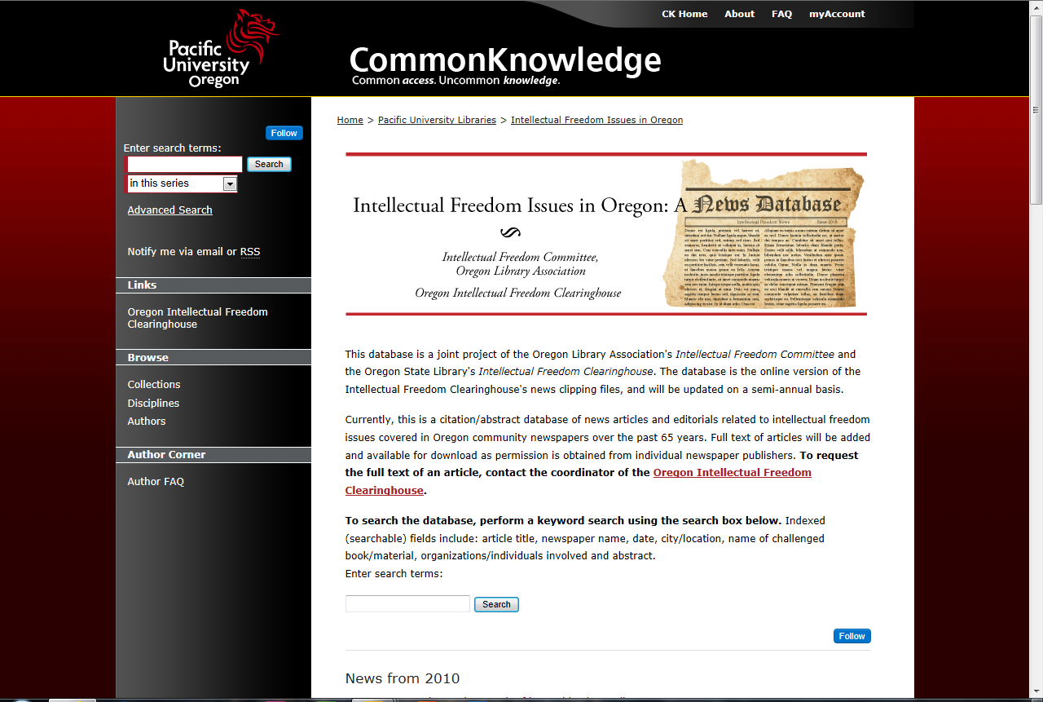
Intellectual Freedom Issues in Oregon Open Access http://commons.pacificu.edu/iforegon/

Slide 3
Why? & How?
Give libraries & communities a more accessible resource for researching the challenges made against books, works of art, movies, etc. in the State of Oregon.
The State Library Intellectual Clearinghouse had a valuable resource that few knew existed
Access to the news articles was cumbersome
Intellectual Freedom Committee saw a way they could help…Pacific University was willing to support the IFC efforts to set up a database using Pacific University’s Digital Commons.
Members of the IFC (Isaac Gilman, Krista Reynolds, Judy Anderson) agreed to spearhead the project in collaboration with Katie Anderson from the Oregon State Library (State Library liaison to the committee.)

Slide 4
The Project
Scan the articles
Create appropriate fields in the database
Create standard vocabulary for newspapers and subjects to add more efficient searching capabilities
Abstract the articles
Data entry & QA
Open for public access

Slide 5
The “raw” data

Slide 6
Progress on the Project
Date ranges are from 1946-2010.
There are currently 462 articles in the database; additional articles are added as they become available.
The collection is extensive, but not comprehensive.
As long as the Oregon Intellectual Freedom Clearinghouse exists, we will continue to add articles relating to intellectual freedom issues as the Oregon State Library receives them from Allen’s Clipping Service.

Slide 7
How do I get a copy of the article?
Pdfs of the full text article may be requested by contacting the Oregon Intellectual Freedom Clearinghouse at the State Library
Copyright clearance for permissions for putting the complete article online are in progress. Currently, only the abstracts are available online.

Slide 8
Intellectual Freedom Issues in Oregon Open Access http://commons.pacificu.edu/iforegon/
Search or
Advanced search
OR Search here

Slide 9
Questions? Comments?
Thank you

