Slide 1
semantic | identity
Nicholas Schiller
(not a cataloger or a metadata librarian)
schiller@vancouver.wsu.edu
@nnschiller
ACRL OR/WA Joint Conference
24 October 2014 | Menucha, Oregon
Ignite Rules:
5 minutes
20 slides
15 seconds per slide

Slide 2
identity
metadata
CC by 2.0 Tony Alter https://flic.kr/p/dMZVkN

Slide 3
predicate
subject
object
is named
this speaker
Nicholas

Slide 4
LDR |  | |||||cam a22||||| a 4500
001 |  | 614774
005 |  | 20020325073420.0
008 |  | 010430s2001 nyu 000 0 eng
010 |  | $a 2001024929
035 |  | $a(OCoLC)ocm46937451
040 |  | $aDLC$cDLC$dC#P$dOQX$dOCoLC
020 |  | $a1559705930 (alk. paper)
041 | 1 | $aeng$hfre
042 |  | $apcc
050 | 00 | $aHM753$b.M3313 2001
082 | 00 | $a302.4$221
049 |  | $aOQXA
100 | 1 | $aMaalouf, Amin.
240 | 10 | $aIdentités meurtrières.$lEnglish
245 | 10 | $aIn the name of identity :$bviolence and the need to belong /$cAmin Maalouf ; translated from the French by Barbara Bray.
250 |  | $a1st North American ed.
260 |  | $aNew York :$bArcade Pub.,$c2001.
300 |  | $a164 p. ;$c22 cm.
650 | 0 | $aGroup identity.
999 |  | $b302.4$c0$i1$j1$k0$x302.4$z0

Slide 5
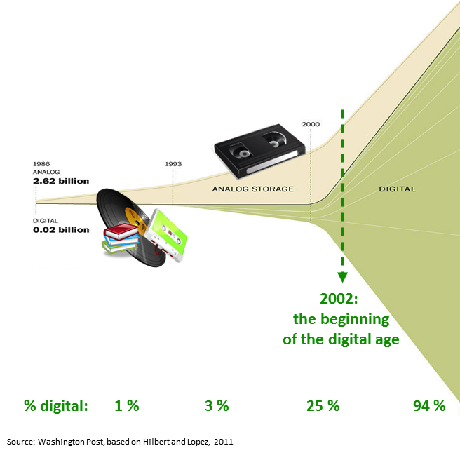
New data are created faster than we can describe them.
(or even store)

Slide 6
Search Engines Scale Better Than Library Catalogs
URL
<title>
<meta name=“description” content =“description of web page”>
<a href=“url”>this is a fabulous page about libraries</a>
<h1>
<h2>
<h3>
<body>

Slide 7
Web scale discovery has limitations
Screen capture from: http://www.google.com/404

Slide 8
“This itself will allow much more efficient searching of the Web as though it were one giant database, rather than one giant book.”
CC by 2.0 Silvio Tanaka https://flic.kr/p/5TSfGB

Slide 9
“This itself will allow much more efficient searching of the Web as though it were one giant database, rather than one giant book.”
CC by 2.0 Silvio Tanaka https://flic.kr/p/5TSfGB

Slide 11
http://journal.code4lib.org/articles/6400

Slide 12
Let’s put this all into a container where it easily fits.

Slide 13
Data need to know what they are.
CC by 2.0 Dianne Griffiths https://flic.kr/p/dD9NYd

Slide 14
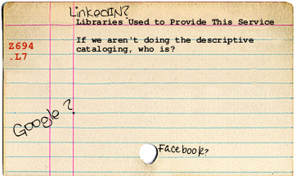
Libraries Do This.
(except: SCALE)

Slide 15
rda
BIBFRAME
OCLC
CC by SA 3.0 Fewskulchor

Slide 16
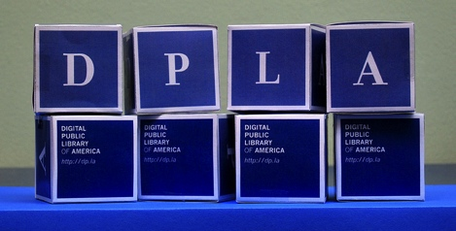
CC by-nc-nd Diana Geis https://flic.kr/p/bjmiF8
OAI-PMH
Enables sharing magic

Slide 17
identity
metadata
CC by 2.0 Tony Alter https://flic.kr/p/dMZVkN

Slide 18
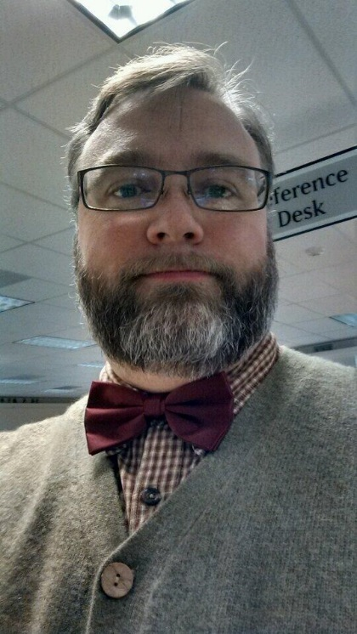
Nicholas Schiller
Washington State University Vancouver
Systems and Instruction Librarian
schiller@vancouver.wsu.edu
14204 NE Salmon Creek Avenue
Vancouver, WA USA 98686-9600
male-he-him

Slide 19
<p class="h-card">
<img class="u-photo" src="http://informationgames.info/images/bowtie.jpg" alt="" />
<a class="p-name u-url" href="http://directory.vancouver.wsu.edu/people/nicholas-schiller">
Nicholas Schiller</a>
<a class=“p-org”>Washington State University Vancouver</a>
<a class=“p-job-title”>Systems and Instruction Librarian</a>
<a class="u-email" href="mailto:schiller@vancouver.wsu.edu">
schiller@vancouver.wsu.edu</a>,
<span class="p-street-address">14204 NE Salmon Creek Avenue</span>
<span class="p-locality">Vancouver</span>,
<span class=“p-region”>Washington</span>
<span class="p-country-name">United States</span>
<span class=“p-postal-code”> 98686-9600</span>
<span class=“p-gender-identity”>male</span>-he-him
</p>

Slide 20
<p class="h-card">
<img class="u-photo" src="http://informationgames.info/images/bowtie.jpg" alt="" />
<a class="p-name u-url" href="http://directory.vancouver.wsu.edu/people/nicholas-schiller">
Nicholas Schiller</a>
<a class=“p-org”>Washington State University Vancouver</a>
<a class=“p-job-title”>Systems and Instruction Librarian</a>
<a class="u-email" href="mailto:schiller@vancouver.wsu.edu">
schiller@vancouver.wsu.edu</a>,
<span class="p-street-address">14204 NE Salmon Creek Avenue</span>
<span class="p-locality">Vancouver</span>,
<span class=“p-region”>Washington</span>
<span class="p-country-name">United States</span>
<span class=“p-postal-code”> 98686-9600</span>
<span class=“p-gender-identity”>male</span>-he-him
</p>

Slide 21
Nicholas Schiller
Washington State University Vancouver
Systems and Instruction Librarian
schiller@vancouver.wsu.edu
14204 NE Salmon Creek Avenue
Vancouver, WA USA 98686-9600
male-he-him

