Slide 1
OSU Valley Library is Going to the Dogs!
Oregon Virtual Reference Summit
May 3, 2013
Valery King
Oregon State Univ. Valley Library

Slide 2
or A Dog and Pony Show or The Dog Ate My Homework or It’s a Dog’s Life or In the Dog House or Puppy Love or…

Slide 3
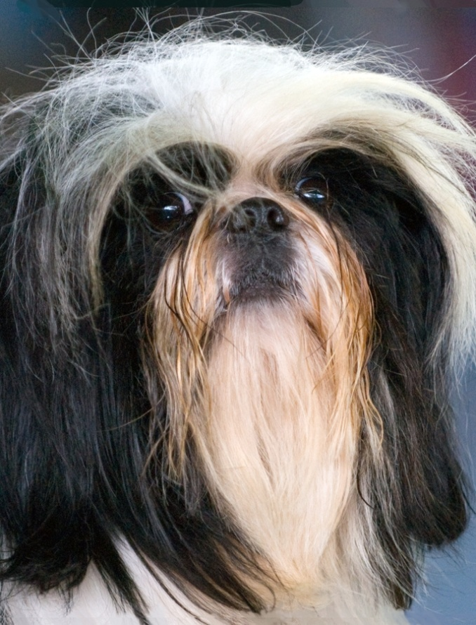
Hey, I’ve got a great idea…
Somebody said…

Slide 4
End-of-Term: Students are Stressed Out…

Slide 5
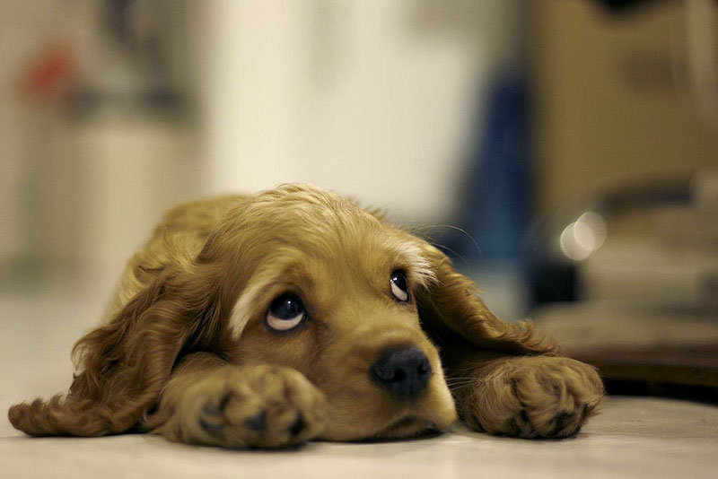
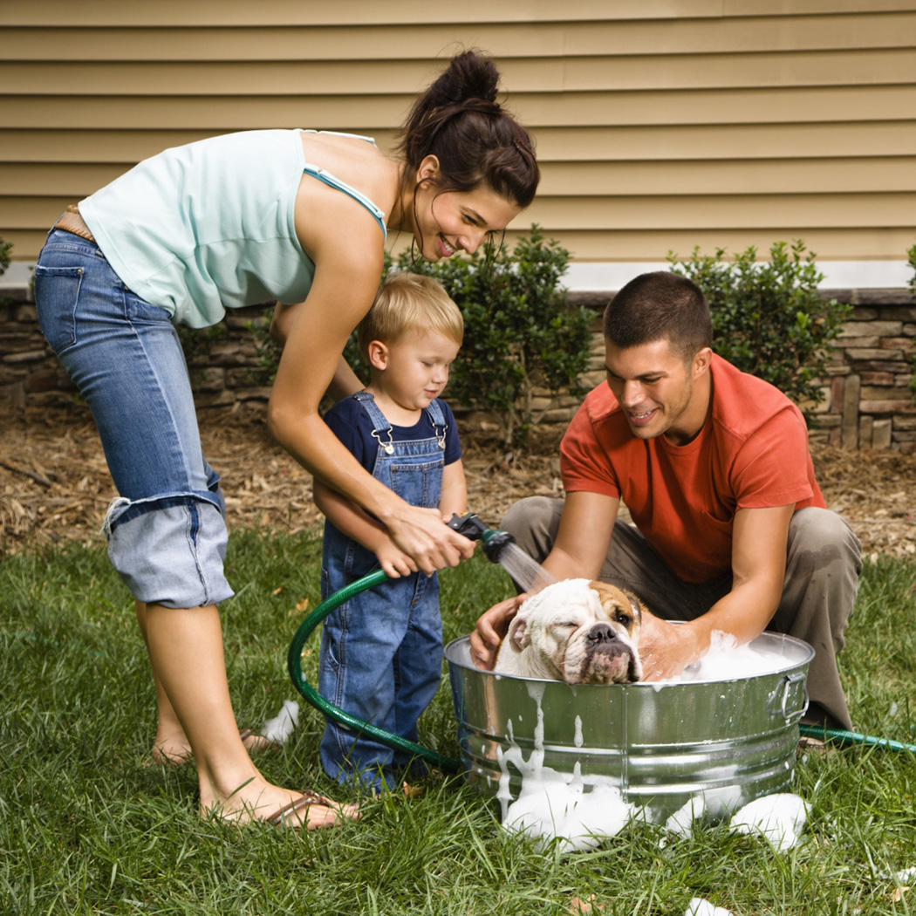
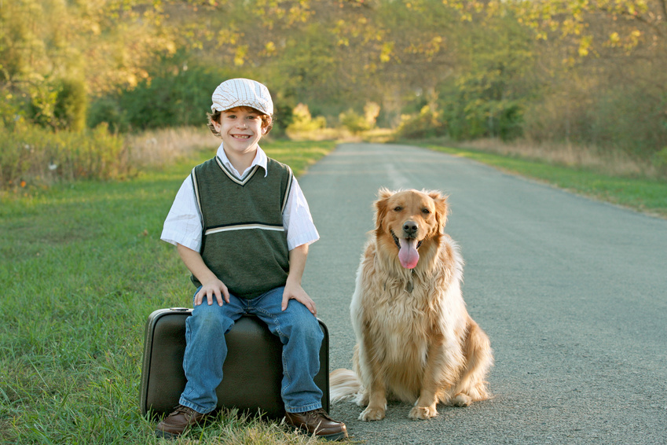
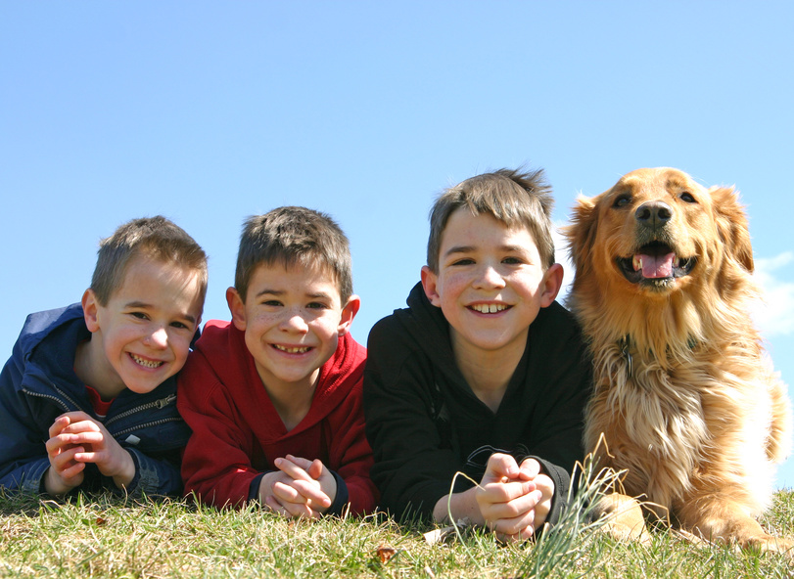
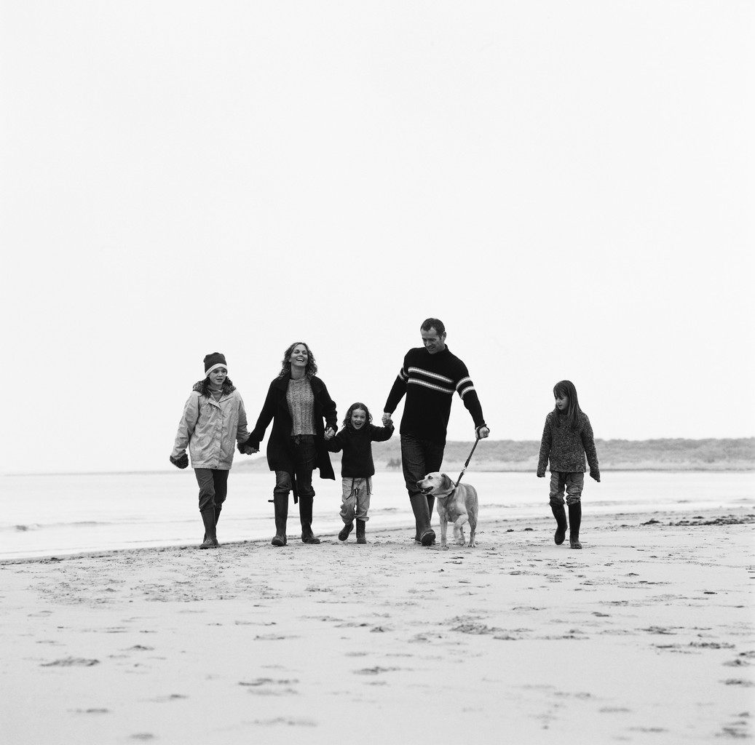
They miss their pets…

Slide 6
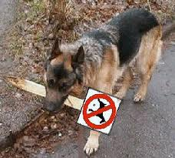
Landlords don’t allow pets, buildings don’t allow pets…

Slide 7
Get Dogs to come to the Library!

Slide 8
Research
College students miss their pets when away from home
Therapy animals help relieve stress (a better, safer option than other dogs)
Contributes to library’s focus on student success & retention

Slide 9
To-Do List
Consult with leader of a successful program (Rice Univ.)
Check with Counseling & Psychological Services on campus (very enthusiastic!)
Clear w/university to have dogs in the building
Find a Therapy dog group in community

Slide 10
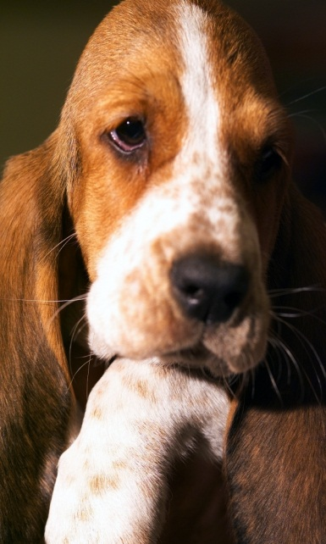
Planning
Schedule visit for Winter Term Dead Week
Create Attendee Survey
Get Library Volunteers
No shortage of helpers! ☺

Slide 11
More Planning
Expenses (quite low)
Hand sanitizer, lint rollers, parking passes for volunteers, poster production
Marketing (vital!)
Limited to posters, flyers in building, OSU email lists, and social media (Facebook)

Slide 12
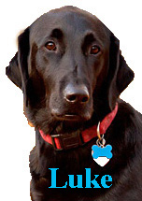
Say hello to WELCOME WAGGERS THERAPY DOGS!
Teams (dog + handler) registered through national organization of therapy dogs
At least 1 month notice (very busy)
No cost for the service (all volunteers)
Carry their own insurance ☺

Slide 13
Advertising
Posters & Flyers
Facebook
(10,000+ views in 4 hours!)

Slide 14
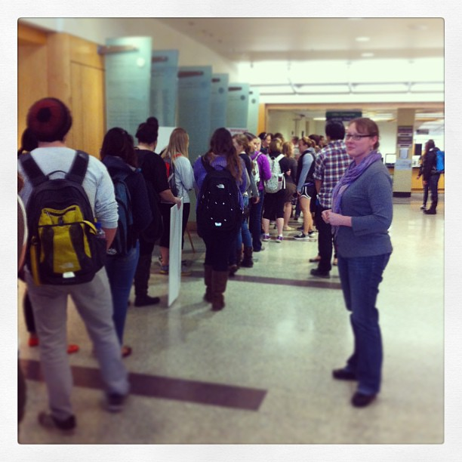
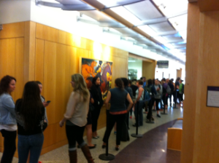
Welcome Waggers are a hit!
Lines out the door both days!

Slide 15
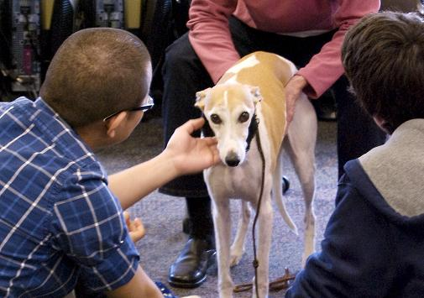
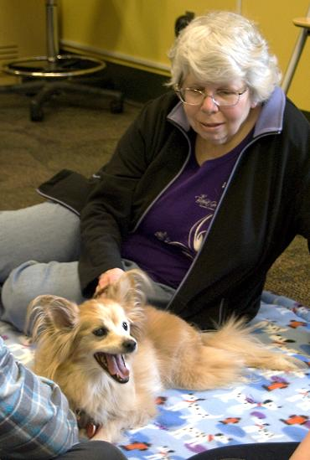
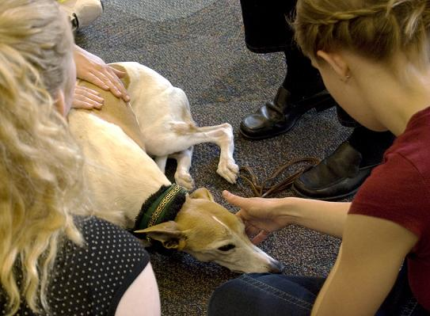
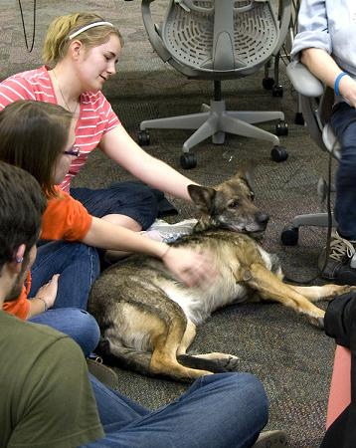
Welcome Waggers are a hit!
Photos by Laura Wilson, OSUL&P staff

Slide 16
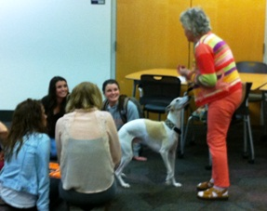
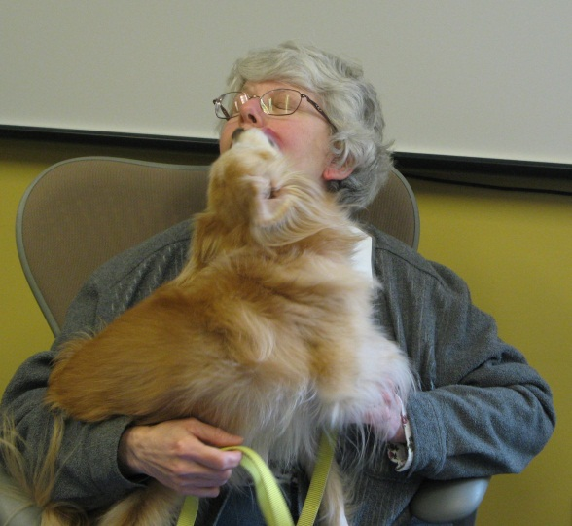
Everyone had a great time
Students …
… staff …
… dogs and handlers, too

Slide 17
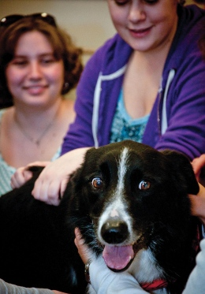
The media got involved
Photos by Hannah Gustin of the BAROMETER staff
Local paper (Gazette-Times)
Student newspaper (Barometer)
OSU news magazine (Life@OSU)

Slide 18
Survey results
375 surveys received
Most just wanted to visit with a dog
100% reported they felt better for coming!
(Many with multiple exclamation points and smiley faces !!! ☺ ☺ ☺ ☺ )
Many commented “I really miss my dog!”
Everyone said it was a good service for the library to offer

Slide 19
Yes! We’re coming back!
Welcome Waggers will return
to the Valley Library
Dead Week of Spring Term, 2013

Slide 20
Task Force members:
Mary Braun
Lisa Greenfield
Patrick Layton
Janine Salwasser
Andrea Wirth

Slide 21
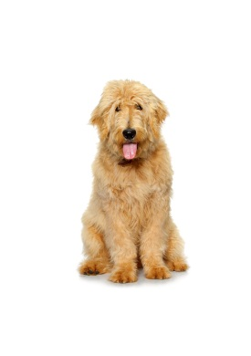
References
Corvallis Gazette Times: “Welcoming Smiles” http://www.gazettetimes.com/news/local/welcoming-smiles/article_9ccaf722-8cb8-11e2-bd35-001a4bcf887a.html
Daily Barometer: "Canines comfort students during dead week" http://www.dailybarometer.com/canines-comfort-students-during-dead-week-1.3009650#.UUH5oGWw8C4.email
Life@OSU: "Therapy Dogs Calm Stressed Students During Dead Week" http://oregonstate.edu/dept/ncs/lifeatosu/2013/therapy-dogs-calm-stressed-students-during-dead-week/
Welcome Waggers website: http://welcomewaggers.org
Valery King
Oregon State University Libraries & Press
valery.king@oregonstate.edu

