Slide 1
Abbie Anderson
Assistant Library Director
North Bend Public Library
Barratt Miller
Youth & Adult Librarian
Crook County Library
Sonja Somerville
Teen Services Librarian
Salem Public Library
April Witteveen
Community Librarian
Deschutes Public Library
Your 2014 Book Ravers!

Slide 2
Vampires
Fantasy
Horror
“Maybe it was that nearly everyone else was dead and she felt a little bit dead too, but she figured that even a vampire deserved to be saved. Maybe she ought to leave him, but she wasn't going to.”
The Coldest Girl in Coldtown—Holly Black

Slide 3
Steampunk
Supernatural
Feminine wiles
Etiquette & Espionage—Gail Carriger

Slide 4
Contemporary
Summer
Going off to college
Small towns
“In Colby, I’d found that people either wanted to stay forever (and usually did) or couldn’t wait to get gone and never look back (ditto). For me, however, it was a mix of the two, this constant push and pull. I loved it here. But I’d been in that circle and star for my entire life, and I so wanted to know what it would feel like to claim another distant spot as my own, if only for a little while.”
The Moon and More—Sarah Dessen

Slide 5
Alternate history
Conspiracies
Power of one
Maggot Moon—Sally Gardner

Slide 6
Humor
Fundamentalism
Rebellion
Identity questions
“Since I was a little boy I’ve believed God is omnipresent, but for the first time, it strikes me as odd. Is it weird that I think there’s an invisible being listening to every thought I have at every moment? … Do I think God cares whether I go see a movie?”
Rapture Practice—Aaron Hartzler

Slide 7
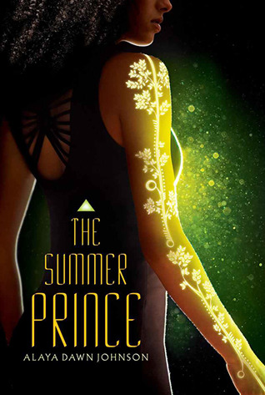
Dystopia
Science fiction
Romance
Multicultural
Art
"When we started this, I swore we would only be art. And maybe we are—good art has a habit of breaking boundaries.”
The Summer Prince—Alaya Dawn Johnson

Slide 8
Reality TV
Acting out
Family and identity
Reality Boy—A.S. King

Slide 9
Mysterious
Creepy
Dual personality
Keep guessing
Charm and Strange—Stephanie Kuehn

Slide 10
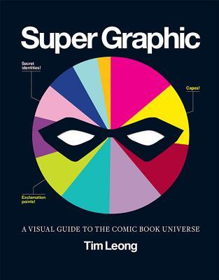
Awesome Statistical Representation
Awesome Geekiness
Awesome Visual Appeal
Super Graphic—Tim Leong

Slide 11
Gay-bashing
Fighting for change
80s AIDS crisis
Chapterless
“People like to say being gay isn’t like skin color, isn’t anything physical. They tell us we always have the option of hiding. But if that’s true, why do they always find us?”
Two Boys Kissing—David Levithan

Slide 12
Living off the grid
Drug addiction
Child abuse
Secrets
I carry the secret close as skin or breath or pee. It rode in the truck with me as surely as those three garbage bags. Even with hours and miles between us, the truth hunkers down fat as a tick tucked into the moistest, darkest place.
If You Find Me—Emily Murdoch

Slide 13
Suicidal Planning
Sexual Abuse
Teen relationships with adults
Forgive Me, Leonard Peacock—Matthew Quick

Slide 14
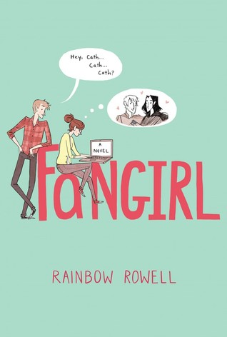
Nerds
College
Anxiety
Fanfiction
Romance
Contemporary
“To really be a nerd, she'd decided, you had to prefer fictional worlds to the real one.”
Fangirl—Rainbow Rowell

Slide 15
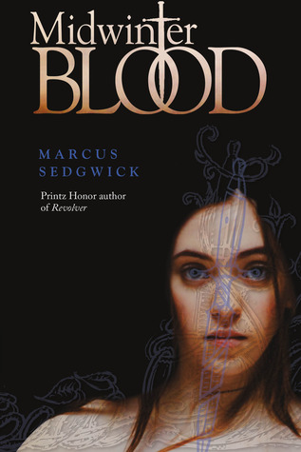
Near Future to Far Past
Multiple Lives
Fate, Love, Sacrifice
Midwinterblood—Marcus Sedgwick

Slide 16
Historical fiction
New Orleans
Criminal underworld
Out of the Easy—Ruta Sepetys

Slide 17
Adoption
Grief
Friendship saves
Counting by 7s—Holly Goldberg Sloan

Slide 18
Boarding School
Troublemakers
A year that changes everything
Winger—Andrew Smith

Slide 19
Historical
Concentration camps
Germany
World War II
"And you know, it was like I was breathing my own self back into me to say these words, to remember that these things existed—the green trees of the eastern woodland at home in North America, their strong and supple branches, sunlight through the trees."
Rose Under Fire—Elizabeth Wein

Slide 20
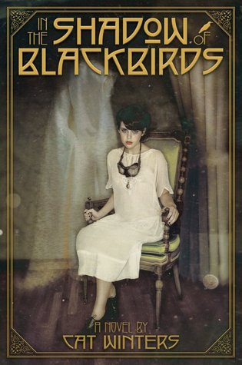
Historical fiction
Spirit Photography
Grief
Ghosts
“I had a little bird,
Its name was Enza,
I opened the window,
And in-flu-enza.”
In the Shadow of Blackbirds—Cat Winters

Slide 21
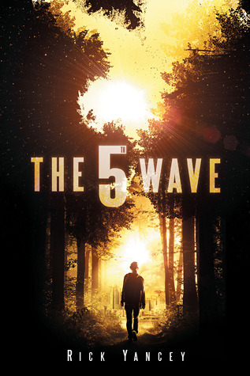
Dystopia
Alien Invasion
Strong Characters (Female and Male--All White)
The 5th Wave—Rick Yancey

Slide 22
PDFs of Book Raves brochures will be available for download:
The OYAN Website:
www.olaweb.org/oyan
NW Central:
nwcentral.org
The OYAN Blog:
oyanpeeps.wordpress.com
Thanks to everyone who nominated and voted for the 2014 Book Raves!

