Slide 1
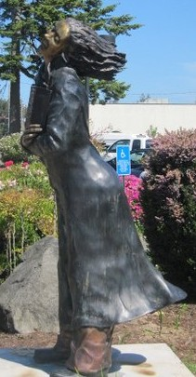
Art at the Siuslaw Public Library a Community Affair
Mary Colgan-Bennetts Siuslaw Public Library

Slide 2
Philosophy
“Attractive displays stimulate the imagination and inspire an appreciation of crafts and art. Display space within the library is free and is intended to showcase local art, spotlight local collections of general interest, and introduce library users to national and regional art.”

Slide 3
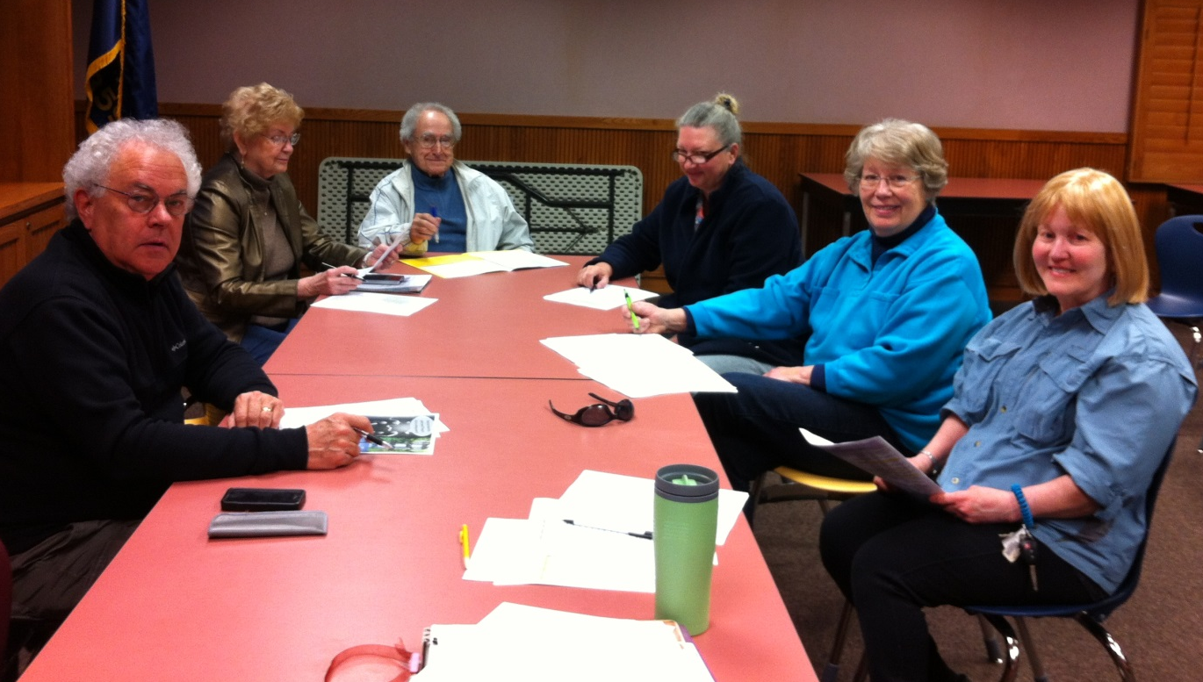
Siuslaw Public Library
Art Committee

Slide 4
Appointed for 2 years by the Library Board of Directors
Meets once a month to review new applications and schedule display set-up
Consists of up to 10 members
Recent addition of a Youth Representative
Members are active in the community and most are artists themselves

Slide 5
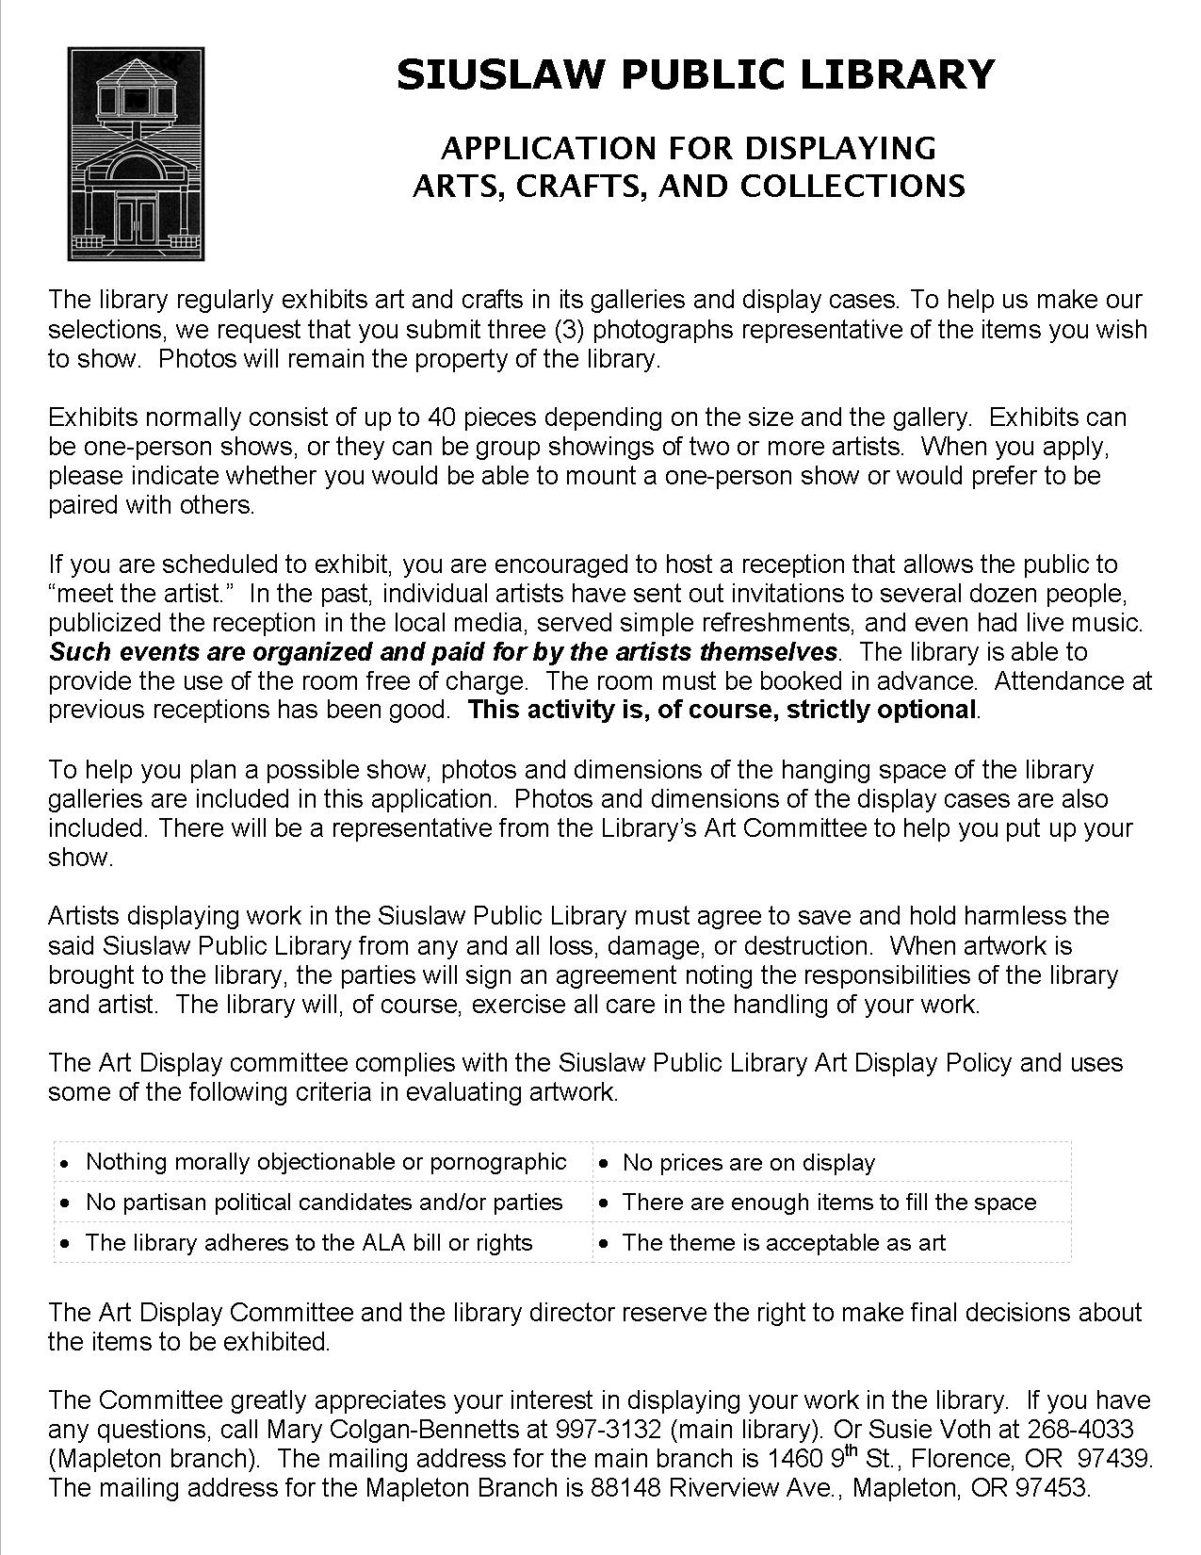
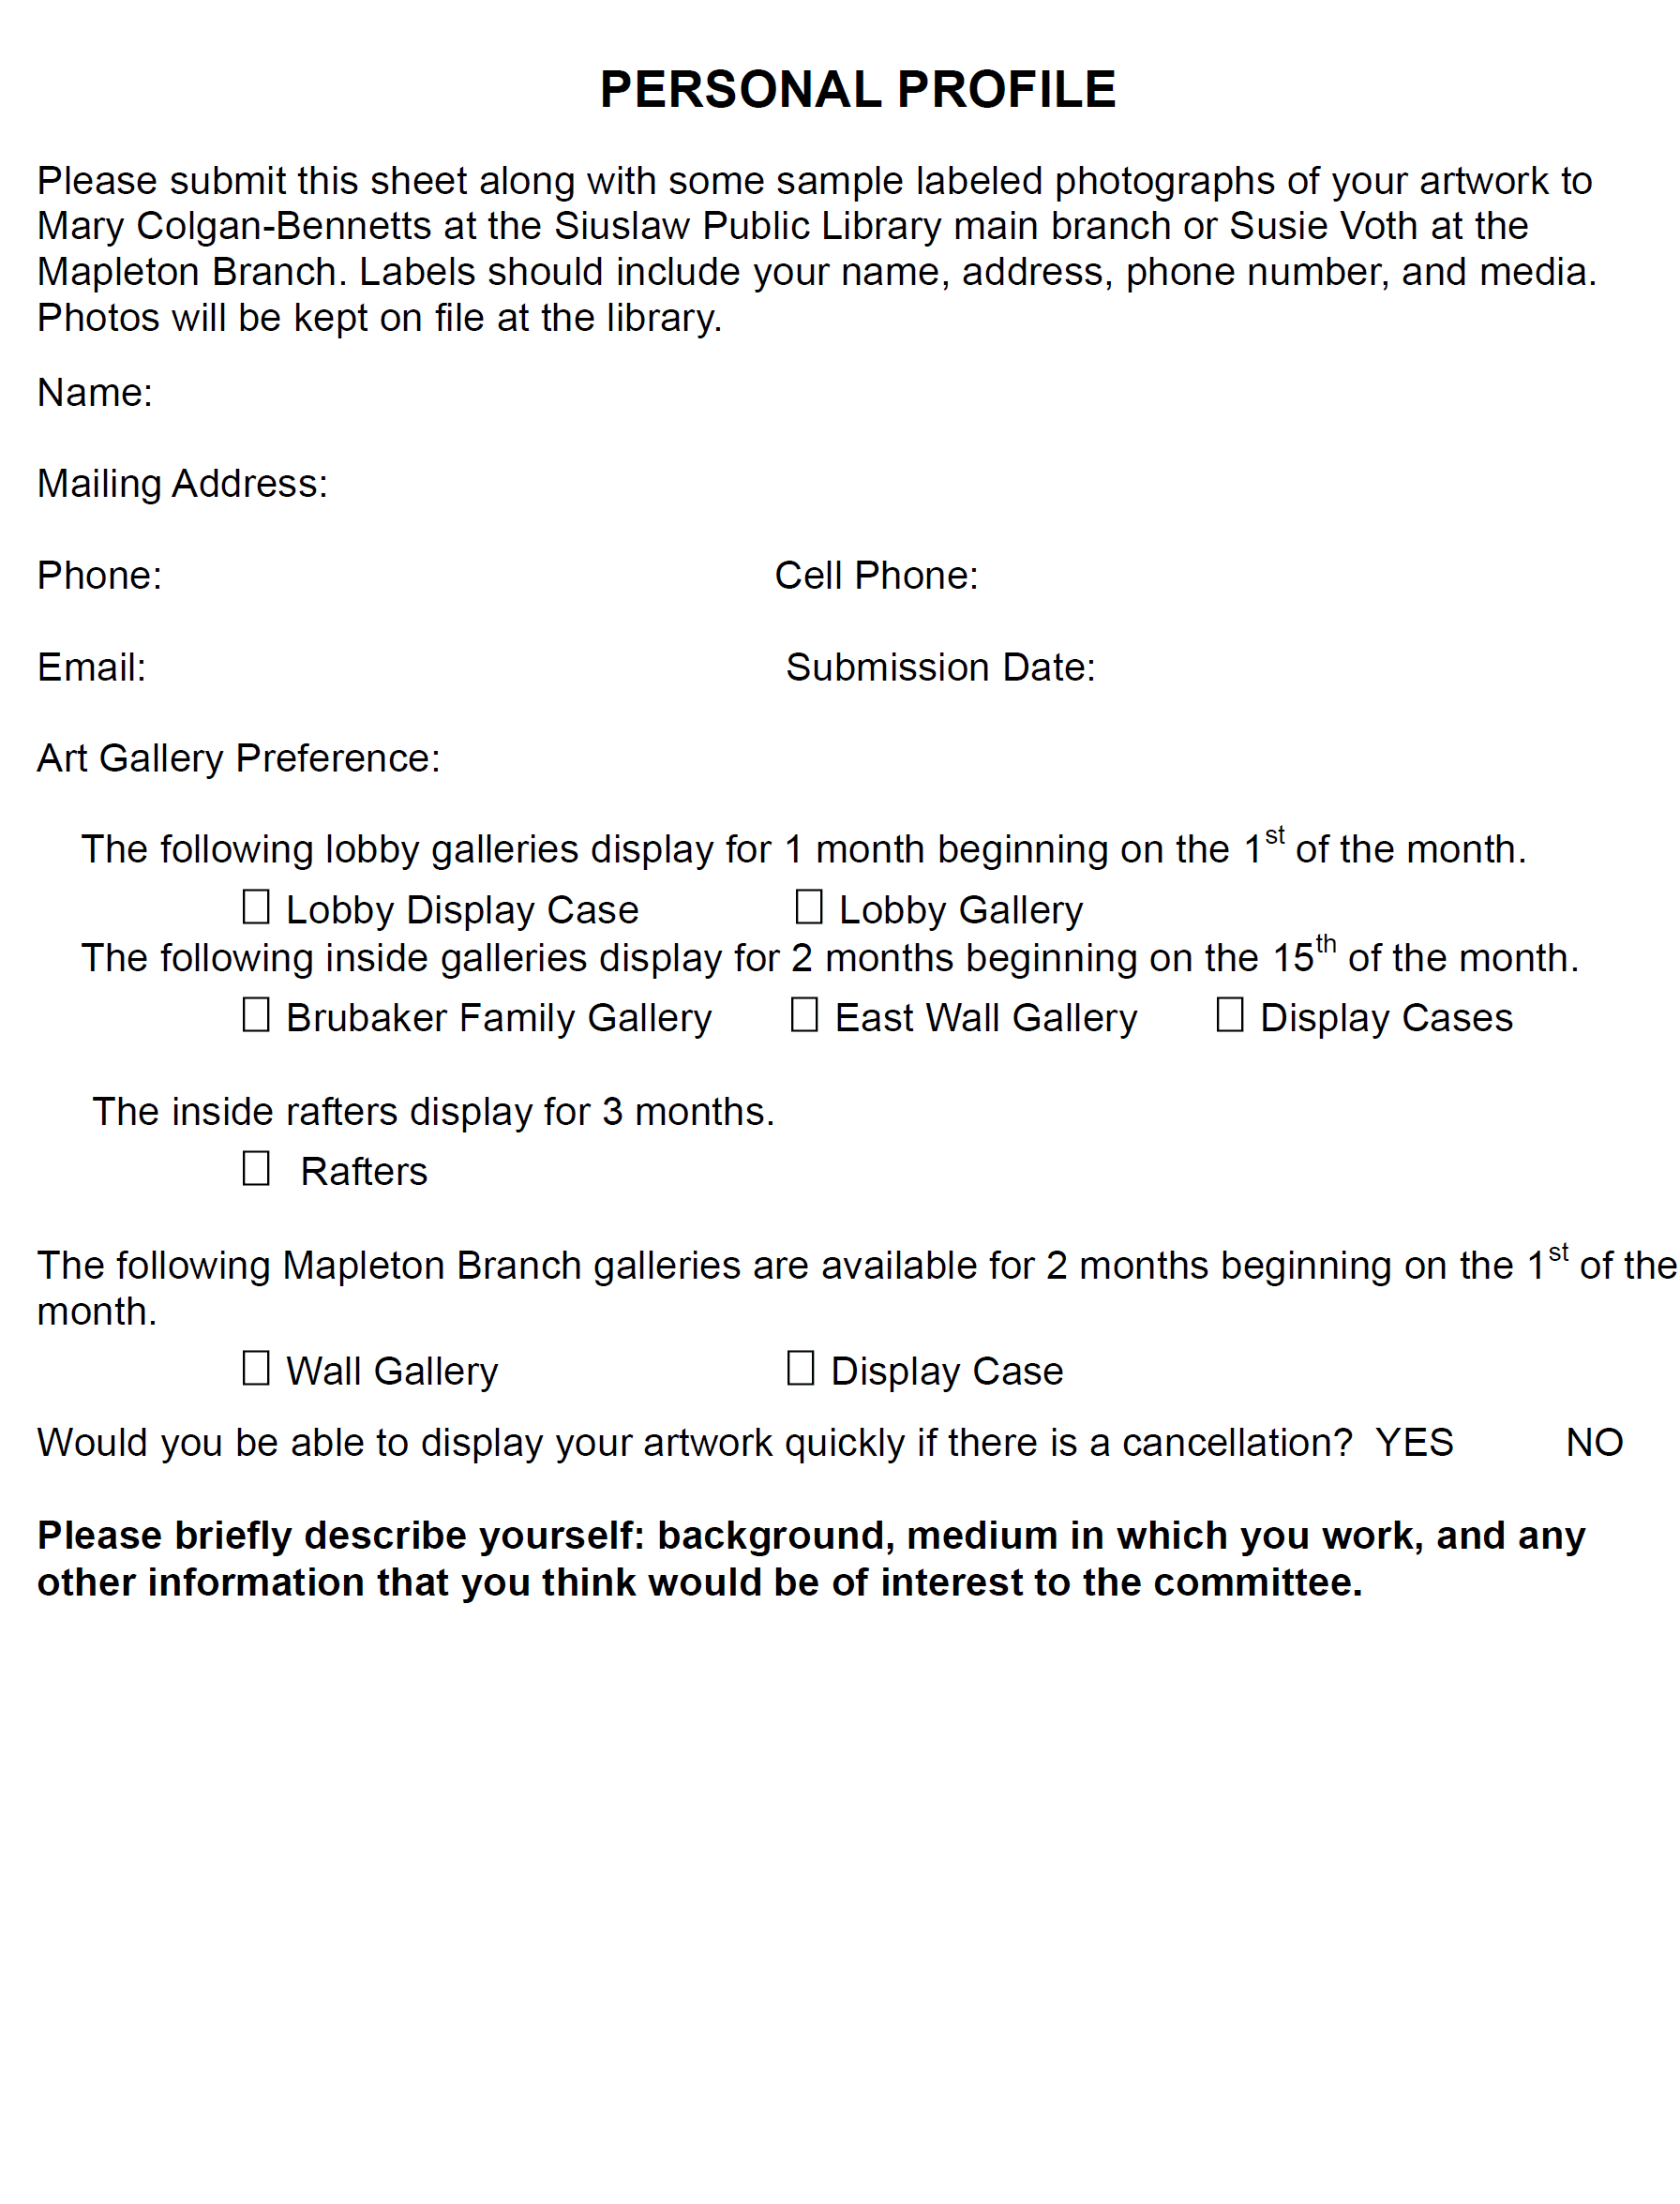

Slide 6
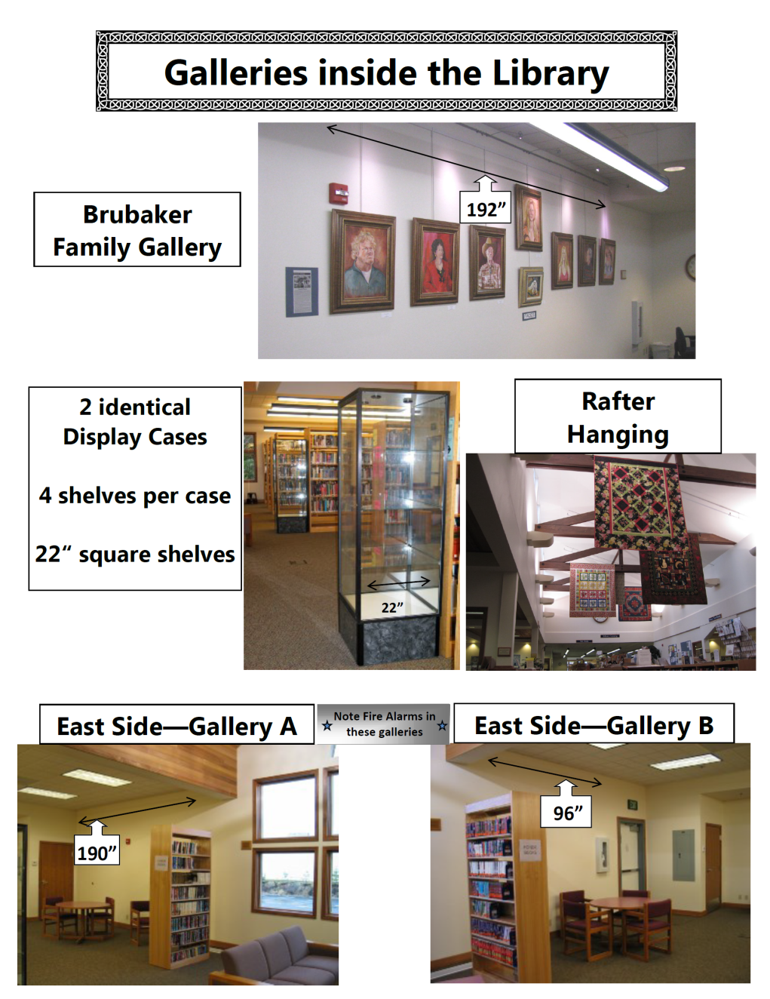

Slide 7
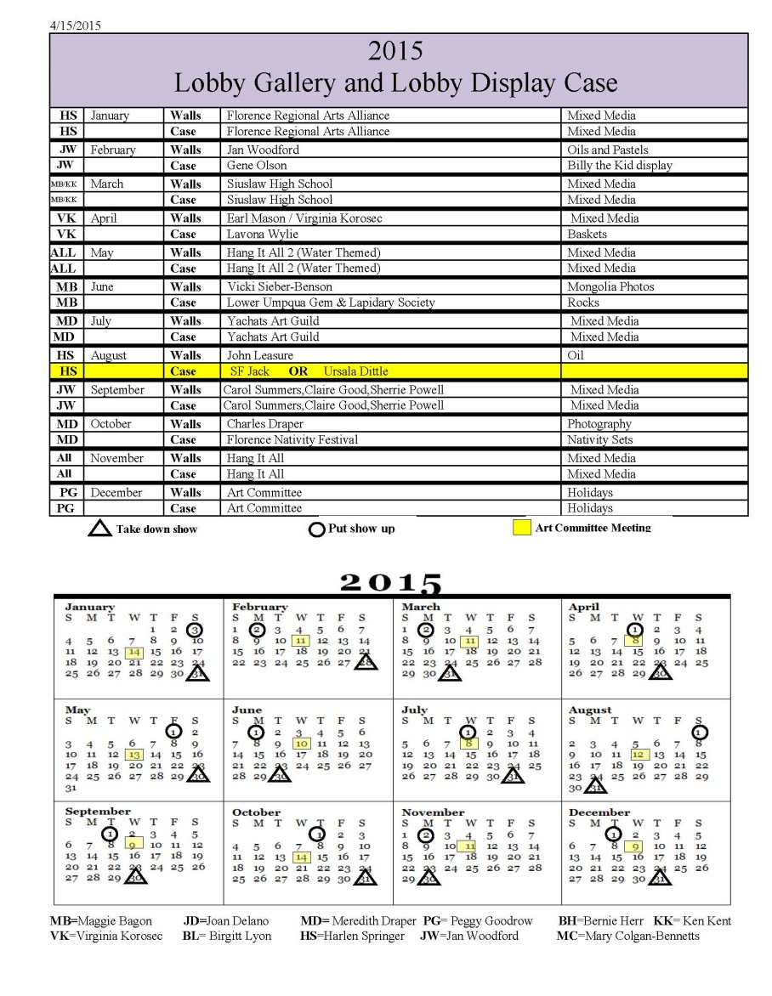
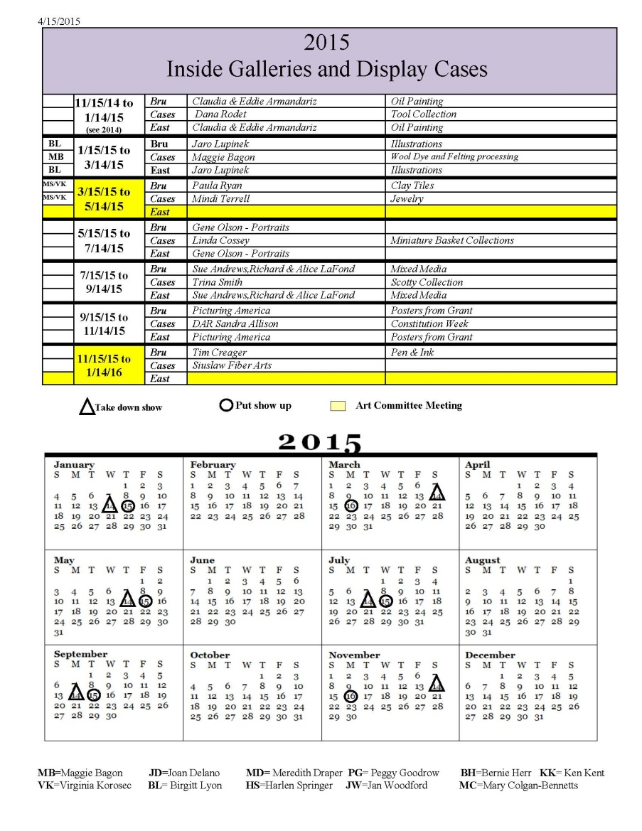
Schedule of Art Shows

Slide 8
Public Art Spaces
Lobby – Changes every month on the first.
Brubaker Wall – Changes on the 15th every other month
Inside Display Cases – Changes on the 15th every other month.
The Rafters – Changes every three months

Slide 9
Public Art Spaces
LOBBY

Slide 10
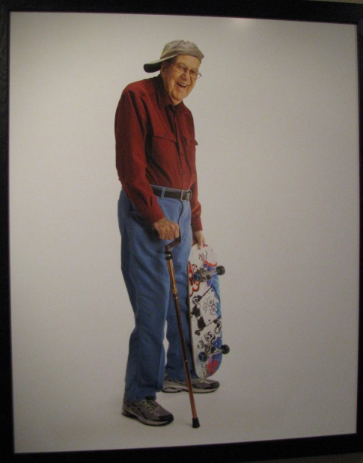
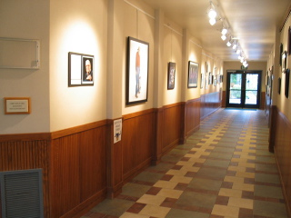
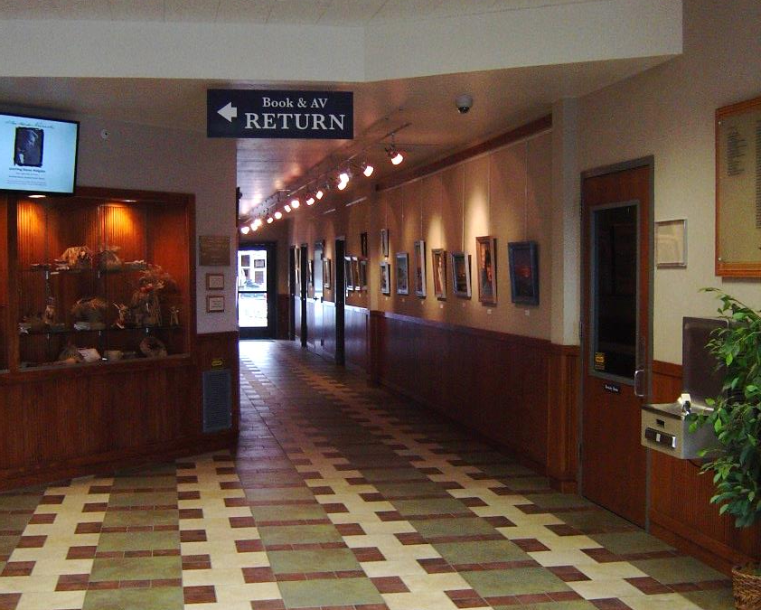
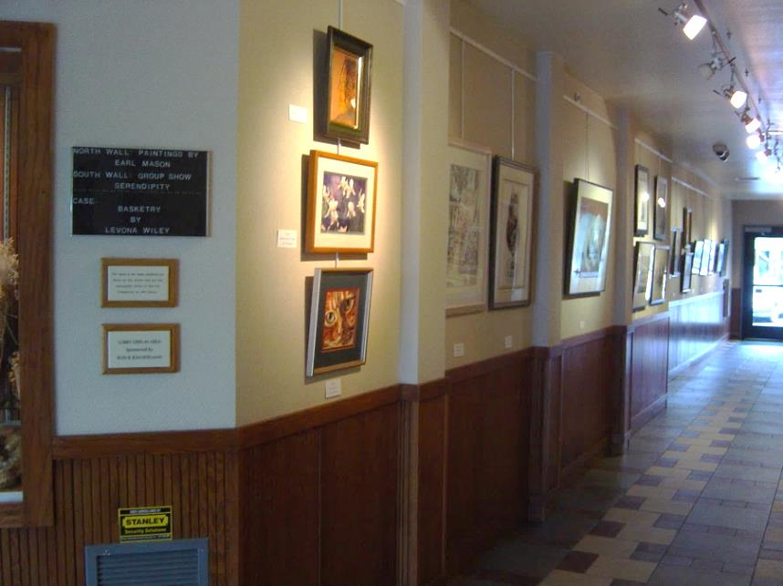
Gallery
Walls

Slide 11
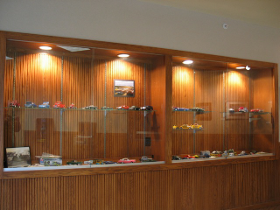
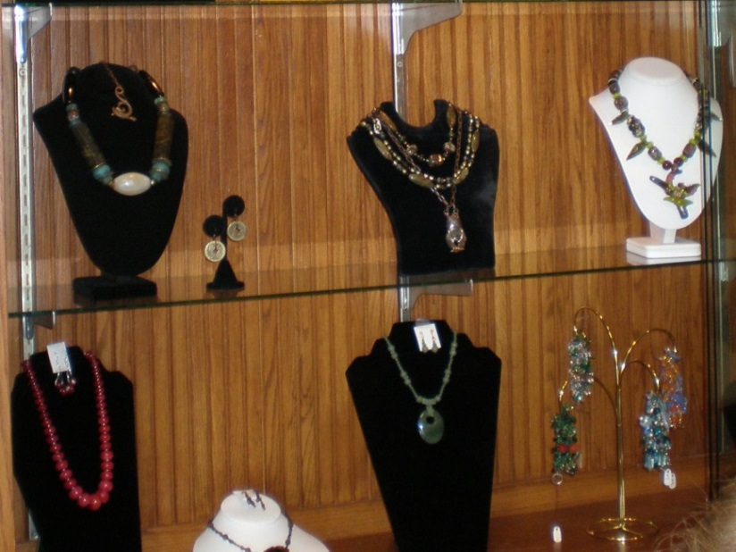
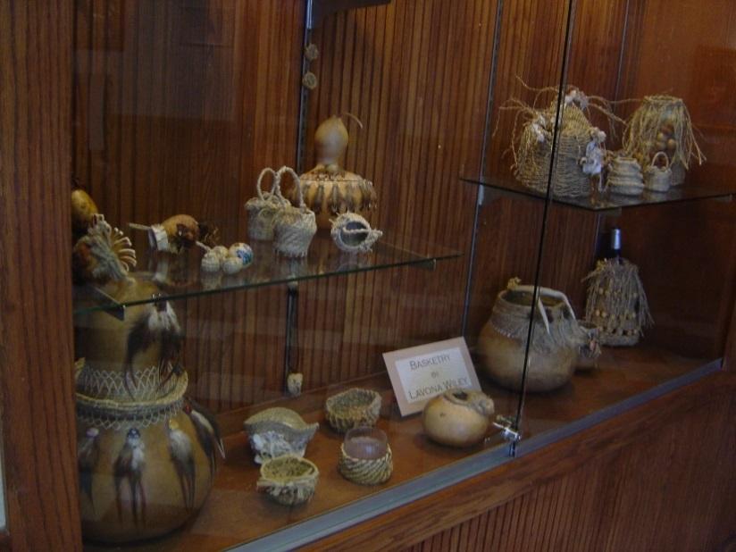
Gallery
Display
Cases

Slide 12
Public Art Spaces
Inside the Library
Brubaker
Wall

Slide 13
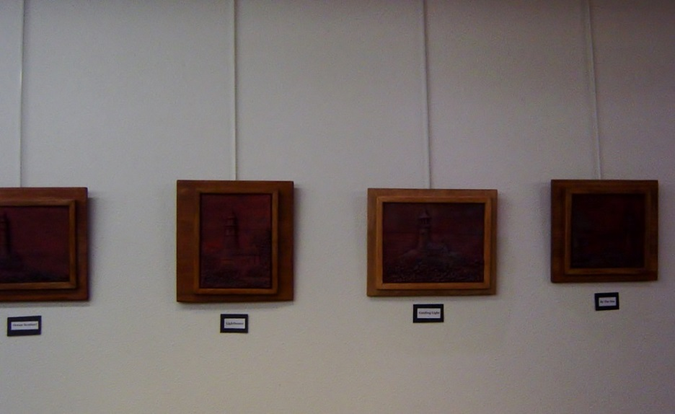
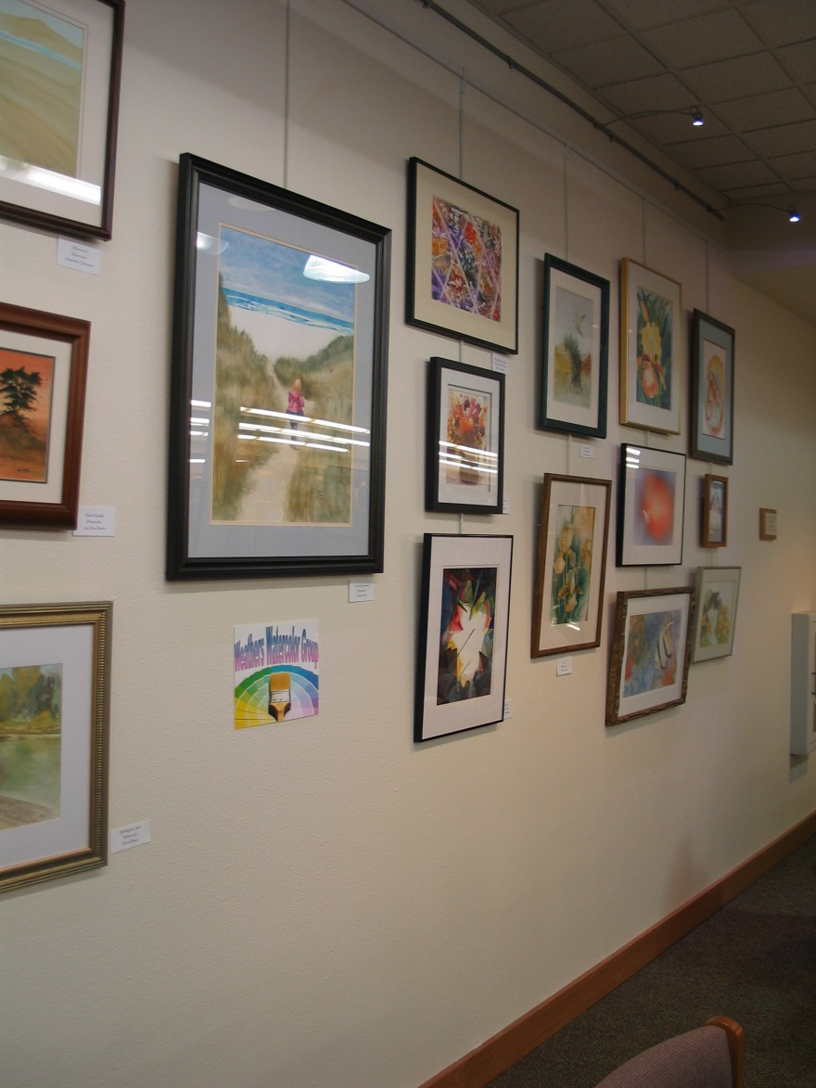
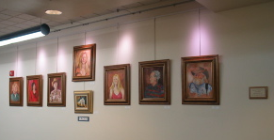

Slide 14
Public Art Spaces
Inside the Library
East
Wall

Slide 15
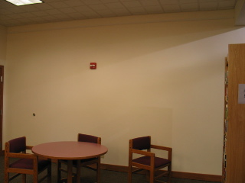
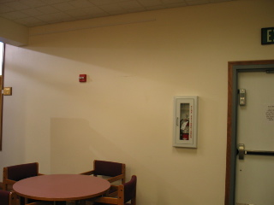

Slide 16
Public Art Spaces
Inside the Library
Display
Cases

Slide 17
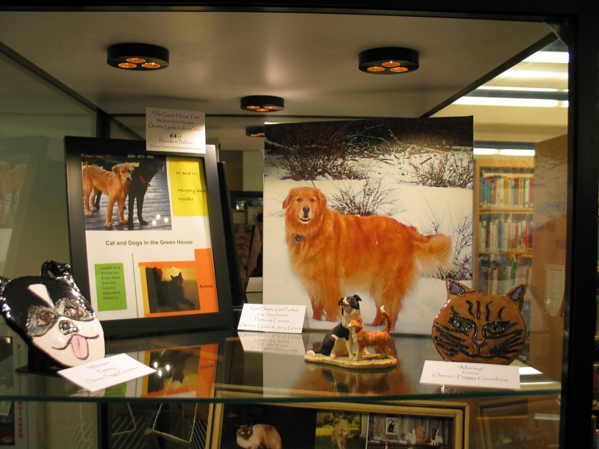
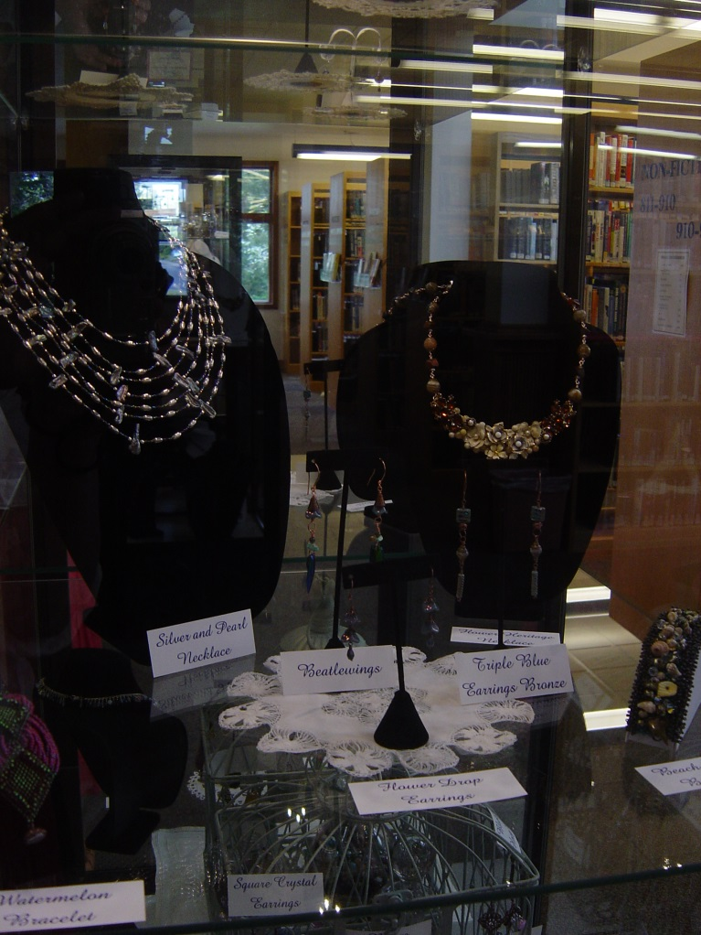
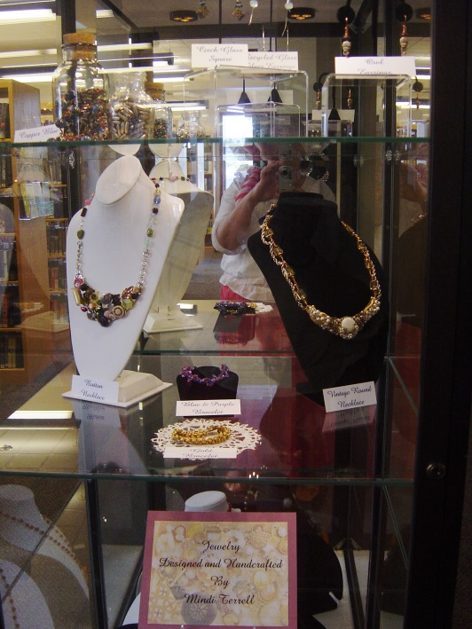

Slide 18
Public Art Spaces
Bromley
Room

Slide 19
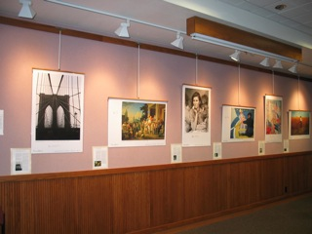
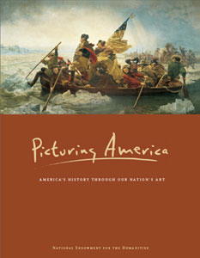
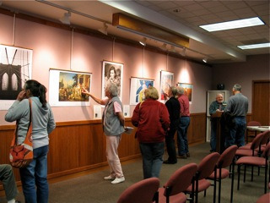

Slide 20
Public Art Spaces
Mapleton Branch Library
Walls and Display Case

Slide 21
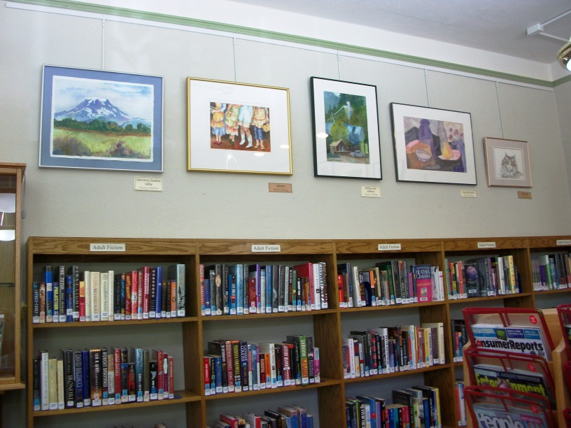
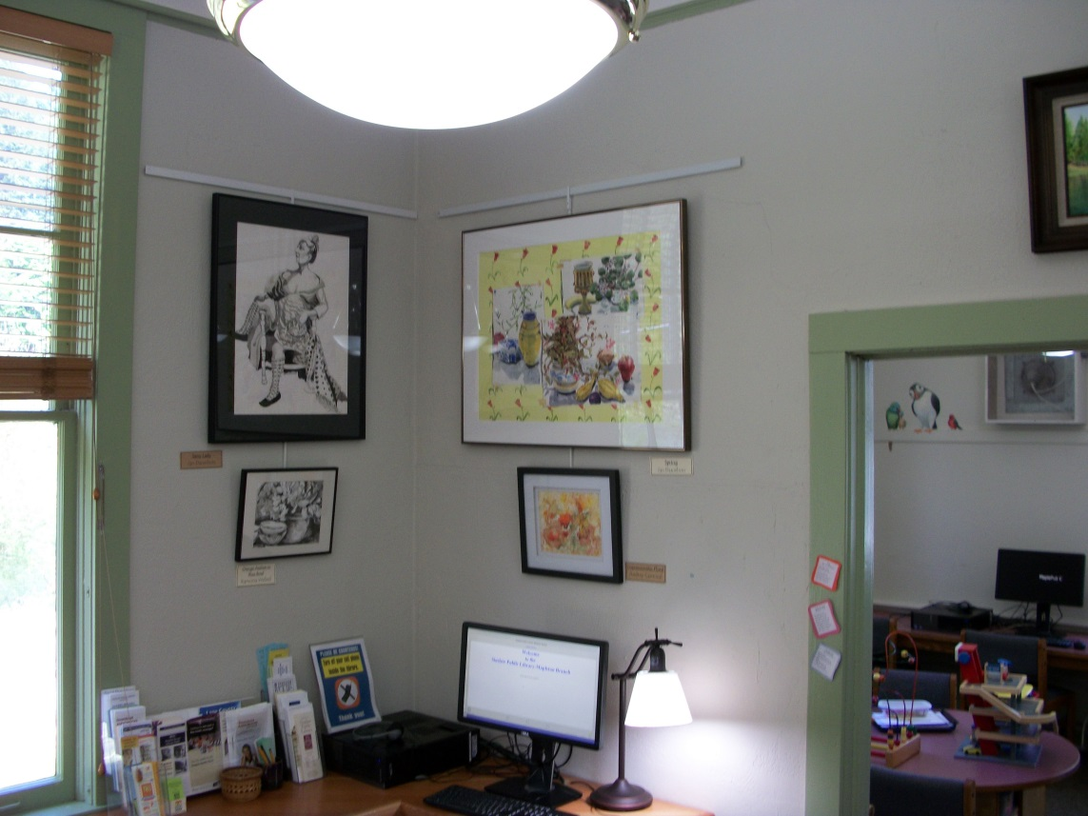
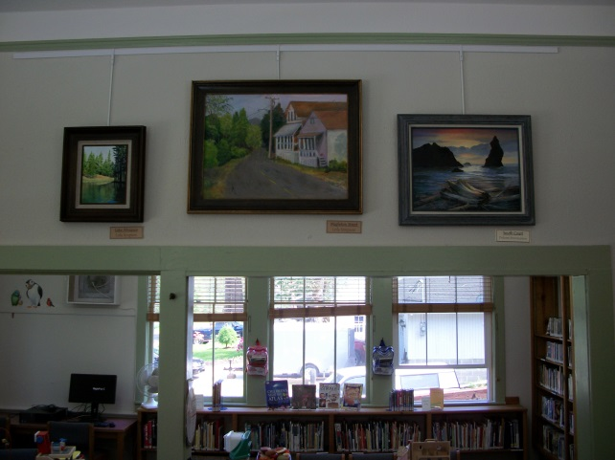

Slide 22
My Art Committee Bucket List
Public Art Spaces
Inside the Library
The Rafters!!

Slide 23
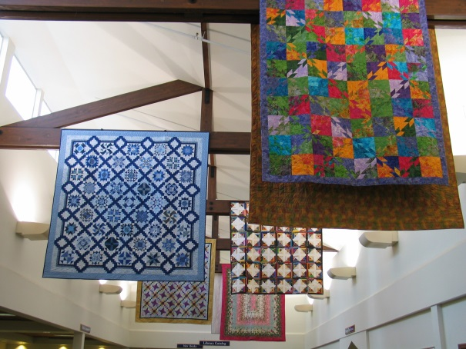
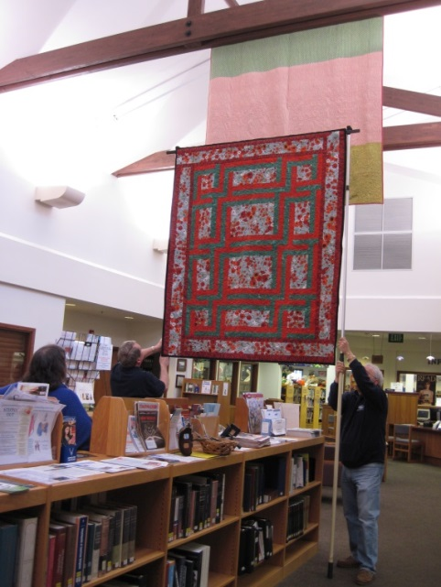
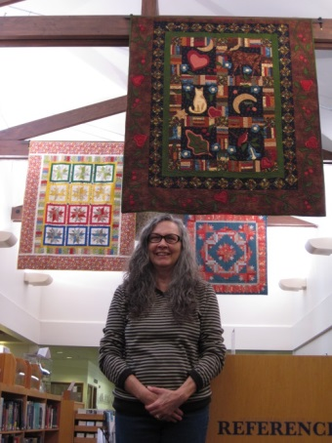
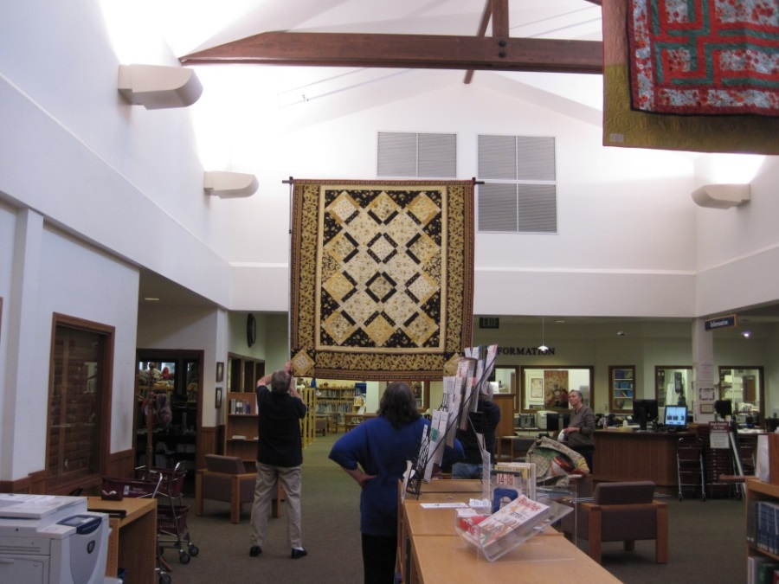

Slide 24

My Art Committee Bucket List!!!

Slide 25
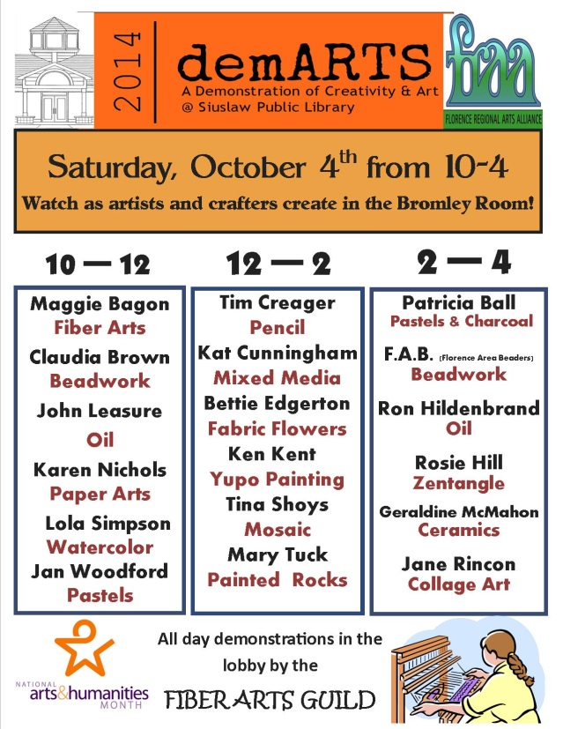

Slide 26
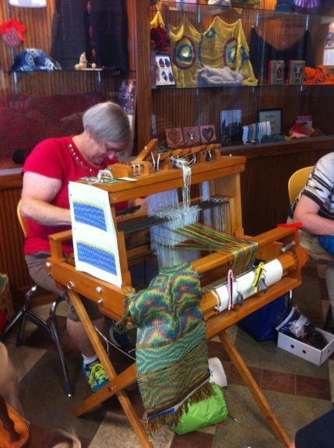
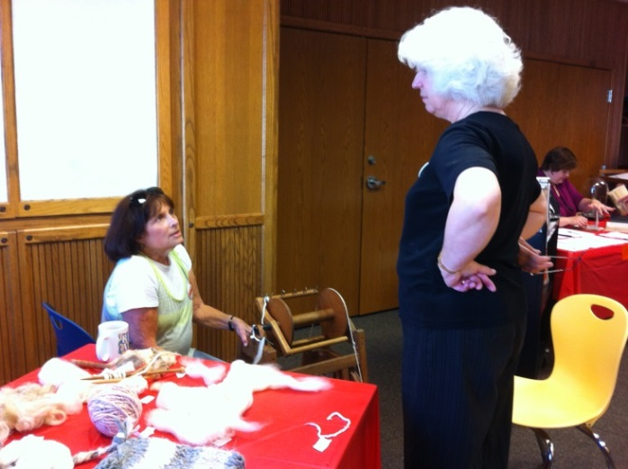
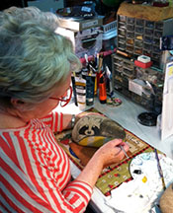
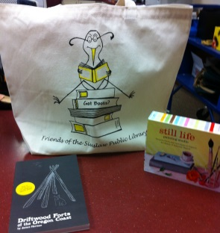
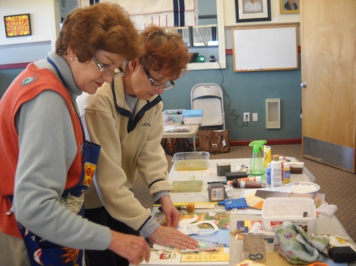
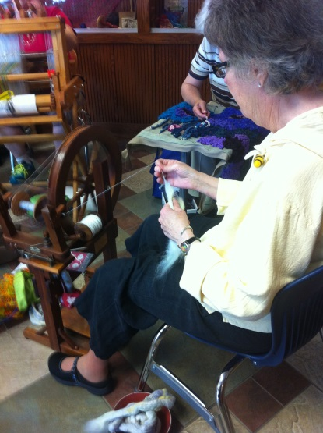
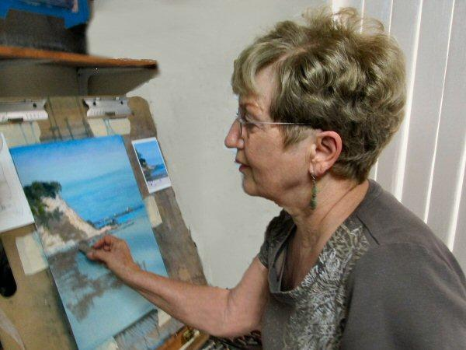
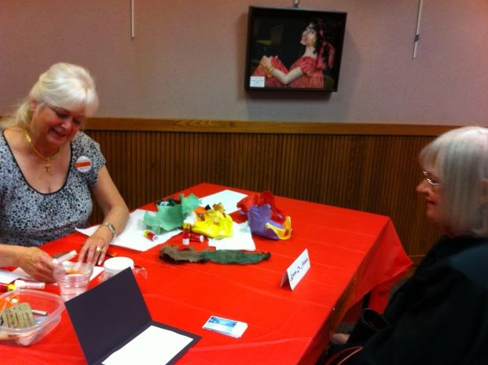

Slide 27

My Art Committee Bucket List!!!
P
P

Slide 28
Hang It All
Began in 1992
Everyone’s an artist!
Anyone can exhibit one piece of art or craft for the month of November
Public voting for “People’s Choice” award
Committee votes for “Best of Show” award

Slide 29
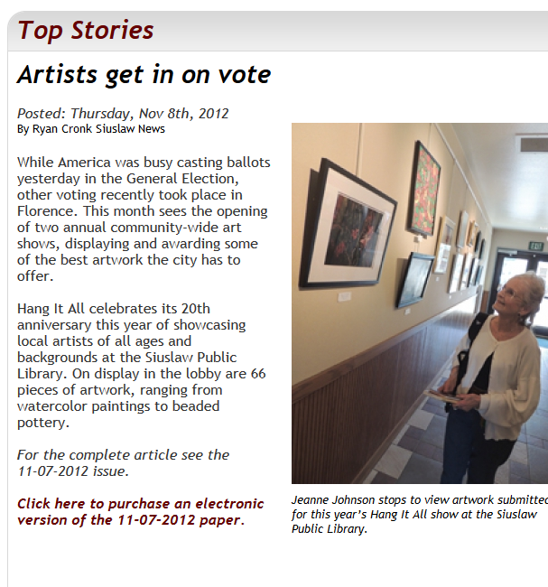
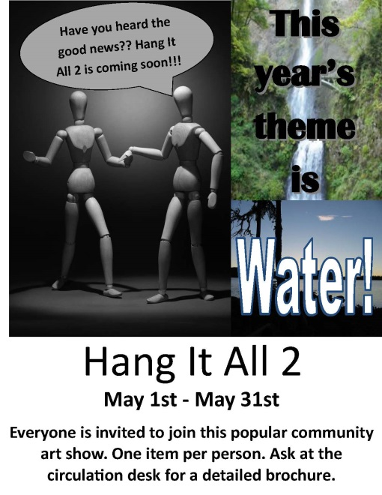
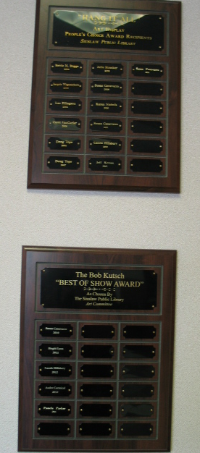
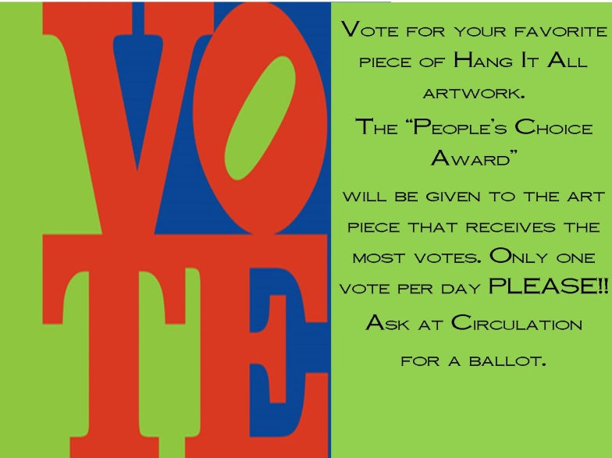

Slide 30
Hang It All-2
The popularity of Hang It All has led a themed art show
Our first year was “Landscape”
This year it’s all about – “Water”
May is the month for themes!

Slide 31
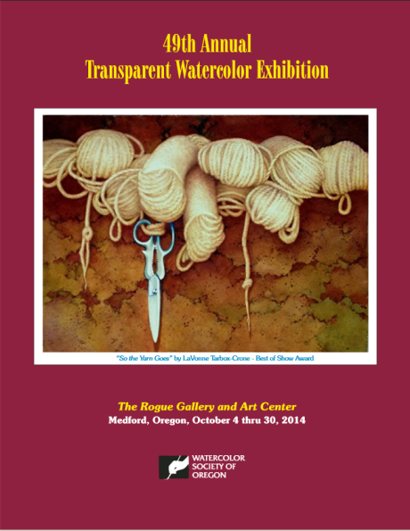
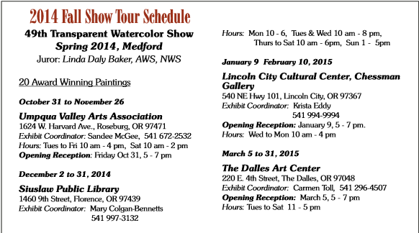
Watercolor Society of Oregon

Slide 32

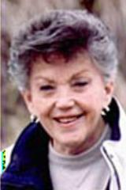





It Never Hurts To Ask!

Slide 33
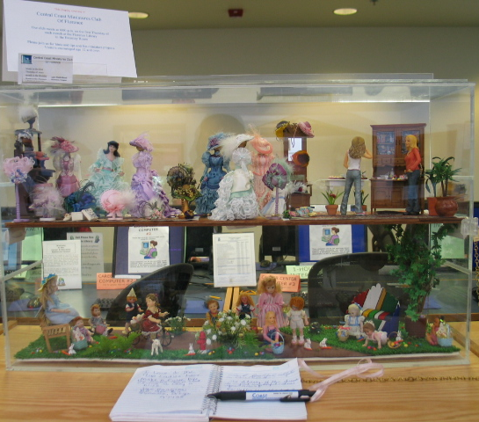
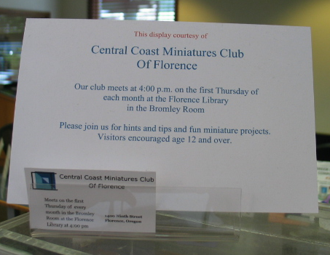
Library Displays

Slide 34





Blind Date
with a
BOOK!!!

Slide 35


Slide 36
Art at the Library –
So What . . .

Slide 37
Connection to the Community
Alliances with local arts and community organizations
Exposure to ideas and art that may not be easily available to our patrons
In a Florence survey in 2004 – viewing art displays and attending library programs was voted as the #2 activity bringing people to the library

Slide 38



Slide 39
“It's not what you look at that matters, it's what you see.” Henry David Thoreau

Slide 40
Thank you
Mary Colgan-Bennetts
Siuslaw Public Library
bennetts@siuslawlibrary.org

