Slide 1
BIBFRAME Testing at the University of Washington
Adam Schiff (Principal Cataloger)
with acknowledgment and thanks to
Charlene Chou (Head, Technical Services, East Asia Library)
for many of these slides

Slide 2
Goals
Train cataloging staff to be familiar with linked data, BibFrame, RDF/XML, Schema.org, etc.
Review converted data to check for missing data, wrongly converted data, data with incorrect FRBR attribution, etc. If any problems, report to LC.
Review converted data for different types of resources, e.g. monographs, serials, e-resources, AV, maps, scores, still images, realia, etc.
Review converted data for non-roman scripts, e.g. CJK, Cyrillic, Hebrew, Arabic, etc.

Slide 3
A series of training sessions
BIBFRAME training session 1-3 + exercises
BIBFRAME classes: diagram & hierarchical listing
BIBFRAME in RDF/XML
Schema.org and RDA/RDF

Slide 4
Core Group
Head of Cataloging and Metadata Services - Chair and Instructor (Joseph Kiegel)
Principal Cataloger
Metadata Librarian
Catalogers of special formats (e.g., serials, media, maps, music, archival resources)
International Studies catalogers
Head of Technical Services of East Asia Library
Slavic Cataloger

Slide 5
Testing procedures, observations and outcome
Testers select examples/records for the Chair to convert
Testers verify the converted data against its original MARC record, and have group discussions.
The Chair reports anything wrong to LC for correction.
The Chair maintains a BIBFRAME Issues List with ticket numbers on GitHub (e.g. #XX) as well as an indication whether each issue was submitted by UW or another institution.

Slide 6
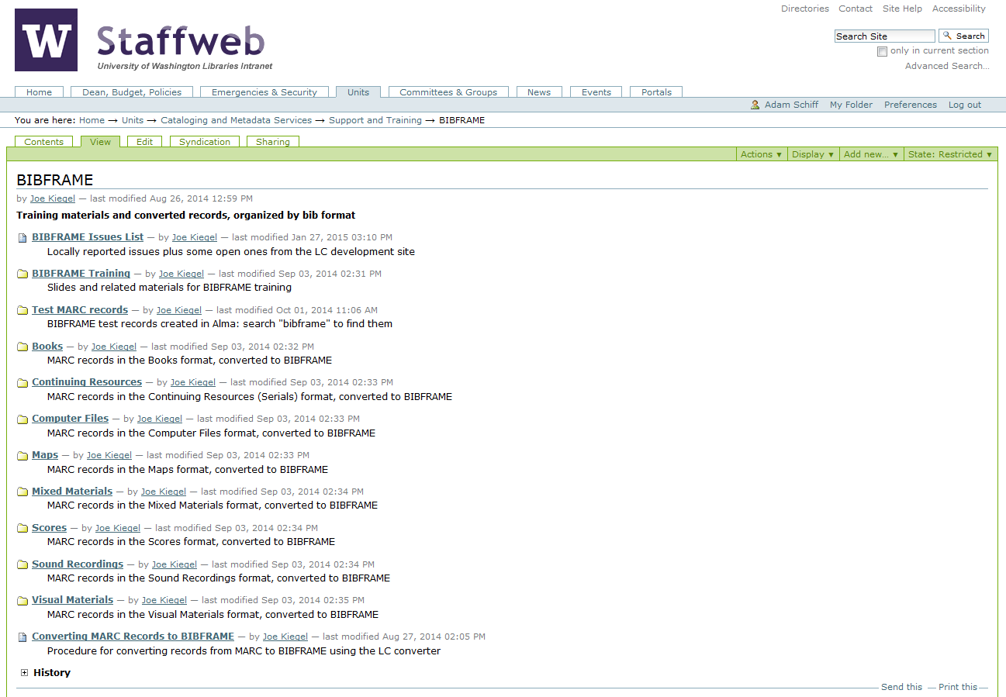

Slide 7
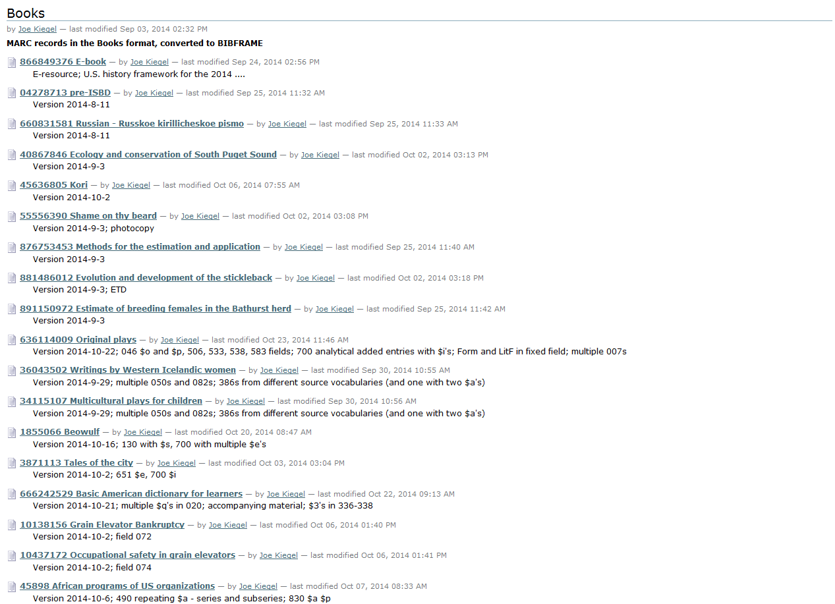

Slide 8
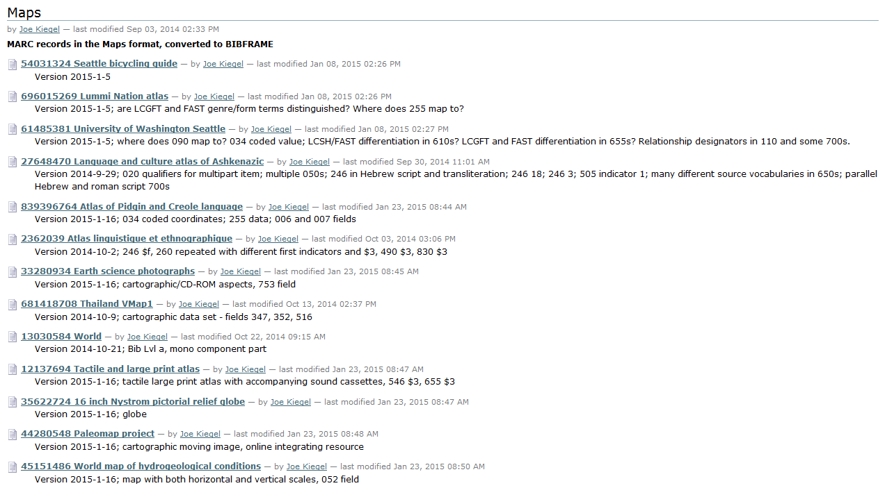

Slide 9
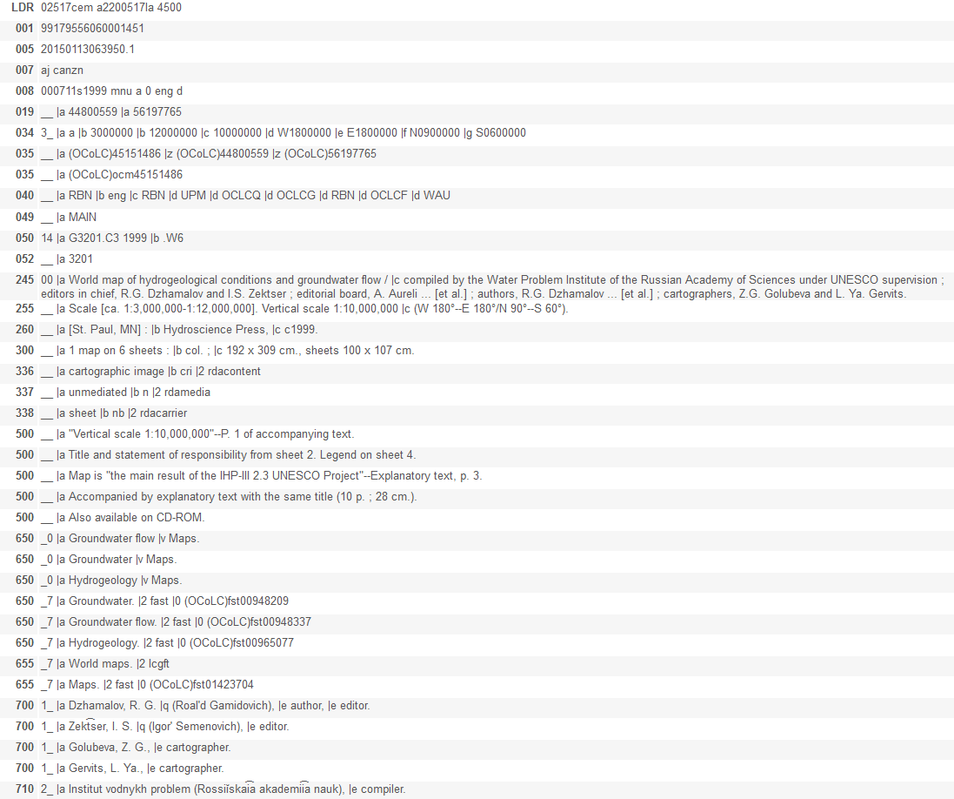
Source record from Alma

Slide 10
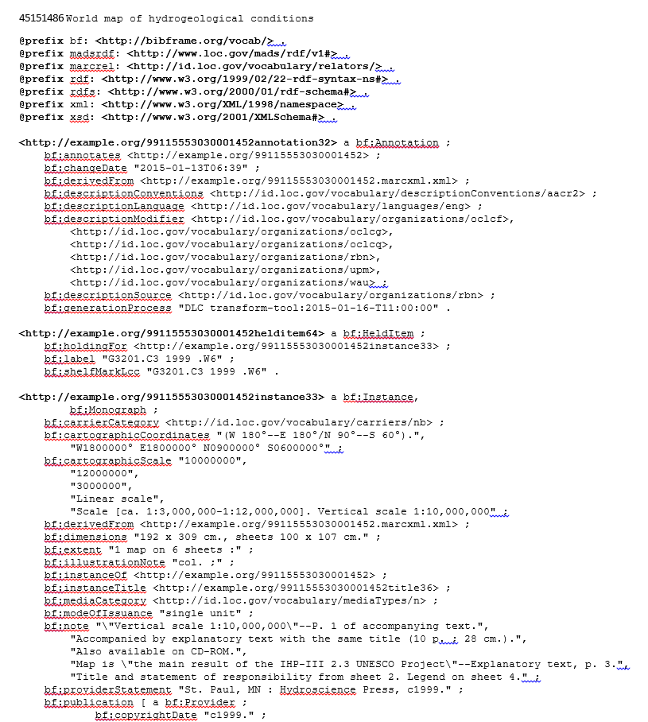
(Beginning of) Record Converted to BIBFRAME
Notes:
The entire converted record is 5 pages long. This is the first page and a little of the second.

Slide 11
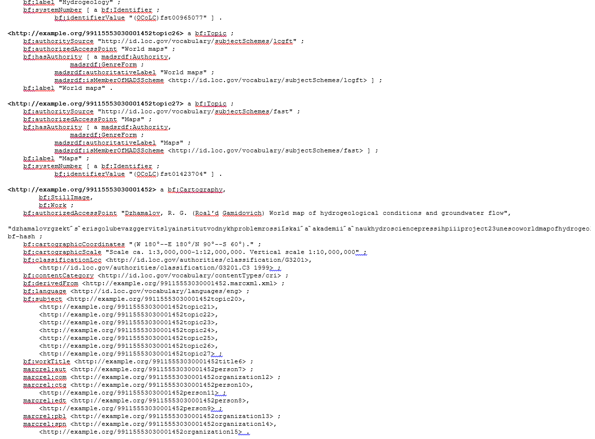
(End of) Record Converted to BIBFRAME
Notes:
This is the end of the fourth page and the fifth page of the converted record.

Slide 12
UW BIBFRAME Issues List: some examples (94 comments from UW)
#83 (other): allow the text of nonstandard relationship designators to be recorded
#105 (other): what is the plan for holdings records?
#129 (UW): workTitle as 245 or 130 a, n, p together as one string; when from 240 include $l and probably other subfields
#144 (UW): Computer Files assigned wrong content-type subclasses
#148 (UW): serialFirstIssue and serialLastIssue need more generic names
#151 (UW): new algorithm for authorizedAccessPoint in Work
#203 (UW): 6XX ind 4 and 7 should not generate madsrdf:isMemberOfMADSScheme
#206 (UW): bf:contentCategory should be in Work not Instance
#207 (UW): bf:formDesignation should have domain Instance or Work, not Title
#222 (UW): bf:cartographicScale is Work information; 034 subfields need labels
#230 (UW): bf:titleType needs a thesaurus, and changes to the range
#233 (UW): The agent link for an original work (from a translation) has only $a
#235 (UW): bf:label in held item link should have both call numbers when there are two
#238 (UW): $3 needs a big-picture solution
#110 (UW): 042 is not converted
#151 (UW): 046 $o, $p are not converted
#220 (UW): 300 $e should be in a separate instance of bf:extent and not combined with $a
#186 (UW): 490 should be mapped to a new property (e.g. bf:seriesStatement) in Instance
#138 (UW): 520 subfield b is not converted
#166 (UW): 546 in languageNote should be in Work not Instance
#214 (UW): 651 is not converted
#123 (UW): example of 700 $i omitted for related work
#126 (UW): 730s generate related works without an indication of language
#168 (UW): 740 2nd indicator 2 should have relationship hasPart; 740 should not have AAP or creator
#229 (UW): 775 may be instance, not work; should not include imprint in access point
#152 (UW): 776 $i is not converted
Notes:
This is a representative sample of the kinds of comments that we submitted to LC. Some of these issues we consider very significant, e.g., the fact that 490 series statements don’t have a property in BIBFRAME and that subjects tagged 651 were not converted.

Slide 13
BIBFRAME Issues List: related to CJK examples
#119 (UW): 020 $q should be retained for display purposes
#174 (UW): 041 gives non-existent language code for Chinese (zho)
#228 (UW): bf:titleStatement should have parallel non-roman script
#224 (UW): 245 $b non-roman should be in bf:subtitle
#201 (UW): bf:responsibilityStatement should retain brackets; not converted for Maps format; only parallel script not romanization; not converted for book w/o non-roman script
#225 (UW): 246 $i with non-roman not given
#178 (UW): 250 repeatability--$3 and parallel scripts
#227 (UW): providerStatement should have parallel non-roman script
#226 (UW): 264 $b with non-roman and multiple publishers duplicates non-roman script
#177 (UW): 505 lacks parallel non-roman script
#116 (UW): 650, @en assigned to foreign language terms
#232 (UW): 650 _7 $2 sk should have non-roman strings with dashes and w/o $2
#157 (UW): 8XX authorized access point should be from 8XX not 490
#162 (UW): language qualifiers on parallel script fields seem wrong (multiple examples)
#173 (UW): non-roman fields missing for related Work entry, e.g. original of translation
#179 (UW): multiparts should not generate multiple instances, for each vol.
#231 (UW): Non-roman forms are not authorized access points
Notes:
Examples of issues related to non-roman fields.

Slide 14
Next Steps
Research and experiments at UW

Slide 15
RDA/RDF vs. BIBFRAME
RDA/RDF is stronger in
BIBFRAME is stronger in
Series
Notes
Technical details of a resource
Inverse properties (e.g. animator/animatorOf)
Administrative metadata
Identifiers
Subject headings
Holdings information
Support for both transcription (literals) and URIs

Slide 16
As Linked Data
Both RDA/RDF and BIBFRAME are able to represent library information as linked data
Both schemas originate in libraries and must be adopted widely by non-library users in order to succeed

Slide 17
As Carriers
RDA/RDF lacks a number of features of a carrier, e.g. administrative metadata
BIBFRAME is currently not capable of carrying constrained RDA without significant loss in information about classes
While neither fully works today, a combination of the two is more successful

Slide 18
Example of a Hybrid (BIBFRAME and RDA/RDF) Title
http://faculty.washington.edu/kiegel/ld/RDA-RDF-BIBFRAME-hybrid.pdf

Slide 19
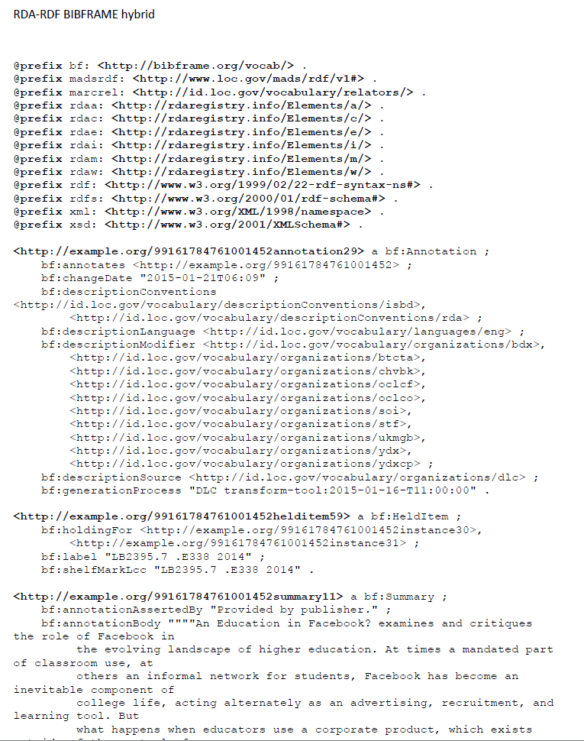
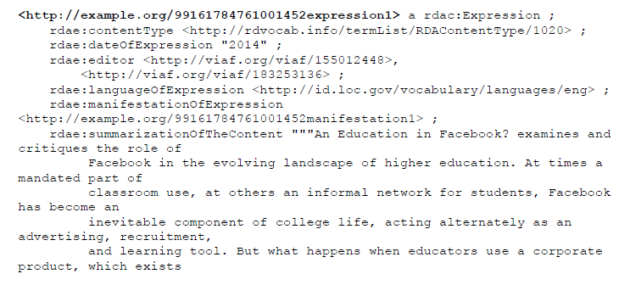
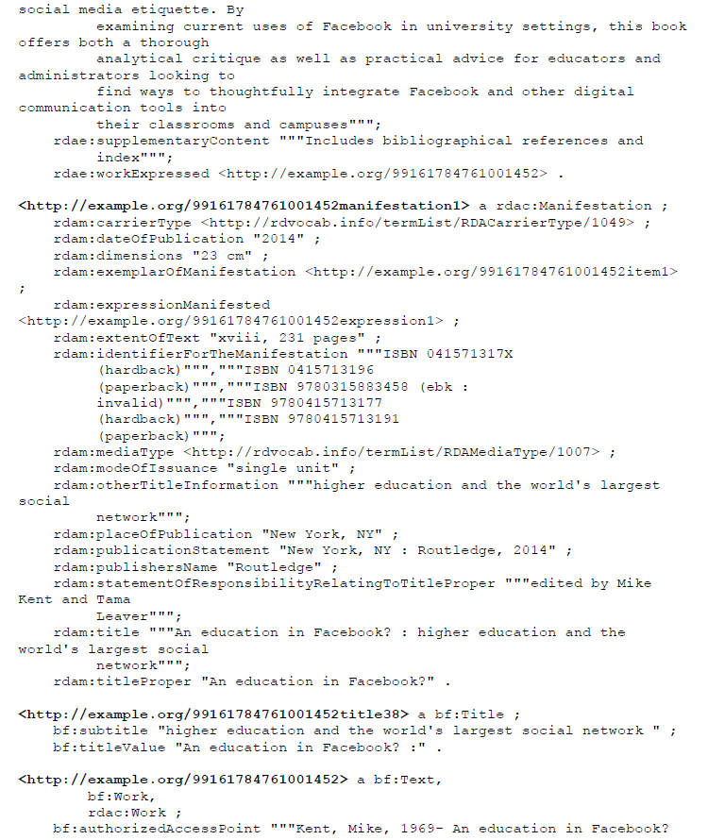
Notes:
ANIMATED SLIDE – click to bring in overlaying parts of the RDA-RDF BIBFRAME hybrid record.

