Slide 1
A VERY SHORT INTRODUCTION TO BIBFRAME
Oregon Library Association
April 16, 2015
Kelley McGrath
University of Oregon

Slide 2
What is BIBFRAME?
Bibliographic Framework Initiative
Intended to…
Replace MARC
Make library data more shareable
Integrate better with the Web
Uses linked data principles

Slide 3
Why Replace MARC?
Tools to work with data
Sharing data
Web visibility
Image from https://openclipart.org/detail/81565/corythosaurus-shadow-mo-02r
http://pages.uoregon.edu/kelleym/KM_MWpresentation.pdf

Slide 4
Why Now?
RDA
U.S. National Libraries RDA testers:
Can’t realize the potential of RDA in MARC

Slide 5
What is Linked Data?
“A set of best practices for publishing and connecting structured data on the Web”
Enables links between data
(like the Web does for documents)
http://linkeddata.org/faq

Slide 6
What is Linked Data?
Tim Berners-Lee’s rules for linked data
http://www.w3.org/DesignIssues/LinkedData.html

Slide 7
What is Linked Data?
Use URIs as names for things
Things (identifiers) NOT strings
http://id.loc.gov/authorities/names/n78095332
NOT
Shakespeare, William, 1564-1616

Slide 8
What is Linked Data?
Use HTTP URIs so that people can look up those names
Works with a Web browser; no special tools needed for look-up
http://id.loc.gov/authorities/names/n78095332
NOT
n78095332

Slide 9
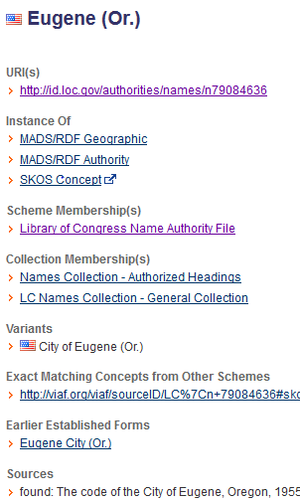
What is Linked Data?
HTML
Use HTTP URIs so that people can look up those names
http://id.loc.gov/authorities/names/n79084636
RDF

Slide 10
What is Linked Data?
When someone looks up a URI, provide useful information, using the standards (RDF*, SPARQL)
RDF = Resource Description Framework
Data model based on triples (more later)
SPARQL = query language for RDF
(something like Z39.50 for MARC)

Slide 11
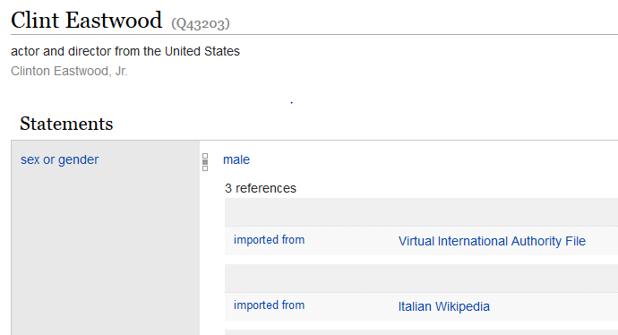
What is Linked Data?
When someone looks up a URI, provide useful information, using the standards (RDF*, SPARQL)

Slide 12
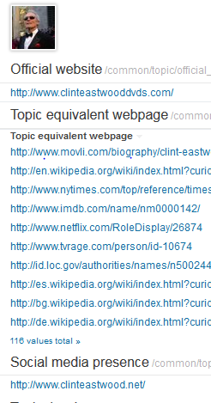
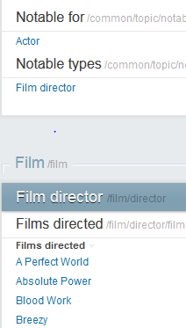
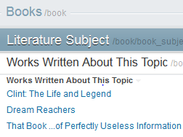
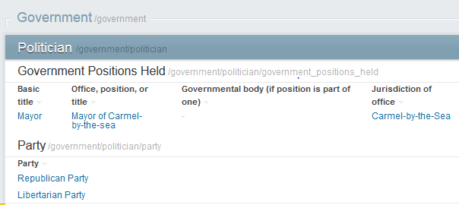
What is Linked Data?
Include links to other URIs so that they can discover more things.

Slide 13
What is Linked Data?
Include links to other URIs so that they can discover more things.
Library data can be linked to by others

Slide 14
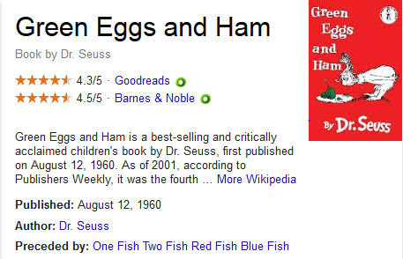
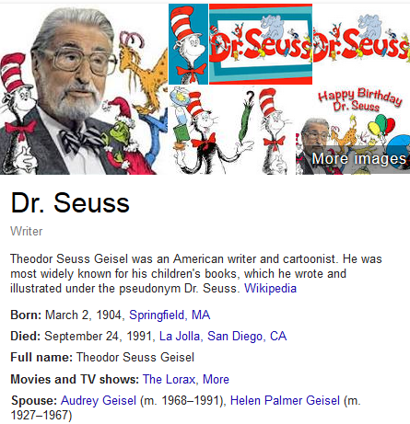
What is Linked Data?
Include links to other URIs so that they can discover more things.
Library catalogs can pull in contextual information from others

Slide 15
What is RDF?
Resource Description Framework
Metadata data model

Slide 16
What is RDF?
Statements or Triples
(not records)
Subject — Predicate — Object
Hamlet was created by William Shakespeare

Slide 17
What is RDF?
Subject and predicate must be URIs
Object can be a URI or a string (free text)
http://www.wikidata.org/wiki/Q41567
http://purl.org/dc/terms/creator
http://id.loc.gov/authorities/names/n78095332

Slide 18
What is RDF?
has creator
William Shakespeare
Hamlet
has birthplace
has birth year
United Kingdom
Stratford-Upon-
Avon
1564
is in country

Slide 19
What does BIBFRAME look like?

Slide 20
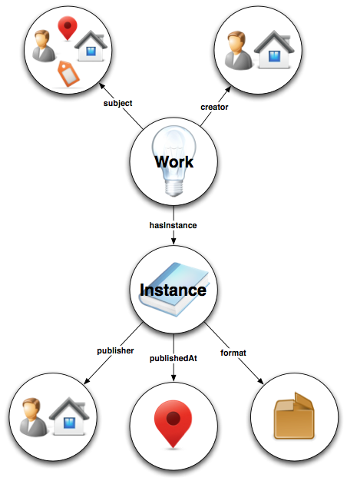
Four Main Classes
Creative Work
Instance
Authority
Annotation

Slide 21
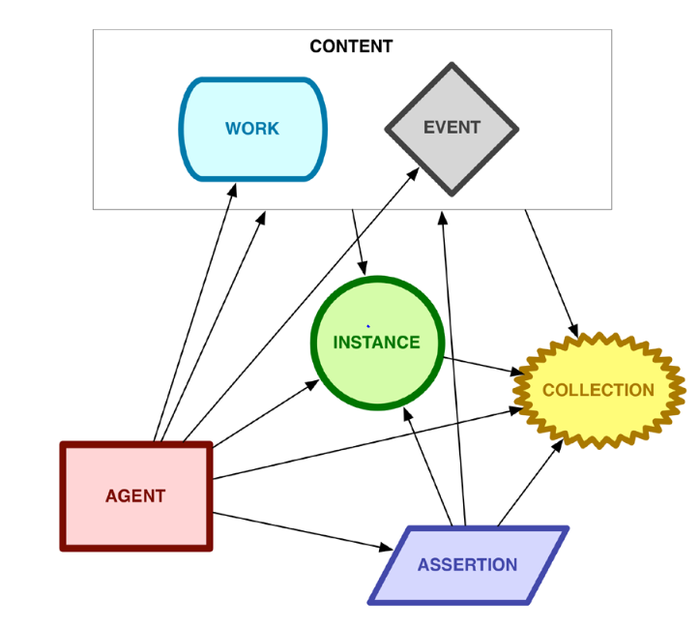
Event?
http://www.loc.gov/bibframe/pdf/bibframe-avmodelingstudy-may15-2014.pdf

Slide 22
Properties for Any Resource
LABEL / PROPERTY | DESCRIPTION | EXPECTED VALUES
Authorized access point authorizedAccessPoint | Controlled string form of a resource label intended to help uniquely identify it, such as a unique title or a unique name plus title | Literal
Identifier identifier | Number or code that uniquely identifies an entity | Identifier
Label label | Text string expressing the property value | Literal
Related resource relatedTo | Any relationship between work or instance resources | URL

Slide 23
Subproperties of Identifier
LABEL / PROPERTY | DESCRIPTION | USED WITH
ISSN-L issnL | International Standard Serial Number that links together various media versions of a continuing resource | Work
ISBN isbn | International Standard Book Number | Instance
Local identifier local | Identifier established locally and not a standard number

Slide 24
Ex. of Properties Used with Identifier
LABEL / PROPERTY | DESCRIPTION | EXPECTED VALUES
Identifier assigner identifierAssigner | Entity that assigned the identifier. | Literal
Identifier qualifier identifierQualifier | Qualifying information associated with the identifier, e.g. specifying its applicability. | Literal
Identifier scheme identifierScheme | Scheme within which the identifier is unique | URL
IdentifierValue identifierValue | Value of the identifier | Literal

Slide 25
FRBR and BIBFRAME Models
FRBR
BIBFRAME
Work
Expression
Manifestation
Work
Instance
Annotation
Item
Slide from BIBFRAME and Moving Away From MARC, Thomas Meehan, 2/20/15

Slide 26
Work & Instance
Resource reflecting a conceptual essence of the cataloging resource
= FRBR work + expression
Resource reflecting an individual, material embodiment of the Work
= FRBR manifestation

Slide 27
Instance Example
<http://bibframe.org/resources/NYG142912/77216072instance52> a bf:Instance,
bf:Monograph ;
bf:creditsNote "Cinematography, Carlo Montuori ..." ;
bf:dimensions "4 3/4 in. +" ;
bf:extent "2 videodiscs (89 min.) : 1 guide (75 p. : ill. ; 19 cm.)" ;
bf:illustrationNote "sd., b&w ;" ;
bf:instanceOf <http://bibframe.org/resources/NYG142912/772160> ;
bf:isbn10 <http://isbn.example.org/193412124X> ;
**bf = <http://bibframe.org/vocab/>
** a = <http://www.w3.org/1999/02/22-rdf-syntax-ns#type>

Slide 28
Work Example
<http://bibframe.org/resources/NYG142912/772160> a bf:MovingImage,
bf:Work ;
bf:authorizedAccessPoint "Zavattini, Cesare, 1902-1989. Ladri di biciclette (Motion picture)" ;
bf:awardNote "Winner, Best Foreign Film, 1950 Golden Globes ..." ;
bf:contentsNote "Disc 2, the supplements. Zavattini …" ;
bf:contributor <http://bibframe.org/resources/NYG142912/772160organization16> ;
**bf = <http://bibframe.org/vocab/>
** a = <http://www.w3.org/1999/02/22-rdf-syntax-ns#type>

Slide 29
Authority
Resource reflecting key authority concepts that have defined relationships reflected in the Work and Instance. Example of Authority Resources include People, Places, Topics, Organizations, etc.

Slide 30
Authority
Direct Approach
ex:wk666 a bf:Work ;
bf:creator <http://id.loc.gov/authorities/names/n79049248> .
Indirect Approach, or, The lightweight abstraction layer
ex:wk666 a bf:Work ;
bf:creator ex:person99 .
ex:person99 a bf:Person ;
authorizedAccessPoint "Waugh, Evelyn,1903-1966." ;
hasAuthority <http://id.loc.gov/authorities/names/n79049248>
Slide from BIBFRAME and Moving Away From MARC, Thomas Meehan, 2/20/15

Slide 31
Authority Example
<http://bibframe.org/resources/NYG142912/772160organization16> a bf:Organization ;
bf:authorizedAccessPoint "Produzioni De Sica S.A." ;
bf:hasAuthority <http://id.loc.gov/authorities/names/no2009152607> ;
bf:label "Produzioni De Sica S.A." .
**bf = <http://bibframe.org/vocab/>
** a = <http://www.w3.org/1999/02/22-rdf-syntax-ns#type>

Slide 32
Annotation
Resource that enhances our knowledge about another resource when knowing, minimally, 'who' is doing the annotating is important. Library Holdings, Cover Art and Reviews are examples types.

Slide 33
Annotation Example (External info.)
<http://bibframe.org/resources/NYG142912/772160annotation53> a bf:Annotation ;
bf:annotates <http://bibframe.org/resources/NYG1429123439/77216072> ;
bf:annotationBody <http://www.mrqe.com/lookup?bicycle+thief> ;
bf:copyNote "Connect to reviews of this title online" .
**bf = <http://bibframe.org/vocab/>
** a = <http://www.w3.org/1999/02/22-rdf-syntax-ns#type>

Slide 34
Annotation Example (Item)
<http://bibframe.org/resources/NYG1429123439/77216072helditem92> a bf:HeldItem ;
bf:holdingFor <http://bibframe.org/resources/NYG1429123439/77216072instance52> ;
bf:label "PN1995.9.M45 B539354 2007" ;
bf:shelfMarkLcc "PN1995.9.M45 B539354 2007" .
**bf = <http://bibframe.org/vocab/>
** a = <http://www.w3.org/1999/02/22-rdf-syntax-ns#type>

Slide 35
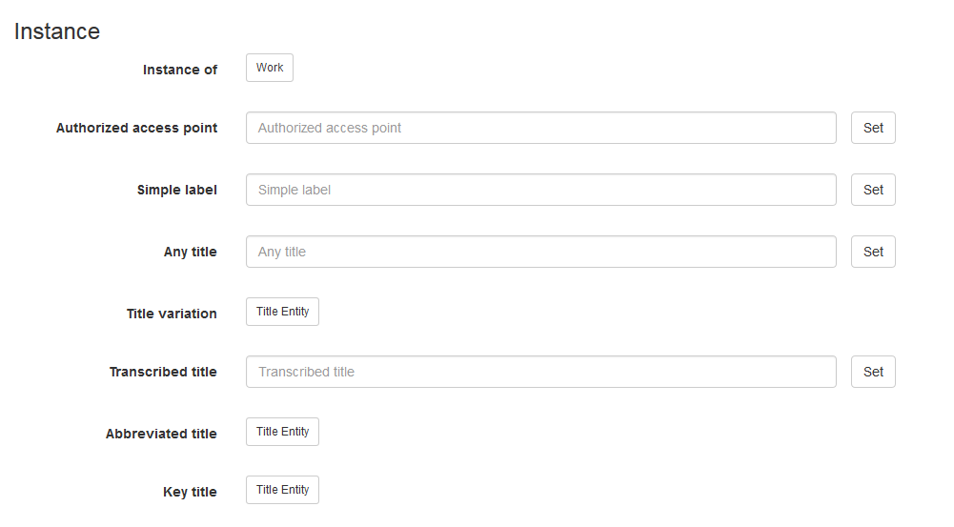
BIBFRAME Editor (LC)
http://bibframe.org/tools/editor/

Slide 36
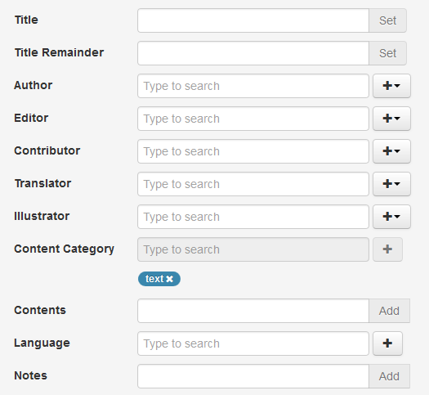
BIBFRAME SCRIBE (Zepheira)
http://editor.bibframe.zepheira.com/static/

Slide 37
Testing: Early Experimenters
Helped develop the basic vocabulary:
British Library, George Washington University, Princeton University, Deutsche National Bibliothek, National Library of Medicine, OCLC, and the Library of Congress

Slide 38
Testing: BIBFLOW (UC Davis)
Two-year IMLS grant to investigate future workflows and roadmap for transition
Store BIBFRAME triples in Kuali OLE
Is it practical to convert all of their bib data to linked data? How should we do this?
www.lib.ucdavis.edu/bibflow/

Slide 39
Testing: LibHub (Zepheira)
Publish BIBFRAME resources for MARC records from participating libraries
Create links among BIBFRAME resources and from BIBFRAME to other resources
Will this raise the visibility of library resources on the Web?
http://www.libhub.org/

Slide 40
Testing: LC Pilot Project
Upcoming pilot project to train 25-30 catalogers to use BIBFRAME and the BIBFRAME editor
Can catalogers create original cataloging, including authority work, in BIBFRAME?
How much and what kind of training is needed?

Slide 41
MARC → BIBFRAME
LC’s Comparison Service (from LCCN)
http://bibframe.org/tools/compare/
LC’s Transformation Service
http://bibframe.org/tools/transform/start
MarcEdit’s MARCNext
http://blog.reeset.net/archives/1359

Slide 42
Whither BIBFRAME?
Stay tuned…

