Slide 1
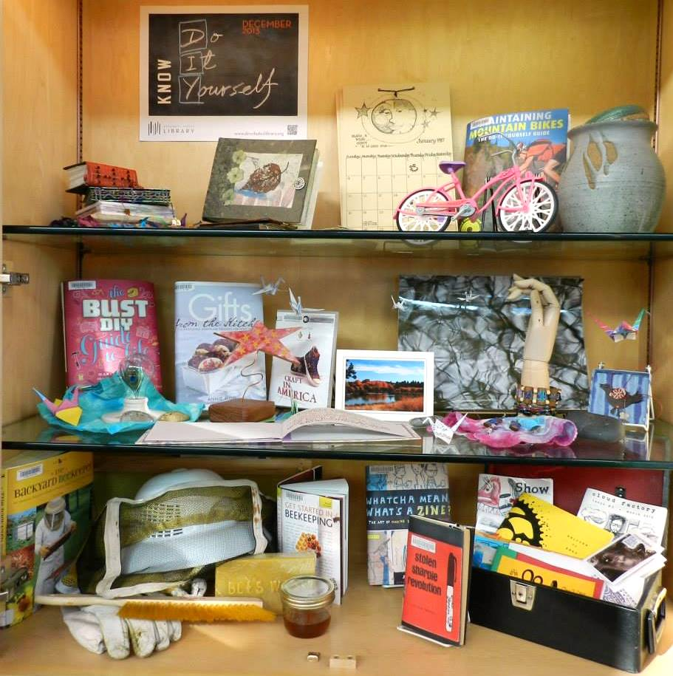
Infusing creativity into book displays
Chris Isett & Kristin McGovern
Public Service Specialists

Slide 2
Purpose of Book Displays
Draw attention to the library collection to increase circulation
Inform on themes and increase awareness of library events
Ignite creative thought and curiosity
Notes:
Today I’m focusing mostly on our glass displays.

Slide 3
Where does the story begin?
How themes are created
Adjustment for library programs
Similarities and differences
between Adult & Children’s displays
Notes:
At DPL, our Community Relations department sets monthly library themes that occur throughout the district. These are based on our “Know More” branding. So for example, some themes we’ve had are “Know Africa, Know Travel,” etc… Library programs and events center around this theme.

Slide 4
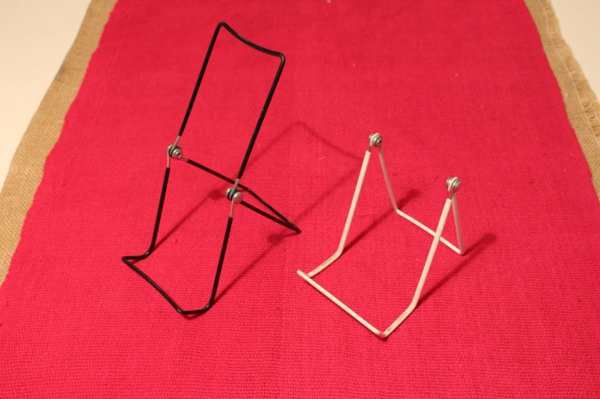
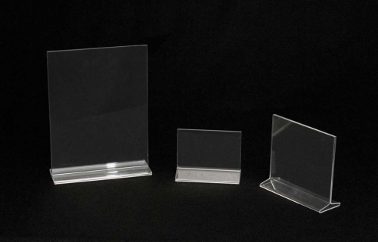
Basics to get started

Slide 5
Acquisition of display elements
Utilizing library collection to showcase books, audiobooks, DVDs, music Cds
Collaboration with staff for interesting 3d elements to enhance theme
Partnerships with community resources
Notes:
We receive many unique items for book displays from staff - it’s a fun collaboration to involve coworkers in the displays. DPL has borrowed items from outside sources, such as military items from the Des Chutes Historical Museum for our WWI display last summer marking the 100 Anniversary of the war.

Slide 6
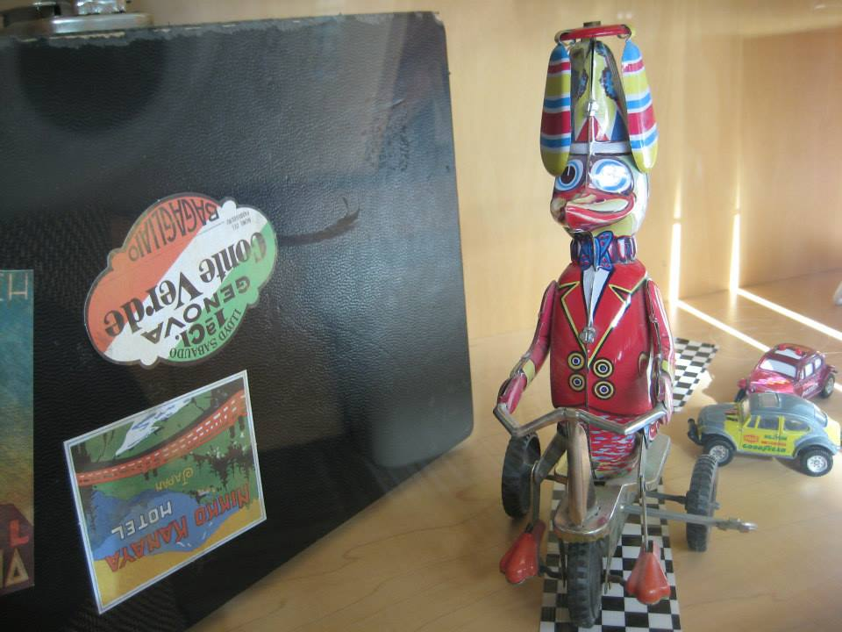
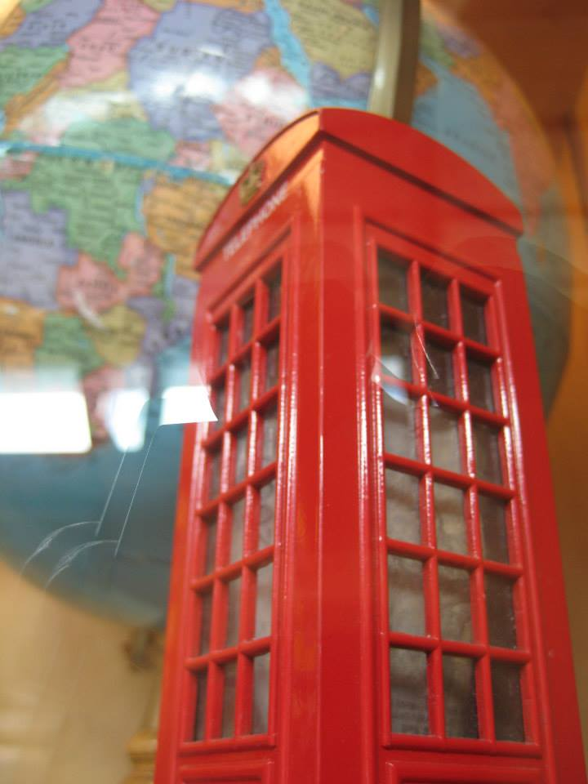
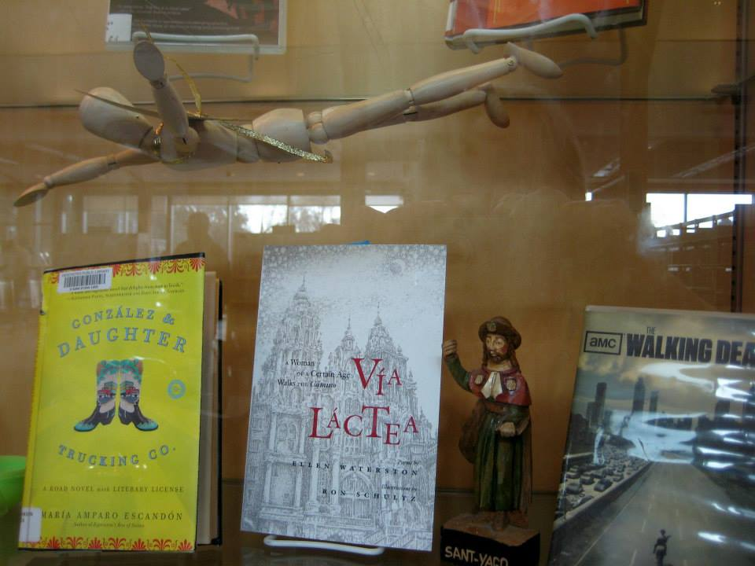

Slide 7
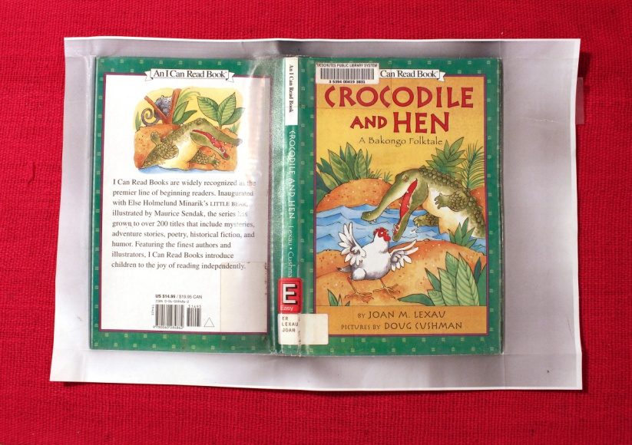
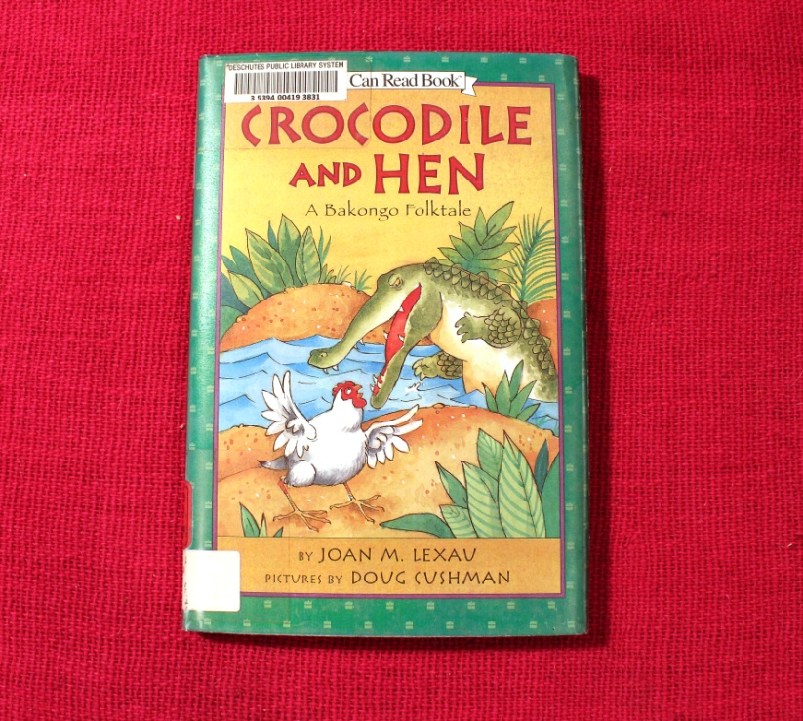
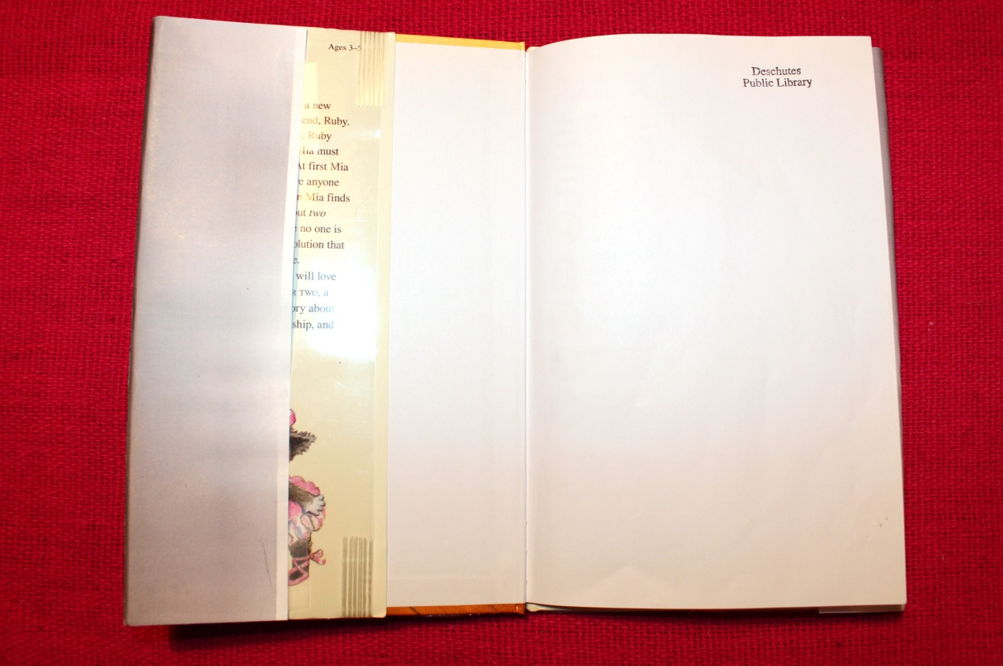
That’s a wrap!
Notes:
When you don’t want to take items out of circulation – make faux items! We often times create decoy books and dvds

Slide 8
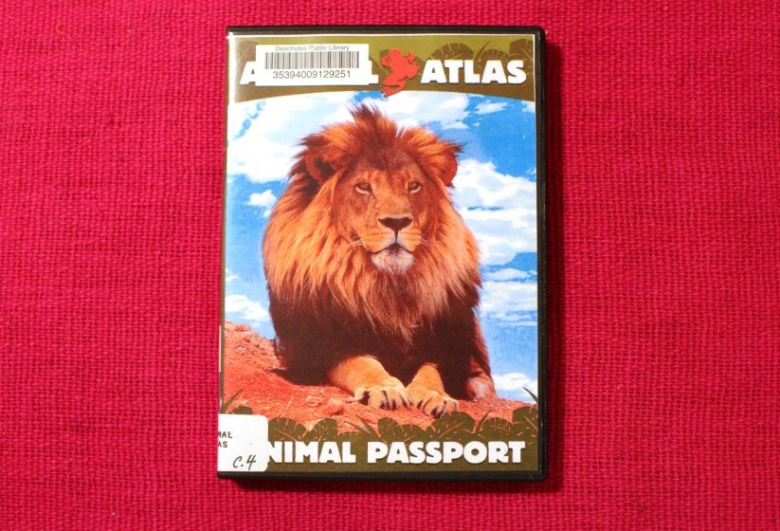
Copy that!

Slide 9
Composition The art of display
Design
Form
Symmetry
Balance
Viewpoints
Notes:
It’s less about proportions, and more about balance. Triangle technique! The triangle, or pyramid, shape creates a sense of stability and harmony where the eye is often drawn to the peak of the display. .

Slide 10
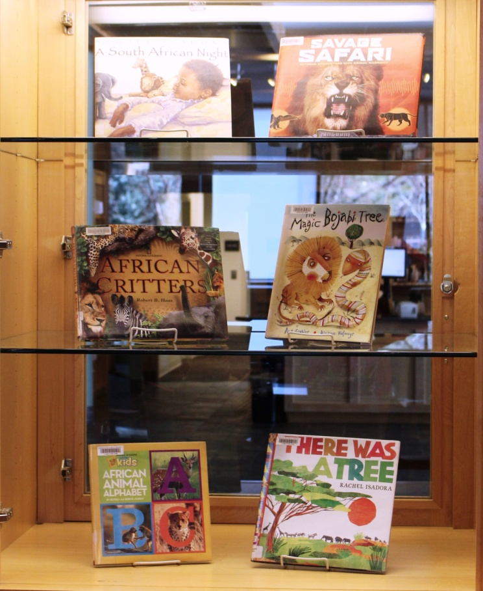
The Goldilocks Dilemma
Find the right balance

Slide 11
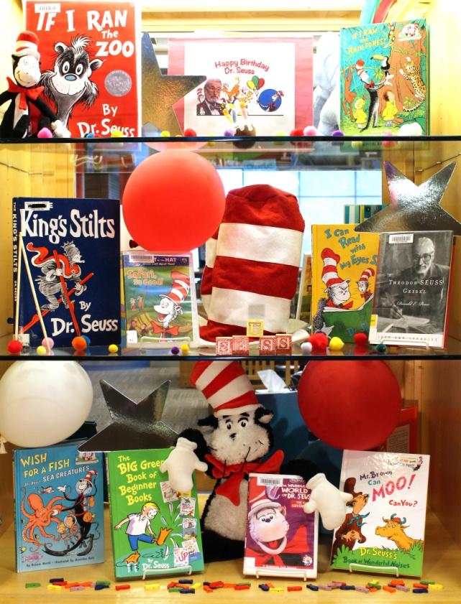
Oh, the things you can think! - Dr. Seuss
Notes:
Two different approaches on same display – both successful

Slide 12
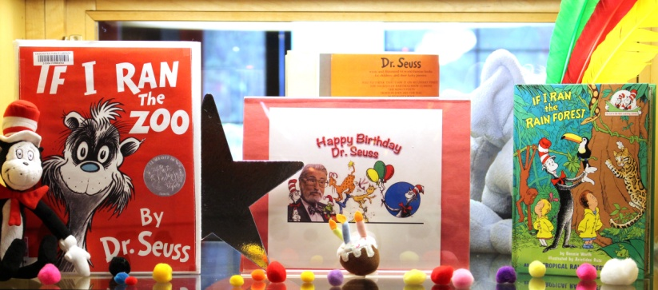
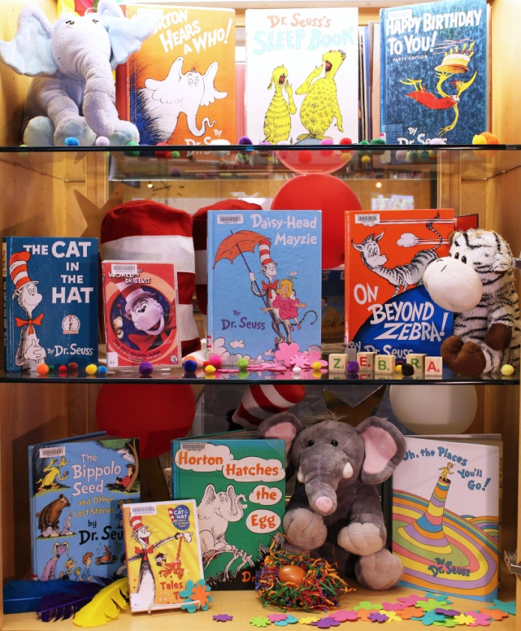
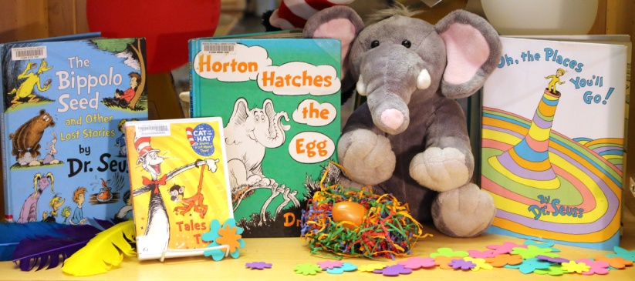
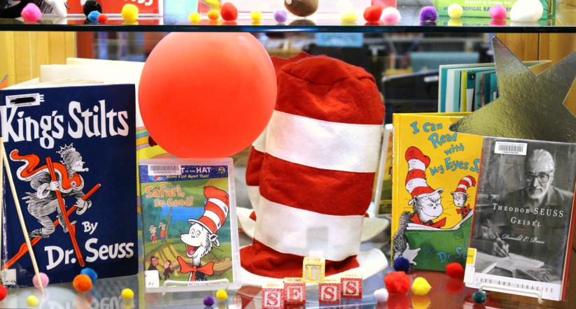
A Birthday for Seuss

Slide 13
Know Africa

Slide 14
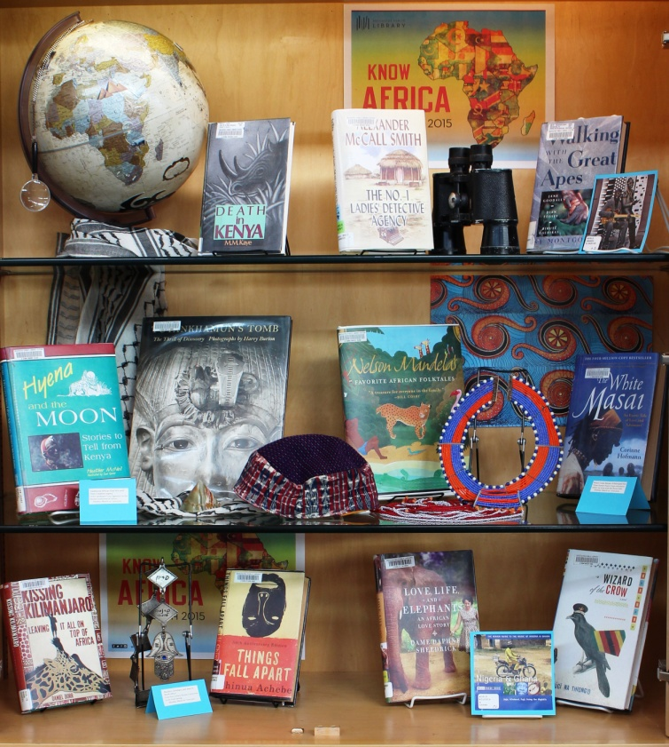
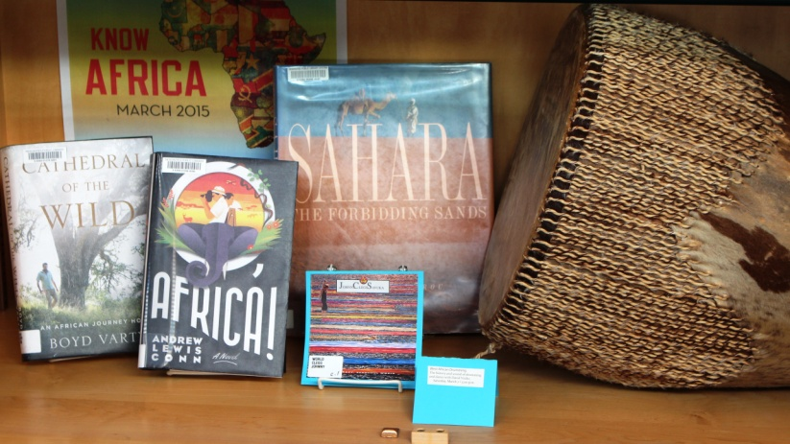
Take the journey……..

Slide 15
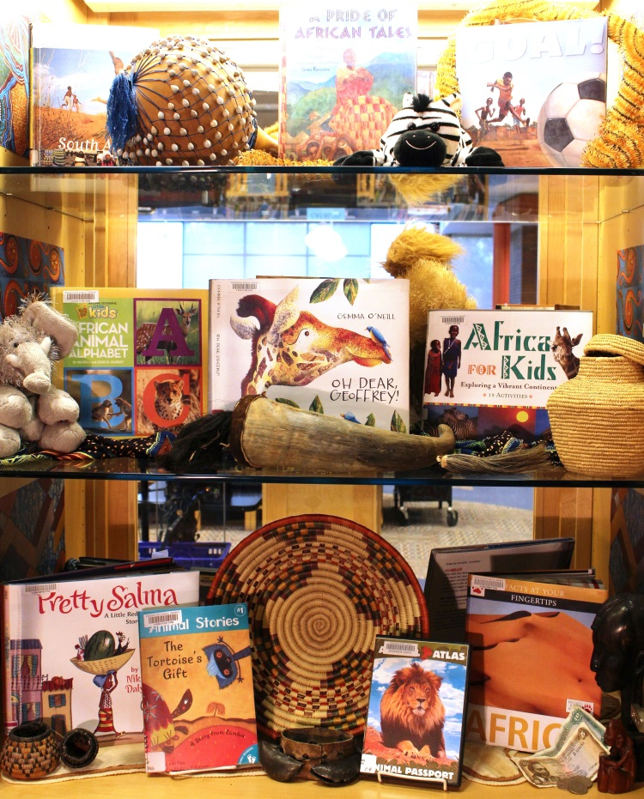
Plant the seed for inquiry….

Slide 16
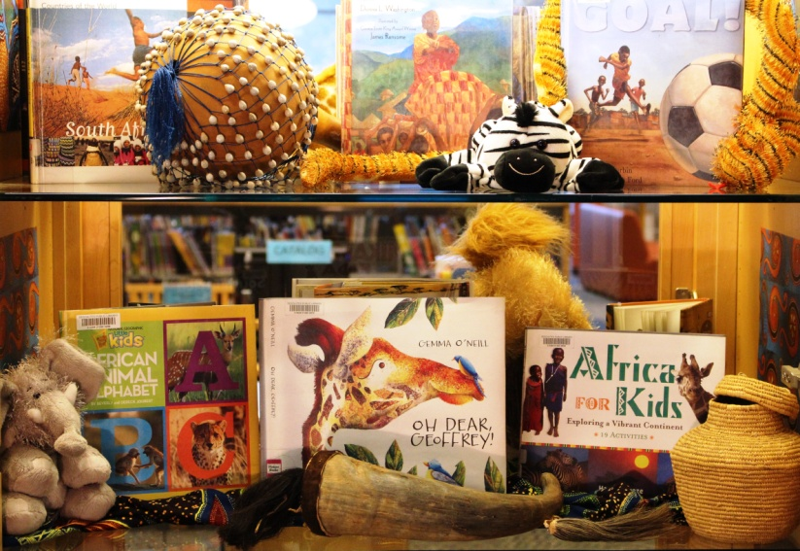
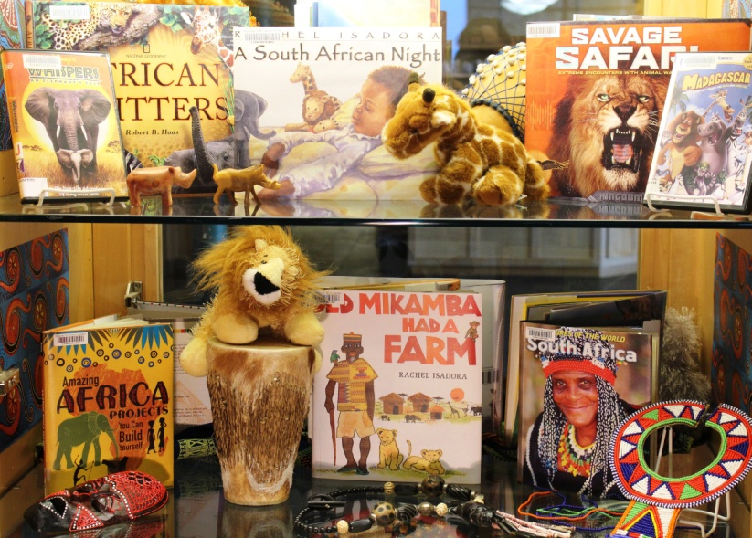
Texture
Color
Diversity
Size
Focal advantage

Slide 17
KNOW FRIGHT

Slide 18
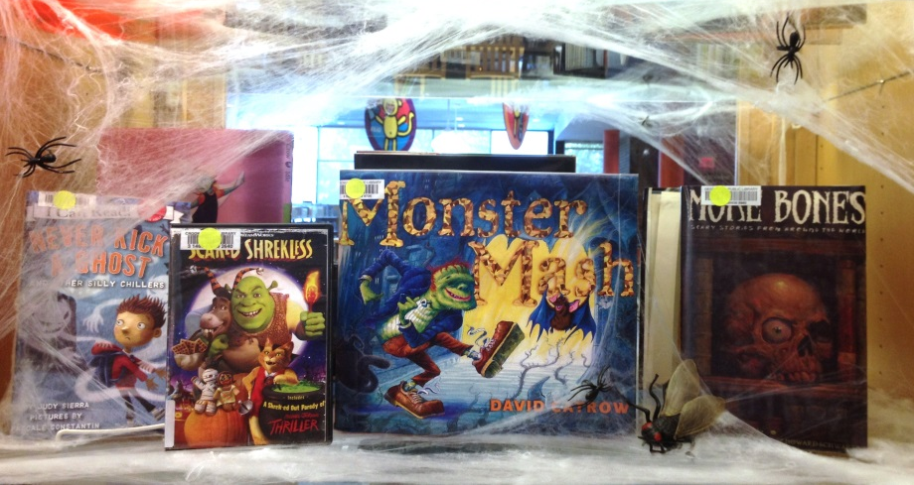
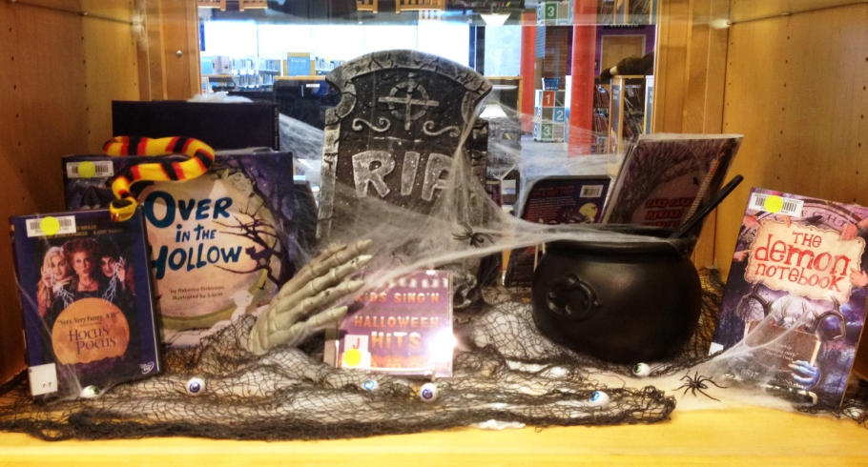
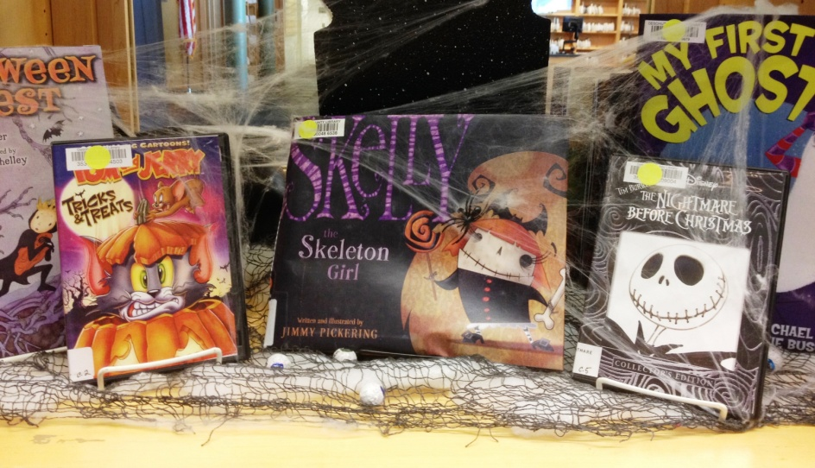
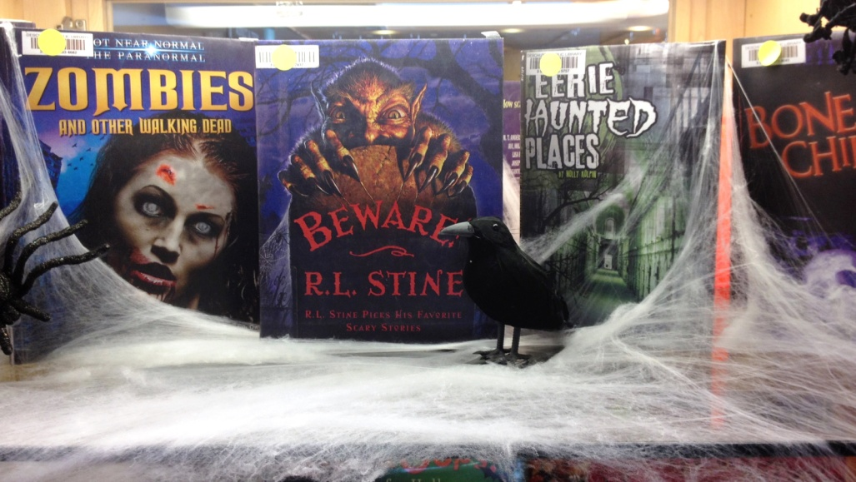
Spooktacular Fun

Slide 19
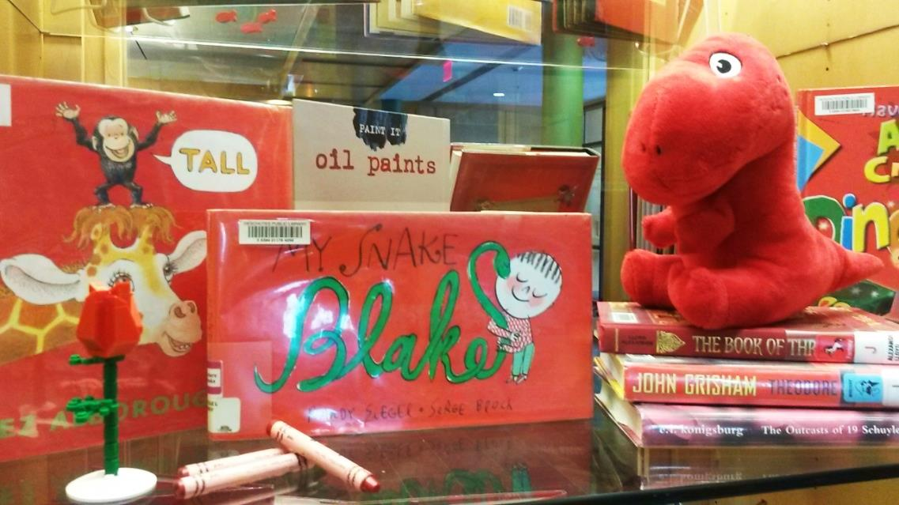
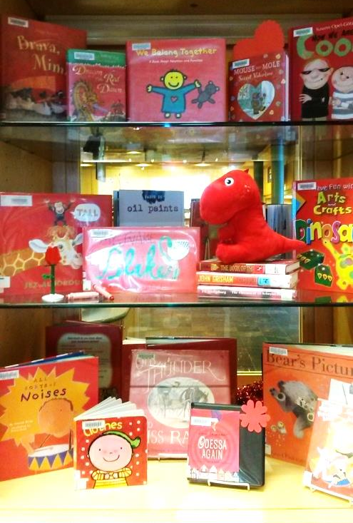
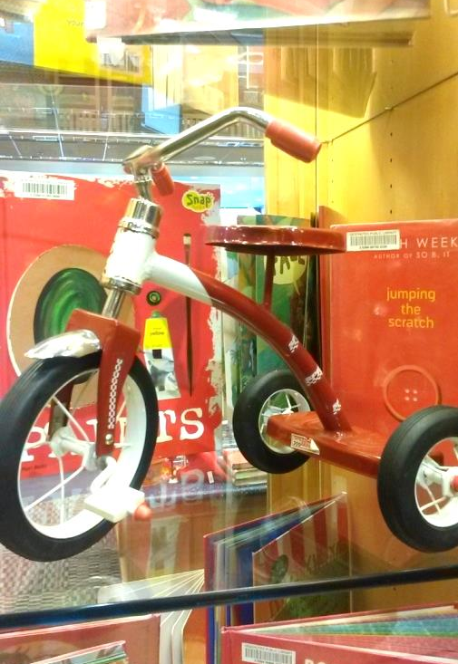
Color Blocked Book Display
Try using one color for a bold statement
Plethora of possibilities
Notes:
This was a fun and easy library display – we simply walked through the children’s area and selected items with

Slide 20
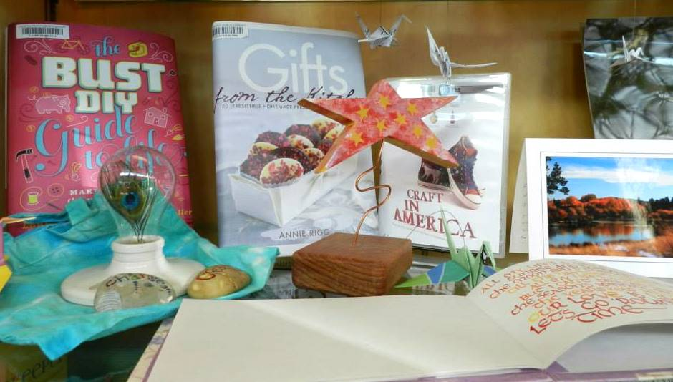
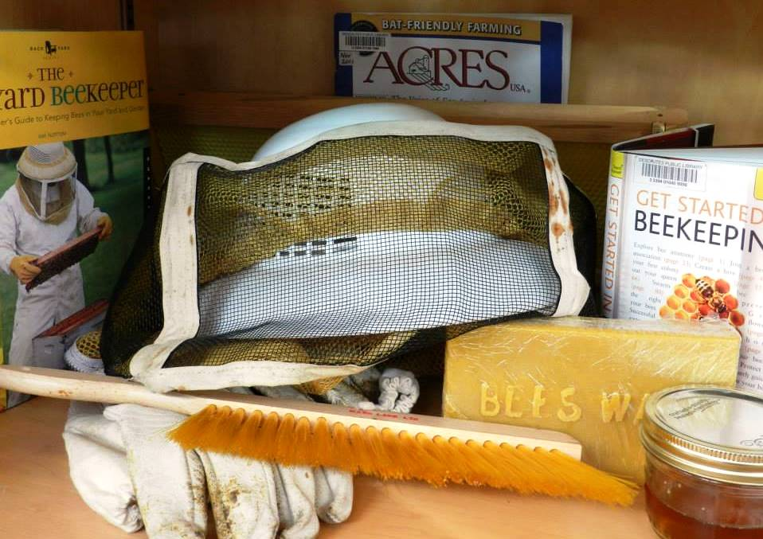
Creativity fuels the soul

Slide 21
Novel Idea
Come together
Get the conversations going
Book clubs galore
Programs, events, meet the author
Fosters local art exhibition
Community Read
2015

Slide 22
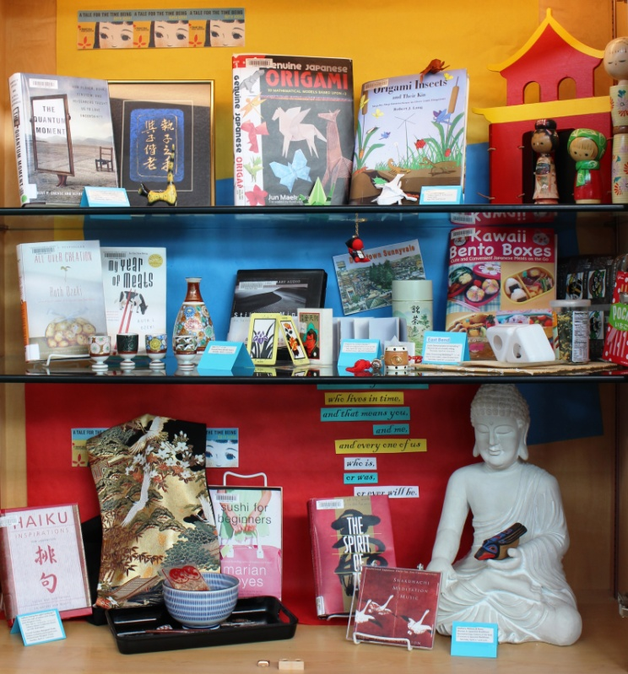
Embody the story being told

Slide 23
Oh, oobee doo, I wanna be like you… I wanna walk like you,Talk like you, to…
-Jungle Book

Slide 24
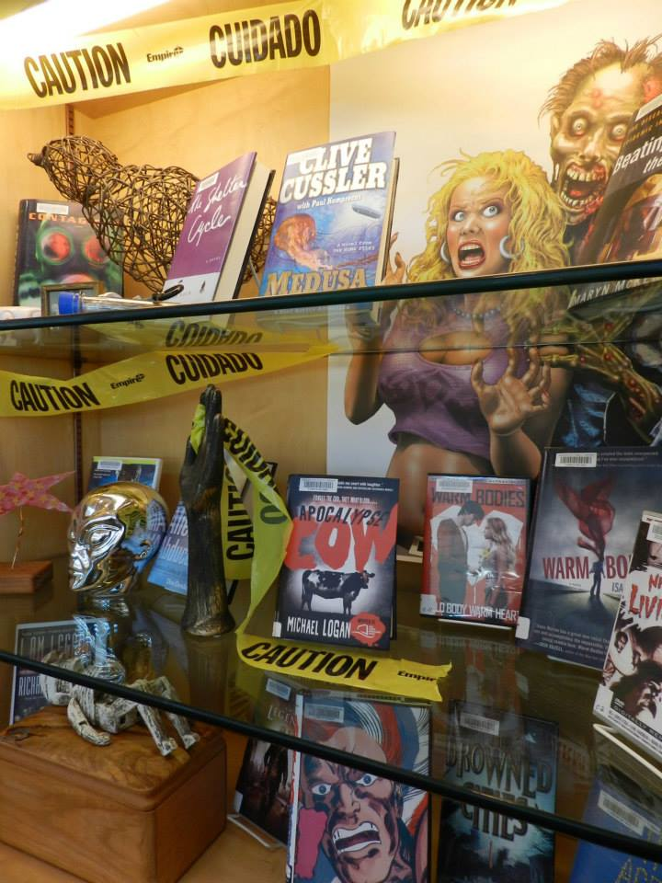
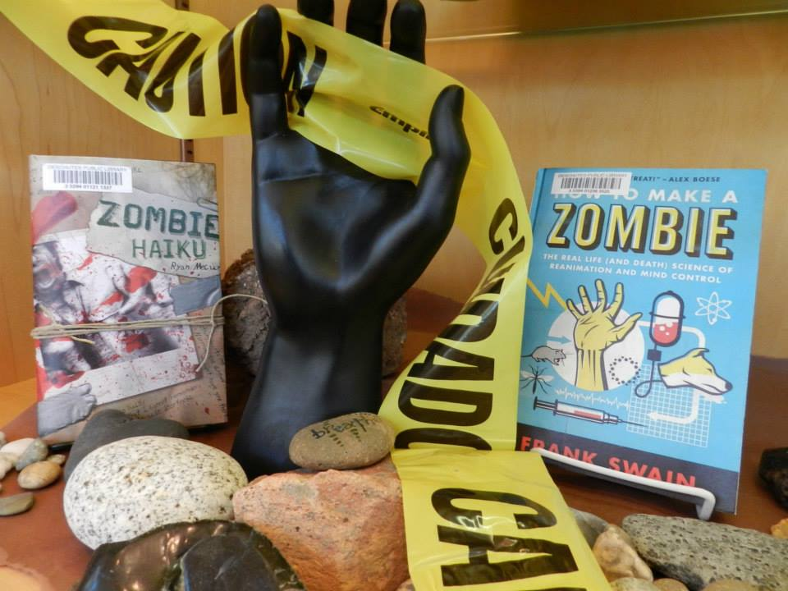
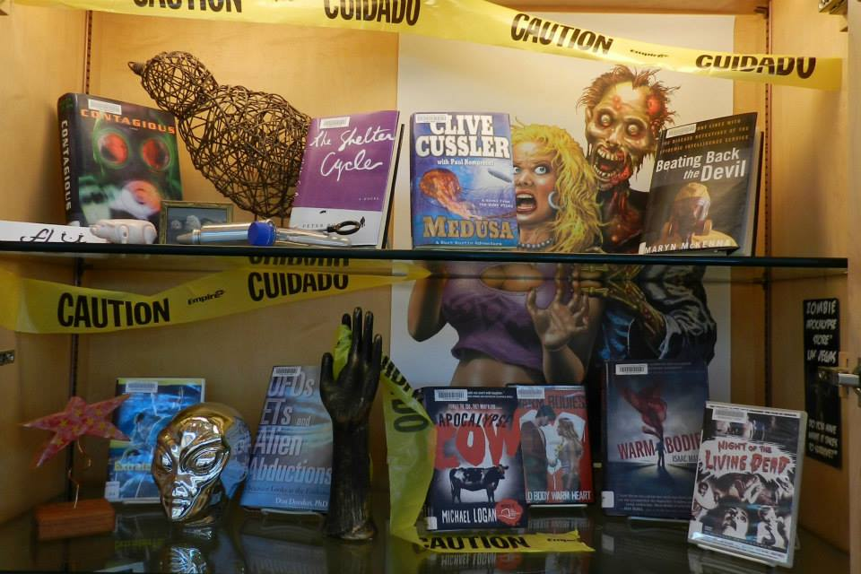
Know Ends…dun dun dun

Slide 25
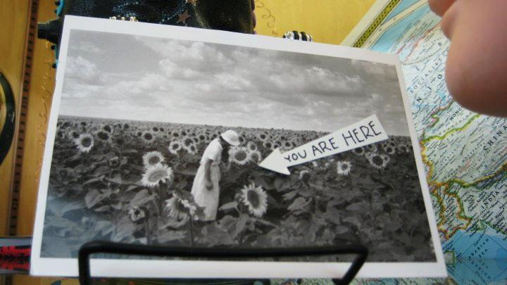
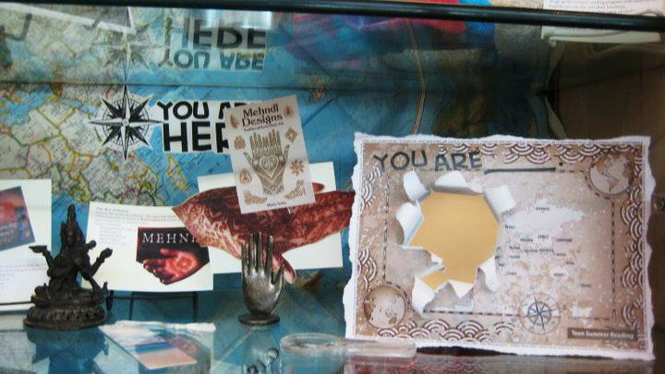
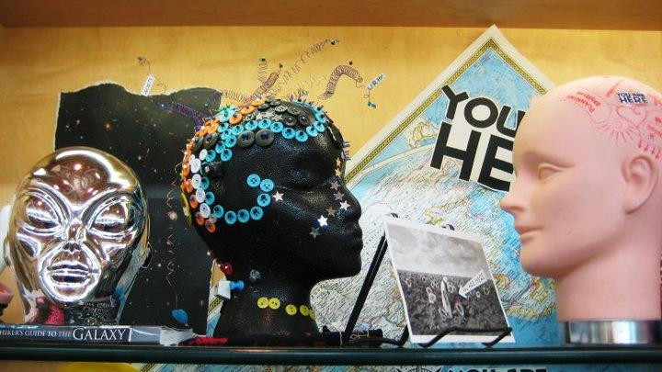
Summer Teen Reads

Slide 26
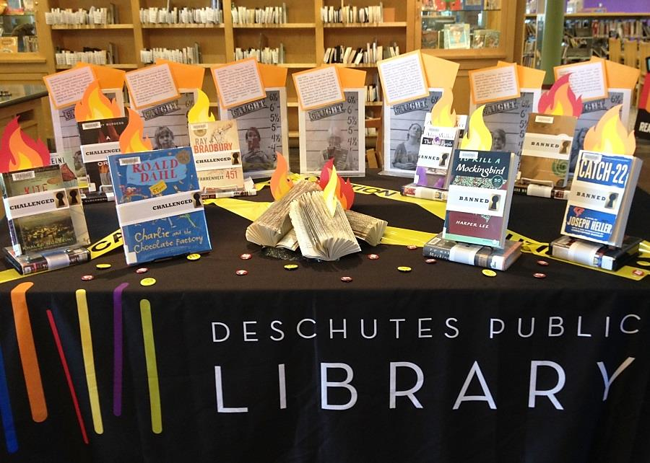
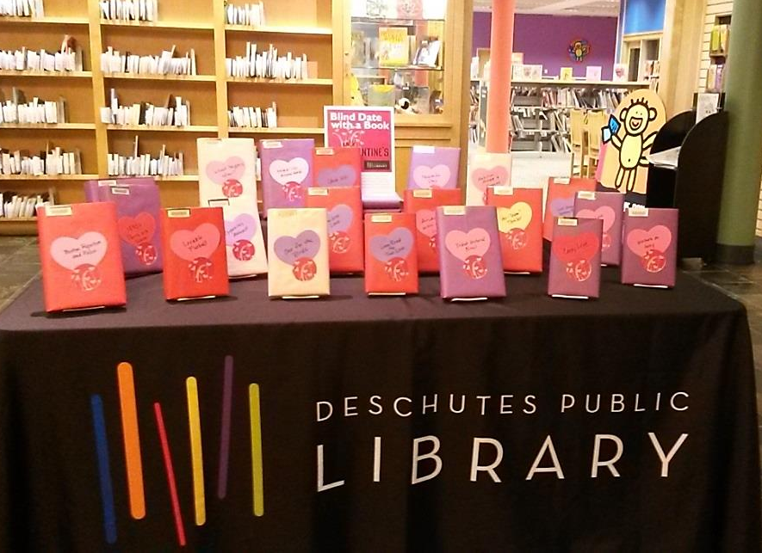
Tables for your fables….

Slide 27
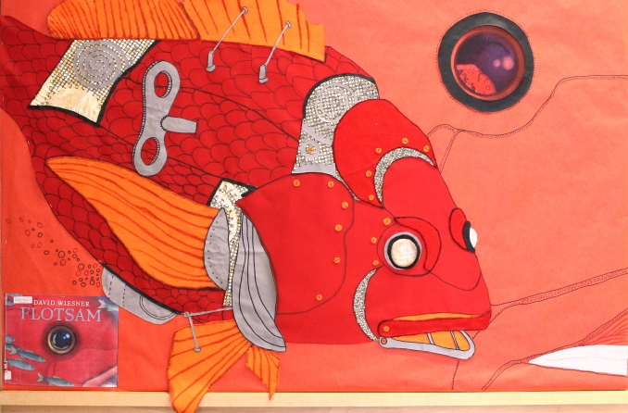
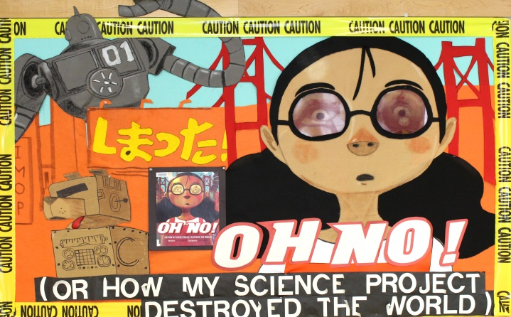
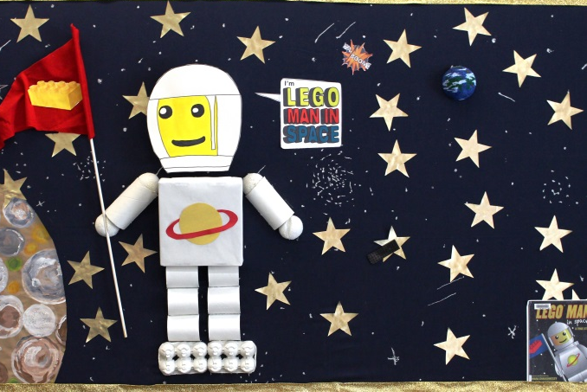
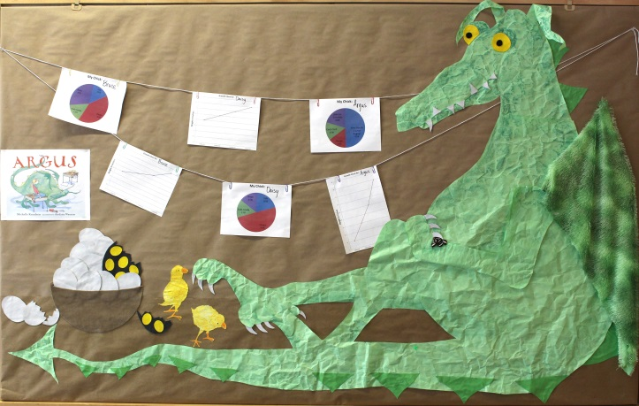
Panels for the ages… or at least the season

Slide 28
Banned Books Week
Don’t be afraid to use humor in your book displays!

Slide 29
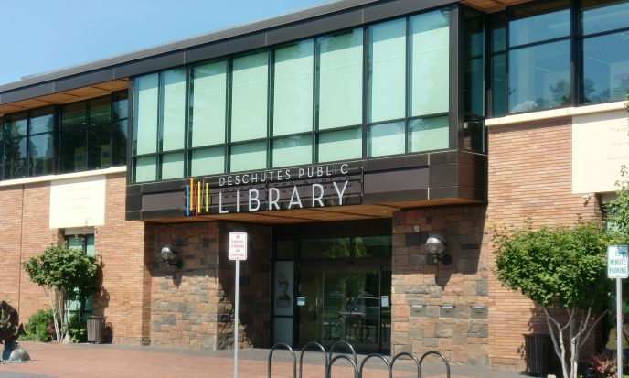
Most of all… Have fun and be Happy!
https://youtu.be/wm5I6Vl-tV4

