Slide 1
Next Generation Science Standards: The Next Big Thing
2015 Oregon Library Association Conference
Jennifer Maurer
School Library Consultant
Oregon State Library
jennifer.maurer@state.or.us
Jamie Rumage
Science Education Specialist
Oregon Department of Education
jamie.rumage@state.or.us
Notes:
Thanks to Jamie Rumage who could not make it to the conference but provided much of the PowerPoint and helped Jennifer Maurer better understand the Next Generation Science Standards.

Slide 2
Tips
Most images are linked to sites that provide more information.
Read the notes section at the bottom of slides for a bit of context.

Slide 3
REVIEW GOALS & OBJECTIVES
Basic understanding of Oregon Science Standards
NGSS history and examples
Connections between NGSS and CCSS
Library resources and support systems
Notes:
Increase awareness and understanding of the NGSS by highlighting how these standards are different than the 2009 standards; identify the connections to the Common Core State Standards

Slide 4
What Are the NGSS?
Nationally-developed science standards
Internationally benchmarked
Written by scientists, engineers, and educators
Oregon contribution: writing and review
Adopted by Oregon in March 2014
Full implementation by 2018-2019
Notes:
Spreading across the country bringing a new generation of science standards--Next Generation Science Standards (NGSS). Capturing the natural curiosity of children with core ideas and meaningful practices, NGSS bring coherence and rigor to science learning. NGSS are a K-12 progression of learning that lead to career and college readiness. The new standards are written as performance expectations that include disciplinary core ideas K-12, and science and engineer practices (skills) blended with crosscutting concepts (linking ideas). Unlike the Common Core State Standards, NGSS addressed diversity and equity issues from the beginning of writing rather than after release.

Slide 5
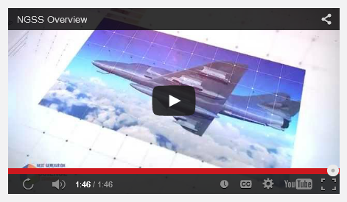
Achieve’s Video Overview of NGSS

Slide 6
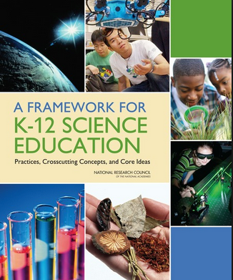
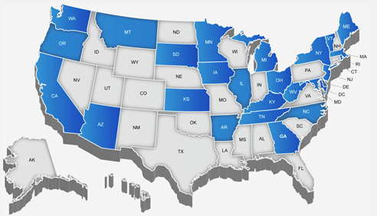
Vision & Mission
Notes:
NGSS Writing Team consists of 41 members from 26 states.
The framework is the grounding document for the NGSS. It is the how-to-guide in implementing the standards (performance expectations). This vision is very much in alignment with the CCSS and CCR which support the 40-40-20 vision for Oregon education.
Suggestion: Read at least the framework’s mission and vision statement and one grade level area. Then dive into the standards.
The Committee on a Conceptual Framework for New Science Education Standards was charged with developing a framework that articulates a broad set of expectations for students in science. The overarching goal of our framework for K-12 science education is to ensure that by the end of 12th grade, all students have some appreciation of the beauty and wonder of science; possess sufficient knowledge of science and engineering to engage in public discussions on related issues; are careful consumers of scientific and technological information related to their everyday lives; are able to continue to learn about science outside school; and have the skills to enter careers of their choice, including (but not limited to) careers in science, engineering, and technology (Framework, ES 1).
Learning as a developmental progression
Engaging students in scientific investigations and argumentation to achieve deeper understanding of core science ideas
Integrating the knowledge of scientific explanations and the practices needed to engage in scientific inquiry and engineering design

Slide 7
Science for All Students
[National Research Council] reports consistently highlight that, when provided with equitable learning opportunities, students from diverse backgrounds are capable of engaging in scientific practices and constructing meaning in both science classrooms and informal settings.
Source: NGSS Lead States, 2013

Slide 8
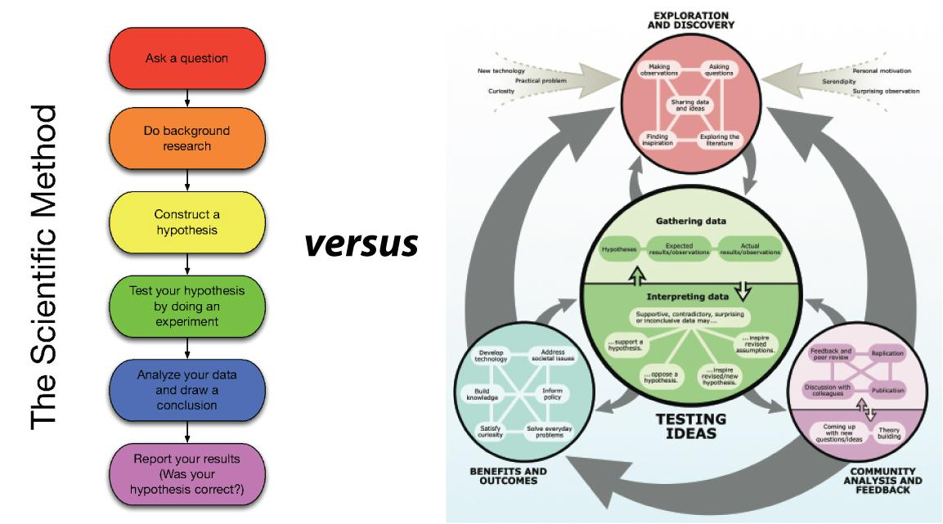
Notes:
Scientists and science educators now emphasize the recursive process of scientific investigation instead of the prior linear scientific method.

Slide 9
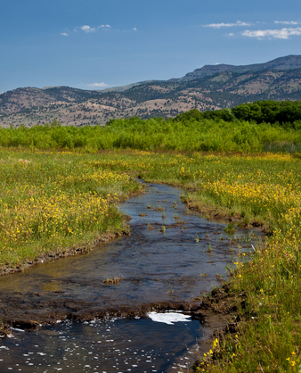
KEY PEDAGOGICAL PRACTICES (SHIFTS)
Focus: The standards are focused on deeper understanding and application of science content reflecting real-world phenomena.
Coherence: Science and engineering (practices) build coherently across K–12.
Rigor: Science and engineering practices are integrated across K–12.
Notes:
Of the six shifts, these three take the strategies we should already be using and make learning more engaging, intentional and relative to our students.
Related elements: connecting science education to students’ sense of place, applying their funds of knowledge and cultural practices, using project-based (place-based) learning, using culturally relevant pedagogy, capitalizing on community involvement and social activism, using role models, providing accommodations and modifications for students with disabilities, adopting language support strategies, home language support, and home culture connections

Slide 10
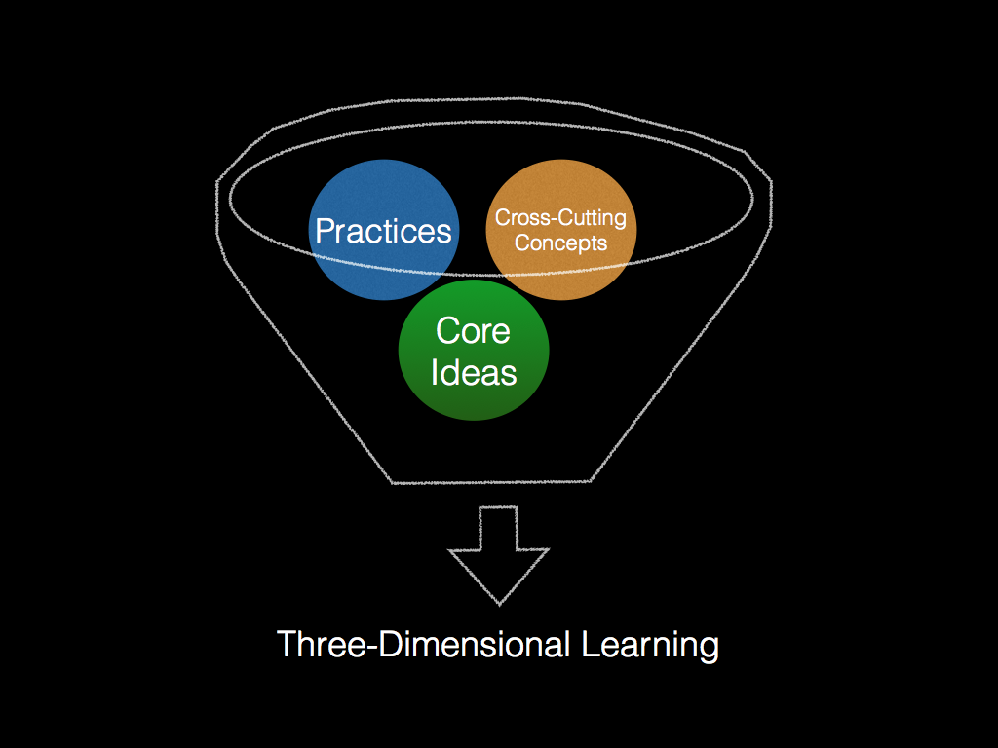
Three Dimensions of the Framework for K-12 Science
Science and Engineering Practices (8)
Disciplinary Core Ideas (4)
Crosscutting Concepts (7)
Notes:
The NGSS architecture includes foundation boxes with three dimensions that will blend together as curriculum is created.
Dimension 1: Practices of scientists and engineers as they investigate and solve problems.
Dimension 2: Crosscutting concepts, link across disciplines of science and other subjects.
Dimension 3: Disciplinary core ideas, concepts of scientific knowledge, written as a progression of learning K-12.

Slide 11
Three-Dimensional Learning
Notes:
Cooking analogy… If I were to invite you over for dinner, none of these (practices, core ideas or crosscutting concepts and their cooking analogies would be very good on their own)... Knowledge and practice must be intertwined in learning experiences!
Think of knowing how to do various techniques in the kitchen like kneading bread, cutting tomatoes, beating an egg, frying or roasting, and so forth as the practices. You could know how to do all of these things and still not be able to prepare a really good meal. Now think of picking out really good ingredients for the meal. You want to pick out a high-quality piece of fish or poultry or excellent pasta for the meal. These are your core ideas. A disciplinary core idea is essential to explaining a number of phenomena. Your main ingredient is essential to the meal. But just as the DCI works with practices to make sense of phenomena and design solutions, you need to know how to cook that main ingredient. But something is still missing. The meal tastes bland. What is missing? To make a really good meal, we need to use spices and herbs to enhance the flavor of the main ingredients. Similarly, to really make sense of phenomena and to design solutions all three dimensions are necessary. To make a really wonderful meal, good main ingredients are necessary, but you need to know how to use various techniques to prepare them, and you must have the species and herbs to enhance the flavors. All three work and blend together to make a great meal. Similarly, to foster three-dimensional learning where all learners can make sense of phenomena and design solutions, all three dimensions need to work and blend together.

Slide 12
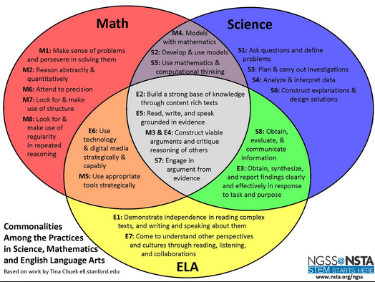
Explicit Ties to ELA & Math
Notes:
ELA = English Language Arts
What does the overlap of standards mean to you? What do you think it could mean for educators? For students?
Jamie views the overlap as an access point for all students to begin to close the achievement gap. We need to be explicit in our lesson/unit developments to begin bridging content. Concepts are not isolated in the real-world; they should not be isolated in classes.
This is the intersection of where there is direct relationships between content areas:
1- Growing knowledge through content rich text
2- Read, write and speak grounded in evidence
3- Construct viable arguments and critique reason of others
4- Engage in arguments from evidence

Slide 13
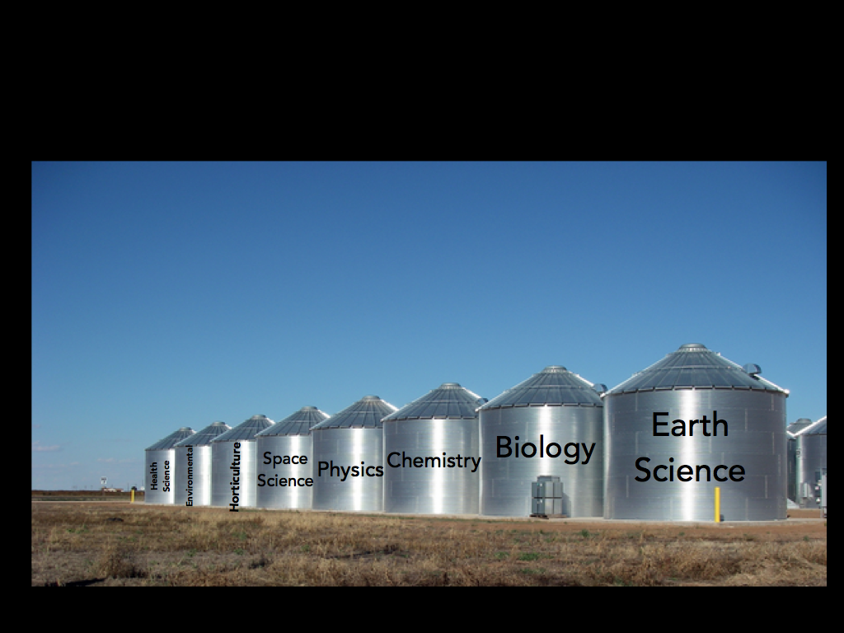
Notes:
Science content overlaps. Teaching in silos is not best practice!

Slide 14
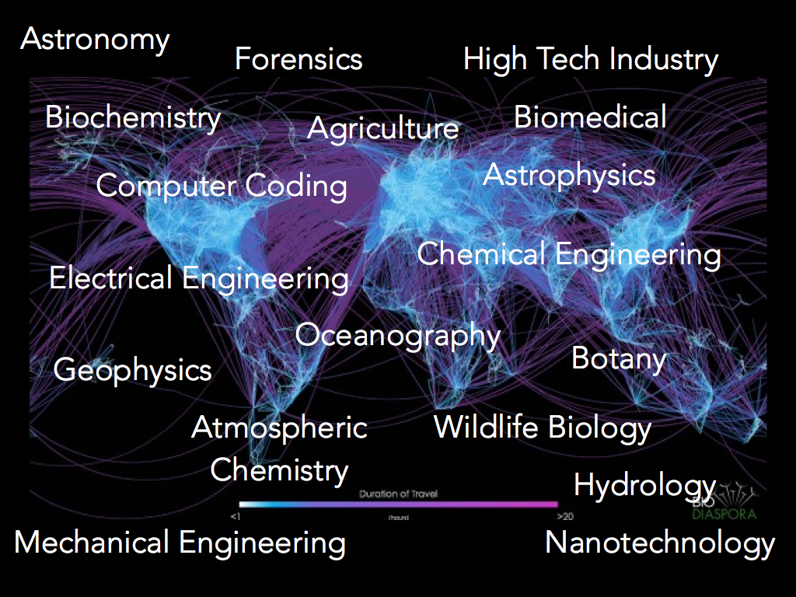
Notes:
In the real world, science is not siloed. Historically, educators likely siliod subjects to make it easier to deliver and assess instruction, but it just is not authentic. Students don’t have to be scientists or engineers, but educators are responsible to provide the opportunity for all students to access these careers.

Slide 15
Notes:
From educators’ perspective, the core ideas are what they are most familiar with – the content and facts. Teachers can and do teach content. Some of the practices have been historically been addressed, but it is the crosscutting concepts that are what most educators indicate they need the most professional development on. While most of the educators understand these on paper, integrating them is where there is work to do.
But the real transformation occurs when educators start to blend the strands/dimensions when instructing students.

Slide 16
Notes:
Performance Expectations (standards) are not a checklist. Typically science standards have been focused on the what and not the how and why.
(Pardon the typo -- extra “the”; it’s part of the image.)

Slide 17
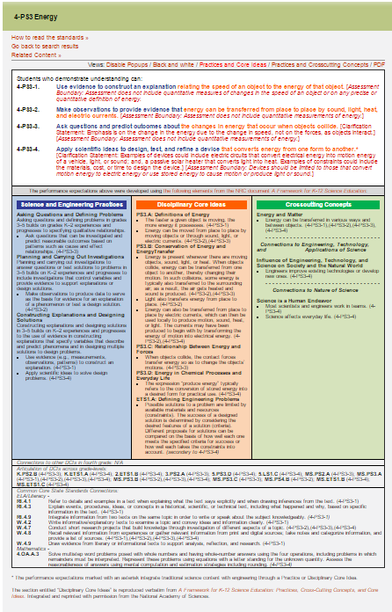
NGSS System Architecture
Performance Expectations
(Standards)
Foundations Boxes
Connections
Boxes
Notes:
All K-12 students get quality science instruction. Concepts build in complexity as students move through the grade levels. Leaving out concepts at the elementary level will impact subsequent learning. On first view of the new standards, you will see an architecture that is unique compared to typical standards. The architecture has key components to assist teachers, administrators, and curriculum developers, but NGSS are not curriculum. They are written as performance expectations that will be the goal of instruction. Performance is the key word here. In the assessment, students are asked to demonstrate they know core ideas of science and engineering by doing science. For example: ask questions, define problems, construct explanations using evidence, revise models, etc.

Slide 18
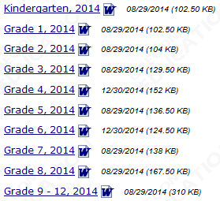
NGSS Topics By Grade Level
Notes:
Science coverage is integrated in the early grades. To see a list of topics covered by grade level, view the PDFs on ODE’s NGSS page or on the “DCI Arrangements of Standards” page at NextGenScience.org. On the latter, there is a master PDF that includes all grade levels plus other options for sorting the standards by grade level and topic. When focusing on science topics, pay attention to the orange column labeled Disciplinary Core Ideas (DCI).

Slide 19
Library Connections & Resources
The remaining slides offer a few
ideas
for how library staff
can support implementation of the NGSS.
Notes:
The goal is to focus on NGSS and not to cover the very broad topic of STEM (science, technology, engineering, and math) in general.

Slide 20
Point Parents to Information
Parent
Fact Sheet
This app from MasteryConnect
is recommended.

Slide 21
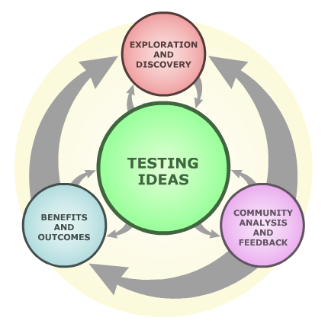
Library Collections
Do materials in your collection reflect the newer recursive process of science versus the former linear scientific method?

Slide 22
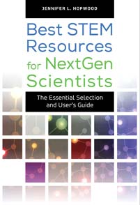
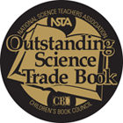
Library Collections
Collection Development Resources
Notes:
The two ABC-Clio books can be borrowed from the Oregon State Library using interlibrary loan.
http://www.oregon.gov/osl/LD/Pages/school/index.aspx#Request_Materials

Slide 23
Library Programming
Oregon’s regional STEM hubs –
potential source of partners and activities
Ex: Portland Metro STEM Partnership lends science lab equipment
Ex: Umpqua Valley STEAM Hub offers a calendar of events

Slide 24
Library Programming
University of Oregon’s Science on Demand
Grad students will provide science demonstrations or workshops for nominal cost
On hiatus until fall 2015 Tip for Science Programming
Don’t stop at the WOW (Repile Man; volcano experiment)
Explain the HOW (include an expert; have related books and links on hand)
Integration
Add science to existing programming (photography club, for ex.)
How can storytimes integrate science “wow and how”?
Notes:
http://stemcore.uoregon.edu/science-on-demand/

Slide 25
Sample of Lessons Posted on ODE Website
http://www.ode.state.or.us/search/page/?=4176 | Life Science | Earth Science | Physical Science
Elementary School | Joanie Appleseed | Bricks for Pigshttp://www.ode.state.or.us/search/page/?=4174 | Toad’s Car
Middle School | Franken Plants | Bioswales | Ultimate Speed Challenge
High School | Biofuel from Algae | Calorimeter (Chemistry) | Littlefoot’s Ride
Notes:
The former Oregon University System with a large team worked together to design some science lessons.
http://www.ode.state.or.us/search/page/?=4176
25

Slide 26
General Resources
Next Generation Science Standards & Appendices

Slide 27
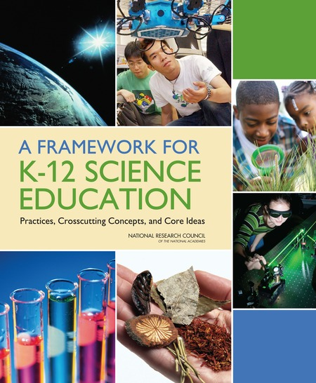
General Resources
National Academies Press
All publications can be read online or downloaded as PDFs for free

Slide 28
General Resources
Four new videos from Achieve and Teaching Channel

Slide 29
Notes:
As a broad overview of the goals of the Next Generation Science Standards, watch what Neil deGrasse Tyson has to say about scientific literacy.
https://www.youtube.com/watch?v=gFLYe_YAQYQ

