Slide 1
Best Practices for Music Cataloging Using RDA
Ann Shaffer, University of Oregon
ashaffer@uoregon.edu
Oregon Library Association
April 17, 2015

Slide 2
What We’ll Cover
RDA as concept and tool
FRBR Group 1 as it relates to music
Resources for music cataloging in RDA
Walk through RDA cataloging for scores and CDs
MLA’s Best Practices
New MARC fields
Authorized Access Points
Cataloging exercises
Notes:
Welcome everyone, and thanks for getting up so early to hear about something other than cannabis! My presentation today will be part talk, part workshop– that is, I’ll give some background and show quite a few example records, but I’m also going to give you some exercises that will help you to apply concepts and try your RDA music cataloging skills.
First I’m going to let you know what I will and will not be covering in this presentation today. I’m going to start with some overviews: first, looking at RDA broadly as a concept and a tool, thinking about what it’s intended to do; then I’ll discuss the FRBR model, in particular FRBR Group 1 and how we can apply its concepts to music scores and recordings. I’ll also offer some resources you can turn to for help when you’re cataloging music in RDA (I’ll repeat those again at the end.)
I’ll then walk through how we would catalog several sample scores and recordings in RDA. I’ll demonstrate how to apply the Music Library Association’s Best Practices for Music Cataloging in RDA. We’ll look closely at some of the new MARC fields in RDA, particularly the 33x fields as they are applied for scores and recordings. We’ll also look carefully at Authorized Access Points, with attention to RDA’s distinction between creators and contributors, which presents some complications in music cataloging. Finally, we’ll look at some sample cases that we’ll catalog together.

Slide 3
What We Won’t Cover
Authority cataloging
More unusual fields and cataloging situations
Audio formats other than CDs
Books
Subject headings for music
Form/Genre and Medium of Performance terms for music
Notes:
Given the constraints of time and experience, there’s a lot about RDA cataloging for music that we won’t be covering. First off, we’ll just be dealing with the construction of bibliographic records today, so we won’t be discussing the creation of authority catalogs. Our RDA practice is not going to be comprehensive, but I do aim to highlight the most common situations we’re likely to encounter in dealing with music materials. For audio cataloging, I’m just going to focus on CDs, not LPs, tapes, or digital audio files. And we won’t be discussing cataloging of music books, since those are treated pretty much like books for any other discipline.

Slide 4
What is RDA about?
is a content standard
is NOT an encoding standard
is NOT a display standard
Provides instructions for how to record individual data elements
not how to create bib or authority RECORDS
concerned with recording individual pieces of data
better compatibility w/linked data tech
could be used by other communities outside of library
But libraries are still recording data in MARC, so our RDA records look somewhat similar to AACR2 records
not organized by format; instructions for all formats of resources in single sequence
use whichever data elements apply to the format you’re cataloging
Notes:
Before we get to the point of actually using RDA, let’s talk about what RDA is (and is not), what it’s designed to do, and how that might or might not differ from what we’re used to seeing under AACR2.
RDA
is a content standard-- tells what info to record
is NOT an encoding standard-- doesn’t tell us what fields to record information in
is NOT a display standard-- doesn’t indicate how information should display to users
The instructions it provides tell us how to to record individual data elements, not how to create bib or authority RECORDS
RDA is concerned with recording individual pieces of data associated with a resource, which lets the data elements be more granular
This gives it better compatibility w/linked data tech
could allow it to be used by other communities outside of library in encoding standards other than MARC records, which could look and function very differently
But libraries are still recording data in MARC, so our RDA records look somewhat similar to AACR2 records
not organized by format; instructions for all records provided in a single sequence
You follow RDA for whichever data elements apply to the format you’re cataloging

Slide 5
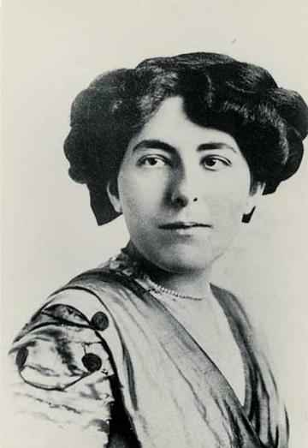
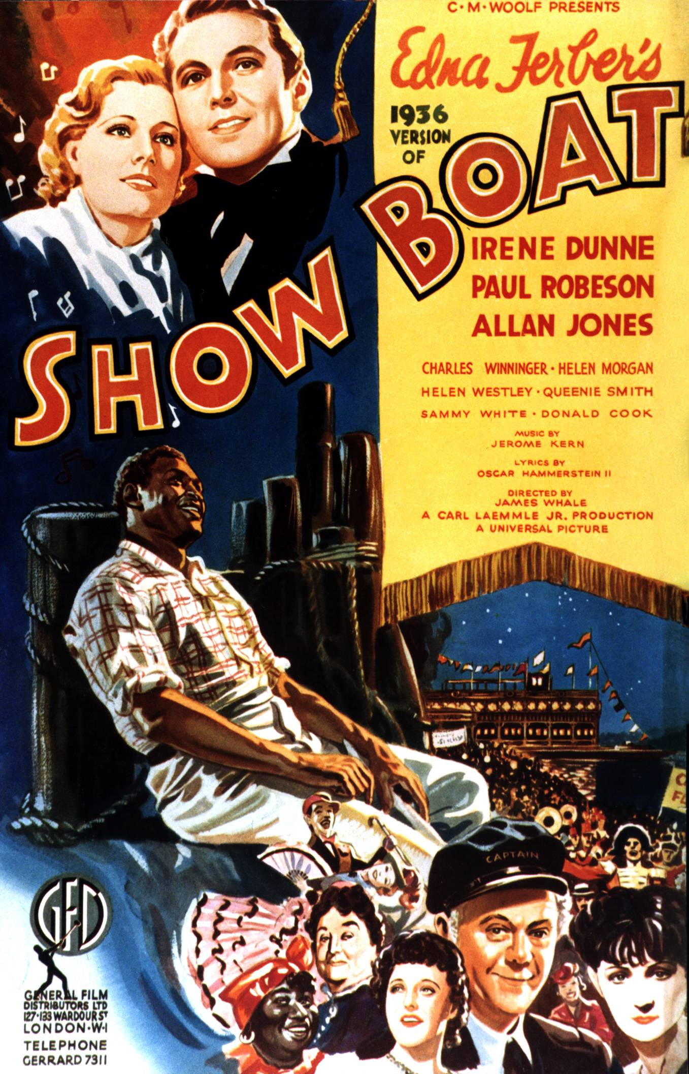
FRBR model
FRBR = Functional Requirements for Bibliographic Records
Conceptual model– describes entities & their relationships to one another
Three groups of entities:
Group 1: Work, Expression, Manifestation, Item (WEMI)
Primary relationships
Group 2: Person, Family, Corporate body
Responsibility relationships
Group 3: Concept, Object, Event, Place
Subject relationships
(Edna FRBR?)
Notes:
RDA is based on FRBR, or the Functional Requirements for Bibliographici Records, a conceptual model developed in 1998 by the International Federation of Library Associations and Institutions (IFLA). The FRBR model represents the bibliographic universe by describing bibliographic entities and their relationships to one another.
Within FRBR, there are 3 groups of entities. Group 1 covers Works, Expressions, Manifestations, and Items (sometimes called WEMI). This group is concerned with the primary relationships between bibliographic entities. We’ll be mainly focused on Group 1 and its relationships in our work today.
Group 2 describes Persons, Families, and Corporate Bodies, and is concerned with responsibility relationships– who is responsible for what, and in what ways? We’ll be drawing on this group today as well, when we deal with creators, contributors, and authorized access points.
Group 3 describes concepts, objects, events, and places, and is mainly concerned with subject relationships. We won’t be as focused on this group today, but it’s influential in the kind of subject, genre, historic, and demographic information that RDA granulates really well.
(The FRBR model should not be confused with Edna Ferber, author of the novel Show Boat, on which the Jerome Kern musical was based, although looking at the primary relationships between her novel and its subsequent theatrical, musical, and film adaptations is a good way to explore the Group 1 entities that we’re dealing with in this session. We’ll start with something simpler, though if you’re like me, now you’ll have “Old Man River” stuck in your head for the rest of the day. You’re welcome!)

Slide 6
FRBR Group 1 Entities
Notes:
Here’s a diagram of the FRBR Group 1 entities, which you’ve probably seen before if you’ve ever attended any other presentation on RDA or FRBR.
Work → conceptual idea of the composition (song, symphony, etc.) in the mind of the composer
in FRBR, Popular music album = aggregate work
Expression →
Scores: musical notation, visual representation of work
each format (score, parts, vocal score, miniature score, transposition, arrangement, translations of vocal text) is a distinct expression
each edited version is a distinct expression
performance of a song (in popular music); each performance is a distinct expression; recording a performance “captures” the expression; also different musicians performing or recording the same song.
CATALOGERS WORK HERE A LOT
Manifestation = physical or digital embodiment of the Expression → PUBLICATION. CATALOGERS ALSO WORK HERE A LOT for BIB RECORDS
publication of the notation (scores)
published physical or digital version of expression
multiple publications of same edition, reprints, paper & digital versions of same edition, are all distinct manifestations
in RDA, albums are treated as manifestations
Item = individual physical or digital instance of the manifestation →
the cd or score in your hand, the mp3 on your iPod, the pdf on your computer

Slide 7
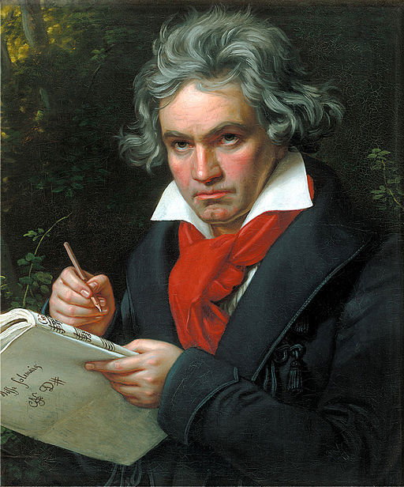
FRBR Group 1 Entities
Dah Dah Dah
DUM!
Work: Beethoven’s 5th Symphony
Full Score
1862, Breitkopf & Härtel
Expression:
Notation or Perforrmance
2011, online
Live Performance
Manifestation:
Specific Publication
Recording
CD
Item:
Unique physical or digital copy
MP3
Notes:
Let’s apply this in terms of some specific musical examples. Let’s start with Beethoven’s 5th Symphony.
Beethoven’s conception of the symphony in his head is equivalent to the Work level here– it is the pure concept of the composition.
The work is realized through the expression. For music, the expression generally takes the form of either notation or performance (but does not refer to any specific publication.) When Beethoven put pen to paper and wrote out a score, that was the first expression of the work in notated form. Each commercial edition of the full score is also considered an expression. Live performances count as expressions too, as do recordings (since the recording captures one specific performance and allows it to be exactly replicated every time it’s played back. So if the Eugene Symphony performs this, that’s one expression, and if they record it, that’s another expression.
The manifestation is the specific published version. The 1862 full score published by Breitkopf & Hartel as part of the Beethoven Werke edition is a manifestation, as is the online version of that edition that was made available on IMSLP in 2011. Similarly, the Eugene Symphony’s recording of the 5th Symphony might be released on CD, as well as in downloadable MP3 format, and each of those would be a distinct manifestation.
Finally, the item is the unique instance of the manifestation. So our library’s particular copy of the Breitkopf score is an item, as is our copy of the CD of the Eugene Symphony’s recording, or the MP3 of that recording that I have on my phone.

Slide 8
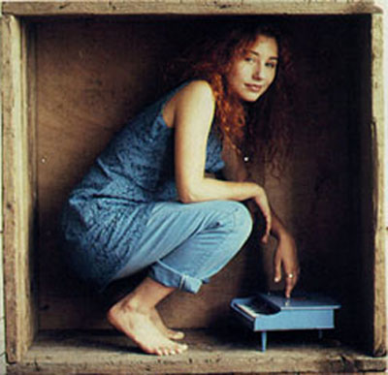
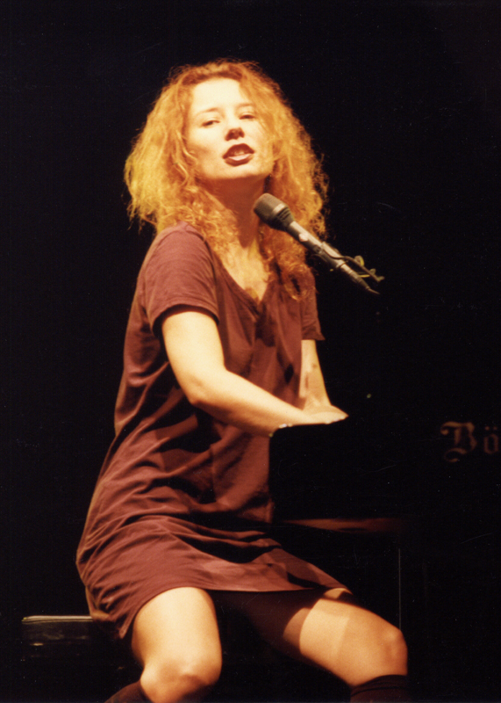
FRBR Group 1 Entities: Popular Music
Work: Tori Amos, “Little Earthquakes”
Recording
1992 CD
1992 Cassette
Expression
2015 Digitally Remastered MP3
Manifestations
Cover by Julean Rai
Item
YouTube Video
Notes:
Here’s a diagram of the FRBR Group 1 entities, which you’ve probably seen before if you’ve ever attended any other presentation on RDA or FRBR.
Work → conceptual idea of the composition (song, symphony, etc.) in the mind of the composer
in FRBR, Popular music album = aggregate work
Expression →
Scores: musical notation, visual representation of work
each format (score, parts, vocal score, miniature score, transposition, arrangement, translations of vocal text) is a distinct expression
each edited version is a distinct expression
performance of a song (in popular music); each performance is a distinct expression; recording a performance “captures” the expression; also different musicians performing or recording the same song.
CATALOGERS WORK HERE A LOT
Manifestation = physical or digital embodiment of the Expression → PUBLICATION. CATALOGERS ALSO WORK HERE A LOT for BIB RECORDS
publication of the notation (scores)
published physical or digital version of expression
multiple publications of same edition, reprints, paper & digital versions of same edition, are all distinct manifestations
in RDA, albums are treated as manifestations
Item = individual physical or digital instance of the manifestation →
the cd or score in your hand, the mp3 on your iPod, the pdf on your computer

Slide 9
FRBR question #1
Beethoven’s 5th has been transcribed or arranged by various musicians for various alternative instrumentations, including solo piano, piano 4 hands, piano trio, and airhorn orchestra. Which FRBR entity do these arrangements belong to?
Work
Expression
Manifestation
Item
Notes:
Answer: Expression

Slide 10
FRBR question #2
You decide you want to learn to play Franz Liszt’s transcription of Beethoven’s 5th for solo piano. You search in OCLC and find several editions: the 1865 Breitkopf & Härtel first edition, the 1998 Dover reprint of that edition, and another edited by José Vianna da Motta as part of the Franz Liszt complete works edition published by Breitkopf & Härtel in 1922. Which Group 1 entity do these editions belong to?
Work
Expression
Manifestation
Item
Notes:
Answer: Manifestation

Slide 11
FRBR question #3
Tori Amos garnered some recognition in the early 1990s for her acoustic piano cover of Nirvana’s song “Smells Like Teen Spirit.” Which WEMI category does this belong to?
Work
Expression
Manifestation
Item
Notes:
Answer: Expression

Slide 12
FRBR question #4
Your library orders a copy of the 2015 remastered edition of Tori Amos’s album Little Earthquakes, and when you catalog it, you notice that this copy has been autographed. If you wanted to highlight this in the catalog record, you might record that in a local note, which would pertain to which WEMI area?
Work
Expression
Manifestation
Item
Notes:
Answer: Item

Slide 13
RDA Structure
RDA Toolkit: Organization
Three broad sections
Attributes– Sections 1-4
Relationships– Sections 5-10
Appendices & Glossary
Notes:
Now that we’re FRBR pros, I want to turn to RDA and look at its structure in light of the FRBR groupings. RDA is accessed via RDA Toolkit, so in looking at the structure and organization of the RDA standards, I’ll also be talking about how to navigate the Toolkit to help find what you need.
There are three broad sections within RDA Toolkit. The first area, covering chapters 1-4, discusses how to describe the Attributes of the resource being described– that is, the FRBR Groups 1, 2, & 3 entities. The second area, covering chapters 5-10, offers guidelines for describing relationships between those entities. Finally, the appendices and glossary at the back have a lot of helpful information.

Slide 14
RDA Structure
Notes:
Here’s a look at the attributes area, sections 1-4. We can see all three of the FRBR groups represented here. Sections 1 & 2 discuss the WEMI group, although reversed in order to start with specific physical and digital publications, and then moving to the more conceptual level of Work and Expression. Section 3 covers FRBR Group 2, and Section 4 covers Group 3.

Slide 15
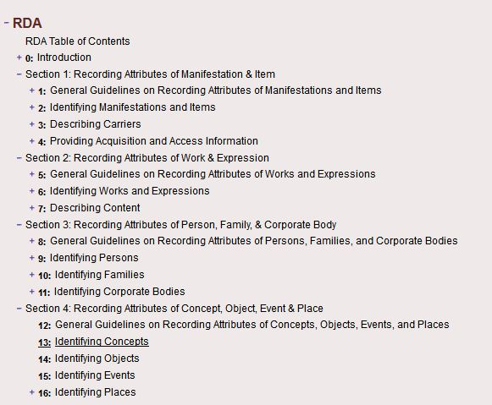
RDA Structure
Notes:
Most of our discussion today will draw on sections 1 and 2, since that is where the guidelines for most of what we do in bibliographic description are located. (Chapters 2-3 in particular deal with manifestation-level information, and Chapter 7 has relevant guidelines for expression-level information.)

Slide 16
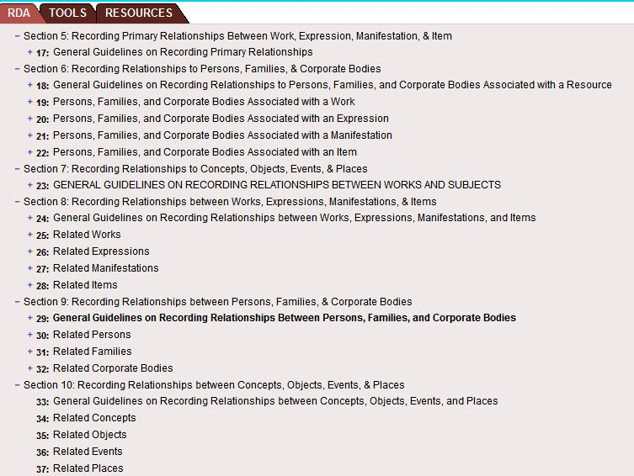
RDA Structure
Notes:
We’ll also look at some of the content in Section 6, the part of the relationships area dealing with persons and corporate bodies.

Slide 17
RDA Toolkit: Other Useful Areas
Tools Tab
RDA to MARC mappings
MARC to RDA mappings
Resources Tab
LC-PCC Policy Statements
AACR2
MLA Best Practices for Music Cataloging Using RDA & MARC 21
Notes:
RDA Toolkit has two other tab areas in addition to the main tab with the RDA guidelines, and making use of the content in these other two areas will help you quite a bit!
The Tools tab contains mapping tools that allow you to map back and forth between RDA data elements and MARC fields, so you can figure out which fields the Preferred Title will go in, or what RDA element the 700 field corresponds to.
The Resources tab is a treasure trove of supporting documentation. The LC-PCC Policy Statements are located here, as well as AACR2 (for easy reference), and the Music Library Association’s Best Practices for Music Cataloging Using RDA & MARC 21. This Best Practices document is currently in version 1.1, and can also be downloaded as a pdf; but all future revisions (starting this July) will only be loaded into RDA Toolkit, not distributed separately in pdf form, so you’ll want to follow it here. Also, it’s more navigable in RDA Toolkit, where you can jump to various sections, while the pdf is just one document with no table of contents.

Slide 18
RDA Terms
Core
Core if
Alternative
Optional addition/omission
Exception
Record
Transcribe
Notes:
RDA has some specialized terminology with specific meanings that merit a quick review:
Core = required element
Core if = required element if certain conditions are met or not met
Alternative = alt guideline applied by choice of cataloging agency or cataloger
Optional addition/omission = option to provide more or less information
Exception = under certain conditions, do not apply the preceding guideline
Record vs. Transcribe
Record = find the data and encoding it according to guidelines, but not necessarily how it appears on the resource
Transcribe - take what appears on the source of information (apply general guidelines on capitalization, punctuation, symbols, etc.)

Slide 19
RDA Cataloging: Notated Music
Notes:
Let’s start with a fairly straightforward example, Eduard Putz’s Adagietto for cello and piano, edited by Julius Berger, and published by Schottt as part of their Cello Library series.

Slide 20
2.2.2 Preferred Source of Information
Title page is preferred source of information
If title page is lacking use
Cover
Caption
Masthead
Colophon
MLA Best Practices
Notes:
RDA 2.2.2 instructs us that the preferred source of information for items consisting of one or more pages, leaves, sheets or cards is the title page. If there is no title page, then you may use the cover, caption, masthead, or colophon as a preferred source of information. In music, we don’t deal with mastheads or colophons very often, so you’re unlikely to use those. The MLA Best Practices tell us to prefer the cover over the caption; this is a reversal from AACR2, which preferred the caption.

Slide 21
2.3.2: Title Proper
Transcribe as it appears on the preferred source of information.
245 10 Adagietto (1990) für Violoncello und Klavier = ǂb for violoncello and piano = pour violoncelle et piano
Notes:
The title proper is the chief name of the resource, and is a core element. Transcribe the title as it appears on the preferred source of information.
Here we have the medium of performance in three different languages. RDA 2.3.2.8.1 and the MLA Best Practices tell us that, if a title consists of a type of musical composition and includes medium of performance, to consider that all part of the title proper. Because we have the medium of performance in several languages, we include the first one listed (in German) in the initial part of the title and add the English and French mediums of performance as parallel title information in $b.

Slide 22
2.4.1.4: Recording Statements of Responsibility
Transcribe statement of responsibility as it appears on the preferred source of information
Record a statement of responsibility naming more than one person as a single statement, whether those people perform the same function or not
245 10 Adagietto (1990) für Violoncello und Klavier = ǂb for violoncello and piano = pour violoncelle et piano / ǂc Eduard Pütz ; herausgegeben von = edited by Julius Berger.

Slide 23
2.5 Edition Statement
Edition statement is a core element, but we don’t have one here, so we don’t need to include it.

Slide 24
2.8 Publication Information
2.8.2: Place of publication
Transcribe
First location listed is core.
2.8.2.4: If multiple locations are given, record them in the order indicated on the resource
MLA BP: If more than one place is listed and there’s no indication which is the “true” place of publication (as opposed to place of printing, distribution, etc.), provide them all
264 _1 Mainz ; ǂa London ; ǂa Berlin ; ǂa Madrid ; ǂa New York ; ǂa Paris ; ǂa Prague ; ǂa Tokyo ; ǂa Toronto
Or
264 _1 Mainz ; ǂa London

Slide 25
2.8.4: Publisher’s Name (264, $b)
Core
Record
Take from anywhere
264 _1 Mainz ; ǂa London ; ǂa Berlin ; ǂa Madrid ; ǂa New York ; ǂa Paris ; ǂa Prague ; ǂa Tokyo ; ǂa Toronto : ǂb Schott,

Slide 26
2.8.6: Date of Publication (264, $c)
Core
Record
Take from anywhere
On title page verso: © 2011 Schott Music GmbH & Ko., KG, Mainz
264 _1 Mainz ; ǂa London ; ǂa Berlin ; ǂa Madrid ; ǂa New York ; ǂa Paris ; ǂa Prague ; ǂa Tokyo ; ǂa Toronto : ǂb Schott, ǂc [2011]
Notes:
Notice that we don’t have a publication date, we have a copyright date. Copyright date is a separate data element in RDA, even if it is the same as a given publication date. If there is no publication date and only a copyright date, MLA BPs say that the copyright date can be used to infer a publication date, which you can provide in brackets.

Slide 27
2.11 Copyright Date
Copyright is a date associated with a claim of protection under copyright
Includes phonogram pressing dates on audio recordings
Not Core
But MLA BP says: “For notated music, routinely record the latest copyright date in 264 (2nd indicator 4) $c.”
Take information from anywhere on resource
264 _4 ǂc ©2011

Slide 28
2.13: Mode of Issuance
Record
LC-PCC Core
Single unit
In MARC, the Leader/07 = M

Slide 29
2.12 Series Statement
Core element
Record
Can come from anywhere (prefer series title page)
T.P. upper right corner:
Below editor’s name: CB 233
490 1_ Cello library = Cello-Bibliothek ; ǂv CB 233
830 _0 Cello Bibliothek ; ǂv CB 233
Notes:
2.12 covers series statements. The series statement is core, but is recorded and can come from anywhere in the resource. Parallel titles proper for series should also be recorded in the series title statement.
2.12.19 addresses numbering within a series. Record it as you see it, following the general guidelines from chapter 1 on transcriptions and numbering.
Here we’ve got the series statements both in the 490 subfield 1, representing what we see on the item, and in the 830, with the controlled authorized access point for the series.

Slide 30
2.15: Identifier for the Manifestation
Core
Record
From anywhere in the source
Most common for scores:
Standard numbers (ISMN, UPC, EAN)
ISMN 979-0-001-17654-5
Publisher’s numbers
54 310 [Plate number at bottom of each page]
024 3_ 9790001176545 ← [ISMN]
028 22 54 310 ǂb Schott

Slide 31
3.2, 3.3, 3.4.3. 3.5, 6.9: Carrier/Content
300 __ 1 score (8 pages) + 1 part (3 pages) ; ǂc 31 cm.
336 __ notated music ǂ2 rdacontent
337 __ unmediated ǂ2 rdamedia
338 __ volume ǂ2 rdacarrier
33x fields replace the AACR2 GMD ǂh [music] & ǂh [sound recording]
RDA 3.4.3 has instructions for recording the extent of the notated music
- some terms have changed
Notes:
336: content type will be “notated music” for scores
337: media = is mediating technology needed to access the content? Not for a score (or other print material that you can read), so it’s “unmediated”.
338: how is the information carried? What is the physical or structural form of it? “Volume” for scores, as for books
3.4.3 Extent of notated music– there have been changes to the vocabulary (Vocab is from 7.20.1.3.)
- Score can now mean notated music for one solo instrument with no other accompaniment, if it represents the entirety of the piece.
- “Miniature score” → “Study score”
3.4 Covers Extent of text, which is core for text resources (scores?)
- Use “Pages,” not “leaves” or “volumes”– do not abbreviate
3.5 covers dimensions
- Record in cm
- LC-PCC Core
- No period after cm

Slide 32
3.2, 3.3, 3.4.3. 3.5, 6.9: Carrier/Content
33x fields for a sound recording:
300 __ 1 audio disc ; ǂc 4 3/4 in.
336 __ performed music ǂ2 rdacontent
337 __ audio ǂ2 rdamedia
338 __ audio disc ǂ2 rdacarrier
Notes:
For the sake of comparison, here are the 33x fields for a sound recording.
The content (336) is performed music, because a recording captures/contains a musical performance.
The media (337) is audio, because accessing the contents of this resource requires the mediation of an audio playback device.
The carrier (338) is audio disc. This would be the same for an LP, which is also an audio disc, but would be different for an mp3 file or a wax cylinder or any kind of tape.

Slide 33
7.13.2: Form of Musical Notation
Record
LC-PCC Core
Can come from any source
Use controlled vocabulary in 7.13.2
Put in 546 $b and capitalize first letter
546 __ $b Staff notation.

Slide 34
19.2 Creator [of work]
Authorized Access point (18.4)
Core (Principal)
For notated music, the creator is the composer
Other creators: librettists, lyricists → will have authorized access points in 7xx
On item: Eduard Pütz
100 1_ Pütz, Eduard, ǂe composer.
Notes:
18.5 Relationship Designator– record it based on Controlled vocabulary; not core. In scores, will be composer, librettist, or lyricist for creators

Slide 35
20.2 Contributor (to expression)
Authorized access point (18.4)
Not core
For music, includes: arranger of music, composer (of expression), editor, translator
7xx fields in MARC
On item: Herausgegeben von / Edited by Julius Berger
MARC: 700 1_ Berger, Julius, ǂe editor.

Slide 36
Complete MARC Record
040 __ ___ ǂb eng ǂc ___ ǂe rda
024 3_ 9790001176545
028 22 54 310 ǂb Schott
050 _4 M233.P985 ǂb A33
100 1_ Pütz, Eduard, ǂe composer.
240 10 Adagietto, ǂm cello, piano
245 10 Adagietto (1990) für Violoncello und Klavier = ǂb for violoncello and piano = pour violoncelle et piano / ǂc Eduard Pütz ; herausgegeben von = edited by Julius Berger.
264 _1 Mainz ; ǂa London ; ǂa Berlin ; ǂa Madrid ; ǂa New York ; ǂa Paris ; ǂa Prague ; ǂa Tokyo ; ǂa Toronto : ǂb Schott, ǂc [2011]
264 _4 ǂc ©2011
300 __ 1 score (8 pages) + 1 part (3 pages) ; ǂc 31 cm.
336 __ notated music ǂ2 rdacontent
337 __ unmediated ǂ2 rdamedia
338 __ volume ǂ2 rdacarrier
490 1_ Cello library = Cello-Bibliothek ; ǂv CB 233
546 __ ǂb staff notation.
650 _0 Violoncello and piano music ǂv Scores and parts.
700 1_ Berger, Julius, ǂe editor.
830 _0 Cello Bibliothek ; ǂv CB 233.
Notes:
Here we see all of the RDA data elements we’ve talked about put together into one record. Note the 040 up at the top has the “ǂe rda”, coding this as an RDA record. We’ve also got our LC call number assigned in the 050, a uniform title for this work provided in the 240, and an LC subject heading in the 650, including the subdivision for format (scores and parts.) [Note: this subject heading contains medium of performance and physical format, elements which will be moving into the 382 (medium of performance) and 655 (genre/form) fields, respectively.]

Slide 37
RDA Cataloging: Sound Recording Elvis Costello, When I Was Cruel
elvis costello
when i was cruel
314 586 775-2
℗© 2002 The Island Def Jam Music Group,
825 Eighth Avenue, New York, New York 10019.
Distributed by Universal Music & Video Distribution Corp.
On back of container:
UPC 7 31458 67752 9
produced by the imposter:
elvis costello/ciaran cahill/leo pearson/kieran lynch
THE ISLAND DEF JAM MUSIC GROUP
A UNIVERSAL MUSIC COMPANY
The cover of the container
The label on the disc itself
(preferred source of information under RDA)
Notes:
Now that we’ve talked through a score example in detail, let’s try working on a sound recording together. Under RDA, the disc label is the preferred source of information; we can also take information from the container, liner notes, and container spine when allowed.
What’s the title proper, and how should we write it in the MARC record?
Who gets the statement of responsibility? [Hint: if we could see the liner notes, we would learn that Elvis Costello wrote all of the songs on this album himself. However, recent changes in RDA now allow us to list performers/interpretors in the statement of responsibility ($c in the 245), which is especially important for popular & jazz recordings.]
Do we have an edition statement?
What publication information do we have? How do we identify the publisher? Place of publication? What about publication date? Copyright date? [Note the ℗ symbol, which indicates the phonogram copyright– the copyright on the audio content.]
Mode of issuance: use the sound recording workform, the leader 007/00=s. The remainder of the coding for the 007 on sound recordings is rather long, coding information on format, playback speed, audio channels, etc., but a usual 007 string for a CD that we can assume is in stereo would be: 007 ## s ǂb d ǂd f ǂe s ǂf n ǂg g ǂh n ǂi n ǂj m ǂk m ǂl n ǂm e ǂn d
Any series statements?
What data elements identify this particular manifestation?
What is the physical extent of this resource?
How should we code the content, media, and carrier fields?
No form of notation needed, since this isn’t a score
Do we have a creator? What kind of relationship designator(s) would we assign the creator?
Do we have any other contributors to the expression? [Not that we see here; there might be other performers identified in the liner notes, and we’d have to decide if they’re important enough to merit access points. Either way, we can credit them in a 511 note.]
What other note/descriptive field might be of significant use to a patron searching the catalog? [505 contents note– to provide keyword access to each song/track. We often don’t need a 505 for scores (if the resource is one work in one movement, as with our earlier example), but they’re very important for sound recordings.]

Slide 38
Complete MARC Record, p. 1
007 s ǂb d ǂd f ǂe s ǂg g ǂk m ǂm e ǂn d
024 1_ 731458677529
028 02 314 586 775-2 $b Island
033 _0 $b 5784 $c D8
033 00 $a 20010924 $b 3804 $c N4
100 1_ Costello, Elvis, $e composer, $e lyricist, $e performer, $e arranger of music.
245 10 When I was cruel / $c Elvis Costello.
Notes:
Here is what a complete MARC record would look like, minus the fixed field content. Here are the 0XX fields, 100, and 245.
We have our 007/leader containing all the coding for the recording format up top.
We’ve got several identifiers of the manifestation here: a UPC number in the 024 field, and the record label catalog number that we saw printed on the disc label in the 028.
The 033 fields are telling us where this album was recorded (the ǂb and ǂc in both 033 fields) as well as the date it was recorded (ǂa in the 2nd 033)
Elvis is in the 100 field as the composer of the music on the album– and also as the lyricist, performer, and arranger! (This information would have come from the container or liner notes.)
We have the title proper (with standardized capitalization) in the 245 and the statement of responsibility in the ǂc.

Slide 39
Complete MARC Record, p. 2
264 _1 New York, New York : $b Island, $c [2002]
264 _4 $c ℗2002, $c ©2002
300 1 audio disc (1:02:53) ; $c 4 3/4 in.
306 010253
336 performed music $2 rdacontent
337 audio $2 rdamedia
338 audio disc $2 rdacarrier
344 digital $g stereo $2 rda
347 audio file $b CD audio $2 rda
Notes:
264 and 3XX fields
We have our publication information in the first 264– we decided that Island, as the sublabel that directly released this CD, is the publisher. We inferred publication date from the copyright date printed on the disc label.
The second 264 shows the copyright date(s)– both the phonogram and text copyright dates have been recorded (with their symbols), even though they’re the same date.
The 300 field provides the physical extent of the resource, including the duration, which is also coded separately in the 306.
Our RDA 33x fields for content, media, and carrier are what we would expect for a CD.
The 34x fields here tell us some additional information about the encoding and format of this audio disc, since the carrier field (338) isn’t specific only to CDs.

Slide 40
Complete MARC Record, p. 3
500 Title from disc label.
500 Rock music.
511 0_ Elvis Costello ; with additional musicians.
508 Produced by The Imposter (Elvis Costello, Ciaran Cahill, Leo Pearson, and Kieran Lynch).
518 $o Recorded $p Windmill Lane Recording, Dublin.
518 $o Recorded $d 2001 September 24 $p Avatar Studios Inc., New York City.
500 Lyrics and credits (16 unnumbered pages) inserted in container.
Notes:
Here are our notes fields.
500– even though we were able to take the title from the preferred source of information, we still have to make a note indicating where we found it.
This second 500 note for rock music is a free-text descriptive note about the genre of the album, since the title of the album and of its individual songs doesn’t make that clear. We can also start using the 655 form/genre fields to code this information as well, but it’s often helpful to use a descriptive note as well.
We have a 511 field that identifies performers (sort of).
508 and the two 518s give us information about the production and the date and place of recording in a more eye-readable format than what we saw in the 033 fields.
And we’ve got one more 500 note letting us know about the booklet inserted into the container, and what information it carries.

Slide 41
Complete MARC Record, p. 4
505 0_ 45 -- Spooky girlfriend -- Tear off your own head (It’s a doll revolution) -- When I was cruel no. 2 -- Soul for hire -- 15 petals -- Tart -- Dust 2... -- Dissolve -- Alibi -- ...Dust -- Daddy can I turn this? -- My little blue window -- Episode of blonde -- Radio silence.
Notes:
And finally the contents note, which tells us the individual song titles.

Slide 42
Practice Example 1: Score
Liszt piano concerti score (in 1 volume, totaling 134 pages, 22 cm)
Title page:
Franz Liszt
THE PIANO CONCERTI
DOVER PUBLICATIONS, INC.
Mineola, New York
Contents page:
First Concerto for Piano and Orchestra in E-flat Major
Second Concerto for Piano and Orchestra in A major
Front cover:
Dover Miniature Scores
FRANZ LISZT
The Piano Concerti in Full Score
Title page verso:
Bibliographical Note
This Dover edition, first published in 2012, is an unabridged and unaltered republication of the two piano concerti from the volume, I: Für Orchester. 4. Abteilung: Werke für Pianoforte und Orchester, edited by B. (Bernhard) Stavenhagen, 1914, from the complete works edition, Franz Liszts Musikalische Werke herausgegeben von der Franz Liszt-Stiftung, published by Breitkopf & Härtel, Leipzig, from 1907 to 1939.
International Standard Book Number
ISBN 13: 978-0-486-48857-8
ISBN 10: 0-486-48857-8
Manufactured in the United States by Courier Corporation
48857801
www.doverpublications.com

Slide 43
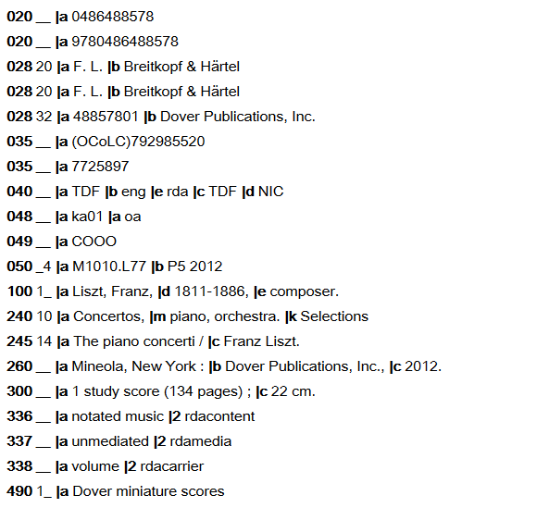
Liszt Score– MARC record, part 1

Slide 44
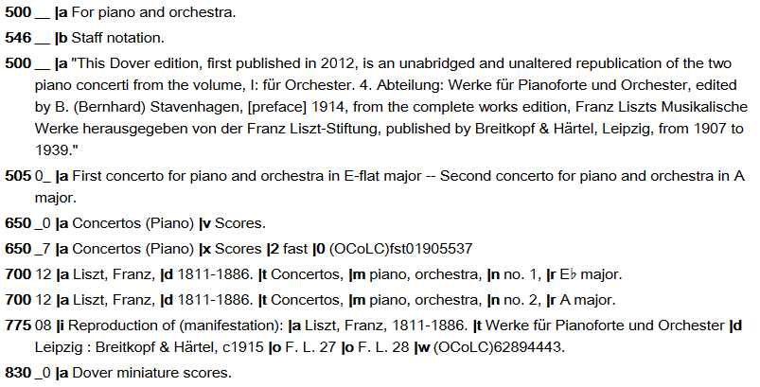
Liszt– MARC record, part 2

Slide 45
Practice Example 2: CD
Danish String Quartet CD (1 disc)
Disc label:
JOSEPH HAYDN
String Quartet No. 63
"Lerchenquartett"
JOHANNES BRAHMS
String Quartet op. 51 No. 2
DANISH STRING QUARTET
Avi-Music
4260085532643
℗+©2012 Bayerischer Rundfunk/Avi-Service for music Cologne/Germany
CO-PRODUCTION WITH BR KLASSIK
Container:
HAYDN · BRAHMS String Quartets
DANISH STRING QUARTET
Back of container:
Bar code: 4260085532643
Spine:
8553264 Avi-Music

Slide 46
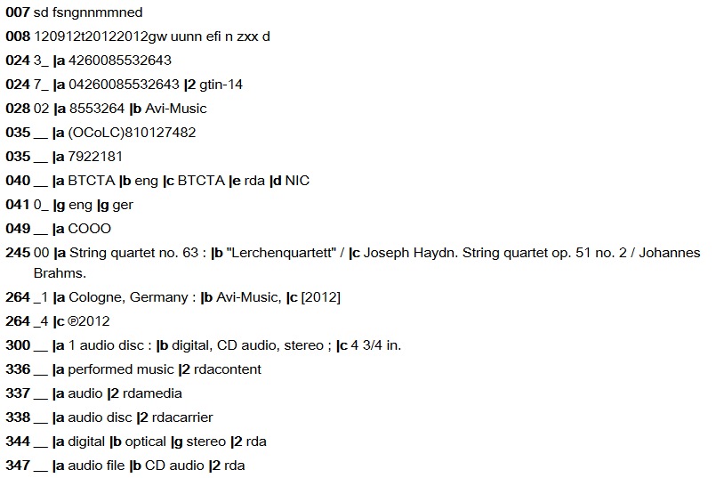
Danish String Quartet– MARC, part 1

Slide 47
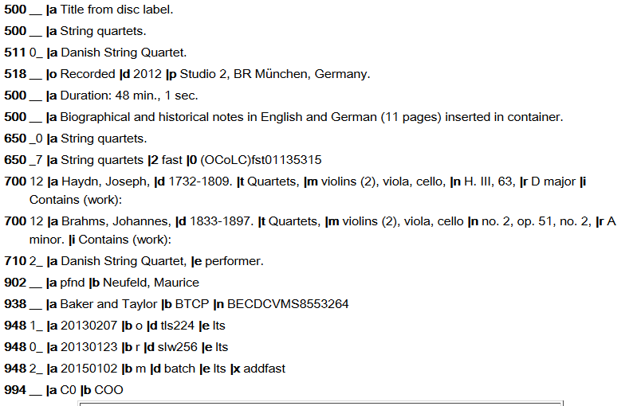
Danish String Quartet– MARC, part 2

Slide 48
Further RDA Resources for Music Catalogers
Music Library Association
Best Practices Document (in RDA Toolkit, under Resources Tab)
v1.1 (Feb. 2015): http://bcc.musiclibraryassoc.org/BCC-Historical/BCC2015/RDA_Best_Practices_for_Music_Cataloging_v1.1-150217.pdf
Pre-Conference/Clearinghouse Training site: http://guides.library.cornell.edu/c.php?g=32270&p=203361
Bibliographic Control Committee (BCC): http://bcc.musiclibraryassoc.org/bcc.html
Now the Cataloging & Metadata Committee (CMC)
Music OCLC Users Group (MOUG): http://musicoclcusers.org/
MOUG-L listserv
RDA Toolkit: http://www.rdatoolkit.org/

Slide 49
Questions?
Ann Shaffer, University of Oregon
ashaffer@uoregon.edu

