Slide 1
Levels, Genres, and Picture Book Topics: Making Your Children’s Collection Reader-Friendly
Presented by:
Steven Engelfried, Youth Services Librarian
Shannon Belford, Youth Reference Librarian
Wilsonville Public Library (OR)

Slide 2
What We’ll Cover
Picture Book Topics
Overview: Reader’s Point of View
Early Reader Levels
Fiction Genres
Non-Fiction Series
Other Collection Adjustments
Group Sharing: Other Experiences and Ideas?

Slide 3
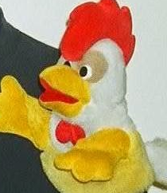
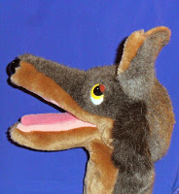
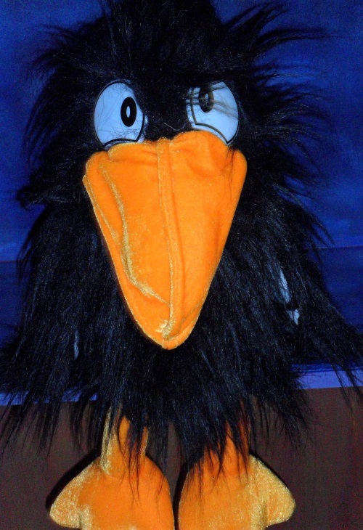
Puppet Time

Slide 4
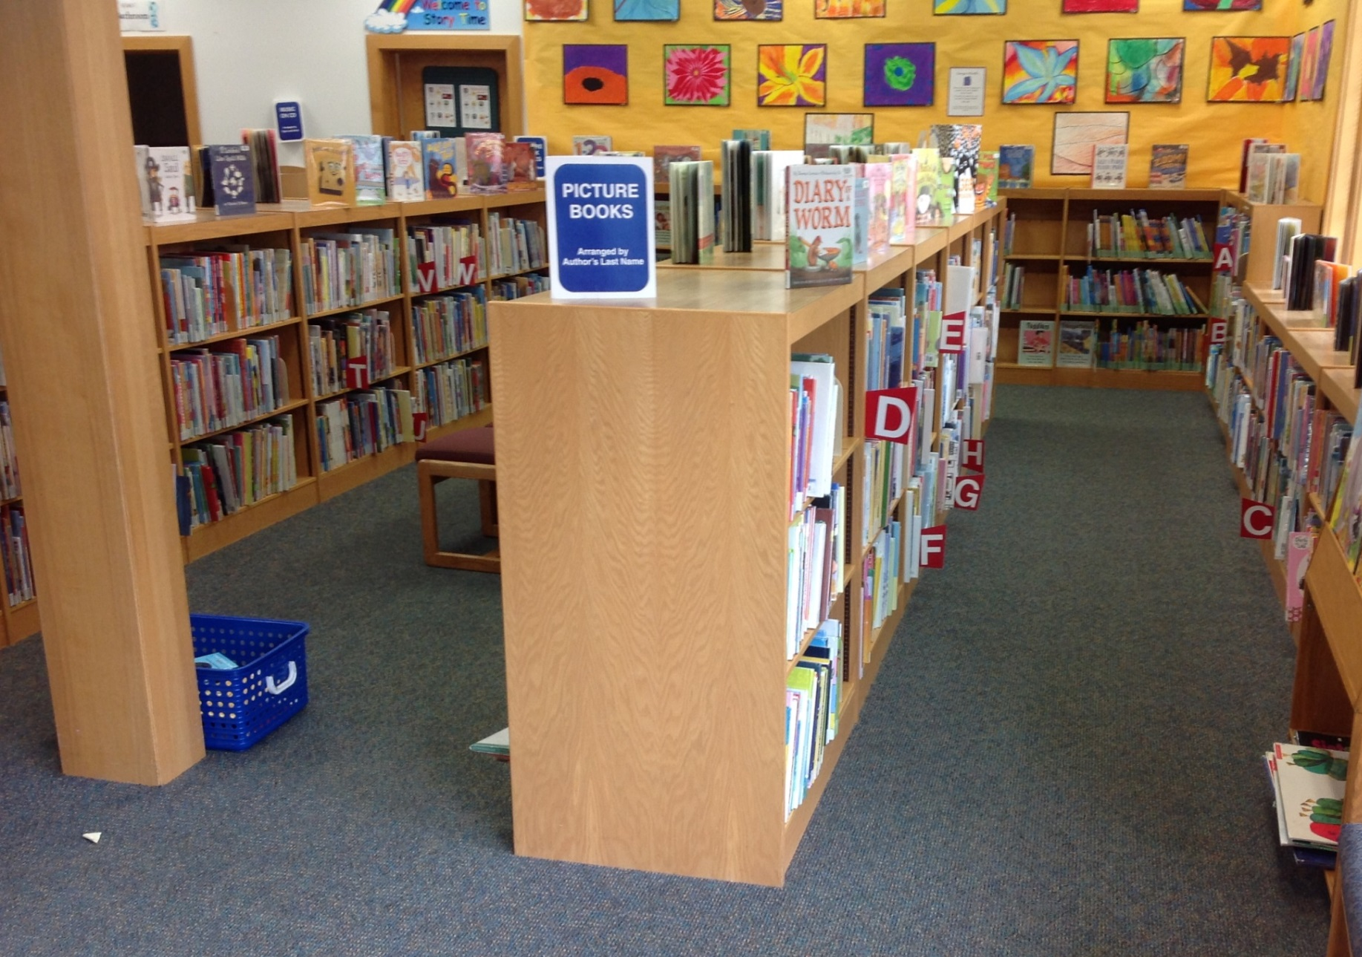
Picture Book Shelves: A to Z
Notes:
Here’s our

Slide 5
Picture Book Shelves: A to Z

Slide 6
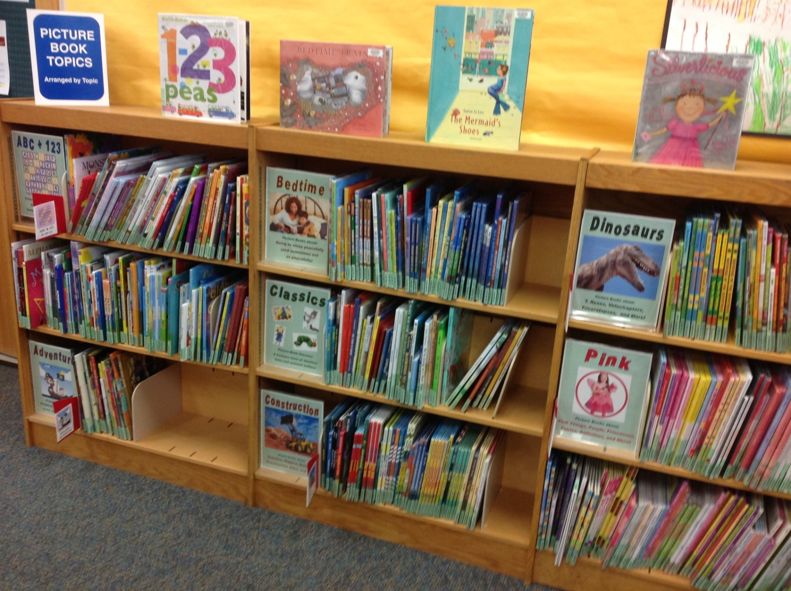
Picture Book Topics

Slide 7
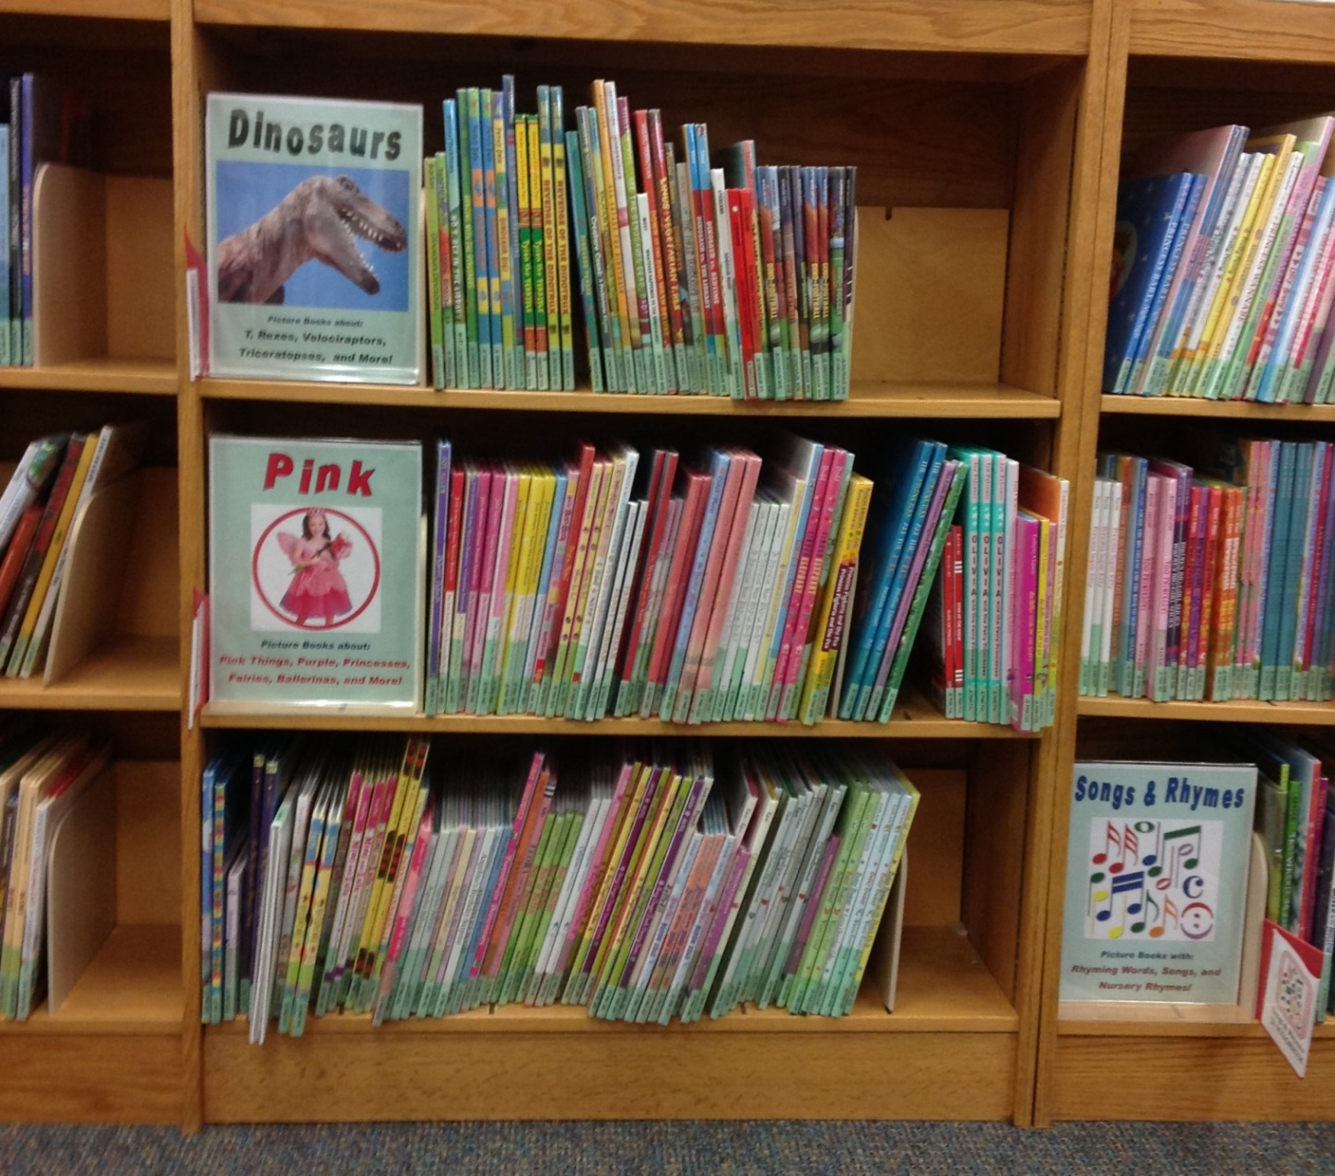
Picture Book Topics

Slide 8
Picture Book Topics: Choices
Choose topics that are most popular and/or useful
Retain author arrangement for most
Currently 20 / 80; Will be 25-30 / 70-75 eventually
Add topics over time, not all at once
Buy mostly new copies
Duplication is okay
Goal: “Here are a bunch of books on that topic”
Not trying to get every book

Slide 9
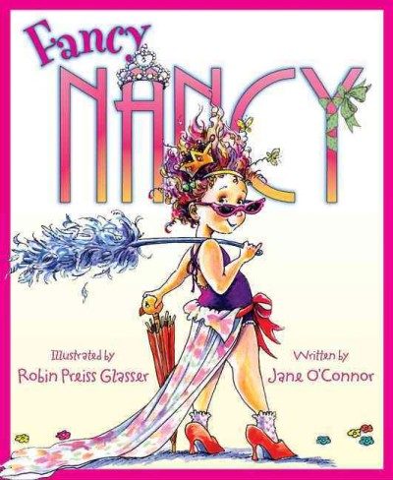
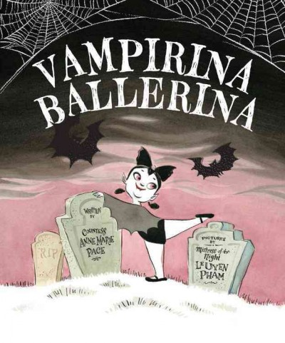
Picture Book Topics: Pink

Slide 10
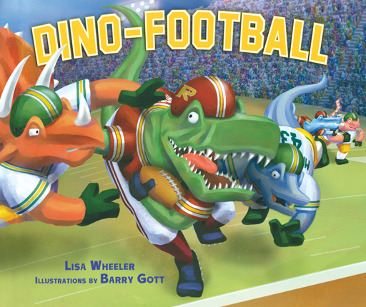
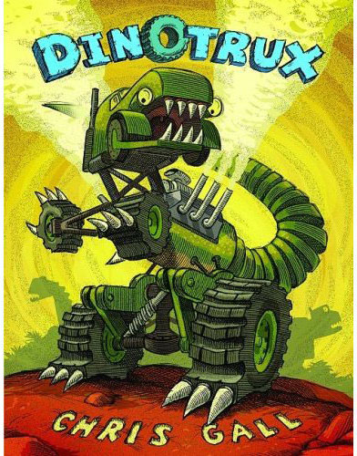
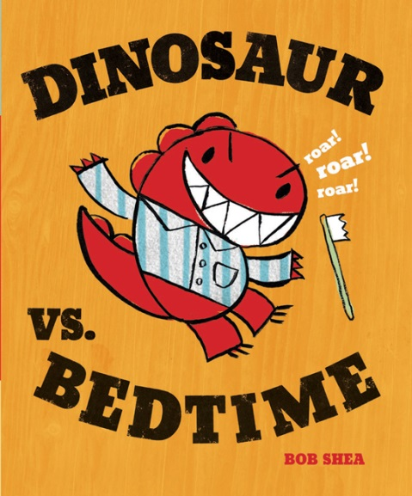
Picture Book Topics: Dinosaurs

Slide 11
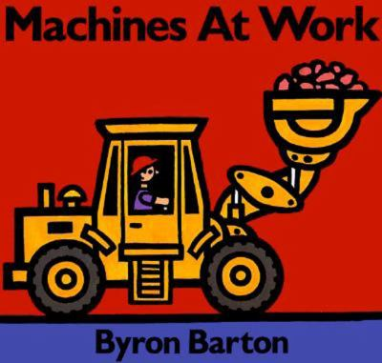
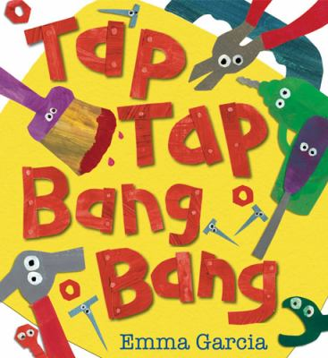
Picture Book Topics: Construction

Slide 12
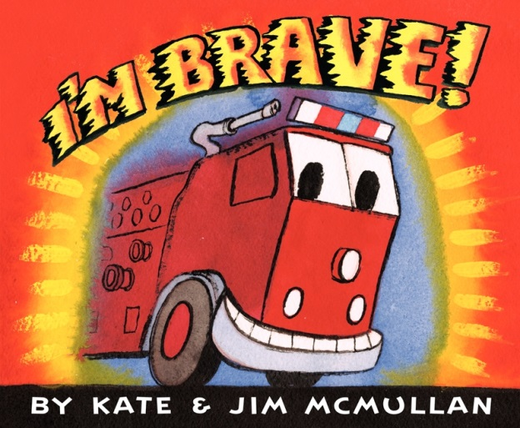
Picture Book Topics: Transportation

Slide 13
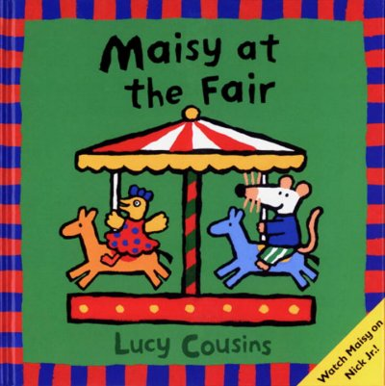
Picture Book Topics: Toddler

Slide 14
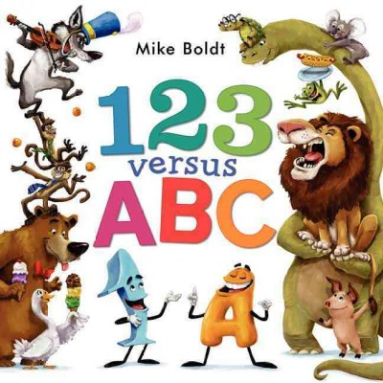
Picture Book Topics: ABC/123

Slide 15
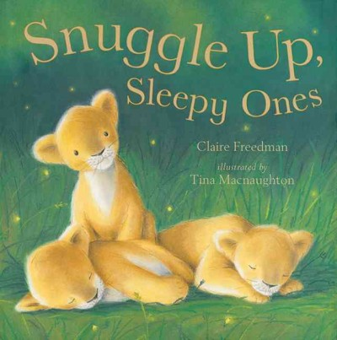
Picture Book Topics: Bedtime

Slide 16
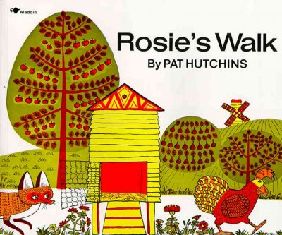
Picture Book Topics: Classics

Slide 17
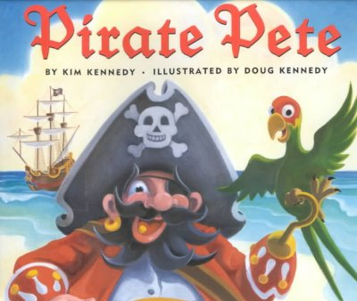
Picture Book Topics: Adventure

Slide 18
Picture Book Topics: Wordless

Slide 19
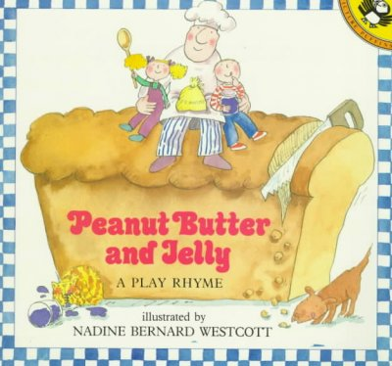
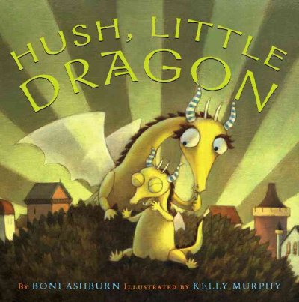
Picture Book Topics:
Songs and Rhymes

Slide 20
Picture Book Topics: Other Approaches
http://www.slideshare.net/gcaserotti/kidlit-reorg-at-darien-library

Slide 21
Picture Book Topics: Other Approaches
Audience suggestions?

Slide 22
Picture Book Topics: Results
Collection | Checked out in past two weeks | Checked out on a given day | Average Turnover Rate
Regular Picture Books | 24% | 31% | 7.3 Circs per Year
Picture Book Topics | 36% | 49% | 9.9 Circs per Year
Percentage Increase | +50% | +58% | +25%

Slide 23
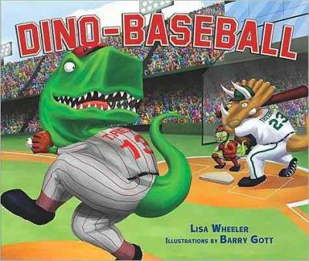
Picture Book Topics: Results
Topics - 67 circs
Regular – 35 circs
Topics - 36 circs
Regular – 23 circs
Topics - 45 circs
Regular – 28 circs

Slide 24
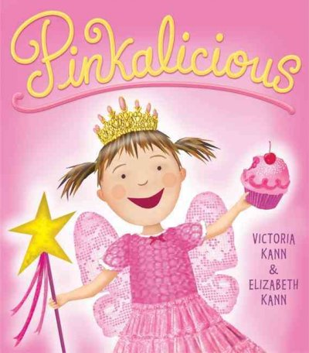
Picture Book Topics: Results
Highest Turnover rates
Pink 12.1
Dinosaurs 11.6
Classics
10.1

Slide 25
Picture Book Topics: Results
Kids can browse on their own with success
Parents can focus their read aloud choices
Some collections support early literacy concepts
Alternate to “branded” picture book selection by kids

Slide 26
Picture Book Topics: Concerns
Finding with catalog doesn’t work so well
Start up cost for each new topic
More budget for topics means less budget for other picture books

Slide 27
Reader’s Point of View
How do readers ask for books?
And how do they expect them to be organized?
Clues that we’re not getting it right
We get the same request over and over again and struggle each time
Readers who know how to search still can’t find what they’re after

Slide 28
Catalog search for pirate picture books
10 pirate books
3 pirate picture books
1 pirate picture book that’s in

Slide 29
Catalog search for pirate picture books

Slide 30
Catalog search for pirate picture books

Slide 31
Reader’s Point of View
Clues that we’re not getting it right
We get the same request over and over again and struggle each time
Readers who know how to search still can’t find what they’re after
We devise shortcuts, tricks, and workarounds

Slide 32
List of Princess Picture Books
Princess Picture Books
P Ada The Malachite Palace
P Allchin The Frog Princess
P Allen Princess Party
P Andersen The Little Mermaid
The Princess and the Pea
P Andrews The Very Fairy Princess
The Very Fairy Princess Takes the Stage
P Atwood Princess Prunella and the Purple Peanut
P Auch The Princess and the Pizza
P Burnett A Little Princess
P Calvert Princess Peepers
P Carlow Kitty Princess and the Newspaper Dress
P Cole Princess Smartypants
Princess Smartypants Rules
P Collins The Willow Maiden
P Cuyler Princess Bess Gets Dressed
P Dale Princess Princess
P Dorrie Lottie’s Princess Dress
P Duff The Princess and the Pumpkin
P Edwards Princess Pigtoria and the Pea
P Evans Princess Prissypants Wishes the World Pink
P Funke The Princess Knight
Princess Pigsty
P Gardner Princess Zelda and the Frog
P Goodhart Arthur’s Tractor: A Fairytale with Mechanical Parts
P Gow Ten Big Toes and a Prince’s Nose
P Grey The Very Smart Pea and the Princess-to-Be
P Heide Princess Hyacinth
P Hirshfield Sassyfras : the True Confessions of a Poodle Princess
P Holabird Angelina and the Princess
P Howland Princess Says Goodnight
P Ipcizade T is for Tiara: A Princess Alphabet
P Isadora The Princess and the Pea
P Johnston The Princess and the Black-Eyed Pea
P Kastner Princess Dinosaur
P Keller Sleeping Bunny

Slide 33
Benefits of Reader-Based Collections
Easier for patrons
Easier for library staff doing reader’s advisory
Opportunities to highlight quality books
Shows we understand and respect our readers

Slide 34
Puppet Time

Slide 35
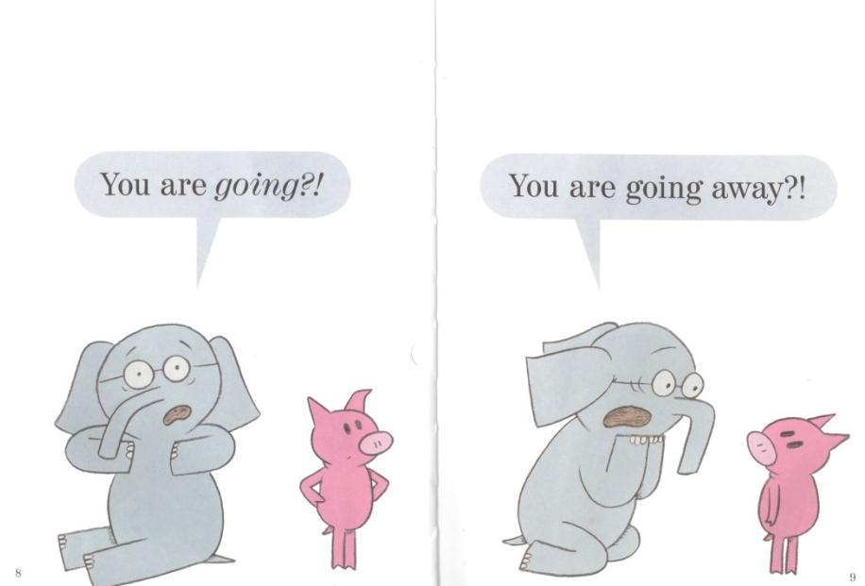
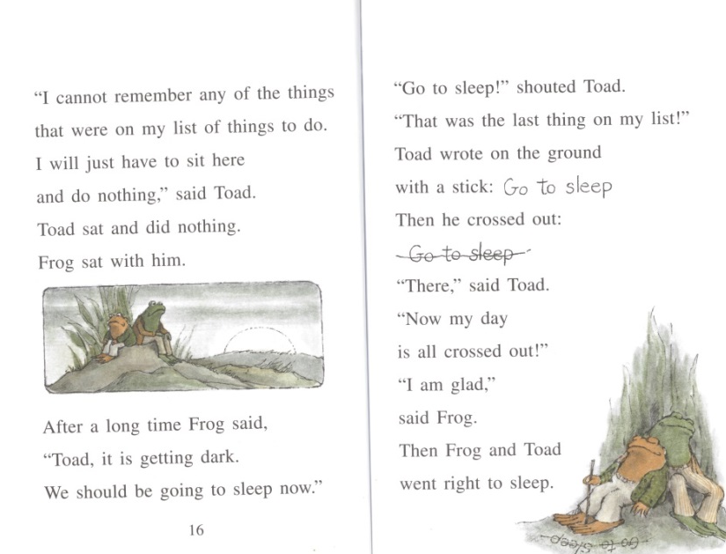
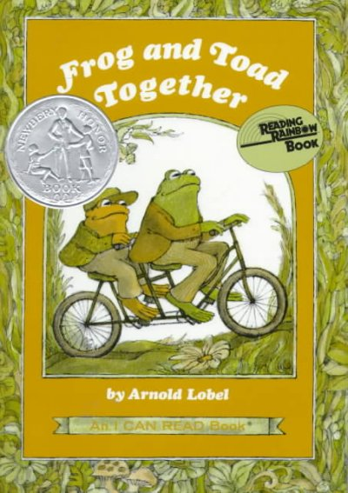
Early Readers: Without Levels

Slide 36
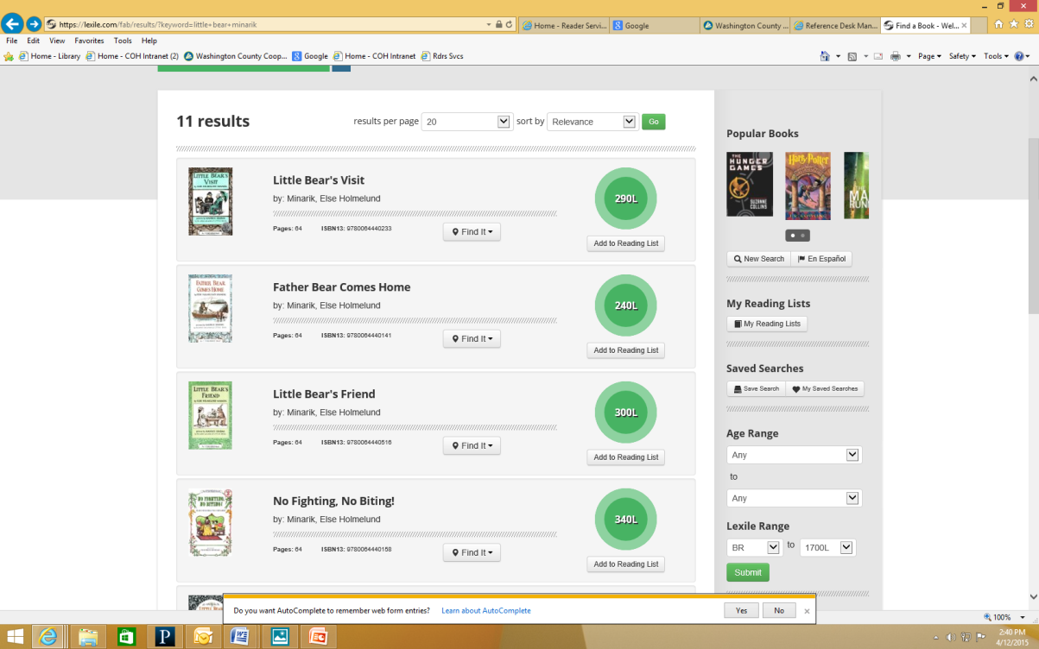
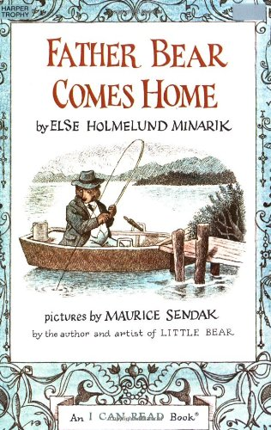
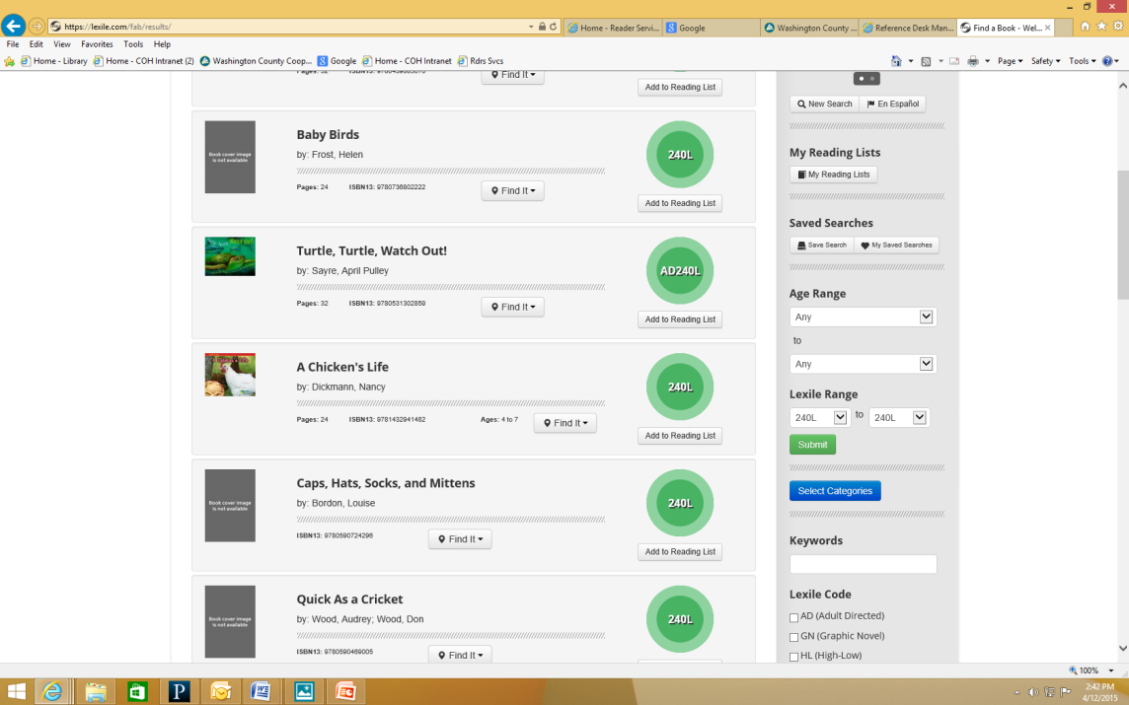
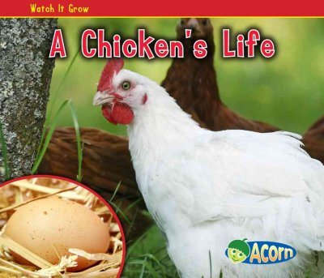
Early Readers: Using Lexiles

Slide 37
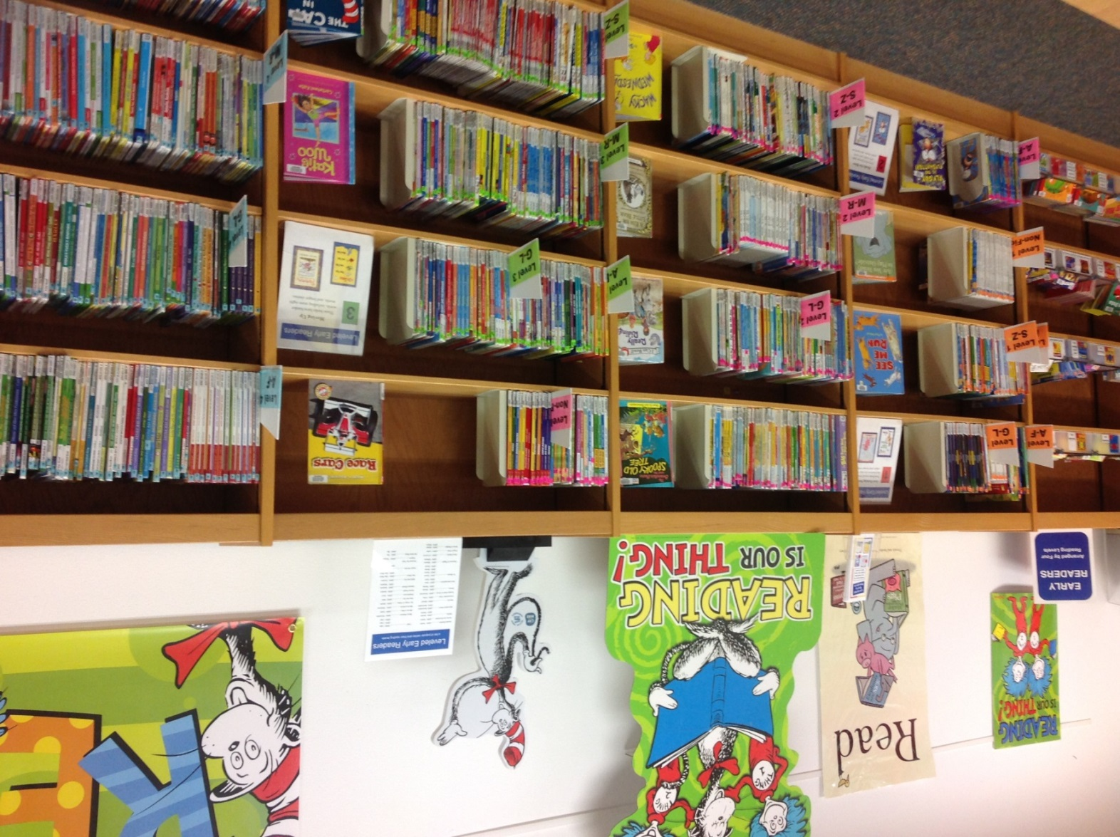
Early Reader Levels

Slide 38
Early Reader Levels: Choices
No lexile look-ups
Ignore publisher levels

Slide 39
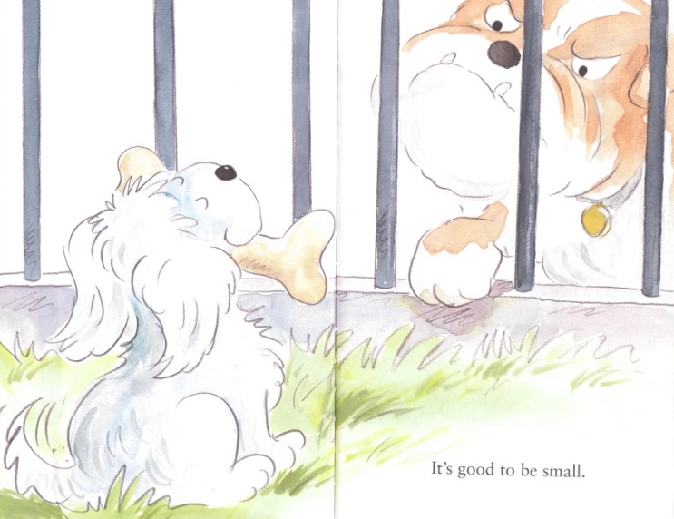
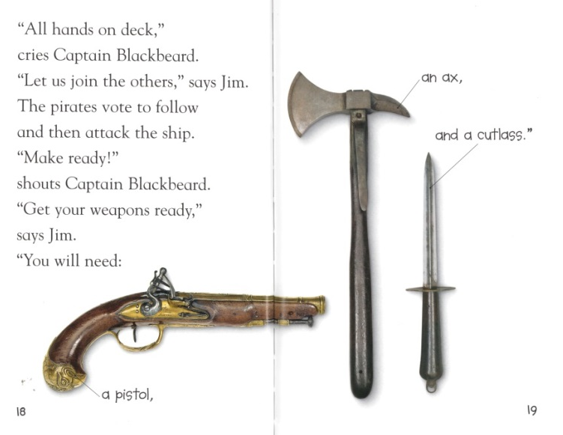
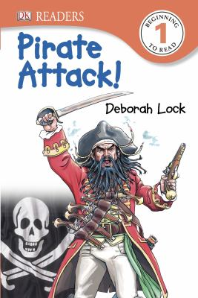
Early Reader Levels

Slide 40
Early Reader Levels: Choices
No lexile look-ups
Ignore publisher levels
Use basic guidelines to determine levels

Slide 41
Early Reader Levels

Slide 42
Early Reader Levels: Choices
No lexile look-ups
Ignore publisher levels
Use basic guidelines to determine levels
Don’t worry too much about getting it exactly right
Goal: “Here are some books grouped by reading level” (not: here are 1st grade books or level 2.3 books)

Slide 43
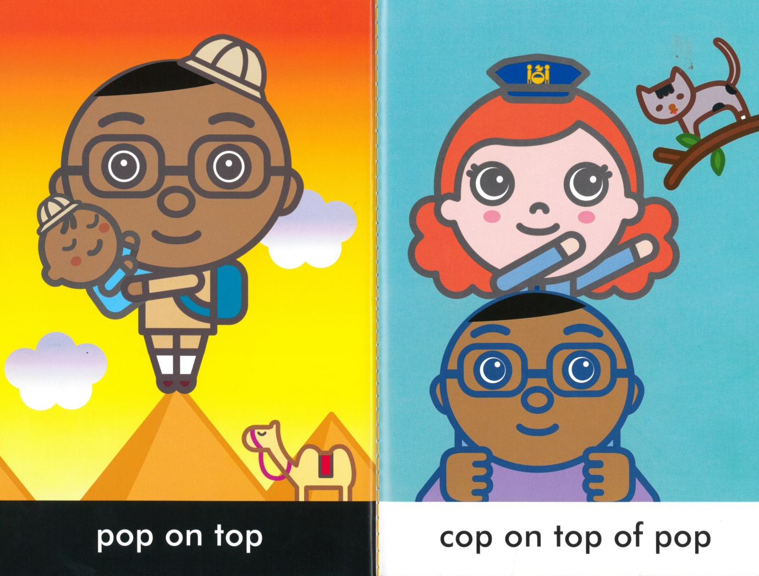
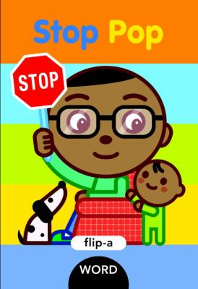
Early Readers: Level 1

Slide 44
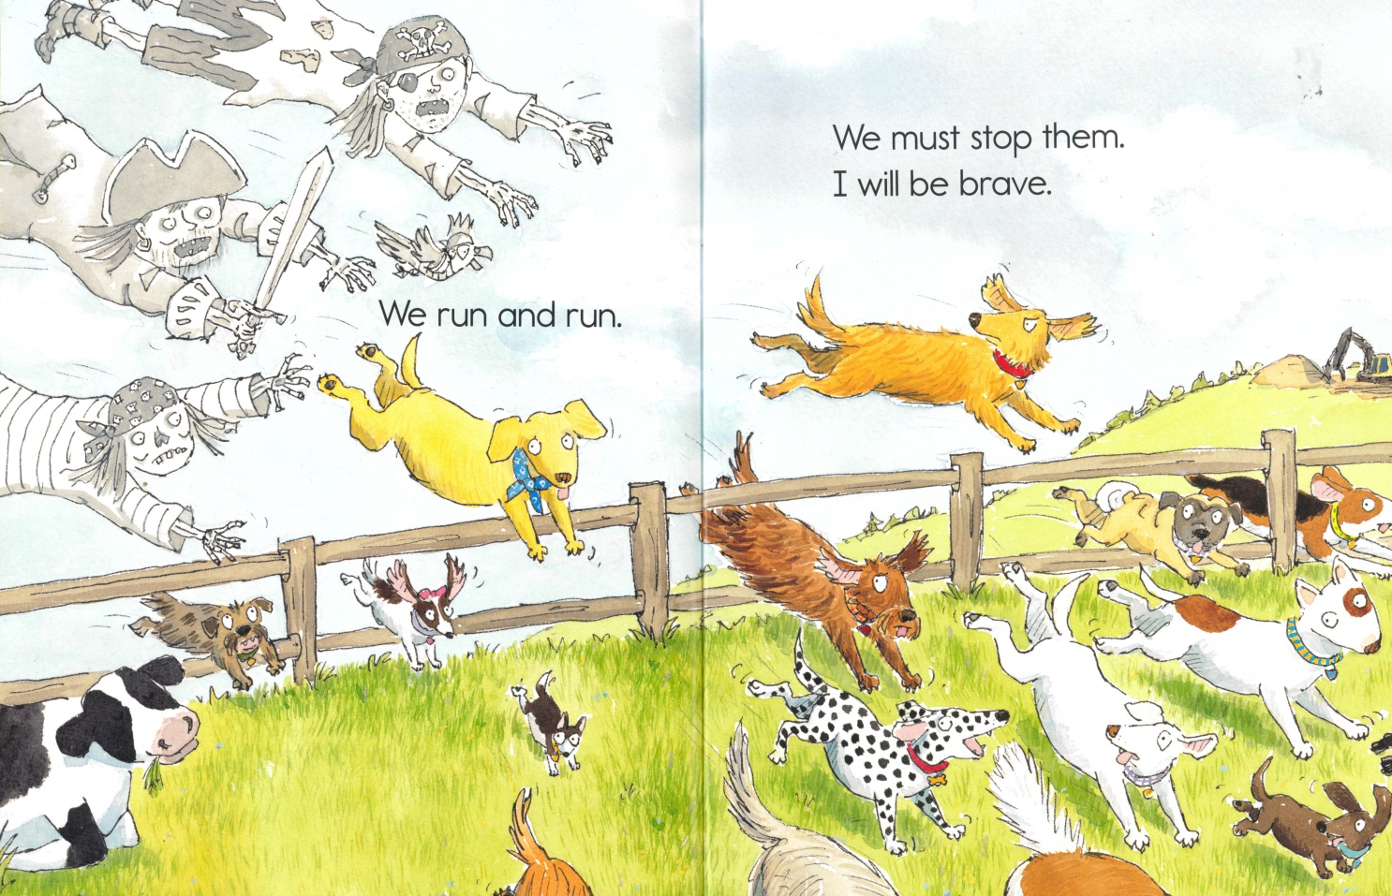
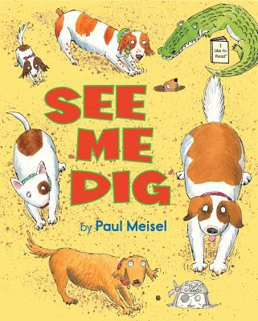
Early Readers: Level 1

Slide 45
Early Readers: Level 2

Slide 46
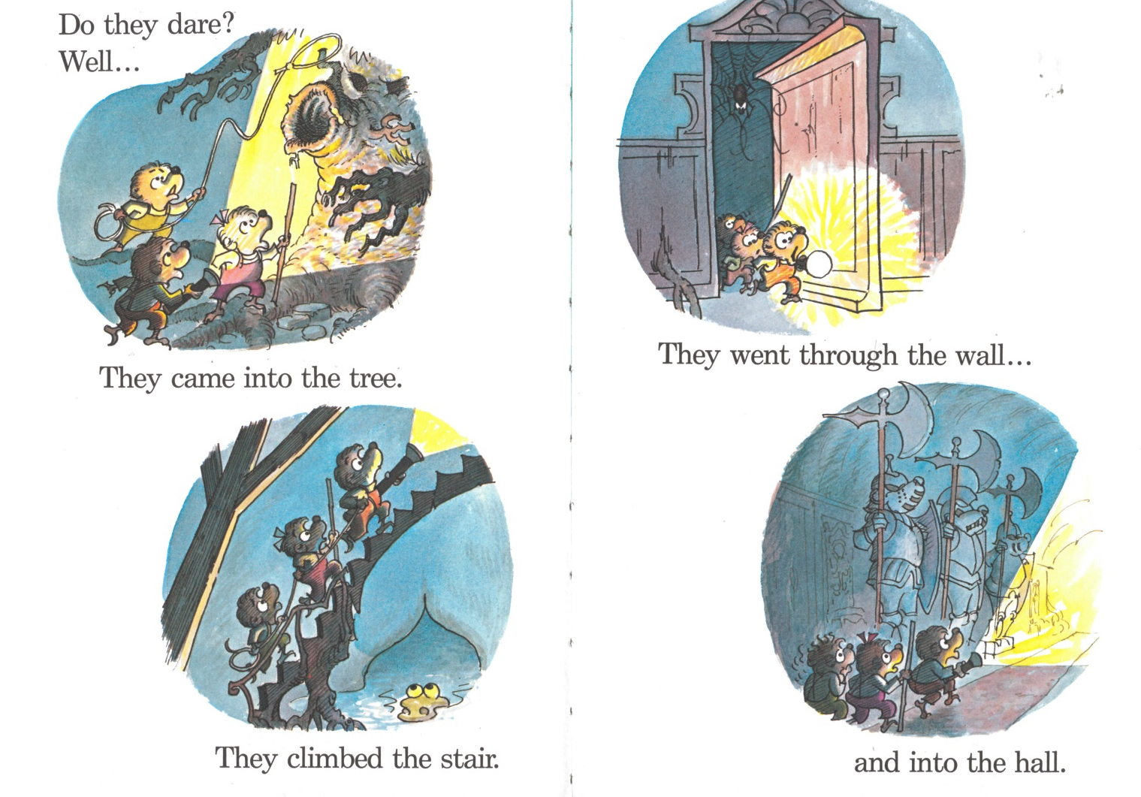
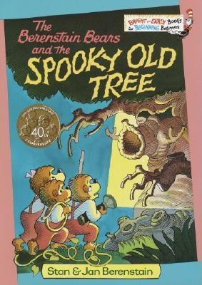
Early Readers: Level 2

Slide 47
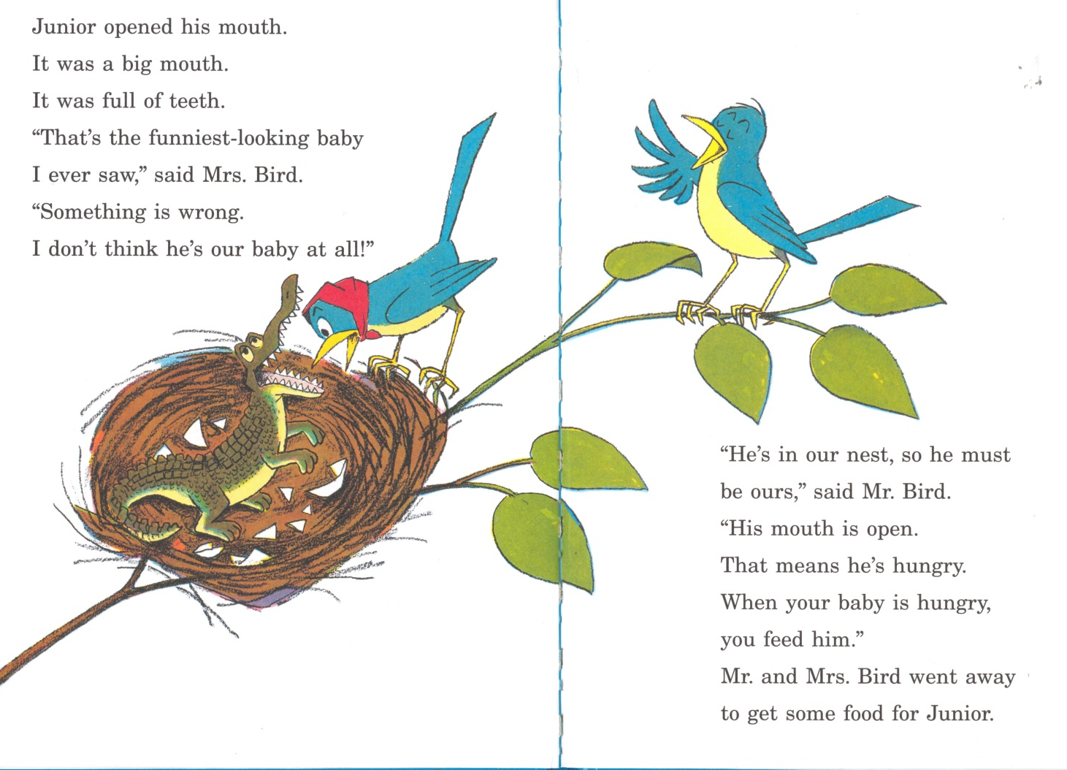
Early Readers: Level 3

Slide 48
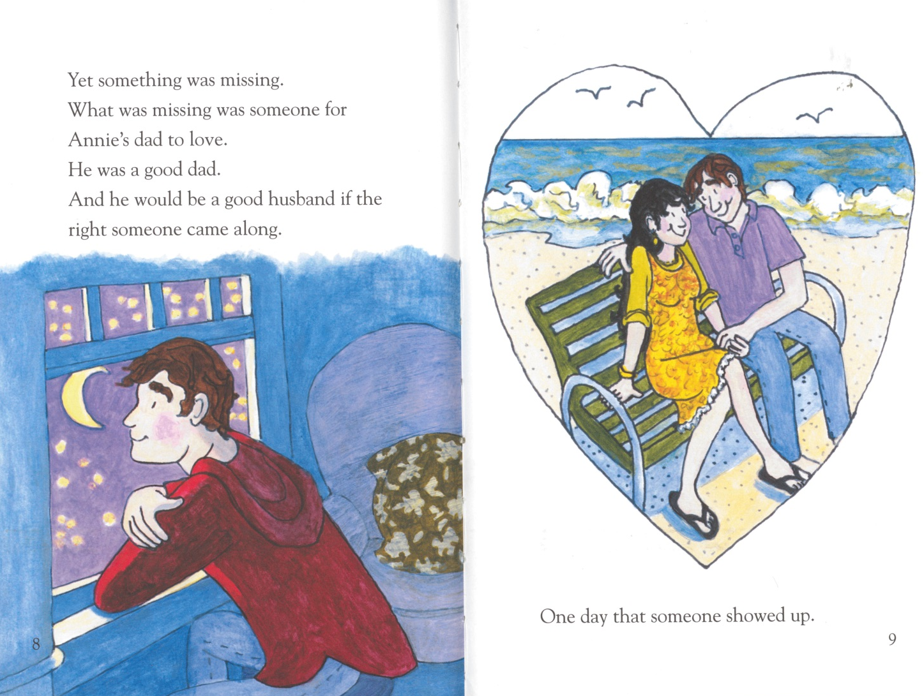
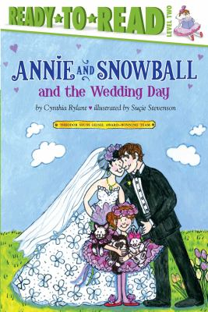
Early Readers: Level 3

Slide 49
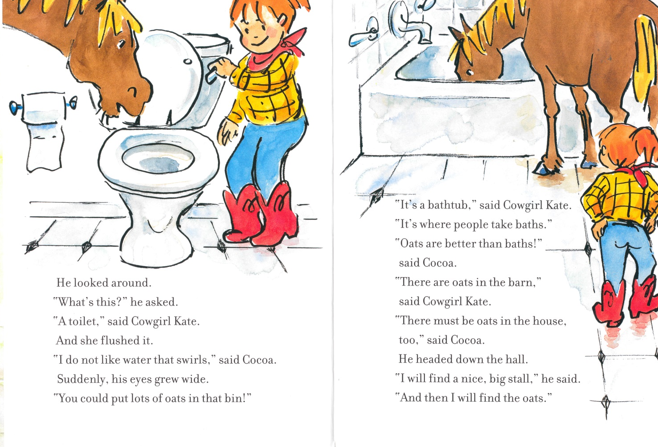
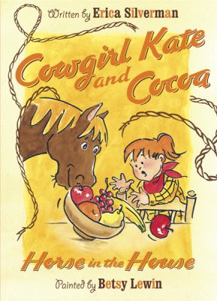
Early Readers: Level 4

Slide 50
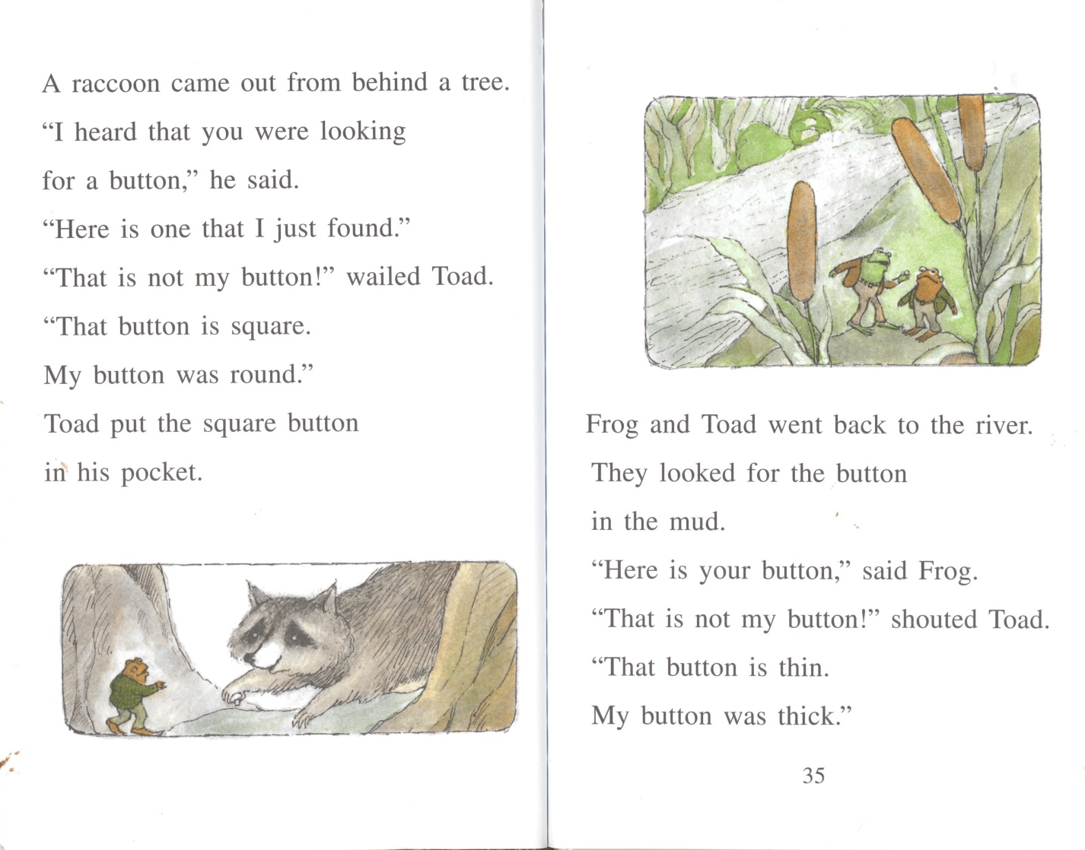
Early Readers: Level 4

Slide 51
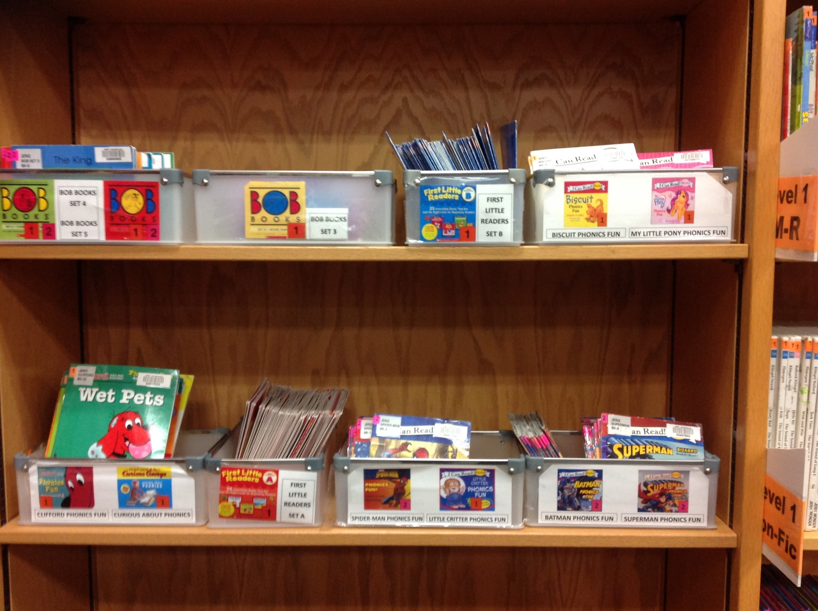
Early Readers Phonics Sets

Slide 52
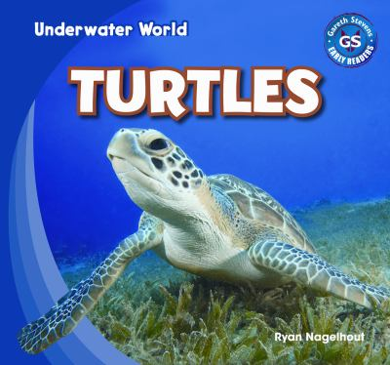
Early Readers Non-Fiction: Level 1

Slide 53
Early Readers Non-Fiction: Level 2

Slide 54
Early Reader Levels

Slide 55
Early Reader Levels: Results
Level | Average Turnover Rate
Level 1 | 5.4 Circs per Year
Level 2 | 8.5 Circs per Year
Level 3 | 7.4 Circs per Year
Level 4 | 6.9 Circs per Year

Slide 56
Early Reader Levels: Results
Patrons appreciate and understand the philosophy
Patrons don’t question level designations
Added interest in reading levels beyond beginners

Slide 57
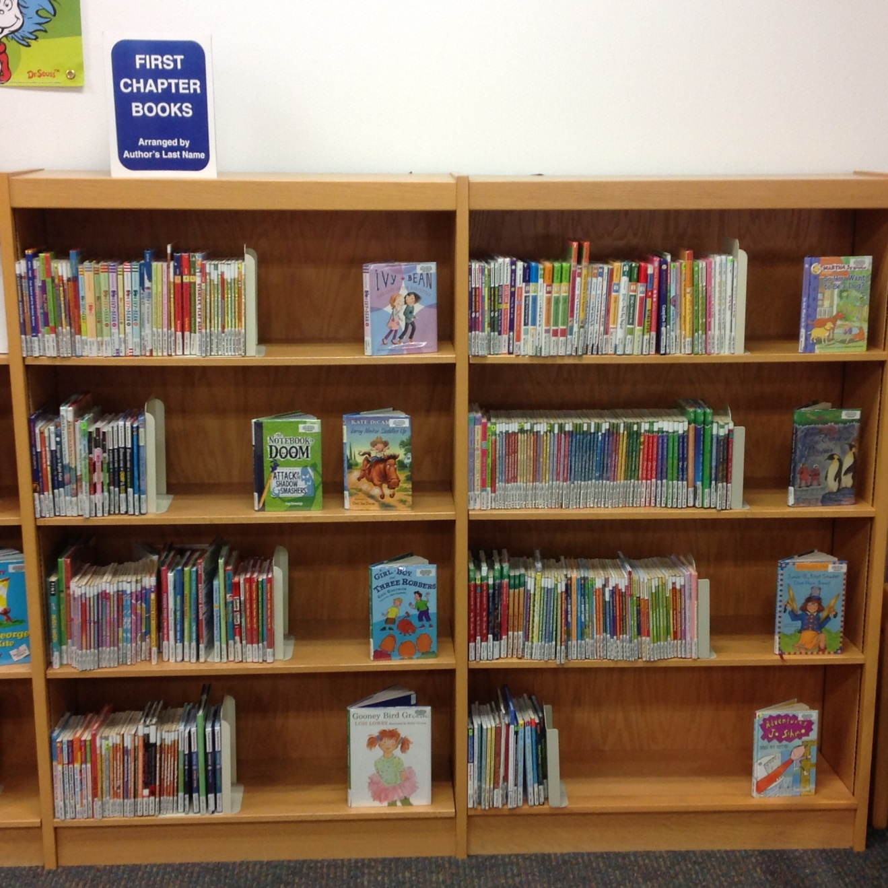
First Chapter Books

Slide 58
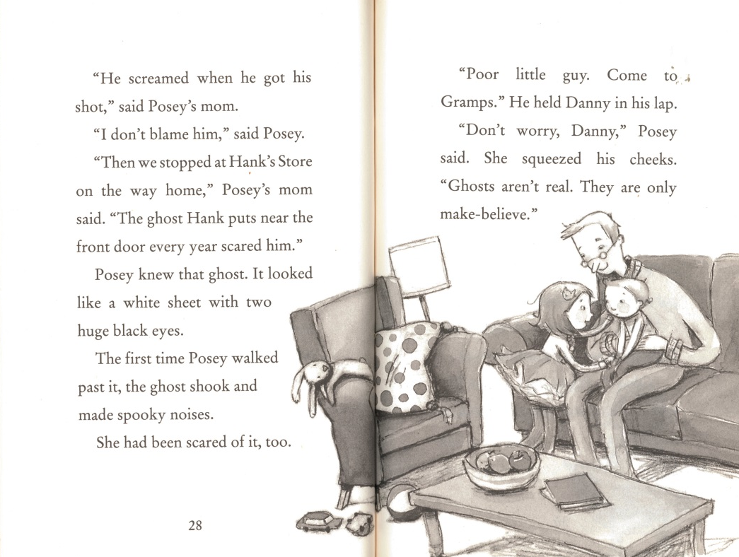
First Chapter Book: Yes

Slide 59
First Chapter Book: Not quite

Slide 60
Early Reader Levels: Concerns
Levels divide up authors and series

Slide 61
Early Readers: Titles by Level

Slide 62
Early Reader Levels: Concerns
Levels divide up authors and series
Increased expectations for reading level grouping

Slide 63
Puppet Time

Slide 64
Fiction Topics: Genre Labels

Slide 65
Fiction Topics: Genre Labels

Slide 66
Fiction Topics

Slide 67
Fiction Topics: Choices
Twelve topics

Slide 68
Fiction Topics: Choices

Slide 69
Fiction Topics: Choices
Twelve topics
Rotate copies from regular fiction
More than straight genres
Thinking about how kids ask for books

Slide 70
Fiction Topics: Choices

Slide 71
Fiction Topics: Choices
Twelve topics
Rotate copies from regular fiction
More than straight genres
Thinking about how kids ask for books
Staff choose books
Goal: “Here are some books in that topic level” (not: here are all of the books in that topic)

Slide 72
Fiction Topics: Results
As helpful for staff as it is for patrons
Books don’t fly off the shelf, but move steadily

Slide 73
Fiction Topics: Concerns
Catalog doesn’t match location
Staff filling shelves can be a challenge

Slide 74
Puppet Time

Slide 75
Non-Fiction: Call Number Search

Slide 76
Non-Fiction: Call Number Search

Slide 77
Non-Fiction Series

Slide 78
Non-Fiction Series: Choices
Have a “featured non-fiction” place
Pick series that cover variety of ages and subjects

Slide 79
Non-Fiction Series: Series Chosen
Basher Science
Cat in the Hat Learning Library
Eyewitness Books
Let’s Read and Find Out
Magic School Bus
Gail Gibbons

Slide 80
Non-Fiction Series: Series Chosen
Magic Tree House Fact Tracker
National Geographic Readers
What Was…?
Who Was…?
- Ology Books

Slide 81
Non-Fiction Series: Choices
Have a “featured non-fiction” place
Pick series that cover variety of ages and subjects
Duplicate many copies to retain Dewey coverage
No need to have complete series
Goal: An attractive starting place for non-fiction browsers
Goal: Provide reading level choices within non-fiction

Slide 82
Non-Fiction Series: Choices
Let’s Read and Find Out
Basher Science

Slide 83
Non-Fiction Series: Results
Series Title | % Checked Out
Cat in the Hat Learning Library | 43%
Eyewitness | 24%
Gail Gibbons | 26%
Let's Read and Find Out | 21%
Magic School Bus | 42%
Magic Tree House | 27%
National Geographic Readers | 68%
Ology Books | 82%
What Was… | 62%
Who Was… | 59%
All Non-Fiction Series | 51%
Non Fiction Overall | 12%

Slide 84
Non-Fiction Series: Concerns
Need to check two places for subject requests

Slide 85
Other Collection Adjustments
Shelf labels for popular Fiction authors and series

Slide 86
Other Collection Adjustments: Fiction

Slide 87
Other Collection Adjustments
Shelf labels for popular Fiction authors and series
Non-Fiction signs with visual guides

Slide 88
Other Collection Adjustments: Non-Fiction

Slide 89
Other Collection Adjustments: Non-Fiction

Slide 90
Other Collection Adjustments: Non-Fiction

Slide 91
Other Collection Adjustments
Shelf labels for popular Fiction authors and series
Non-Fiction signs with visual guides
Collections signs that are consistent and logical

Slide 92
Other Collection Adjustments: Signage

Slide 93
Other Collection Adjustments: Signage

Slide 94
Other Collection Adjustments
Shelf labels for popular Fiction authors and series
Non-Fiction signs with visual guides
Collections signs that are consistent and logical
Separate Graphic Novels and Manga in YA

Slide 95
Other Collection Adjustments: GN/Manga

Slide 96
Other Collection Adjustments: GN/Manga

Slide 97
Wrap Up
Can do this stuff a little at a time
Changes can be headaches to staff, but seem fresh to patrons
Include Tech Services and Circulation staff in the process
Evaluation forms
Contact us with any questions
Steven: engelfried@wilsonvillelibrary.org
Shannon: belford@wilsonvillelibrary.org

Slide 98
Levels, Genres, and Picture Book Topics: Making Your Children’s Collection Reader-Friendly
Presented by:
Steven Engelfried, Youth Services Librarian
Shannon Belford, Youth Reference Librarian
Wilsonville Public Library (OR)

