Slide 1
Influence Without Authority Guest Speaker: Joseph J. Hernandez SSD Annual Gateways Conference Friday, July 17, 2015 “many roles, One Goal: Meeting the needs of our communities”

Slide 2
Background
Joseph J. Hernandez: CCC ACT-On Career Coach, Business & Management/Supervisory Development Instructor

Slide 3
Introduction
Influence is a precise form of communication exercised with the intent of getting something done through another person or group.
Or essentially any behavior that attempts to alter someone's attitudes or behavior for mutual benefit.
Effective influence requires strength, flexibility, and focus.
Effective influencers think strategically, build strong influence relationships and focus their communication in order to achieve their desired results.

Slide 4
Nature of Influence
A better basis for building influence relationships is set through these principles.
Implicit-unspoken but integral to the relationship
Learning of complex information in an incidental manner; without awareness of what has been learned.
Explicit-discussed and agreed upon
Unfold and makes visible; able to find solutions.

Slide 5
Implicit Principles
Fairness-the other will strive to be just and evenhanded, to play by the rules
Integrity-the other will honor any agreements that he or she makes
Trust—you can assume that what the others says to be true is true
This is foundational because without trust you have no influencing ability (other’s will be less inclined to listen to what you have to say).

Slide 6
Explicit Principles
Agreement to agree-on a specific issue of importance to both or all parties, you begin by committing to a process that will only end when both or all parties are satisfied with the result.
Agreement to listen-if any party is unsatisfied with the way things are working you will take the time to listen to one another’s concerns. This also implies that if any party is unsatisfied they agree to say something about it to one another rather than to third parties.
Agreement to resolve conflict-if conflicts arise, you are committed to resolving them satisfactorily. If you cannot do it yourselves you will jointly ask a third party to help you resolve it.
Agreement to think “outside the box”-you will put aside current limitations and assumptions and explore possibilities without premature judgment.

Slide 7
Establishing Goals and Purpose
In any influence situation, it is important to establish your goal before you begin.
First you need to be clear in your own mind about what you are intending to accomplish through influencing the other.
How will I know that I have succeeded? (This is a question that you can begin to ask yourself) What measures will indicate if you have been successful in your influencing?

Slide 8
Understanding your Results
Achieving results depends on how greatly you want it and knowing what you want to achieve.
Being clear up front on the result that you are aiming for helps define your influence purpose and goal. This also enables you to choose the behaviors that will have the best chance of taking you there.
Being focused is important.
It means having clarity about the goal and persistence in pursuing it.

Slide 9
Context
Current organizational issues and events
Current state of mind of your influence target
Recent history that affects the relationship
Putting it all together for an influencing process:
It is important to understand the information that we just covered to be successful in your influencing process!
Next we will look at power, authority and motivation vs. manipulation

Slide 10
The meaning of power
Power is the capacity of a person, team, or organization to influence others.
Potential to influence
not actual behavior to influence
Perception – not necessarily reality
Perceived control over valued resources
Asymmetric dependence
One party is more dependent on the other

Slide 11
Reward and Coercive Power
Reward Power
Ability to control the allocation of rewards valued by others and to remove negative sanctions
Coercive Power
Ability to apply punishment
Peer pressure is a form of coercive power
Reward and coercive power exist upward as well as downward in hierarchies.

Slide 12
Expert Power
The capacity to influence others by possessing knowledge or skills that they value
People gain power by using their expertise to:
Prevent environmental changes
Forecast environmental changes
Absorb environmental changes

Slide 13
Referent Power
Occurs when others identify with, like, or otherwise respect the person
Associated with charismatic leadership
Can you think of someone who you have given referent power to?

Slide 14
Centrality
Degree and nature of interdependence between the power holder and others (reflects the person’s importance to others)
Centrality is a function of:
How many others are affected by you
How quickly others are affected by you

Slide 15
Discretion and visibility
Discretion
The freedom to exercise judgment
Rules limit discretion, limit power
Also a perception – acting as if you have discretion
Visibility
Make others aware of your presence –more face time, locate office near busy routes
Symbols communicate your power source(s)
Educational diplomas
Clothing etc (stethoscope around neck)

Slide 16
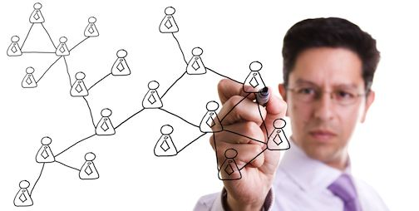
Through Social Networks
Social networks – people connected to each other through forms of interdependence
Generate power through social capital -- goodwill and resulting resources shared among members in a social network
Three power resources through social networks: (1) Knowledge sharing, (2) visibility, (3) referent power

Slide 17
Social Network Ties
Strong ties:
Close-knit relationships (frequent interaction, high volume sharing, multiple roles)
Offer resources more quickly/plentifully, but less unique
Weak ties
Acquaintances
Offer unique resources not held by us or people in other networks
Many ties
Resources increase with number of ties
Limits on number of weak/strong ties one can create

Slide 18
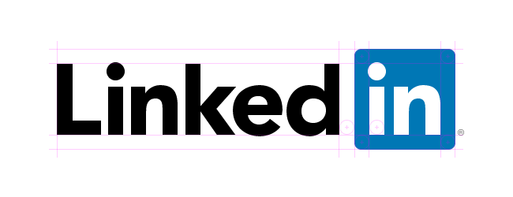
Social Network Centrality
Person’s importance in a network
Three factors in centrality:
Between-ness – extent you are located between others in the network (i.e. information gatekeeper)
Degree centrality -- Number of people connected to you
Closeness – stronger relationships (faster/plentiful resources)

Slide 19
Beginning to Influencing others
Remember
Influence--any behavior that attempts to alter someone’s attitudes or behavior.
Positive influence has a mutual benefit.
Applies one or more power bases (we just covered these).
Process through which people achieve objectives.
Vital to understand the different types of influence (next slide).

Slide 20
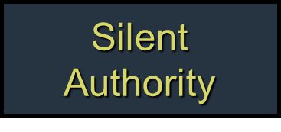
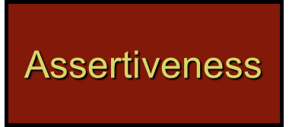
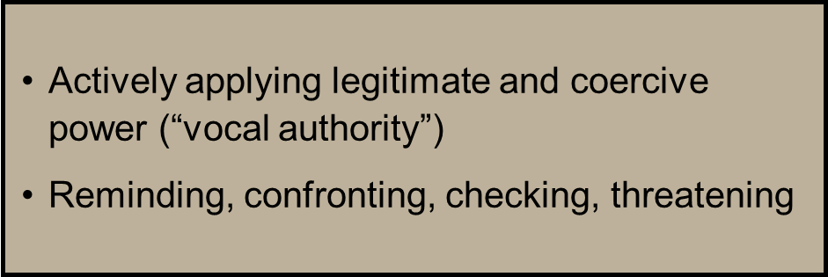
Types of influence

Slide 21
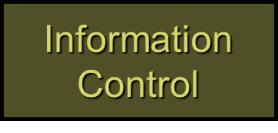
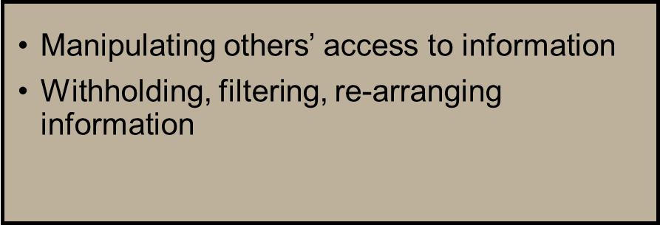
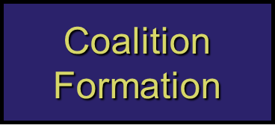
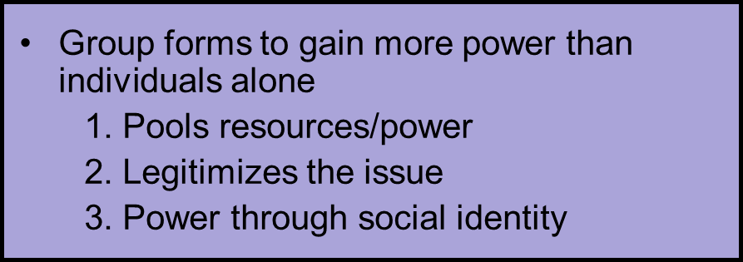
Types of influence (cont.)

Slide 22
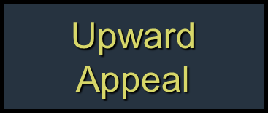
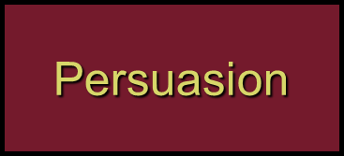
Types of influence (cont.)

Slide 23
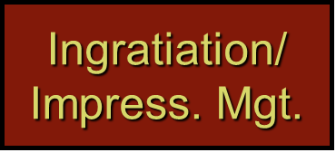
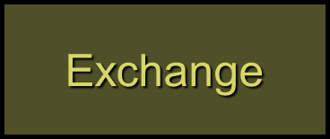
Types of influence (cont.)

Slide 24
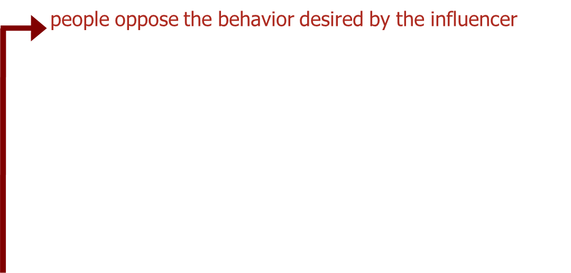
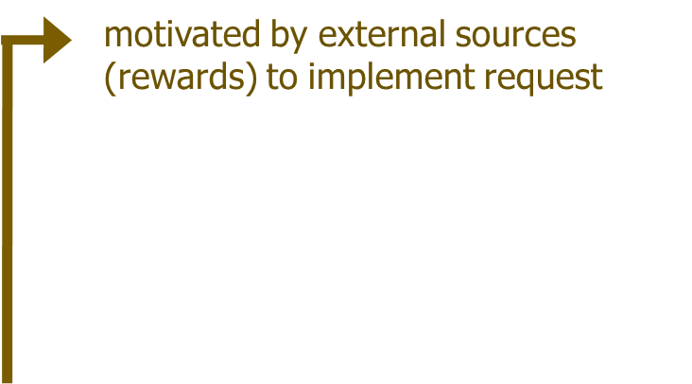
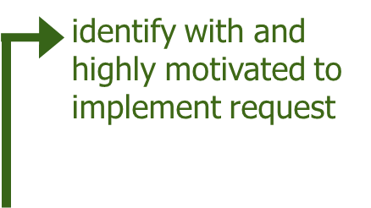
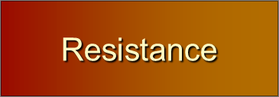
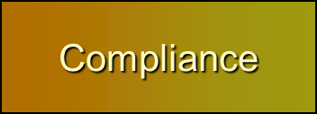
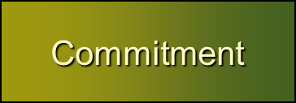
Consequences of influence tactics

Slide 25
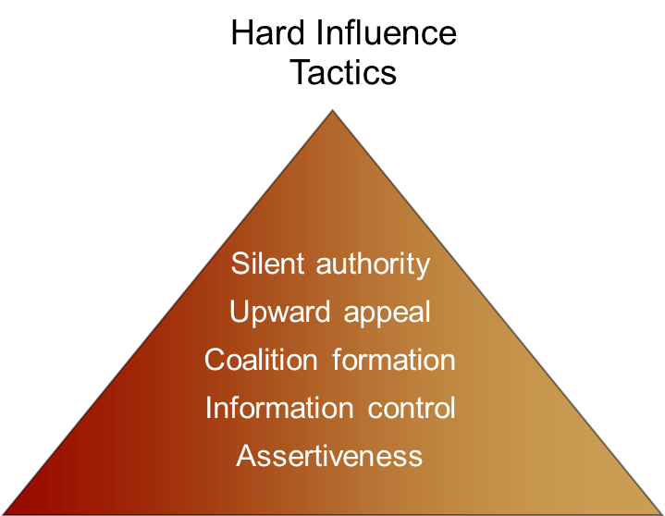
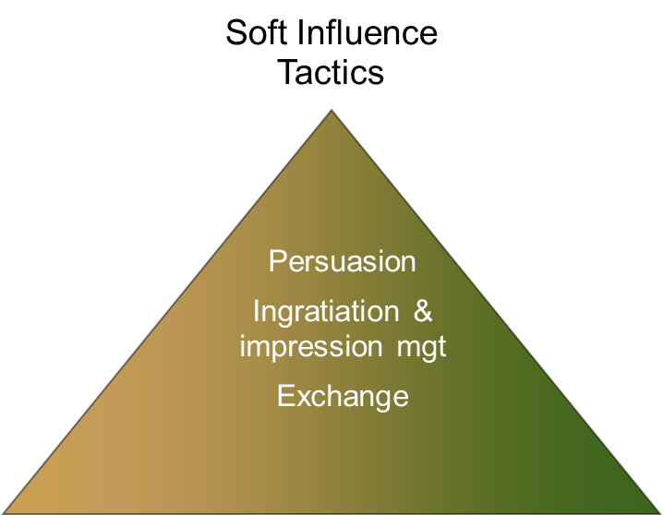
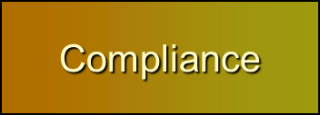
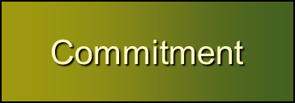
Consequences of influence tactics

Slide 26
Contingencies of influence tactics
“Soft” tactics generally more acceptable than “hard” tactics
Appropriate influence tactic depends on:
Influencer’s power base
Organizational position
Cultural values and expectations

Slide 27
What is authority?
What is Authority?
The definition of authority is the legitimate (legal) right to limit choice. Or essentially the power or right to give orders, make decisions, and enforce obedience through various mediums.
So what does that mean? Let's take a look back at power and influence.
Power could be said to be the ability to limit choice. It can be identified with several factors such as strength, status, or capacity.
Influence could be defined as the ability to get others to do what you want them to do. The influence process is voluntary. It can be associated with terms such as trust, respect, coaching, and leadership.

Slide 28
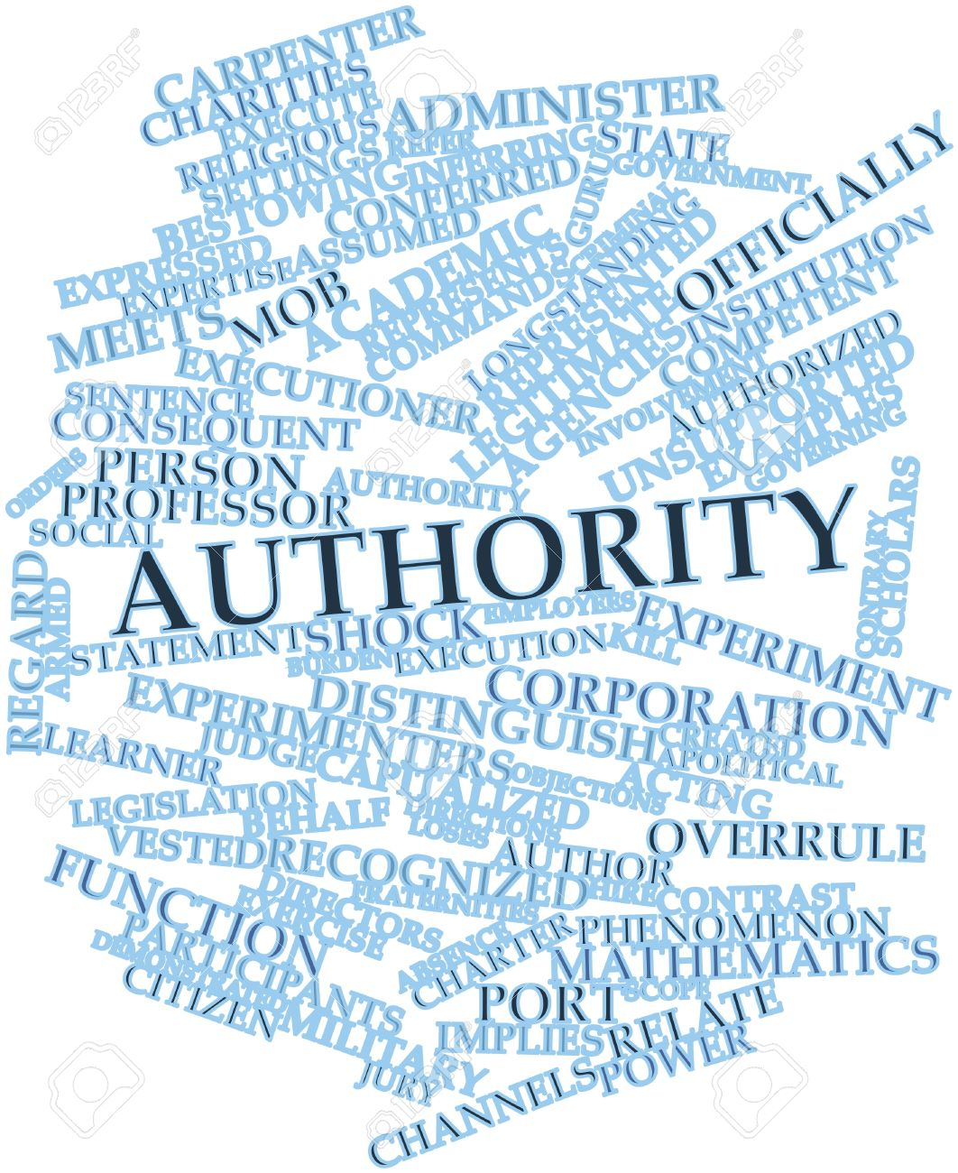
What is authority (cont.)
So what terms could be associated with authority?
Dominance
Leadership
Control
Management
Person in charge
Rule
What other terms come to mind?

Slide 29
What is authority (cont.)
Start to think of your own experiences and think about your supervisors, colleagues, or family members.
Did they have authority in certain situations and did they try to influence you in a way that would get you to do something for them?
In tying all three terms together: power, influence and authority; it will give you a great advantage in influencing others effectively.

Slide 30
Motivation vs. manipulation
Fundamental difference between motivation and manipulation
Motivation is empowering and encouraging and may be based on an internal factor such as caring what others will benefit out it as well. It can aid in influencing others to do something positively.
Manipulation is based on selfish needs and is concerned with external factors meaning that the individual who is doing the manipulation is wanting something with disregard of other individuals and convincing them that your way is correct.
Can you think of a time when you have seen motivation or manipulation in play?

Slide 31
Motivation vs. manipulation
Another interesting area of concern is with behavioral reasons tied to influencing. Think of these key questions:
What are possible reasons for failing to influence a person one-on-one?
In-person vs. over an email…
What are possible factors or behaviors cause people to fail when trying to influence another person?
Here are some things to think about in regards to these questions:
Poor eye contact
Body language
Tone of voice
Negative attitude
Differing perspective
Not finding a common ground
Ineffective communication

Slide 32
Influence Plan
Part 1:
Set Goals
Specifically, what do you want the other person to do? What results will satisfy you? How will you know you have accomplished your purpose? (The criteria for your goal should be: clear, observable, realistic, specific, and flexible).
State your influence goal:_______________________________________________________
Establish Purpose
In general, what do you to achieve?

Slide 33
Influence plan (cont.)
Part 2:
Choose Behaviors
Which behaviors are likely to be most useful in the situation? Highlight behaviors that will help you achieve your purpose.
Consider Context
What is the context within this influence is taking place? (Organizational, relationship, and individual factors).
What factors do I need to keep in mind that may affect its outcome?

Slide 34
Influence Plan (cont.)
Part 3:
Plan Sequence
Decide on a logical order for using the highlighted behaviors. Make a plan of what you will do
Trouble Shoot
Consider any potential problems or issues that might interfere with the success of your approach. Think about what to do if they should arise.
Focus on Next Steps
Whether you are successful in achieving your goal or not, there will probably be further action steps. Identify those now.
Next steps if I achieve my goal or an acceptable alternative.
Next steps if I do not achieve my goal or an acceptable alternative.
Remember to be a great influencer you have to utilize strength, focus and flexibility!

Slide 35
Contact information
For a copy of an influence plan sample and other helpful material please email me at: joseph.hernandez@pcc.edu.

