Slide 1
TRAINING, MOTIVATING, AND ENGAGING VOLUNTEERS AND STUDENT EMPLOYEES

Slide 2
“Volunteering is the ultimate exercise in democracy. You vote in elections once a year, but when you volunteer you vote every day about the kind of community you want to live in.”

Slide 3
Why Volunteers are Important to Libraries
Provide priceless hours of service
They keep us “in business”
Help us build relationships
in the community
Important voting block

Slide 4
What Motivates Volunteers to Serve?
Try something new
Make a difference
School Credit
Learn new skills
Keep busy
Socialize
Give back to the community
Have fun
Maintain skills during a job search
Meet new people

Slide 5
Why are Student Employees Important to Libraries?
Provide hours of service often during less desirable hours for permanent staff
Help serve as liaisons and voices of our student patrons
Support the development of students in a professional environment

Slide 6
Training

Slide 7
Orientation
Orientation
Information about the library
Rules/Policies
Responsibilities
Tasks/opportunities
How to sign in/out
Meet staff
Tour of library

Slide 8
Volunteer’s First Day
Keep it simple on the volunteers first day
Stick to an easy job
Notes:
https://www.youtube.com/watch?v=NHiUQb5xg7A

Slide 9
Your Role as Support Service Staff
Set aside time to “be there” for volunteers
Always be willing to answer questions
Be welcoming and gracious
Realize training takes time and repetition
Keep it simple

Slide 10
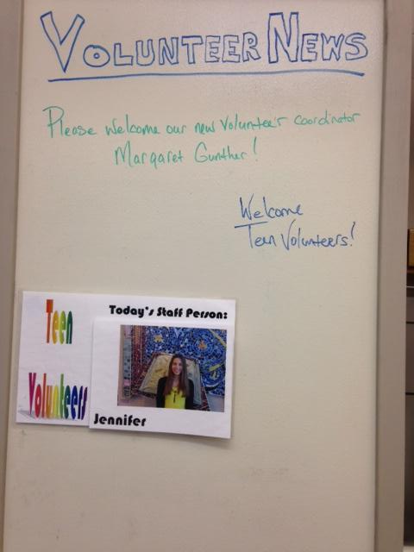
Assigning Staff
Set a schedule for staff members to be assigned “Volunteer Greeter”
Welcome volunteer
Provide training/refresher
Answer provider
Check in

Slide 11
Making Mistakes
Remember that volunteers are still learning and mistakes are to be expected
Correct gently
Relate their learning experience to yours when you first learned this task

Slide 12
Phrases to Use
“It’s okay to make mistakes. There is a lot to learn when you start volunteering.”
“When I first started working here I made several mistakes. There is so much to learn and remember!”
“We might have missed this in our training so let me show you how to do that.”
Always correct gently and with a positive tone of voice. Never attach blame or annoyance.

Slide 13
“Recruit the right people, train them, continually communicate with them, ask their opinions, involve them, recognize them, and celebrate them. If you show respect for their opinions and involvement, they will be proud of what they’ll deliver quality service.”
The Disney Way: Harnessing the Management Secrets of Disney in your Company by Bill Capodagli and Lynn Jackson

Slide 14
The Beginning of Training
The Packet, Tours, and Checklist
Information about the library
Rules/policies
Responsibilities
Tasks
How to sign in/out
Meet staff
Tour of library and circulation desk

Slide 15
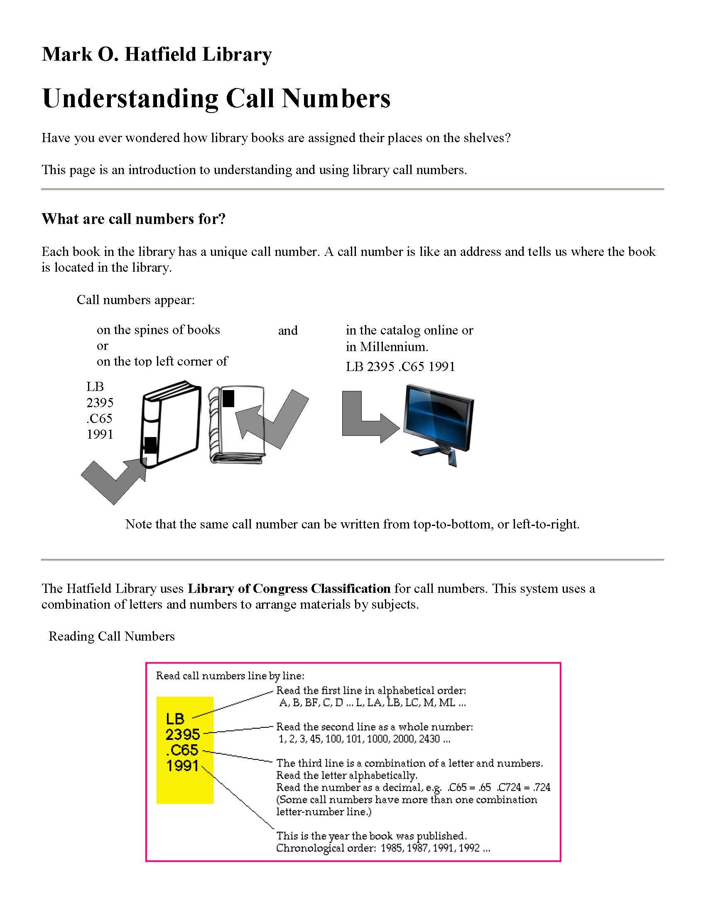
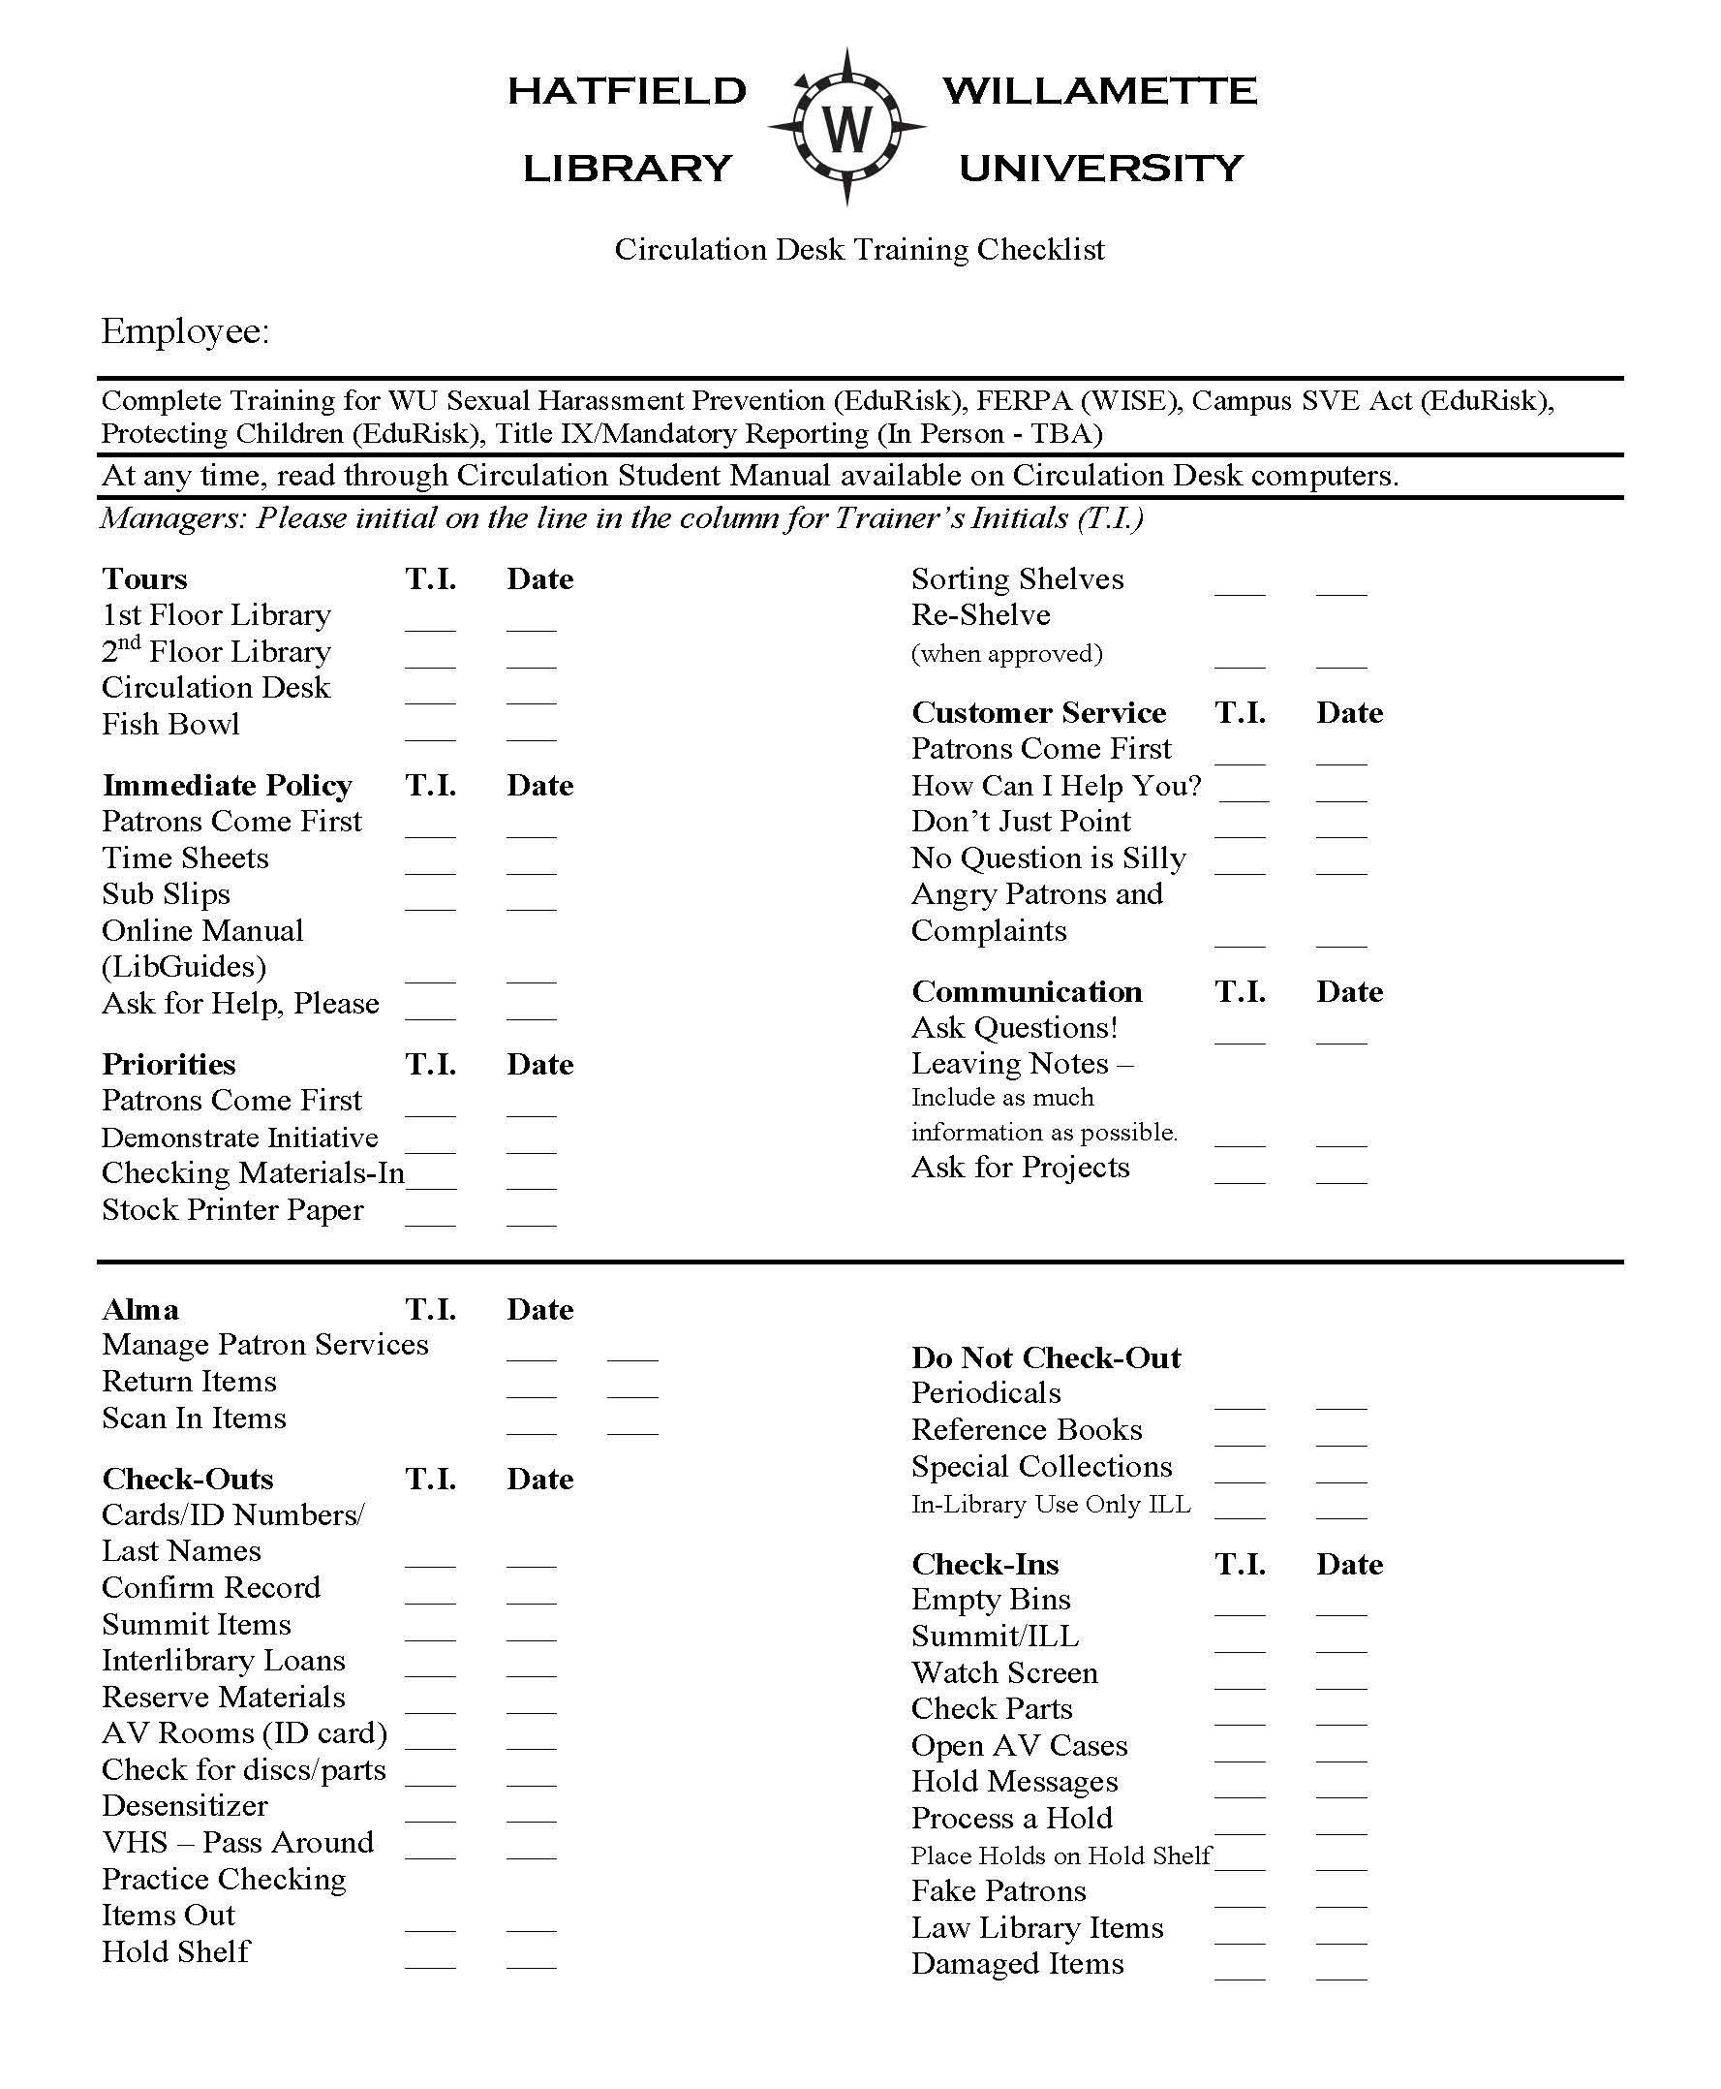

Slide 16
LibGuides, Meetings (Large and Small), Notes
Hands-on training, role playing
LibGuides
All-staff meetings, get everyone on the same page
Student manager meetings

Slide 17
Remind and Teach Staff
As employees, why are we here?
Are we here for the books?
Are we here for the computers?
Are we here for the databases?
I say we are here for the PEOPLE!

Slide 18
Most Importantly….
...Lead By Example
If you want your student employees to value certain tasks or value customer service, YOU must demonstrate those same values.
In our case, Student Managers must also lead by example

Slide 19
Follow-Up and Accountability
Check in with your student employees to see how they are doing and how are they feeling.
Verify the checklist or tasks are being completed.
Test carts for shelving are an easy example.

Slide 20
Motivating

Slide 21
Most Importantly…
Gratitude!
Tell volunteers how much you appreciate their time
Encourage through praise

Slide 22
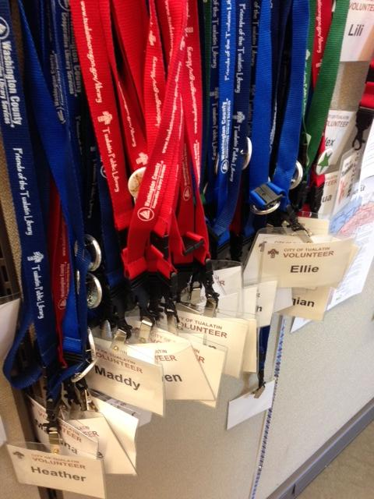
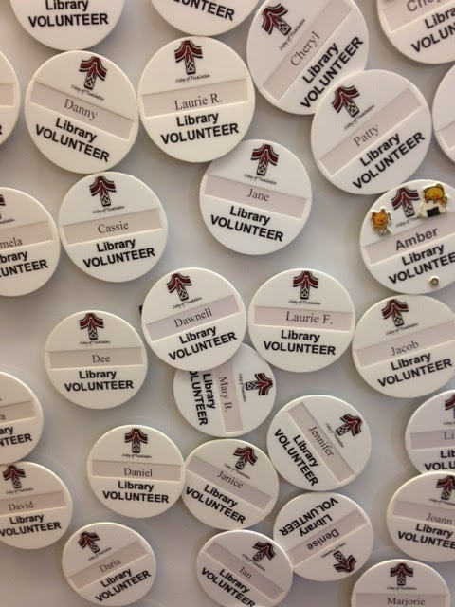
Other ways to motivate
Set a goal for volunteers to reach

Slide 23
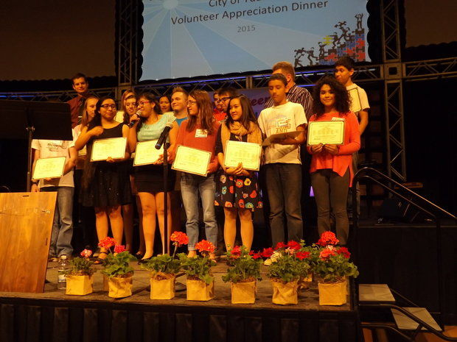
Award Winning Volunteers

Slide 24
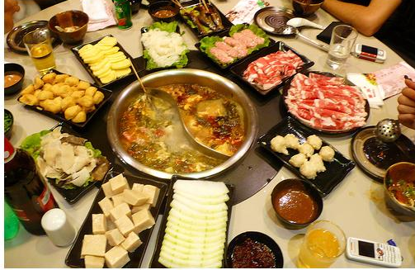
The Way to a Volunteer’s Heart….
FOOD!
Plan luncheons with the goal of volunteer appreciation

Slide 25
Motivation - Why Are They Working?
Help pay their college expense.
Help to pay for living expenses
Extra spending money
Help pay their parents or families back
Gain work experience
Understand how a library works (at least that’s what they put on their applications)

Slide 26
Motivation Once They Have a Job
Self-motivation
Teamwork/respect of other staff
To be appreciated
Evaluation
Resume-building
Recommendation for future employment

Slide 27
Engaging

Slide 28
Engaging Volunteers
Develop relationships with volunteers
Learn their name
Get to know their interests, hobbies, favorite book
You may have something in common!

Slide 29
Opportunities for all Ages and Abilities
Note that volunteers have different strengths and abilities
Provide a variety of tasks for those with:
Mobility restrictions
Limited time

Slide 30
Engage Youth
“Me and My Family”
After hours event
Special volunteer event for children age 3 -12
Tasks age appropriate
Storytime and snack
Children learn importance of community involvement

Slide 31
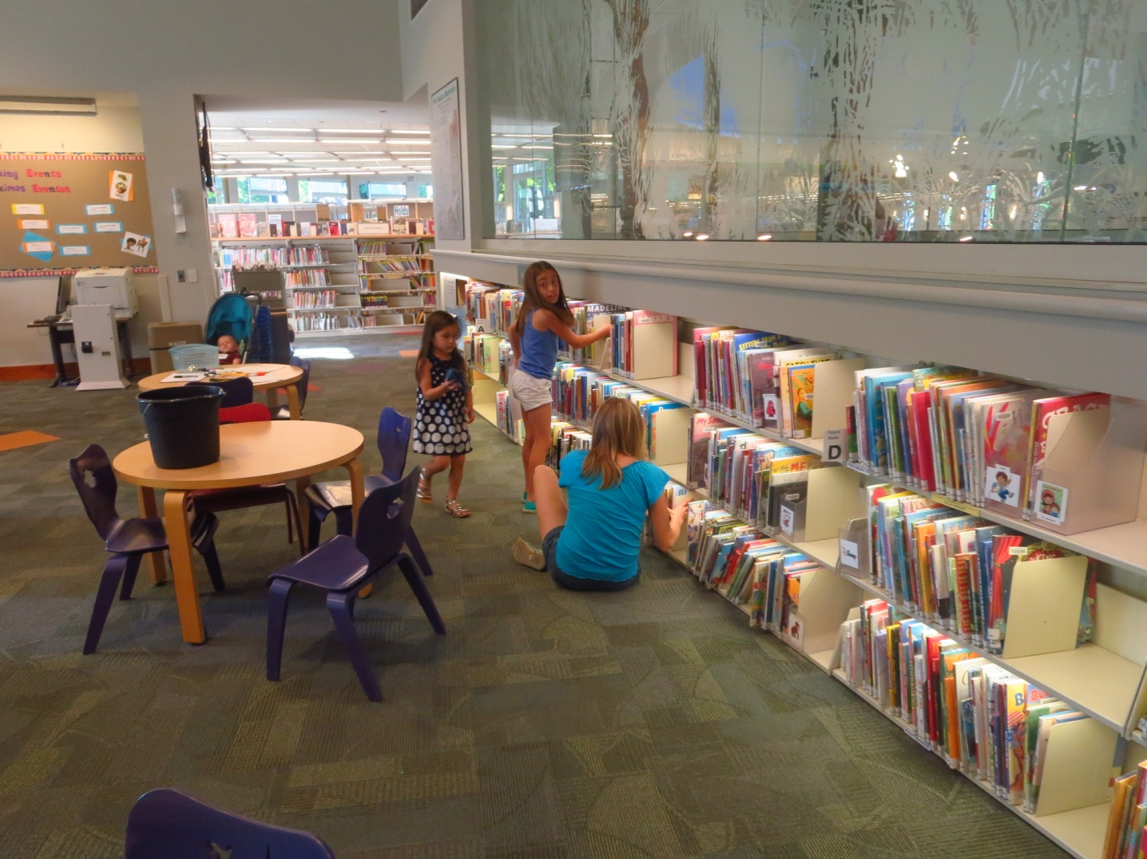
“Me and My Family” Event

Slide 32
Summer Teen Volunteers
Every summer we recruit teens to volunteer a minimum of 20 hours
Volunteering is job experience
Teen tasks: shelving, summer reading table, pulling holds, program prep.

Slide 33
Tualatin Summer Teens

Slide 34
Spruce Up the Library
Event for public to come clean the library
After hours event
Variety of ages, abilities, and tasks

Slide 35
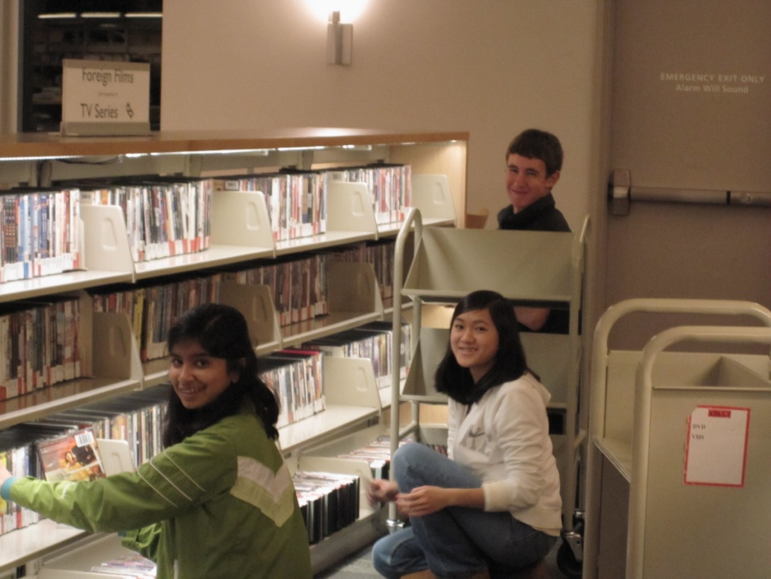
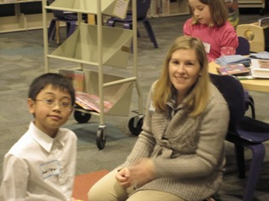
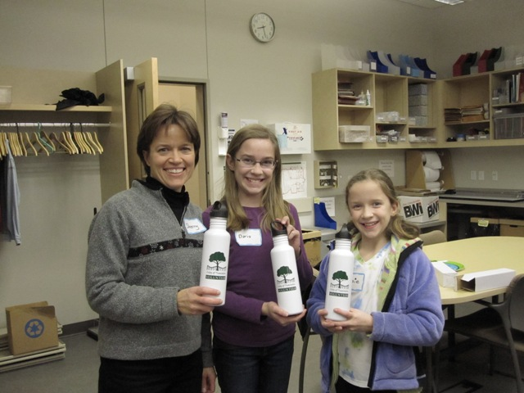
DECEMBER 19, 2010 SPRUCE UP THE LIBRARY!
24 volunteers shelved and checked in materials, searched for Holds, ate pizza and had a great time while helping us keep the library neat!
This family received recognition for attending three Spruce up the Library events!

Slide 36
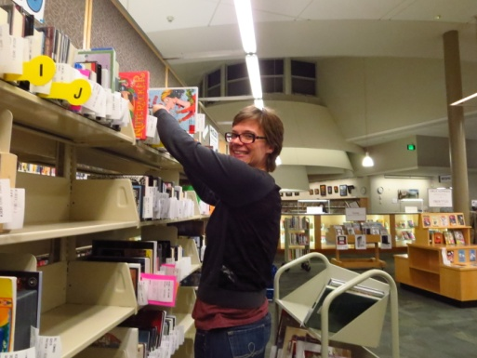
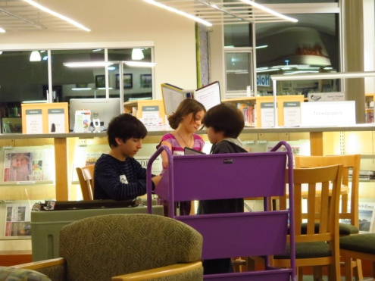
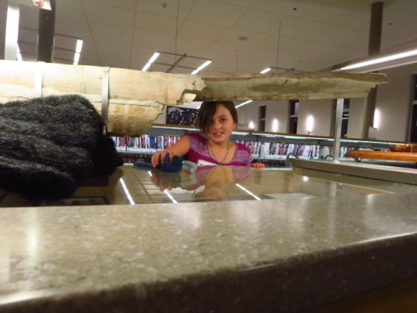
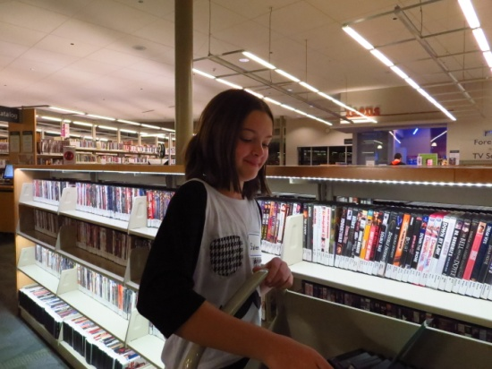
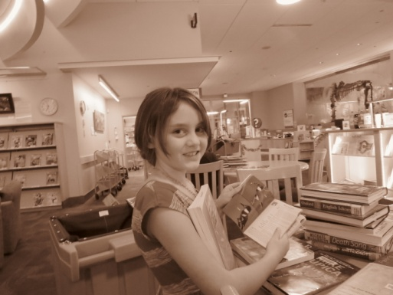
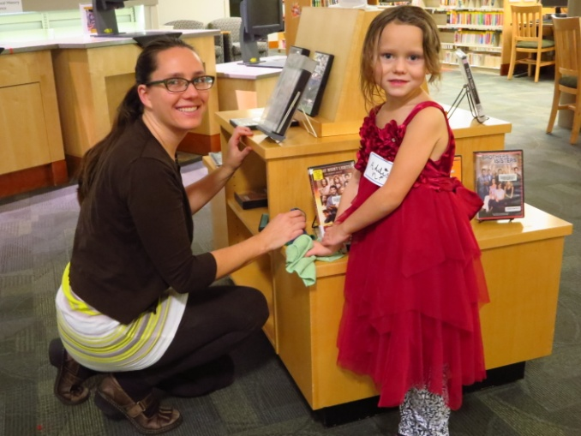
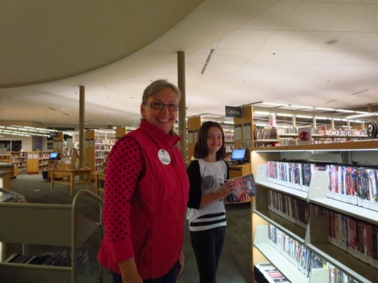
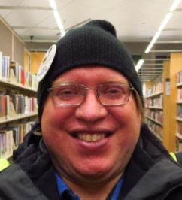
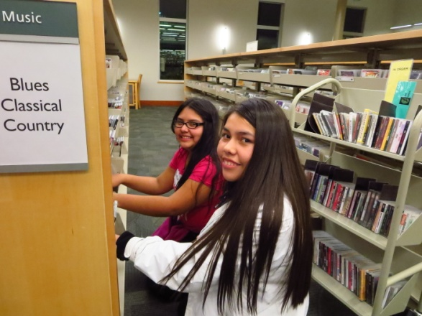
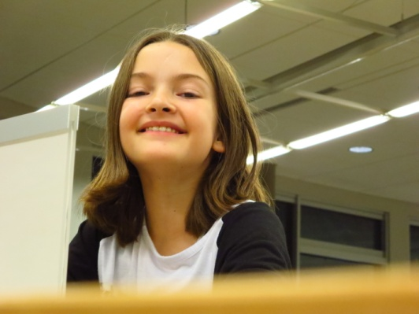
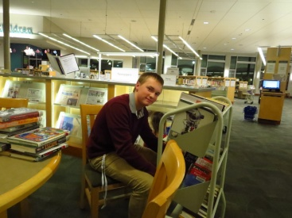
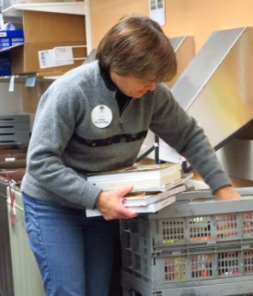
SPRUCE UP TUALATIN LIBRARY
Making civic engagement and learning opportunities available to families
27 Volunteers, a Dust Bunny Hunt, Pizza & Lots of Fun in the Library!

Slide 37
Engagement
“Refers to a state of motivation, wherein one is psychologically present…is focused on and aligned with the goals of the job and organization, and channels his or her emotional and cognitive self to transform work into meaningful and purposeful accomplishment.”
Understanding Employee Engagement Theory, Research and Practice, pg. 23

Slide 38
Thoughts to Help Increase Engagement
Treat all staff as valued individuals
Empower them to identify problems with workflows, or tasks that need to be completed.
Let them know what is going on within the entire library. What’s the plan? What’s the mission? Inform them!
Performance feedback
Be open to new ideas and suggestions

Slide 39
Examples of Ways to Increase Engagement
The boring stuff!
The fun stuff!
Weekend tasks
Manager Shift Reports
Evaluations
Suggestion box
Food – pizza, donuts, cupcakes, coffee trips
Easter egg hunt, little gifts, thank-you notes
Prize box

Slide 40
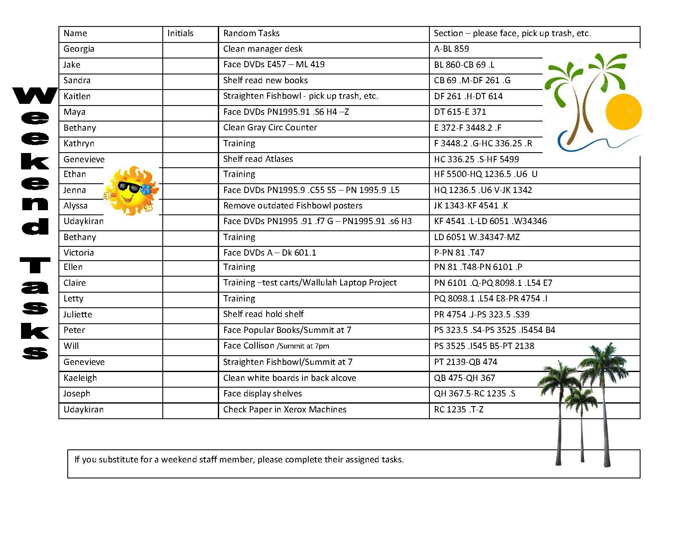
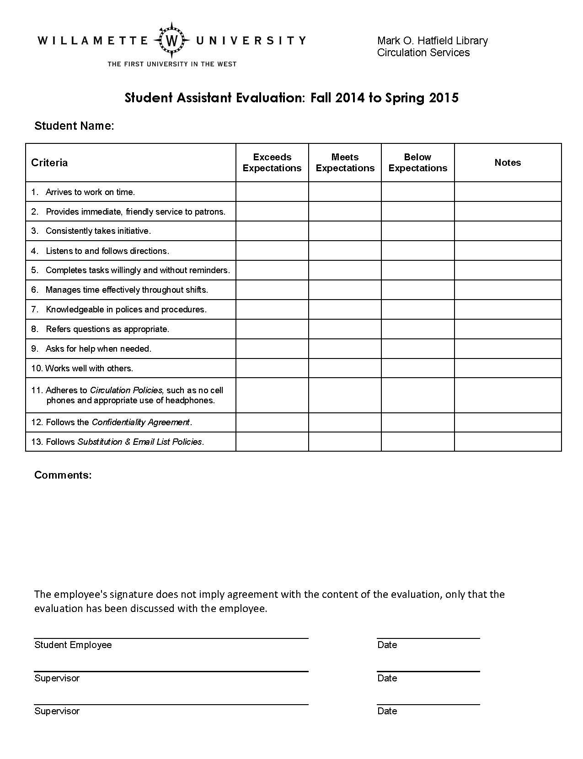

Slide 41
The Student Manager Position
Identify candidates and encourage them to apply
Candidates submit an application and are then interviewed
Increase in responsibility, as well as hourly wage
The best Student Managers lead by example and often set the tone for the entire department

Slide 42
A Few Books...
Perozzi, B. 2009. Enhancing Student Learning Through College Employment. Bloomington, IN: Association of College Unions International.
Byrne, Zinta S. 2015. Understanding what employee engagement is and is not: implications for theory, research and practice. New York, NY: Routledge.
Christensen, John. Fish!: Catch the Energy, Release the Potential! Burnsville, MN: ChartHouse International Learning Corp, 2002.
Capodagli, Bill, and Lynn Jackson. The Disney Way: Harnessing the Magic of Disney in Your Organization. New York: McGraw Hill, 1998.
Kinni, Ted. Be Our Guest: Perfecting the Art of Customer Service. New York: Disney, 2011
Baldwin, David A, and Daniel Barkley. Complete Guide for Supervisors of Student Employees in Today's Academic Libraries. Westport, Conn: Libraries Unlimited, 2007.

