Slide 1
Making Our Voices Heard
The Story of the OLA
Support Staff Division

Slide 2
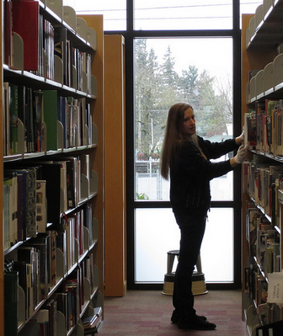
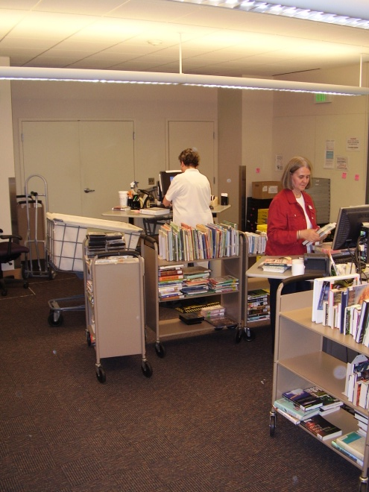
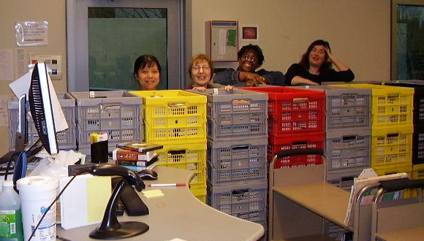
Libraries are not just about librarians - support staff are essential to successful libraries!
Multnomah County Library support staff at work

Slide 3
Challenges For Support Staff
Budget cuts
Fewer positions available
Part time jobs instead of full time
Increasing workload
Difficult to get a promotion
Physical/repetitive nature of the work
Keeping up with the regular workload
makes it difficult to find time for other activities

Slide 4
What is the Support Staff Division?
Goals:
Provide opportunities for support staff to learn, grow, interact, and collaborate
Advocate for support staff so that we are represented, included, and valued

Slide 5
Why is OLA SSD important to library workers?
To make our voices heard
To connect and communicate with library staff from all over the state
Leadership opportunities
Learning opportunities
Scholarships to assist with training and conference costs

Slide 6
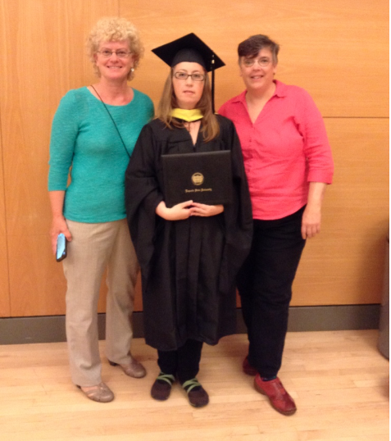
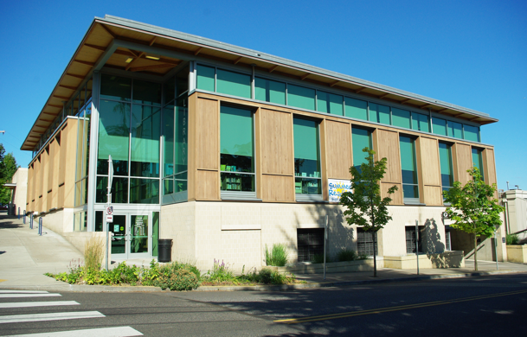
How OLA SSD has been important for me
My library – the Hillsdale Library in SW Portland

Slide 7
Making Our Voices Heard
Committee and Board Meetings
Civic engagement
Civil discourse
Democratic process
Collaboration
Teamwork

Slide 8
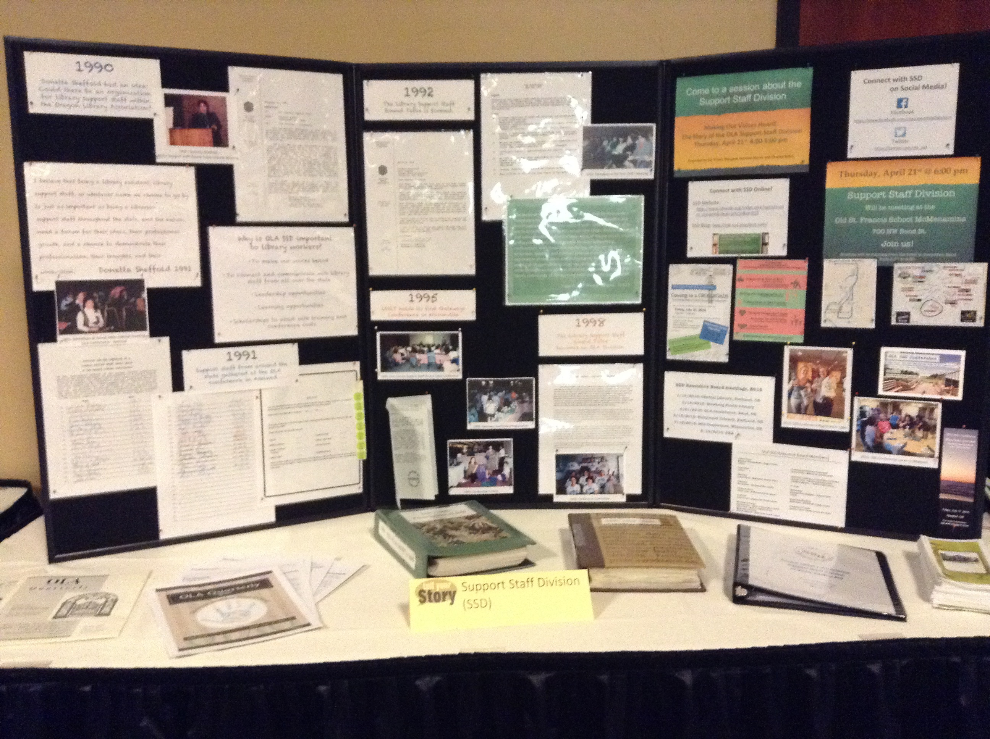
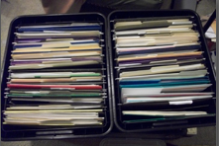
Learning and Creativity
Support Staff Division Archivist

Slide 9
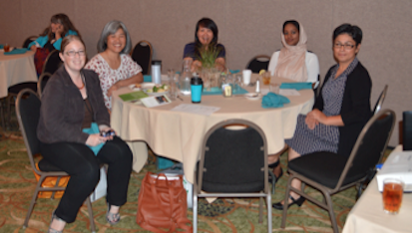
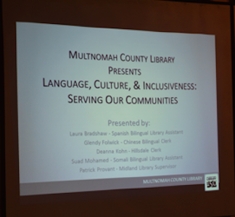
Leadership
Presenting at the 2015
OLA SSD Conference
Notes:
Leadership

Slide 10
Communication and Connections
Continuing Education Committee

Slide 11
The Future of SSD
Goals:
Preserve SSD and ensure it continues
Recruit new members
Increase communication and interaction
Increase member participation
Outreach throughout the state
Offer more training and learning opportunities
Use new technology and social media

Slide 12
How can staff at your library
get involved?
Let staff know that they can join OLA too!
Membership dues are determined by salary, starting at $30 a year
Join OLA: http://www.olaweb.org/join-now

Slide 13
Any member can attend SSD board meetings
In person
or virtually through GoTo Meetings
SSD Executive Board meetings, 2015-2016
9/18/2015 Eugene Public Library
11/13/2015 Eugene Public Library
1/15/2016 Central Library, Portland, OR
3/11/2016 Newberg Public Library
4/21/2016 OLA Conference
5/13/2016 Hollywood Library, Portland, OR
7/15/2016 SSD Conference
8/19/2016 TBA

Slide 14
Participation and Leadership
SSD Executive Board
Officer Positions:
Chair
Chair-Elect
Past-Chair
Recorder
Treasurer
Archivist
Members at Large
Committees:
Continuing Education Committee
Conference Committee
IT Team
Current representatives:
http://www.olaweb.org/index.php?option=com_content&view=article&id=314

Slide 15
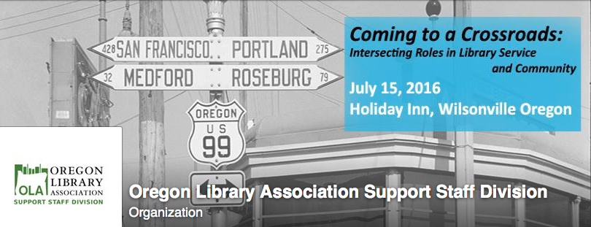
2016 OLA SSD Conference
http://ola-ssd.blogspot.com/p/current-conference.html
Notes:
Main event each year – connect, communicate, interact, learn

Slide 16
2015 Conference info:
http://ola-ssd.blogspot.com/p/2012-conference.html
2015 Conference materials:
http://b8f.645.myftpupload.com/conference-materials/support-staff-division-conference-2015/
Notes:
If you want to know more about last year’s conference:

Slide 17
Need help to fund attendance?
Conference attendance scholarship: http://www.olaweb.org/index.php?option=com_content&view=article&id=319
SSD also offers conference registration discounts:
four attendees from one library/library system for the cost of three
$50 travel assistance scholarship for travelling more than 150 miles to attend

Slide 18
Acquire knowledge and skills
http://www.olaweb.org/index.php?option=com_content&view=article&id=165
http://ala-apa.org/lssc/
Classes offered by:
Portland Community College:
http://www.pcc.edu/programs/education/library-asst/
Highline College (in Washington, but has online classes) https://lis.highline.edu/certificates.php
Certification scholarships: http://www.olaweb.org/index.php?option=com_content&view=article&id=319

Slide 19
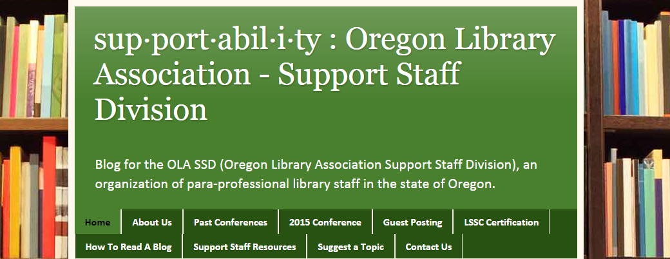
More Information: Online
SSD Website: http://www.olaweb.org/index.php?option=com_content&view=article&id=313
SSD Blog: http://ola-ssd.blogspot.com/

Slide 20
More Information: Social Media
Facebook
https://www.facebook.com/olasupportstaffdivision
Twitter https://twitter.com/ola_ssd

Slide 21
More information: Read
Oregon Library Association Quarterly Journal http://commons.pacificu.edu/olaq/
Subscribe to the mailing list:
http://listsmart.osl.state.or.us/mailman/listinfo/ssd
Check out Volume 20, Number 3 (2014)
“The Wide World of Support Staff”

Slide 22
Tonight! Dinner meeting: 6:00 pm
Old St. Francis School
McMenamins
700 NW Bond St.
Join us!
Don’t forget to stop by our table in the exhibit hall!

