Slide 1
Genre Terms for Literature in LCGFT
Lori Robare
OLA Conference, Bend
April 21, 2016

Slide 2
What we’ll cover
Brief background on
LCGFT
MARC coding for genre terms in bibliographic records
Genre terms for literature in LCGFT
Library of Congress documentation and practices
New vocabulary and MARC fields: Demographic group terms

Slide 3
What do we mean by Genre/Form?
Genre/form terms describe what a resource is, rather than what it is about
Genre: category of composition distinguished by various characteristics that may include style, technique, theme, mood, plot formula, character types, etc.
horror fantasy utopian
Form: refers to the format or purpose of a category of works and is independent of the content
comics poetry plays
Notes:
LCGFT terms often combine genre and form into one heading
Horror comics; Fantasy poetry; Utopian plays

Slide 4
Genre/form in LCSH
Mix with topic in main headings
Literature
Chick lit, Experimental fiction, Western stories, American poetry
Assigned as subject heading to collections of literary texts (not individual works)
Music
Headings for musical forms, types, styles established in the plural:
Fanfares, Piano quartets, Symphonies, Operas
Subdivision $x History and criticism added when a work is about the form
With some exceptional practices in music (singular term for works about the form)
Form often brought out in 6XX $v
E.g., $v Fiction, $v Drama,
Notes:
LCSH has long included headings that denote what a work is rather than what it is about (Detective and mystery stories; Constitutions). This are not limited to music and literature by any means, but such terms are especially prevalent in these areas.

Slide 5
Current LC practice for genre/form for literature in LCSH (a few highlights)
Collections of texts by several authors: form or genre combined with nationality or language in a phrase heading
650 _0 American poetry $y 20th century.
Collection of texts by one author: form or genre expressed only if highly specific
650 _0 Sonnets, American. (but not American poetry or Short stories)
A single novel: form subdivisions used; no form/genre headings in 650
650 _0 Cooking $v Fiction.

Slide 6
LCGFT
Library of Congress Genre/Form Terms for Library and Archival Materials
Thesaurus developed by LC, beginning in 2007
First considered part of LCSH, now a stand-alone vocabulary
Genres and forms broadly defined as categories of resources that share known conventions
May describe the purpose, structure, content, and/or themes of resources
Genre/form terms describing content and themes most frequently refer to creative works and denote common rhetorical devices (plot, setting, character types, etc.)
Notes:
Intent: formally separate genre/form terms from LCSH

Slide 7
LC’s genre projects: completed
Moving images (films, television programs, video recordings)
First terms approved in 2007
Application first documented in Subject Headings Manual (SHM) H 1913
Radio programs, other recorded sound
Small project, based on LC’s Radio Form/Genre Guide (RADFG)
First terms approved in 2008; application first documented in SHM H 1969.5
Cartographic materials
Undertaken with LC’s Geography and Maps Division
First terms approved 2010
First project to precipitate changes to LCSH policy: cancellation of form subdivisions
Notes:
Rationale for project order: LC’s Moving Image, Broadcasting & Recorded Sound Division approached LC Policy Division, wanting MIGFG to be included in LCSH. Small, defined subgroup of terms, would help identify & solve problems likely to be encountered with larger projects
Projects are considered “complete” when the commonly used terms for a given discipline are incorporated into LCGFT and are implemented at LC. As we’ll see, additional terms do get added.

Slide 8
LC’s genre projects: completed
Cookbooks
Very small project! (3 terms)
Guidance in SHM H 1475
Law
First project in which LC collaborated with another organization, American Association of Law Libraries
Added to LCGFT in November 2010
Administrative regulations, Constitutions, Municipal ordinances, Statutes and codes
Music
LC partnership with Music Library Association
Work has been underway for several years
Notes:
Cookbooks, Community cookbooks, Literary cookbooks

Slide 9
LC’s genre projects “completed” (but LC is not yet not using)
General terms
ALA Subject Analysis Committee (SAC) Subcommittee on Genre/Form Implementation (SGFI) formed General Terms Working Group in 2012
About 175 terms added to LCGFT January 2015
Religion
LC collaborated with American Theological Library Association (ATLA)
45 terms added to LCGFT in September 2015
Literature
LC partnership with SAC SGFI, Working Group on LCGFT Literature Terms, since 2012
About 380 terms added to LCGFT by Fall 2015

Slide 10
The lone genre project still in process
Art
LC collaborating with Art Libraries Society of North America (ARLIS/NA)
Began in 2014
Goal: list of proposed terms ready for LC after 2016 ARLIS/NA conference
Notes:
Art: from Sherman’s notes:
high level, do not want to recreate AAT or TGM
styles, e.g., baroque, neorealist, experimental
reproductions, e.g., photographs, art reproductions, illustrated works

Slide 11
New: companion vocabularies
Not part of LCGFT
For aspects of LCSH genre/form terms that are not genre
Examples: ethnicity or nationality of creator, medium of performance, intended audience
Demographic group terms: LCDGT
Library of Congress Demographic Group Terms
Medium of performance: LCMPT
Library of Congress Medium of Performance Terms
Notes:
Development of new areas of LCGFT highlighted the need for separate, companion vocabularies to accommodate aspects of existing LCSH genre/form headings that were not in fact genre
We’ll hear much more about LCDGT later in this program.

Slide 12
Evolution of MARC coding: bibliographic
Before LCGFT, common to use LCSH headings as genre terms:
655 _0 Horror films.
Or, to use other vocabularies to bring out genre for moving images
655 _7 Crime. $2 migfg
Common to use LCSH terms as genre to bring out audience:
655 _0 Young adult fiction.
Also common to use GSAFD to bring out the genre of individual works of fiction, drama (etc.)
655 _7 Adventure fiction. $2 gsafd

Slide 13
Evolution of MARC coding: bibliographic
Coding of LCGFT terms today:
655 _7 Magic realist fiction. $2 lcgft
655 _7 Television cooking shows. $2 lcgft
655 _7 Literary cookbooks. $2 lcgft
NOTE: when first released, LCGFT terms were coded with 655 _0 – this changed in 2011
Today, if you want to use an LCSH term that is NOT in LCGFT, you can code it with “0”
655 _0 Large type books.
If you wish to follow non-standard practice for subdivision, code as “local”
655 _7 Foreign language films $x Italian. $2 local
Notes:
2nd bullet – originally LCGFT terms were still considered part of LCSH (as we’ll see when we look at the next slide) and so they were coded in 655 as being from LCSH, with second indicator “0”

Slide 14
Where to find LCGFT terms
Classification Web
Used to be special section in LCSH “Big Red Books” (no longer in print)
Authority records in Connexion
Library of Congress Authorities (http://authorities.loc.gov/)
LC Linked Data Service (id.loc.gov)

Slide 15
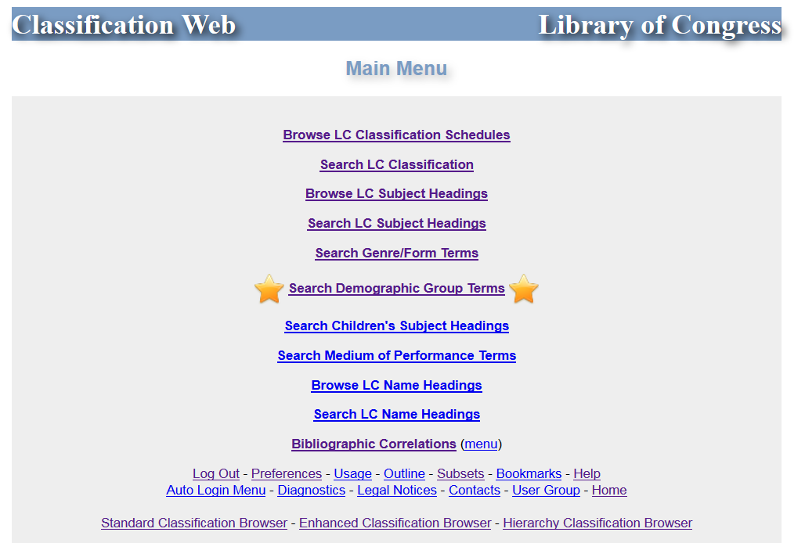

Slide 16
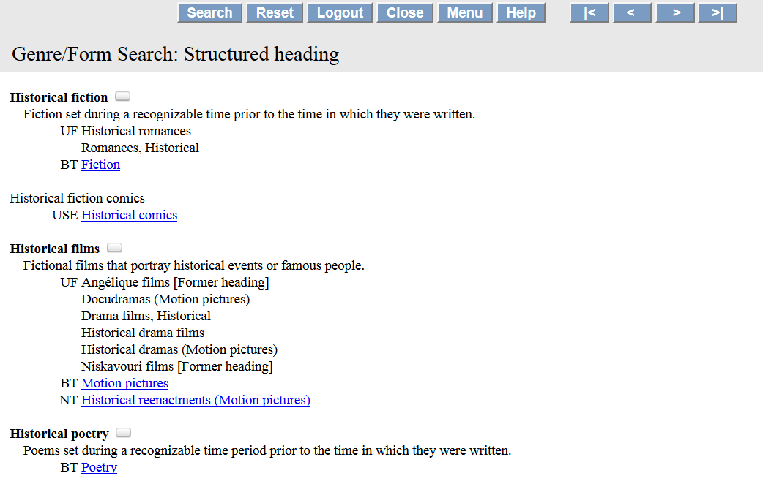

Slide 17
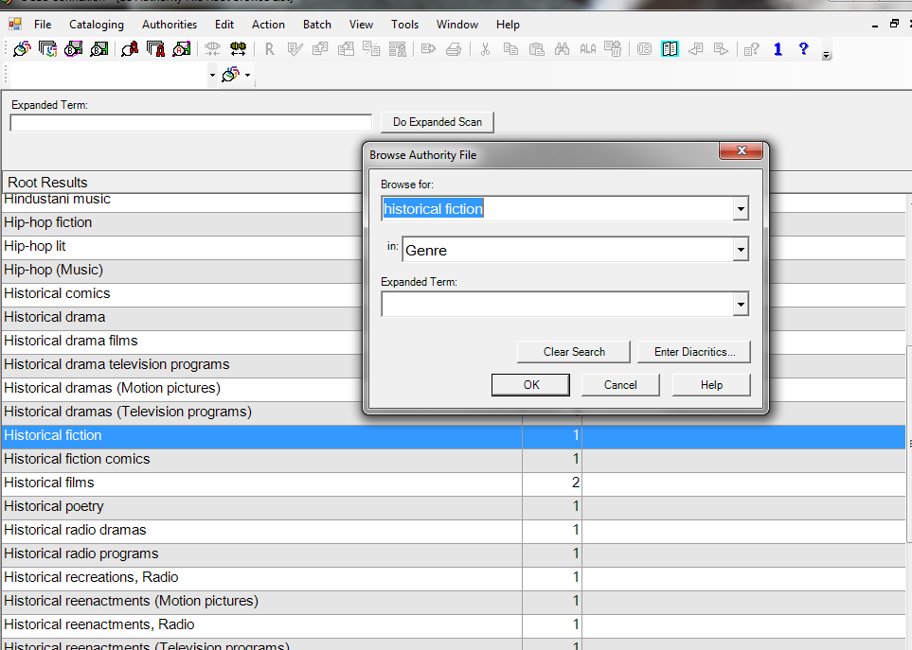

Slide 18
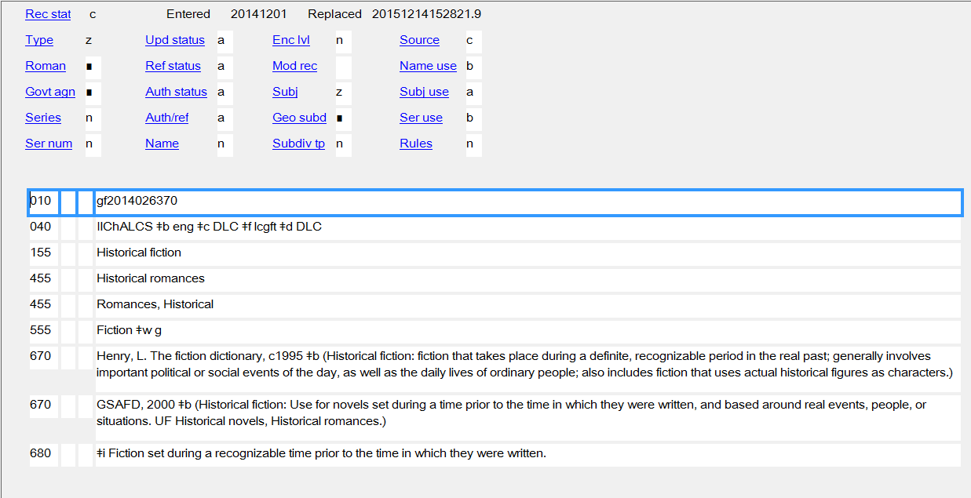

Slide 19
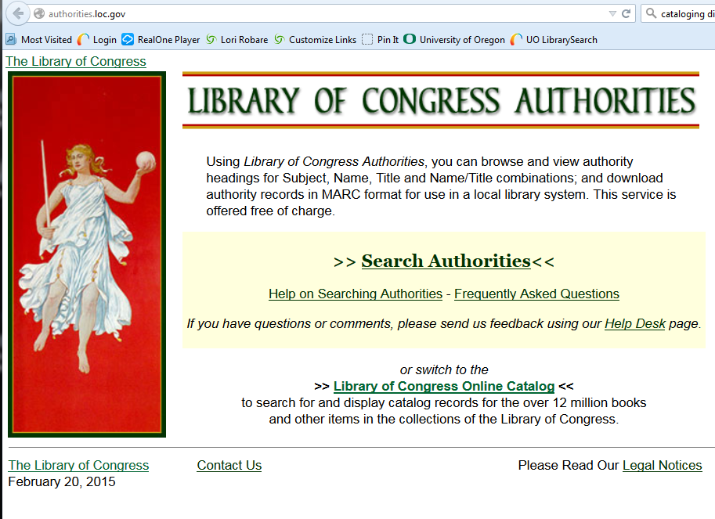

Slide 20
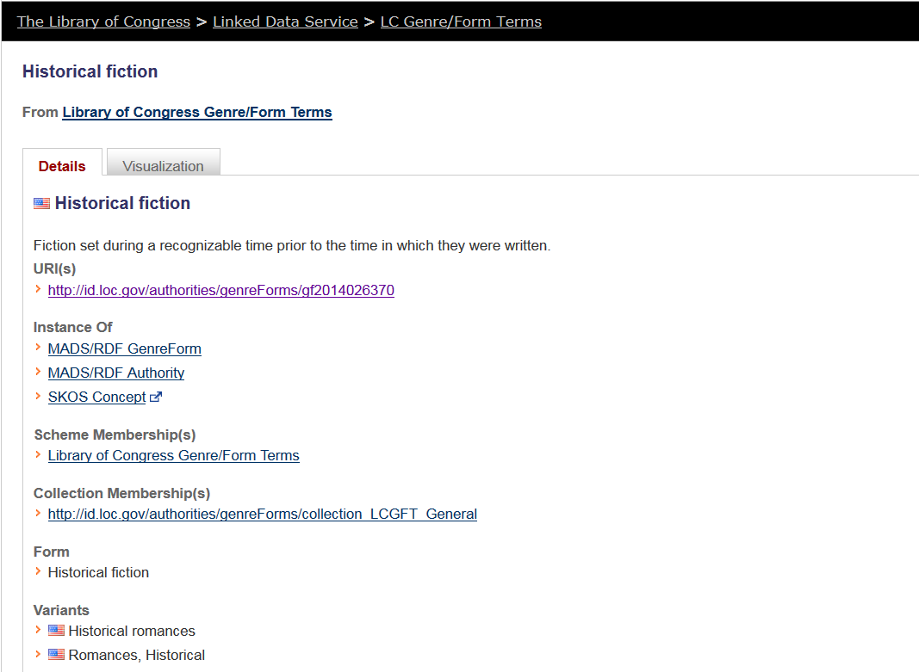

Slide 21
Genre terms for literature in LCGFT
Literature is the top term. Terms mostly fall under five main forms:
Comics (Graphic works)
Drama
Fiction
Folk literature
Poetry
Notes:
ALA ALCTS Subject Analysis Committee Subcommittee on Genre/Form Implementation Working Group on LCGFT Literature Terms developed initial list of terms
The WG initially looked at literature terms in LCSH, but they did not limit themselves to that; many new terms that aren’t in LCSH were proposed

Slide 22
Explicit aspects like audience, creator characteristics, place of origin, language, and time period of creation that are often included in LCSH were out of scope for LCGFT, so you will not find terms like these from LCSH:
Children’s poetry
Buddhist stories
Christian fiction
Gay men’s writings
College prose
Byzantine literature
Literature, Medieval
Russian drama

Slide 23
A few examples where LCGFT and LCSH terms differ
LCSH: Adventure stories LCSH: Motion picture plays LCSH: Horror comic books, strips, etc.
LCGFT: Action and adventure fiction LCGFT: Screenplays LCGFT: Horror comics
LCSH: Comic books, strips, etc. LCSH: Nonfiction novel LCSH: Gothic fiction (Literary genre)
LCGFT: Comics (Graphic works) LCGFT: Nonfiction novels LCGFT: Gothic fiction
LCSH: Horror tales LCSH: Moralities LCSH: Spy stories
LCGFT: Horror fiction LCGFT: Morality plays LCGFT: Spy fiction
LCSH: Plot-your-own stories LCSH: Comedy LCSH: Tragedy
LCGFT: Choose-your-own stories LCGFT: Comedy plays LCGFT: Tragedies (Drama)
LCSH: Mysteries and miracle-plays LCSH: Magic realism (Literature) LCSH: Suspense fiction
LCGFT: Mystery and miracle plays LCGFT: Magic realist fiction LCGFT: Thrillers (Fiction)
Notes:
All LCGFT terms are in the plural form, unlike some LCSH headings.

Slide 24
Sample headings, A-Y (no Z yet)
Abecedariuses
Allegories
Apocalyptic comics
Autobiographical fiction
Bible fiction
Cell phone novels
Detective and mystery
fiction
Dystopian fiction
Educational comics
Fables
Fan fiction
Folk tales
Fotonovelas
Haiku
Humorous comics
Kabuki plays
Laudatory poetry
Legal drama (Literature)
Legends
Love poetry
Magic realist fiction
Medical fiction
Monologues
Noir comics
Nonfiction comics
Nonsense verse
Novels of manners
Nursery rhymes
One-act plays
Pageants
Parables
Paranormal fiction
Parodies (Literature)
Picaresque fiction
Problem plays
Puppet plays
Quatrains
Religious poetry
Road fiction
Robinsonades
Romance fiction
Romans à clef
Satirical literature
Sentimental comedies
Society verse
Space operas
Spoken word poetry
Sports comics
Steampunk fiction
Stories in rhyme
Superhero comics
Tall tales
Ten-minute plays
Thrillers (Fiction)
Tijuana bibles
Time-travel fiction
True crime comics
Urban fiction
Yue fu
Notes:
Abecedariuses: Poems in which each line or stanza begins with a successive letter of the alphabet
Robinsonades: Fiction about survival without the aid of civilization, frequently on a deserted island after a shipwreck or marooning
Tijuana bibles: Small, oblong pornographic comics clandestinely published in the United States between the 1920s and 1960s that usually parodied popular newspaper comic strip characters or celebrities
Steampunk fiction: Science fiction set in the 19th century that features steam-powered machinery and related technologies extrapolated from the science of that era.
Yue fu: This heading is used as a genre/form heading for Chinese poems derived from folk songs.

Slide 25
Changes in Practice
For the time being, LC recommends assigning subjects as you do now, according to policies in the Subject Headings Manual
In addition, assign LCGFT literature terms both to individual works and compilations
Consider also adding audience and creator/contributor aspects in 385 and 386
New vocabulary, Library of Congress Demographic Group Terms (LCDGT) is recommended, but other vocabularies may be used

Slide 26
Examples: a compilation
245 00 An anthology of medieval love debate poetry / $c translated and edited by Barbara K. Altmann and R. Barton Palmer.
386 __ $n nat $a French $2 lcdgt
650 _0 French poetry $y To 1500 $v Translations into English.
650 _0 Debate poetry, French $v Translations into English.
650 _0 Love poetry, French $v Translations into English.
655 _7 Debate poetry. $2 lcgft
655 _7 Love poetry. $2 lcgft
Notes:
Eventually the 650s will go away

Slide 27
Examples: an individual work
100 1_ Rakov, David.
245 10 Love, dishonor, marry, die, cherish, perish : $b a novel / $c by David Rakov.
650 _0 Humanity $v Fiction.
650 _0 Life change events $v Fiction.
650 _0 Generosity $v Fiction.
650 _0 Cruelty $v Fiction.
655 _7 Novels in verse. $2 lcgft

Slide 28
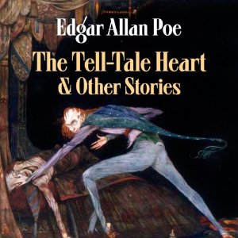
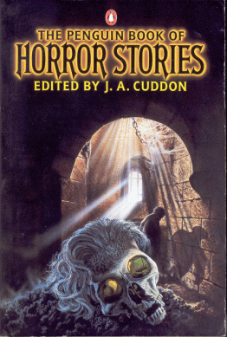
Reminder: Assign to both individual works and compilations by one or multiple authors
655 _7 Horror fiction. $2 lcgft 655 _7 Horror fiction. $2 lcgft 655 _7 Horror fiction. $2 lcgft
655 _7 Short stories. $2 lcgft 655 _7 Short stories. $2 lcgft 655 _7 Short stories. $2 lcgft
Notes:
Picture sources:
http://improbabilitydrive.deviantart.com/art/The-Tell-Tale-Heart-359554129
http://download-audiobooks.net/audiobooks/9263-edgar-allan-poes-the-tell-tale-heart-and-other-stories.html
https://vaultofevil.wordpress.com/2007/09/01/page/2/

Slide 29
LC practice and documentation
As of January 2016, LC had not yet decided when it will implement the “general,” religion, and literature genre/form terms
Catalogers should continue to assign subject headings according to policies in the SHM, along with the new genre/form terms
Example, for a collection of poetry:
10 Technically, it’s not my fault : $b concrete poems / $c by John Grandits.
_0 Concrete poetry, American.
655 _7 Concrete poetry. $2 lcgft

Slide 30
Draft Policies for Assignment of LCGFT Terms
LC Policy and Standards Division (PSD) has published a draft genre/form terms manual (similar to the Subject Headings Manual)
Includes guidelines and instructions for assigning genre/form terms and proposing new ones
Instruction sheets are numbered beginning with “J”
Available at: http://www.loc.gov/aba/publications/FreeLCGFT/freelcgft.html
Comments on the draft are accepted through May 31, 2016
Notes:
There is one instruction sheet specifically for literature, which we’ll review in conjunction with overall instructions.

Slide 31
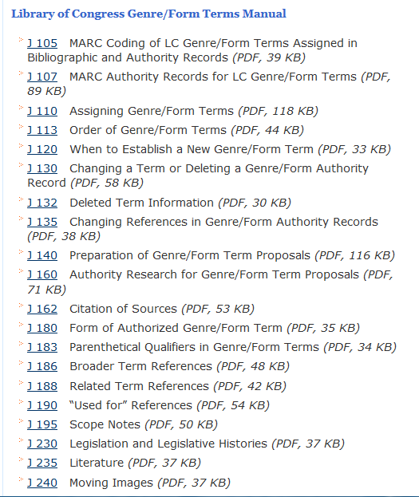

Slide 32
Draft Policies for Assignment of LCGFT Terms
Assigning Genre/Form Terms (J 110)
Assign genre/form terms only as they come readily to mind after a superficial review of the resource being cataloged
Assign genre/form terms that describe the resource as a whole
LC genre/form terms should be assigned in addition to LC subject headings
LC genre/form terms should follow the subject headings and precede genre/form terms from other vocabularies

Slide 33
Draft: Assigning Genre/Form Terms (J 110)
Specificity:
Assign terms that are as specific as the genres/forms exemplified by a resource. Any given term may be specific or general depending on the particular resource being cataloged. For example, the term Poetry is specific when assigned to an anthology of poetry that consists of many poetic forms.
Use the hierarchical structure built into LCGFT to find as close a match as possible between the genre(s) and forms(s) of the resource and the terms that exist to express them in LCGFT.
In situations where a needed term is not established, see J 120 for general guidelines on proposing new genre/form terms.
Notes:
…but Poetry is too broad when assigned to a collection consisting only of sonnets.

Slide 34
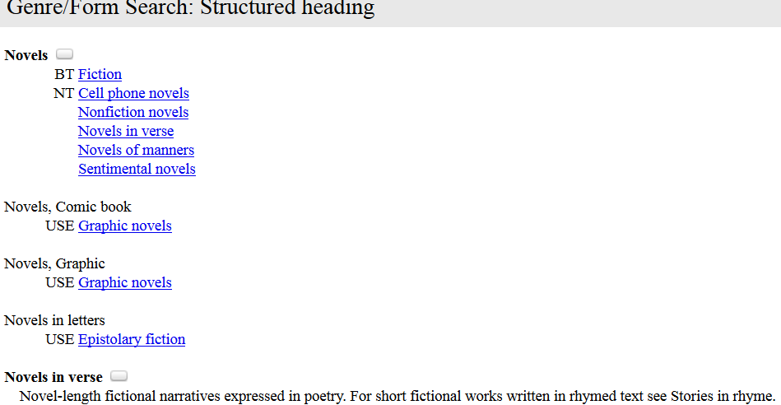

Slide 35
Draft: Assigning Genre/Form Terms (J 110)
Specificity:
Sometimes an array of terms is needed to express the genre or form (e.g., Science fiction, Romance fiction, and Novels are all assigned for a science fiction romance novel)
If a compilation consists of a predominant genre or form but includes works that would be assigned another term in the hierarchy, it is OK to assign both a broader and narrower term. For example, Limericks is a narrower term of Humorous poetry. If a collection primarily contains limericks, but also contains a significant proportion of other types of humorous poetry, both terms may be assigned.

Slide 36
Draft: Assigning Genre/Form Terms (J 110)
Assign to both individual works and compilations
Number of Terms:
No limit to how many terms can be assigned. But they should reflect the preponderant genres and forms exemplified by the resource being cataloged. Apply your judgment as to which genres and forms are significant enough to provide access to.
For example, do not assign Indexes to every book that happens to have an index. Assign Indexes to resources that essentially are indexes (i.e., in fixed field you’ve coded Cont (Nature of Contents) with value “i” and you’ve used subdivision $v Indexes in subjects).

Slide 37
Examples: several genre terms assigned
100 1_ Grahame-Smith, Seth.
245 10 Pride and prejudice and zombies : $b the graphic novel / $c Jane Austen and Seth Grahame-Smith ; adapted by Tony Lee ...
650 _0 [subject headings not shown]
655 _7 Graphic novels. $2 lcgft
655 _7 Parodies (Literature). $2 lcgft
655 _7 Horror comics. $2 lcgft
655 _7 Humorous comics. $2 lcgft
655 _7 Adaptations. $2 lcgft

Slide 38
Draft: Assigning Genre/Form Terms (J 110)
Two or three related terms: if a term exists that represents the two or three genres or forms displayed by a resource AND includes no other genres or forms within its scope, assign one term instead of two or three narrower terms.
Rule of three: if a genre/form includes in its scope more than three sub-genres or forms, but the resource being cataloged consists of only two or three of those, assign the appropriate two or three terms instead of the broader term.
And yes, there is a Rule of four.

Slide 39
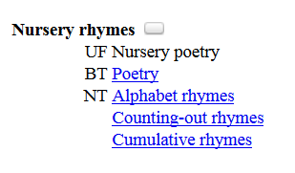
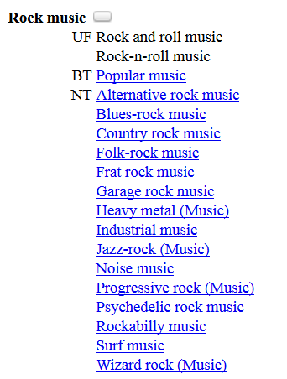
Title: A collection of accumulative rhymes, alphabet rhymes, and counting-out rhymes.
Term: Nursery rhymes.
Title: Time machine : the history of Canadian 60’s garage, punk, and surf, 1985-95.
Terms: Garage rock music.
Punk rock music.
Surf music.

Slide 40
Draft: Assigning Genre/Form Terms (J 110)
Rule of four:
In certain circumstances, it may be preferable to assign terms for four sub-genres or forms of a broad term. If a term covers a broad range and each sub-genre or form comprises only a small portion of that whole range, assign the four sub-genres or forms.
Example: a poetry anthology that consists of haiku, senryu, tanka, and kyōka may be assigned terms for those four genres instead of the broad term Poetry.
LC practice: do not exceed four sub-genres or forms under any circumstances.

Slide 41
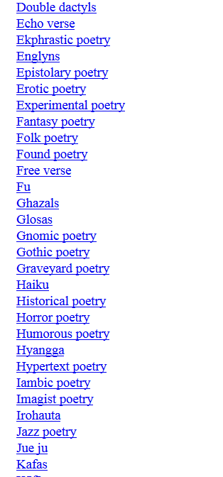
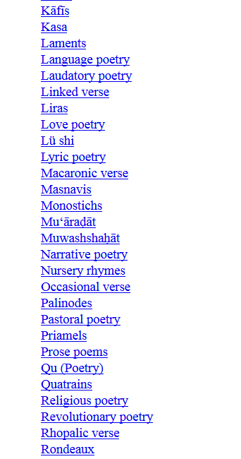
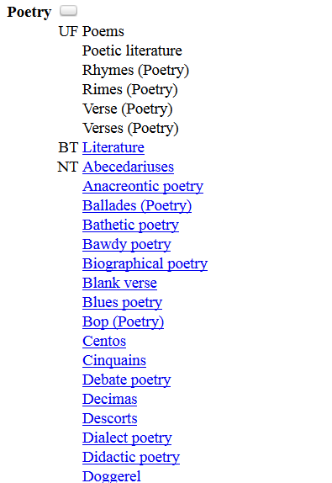
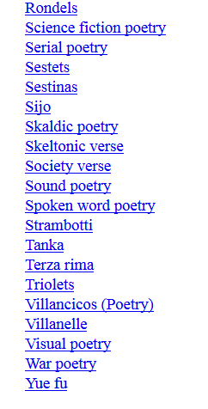

Slide 42
Scope notes can be very helpful!
VS.

Slide 43
Examples
100 1_ Tuck, Lily, $d 1938- $e author.
14 The double life of Liliane : $b a novel / $c Lily Tuck.
“As the child of a German movie producer father who lives in Italy and a beautiful, artistically talented mother who resides in New York, Liliane’s life is divided between those two very different worlds … An intimate and poignant coming-of-age portrait of the writer as a young woman.”—From book jacket.
655 _7 Autobiographical fiction. $2 lcgft
655 _7 Domestic fiction. $2 lcgft
655 _7 Bildungsromans. $2 lcgft

Slide 44
Examples
100 1_ Kirk, James T., $d 2233-2371, $e author.
14 The autobiography of James T. Kirk : $b the story of Starfleet’s greatest captain / $c by James T. Kirk ; edited by David A. Goodman.
Chronicles the greatest Starfleet captain’s life in his own words. …Kirk’s singular voice rings through the text, giving insight into his convictions, his bravery, and his commitment to the life—in all forms—throughout this Galaxy and beyond.
655 _7 Science fiction. $2 lcgft
655 _7 Fictional autobiographies. $2 lcgft

Slide 45
Draft Policies for Literature (J 235)
Fiction
In addition to terms assigned according to J 110, assign a term that indicates the length of the resource when it is readily apparent (e.g., Novels; Novellas; Short stories; Flash fiction). Example:
Title: The secret of the old clock / Carolyn Keene.
Terms: Detective and mystery fiction.
Novels.
Notes:
In general, literary resources are assigned genre/form terms according to the guidelines in J 110, but there are special provisions

Slide 46
Draft Policies for Literature (J 235)
Poetry
The general guideline to assign genre/form terms only as they come readily to mind after a superficial review is particularly important for poetry. Rely chiefly on the title, introduction, cover information, etc., to determine whether the poetry is of a specific genre or form. If not, assign the term Poetry.
Title: For you with love / compiled by Kay Anne Carson.
Term: Love poetry.
Title: Half of the world in light : new and selected poems / Juan Felipe Herrera.
Term: Poetry.

Slide 47
Draft Policies for Literature (J 235)
Poetry (continued)
If the genre or form of a poem or collection of poetry is known to the cataloger due to the cataloger’s academic or cultural background, etc., one or more genre/form terms may be assigned to represent the genre or form. Examples:
Title: The Odyssey / Homer.
Term: Epic poetry.
Title: The rape of the lock / Alexander Pope.
Term: Mock-heroic poetry.

Slide 48
Draft Policy: Order of Terms (J 113)
If the classification number reflects a genre or form, put that term first
If there is a predominant genre or form, assign the term that represents that genre or form as the first term. If the predominant genre or form cannot be represented by a single term, assign as the first group of terms those that, taken together, express the predominant form. For example, for a biographical dictionary, assign both Biographies and Dictionaries. The order doesn’t matter unless the first bullet above applies.

Slide 49
LCGFT and Other Characteristics
What happens when 650 is only used for terms representing what something is about? That is, what happens to the other important characteristics that can’t go in 650 or 655? For example, consider:
650 _0 American poetry $x Women authors.
650 _0 American poetry $x African American authors.
650 _0 American poetry $y 20th century.
The above three subjects would currently be assigned to an anthology of 20th century poetry by African American women. The genre/form is Poetry. Since the work isn’t about 20th century African American women’s poetry, if we stop using 650, and 655 only holds the genre/form, where do we put the information that the creators are American, African American, Women and that the works were created in the 20th century?

Slide 50
LCDGT: LC Demographic Group Terms
Purpose: to describe
Creators of, and contributors to, resources
Intended audiences of resources
Status
Pilot Phase 3
Includes about 800 terms and a draft manual for application
Draft Demographic Group Terms Manual: http://www.loc.gov/aba/publications/FreeLCDGT/freelcdgt.html
Comments accepted through May 31, 2016
Vocabulary also available in Classification Web
Following slides with color background are courtesy of Janis Young, LC

Slide 51
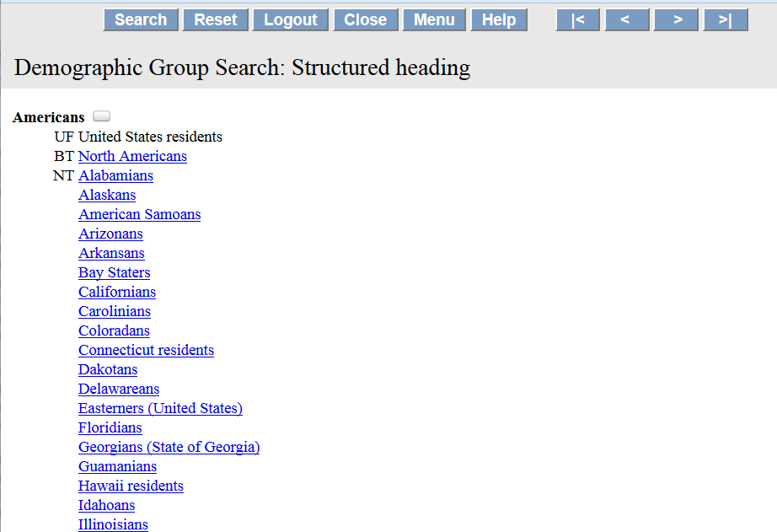

Slide 52
MARC 385 – Audience Characteristics
Indicators both blank
Subfields:
$a – Audience term (R)
$b – Audience code (R)
$m – Demographic group term (NR)
$n – Demographic group code (NR)
$2 – Source (NR)
$3 – Materials specified (NR)
$0 – Authority record control number or standard number (R)
Notes:
Field Definition and Scope
A category of persons for which a resource is intended or a category of persons representing the intellectual level for which the content of a resource is considered appropriate.
If a demographic group is not specified then multiple audience characteristics from the same source vocabulary or code list may be recorded in the same field in separate occurrences of subfield $a and subfield $b. If a demographic group is specified then the characteristics in the field must all come from the same group. Terms from different source vocabularies are recorded in separate occurrences of the field.

Slide 53
MARC 386 – Creator/Contributor Characteristics
Indicators both blank
Subfields:
$a – Creator/contributor term (R)
$b – Creator/contributor term code (R)
$m – Demographic group term (NR)
$n – Demographic group code (NR)
$2 – Source (NR)
$3 – Materials specified (NR)
$0 – Authority record control number or standard number (R)
Notes:
Field Definition and Scope
A group category to which the creator(s) of a work or compilation of works, or the contributor(s) to an expression or compilation of expressions, belongs.
If a demographic group is not specified then multiple creator/contributor group categories from the same source vocabulary or code list may be recorded in the same field in separate occurrences of subfield $a and subfield $b. If a demographic group is specified then the categories in the field must all come from the same group. Terms from different source vocabularies are recorded in separate occurrences of the field.

Slide 54
MARC 385/386 $m and $n
$m – Demographic group term (NR)
$n – Demographic group code (NR)
During the development of the 385 and 386 fields, some commented that many class of persons headings belong to broader group categories that users might want to search or limit by. For example, children, tweens, teenagers, young adults, middle-aged persons, and senior citizens are all examples of age groups. Catholics, Baptists, Jews, Buddhists, Mormons, Muslims, Hindus, and Wiccans are all examples of religious groups.
$m and $n were added to the final proposals to accommodate this information. The SAC Genre/Form Implementation Subcommittee came up with an initial list of group categories. LC PSD agreed to maintain the list.
Notes:
Case study: a user might seek works aimed at a religious audience, but the specific religion is not important to them. In this case, it would be nice to be able to code that a work is for a religious audience regardless of the actual religion.

Slide 55
LCDGT Structure
Eleven categories
Age
Educational Level
Ethnic/Cultural
Gender
Language
Medical, Psychological, Disability
National/Regional
Occupation/Field of Activity
Religion
Sexual Orientation
Social
Slide from Janis Young
Notes:
Age category [age] Use for the chronological age of the group members (e.g., Adults; Children; Infants).
Educational level category [edu] Use for the educational level of the group members (e.g., First grade students; Graduate students; High school students).
Ethnic/Cultural category [eth] Use for the ethnic or cultural identification of the group members (e.g., Asian Americans; Maratha (Indic people); Muscogee (North American people)). For ethnic and cultural groups that are also demonyms associated with a supra-national region, a country, or a sub-national region or jurisdiction, prefer the National/Regional category.
Gender category [gdr] Use for the gender of the group members (e.g., Females; Males; Transgender people).
Language category [lng] Use for the language associated with the group members (e.g., Arabic speakers; English speakers; Zulu speakers).
Medical, psychological, and disability category [mpd]
Use for the medical or psychological condition, or the physical or mental disability, of the group members (e.g., Breast cancer patients; Mentally ill; Deaf).
National/Regional category [nat] Use for the demonym related to a supra-national region, a country, or a sub-national region or jurisdiction that is associated with the group members (e.g., Angolans; Bavarians; Easterners (United States)). For ethnic and cultural groups that are not also demonyms, prefer the Ethnic/Cultural category.
Occupation/Field of Activity category [occ] Use for the activity or avocation associated with the group members (e.g., Hunters; Mathematicians; Textile artists).
Religion category [rel] Use for the religion, denomination, sect., etc., of the group members (e.g., Buddhists; Presbyterians; Shiites)
Sexual Orientation category [sxo]
Use for the sexual orientation of the group members (e.g., Bisexuals; Gay men; Heterosexuals).
Social category [soc]
Use for identifiable social groups that cannot be included in the other categories (e.g., Children of divorced parents; Nursing students; Socialists).

Slide 56
Application in Brief
Assign as many terms as needed to describe the creators of, and contributors to, resources, and the intended audiences of resources
In bibliographic records and in authority records for works
Slide from Janis Young

Slide 57
Application in Brief
Creators/contributors
Self-identification is key
Prefer affirmative statements rather than relying on gendered pronouns or photographs
“In case of doubt, leave it out.”
Slide from Janis Young

Slide 58
Application in Brief
Creators/Contributors
I am not my breast cancer : women talk openly about love & sex, hair loss & weight gain, mothers & daughters, and being a woman with breast cancer.
“This book gathers the warm, loving, frank, and informed voices of more than 800 women – from every state in the nation and from continents as far away as Australia and Africa...”–Summary.
Slide from Janis Young

Slide 59
Application in Brief
Creators/Contributors
I am not my breast cancer : women talk openly about love & sex, hair loss & weight gain, mothers & daughters, and being a woman with breast cancer.
386 ## $a Breast cancer patients $2 lcdgt
386 ## $a Women $2 lcdgt
Slide from Janis Young
Notes:
Non-literary example

Slide 60
Application: Creators/Contributors
245 00 Blood and bone : $b poems by physicians / $c edited by Angela Belli and Jack Coulehan.
386 __ Physicians $2 lcdgt
386 __ Americans $2 lcdgt
650 _0 Physicians’ writings, American.
650 _0 American poetry $y 20th century.
650 _0 Human body $v Poetry.
655 _7 Poetry. $2 lcgft

Slide 61
Application in Brief
Audiences
Explicit: statements in the title, introduction, etc.
Implicit: an audience that comes readily to mind after a superficial review of the resource
Should be assigned with caution
“In case of doubt, leave it out.”
Slide from Janis Young

Slide 62
Application in Brief
Audiences
My neighbour’s faith : Islam explained for Christians.
385 ## $a Christians $2 lcdgt
Slide from Janis Young

Slide 63
Application: Audiences (non-literary example)
100 1_ Zuniga, Andres.
245 10 Street-smart Spanish for first responders / $c Andres Zuniga.
385 __ First responders $2 lcdgt
385 __ English speakers $2 lcdgt
650 _0 Spanish language $v Conversation and phrase books (for first responders)
655 _7 Phrase books. $2 lcgft

Slide 64
Application: Audiences (literary example)
100 1_ Kenyon, Sherrilyn, $d 1965- $e author.
245 10 Illusion / $c Sherrilyn Kenyon.
385 __ Young adults $2 lcdgt
520 Son of a demon Nick Gautier just wants to be a normal guy, but when he is sucked into an alternate reality, he realizes the value of his powers.
650 _0 Good and evil $v Juvenile fiction.
650 _0 Demonology $v Juvenile fiction.
650 _0 Teenage boys $v Juvenile fiction.
655 _0 Young adult fiction. ??
655 _7 Paranormal fiction. $2 lcgft
Notes:
Chronicles of Nick series

Slide 65
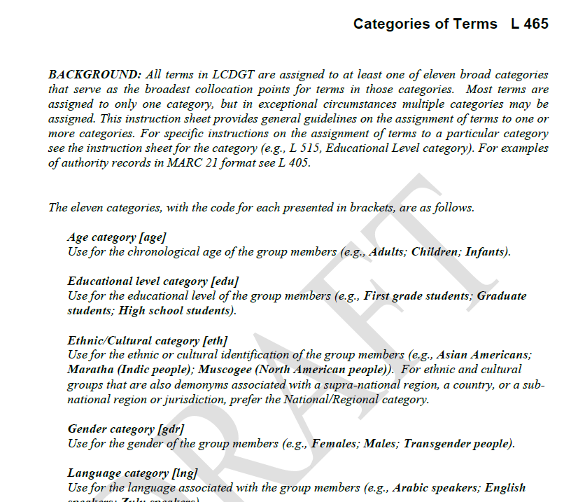
Age -- age
Educational level -- edu
Ethnic/cultural -- eth
Gender -- gdr
Language -- lng
Medical, psychological, disability -- mpd
National/regional -- nat
Occupation/field of activity - occ
Religion -- rel
Sexual orientation -- sxo
Social -- soc

Slide 66
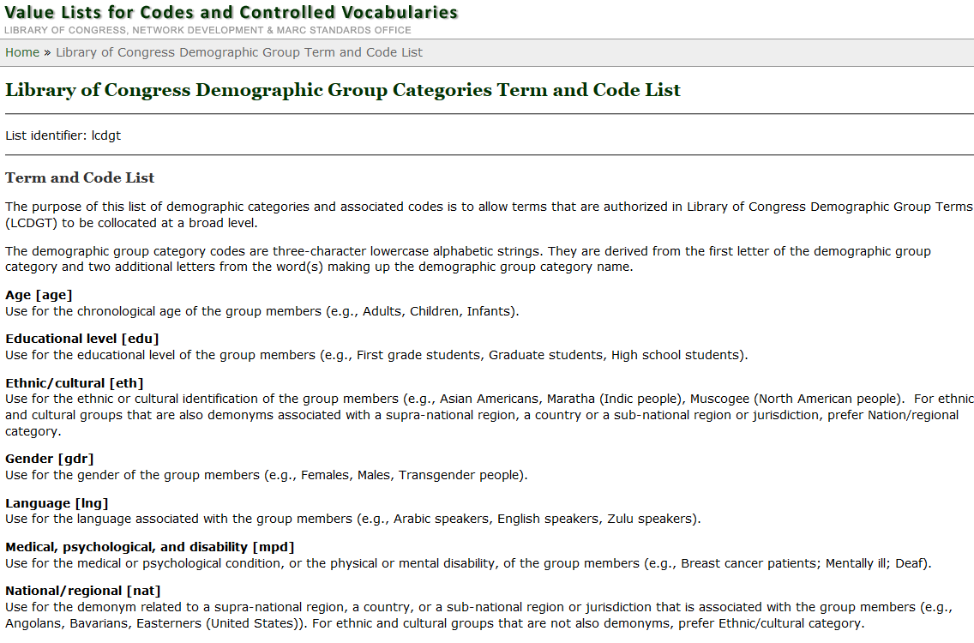
http://www.loc.gov/standards/valuelist/lcdgt.html
Notes:
These are the terms and codes that currently may be used in subfields $m and $n of fields 385 and 386.

Slide 67
MARC coding for category terms/codes
MARC format: demographic group terms or codes are valid in bibliographic and authority records
Example on next slide, use of different vocabularies
Draft LCDGT manual:
Shows several options for coding 385 and 386
Including whether to repeat terms or repeat fields
Category codes ($n) are shown in examples, category terms ($m) are not
LC practice: not supplying category

Slide 68
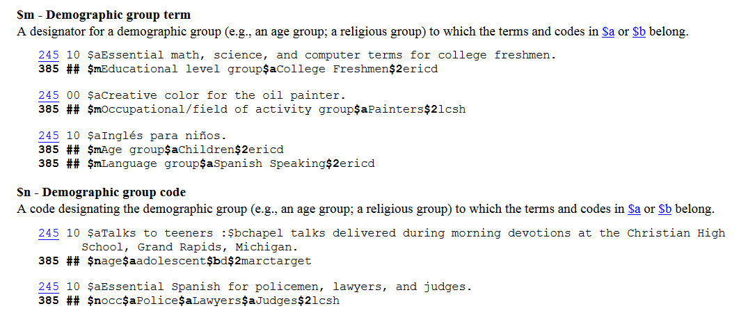

Slide 69
Application: Audience, using codes
100 1_ Alemagna, Beatrice, $e author, $e illustrator.
245 14 The wonderful fluffy little squishy / $c Beatrice Alemagna.
385 __ $n age $a Children $2 lcdgt
650 _0 Gifts $v Juvenile fiction.
650 _0 Birthdays $v Juvenile fiction.
650 _0 Animals $v Juvenile fiction.
655 _0 Picture books for children. ?? does the 385 + LCGFT meet the need?
655 _7 Fiction. $2 lcgft
655 _7 Illustrated works. $2 lcgft

Slide 70
Application: Creators, using codes
245 04 The Oxford anthology of African-American poetry / $c edited by Arnold Rampersad ; associate editor, Hilary Herbold.
386 __ $n eth $a African Americans $2 lcdgt
386 __ $n nat $a Americans $2 lcdgt
650 _0 American poetry $x African American authors.
650 _0 African Americans $v Poetry.
655 _7 Poetry. $2 lcgft

Slide 71
Where do you find the category codes?
Draft LCDGT manual, L 465, Categories of Terms
In authority records, 072 field
During the pilot phase, there are no authority records in Connexion
You can find authority records in Classification Web
Category terms are also given large PDF file of all current LCDGT terms, on LCDGT web site

Slide 72
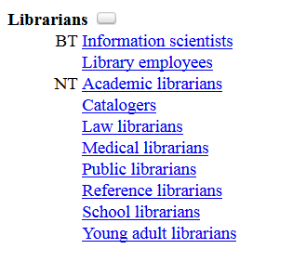
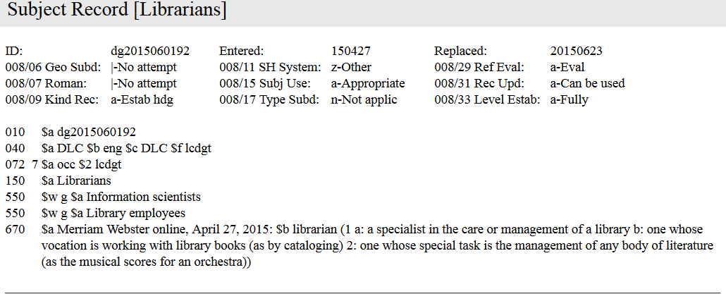

Slide 73
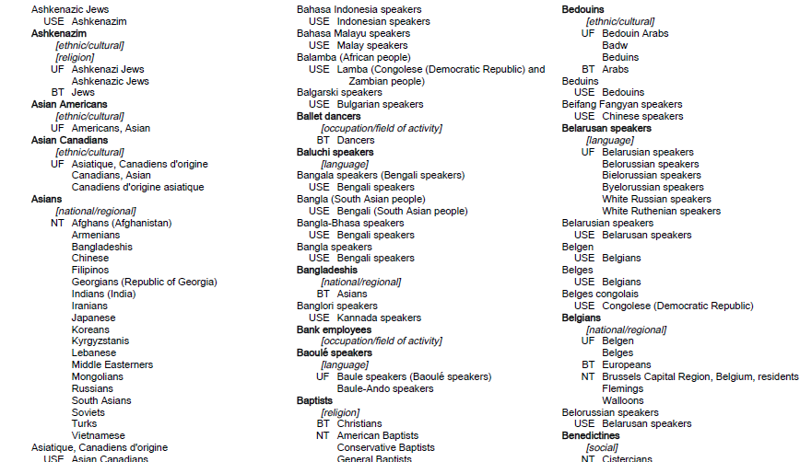
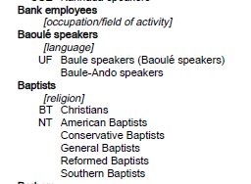

Slide 74
Application: Audience and Creators, using terms
245 00 10 by 10 : $b ten ten-minute plays by ten leading playwrights for young audiences, each inspired by one of the Ten commandments / $c edited by Jeff Gottesfeld.
385 __ $m Age $a Teenagers $2 lcdgt
386 __ $m National/regional $a Americans $2 lcdgt
650 _0 Young adult drama, American.
650 _0 Ten-minute plays, American.
650 _0 Teenagers $v Juvenile drama.
630 00 Ten commandments $v Juvenile drama.
655 _7 Ten-minute plays. $2 lcgft

Slide 75
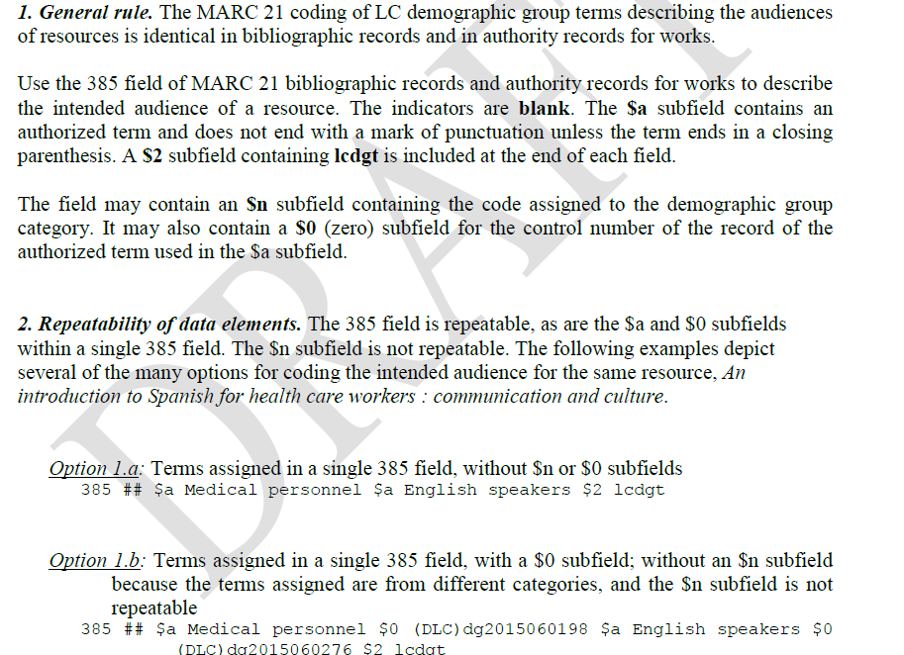
L 410: MARC Coding of LCDGT in Bib and Authority Records
Many options for repeating data elements!

Slide 76
LC practice: LCDGT codes in fields 385 and 386
In field 385 or 386:
$a for the authorized term (repeatable)
$2 for the source of term -- $2 lcdgt (other vocabularies may be used)
$n for the code assigned to the demographic group category for the term – it is optional!
$0 for the control number of the record for the term in $a (not used now)
385 and 386 are repeatable
Subfield $a is repeatable within a field
Subfield $n is NOT repeatable within a field
See L 410 and L 412 for specific guidance on coding LCDGT in bib and authority records

Slide 77
What to do about $n? Include it or not?
There is no PCC policy or best practice at this point
Manual shows examples with and without $n
Also many options for repeating data elements
OK to repeat $a within one 385/386 with no $n
If adding $n, must have separate 385s or 386s for each category
LC practice:
Terms assigned in multiple 385 or 386 fields, without $n

Slide 78
Examples
385 __ $a Medical personnel $2 lcdgt THIS IS LC PRACTICE
385 __ $a English speakers $2 lcdgt
385 __ $a Medical personnel $a English speakers $2 lcdgt OK
385 __ $n occ $a Medical personnel $2 lcdgt OK
385 __ $n lng $a English speakers $2 lcdgt
NOT:
385 __ $n occ $a Medical personnel $n lng $a English speakers $2 lcdgt

Slide 79
LCDGT vocabulary: conundrums
Several problems have arisen in the development of the vocabulary
Some have to do with cultural assumptions and U.S. perspective
Students in elementary, junior high, middle school
Students in other educational systems?
Demonyms (terms for residents of specific places) raise many issues
Phase 1 of pilot: terms for residents of continents, regions, countries, first-level administrative subdivisions (e.g., states, provinces) but no lower
North Americans; Americans; Oregonians but not Portlanders
Europeans; French but not Parisians
In principle, demonyms for local places should be in scope
Notes:
Local places: counties, cities, city sections

Slide 80
Conundrums: Demonyms
Conflict is rife
State of California California, Pa.
Manhattan, Kan. Manhattan, N.Y.
Paris, France Paris, Tex.
Holland Holland, Ky.
Fairfax County, Va. Fairfax City, Va.
Slide from Janis Young

Slide 81
Conundrums: Demonyms
Demonyms
Do we disambiguate the demonyms?
If so…
How?
Should conflict be absolute?
Slide from Janis Young

Slide 82
Conundrums: Demonyms
Qualify all terms below the country level?
Californians (California, Ky.)
Californians (California, Pa.)
Californians (State of California)
Brandenburgers (Brandenburg, State of Brandenburg, Germany)
Brandenburgers (Brandenburg, State of Hesse, Germany)
Brandenburgers (State of Brandenburg, Germany)
Slide from Janis Young

Slide 83
Conundrums: Demonyms
“Thought experiment” on our website
Comments appreciated through January 30, 2016 to jayo@loc.gov
http://www.loc.gov/catdir/cpso/lcdgt-demonyms.pdf
Slide from Janis Young

Slide 84
Other Characteristics Related to Genre/Form
Audience Characteristics – various fields including new 385
Creator/Contributor Characteristics – various fields including new 386
Language – fixed field Lang (008/35-37), 041, 546, 600-651
Time Period of Creation – 046 $k/$l and $o/$p, and new 388 (not yet implemented in OCLC)
Place of Creation/Origin – new 370 (not yet implemented in OCLC), 751
Medium of Performance – 382

Slide 85
Summary
Assign LCGFT in field 655 in addition to whatever subject headings you assign in 600-651.
Consider joining SACO if you think you might want to make proposals for additional terms to include in LCGFT or LCDGT
For now, if using LCSH, continue to follow existing policies found in the Subject Headings Manual
Consider adding 385 for audience and 386 for creator/contributor characteristics, using LCDGT or another vocabulary
LCDGT is still in pilot phase so some adjustments may happen before it is final
Useful to at least think about when you would assign terms and what you would assign

Slide 86
The future?
041 1_ $ eng $h fre
046 __ $o 1300 $p 1500
245 00 An anthology of medieval love debate poetry / $c translated and edited by Barbara K. Altmann and R. Barton Palmer.
386 __ $n nat $a French $2 lcdgt
388 1_ Middle Ages $2 lcsh
655 _7 Debate poetry. $2 lcgft
655 _7 Love poetry. $2 lcgft
Notes:
Eventually it is expected that the 650s will go away
The authors included in the anthology are all from the 14th and 15th centuries, so the 046 has been coded with a range of 1300-1500. If the exact dates of each of the five works in the collection were known, a more precise range could be given in the 046.
388 – first indicator, Type of time period, 1=Creation of work

Slide 87
Resources: Spreadsheet to help transition from GSAFD to LCGFT
Compiled by Cathy Lamoureaux, Carnegie Library of Pittsburgh
Available at http://1drv.ms/1HwvMOh
Alphabetical lists of LCGFT terms by heading and by category (drama, fiction, poetry, etc.)
GSAFD to LCGFT comparison
LCSH to LCGFT comparison

Slide 88
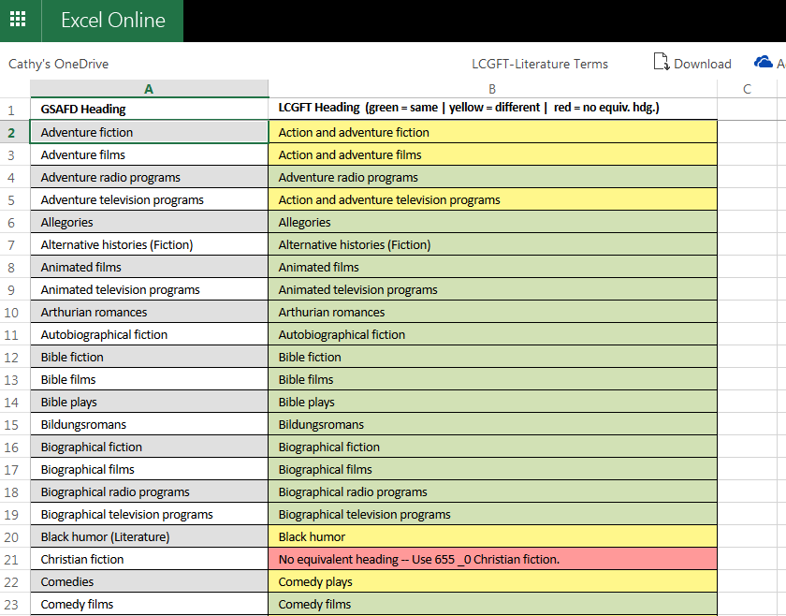

Slide 89
Resources: http://loc.gov/catdir/cpso/genreformgeneral.html

Slide 90
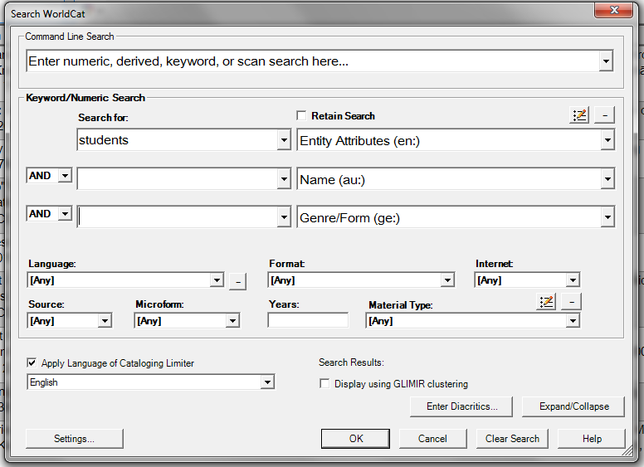
Search the “Entity Attributes” index in Connexion to see how people are using the 385 and 386 fields

Slide 91
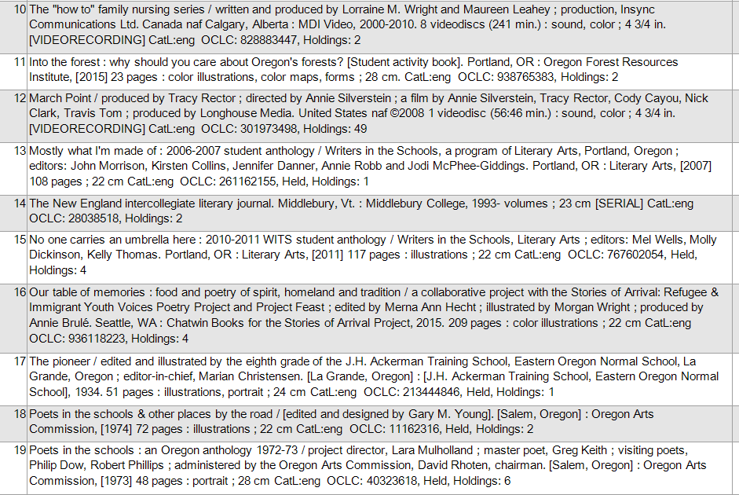

Slide 92
Resources
Draft Genre/Form Terms Manual
http://www.loc.gov/aba/publications/FreeLCGFT/freelcgft.html
LCDGT information, including draft manual
http://loc.gov/catdir/cpso/lcdgt-acceptance-manual.html
LC Demographic Group Categories Term and Code List
http://www.loc.gov/standards/valuelist/lcdgt.html

Slide 93
Thank you!
And thanks to Adam Schiff (University of Washington) and Janis Young (Library of Congress) for the use of some slides
lrobare@uoregon.edu

