Slide 1
Health and Wellness

Slide 2
BAM Body and Mind
Notes:
From the Centers for Disease Control
A wide range of topics covered – exercise, nutrition, peer pressure, bullying
Oriented toward younger kids
Click through each subtopic
Games are not high tech
Diseases – a little dated
Food and Nutrition – Cool Treats
Physical Activity – Motion Commotion
Your Safety – H20 Smartz
Your Life – Got Butterflies?
Your Body – Lurking in the Locker Room (Jockstraps vs Makeup)

Slide 3
Train Like an Astronaut
Video example
https://youtu.be/-iszszmF0Sk
Notes:
Videos and other activities that model exercises used by astronauts for training.
Show other activities: Educational Activities, Hydration Station. Learn about the importance of hydration in space – create “simulated urine”
Show how activity aligns with national standards.
Point out adaptive physical activities handout … also activities in Spanish.

Slide 4
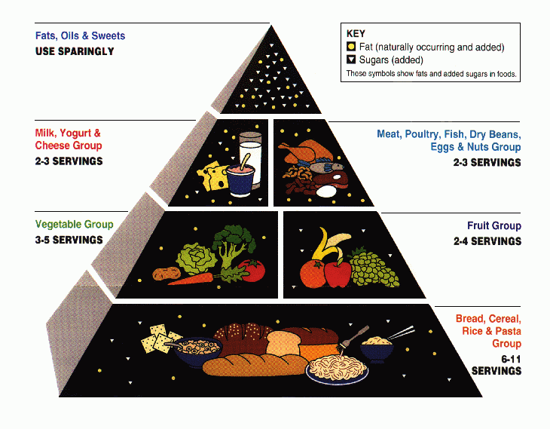
ChooseMyPlate.gov
Notes:
Replaces Food Pyramid

Slide 5
ChooseMyPlate.gov
Portion Distortion Quiz
Notes:
Once on web site, show Online Tools => SuperTracker
help you plan, analyze, and track your diet and physical activity. Find out what and how much to eat; track foods, physical activities, and weight; and personalize with goal setting, virtual coaching, and journaling.
Show scavenger hunt, activity to use with tool. Teen level.
Then Portion Distortion, PowerPoint files – move back to my PowerPoint to show

Slide 6
COFFEE
20 Years Ago
Coffee (with whole milk and sugar)
Today
Mocha Coffee (with steamed whole milk and mocha syrup)
45 calories
8 ounces
How many calories
are in today's coffee?

Slide 7
COFFEE
20 Years Ago
Coffee (with whole milk and sugar)
Today
Mocha Coffee (with steamed whole milk and mocha syrup)
45 calories
8 ounces
350 calories
16 ounces
Calorie Difference: 305 calories

Slide 8
CHICKEN CAESAR SALAD
20 Years Ago
Today
390 calories
1 ½ cups
How many calories are in today’s chicken Caesar salad?

Slide 9
CHICKEN CAESAR SALAD
20 Years Ago
Today
390 calories
1 ½ cups
790 calories
3 ½ cups
Calorie Difference: 400 calories

Slide 10
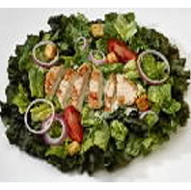
Maintaining a Healthy Weight is a Balancing Act
Calories In = Calories Out
How long will you have to walk the dog in order to burn those extra 400 calories?*
*Based on 160-pound person

Slide 11
Calories In = Calories Out
If you walk the dog for 1 hour and 20 minutes, you will burn approximately 400 calories.*
*Based on 160-pound person

Slide 12
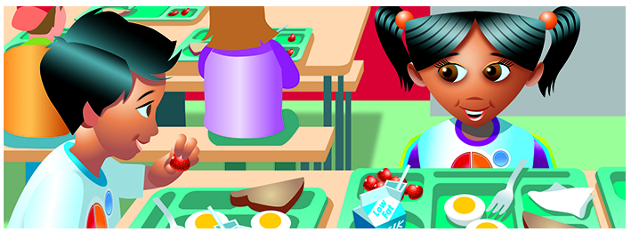
ChooseMyPlate.gov
Team Nutrition links to materials
http://www.fns.usda.gov/tn/myplate
Link to song: http://www.fns.usda.gov/multimedia/music/alivewithfive.mp3
Notes:
I found it a little confusing to find resources with the site’s navigation, but the USDA Team Nutrition site has a good page that links to activities.
Point out Graphics Library
Song

Slide 13
Balanced Energy Physical Activity Toolkit
Notes:
From the OSU Extension Service’s GROW Healthy Kids and Communities initiatives.

Slide 14
Balanced Energy Physical Activity Toolkit
Notes:
Activity cards – show grade level, equipment needed. Most activities are oriented toward elementary level.
Videos also demonstrate some of activities. Food Ball Pass as example.
Contact to see if you can get the kits: Kathy Gunter 541-737-3624

