Slide 1
Telling The Library’s Story Through Linked Data
Teresa Ferguson
Technical Services Manager
Tigard Public Library

Slide 2
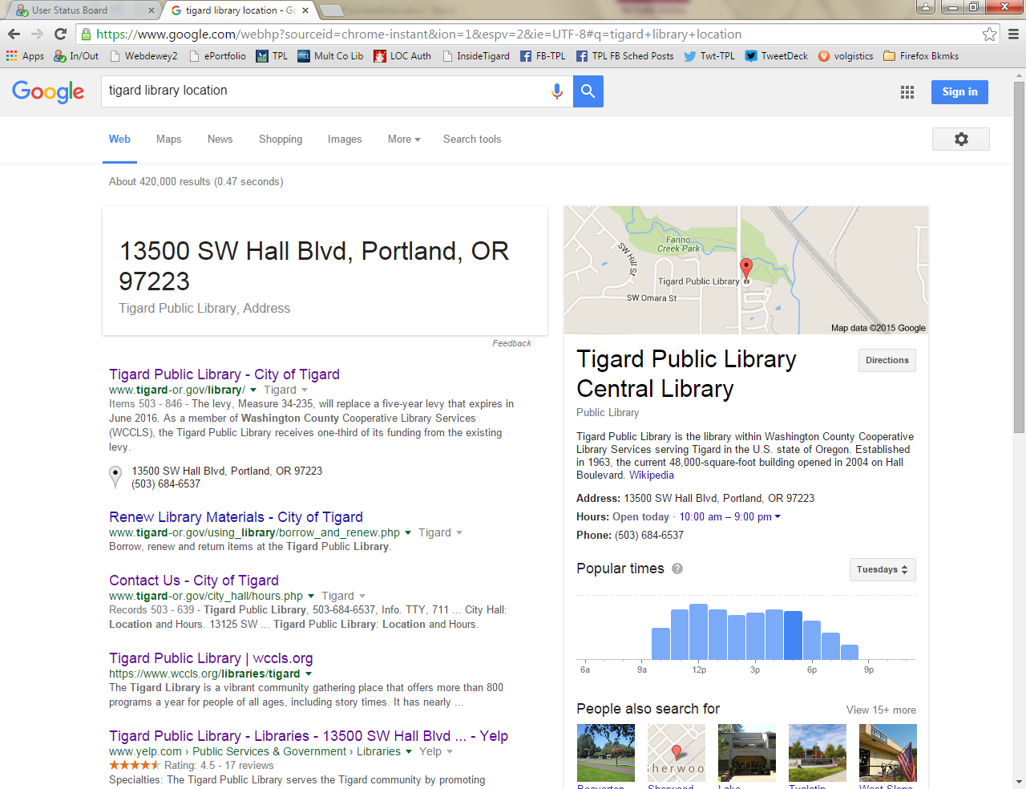
Semantic Web
Strings to Things
HTML and Linked Data
Answer Box
Knowledge Card

Slide 3
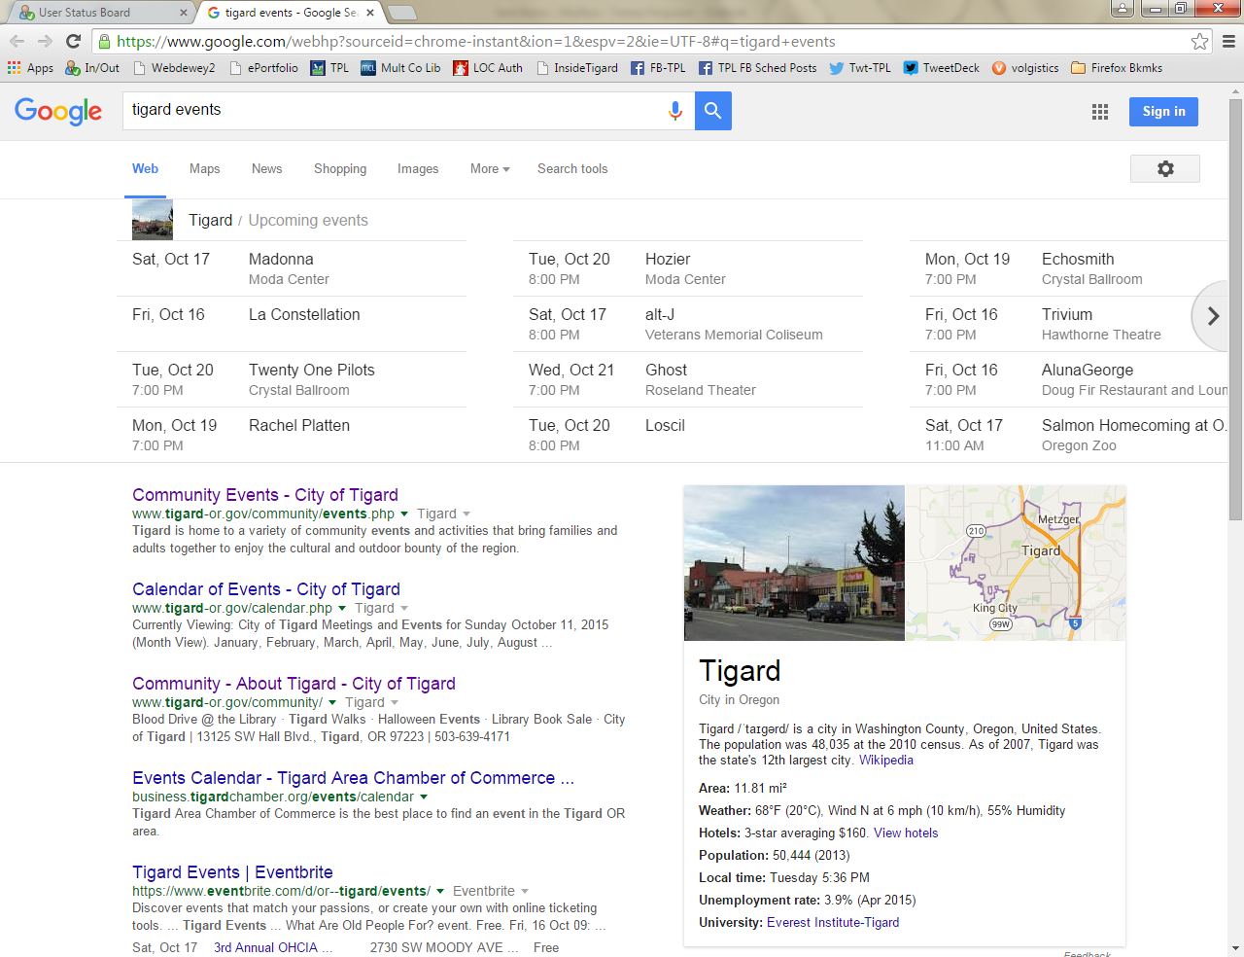
Semantic Web & Linked Data
Carousel

Slide 4
My Experience Adding Linked Data to Event Code on Website
Find out if your Content Management System has a linked data form that will handle the coding for you. (eg. Drupal)
If not, create code using http://schema.org/docs/gs.html
Event Coding: http://schema.org/Event
Make the code easy for staff to modify for future programs, I bolded the text that needs to be updated.

Slide 5
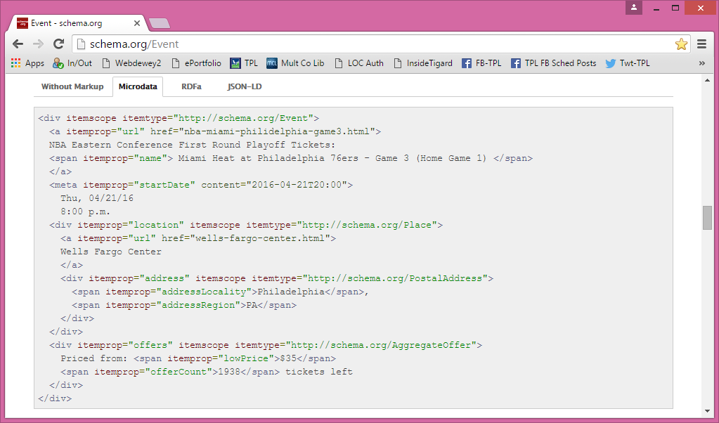
Schema.org Event Code

Slide 6
Sample Tigard Library Event Code
<div itemscope itemtype="http://schema.org/Event">
<a itemprop="url" href="http://www.tigard-or.gov/programs/adults.php">Tigard Public Library Adult Programs</a><br />
<a itemprop="url" href="http://calendar.wccls.org/MasterCalendar/EventDetails.aspx?data=hHr80o3M7J7vHyFYaiz98LCeLkuvR2dwOJbu0kOZXz3%2bUvH7GRPpDwdyw1QvaH7x">Solar Energy for the Home</a><br />
<b><span itemprop="name"> Solar Oregon: Solar Energy for the Home </span></b><br />
<span itemprop="description"> Find out how to harness the sun in your home. Solar Oregon will present the latest information about home solar electricity and water heating. Learn about the newest technology, financing and tax credits. </span><br />
<meta itemprop="startDate" content="2016-02-10T19:00">
Wednesday, February 10, 2016 | 7 - 8:30 p.m.
<div itemprop="location" itemscope itemtype="http://schema.org/Place">
<a itemprop="name" content="Tigard Public Library">
<a itemprop="url" href="http://www.tigard-or.gov/library.php">Tigard Public Library</a>
<span itemprop="telephone">(503) 684-6537</span>
<div itemprop="address" itemscope itemtype="http://schema.org/PostalAddress">
<span itemprop="streetAddress">13500 SW Hall Blvd.</span>
<span itemprop="addressLocality">Tigard</span>,
<span itemprop="addressRegion">OR</span>
<span itemprop="postalCode">97223-8111</span>
</div>
</div>
<div itemprop="offers" itemscope itemtype="http://schema.org/AggregateOffer">
Price: <span itemprop="lowPrice">$0</span>
</div>

Slide 7
Test Code
Test the code using google structured data testing tool: https://developers.google.com/structured-data/testing-tool/
Or another code testing site: http://www.seoskeptic.com/structured-data-markup-validation-testing-tools/
If there are errors in the code fix them or search to see if they are errors that frequently appear even though the code is correct. If so, ignore errors.

Slide 8
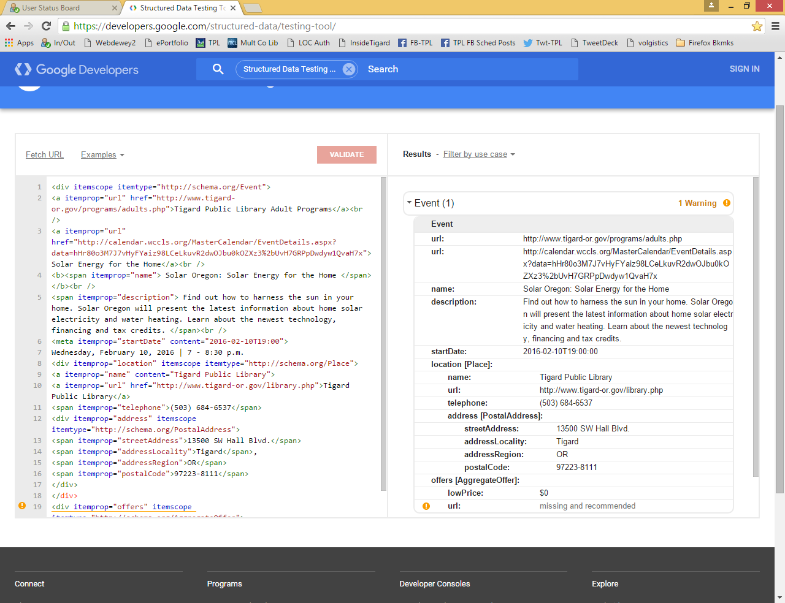

Slide 9
Posting Code
Have your webmaster post the code.
If the code strips out the schema data, google how to fix.
Fix it by adding Schema.org attributes to the default list in the RICHTEXT_ALLOWED_ATTRIBUTES setting.
OR work with CMS to create a page that allows linked data coding.
Post code again.

Slide 10
Results?
Test google results. Check periodically to see if there is a difference in program attendance and better results in search engine.
Look for test differences in your linked data code versus your standard code. I used a different phone number for program registration and minor text changes.
Accomplishments:
Registration for a program filled up in one day
Increased attendance at programs
Understand code, triples, linked data, semantic web
Ready to apply to catalog
Webmaster and Library Director are interested in linked data

